Slide 1
Multi-lingual and cross-lingual models
FMNLP, Fall 1401
Yadollah Yaghoobzadeh
University of Tehran
Slides adapted from CMU, CS11-747 Neural Networks for NLP, Graham Neubig

Slide 2
Multilingual Learning
We would like to learn models that process multiple languages
Why?
Transfer Learning: Improve accuracy on lower- resource languages by transferring knowledge from higher-resource languages
Memory Savings: Use one model for all languages, instead of one for each

Slide 3
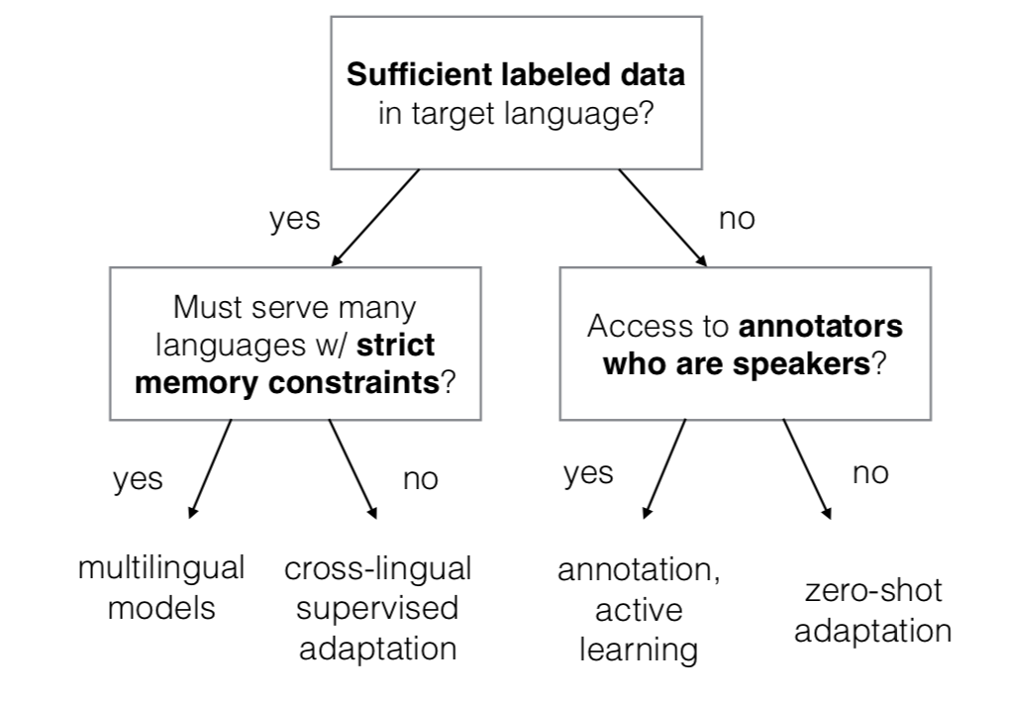
High-level Multilingual Learning Flowchart

Slide 4
Multi-lingual Sequence-to- sequence Models
It is possible to learn a single model that handles several languages
Even as simple as adding a tag about the target language for generation (Johnson et al. 2016)
<fr> this is an example → ceci est un exemple <ja> this is an example → これは例です

Slide 5
Difficulties in Fully Multi-lingual Learning
For a fixed sized model, the per-language capacity decreases as we increase the number of languages. (Conneau et al, 2019)
Increasing the number of low-resource languages —> decrease in the quality of high-resource language translations (Aharoni et al, 2019)
How to mitigate? Better data balancing, better parameter sharing

Slide 6
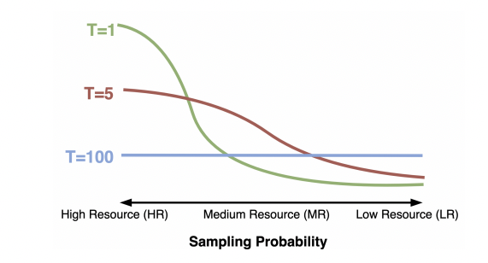
Heuristic Sampling of Data
Sample data based on dataset size scaled by a temperature term
Easy control of how much to upsample low-resource data

Slide 7
Multilingual Pre-trained Models

Slide 8
So far,
We have seen English-only models like BERT, T5, RoBERTa, XLNet, etc.
We can pretrain similar models for different languages using monolingual data: ParsBERT (Persian), FlauBERT (French), PhoBERT (Vietnamese).
But we can also pretrain a single multilingual model using multilingual data: mBERT, XLM-R, mBART, etc.

Slide 9
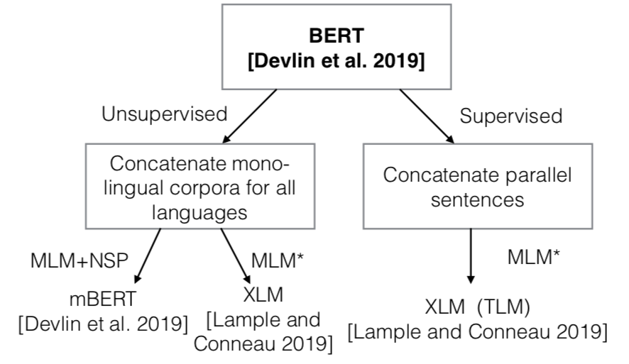
Multi-lingual Pre-training

Slide 10
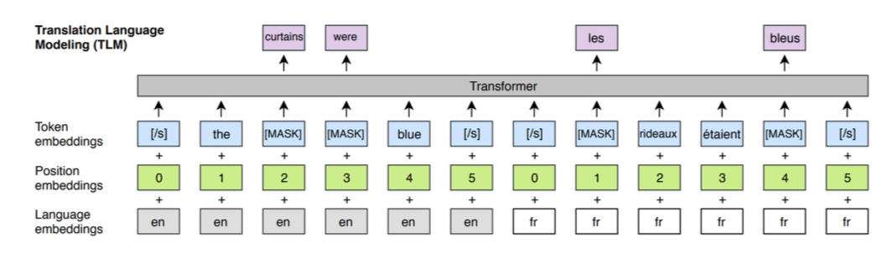
Multilingual Masked Language Modeling
Also called Translation language modeling (TLM) (Lample and Conneau 2019)

Slide 11
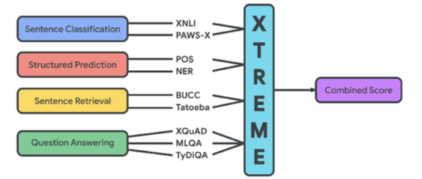
Multilingual Representation Evaluation
Large-scale benchmarks that cover many tasks
XTREME: 40 languages, 9 tasks (Hu et al. 2020)
XGLUE: less typologically diverse but contains generation (Liang et al. 2020)
XTREME-R harder version based on XTREME (Ruder et al. 2021)

Slide 12
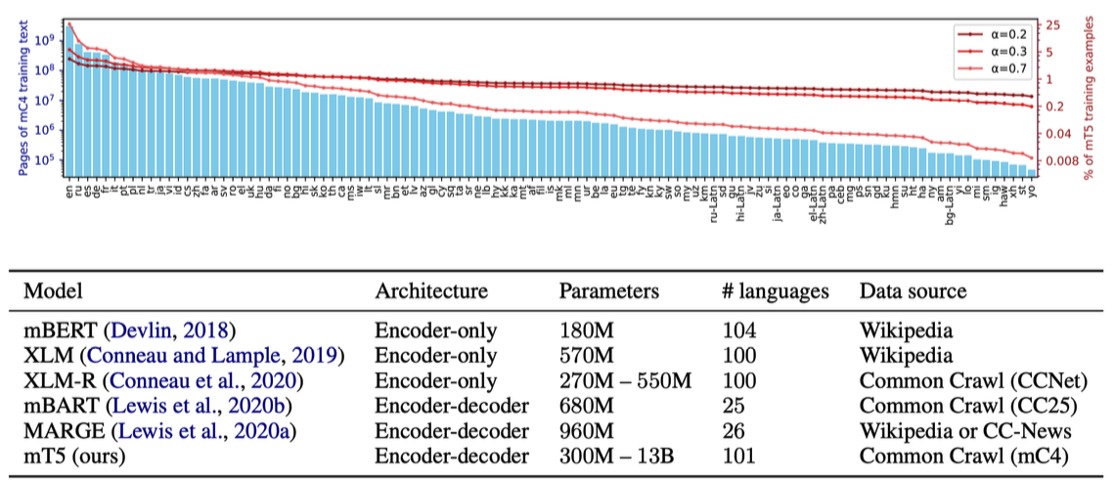
mC4 dataset
107 languages, lower-resource languages upsampled based on their frequency in the dataset
mT5 paper, Sue et al., ACL 2021

Slide 13
Cross-lingual Transfer Learning

Slide 14
Cross-lingual Transfer Learning
Leverages data from one or more high-resource languages to do better on a target language
Popular strategies:
Multilingual learning (above)
Pre-train and fine-tune
Zero-shot transfer
Annotation projection

Slide 15
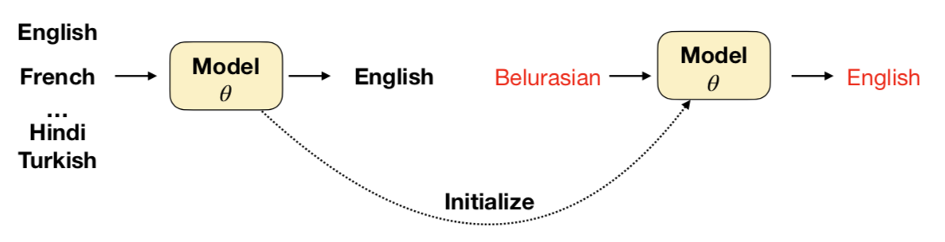
Pre-train and Fine-tune
First, do multilingual training on many languages (eg. 58 languages)
Next fine-tune the model on a new low-resource language

Slide 16
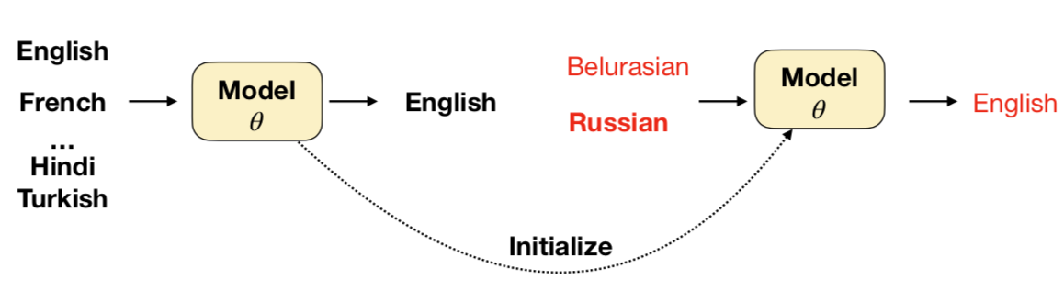
Similar Language Regularization
Regularized fine-tuning: fine-tune on low-resource language and its related high-resource language to avoid overfitting

Slide 17
Zero-shot transfer for pretrained representations
Pretrain: large language model using monolingual data from many different languages
Fine-tune: using annotated data in a given language (eg. English)
Test: test the fine-tuned model on a different language from the fine-tuned language (eg. French)
Multilingual pretraining learns a universal representation.

Slide 18
XLM-R
Pretrained Transformer model on 100 languages
Increases pretraining corpus size by using Wikipedia and CommonCrawl

Slide 19
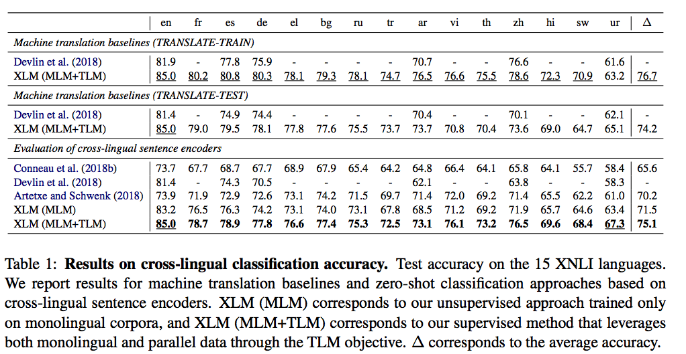
XLM-R results (XNLI evaluation)

Slide 20
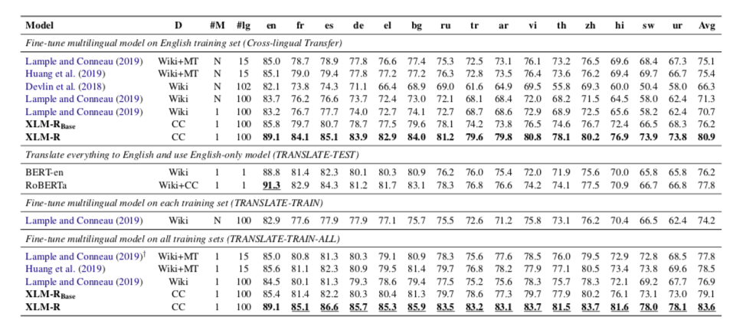
XLM-R results (XNLI evaluation)
Notes:
TRANSLATE-TRAIN, where the English MultiNLI training set is machine translated into each XNLI language, and TRANSLATE-TEST where every dev and test set of XNLI is translated to English.
Training data only exists in English.

Slide 21
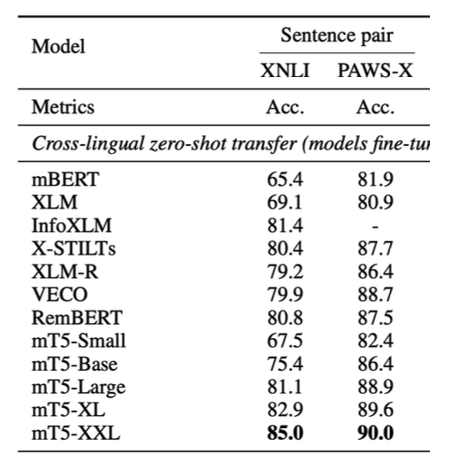
Other results

Slide 22
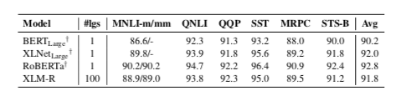
XLM-R vs Monolingual Models
Glue Dev results

Slide 23
Which Language to Use?
When transferring from another language, it is ideal that it is
similar to the target language
data-rich

Slide 24
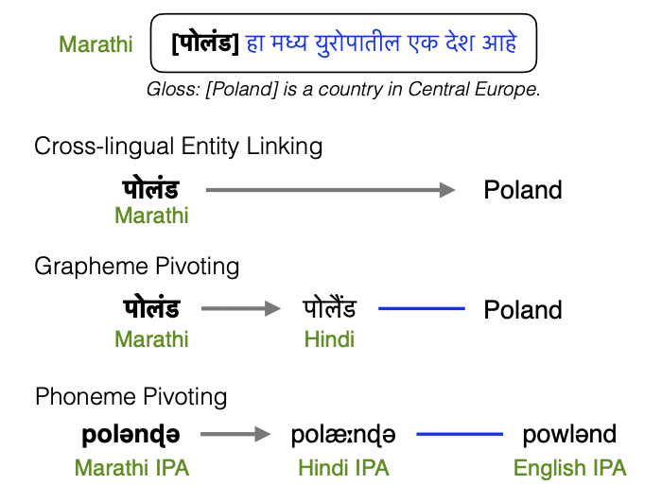
What if languages don’t share the same script?
Use phonological representations to make the similarity between languages apparent.
e.g.: Rijhwani et al (2019) use a pivot-based entity linking system for low- resource languages.

Slide 25
Resources
Unsupervised Cross-lingual Representation Learning at Scale (Conneau et al. 2019)
Cross-lingual Language Model Pretraining (Lample and Conneau 2019)
Google's Multilingual Translation System (Johnson et al. 2016)
Massively Multilingual NMT (Aharoni et al. 2019)
XGLUE (Liang et al. 2020)
XTREME (Hu et al. 2020)
XTREME-R (Ruder et al. 2021)
How multilingual is Multilingual BERT? (Pires et al. 2019)
Choosing Transfer Languages for Cross-Lingual Learning (Lin et al. 2019)
Phonological Transfer for Entity Linking (Rijhwani et al. 2019)

