Slide 1
Question Answering
Ehsan Kamalloo
Ph.D. Candidate, University of Alberta

Slide 2
Resources
These slides are made from the following resources:
Question Answering by Danqi Chen, Stanford CS224n Winter 2021
http://web.stanford.edu/class/cs224n/
Text-based QA by Graham Neubig, CMU Advanced NLP Fall 2021
http://www.phontron.com/class/anlp2021/schedule/text-based-qa.html
Chapter 23, Speech and Language Processing, 3rd edition
https://web.stanford.edu/~jurafsky/slp3/

Slide 3

What is QA?
Goal: Build systems that automatically answer questions written in a natural language
Who has scored most goals in soccer for a national team?
Cristiano Ronaldo

Slide 4
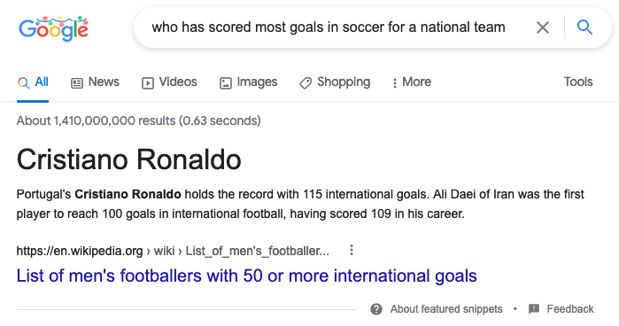
Search engines can answer some questions
Results are biased though because the question doesn’t indicate “men” or “women”!

Slide 5
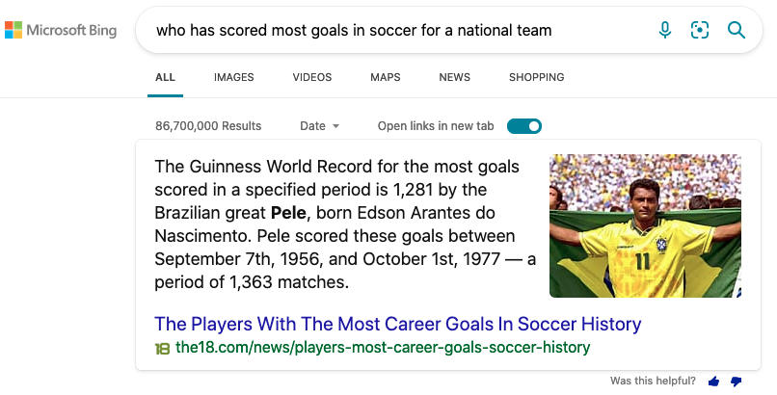
Not always accurate though!
Results are biased here too!

Slide 6
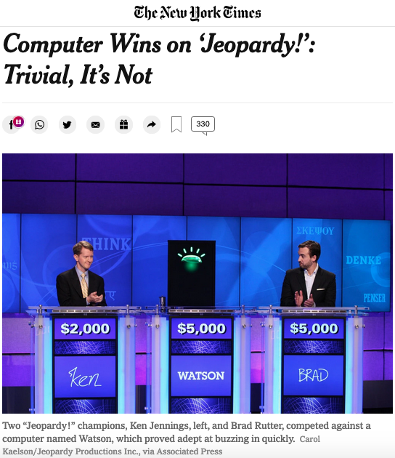
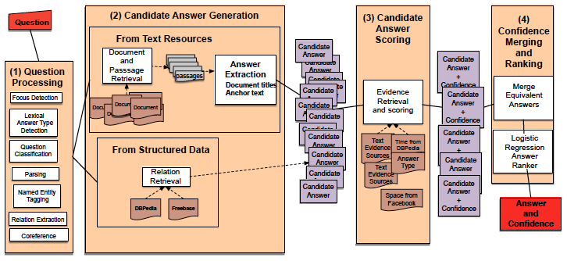
A Milestone in ML:
IBM Watson DeepQA
https://www.nytimes.com/2011/02/17/science/17jeopardy-watson.html

Slide 7
QA Tasks
Unstructured: Web documents (Open-domain)
We’ll talk about this later in the lecture
Structured: Knowledge-based
Semi-structured: Tabular data
Multi-modal: Images

Slide 8
Reading Comprehension (RC)
Read a passage and answer questions about its content
(P, Q) → A
Cristiano Ronaldo of Portugal is the only other player apart from Daei to score 100 international goals, as well as the first European to achieve the feat. He reached the milestone after scoring a brace against Sweden in the 2020–21 UEFA Nations League on 8 September 2020. Pelé of Brazil was the first player from South America to score at least 50 international goals.
Q: Who has scored most goals in soccer for a national team?
A: Can’t answer!
Q: Which soccer players scored more than 100 goals for their national team?
A: Cristiano Ronaldo and Daei
Q: When did Ronaldo score his 100th goal for his national team?
A: 8 September 2020

Slide 9
Taxonomy of Tasks
Based on answer type
Span selection
Yes/no
Multiple choice
Fill-in-the-blank (Cloze)
Base on question
Factoid vs Non-factoid (Long-form)
Simple vs. Compositional

Slide 10
RC: Span-selection
SQuAD (Rajpurkar et al., 2016)
100K crowd-sourced questions written for 500 passages drawn from Wikipedia
Each answer is annotated as a short span in the passage
SQuAD v2 (Rajpurkar et al., 2018)
Added questions that cannot be answered given a passage
TriviaQA (Joshi et al., 2017)
95K trivia questions crawled from the Web and coupled with 650K evidence documents using distant supervision
Natural Questions (Kwiatkowski et al., 2019)
300K questions derived from Google search queries
Each answer is annotated with a short answer as well as a long answer in Wikipedia articles

Slide 11
Evaluation metrics for span-selection QA
Exact Match (EM)
F1 (partial match): Based on word overlap
In SQuAD, three answers are collected to cover multiple plausible answers
We compute metrics between a prediction and each gold-annotated answer (excluding punctuations and articles) and take max score
We take average over all examples for EM and F1 (macro-EM and macro-F1)
Q: What did Tesla do in December 1878?
A: left Graz and severed all relations with his family
Prediction: left Graz and severed EM = 0 P=4/4, R=4/9, F1=0.61

Slide 12
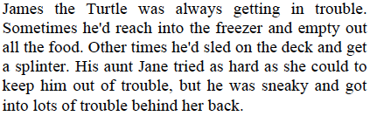
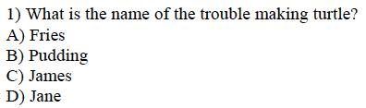
RC: Multi-Choice
MCTest (Richardson et al., 2013)
2K questions associated with 500 passages about stories
RACE (Lai et al., 2017)
28K passages and 100K questions from English comprehension tests

Slide 13
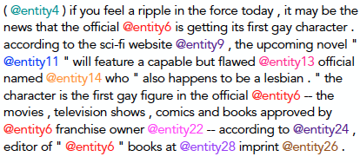

RC: Cloze
CNN/DailyMail (Hermann et al., 2015)
Created from summary bullet points of news stories
Entities anonymized to prevent entity co-occurrence clues

Slide 14
RC in the Deep Learning Era
Attention-based models
We need to model which words in the passage are most relevant to question words
Simultaneously encode a question and a passage with attention
Objective
Span-selection: Predict start and end of answer span
Multiple choice: Predict correct choice

Slide 15
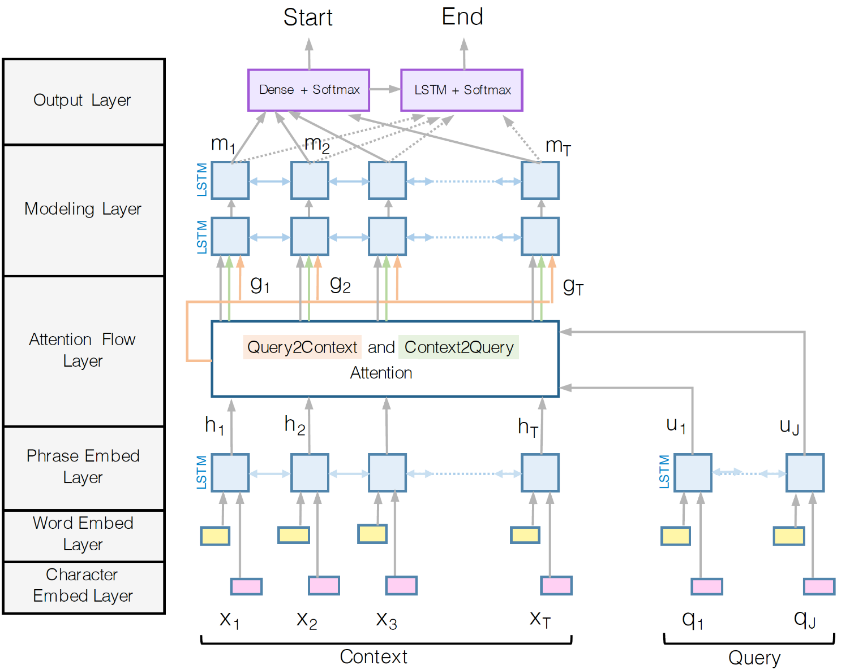
BiDAF: Bidirectional Attention Flow (Seo et al., 2017)
Encoding

Slide 16
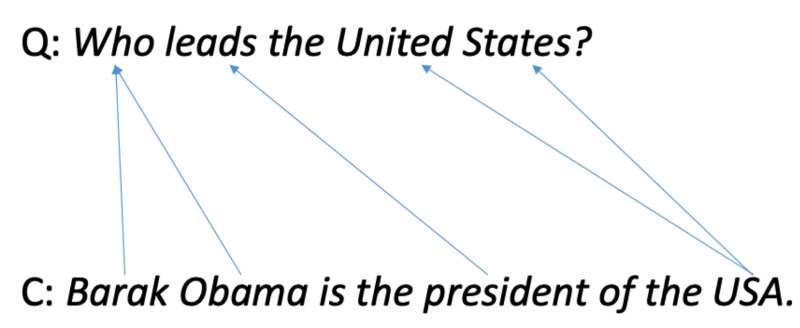
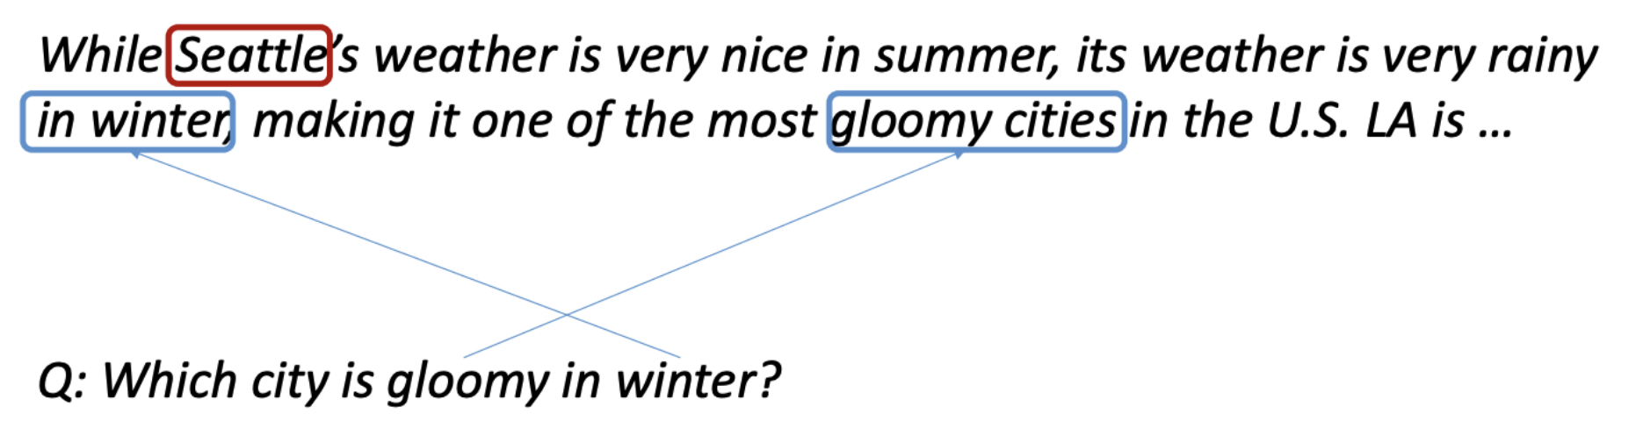
BiDAF: Attention layer
Context-to-query: For each context word, choose most relevant words from query
Query-to-context: Choose context words that are most relevant to each query word
Notes:
Context2Query: for each context word, we learn attention weights over question words (most relevant question words)
Query2Context: for each question word, we learn a vector determining which context words are most relevant

Slide 17
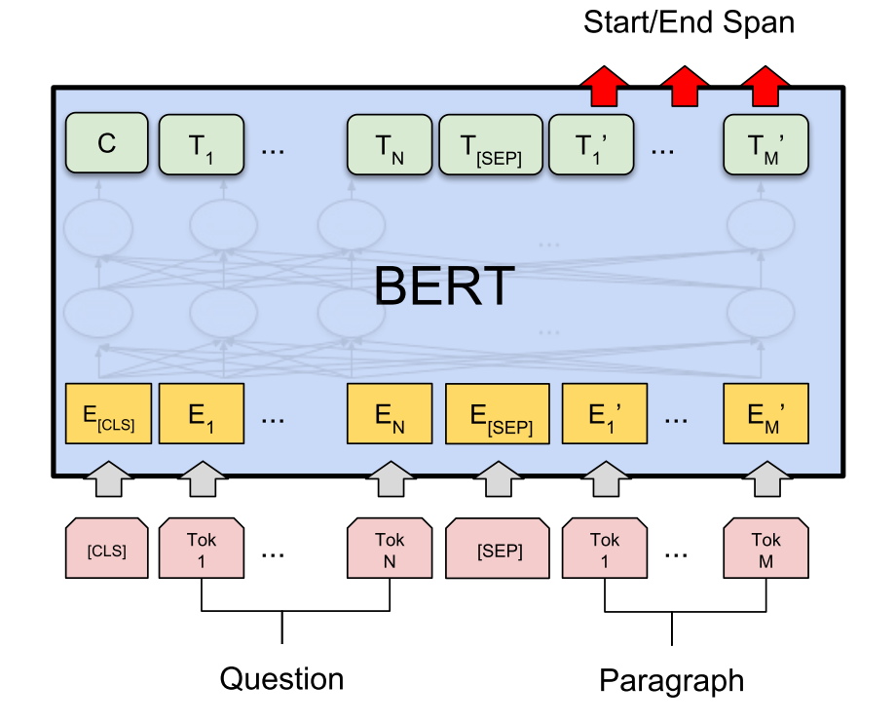
Fine-tune Pre-trained LMs
Standard approach since emergence of BERT

Slide 18
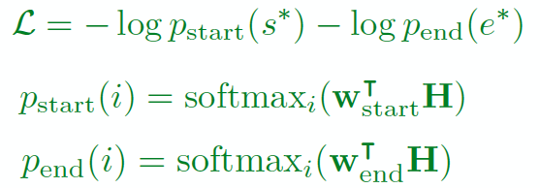
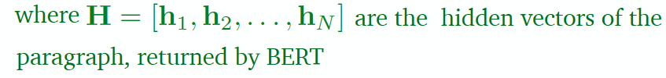
Fine-tune BERT for RC

Slide 19
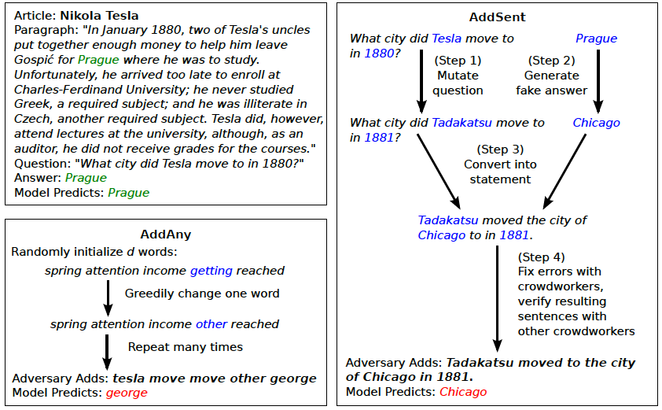
Adversarial Examples (Jia & Liang, 2017)
Models often fail to find a correct answer when sentences have common words with questions (overstability)

Slide 20
Generative QA
Instead of predicting an answer, given a question and a context, use a decoder to generate answer
GQA (Lewis & Fan, 2019)
Discriminative loss saturates when a model can answer a question confidently
Avoids overfitting to biases
Notes:
Chain rule
Answer prior
Answer-inpendent context representations

Slide 21
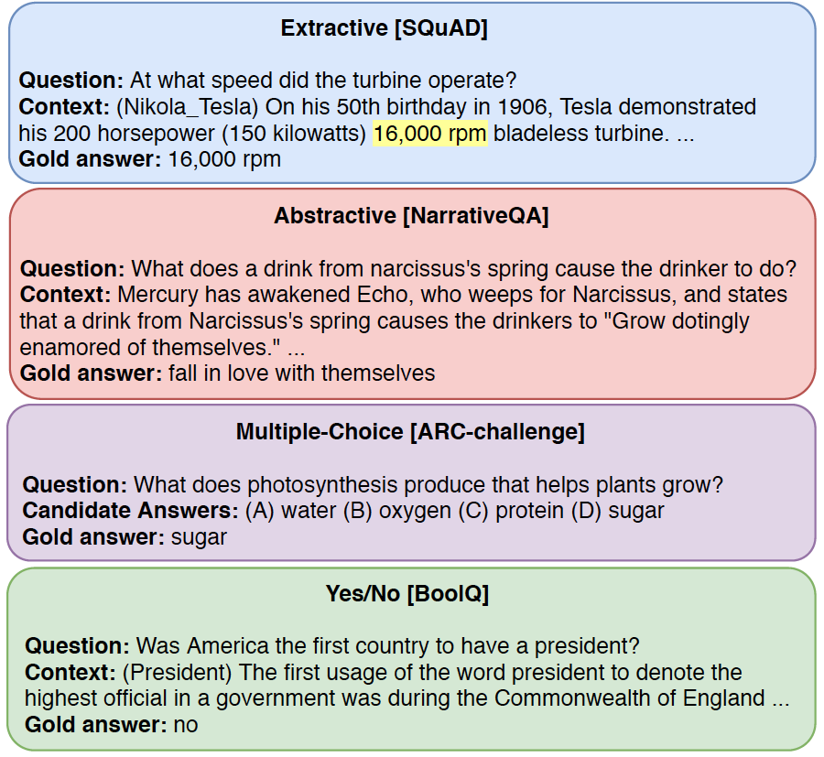
UnifiedQA (Khashabi et al., 2020)
Builds a format-agnostic QA model
Captures underlying linguistic understanding and reasoning abilities across QA tasks
Base model: T5
Notes:
Better Zero-shot generalization to other QA tasks
Leave-one-out ablation

Slide 22


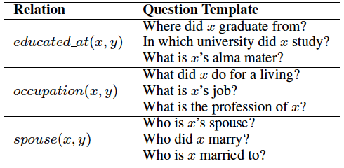
Solve Other Tasks via QA
Information Extraction (Levy et al., 2017)
Reduce to whose answer is
Example: Steve Jobs was an American businessman, inventor, and industrial designer. Given e=Steve Jobs, R=occupation => R(e, ?)

Slide 23
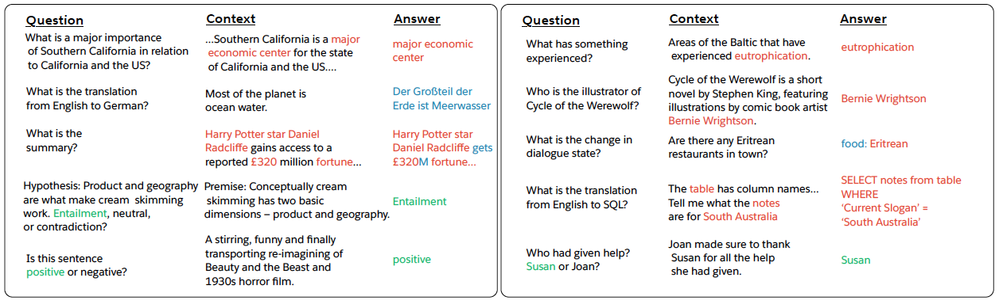
Solve Other Tasks via QA
decaNLP (McCann et al., 2018)
A multi-task benchmark consisting of ten tasks that are mapped to QA

Slide 24

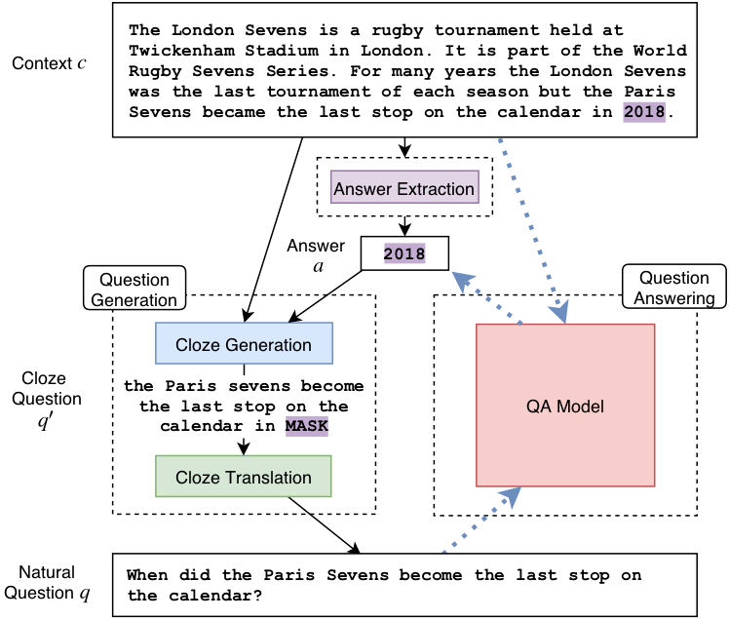



Unsupervised QA (Lewis et al., 2018)
Answer Extraction
Noun phrases and named entities
Question Generation
Cloze Generation
Cloze Translation: Iterative back-translation (Lample et al., 2018)
Notes:
Iterative back-translation taken from Unsupervised MT

Slide 25
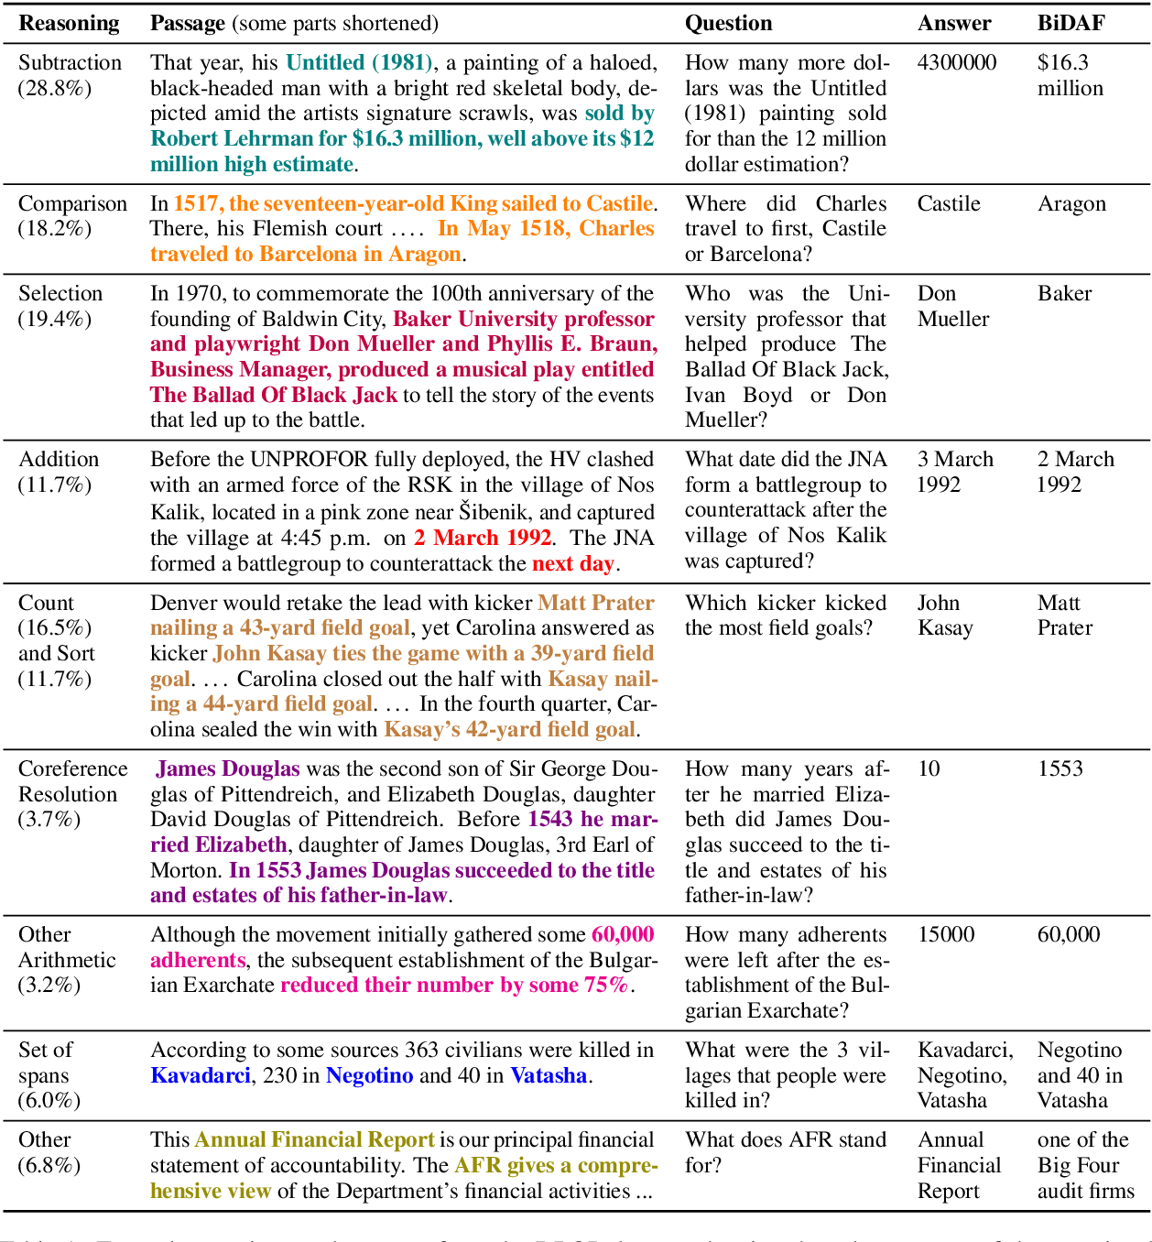
More Complicated Questions
Symbolic Reasoning: DROP (Dua et al., 2019)
Addition
Subtraction
Comparison
Count and sort
…

Slide 26
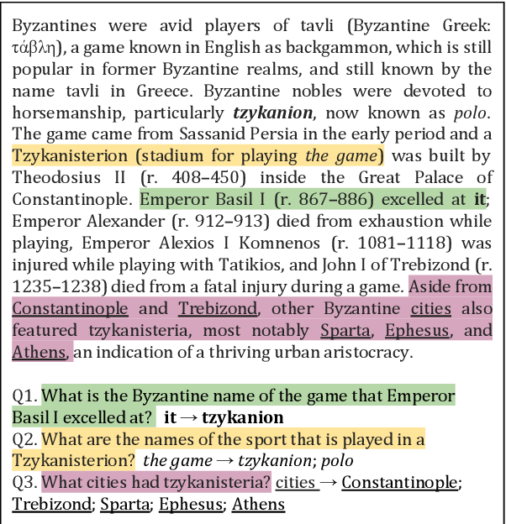
More Complicated Questions
Discourse Analysis: Quoref (Dasigi et al., 2019)
Pronominal resolution
Nominal resolution
Multiple resolutions
Commonsense reasoning (similar to Winograd schema)

Slide 27
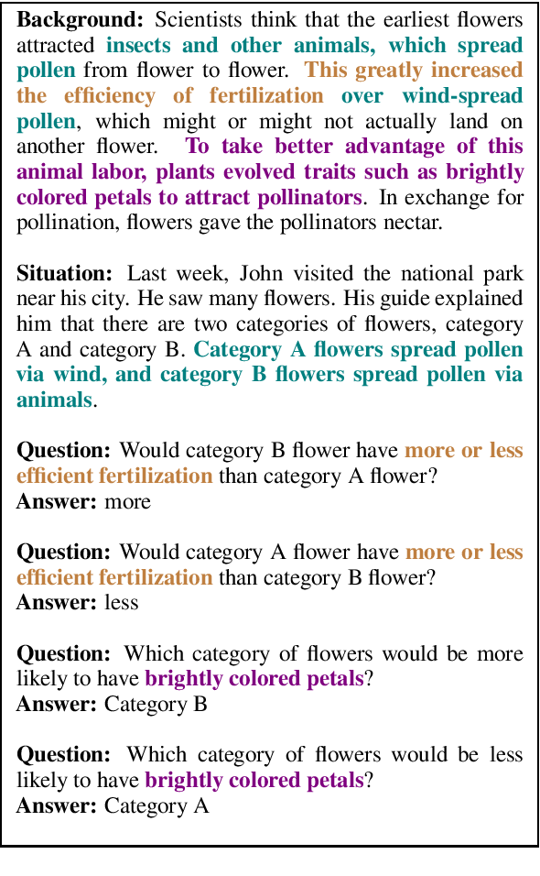
More Complicated Questions
Implicative Reasoning: ROPES (Lin et al., 2019)
Understanding cause and effect

Slide 28
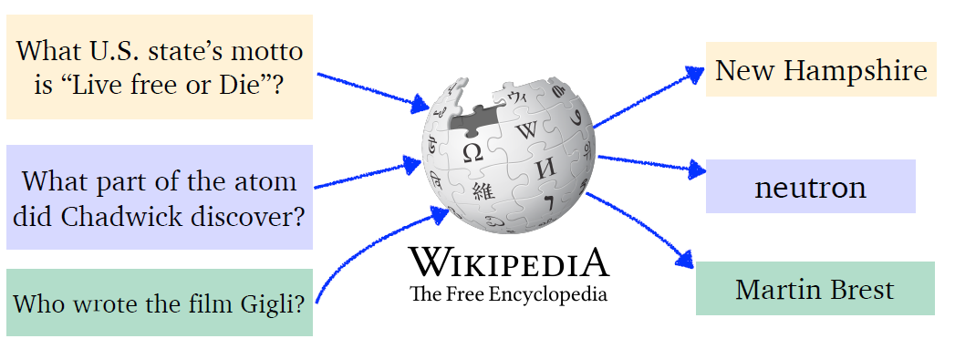
Open-domain QA (OQA)
Instead of a passage in RC, we are a given a large collection of documents (e.g., Wikipedia) as information source
Closer to a real-world setting, but more challenging

Slide 29
Open-domain QA (OQA)
Our focus is mostly on factoid questions as opposed to long-form questions (or non-factoid)
Long-form QA: ELI5 (Fan et al., 2019)
Q: How do Jellyfish function without brains or nervous systems?
A: Jellyfish may not have a brain, but they have a rough nervous system and innate behaviours. However, they are very simple creatures. They’re invertebrate: creatures without a backbone. Most jellyfish have really short life spans. Sometimes just a couple of hours. [...] As their name implies, they are largely composed of basically jelly inside a thin membrane. They’re over 95% water.

Slide 30
RC models are prohibitively expensive
During inference, it is not practical to concatenate an incoming question with all passages in the information source

Slide 31
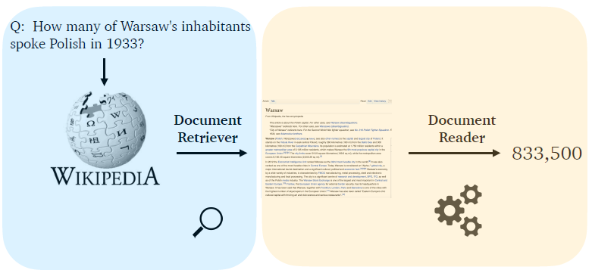
Retrieval-reader Pipeline

Slide 32
DrQA (Chen et al., 2017)
Retriever = TF-IDF retrieval return a list of relevant documents
TF-IDF treats documents as bag-of-words and is based on term frequency.
Reader = An LSTM-based RC model with some manually crafted features
BERTserini (Yang et al., 2019) used BM25 as retriever and BERT as reader.

Slide 33
Challenges of Retriever-reader Models
TF-IDF retrieval suffers from the vocabulary mismatch bottleneck
When question is a paraphrase of what appears in documents
This reduces recall in retrieved documents
Turns out these readers are easily distracted by documents that have word overlap with questions but do not contain an answer

Slide 34
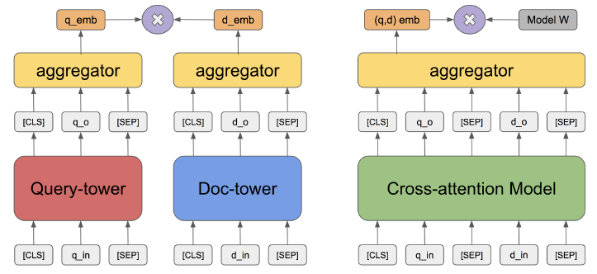
Retriever can be trained
Via a dual encoder or bi-encoder strategy
Image Credit: (Chang et al., 2020)

Slide 35

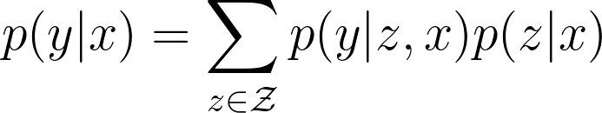
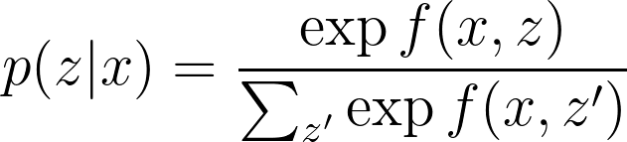
Why Training Retriever Is Challenging (Guu et al., 2020)
Suppose = output answer, = input question, = relevant documents from a knowledge source
Retriever probability
Navigating entire knowledge source is computationally expensive

Slide 36
ORQA (Lee et al., 2019)
Scoring function can be decomposed as follows: b = text block, s = a span of text within b, q = question
Inference:

Slide 37
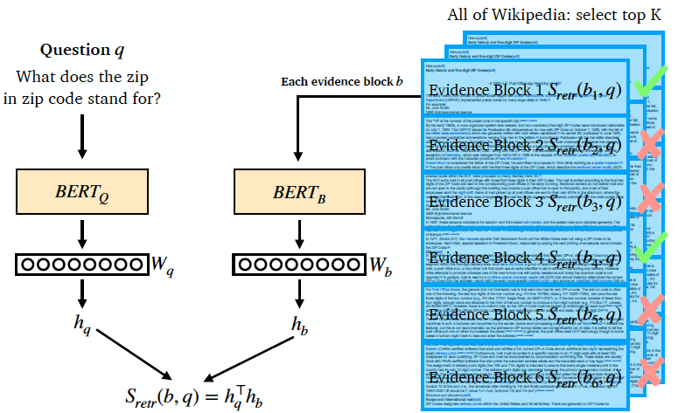
ORQA (Lee et al., 2019): Retriever

Slide 38
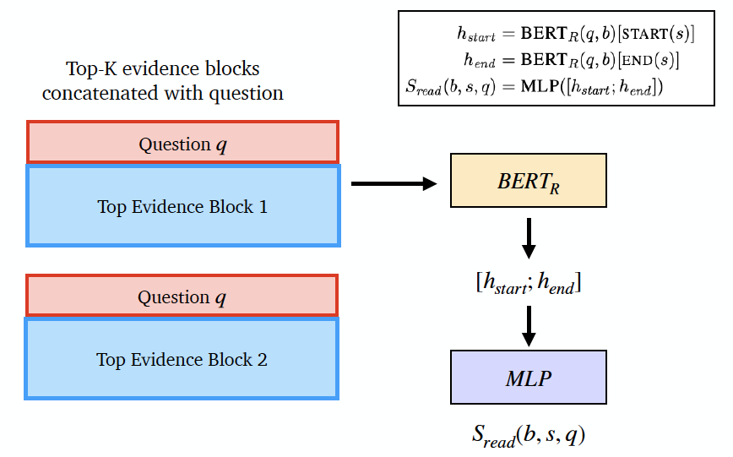
ORQA (Lee et al., 2019): Reader

Slide 39
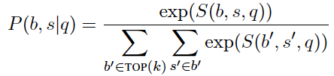
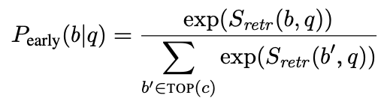
ORQA (Lee et al., 2019): How the retrieval training barrier resolved?
Only update retriever for a larger set of blocks
k=5, but what if top-k blocks do not contain the answer at all
c=5000

Slide 40
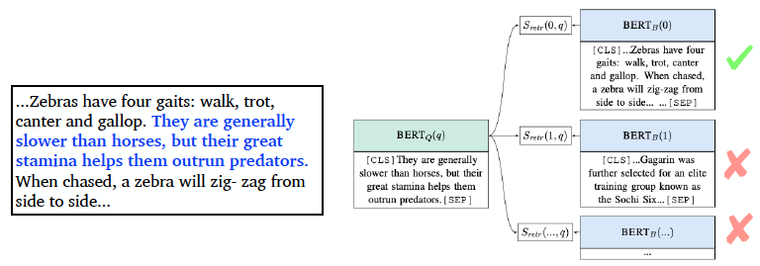
ORQA (Lee et al., 2019): Inverse Cloze Task
Cold-start problem: Retriever does not retrieve meaningful results to pass to reader in early stages of training
Pre-training as a remedy: For a random sentence, select true context among candidates in the batch

Slide 41
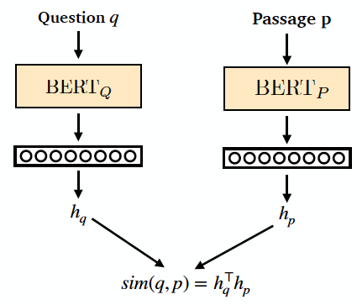

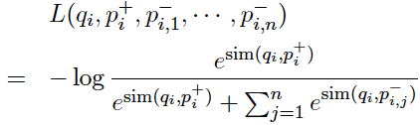
Dense Passage Retriever (DPR; Karpukhin et al., 2020)
Unlike ORQA, doesn’t require pre-training
Based on contrastive learning (InfoNCE loss)
Question & positive passage
negative passages

Slide 42
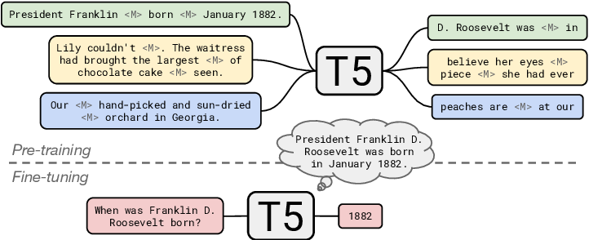
Large Language Models in OQA
Fine-tune T5 on a QA dataset with no retrieval (Roberts et al., 2020)

Slide 43
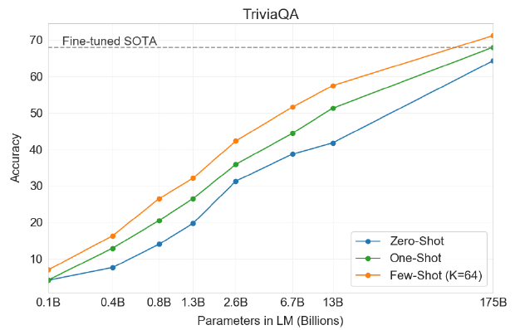
Large Language Models in OQA
Few-shot QA using GPT-3 (Brown et al., 2020)

Slide 44
Thank you!
Feel free to contact me if you have any questions: kamalloo@ualberta.ca

