Slide 1
generalization And robustness
FMNLP, Fall 1401
Yadollah Yaghoobzadeh
University of Tehran

Slide 2
Generalization
We usually make IID assumption for train and evaluation sets
A model must generalize from data in train set to unseen data in evaluation set
This setup is called in-distribution generalization
if a heuristic holds for many examples in train set, model learns that.

Slide 3
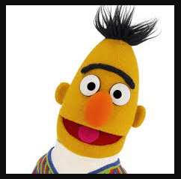
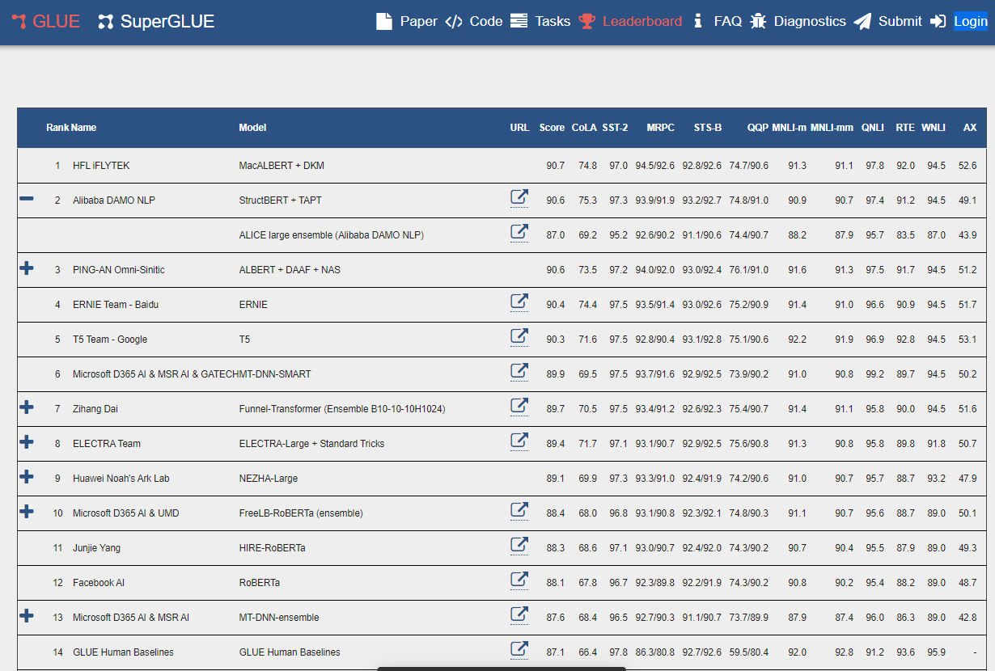
Pre-trained language models (PLMs) are great statistical learners!

Slide 4
Natural language inference (NLI)
Given a premise and a hypothesis, specify the relation between them.
Premise | Hypothesis | Label
Four women are sitting outside eating lunch. | Four women are eating outside. | Entailment
 | The women are watching their kids. | Neutral
 | The women are having dinner. | Contradiction

Slide 5
Spurious correlations or Heuristics or Dataset biases
“Spurious correlations or heuristics are predictive rules that work for majority of examples in the dataset but do not hold in general”.
Examples:
“not” in hypothesis is correlated with “contradiction”.
high “world-overlap” between hypothesis and premise is correlated with “entailment”.

Slide 6
PLMs rely on spurious correlations

Slide 7
HANS dataset (McCoy et al., 2019)
tests if models rely on word-overlap heuristic.
Premise | Hypothesis | Label
The doctor was visited by the judge. | The judge visited the doctor | Entailment
 | The doctor visited the judge. | Non-entailment

Slide 8
BERT accuracy on MNLI and HANS when trained on MNLI
 | MNLI | HANS
BERT | 84.5 | 62.9
Random | 33.0 | 50.0

Slide 9
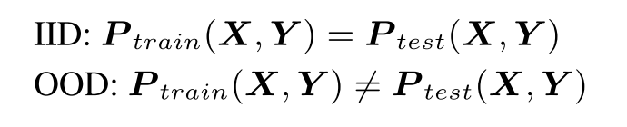
HANS is a challenging set
Or an Out-of-distribution (OOD) set because the distribution is different from training sets of MNLI.
In MNLI, majority of high word-overlap examples are entailment, but in HANS there is no majority.

Slide 10
How to improve the accuracy on HANS?

Slide 11
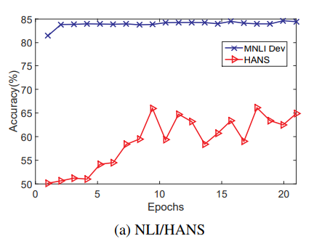
Training log
Longer training = better learning from minority examples = better performance on HANS (Tu et al., 2020).
From Tu et al. (2020)

Slide 12
Minority examples are training examples that violate the heuristics
E.g.,
or
examples with high word-overlap labeled as non-entailment.
examples with negation in premise but labeled as entailment

Slide 13
Finding minority examples
Training a heuristic-based model
e.g., a logistic regression classifier with word-overlap value as its only feature
Examples that this model gets wrong during training violate the heuristic
Automatic methods of ranking training examples

Slide 14

Forgettable examples
Examples learned and then forgotten during training, or never learned.
Originally explored for image classification (Toneva et al., 2019) to find salient examples in training set.

Slide 15
Number of forgettable examples in MNLI
Model | MNLI (393k)
BoW | 63k
BiLSTM | 47k
BERT | 18k

Slide 16
Forgettable examples and minorities
 | Entailment | Non-entailment
all | .33 | .22
BOW forgettables | .26 | .30
BiLSTM forgettables | .25 | .28
BERT forgettables | .26 | .26
Word-overlap between premise & hypothesis

Slide 17
How to exploit minority examples to increase robustness?

Slide 18
Our proposed framework
Forgettable examples
BERT MNLI
Fine-tune
Robust BERT MNLI

Slide 19
Accuracy on HANS and MNLI
 | MNLI | HANS
BERT | 84.4 | 62.9
BERT + BoW forgettables | 83.1 | 70.5
BERT + Random (same size as above) | 84.3 | 63.6
BERT + BiLSTM forgettables | 82.9 | 70.4
Clark et al. (2019) Reweight | 83.5 | 69.2
Utama et al. (2020) Reg-conf_{hans} | 84.3 | 69.1
Baselines use bias-only models based on HANS

Slide 20
Accuracy on HANS and MNLI
 | MNLI | HANS
BERT | 84.4 | 62.9
BERT + BoW forgettables | 83.1 | 70.5
BERT + Random (same size as above) | 84.3 | 63.6
BERT + BiLSTM forgettables | 82.9 | 70.4
Clark et al. (2019) Reweight | 83.5 | 69.2
Utama et al. (2020) Reg-conf_{hans} | 84.3 | 69.1
Baselines use bias-only models based on HANS

Slide 21
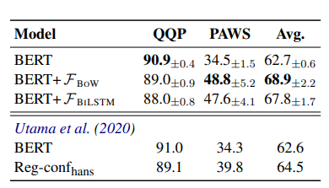
Other datasets: QQP and PAWS

Slide 22
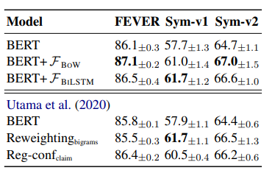
Other datasets: FEVER and FEVER-Symm

Slide 23
Tradeoff of in-domain vs out-of-domain generalization
HANS is improved but MNLI is worse
It is important to balance performance of majorities and minorities

Slide 24
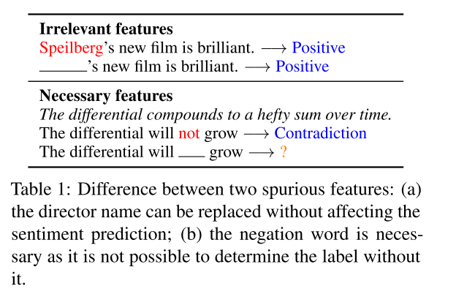
Are All Spurious Features in Natural Language Alike?
Are All Spurious Features in Natural Language Alike? An Analysis through a Causal Lens, EMNLP 2022

Slide 25
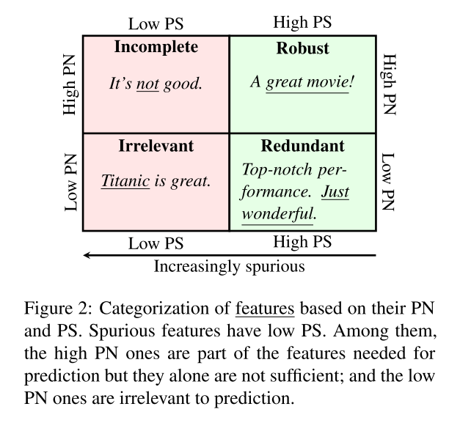
Necessity and sufficiency
PS: probability of sufficiency
PN: probability of necessity
Are All Spurious Features in Natural Language Alike? An Analysis through a Causal Lens, EMNLP 2022

Slide 26
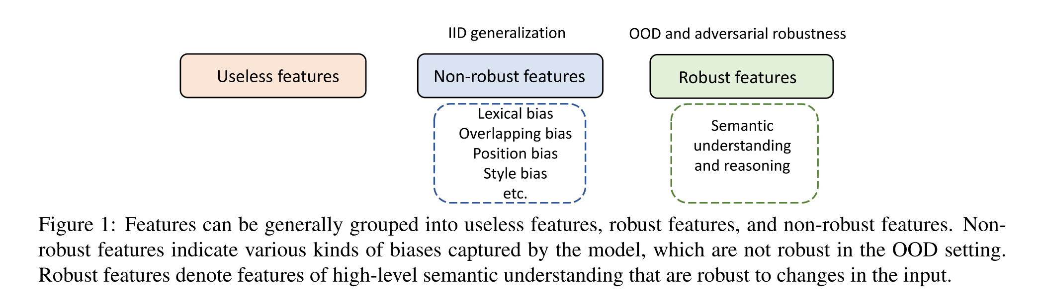
Another perspective

Slide 27
What about spurious features in NLI?
Word-overlap and negation both have
high PN
low PS
Debiasing methods try to remove them by balancing wrt these features:
having the same number of negation in each label

Slide 28
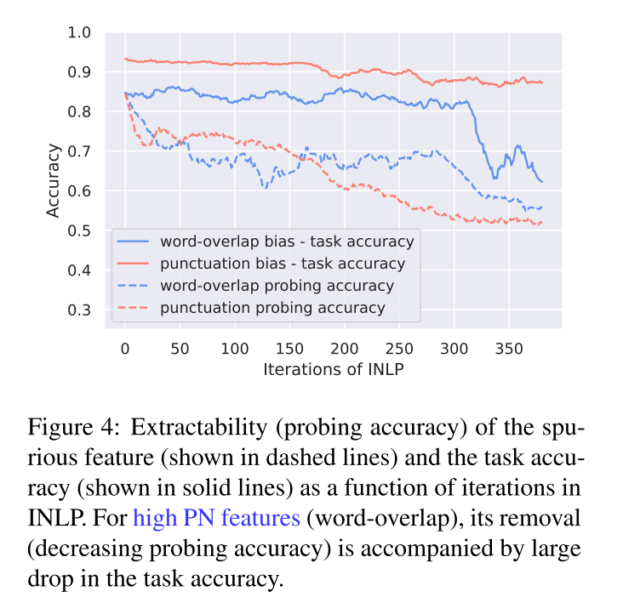
Removing high PN features
from the representation hurt
performance!

Slide 29
Debiasing models do use the high PN features but they ignore low PN ones
In general, models must learn high PS features
High PS features are usually more complicated and composite features
perhaps the very large language models actually learn the semantics because they perform very well on OOD

Slide 30
For high PN features, models must learn composite features for minority examples
e.g., double negation for positive labels
e.g., full word-overlap but different subject for non-entailment
These composite features could be different for different examples even in the same class
What about majority examples? what does the model learn there?
e.g., negation and negative class

Slide 31
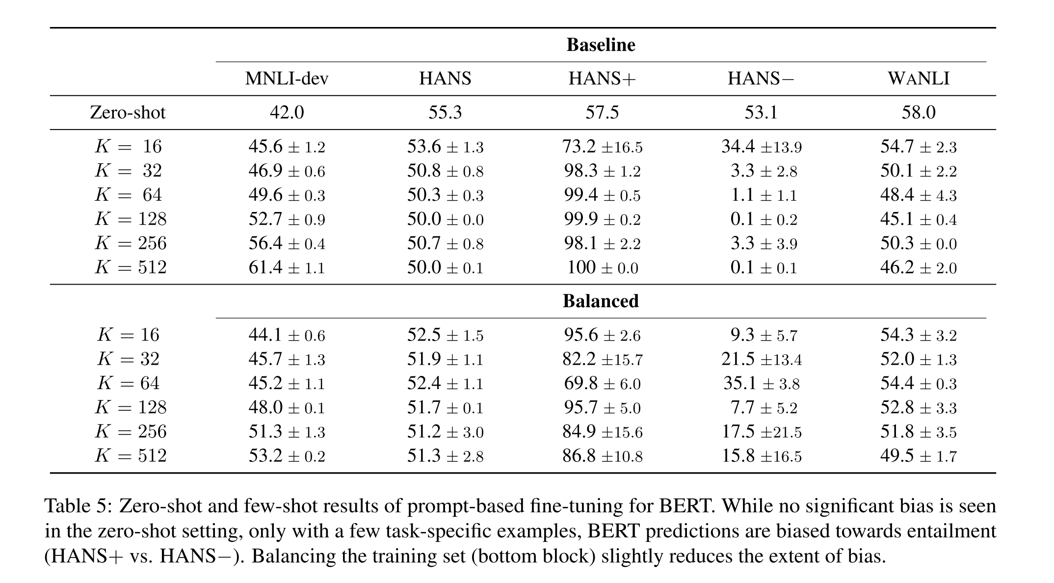
Models get biased towards entailment even after few examples
Looking at the Overlooked: An Analysis on the Word-Overlap Bias in Natural Language Inference, EMNLP 2022

Slide 32
The composite features in majority class are easier to learn

Slide 33
General shortcuts in NLP tasks
Lexical
overlap
Position
Style
Shortcut Learning of Large Language Models in Natural Language Understanding: A Survey, arXiv 2022

Slide 34
Other types of robustness
Adversarial attacks
in inference, small but careful perturbation results in label change
Backdoor attacks
during training, adds a feature that attacks the model by changing its label whenever that feature exists

Slide 35
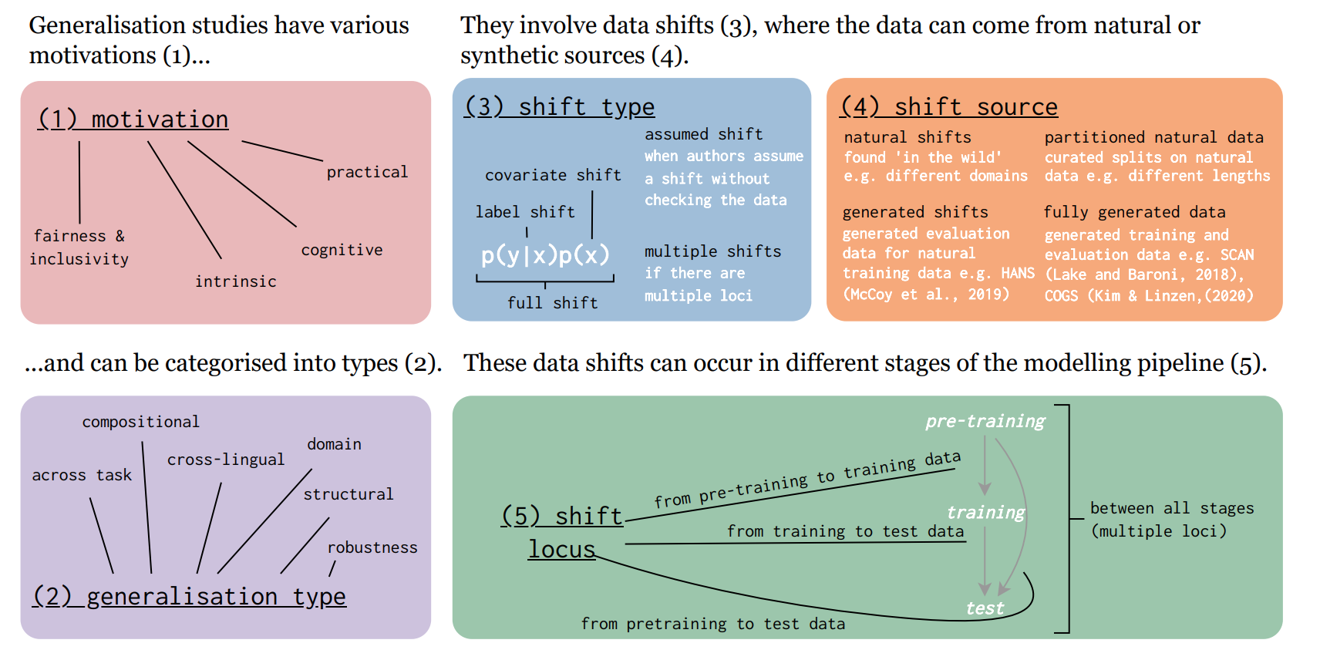
Generalization taxonomy
https://arxiv.org/pdf/2210.03050.pdf

Slide 36
References
https://arxiv.org/abs/2208.11857
Shortcut Learning of Large Language Models in Natural Language Understanding: A Survey
https://arxiv.org/pdf/2210.03050.pdf
State-of-the-art generalisation research in NLP: a taxonomy and review
https://aclanthology.org/2021.eacl-main.291.pdf
Increasing Robustness to Spurious Correlations using Forgettable Examples
https://aclanthology.org/P19-1334.pdf
Right for the Wrong Reasons: Diagnosing Syntactic Heuristics in Natural Language Inference

