Slide 1
JUNIPER SALON
A calmer way to fill
last-minute cancellations
A working waitlist prototype powered by Temporal
Business goal: refill at least half of cancellations.
The prototype demonstrates the process. A live pilot must measure the result.
Top risk: staff must enter each reservation in Square to avoid calendar conflicts.
Notes:
Source: supplied Lena interview. The 50% target is not measured evidence. Square remains authoritative. All demo clients and messages are fictional.

Slide 2
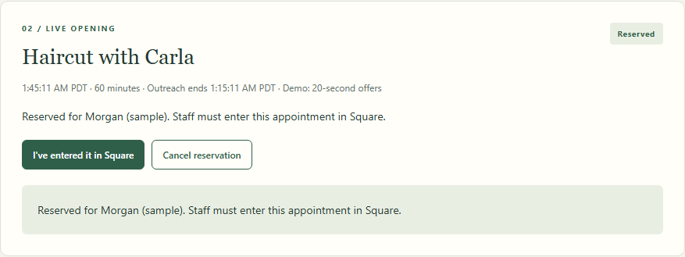
One offer at a time
1 Match the opening
Service, duration, availability, stylist and consent determine eligibility.
2 Wait for a reply
Contact the earliest eligible client. Declines and 15-minute timeouts advance the queue.
3 Reserve and hand off
The reservation includes a clear Square reminder.
A valid acceptance stops outreach. Staff complete the Square entry.
Demo path: decline, timeout, then acceptance.
Shown: the reservation following the restart test.
02
Notes:
Source: actual local browser demonstration and actual reservation-panel screenshot after the restart test. The screenshot shows fictional clients and sample hours. The labeled demo response window is 20 seconds. Standard timing is 15 minutes. The main demo in evidence/juniper-dashboard.png separately shows decline, timeout, then acceptance.

Slide 3
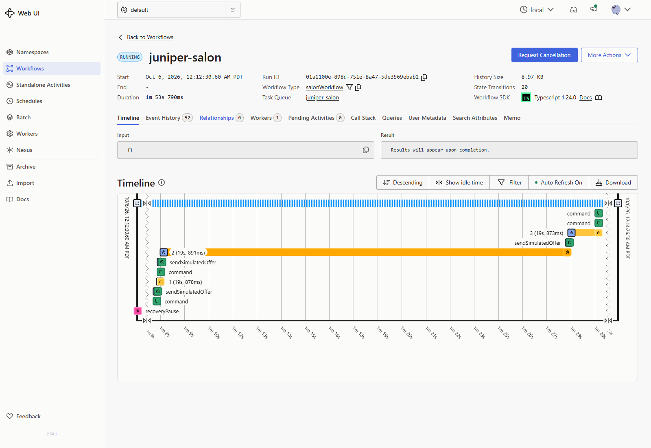
Temporal keeps the process and its deadlines
Durable waiting
The workflow records offers and waits for replies or timers. Browser refreshes do not reset progress.
Staff review after restart
Recovery pauses outreach. Replies are rejected until staff resume. Expired offers stay expired.
Real process restart verified the pause and original deadline.
The salon workflow remains running after a reservation.
03
Notes:
Sources: actual Temporal UI screenshot and actual process restart verification in evidence/README.md. Technical reference: https://docs.temporal.io/develop/typescript/workflows/message-passing and https://docs.temporal.io/develop/typescript/workflows/timers. A standalone Temporal infrastructure reconnect still requires restarting the application for operator review.

Slide 4
What is ready, and what comes next
Demonstrated
Before a real pilot
Sequential offers, expiry and reservation
Late and competing replies rejected
Opt-outs, quiet hours and staff controls
Message failure and restart review
Confirm salon hours and time zone.
Connect messaging and Square safely.
Add production identity and monitoring.
Test recovery across infrastructure outages.
Local protection
Measure the business result
Staff sign-in, loopback services, validated
requests and fictional client data.
Refilled cancellations / eligible cancellations,
plus staff time and booking conflicts.
The 50% target is still to be validated.
04
Notes:
Sources: supplied customer interview, tests/, docs/SECURITY.md and evidence/README.md. No claim of zero possible security vulnerabilities or measured revenue impact. Real SMS, Square writes and public deployment are out of scope.

