Slide 1
Chapter 2
Instructions: Language of the Computer
Notes:
The University of Adelaide, School of Computer Science
Chapter 2 — Instructions: Language of the Computer

Slide 2
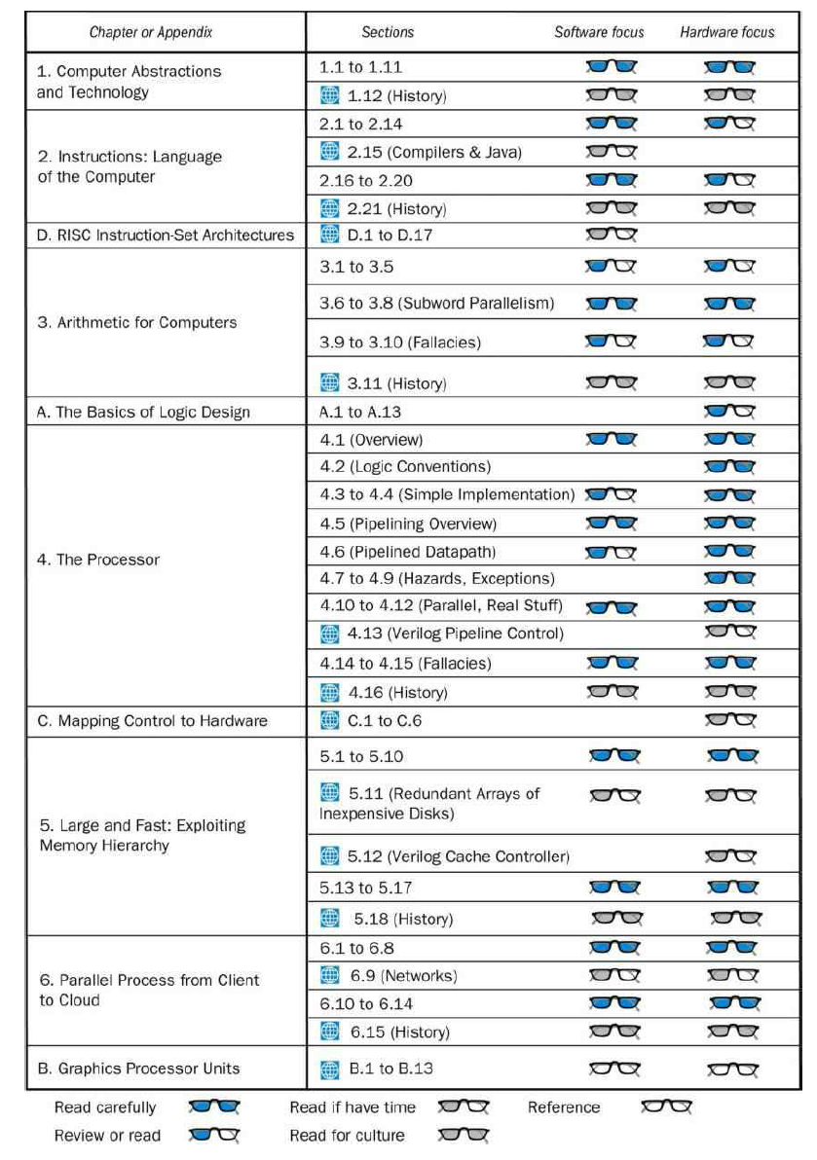
Chapter 2 — Instructions: Language of the Computer — <number>

Slide 3
Instruction Set
§2.1 Introduction
The repertoire of instructions of a computer
Different computers have different instruction sets
  But with many aspects in common
Early computers had very simple instruction sets
  Simplified implementation
Many modern computers also have simple instruction sets
Chapter 2 — Instructions: Language of the Computer — <number>
Notes:
The University of Adelaide, School of Computer Science
Chapter 2 — Instructions: Language of the Computer

Slide 4
The MIPS Instruction Set
Used as the example throughout the book
Stanford MIPS commercialized by MIPS Technologies (www.mips.com)
Large share of embedded core market
  Applications in consumer electronics, network/storage equipment, cameras, printers, …
Typical of many modern ISAs
  See MIPS Reference Data tear-out card, and Appendixes B and E
Chapter 2 — Instructions: Language of the Computer — <number>
Notes:
The University of Adelaide, School of Computer Science
Chapter 2 — Instructions: Language of the Computer

Slide 5
The RISC-V Instruction Set
Used as the example throughout the book
Developed at UC Berkeley as open ISA
Now managed by the RISC-V Foundation (riscv.org)
Typical of many modern ISAs
  See RISC-V Reference Data tear-out card
Similar ISAs have a large share of embedded core market
  Applications in consumer electronics, network/storage equipment, cameras, printers, …
Chapter 2 — Instructions: Language of the Computer — <number>
Notes:
The University of Adelaide, School of Computer Science
Chapter 2 — Instructions: Language of the Computer

Slide 6
ISA
MIPS Green Card:
  https://inst.eecs.berkeley.edu/~cs61c/resources/MIPS_Green_Sheet.pdf
RISC-V Greed Card:
  https://www.cl.cam.ac.uk/teaching/1617/ECAD+Arch/files/docs/RISCVGreenCardv8-20151013.pdf
Chapter 2 — Instructions: Language of the Computer — <number>

Slide 7
Arithmetic Operations
Add and subtract, three operands
  Two sources and one destination
add a, b, c // a gets b + c
All arithmetic operations have this form
Design Principle 1: Simplicity favours regularity
  Regularity makes implementation simpler
  Simplicity enables higher performance at lower cost
§2.2 Operations of the Computer Hardware
Chapter 2 — Instructions: Language of the Computer — <number>
Notes:
The University of Adelaide, School of Computer Science
Chapter 2 — Instructions: Language of the Computer

Slide 8
Arithmetic Example
C code:
f = (g + h) - (i + j);
Compiled RISC-V code:
add t0, g, h // temp t0 = g + h
add t1, i, j // temp t1 = i + j
add f, t0, t1 // f = t0 - t1
Chapter 2 — Instructions: Language of the Computer — <number>
Notes:
The University of Adelaide, School of Computer Science
Chapter 2 — Instructions: Language of the Computer

Slide 9
Register Operands (RISC-V)
Arithmetic instructions use register
operands
RISC-V has a 32 × 64-bit register file
  Use for frequently accessed data
  64-bit data is called a “doubleword”
    32 x 64-bit general purpose registers x0 to x30
  32-bit data is called a “word”
Design Principle 2: Smaller is faster
  c.f. main memory: millions of locations
Chapter 2 — Instructions: Language of the Computer — <number>
Notes:
The University of Adelaide, School of Computer Science
Chapter 2 — Instructions: Language of the Computer

Slide 10
Register Operands (MIPS)
Arithmetic instructions use register
operands
MIPS has a 32 × 32-bit register file
  Use for frequently accessed data
  Numbered 0 to 31
  32-bit data called a “word”
Assembler names
  $t0, $t1, …, $t9 for temporary values
  $s0, $s1, …, $s7 for saved variables
Design Principle 2: Smaller is faster
  c.f. main memory: millions of locations
§2.3 Operands of the Computer Hardware
Chapter 2 — Instructions: Language of the Computer — <number>
Notes:
The University of Adelaide, School of Computer Science
Chapter 2 — Instructions: Language of the Computer

Slide 11
RISC-V Registers
x0: the constant value 0
x1: return address
x2: stack pointer
x3: global pointer
x4: thread pointer
x5 – x7, x28 – x31: temporaries
x8: frame pointer
x9, x18 – x27: saved registers
x10 – x11: function arguments/results
x12 – x17: function arguments
Chapter 2 — Instructions: Language of the Computer — <number>

Slide 12
Register Operand Example
C code:
f = (g + h) - (i + j);
  f, …, j in x19, x20, …, x23
Compiled RISC-V code:
add x5, x20, x21
add x6, x22, x23
sub x19, x5, x6
Chapter 2 — Instructions: Language of the Computer — <number>
Notes:
The University of Adelaide, School of Computer Science
Chapter 2 — Instructions: Language of the Computer

Slide 13
Memory Operands
Main memory used for composite data
  Arrays, structures, dynamic data
To apply arithmetic operations
  Load values from memory into registers
  Store result from register to memory
Memory is byte addressed
  Each address identifies an 8-bit byte
RISC-V is Little Endian
  Least-significant byte at least address of a word
  c.f. Big Endian: most-significant byte at least address
RISC-V does not require words to be aligned in memory
  Unlike some other ISAs
Chapter 2 — Instructions: Language of the Computer — <number>
Notes:
The University of Adelaide, School of Computer Science
Chapter 2 — Instructions: Language of the Computer

Slide 14
Memory Operands (MIPS)
Main memory used for composite data
  Arrays, structures, dynamic data
To apply arithmetic operations
  Load values from memory into registers
  Store result from register to memory
Memory is byte addressed
  Each address identifies an 8-bit byte
MIPS is Big Endian
  Most-significant byte at least address of a word
  c.f. Little Endian: least-significant byte at least address
Words are aligned in memory
  Address must be a multiple of 4
Chapter 2 — Instructions: Language of the Computer — <number>
Notes:
The University of Adelaide, School of Computer Science
Chapter 2 — Instructions: Language of the Computer

Slide 15
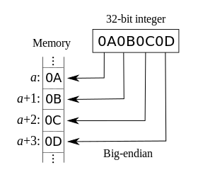
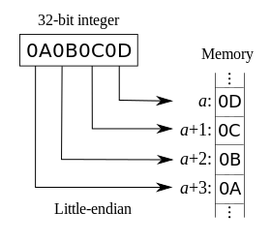
Big-Endian vs Little-Endian
https://en.wikipedia.org/wiki/Endianness
Chapter 2 — Instructions: Language of the Computer — <number>

Slide 16
Memory Operand Example
C code:
A[12] = h + A[8];
  h in x21, base address of A in x22
Compiled RISC-V code:
  Index 8 requires offset of 64
    8 bytes per doubleword
ld x9, 64(x22)
add x9, x21, x9
sd x9, 96(x22)
Chapter 2 — Instructions: Language of the Computer — <number>
Notes:
The University of Adelaide, School of Computer Science
Chapter 2 — Instructions: Language of the Computer

Slide 17
Memory Operand (MIPS)
C code:
A[12] = h + A[8];
  h in $s2, base address of A in $s3
Compiled MIPS code:
  Index 8 requires offset of 32
lw $t0, 32($s3) # load word
add $t0, $s2, $t0
sw $t0, 48($s3) # store word
Chapter 2 — Instructions: Language of the Computer — <number>
Notes:
The University of Adelaide, School of Computer Science
Chapter 2 — Instructions: Language of the Computer

Slide 18
Registers vs. Memory
Registers are faster to access than memory
Operating on memory data requires loads and stores
  More instructions to be executed
Compiler must use registers for variables as much as possible
  Only spill to memory for less frequently used variables
  Register optimization is important!
Chapter 2 — Instructions: Language of the Computer — <number>
Notes:
The University of Adelaide, School of Computer Science
Chapter 2 — Instructions: Language of the Computer

Slide 19
Immediate Operands
Constant data specified in an instruction
addi x22, x22, 4
Make the common case fast
  Small constants are common
  Immediate operand avoids a load instruction
Chapter 2 — Instructions: Language of the Computer — <number>
Notes:
The University of Adelaide, School of Computer Science
Chapter 2 — Instructions: Language of the Computer

Slide 20
The Constant Zero
MIPS register 0 ($zero) is the constant 0
  Cannot be overwritten
Useful for common operations
  E.g., move between registers
  add $t2, $s1, $zero
RISC-V register 0 (x0) is the constant 0
Chapter 2 — Instructions: Language of the Computer — <number>
Notes:
The University of Adelaide, School of Computer Science
Chapter 2 — Instructions: Language of the Computer

Slide 21
Unsigned Binary Integers
Given an n-bit number
§2.4 Signed and Unsigned Numbers
Range: 0 to +2^{n} – 1
Example
  0000 0000 … 0000 1011₂
  = 0 + … + 1×2³ + 0×2² +1×2¹ +1×2⁰
  = 0 + … + 8 + 0 + 2 + 1 = 11₁₀
Using 64 bits: 0 to +18,446,774,073,709,551,615
Chapter 2 — Instructions: Language of the Computer — <number>
Notes:
The University of Adelaide, School of Computer Science
Chapter 2 — Instructions: Language of the Computer

Slide 22
2s-Complement Signed Integers
Given an n-bit number
Range: –2^{n – 1} to +2^{n – 1} – 1
Example
  1111 1111 … 1111 1100₂
  = –1×2³¹ + 1×2³⁰ + … + 1×2² +0×2¹ +0×2⁰
  = –2,147,483,648 + 2,147,483,644 = –4₁₀
Using 64 bits: −9,223,372,036,854,775,808
to 9,223,372,036,854,775,807
Chapter 2 — Instructions: Language of the Computer — <number>
Notes:
The University of Adelaide, School of Computer Science
Chapter 2 — Instructions: Language of the Computer

Slide 23
2s-Complement Signed Integers
Bit 63 is sign bit
  1 for negative numbers
  0 for non-negative numbers
–(–2^{n – 1}) can’t be represented
Non-negative numbers have the same unsigned and 2s-complement representation
Some specific numbers
  0: 0000 0000 … 0000
  –1: 1111 1111 … 1111
  Most-negative: 1000 0000 … 0000
  Most-positive: 0111 1111 … 1111
Chapter 2 — Instructions: Language of the Computer — <number>
Notes:
The University of Adelaide, School of Computer Science
Chapter 2 — Instructions: Language of the Computer

Slide 24

Signed Negation
Complement and add 1
  Complement means 1 → 0, 0 → 1
Example: negate +2
  +2 = 0000 0000 … 0010_{two}
  –2 = 1111 1111 … 1101_{two} + 1
  = 1111 1111 … 1110_{two}
Chapter 2 — Instructions: Language of the Computer — <number>
Notes:
The University of Adelaide, School of Computer Science
Chapter 2 — Instructions: Language of the Computer

Slide 25
Sign Extension
Representing a number using more bits
  Preserve the numeric value
Replicate the sign bit to the left
  c.f. unsigned values: extend with 0s
Examples: 8-bit to 16-bit
  +2: 0000 0010 => 0000 0000 0000 0010
  –2: 1111 1110 => 1111 1111 1111 1110
In RISC-V instruction set
  lb: sign-extend loaded byte
  lbu: zero-extend loaded byte
Chapter 2 — Instructions: Language of the Computer — <number>
Notes:
The University of Adelaide, School of Computer Science
Chapter 2 — Instructions: Language of the Computer

Slide 26
Representing Instructions
Instructions are encoded in binary
  Called machine code
RISC-V/MIPS instructions
  Encoded as 32-bit instruction words
  Small number of formats encoding operation code (opcode), register numbers, …
  Regularity!
§2.5 Representing Instructions in the Computer
Chapter 2 — Instructions: Language of the Computer — <number>
Notes:
The University of Adelaide, School of Computer Science
Chapter 2 — Instructions: Language of the Computer

Slide 27
Hexadecimal
Base 16
  Compact representation of bit strings
  4 bits per hex digit
0 | 0000 | 4 | 0100 | 8 | 1000 | c | 1100
1 | 0001 | 5 | 0101 | 9 | 1001 | d | 1101
2 | 0010 | 6 | 0110 | a | 1010 | e | 1110
3 | 0011 | 7 | 0111 | b | 1011 | f | 1111
Example: eca8 6420
  1110 1100 1010 1000 0110 0100 0010 0000
Chapter 2 — Instructions: Language of the Computer — <number>
Notes:
The University of Adelaide, School of Computer Science
Chapter 2 — Instructions: Language of the Computer

Slide 28
RISC-V R-format Instructions
funct7
rs2
rs1
funct3
rd
opcode
7 bits
5 bits
5 bits
3 bits
5 bits
7 bits
Instruction fields
  opcode: operation code
  rd: destination register number
  funct3: 3-bit function code (additional opcode)
  rs1: the first source register number
  rs2: the second source register number
  funct7: 7-bit function code (additional opcode)
Chapter 2 — Instructions: Language of the Computer — <number>
Notes:
The University of Adelaide, School of Computer Science
Chapter 2 — Instructions: Language of the Computer

Slide 29
MIPS R-format Instructions
op
rs
rt
rd
shamt
funct
6 bits
5 bits
5 bits
5 bits
5 bits
6 bits
Instruction fields
  op: operation code (opcode)
  rs: first source register number
  rt: second source register number
  rd: destination register number
  shamt: shift amount (00000 for now)
  funct: function code (extends opcode)
Chapter 2 — Instructions: Language of the Computer — <number>
Notes:
The University of Adelaide, School of Computer Science
Chapter 2 — Instructions: Language of the Computer

Slide 30
R-format Example
funct7
rs2
rs1
funct3
rd
opcode
7 bits
5 bits
5 bits
3 bits
5 bits
7 bits
add x9,x20,x21
0
21
20
0
9
51
0000000
10101
10100
000
01001
0110011
0000 0001 0101 1010 0000 0100 1011 0011_{two} =
015A04B3₁₆
Chapter 2 — Instructions: Language of the Computer — <number>
Notes:
The University of Adelaide, School of Computer Science
Chapter 2 — Instructions: Language of the Computer

Slide 31
RISC-V I-format Instructions
immediate
rs1
funct3
rd
opcode
12 bits
5 bits
3 bits
5 bits
7 bits
Immediate arithmetic and load instructions
  rs1: source or base address register number
  immediate: constant operand, or offset added to base address
    2s-complement, sign extended
Design Principle 3: Good design demands good compromises
  Different formats complicate decoding, but allow 32-bit instructions uniformly
  Keep formats as similar as possible
Chapter 2 — Instructions: Language of the Computer — <number>
Notes:
The University of Adelaide, School of Computer Science
Chapter 2 — Instructions: Language of the Computer

Slide 32
RISC-V S-format Instructions
imm[11:5]
rs2
rs1
funct3
imm[4:0]
opcode
7 bits
5 bits
5 bits
3 bits
5 bits
7 bits
Different immediate format for store instructions
  rs1: base address register number
  rs2: source operand register number
  immediate: offset added to base address
    Split so that rs1 and rs2 fields always in the same place
Chapter 2 — Instructions: Language of the Computer — <number>
Notes:
The University of Adelaide, School of Computer Science
Chapter 2 — Instructions: Language of the Computer

Slide 33
MIPS I-format Instructions
op
rs
rt
constant or address
6 bits
5 bits
5 bits
16 bits
Immediate arithmetic and load/store instructions
  rt: destination or source register number
  Constant: –2¹⁵ to +2¹⁵ – 1
  Address: offset added to base address in rs
Chapter 2 — Instructions: Language of the Computer — <number>
Notes:
The University of Adelaide, School of Computer Science
Chapter 2 — Instructions: Language of the Computer

Slide 34

Stored Program Computers
The BIG Picture
Instructions represented in binary, just like data
Instructions and data stored in memory
Programs can operate on programs
  e.g., compilers, linkers, …
Binary compatibility allows compiled programs to work on different computers
  Standardized ISAs
Chapter 2 — Instructions: Language of the Computer — <number>
Notes:
The University of Adelaide, School of Computer Science
Chapter 2 — Instructions: Language of the Computer

Slide 35
Logical Operations
Instructions for bitwise manipulation
§2.6 Logical Operations
Operation | C | Java | RISC-V
Shift left | << | << | slli
Shift right | >> | >>> | srli
Bit-by-bit AND | & | & | and, andi
Bit-by-bit OR | | | | | or, ori
Bit-by-bit XOR | ^ | ^ | xor, xori
Bit-by-bit NOT | ~ | ~
Useful for extracting and inserting groups of bits in a word
Chapter 2 — Instructions: Language of the Computer — <number>
Notes:
The University of Adelaide, School of Computer Science
Chapter 2 — Instructions: Language of the Computer

Slide 36
Shift Operations
funct6
immed
rs1
funct3
rd
opcode
6 bits
6 bits
5 bits
3 bits
5 bits
7 bits
immed: how many positions to shift
Shift left logical
  Shift left and fill with 0 bits
  slli by i bits multiplies by 2^{i}
Shift right logical
  Shift right and fill with 0 bits
  srli by i bits divides by 2^{i} (unsigned only)
Chapter 2 — Instructions: Language of the Computer — <number>
Notes:
The University of Adelaide, School of Computer Science
Chapter 2 — Instructions: Language of the Computer

Slide 37
AND Operations
Useful to mask bits in a word
  Select some bits, clear others to 0
and x9,x10,x11
x10
00000000 00000000 00000000 00000000 00000000 00000000 00001101 11000000
x11
00000000 00000000 00000000 00000000 00000000 00000000 00111100 00000000
x9
00000000 00000000 00000000 00000000 00000000 00000000 00001100 00000000
Chapter 2 — Instructions: Language of the Computer — <number>
Notes:
The University of Adelaide, School of Computer Science
Chapter 2 — Instructions: Language of the Computer

Slide 38
OR Operations
Useful to include bits in a word
  Set some bits to 1, leave others unchanged
or x9,x10,x11
x10
00000000 00000000 00000000 00000000 00000000 00000000 00001101 11000000
x11
00000000 00000000 00000000 00000000 00000000 00000000 00111100 00000000
x9
00000000 00000000 00000000 00000000 00000000 00000000 00111101 11000000
Chapter 2 — Instructions: Language of the Computer — <number>
Notes:
The University of Adelaide, School of Computer Science
Chapter 2 — Instructions: Language of the Computer

Slide 39
XOR Operations
Differencing operation
  Set some bits to 1, leave others unchanged
xor x9,x10,x12 // NOT operation
x10
00000000 00000000 00000000 00000000 00000000 00000000 00001101 11000000
x12
11111111 11111111 11111111 11111111 11111111 11111111 11111111 11111111
x9
11111111 11111111 11111111 11111111 11111111 11111111 11110010 00111111
Chapter 2 — Instructions: Language of the Computer — <number>
Notes:
The University of Adelaide, School of Computer Science
Chapter 2 — Instructions: Language of the Computer

Slide 40
Conditional Operations
Branch to a labeled instruction if a condition is true
  Otherwise, continue sequentially
beq rs1, rs2, L1
  if (rs1 == rs2) branch to instruction labeled L1
bne rs1, rs2, L1
  if (rs1 != rs2) branch to instruction labeled L1
§2.7 Instructions for Making Decisions
Chapter 2 — Instructions: Language of the Computer — <number>
Notes:
The University of Adelaide, School of Computer Science
Chapter 2 — Instructions: Language of the Computer

Slide 41

Compiling If Statements
C code:
if (i==j) f = g+h;
else f = g-h;
  f, g, … in x19, x20, …
Compiled RISC-V code:
bne x22, x23, Else
add x19, x20, x21
beq x0,x0,Exit // unconditional
Else: sub x19, x20, x21
Exit: …
Assembler calculates addresses
Chapter 2 — Instructions: Language of the Computer — <number>
Notes:
The University of Adelaide, School of Computer Science
Chapter 2 — Instructions: Language of the Computer

Slide 42
Compiling Loop Statements
C code:
while (save[i] == k) i += 1;
  i in x22, k in x24, address of save in x25
Compiled RISC-V code:
Loop: slli x10, x22, 3
add x10, x10, x25
ld x9, 0(x10)
bne x9, x24, Exit
addi x22, x22, 1
beq x0, x0, Loop
Exit: …
Chapter 2 — Instructions: Language of the Computer — <number>
Notes:
The University of Adelaide, School of Computer Science
Chapter 2 — Instructions: Language of the Computer

Slide 43
Basic Blocks
A basic block is a sequence of instructions with
  No embedded branches (except at end)
  No branch targets (except at beginning)
A compiler identifies basic blocks for optimization
An advanced processor can accelerate execution of basic blocks
Chapter 2 — Instructions: Language of the Computer — <number>
Notes:
The University of Adelaide, School of Computer Science
Chapter 2 — Instructions: Language of the Computer

Slide 44
More Conditional Operations
blt rs1, rs2, L1
  if (rs1 < rs2) branch to instruction labeled L1
bge rs1, rs2, L1
  if (rs1 >= rs2) branch to instruction labeled L1
Example
  if (a > b) a += 1;
  a in x22, b in x23
  bge x23, x22, Exit // branch if b >= a
  addi x22, x22, 1
  Exit:
Chapter 2 — Instructions: Language of the Computer — <number>
Notes:
The University of Adelaide, School of Computer Science
Chapter 2 — Instructions: Language of the Computer

Slide 45
MIPS Design (1/2)
Set result to 1 if a condition is true
  Otherwise, set to 0
slt rd, rs, rt
  if (rs < rt) rd = 1; else rd = 0;
slti rt, rs, constant
  if (rs < constant) rt = 1; else rt = 0;
Use in combination with beq, bne
  slt $t0, $s1, $s2 # if ($s1 < $s2)
  bne $t0, $zero, L # branch to L
Chapter 2 — Instructions: Language of the Computer — <number>
Notes:
The University of Adelaide, School of Computer Science
Chapter 2 — Instructions: Language of the Computer

Slide 46
MIPS Design (2/2)
Why not blt, bge, etc?
Hardware for <, ≥, … slower than =, ≠
  Combining with branch involves more work per instruction, requiring a slower clock
  All instructions penalized!
beq and bne are the common case
This is a good design compromise for low-end processors
Chapter 2 — Instructions: Language of the Computer — <number>
Notes:
The University of Adelaide, School of Computer Science
Chapter 2 — Instructions: Language of the Computer

Slide 47
Signed vs. Unsigned
Signed comparison: blt, bge
Unsigned comparison: bltu, bgeu
Example
  x22 = 1111 1111 1111 1111 1111 1111 1111 1111
  x23 = 0000 0000 0000 0000 0000 0000 0000 0001
  x22 < x23 // signed
    –1 < +1
  x22 > x23 // unsigned
    +4,294,967,295 > +1
Chapter 2 — Instructions: Language of the Computer — <number>
Notes:
The University of Adelaide, School of Computer Science
Chapter 2 — Instructions: Language of the Computer

Slide 48
Procedure Calling
Steps required
  Place parameters in registers x10 to x17
  Transfer control to procedure
  Acquire storage for procedure
  Perform procedure’s operations
  Place result in register for caller
  Return to place of call (address in x1)
§2.8 Supporting Procedures in Computer Hardware
Chapter 2 — Instructions: Language of the Computer — <number>
Notes:
The University of Adelaide, School of Computer Science
Chapter 2 — Instructions: Language of the Computer

Slide 49
Procedure Call Instructions
Procedure call: jump and link
jal x1, ProcedureLabel
  Address of following instruction put in x1
  Jumps to target address
Procedure return: jump and link register
jalr x0, 0(x1)
  Like jal, but jumps to 0 + address in x1
  Use x0 as rd (x0 cannot be changed)
  Can also be used for computed jumps
    e.g., for case/switch statements
Chapter 2 — Instructions: Language of the Computer — <number>
Notes:
The University of Adelaide, School of Computer Science
Chapter 2 — Instructions: Language of the Computer

Slide 50
Leaf Procedure Example
C code:
long long int leaf_example (
long long int g, long long int h,
long long int i, long long int j) {
long long int f;
f = (g + h) - (i + j);
return f;
}
  Arguments g, …, j in x10, …, x13
  f in x20
  temporaries x5, x6
  Need to save x5, x6, x20 on stack
Chapter 2 — Instructions: Language of the Computer — <number>
Notes:
The University of Adelaide, School of Computer Science
Chapter 2 — Instructions: Language of the Computer

Slide 51
Leaf Procedure Example
RISC-V code:
leaf_example:
addi sp,sp,-24
sd x5,16(sp)
sd x6,8(sp)
sd x20,0(sp
add x5,x10,x11
add x6,x12,x13
sub x20,x5,x6
addi x10,x20,0
ld x20,0(sp)
ld x6,8(sp)
ld x5,16(sp)
addi sp,sp,24
jalr x0,0(x1)
Save x5, x6, x20 on stack
x5 = g + h
x6 = i + j
f = x5 – x6
copy f to return register
Resore x5, x6, x20 from stack
Return to caller
Chapter 2 — Instructions: Language of the Computer — <number>
Notes:
The University of Adelaide, School of Computer Science
Chapter 2 — Instructions: Language of the Computer

Slide 52
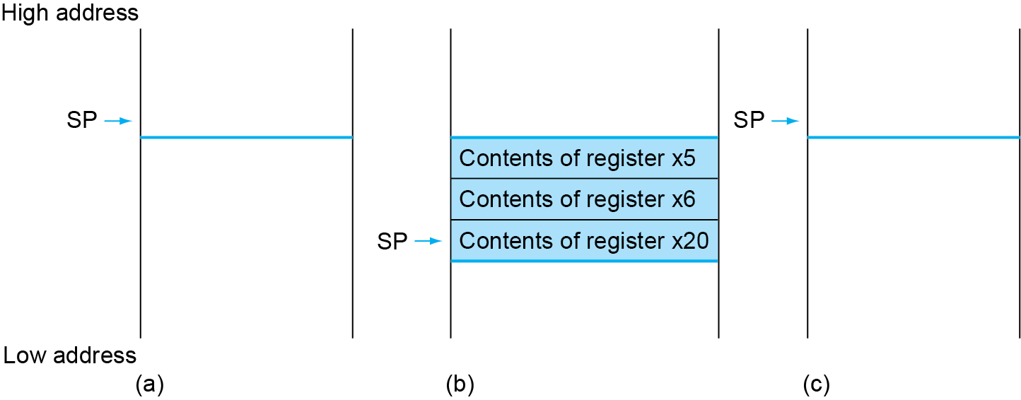
Local Data on the Stack
Chapter 2 — Instructions: Language of the Computer — <number>

Slide 53
Register Usage
x5 – x7, x28 – x31: temporary registers
  Not preserved by the callee
x8 – x9, x18 – x27: saved registers
  If used, the callee saves and restores them
Chapter 2 — Instructions: Language of the Computer — <number>

Slide 54
Non-Leaf Procedures
Procedures that call other procedures
For nested call, caller needs to save on the stack:
  Its return address
  Any arguments and temporaries needed after the call
Restore from the stack after the call
Chapter 2 — Instructions: Language of the Computer — <number>
Notes:
The University of Adelaide, School of Computer Science
Chapter 2 — Instructions: Language of the Computer

Slide 55
Non-Leaf Procedure Example
C code:
long long int fact (long long int n)
{
if (n < 1) return f;
else return n * fact(n - 1);
}
  Argument n in x10
  Result in x10
Chapter 2 — Instructions: Language of the Computer — <number>
Notes:
The University of Adelaide, School of Computer Science
Chapter 2 — Instructions: Language of the Computer

Slide 56
Non-Leaf Procedure Example
RISC-V code:
fact:
addi sp,sp,-16
sd x1,8(sp)
sd x10,0(sp)
addi x5,x10,-1
bge x5,x0,L1
addi x10,x0,1
addi sp,sp,16
jalr x0,0(x1)
L1: addi x10,x10,-1
jal x1,fact
addi x6,x10,0
ld x10,0(sp)
ld x1,8(sp)
addi sp,sp,16
mul x10,x10,x6
jalr x0,0(x1)
Save return address and n on stack
x5 = n - 1
if n >= 1, go to L1
Else, set return value to 1
Pop stack, don’t bother restoring values
Return
n = n - 1
call fact(n-1)
move result of fact(n - 1) to x6
Restore caller’s n
Restore caller’s return address
Pop stack
return n * fact(n-1)
return
Chapter 2 — Instructions: Language of the Computer — <number>
Notes:
The University of Adelaide, School of Computer Science
Chapter 2 — Instructions: Language of the Computer

Slide 57
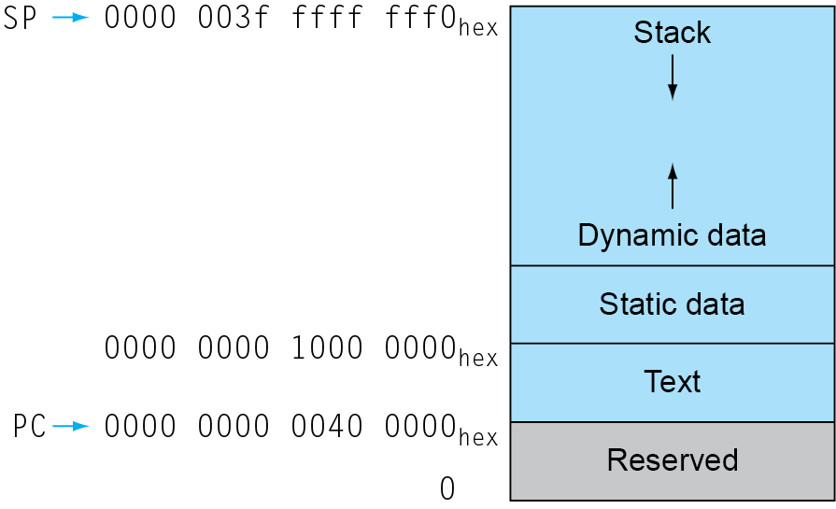
Memory Layout
Text: program code
Static data: global variables
  e.g., static variables in C, constant arrays and strings
  x3 (global pointer) initialized to address allowing ±offsets into this segment
Dynamic data: heap
  E.g., malloc in C, new in Java
Stack: automatic storage
Chapter 2 — Instructions: Language of the Computer — <number>
Notes:
The University of Adelaide, School of Computer Science
Chapter 2 — Instructions: Language of the Computer

Slide 58
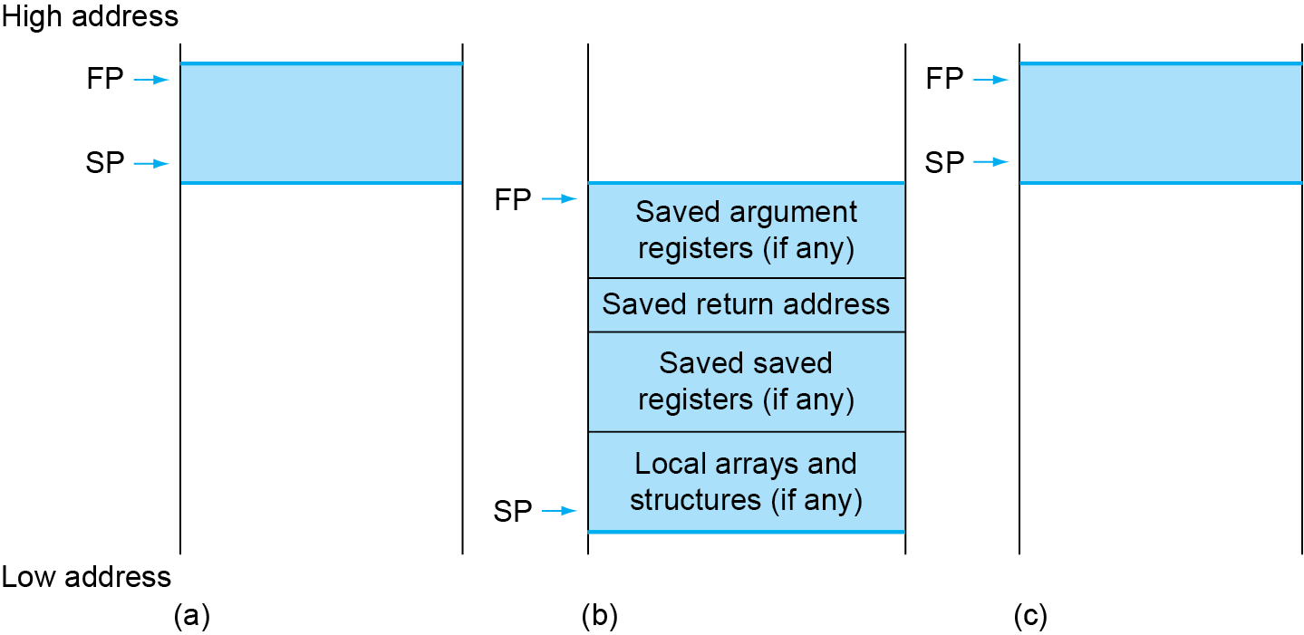
Local Data on the Stack
Local data allocated by callee
  e.g., C automatic variables
Procedure frame (activation record)
  Used by some compilers to manage stack storage
Chapter 2 — Instructions: Language of the Computer — <number>
Notes:
The University of Adelaide, School of Computer Science
Chapter 2 — Instructions: Language of the Computer

Slide 59
Character Data
Byte-encoded character sets
  ASCII: 128 characters
    95 graphic, 33 control
  Latin-1: 256 characters
    ASCII, +96 more graphic characters
Unicode: 32-bit character set
  Used in Java, C++ wide characters, …
  Most of the world’s alphabets, plus symbols
  UTF-8, UTF-16: variable-length encodings
§2.9 Communicating with People
Chapter 2 — Instructions: Language of the Computer — <number>
Notes:
The University of Adelaide, School of Computer Science
Chapter 2 — Instructions: Language of the Computer

Slide 60
Byte/Halfword/Word Operations
RISC-V byte/halfword/word load/store
  Load byte/halfword/word: Sign extend to 64 bits in rd
    lb rd, offset(rs1)
    lh rd, offset(rs1)
    lw rd, offset(rs1)
  Load byte/halfword/word unsigned: Zero extend to 64 bits in rd
    lbu rd, offset(rs1)
    lhu rd, offset(rs1)
    lwu rd, offset(rs1)
  Store byte/halfword/word: Store rightmost 8/16/32 bits
    sb rs2, offset(rs1)
    sh rs2, offset(rs1)
    sw rs2, offset(rs1)
Chapter 2 — Instructions: Language of the Computer — <number>
Notes:
The University of Adelaide, School of Computer Science
Chapter 2 — Instructions: Language of the Computer

Slide 61
String Copy Example
C code:
  Null-terminated string
void strcpy (char x[], char y[])
{ size_t i;
i = 0;
while ((x[i]=y[i])!='\0')
i += 1;
}
Chapter 2 — Instructions: Language of the Computer — <number>
Notes:
The University of Adelaide, School of Computer Science
Chapter 2 — Instructions: Language of the Computer

Slide 62
String Copy Example
RISC-V code:
strcpy:
addi sp,sp,-8 // adjust stack for 1 doubleword
sd x19,0(sp) // push x19
add x19,x0,x0 // i=0
L1: add x5,x19,x11 // x5 = addr of y[i]
lbu x6,0(x5) // x6 = y[i]
add x7,x19,x10 // x7 = addr of x[i]
sb x6,0(x7) // x[i] = y[i]
beq x6,x0,L2 // if y[i] == 0 then exit
addi x19,x19, 1 // i = i + 1
jal x0,L1 // next iteration of loop
L2: ld x19,0(sp) // restore saved x19
addi sp,sp,8 // pop 1 doubleword from stack
jalr x0,0(x1) // and return
Chapter 2 — Instructions: Language of the Computer — <number>
Notes:
The University of Adelaide, School of Computer Science
Chapter 2 — Instructions: Language of the Computer

Slide 63
32-bit Constants
Most constants are small
  12-bit immediate is sufficient
For the occasional 32-bit constant
lui rd, constant
  Copies 20-bit constant to bits [31:12] of rd
  Extends bit 31 to bits [63:32]
  Clears bits [11:0] of rd to 0
§2.10 RISC-V Addressing for Wide Immediates and Addresses
lui x19, 976 // 0x003D0
0000 0000 0000 0000
0000 0000 0000 0000
0000 0000 0011 1101 0000
0000 0000 0000
addi x19,x19,1280 // 0x500
0000 0000 0000 0000
0000 0000 0000 0000
0000 0000 0011 1101 0000
0101 0000 0000
Chapter 2 — Instructions: Language of the Computer — <number>
Notes:
The University of Adelaide, School of Computer Science
Chapter 2 — Instructions: Language of the Computer

Slide 64
Branch Addressing
Branch instructions specify
  Opcode, two registers, target address
Most branch targets are near branch
  Forward or backward
SB format:
imm
[10:5]
rs2
rs1
funct3
imm
[4:1]
opcode
imm[12]
imm[11]
PC-relative addressing
  Target address = PC + immediate × 2
Chapter 2 — Instructions: Language of the Computer — <number>
Notes:
The University of Adelaide, School of Computer Science
Chapter 2 — Instructions: Language of the Computer

Slide 65
Jump Addressing
Jump and link (jal) target uses 20-bit immediate for larger range
UJ format:
imm[10:1]
imm[19:12]
rd
opcode
5 bits
7 bits
imm[20]
imm[11]
For long jumps, eg, to 32-bit absolute address
  lui: load address[31:12] to temp register
  jalr: add address[11:0] and jump to target
Chapter 2 — Instructions: Language of the Computer — <number>
Notes:
The University of Adelaide, School of Computer Science
Chapter 2 — Instructions: Language of the Computer

Slide 66
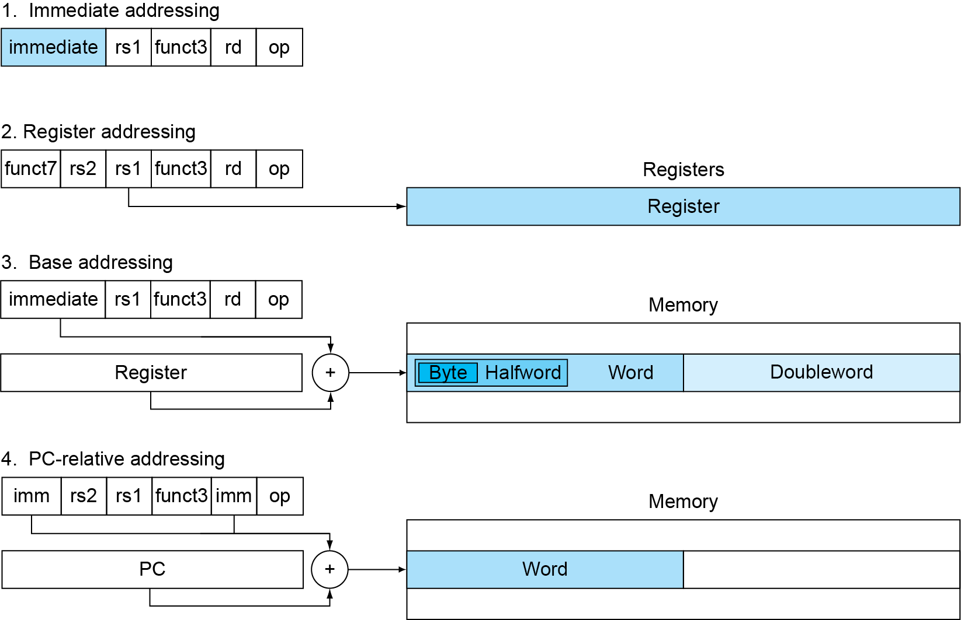
RISC-V Addressing Summary
Chapter 2 — Instructions: Language of the Computer — <number>

Slide 67
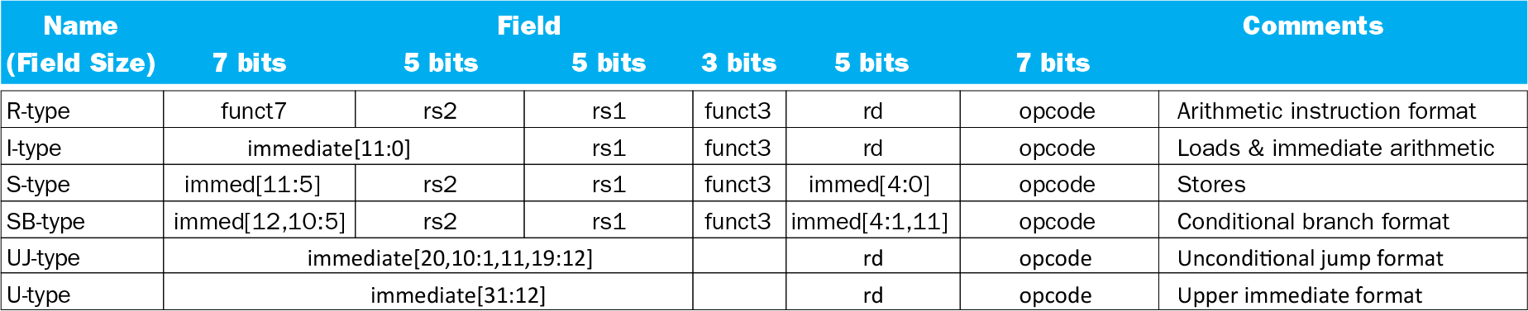
RISC-V Encoding Summary
Chapter 2 — Instructions: Language of the Computer — <number>

Slide 68
Synchronization
Two processors sharing an area of memory
  P1 writes, then P2 reads
  Data race if P1 and P2 don’t synchronize
    Result depends of order of accesses
Hardware support required
  Atomic read/write memory operation
  No other access to the location allowed between the read and write
Could be a single instruction
  E.g., atomic swap of register ↔ memory
  Or an atomic pair of instructions
§2.11 Parallelism and Instructions: Synchronization
Chapter 2 — Instructions: Language of the Computer — <number>
Notes:
The University of Adelaide, School of Computer Science
Chapter 2 — Instructions: Language of the Computer

Slide 69
Synchronization in RISC-V
Load reserved: lr.d rd,(rs1)
  Load from address in rs1 to rd
  Place reservation on memory address
Store conditional: sc.d rd,(rs1),rs2
  Store from rs2 to address in rs1
  Succeeds if location not changed since the lr.d
    Returns 0 in rd
  Fails if location is changed
    Returns non-zero value in rd
Chapter 2 — Instructions: Language of the Computer — <number>
Notes:
The University of Adelaide, School of Computer Science
Chapter 2 — Instructions: Language of the Computer

Slide 70
Synchronization in RISC-V
Example 1: atomic swap (to test/set lock variable)
  again: lr.d x10,(x20)
  sc.d x11,(x20),x23 // X11 = status
  bne x11,x0,again // branch if store failed
  addi x23,x10,0 // X23 = loaded value
Example 2: lock
  addi x12,x0,1 // copy locked value
  again: lr.d x10,(x20) // read lock
  bne x10,x0,again // check if it is 0 yet
  sc.d x11,(x20),x12 // attempt to store
  bne x11,x0,again // branch if fails
  Unlock:
  sd x0,0(x20) // free lock
Chapter 2 — Instructions: Language of the Computer — <number>

Slide 71
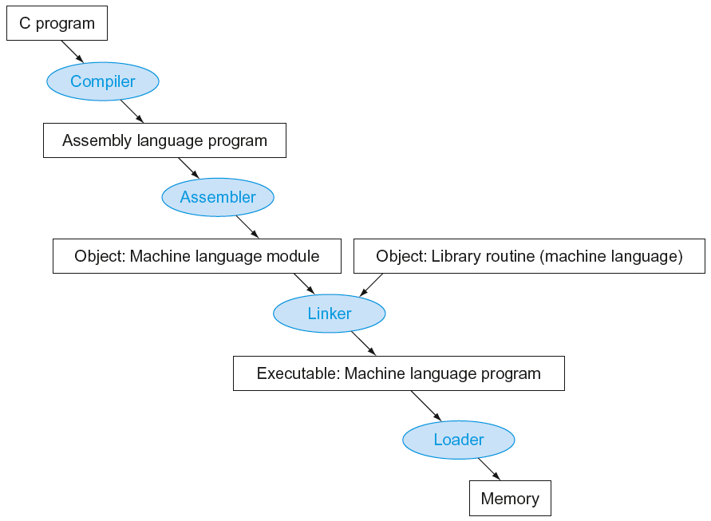
Translation and Startup
Many compilers produce object modules directly
§2.12 Translating and Starting a Program
Static linking
Chapter 2 — Instructions: Language of the Computer — <number>
Notes:
The University of Adelaide, School of Computer Science
Chapter 2 — Instructions: Language of the Computer

Slide 72
Producing an Object Module
Assembler (or compiler) translates program into machine instructions
Provides information for building a complete program from the pieces
  Header: described contents of object module
  Text segment: translated instructions
  Static data segment: data allocated for the life of the program
  Relocation info: for contents that depend on absolute location of loaded program
  Symbol table: global definitions and external refs
  Debug info: for associating with source code
Chapter 2 — Instructions: Language of the Computer — <number>
Notes:
The University of Adelaide, School of Computer Science
Chapter 2 — Instructions: Language of the Computer

Slide 73
Linking Object Modules
Produces an executable image
  1. Merges segments
  2. Resolve labels (determine their addresses)
  3. Patch location-dependent and external refs
Could leave location dependencies for fixing by a relocating loader
  But with virtual memory, no need to do this
  Program can be loaded into absolute location in virtual memory space
Chapter 2 — Instructions: Language of the Computer — <number>
Notes:
The University of Adelaide, School of Computer Science
Chapter 2 — Instructions: Language of the Computer

Slide 74
Loading a Program
Load from image file on disk into memory
  1. Read header to determine segment sizes
  2. Create virtual address space
  3. Copy text and initialized data into memory
    Or set page table entries so they can be faulted in
  4. Set up arguments on stack
  5. Initialize registers (including sp, fp, gp)
  6. Jump to startup routine
    Copies arguments to x10, … and calls main
    When main returns, do exit syscall
Chapter 2 — Instructions: Language of the Computer — <number>
Notes:
The University of Adelaide, School of Computer Science
Chapter 2 — Instructions: Language of the Computer

Slide 75
Dynamic Linking
Only link/load library procedure when it is called
  Requires procedure code to be relocatable
  Avoids image bloat caused by static linking of all (transitively) referenced libraries
  Automatically picks up new library versions
Chapter 2 — Instructions: Language of the Computer — <number>
Notes:
The University of Adelaide, School of Computer Science
Chapter 2 — Instructions: Language of the Computer

Slide 76
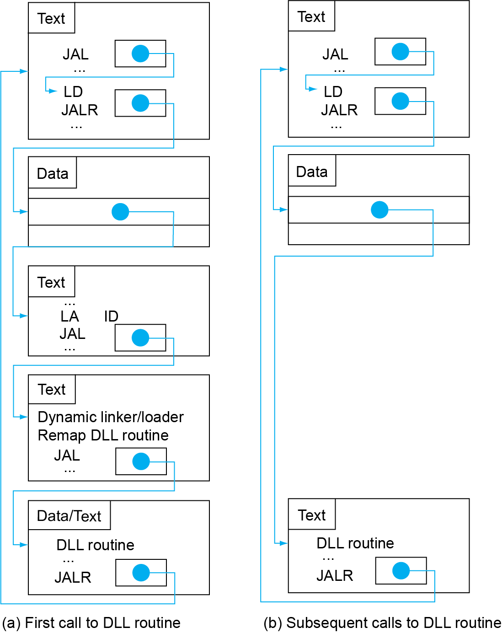
Lazy Linkage
Indirection table
Stub: Loads routine ID,
Jump to linker/loader
Linker/loader code
Dynamically
mapped code
Chapter 2 — Instructions: Language of the Computer — <number>
Notes:
The University of Adelaide, School of Computer Science
Chapter 2 — Instructions: Language of the Computer

Slide 77
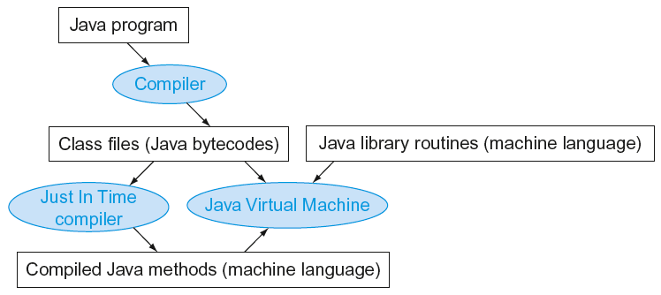
Starting Java Applications
Simple portable instruction set for the JVM
Compiles bytecodes of “hot” methods into native code for host machine
Interprets bytecodes
Chapter 2 — Instructions: Language of the Computer — <number>
Notes:
The University of Adelaide, School of Computer Science
Chapter 2 — Instructions: Language of the Computer

Slide 78
C Sort Example
Illustrates use of assembly instructions for a C bubble sort function
Swap procedure (leaf)
  void swap(long long int v[],
  long long int k)
  {
  long long int temp;
  temp = v[k];
  v[k] = v[k+1];
  v[k+1] = temp;
  }
  v in x10, k in x11, temp in x5
§2.13 A C Sort Example to Put It All Together
Chapter 2 — Instructions: Language of the Computer — <number>
Notes:
The University of Adelaide, School of Computer Science
Chapter 2 — Instructions: Language of the Computer

Slide 79
The Procedure Swap
swap:
slli x6,x11,3 // reg x6 = k * 8
add x6,x10,x6 // reg x6 = v + (k * 8)
ld x5,0(x6) // reg x5 (temp) = v[k]
ld x7,8(x6) // reg x7 = v[k + 1]
sd x7,0(x6) // v[k] = reg x7
sd x5,8(x6) // v[k+1] = reg x5 (temp)
jalr x0,0(x1) // return to calling routine
Chapter 2 — Instructions: Language of the Computer — <number>
Notes:
The University of Adelaide, School of Computer Science
Chapter 2 — Instructions: Language of the Computer

Slide 80
The Sort Procedure in C
Non-leaf (calls swap)
  void sort (long long int v[], size_t n)
  {
  size_t i, j;
  for (i = 0; i < n; i += 1) {
  for (j = i – 1;
  j >= 0 && v[j] > v[j + 1];
  j -= 1) {
  swap(v,j);
  }
  }
  }
  v in x10, n in x11, i in x19, j in x20
Chapter 2 — Instructions: Language of the Computer — <number>
Notes:
The University of Adelaide, School of Computer Science
Chapter 2 — Instructions: Language of the Computer

Slide 81
The Outer Loop
Skeleton of outer loop:
  for (i = 0; i <n; i += 1) {
li x19,0 // i = 0
for1tst:
bge x19,x11,exit1 // go to exit1 if x19 ≥ x11 (i≥n)
(body of outer for-loop)
addi x19,x19,1 // i += 1
j for1tst // branch to test of outer loop
exit1:
Chapter 2 — Instructions: Language of the Computer — <number>
Notes:
The University of Adelaide, School of Computer Science
Chapter 2 — Instructions: Language of the Computer

Slide 82
The Inner Loop
Skeleton of inner loop:
  for (j = i − 1; j >= 0 && v[j] > v[j + 1]; j − = 1) {
addi x20,x19,-1 // j = i −1
for2tst:
blt x20,x0,exit2 // go to exit2 if X20 < 0 (j < 0)
slli x5,x20,3 // reg x5 = j * 8
add x5,x10,x5 // reg x5 = v + (j * 8)
ld x6,0(x5) // reg x6 = v[j]
ld x7,8(x5) // reg x7 = v[j + 1]
ble x6,x7,exit2 // go to exit2 if x6 ≤ x7
mv x21, x10 // copy parameter x10 into x21
mv x22, x11 // copy parameter x11 into x22
mv x10, x21 // first swap parameter is v
mv x11, x20 // second swap parameter is j
jal x1,swap // call swap
addi x20,x20,-1 // j –= 1
j for2tst // branch to test of inner loop
exit2:
Chapter 2 — Instructions: Language of the Computer — <number>
Notes:
The University of Adelaide, School of Computer Science
Chapter 2 — Instructions: Language of the Computer

Slide 83
Preserving Registers
Preserve saved registers:
addi sp,sp,-40 // make room on stack for 5 regs
sd x1,32(sp) // save x1 on stack
sd x22,24(sp) // save x22 on stack
sd x21,16(sp) // save x21 on stack
sd x20,8(sp) // save x20 on stack
sd x19,0(sp) // save x19 on stack
Restore saved registers:
exit1:
sd x19,0(sp) // restore x19 from stack
sd x20,8(sp) // restore x20 from stack
sd x21,16(sp) // restore x21 from stack
sd x22,24(sp) // restore x22 from stack
sd x1,32(sp) // restore x1 from stack
addi sp,sp, 40 // restore stack pointer
jalr x0,0(x1)
Chapter 2 — Instructions: Language of the Computer — <number>
Notes:
The University of Adelaide, School of Computer Science
Chapter 2 — Instructions: Language of the Computer

Slide 84




Effect of Compiler Optimization
Compiled with gcc for Pentium 4 under Linux
Chapter 2 — Instructions: Language of the Computer — <number>
Notes:
The University of Adelaide, School of Computer Science
Chapter 2 — Instructions: Language of the Computer

Slide 85



Effect of Language and Algorithm
Chapter 2 — Instructions: Language of the Computer — <number>
Notes:
The University of Adelaide, School of Computer Science
Chapter 2 — Instructions: Language of the Computer

Slide 86
Lessons Learnt
Instruction count and CPI are not good performance indicators in isolation
Compiler optimizations are sensitive to the algorithm
Java/JIT compiled code is significantly faster than JVM interpreted
  Comparable to optimized C in some cases
Nothing can fix a dumb algorithm!
Chapter 2 — Instructions: Language of the Computer — <number>
Notes:
The University of Adelaide, School of Computer Science
Chapter 2 — Instructions: Language of the Computer

Slide 87
Arrays vs. Pointers
Array indexing involves
  Multiplying index by element size
  Adding to array base address
Pointers correspond directly to memory addresses
  Can avoid indexing complexity
§2.14 Arrays versus Pointers
Chapter 2 — Instructions: Language of the Computer — <number>
Notes:
The University of Adelaide, School of Computer Science
Chapter 2 — Instructions: Language of the Computer

Slide 88
Example: Clearing an Array
clear1(int array[], int size) { int i; for (i = 0; i < size; i += 1) array[i] = 0; } | clear2(int *array, int size) { int *p; for (p = &array[0]; p < &array[size]; p = p + 1) *p = 0; }
li x5,0 // i = 0 loop1: slli x6,x5,3 // x6 = i * 8 add x7,x10,x6 // x7 = address // of array[i] sd x0,0(x7) // array[i] = 0 addi x5,x5,1 // i = i + 1 blt x5,x11,loop1 // if (i<size) // go to loop1 | mv x5,x10 // p = address // of array[0] slli x6,x11,3 // x6 = size * 8 add x7,x10,x6 // x7 = address // of array[size] loop2: sd x0,0(x5) // Memory[p] = 0 addi x5,x5,8 // p = p + 8 bltu x5,x7,loop2 // if (p<&array[size]) // go to loop2
Chapter 2 — Instructions: Language of the Computer — <number>
Notes:
The University of Adelaide, School of Computer Science
Chapter 2 — Instructions: Language of the Computer

Slide 89
Comparison of Array vs. Ptr
Multiply “strength reduced” to shift
Array version requires shift to be inside loop
  Part of index calculation for incremented i
  c.f. incrementing pointer
Compiler can achieve same effect as manual use of pointers
  Induction variable elimination
  Better to make program clearer and safer
Chapter 2 — Instructions: Language of the Computer — <number>
Notes:
The University of Adelaide, School of Computer Science
Chapter 2 — Instructions: Language of the Computer

Slide 90
MIPS Instructions
MIPS: commercial predecessor to RISC-V
Similar basic set of instructions
  32-bit instructions
  32 general purpose registers, register 0 is always 0
  32 floating-point registers
  Memory accessed only by load/store instructions
    Consistent use of addressing modes for all data sizes
Different conditional branches
  For <, <=, >, >=
  RISC-V: blt, bge, bltu, bgeu
  MIPS: slt, sltu (set less than, result is 0 or 1)
    Then use beq, bne to complete the branch
§2.16 Real Stuff: MIPS Instructions
Chapter 2 — Instructions: Language of the Computer — <number>
Notes:
The University of Adelaide, School of Computer Science
Chapter 2 — Instructions: Language of the Computer

Slide 91
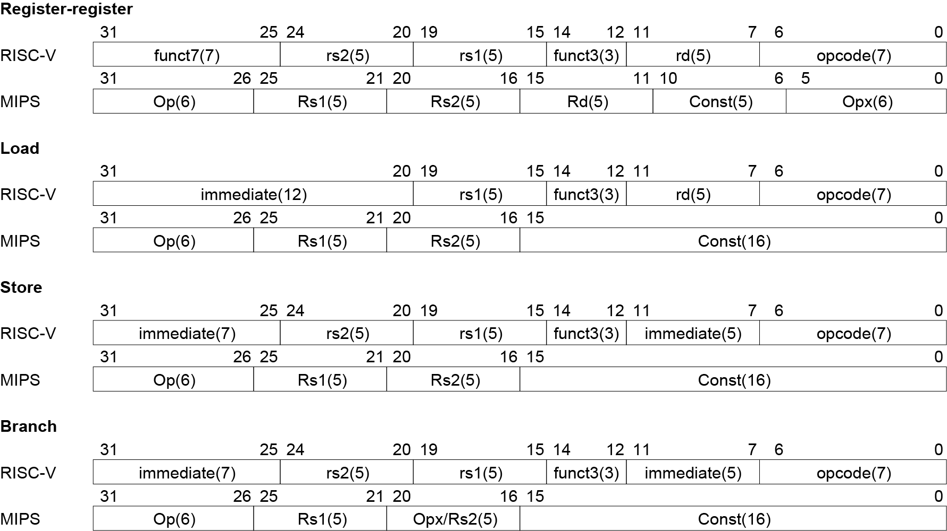
Instruction Encoding
Chapter 2 — Instructions: Language of the Computer — <number>
Notes:
The University of Adelaide, School of Computer Science
Chapter 2 — Instructions: Language of the Computer

Slide 92
The Intel x86 ISA
Evolution with backward compatibility
  8080 (1974): 8-bit microprocessor
    Accumulator, plus 3 index-register pairs
  8086 (1978): 16-bit extension to 8080
    Complex instruction set (CISC)
  8087 (1980): floating-point coprocessor
    Adds FP instructions and register stack
  80286 (1982): 24-bit addresses, MMU
    Segmented memory mapping and protection
  80386 (1985): 32-bit extension (now IA-32)
    Additional addressing modes and operations
    Paged memory mapping as well as segments
§2.17 Real Stuff: x86 Instructions
Chapter 2 — Instructions: Language of the Computer — <number>
Notes:
The University of Adelaide, School of Computer Science
Chapter 2 — Instructions: Language of the Computer

Slide 93
The Intel x86 ISA
Further evolution…
  i486 (1989): pipelined, on-chip caches and FPU
    Compatible competitors: AMD, Cyrix, …
  Pentium (1993): superscalar, 64-bit datapath
    Later versions added MMX (Multi-Media eXtension) instructions
    The infamous FDIV bug
  Pentium Pro (1995), Pentium II (1997)
    New microarchitecture (see Colwell, The Pentium Chronicles)
  Pentium III (1999)
    Added SSE (Streaming SIMD Extensions) and associated registers
  Pentium 4 (2001)
    New microarchitecture
    Added SSE2 instructions
Chapter 2 — Instructions: Language of the Computer — <number>
Notes:
The University of Adelaide, School of Computer Science
Chapter 2 — Instructions: Language of the Computer

Slide 94
The Intel x86 ISA
And further…
  AMD64 (2003): extended architecture to 64 bits
  EM64T – Extended Memory 64 Technology (2004)
    AMD64 adopted by Intel (with refinements)
    Added SSE3 instructions
  Intel Core (2006)
    Added SSE4 instructions, virtual machine support
  AMD64 (announced 2007): SSE5 instructions
    Intel declined to follow, instead…
  Advanced Vector Extension (announced 2008)
    Longer SSE registers, more instructions
If Intel didn’t extend with compatibility, its competitors would!
  Technical elegance ≠ market success
Chapter 2 — Instructions: Language of the Computer — <number>
Notes:
The University of Adelaide, School of Computer Science
Chapter 2 — Instructions: Language of the Computer

Slide 95

Basic x86 Registers
Chapter 2 — Instructions: Language of the Computer — <number>
Notes:
The University of Adelaide, School of Computer Science
Chapter 2 — Instructions: Language of the Computer

Slide 96
Basic x86 Addressing Modes
Two operands per instruction
Source/dest operand | Second source operand
Register | Register
Register | Immediate
Register | Memory
Memory | Register
Memory | Immediate
Memory addressing modes
  Address in register
  Address = R_{base} + displacement
  Address = R_{base} + 2^{scale} × R_{index} (scale = 0, 1, 2, or 3)
  Address = R_{base} + 2^{scale} × R_{index} + displacement
Chapter 2 — Instructions: Language of the Computer — <number>
Notes:
The University of Adelaide, School of Computer Science
Chapter 2 — Instructions: Language of the Computer

Slide 97
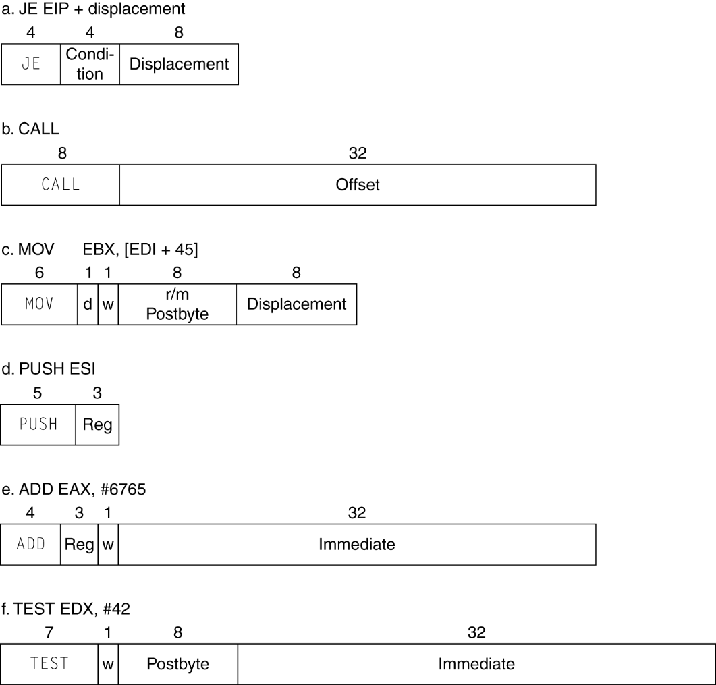
x86 Instruction Encoding
Variable length encoding
  Postfix bytes specify addressing mode
  Prefix bytes modify operation
    Operand length, repetition, locking, …
Chapter 2 — Instructions: Language of the Computer — <number>
Notes:
The University of Adelaide, School of Computer Science
Chapter 2 — Instructions: Language of the Computer

Slide 98
Implementing IA-32
Complex instruction set makes implementation difficult
  Hardware translates instructions to simpler microoperations
    Simple instructions: 1–1
    Complex instructions: 1–many
  Microengine similar to RISC
  Market share makes this economically viable
Comparable performance to RISC
  Compilers avoid complex instructions
Chapter 2 — Instructions: Language of the Computer — <number>
Notes:
The University of Adelaide, School of Computer Science
Chapter 2 — Instructions: Language of the Computer

Slide 99
Other RISC-V Instructions
Base integer instructions (RV64I)
  Those previously described, plus
  auipc rd, immed // rd = (imm<<12) + pc
    follow by jalr (adds 12-bit immed) for long jump
  slt, sltu, slti, sltui: set less than (like MIPS)
  addw, subw, addiw: 32-bit add/sub
  sllw, srlw, srlw, slliw, srliw, sraiw: 32-bit shift
32-bit variant: RV32I
  registers are 32-bits wide, 32-bit operations
§2.18 The Rest of the RISC-V Instruction Set
Chapter 2 — Instructions: Language of the Computer — <number>

Slide 100
Instruction Set Extensions
M: integer multiply, divide, remainder
A: atomic memory operations
F: single-precision floating point
D: double-precision floating point
C: compressed instructions
  16-bit encoding for frequently used instructions
Chapter 2 — Instructions: Language of the Computer — <number>

Slide 101
Fallacies
Powerful instruction ⇒ higher performance
  Fewer instructions required
  But complex instructions are hard to implement
    May slow down all instructions, including simple ones
  Compilers are good at making fast code from simple instructions
Use assembly code for high performance
  But modern compilers are better at dealing with modern processors
  More lines of code ⇒ more errors and less productivity
§2.19 Fallacies and Pitfalls
Chapter 2 — Instructions: Language of the Computer — <number>
Notes:
The University of Adelaide, School of Computer Science
Chapter 2 — Instructions: Language of the Computer

Slide 102

Fallacies
Backward compatibility ⇒ instruction set doesn’t change
  But they do accrete more instructions
x86 instruction set
Chapter 2 — Instructions: Language of the Computer — <number>
Notes:
The University of Adelaide, School of Computer Science
Chapter 2 — Instructions: Language of the Computer

Slide 103
Pitfalls
Sequential words are not at sequential addresses
  Increment by 4, not by 1!
Keeping a pointer to an automatic variable after procedure returns
  e.g., passing pointer back via an argument
  Pointer becomes invalid when stack popped
Chapter 2 — Instructions: Language of the Computer — <number>
Notes:
The University of Adelaide, School of Computer Science
Chapter 2 — Instructions: Language of the Computer

Slide 104
Concluding Remarks
Design principles
  1. Simplicity favors regularity
  2. Smaller is faster
  3. Good design demands good compromises
Make the common case fast
Layers of software/hardware
  Compiler, assembler, hardware
RISC-V: typical of RISC ISAs
  c.f. x86
§2.20 Concluding Remarks
Chapter 2 — Instructions: Language of the Computer — <number>
Notes:
The University of Adelaide, School of Computer Science
Chapter 2 — Instructions: Language of the Computer

