Slide 1
Chapter 1: Introduction

Slide 2
Chapter 1: Introduction
What Operating Systems Do
Computer-System Organization
Computer-System Architecture
Operating-System Operations
Resource Management
Security and Protection
Virtualization
Distributed Systems
Kernel Data Structures
Computing Environments
Free/Libre and Open-Source Operating Systems

Slide 3
Objectives
9th edition, 9e
To provide a grand tour of the major operating systems components
To provide coverage of basic computer system organization
10th edition, 10e
Describe the general organization of a computer system and the role of interrupts
Describe the components in a modern, multiprocessor computer system
Illustrate the transition from user mode to kernel mode
Discuss how operating systems are used in various computing environments
Provide examples of free and open-source operating systems

Slide 4
What Does the Term Operating System Mean?
An operating system is “fill in the blanks”
What about:
Car
Airplane
Printer
Washing Machine
Toaster
Compiler
Etc.
System is an organized entity!

Slide 5
What is an Operating System?
9e
A (system) program that
manages the computer hardware (and software)
provides a basis for application programs and acts as an intermediary between a user of a computer and the computer hardware.
10e
A program that acts as an intermediary between a user of a computer and the computer hardware
旗標: 讓使用者妥善地使用軟硬體資源的系統程式
Notes:
讓:非必要

Slide 6
Operating System Goals
9e
Mainframe OSes are designed primarily to optimize utilization of hardware.
PC OSes support complex games, business applications, and everything in between.
OSes for handheld systems are designed to provide an environment in which a user can easily interface with the computer to execute programs.
Convenient (GUI), efficient, both, or between
10e
Execute user programs and make solving user problems easier
Make the computer system convenient to use
Use the computer hardware in an efficient manner

Slide 7
Computer System Structure
Computer system can be divided into four components:
Hardware – provides basic computing resources
CPU, memory, I/O devices
Operating system
Controls and coordinates use of hardware among various applications and users
Application programs – define the ways in which the system resources are used to solve the computing problems of the users
Word processors, compilers, web browsers, database systems, video games
Users
People, machines, other computers

Slide 8
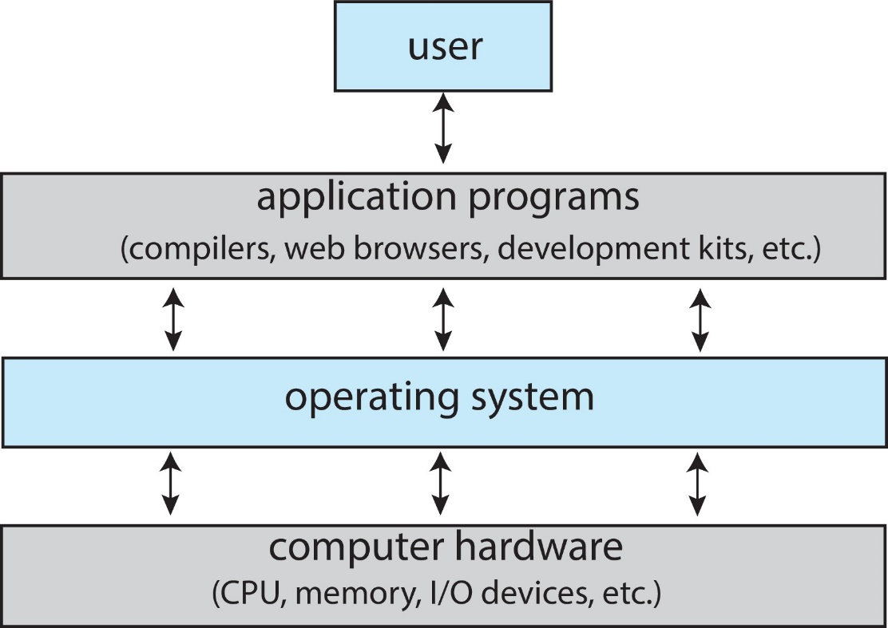
Abstract View of Components of Computer
10e

Slide 9
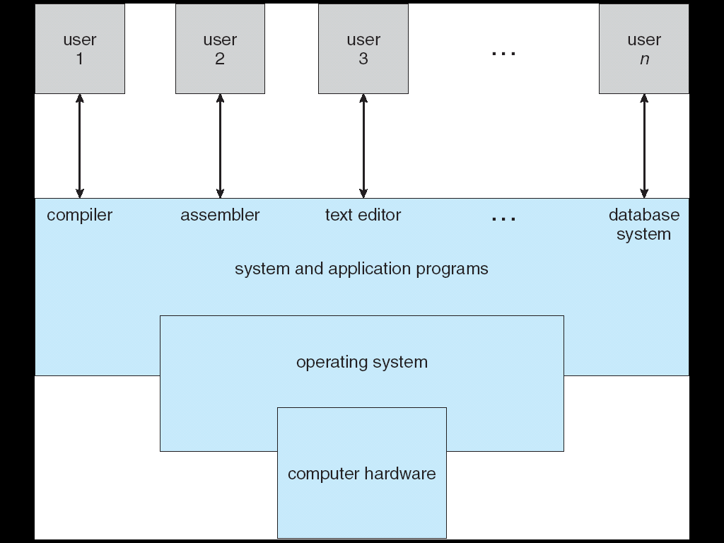
Computer System Structure and Components
9e
Similar to
a Government!
Notes:
Computer system can be divided into four components
Hardware – provides basic computing resources
CPU, memory, I/O devices
Operating system
Controls and coordinates use of hardware among various applications and users
Application programs – define the ways in which the system resources are used to solve the computing problems of the users
Word processors, compilers, web browsers, database systems, video games
Users
People, machines, other computers

Slide 10
What Operating Systems Do?
Depends on the point of view
Users want convenience, ease of use and good performance
Don’t care about resource utilization
But shared computer such as mainframe or minicomputer must keep all users happy
Operating system is a resource allocator and control program making efficient use of HW and managing execution of user programs
Users of dedicate systems such as workstations have dedicated resources but frequently use shared resources from servers
Mobile devices like smartphones and tables are resource poor, optimized for usability and battery life
Mobile user interfaces such as touch screens, voice recognition
Some computers have little or no user interface, such as embedded computers in devices and automobiles
Run primarily without user intervention

Slide 11
Operating System Roles
User View
Server, Mainframe, Workstations, PC, Handhelds.
System View
OS is a resource allocator
Manages all resources
Decides between conflicting requests for efficient and fair resource use
OS is a control program
Controls execution of programs to prevent errors and improper use of the computer

Slide 12
Defining Operating Systems
Term OS covers many roles
Because of myriad designs and uses of OSs
Present in toasters through ships, spacecraft, game machines, TVs and industrial control systems
Born when fixed use computers for military became more general purpose and needed resource management and program control

Slide 13
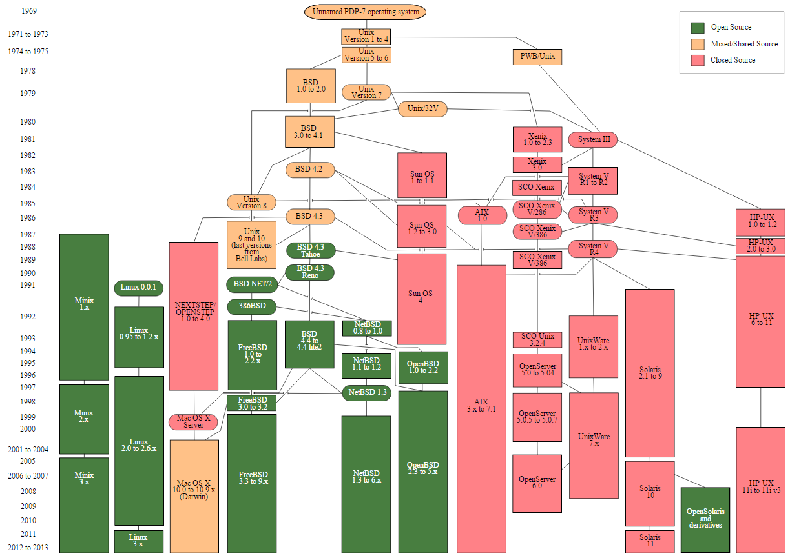
Operating System Definition
No universally accepted definition
“Everything a vendor ships when you order an operating system” is a good approximation
But varies wildly
“The one program running at all times on the computer” is the kernel, part of the operating system
Everything else is either
A system program (ships with the operating system, but not part of the kernel) , or
An application program, all programs not associated with the operating system
Today’s OSes for general purpose and mobile computing also include middleware – a set of software frameworks that provide addition services to application developers such as databases, multimedia, graphics

Slide 14
Why Study Operating Systems?
Although there are many practitioners of computer science, only a small portion of them will be involved in the creation or modification of an OS.
As all code runs on top of an OS, knowledge of how OSs works is crucial to proper, efficient, efficient, and secure programming.
Understanding the fundamentals of OSs, how they drive computer hardware, and what they provide to applications is not only essential to those who program them but also highly useful to those who write programs on them and use them.
Notes:
New in 10e

Slide 15
Overview of Computer System Structure

Slide 16
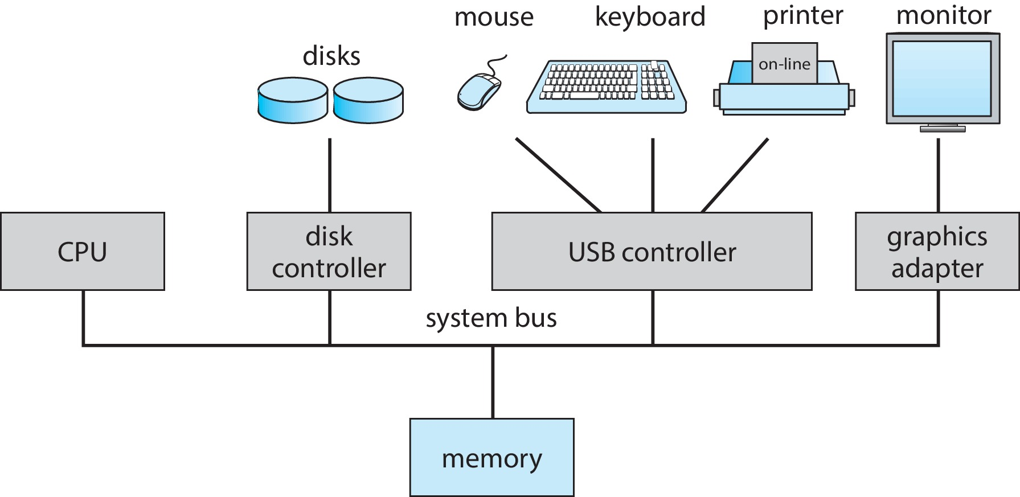
Computer System Organization
Computer-system operation
One or more CPUs, device controllers connect through common bus providing access to shared memory
Concurrent execution of CPUs and devices competing for memory cycles

Slide 17
Computer-System Operation (1/2)
Computer Startup
bootstrap program is loaded at power-up or reboot
Typically stored in ROM or EPROM, generally known as firmware
Initializates all aspects of system
Loads operating system kernel and starts execution
One or more CPUs, device controllers connect through common bus providing access to shared memory
Concurrent execution of CPUs and devices competing for memory cycles
Notes:
Not in 10e

Slide 18
Computer-System Operation (2/2)
I/O devices and the CPU can execute concurrently
Each device controller is in charge of a particular device type
Each device controller has a local buffer
Each device controller type has an operating system device driver to manage it
CPU moves data from/to main memory to/from local buffers
I/O is from the device to local buffer of controller
Device controller informs CPU that it has finished its operation by causing an interrupt

Slide 19
Common Functions of Interrupts
Interrupt transfers control to the interrupt service routine generally, through the interrupt vector, which contains the addresses of all the service routines
Interrupt architecture must save the address of the interrupted instruction
A trap or exception is a software-generated interrupt caused either by an error or a user request
An operating system is interrupt driven

Slide 20
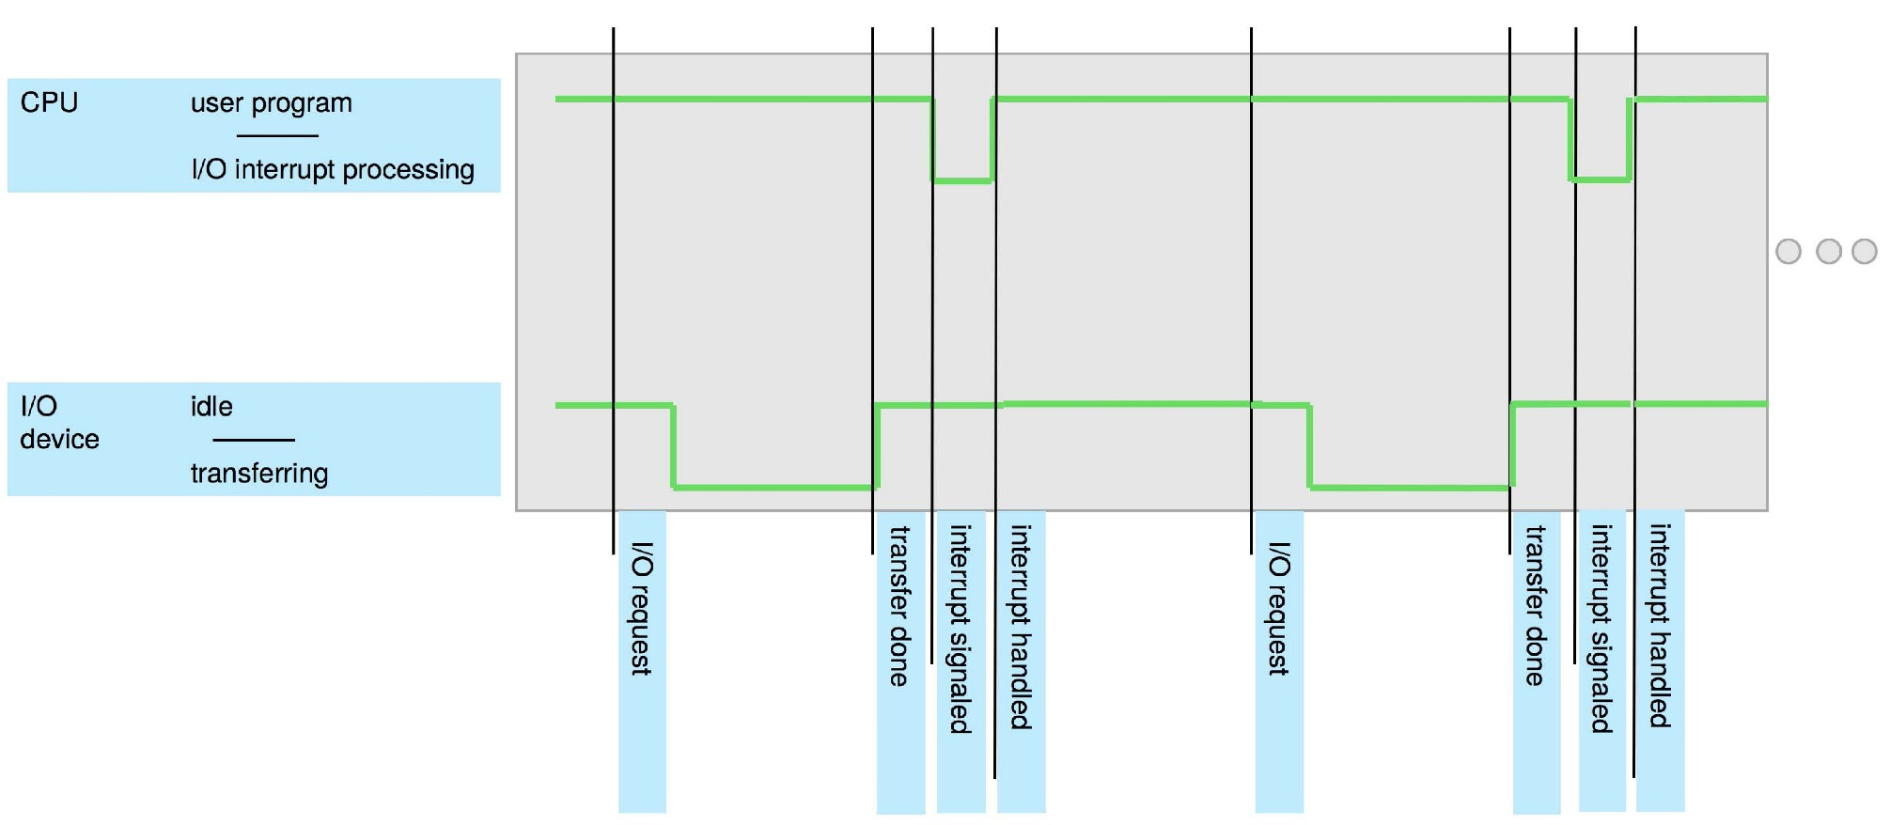
Interrupt Timeline

Slide 21
Interrupt Handling
The operating system preserves the state of the CPU by storing registers and the program counter.
Determines which type of interrupt has occurred:
polling
vectored interrupt system
Separate segments of code determine what action should be taken for each type of interrupt

Slide 22
Interrupt-driven I/O Cycle

Slide 23
I/O Structure
After I/O starts, control returns to user program only upon I/O completion.
Wait instruction idles the CPU until the next interrupt
Wait loop (contention for memory access).
At most one I/O request is outstanding at a time, no simultaneous I/O processing.
After I/O starts, control returns to user program without waiting for I/O completion.
System call – request to the operating system to allow user to wait for I/O completion.
Device-status table contains entry for each I/O device indicating its type, address, and state.
OS indexes into I/O device table to determine device status and to modify table entry to include interrupt.

Slide 24
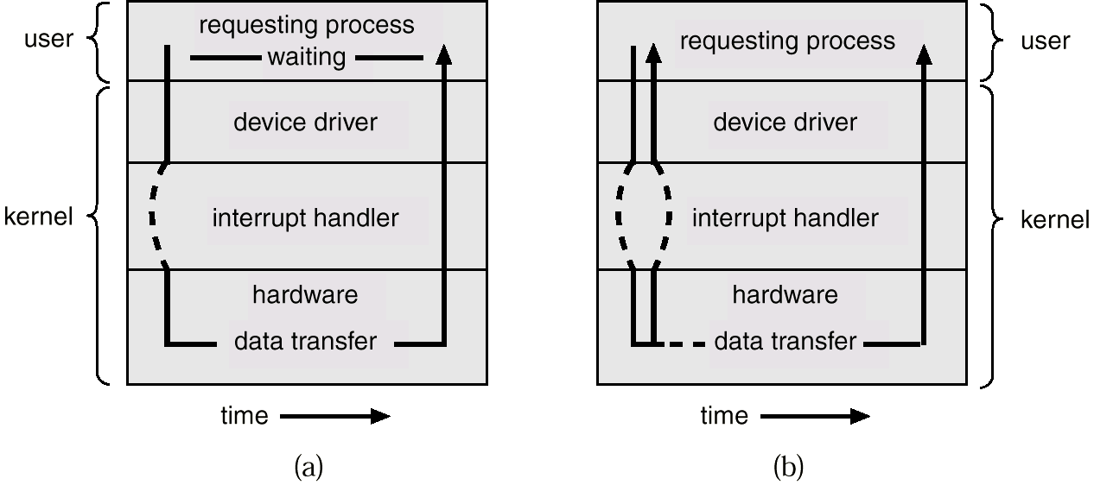
Two I/O Methods
Synchronous
Asynchronous

Slide 25
Storage Structure

Slide 26
Storage Structure
Main memory – only large storage media that the CPU can access directly
Random access
Typically volatile
Typically random-access memory in the form of Dynamic Random-access Memory (DRAM)
Secondary storage – extension of main memory that provides large nonvolatile storage capacity
Hard Disk Drives (HDD) – rigid metal or glass platters covered with magnetic recording material
Disk surface is logically divided into tracks, which are subdivided into sectors
The disk controller determines the logical interaction between the device and the computer
Non-volatile memory (NVM) devices– faster than hard disks, nonvolatile
Various technologies
Becoming more popular as capacity and performance increases, price drops

Slide 27
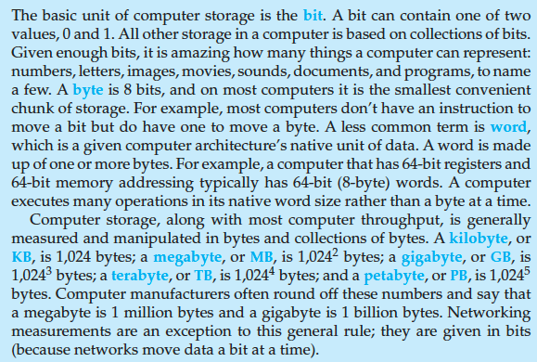
Storage Definitions and Notation Review
The basic unit of computer storage is the bit. A bit can contain one of two
values, 0 and 1. All other storage in a computer is based on collections of bits.
Given enough bits, it is amazing how many things a computer can represent:
numbers, letters, images, movies, sounds, documents, and programs, to name
a few. A byte is 8 bits, and on most computers it is the smallest convenient
chunk of storage. For example, most computers don’t have an instruction to
move a bit but do have one to move a byte. A less common term is word,
which is a given computer architecture’s native unit of data. A word is made
up of one or more bytes. For example, a computer that has 64-bit registers and
64-bit memory addressing typically has 64-bit (8-byte) words. A computer
executes many operations in its native word size rather than a byte at a time.
Computer storage, along with most computer throughput, is generally
measured and manipulated in bytes and collections of bytes. A kilobyte, or
KB , is 1,024 bytes; a megabyte, or MB, is 1,024² bytes; a gigabyte, or GB, is
1,024³ bytes; a terabyte, or TB, is 1,024⁴ bytes; and a petabyte, or PB, is 1,024⁵
bytes. Computer manufacturers often round off these numbers and say that
a megabyte is 1 million bytes and a gigabyte is 1 billion bytes. Networking
measurements are an exception to this general rule; they are given in bits
(because networks move data a bit at a time).

Slide 28
Storage Hierarchy
Storage systems organized in hierarchy
Speed
Cost
Volatility
Caching – copying information into faster storage system; main memory can be viewed as a cache for secondary storage
Device Driver for each device controller to manage I/O
Provides uniform interface between controller and kernel

Slide 29
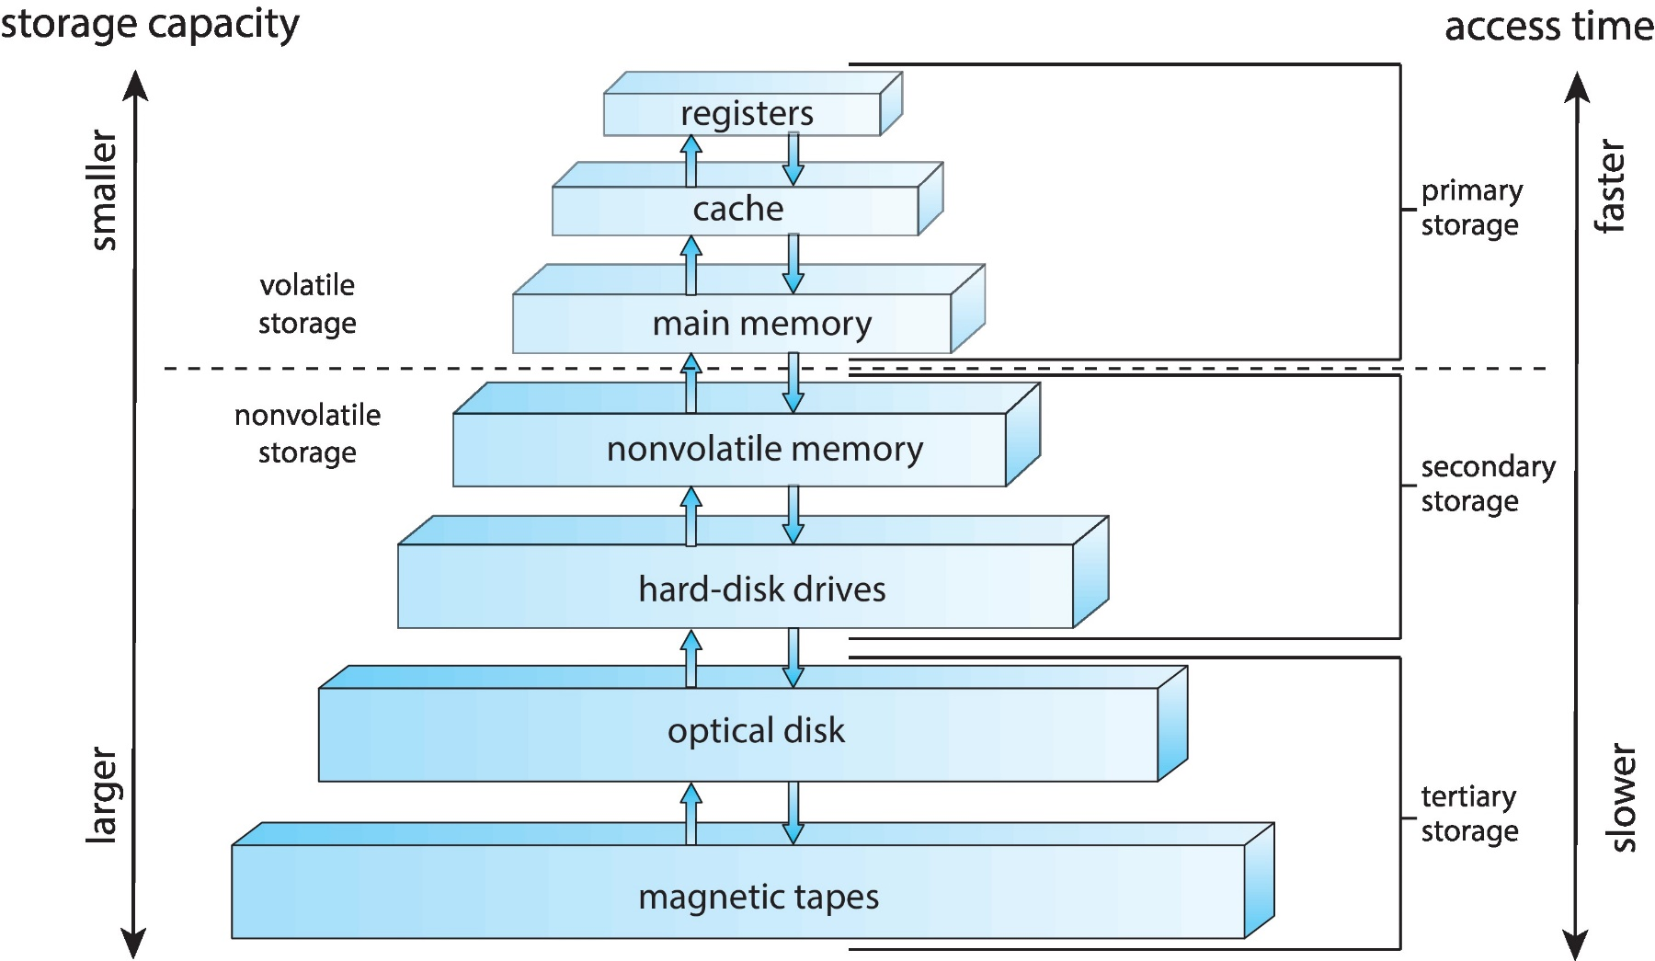
Storage-Device Hierarchy

Slide 30
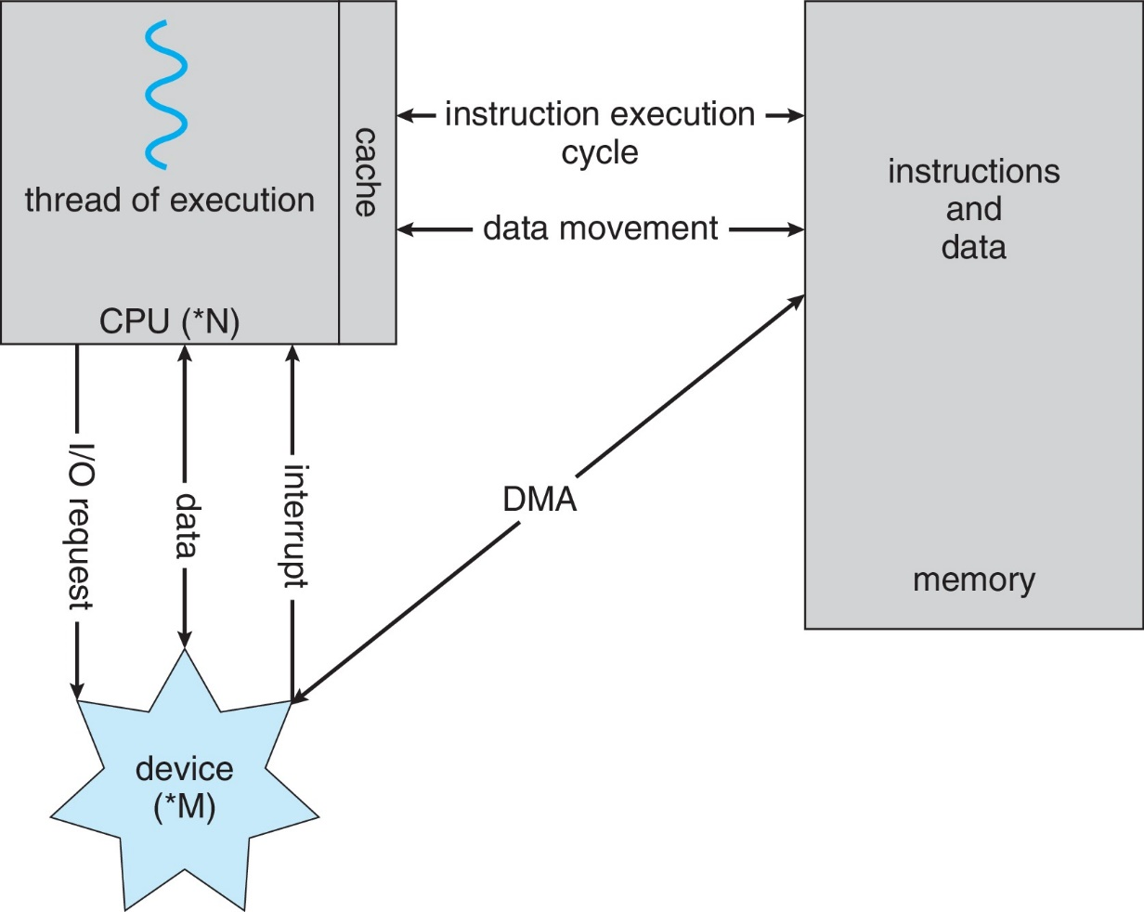
How a Modern Computer Works?
A von Neumann architecture

Slide 31
Direct Memory Access Structure
Used for high-speed I/O devices able to transmit information at close to memory speeds
Device controller transfers blocks of data from buffer storage directly to main memory without CPU intervention
Only one interrupt is generated per block, rather than the one interrupt per byte

Slide 32
Computer System Architecture

Slide 33
Computer-System Architecture
Most systems use a single general-purpose processor
Most systems have special-purpose processors as well
Multiprocessors systems growing in use and importance
Also known as parallel systems, tightly-coupled systems
Advantages include:
Increased throughput
Economy of scale
Increased reliability – graceful degradation or fault tolerance
Two types:
Asymmetric Multiprocessing – each processor is assigned a specie task.
Symmetric Multiprocessing – each processor performs all tasks

Slide 34
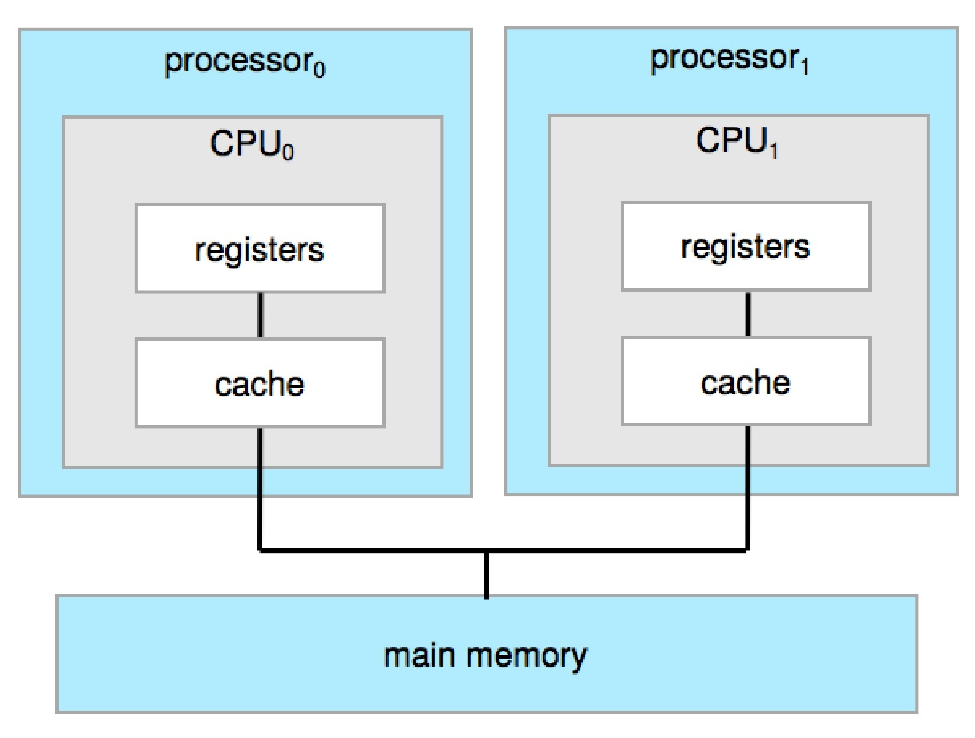
Symmetric Multiprocessing Architecture

Slide 35
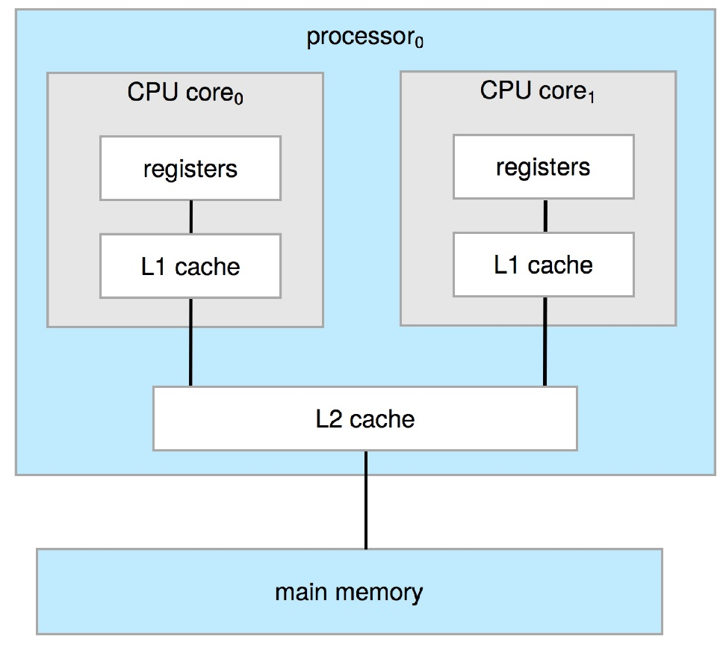
Dual-Core Design
Multi-chip and multicore
Systems containing all chips
Chassis containing multiple separate systems

Slide 36
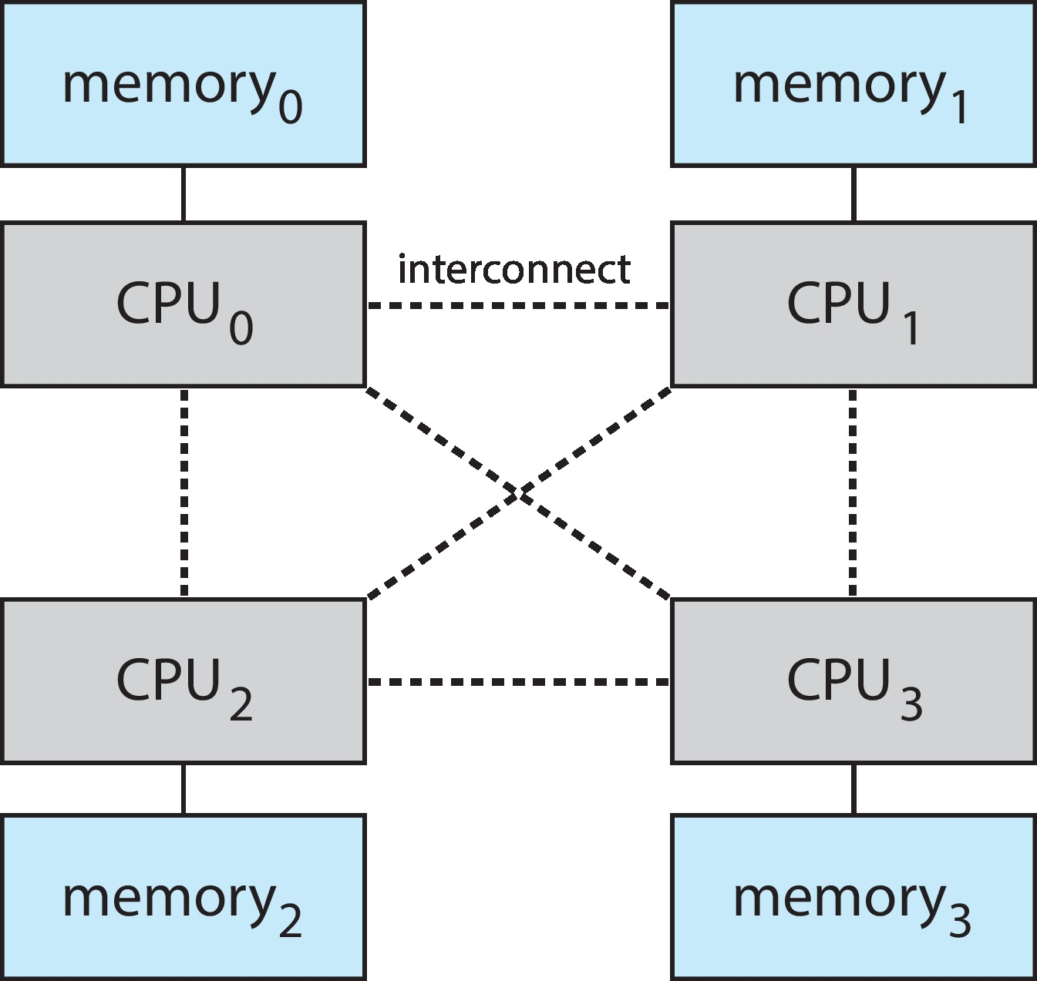
Non-Uniform Memory Access (NUMA) System

Slide 37
Clustered Systems
Like multiprocessor systems, but multiple systems working together
Usually sharing storage via a storage-area network (SAN)
Provides a high-availability service which survives failures
Asymmetric clustering has one machine in hot-standby mode
Symmetric clustering has multiple nodes running applications, monitoring each other
Some clusters are for high-performance computing (HPC)
Applications must be written to use parallelization
Some have distributed lock manager (DLM) to avoid conflicting operations

Slide 38
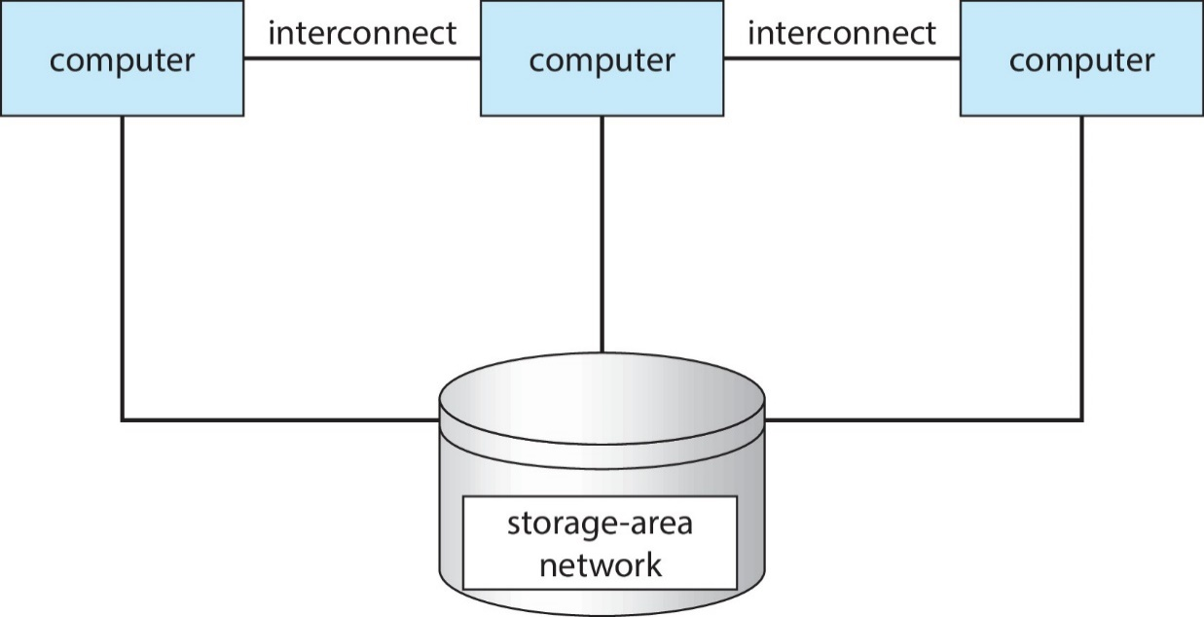
Clustered Systems

Slide 39
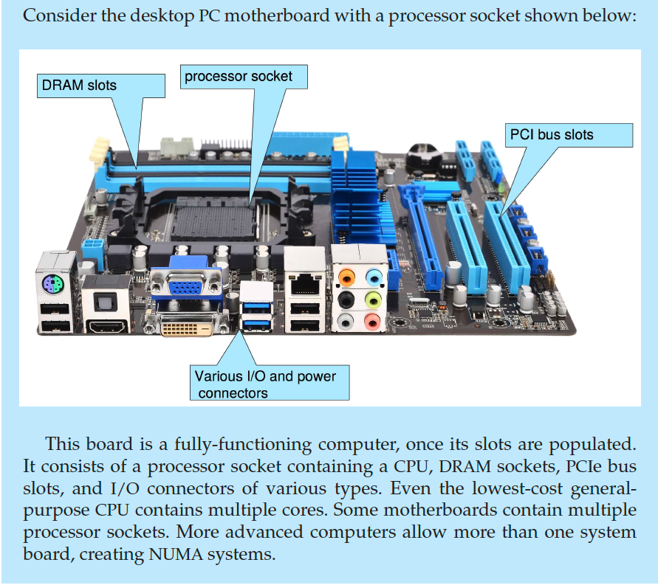
PC Motherboard

Slide 40
Operating-System Operations

Slide 41
Operating-System Operations
Bootstrap program – simple code to initialize the system, load the kernel
Kernel loads
Starts system daemons (services provided outside of the kernel)
Kernel interrupt driven (hardware and software)
Hardware interrupt by one of the devices
Software interrupt (exception or trap):
Software error (e.g., division by zero)
Request for operating system service – system call
Other process problems include infinite loop, processes modifying each other or the operating system
Notes:
Trap: invalid memory access
Top
top -H

Slide 42
Multiprogramming (Batch system)
Single user cannot always keep CPU and I/O devices busy
Multiprogramming organizes jobs (code and data) so CPU always has one to execute
A subset of total jobs in system is kept in memory
One job selected and run via job scheduling
When job has to wait (for I/O for example), OS switches to another job

Slide 43
Multitasking (Timesharing)
A logical extension of Batch systems– the CPU switches jobs so frequently that users can interact with each job while it is running, creating interactive computing
Response time should be < 1 second
Each user has at least one program executing in memory  process
If several jobs ready to run at the same time  CPU scheduling
If processes don’t fit in memory, swapping moves them in and out to run
Virtual memory allows execution of processes not completely in memory

Slide 44
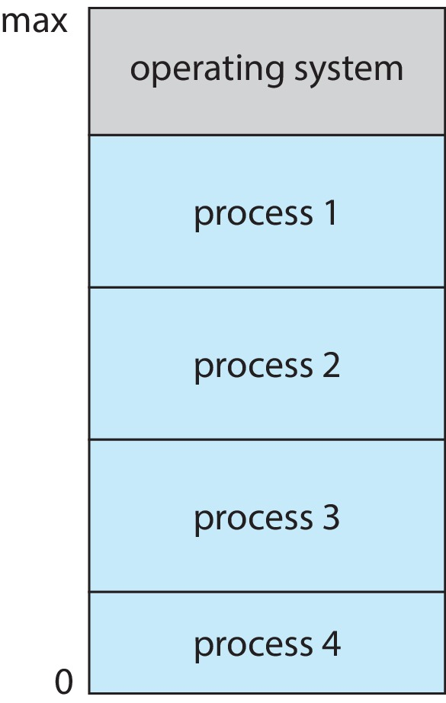
Memory Layout for Multiprogrammed System

Slide 45
Dual-mode Operation
Dual-mode operation allows OS to protect itself and other system components
User mode and kernel mode
Mode bit provided by hardware
Provides ability to distinguish when system is running user code or kernel code.
When a user is running  mode bit is “user”
When kernel code is executing  mode bit is “kernel”
How do we guarantee that user does not explicitly set the mode bit to “kernel”?
System call changes mode to kernel, return from call resets it to user
Some instructions designated as privileged, only executable in kernel mode

Slide 46
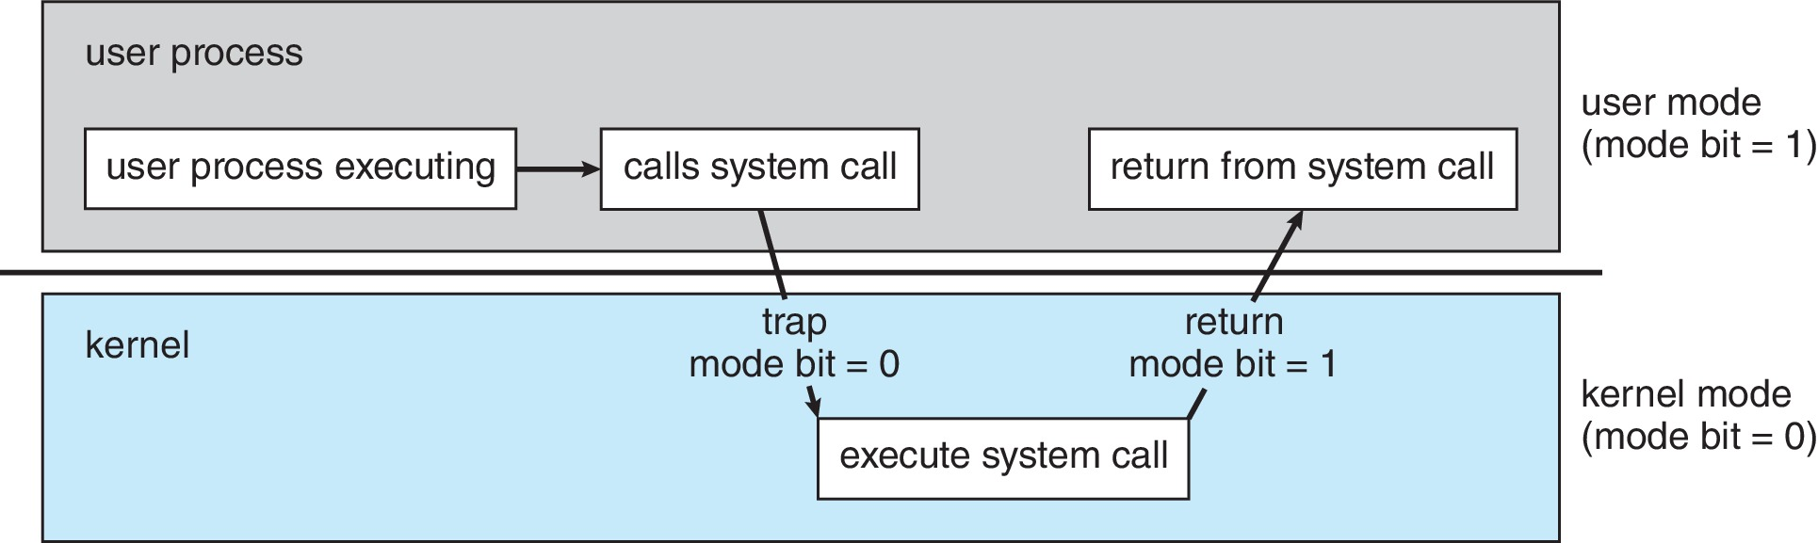
Transition from User to Kernel Mode

Slide 47
Timer
Timer to prevent infinite loop (or process hogging resources)
Timer is set to interrupt the computer after some time period
Keep a counter that is decremented by the physical clock
Operating system set the counter (privileged instruction)
When counter zero generate an interrupt
Set up before scheduling process to regain control or terminate program that exceeds allotted time

Slide 48
Resource Management

Slide 49
Process Management
A process is a program in execution. It is a unit of work within the system.
Program is a passive entity; process is an active entity.
Process needs resources to accomplish its task
CPU, memory, I/O, files
Initialization data
Process termination requires reclaim of any reusable resources
Single-threaded process has one program counter specifying location of next instruction to execute
Process executes instructions sequentially, one at a time, until completion
Multi-threaded process has one program counter per thread
Typically system has many processes, some user, some operating system running concurrently on one or more CPUs
Concurrency by multiplexing the CPUs among the processes / threads

Slide 50
Process Management Activities
The operating system is responsible for the following activities in connection with process management:
Creating and deleting both user and system processes
Suspending and resuming processes
Providing mechanisms for process synchronization
Providing mechanisms for process communication
Providing mechanisms for deadlock handling

Slide 51
Memory Management
To execute a program all (or part) of the instructions must be in memory
All (or part) of the data that is needed by the program must be in memory
Memory management determines what is in memory and when
Optimizing CPU utilization and computer response to users
Memory management activities
Keeping track of which parts of memory are currently being used and by whom
Deciding which processes (or parts thereof) and data to move into and out of memory
Allocating and deallocating memory space as needed

Slide 52
File-system Management
OS provides uniform, logical view of information storage
Abstracts physical properties to logical storage unit - file
Each medium is controlled by device (i.e., disk drive, tape drive)
Varying properties include access speed, capacity, data-transfer rate, access method (sequential or random)
File-System management
Files usually organized into directories
Access control on most systems to determine who can access what
OS activities include
Creating and deleting files and directories
Primitives to manipulate files and directories
Mapping files onto secondary storage
Backup files onto stable (non-volatile) storage media

Slide 53
Mass-Storage Management
Usually disks used to store data that does not fit in main memory or data that must be kept for a “long” period of time
Proper management is of central importance
Entire speed of computer operation hinges on disk subsystem and its algorithms
OS activities
Mounting and unmounting
Free-space management
Storage allocation
Disk scheduling
Partitioning
Protection

Slide 54
Caching
Important principle, performed at many levels in a computer (in hardware, operating system, software)
Information in use copied from slower to faster storage temporarily
Faster storage (cache) checked first to determine if information is there
If it is, information used directly from the cache (fast)
If not, data copied to cache and used there
Cache smaller than storage being cached
Cache management important design problem
Cache size and replacement policy

Slide 55
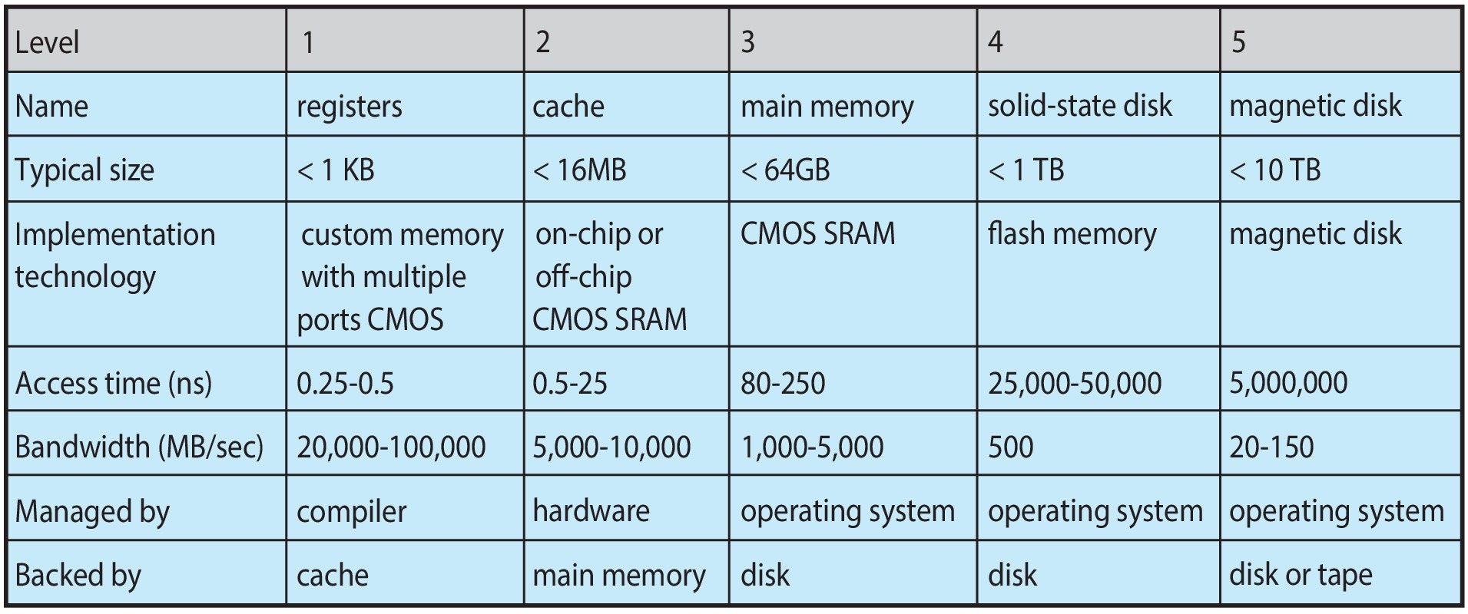
Characteristics of Various Types of Storage
Movement between levels of storage hierarchy can be explicit or implicit

Slide 56
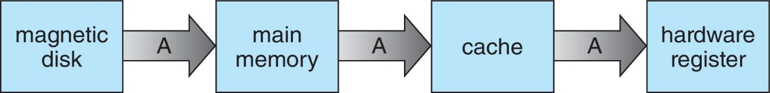
Migration of data “A” from Disk to Register
Multitasking environments must be careful to use most recent value, no matter where it is stored in the storage hierarchy
Multiprocessor environment must provide cache coherency in hardware such that all CPUs have the most recent value in their cache
Distributed environment situation even more complex
Several copies of a datum can exist
Various solutions covered in Chapter 19

Slide 57
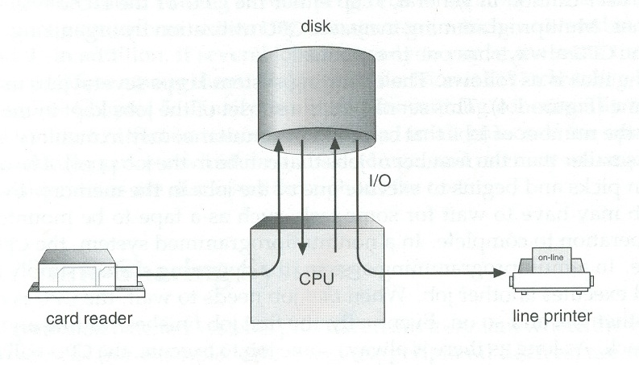
I/O Subsystem
One purpose of OS is to hide peculiarities of hardware devices from the user
I/O subsystem responsible for
Memory management of I/O including buffering (storing data temporarily while it is being transferred), caching (storing parts of data in faster storage for performance), spooling (the overlapping of output of one job with input of other jobs)
General device-driver interface
Drivers for specific hardware devices

Slide 58
Protection and Security
Protection – any mechanism for controlling access of processes or users to resources defined by the OS
Security – defense of the system against internal and external attacks
Huge range, including denial-of-service, worms, viruses, identity theft, theft of service
Systems generally first distinguish among users, to determine who can do what
User identities (user IDs, security IDs) include name and associated number, one per user
User ID then associated with all files, processes of that user to determine access control
Group identifier (group ID) allows set of users to be defined and controls managed, then also associated with each process, file
Privilege escalation allows user to change to effective ID with more rights
What is the problem?
Notes:
每奈秒(ns)產生1兆個UUID，要花100億年才會將所有UUID(128 bit)用完。

Slide 59
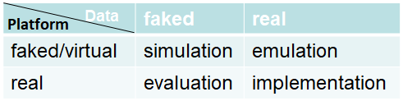
Virtualization
Allows operating systems to run applications within other OSs
Vast and growing industry
Emulation used when source CPU type different from target type (i.e. PowerPC to Intel x86)
Generally slowest method
When computer language not compiled to native code – Interpretation
Virtualization – OS natively compiled for CPU, running guest OSs also natively compiled
Consider VMware running WinXP guests, each running applications, all on native WinXP host OS
VMM (virtual machine Manager) provides virtualization services
Use cases involve laptops and desktops running multiple OSs for exploration or compatibility
Apple laptop running Mac OS X host, Windows as a guest
Developing apps for multiple OSes without having multiple systems
Quality assurance testing applications without having multiple systems
Executing and managing compute environments within data centers
VMM can run natively, in which case they are also the host
There is no general-purpose host then (VMware ESX and Citrix XenServer)
Notes:
OpenStack

Slide 60
Computing Environments - Virtualization

Slide 61
Distributed Systems
Collection of separate, possibly heterogeneous, systems networked together
Network is a communications path, TCP/IP most common
Local Area Network (LAN)
Wide Area Network (WAN)
Metropolitan Area Network (MAN)
Personal Area Network (PAN)
Network Operating System provides features between systems across network
Communication scheme allows systems to exchange messages
Distributed Operating System provides a less autonomous environment
Illusion of a single system

Slide 62
Kernel Data Structure

Slide 63
Kernel Data Structures (1/4)
Many similar to standard programming data structures
Singly linked list
Doubly linked list
Circular linked list

Slide 64
Kernel Data Structures (2/4)
Binary search tree left ⬅ right
Search performance is O(n)
Balanced binary search tree is O(lg n)
17
17
12
35
12
32
6
14
32
40
6
14
40
35

Slide 65
Kernel Data Structures (3/4)
Hash function can create a hash map
Bitmap – string of n binary digits representing the status of n items
Linux data structures defined in include files <linux/list.h>, <linux/kfifo.h>, <linux/rbtree.h>

Slide 66
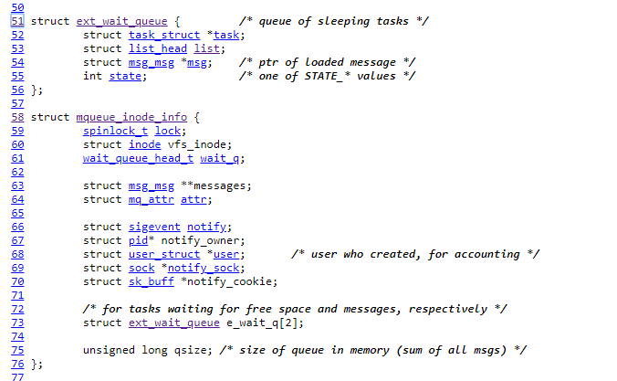

Kernel Data Structure (4/4)
Lists, Stacks, and Queues
Trees
Hash Functions and Maps
Bitmaps
<linux/list.h>

Slide 67
Computer System Environments

Slide 68
Computing Environments
Traditional
Mobile
Client Server
Pear-to-Pear
Cloud computing
Real-time Embedded

Slide 69
Traditional
Stand-alone general-purpose machines
But blurred as most systems interconnect with others (i.e., the Internet)
Portals provide web access to internal systems
Network computers (thin clients) are like Web terminals
Mobile computers interconnect via wireless networks
Networking becoming ubiquitous – even home systems use firewalls to protect home computers from Internet attacks

Slide 70
Mobile
Handheld smartphones, tablets, etc.
What is the functional difference between them and a “traditional” laptop?
Extra feature – more OS features (GPS, gyroscope)
Allows new types of apps like augmented reality
Use IEEE 802.11 wireless, or cellular data networks for connectivity
Leaders are Apple iOS and Google Android

Slide 71
Client Server
Client-Server Computing
Dumb terminals supplanted by smart PCs
Many systems now servers, responding to requests generated by clients
Compute-server system provides an interface to client to request services (i.e., database)
File-server system provides interface for clients to store and retrieve files

Slide 72
Peer-to-Peer
Another model of distributed system
P2P does not distinguish clients and servers
Instead all nodes are considered peers
May each act as client, server or both
Node must join P2P network
Registers its service with central lookup service on network, or
Broadcast request for service and respond to requests for service via discovery protocol
Examples include Napster and Gnutella, Voice over IP (VoIP) such as Skype

Slide 73
Web-Based Computing, 9e
Web has become ubiquitous
PCs most prevalent devices
More devices becoming networked to allow web access
New category of devices to manage web traffic among similar servers: load balancers
Use of operating systems like Windows 95, client-side, have evolved into Linux and Windows XP, which can be clients and servers

Slide 74
Cloud Computing
Delivers computing, storage, even apps as a service across a network
Logical extension of virtualization because it uses virtualization as the base for it functionality.
Amazon EC2 has thousands of servers, millions of virtual machines, petabytes of storage available across the Internet, pay based on usage
Many types
Public cloud – available via Internet to anyone willing to pay
Private cloud – run by a company for the company’s own use
Hybrid cloud – includes both public and private cloud components
Software as a Service (SaaS) – one or more applications available via the Internet (i.e., word processor)
Platform as a Service (PaaS) – software stack ready for application use via the Internet (i.e., a database server)
Infrastructure as a Service (IaaS) – servers or storage available over Internet (i.e., storage available for backup use)

Slide 75
Cloud Computing (cont.)
Cloud computing environments composed of traditional OSs, plus VMMs, plus cloud management tools
Internet connectivity requires security like firewalls
Load balancers spread traffic across multiple applications
Edge Computing?

Slide 76
Real-Time Embedded Systems
Embedded systems are the most prevalent form of computers
Vary considerable, special purpose, limited purpose OS, real-time OS
Use expanding
Many other special computing environments as well
Some have OSs, some perform tasks without an OS
Real-time OS has well-defined fixed time constraints
Processing must be done within constraint
Correct operation only if constraints met

Slide 77
Free and Open-Source Operating Systems
Operating systems made available in source-code format rather than just binary closed-source and proprietary
Counter to the copy protection and Digital Rights Management (DRM) movement
Started by Free Software Foundation (FSF), which has “copyleft” GNU Public License (GPL)
Free software and open-source software are two different ideas championed by different groups of people
http://gnu.org/philosophy/open-source-misses-the-point.html/
Examples include GNU/Linux and BSD UNIX (including core of Mac OS X), and many more
Can use VMM like VMware Player (Free on Windows), Virtualbox (open source and free on many platforms - http://www.virtualbox.com)
Use to run guest operating systems for exploration

Slide 78
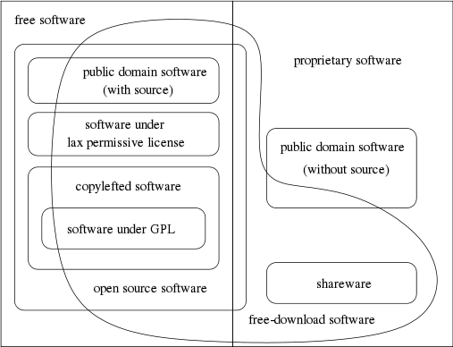
Categories of Free and Nonfree Software

Slide 79
The Study of Operating Systems
There has never been a more interesting time to study operating systems, and it has never been
easier. The open-source movement has overtaken operating systems, causing many of them to
be made available in both source and binary (executable) format. The list of operating
systems available in both formats includes Linux, BUSD UNIX, Solaris, and part of macOS.
The availability of source code allows us to study operating systems from the inside out.
Questions that we could once answer only by looking at documentation or the behavior of an
operating system we can now answer by examining the code itself.
Operating systems that are no longer commercially viable have been open-sourced as well, enabling
us to study how systems operated in a time of fewer CPU, memory, and storage resources.
An extensive but incomplete list of open-source operating-system projects is available
from https://curlie.org/Computers/Software/Operating_Systems/Open_Source/
In addition, the rise of virtualization as a mainstream (and frequently free) computer function
makes it possible to run many operating systems on top of one core system. For example, VMware
(http://www.vmware.com) providesa free “player” for Windows on which hundreds of free
“virtual appliances” can run. Virtualbox (http://www.virtualbox.com) provides a free, open-source
virtual machine manager on many operating systems. Using such tools, students can try out
hundreds of operating systems without dedicated hardware.
In some cases, simulators of specific hardware are also available … (in the abstract)
The advent of open-source operating systems has also made it easier to make the move from
student to operating-system developer. With some knowledge, some effort, and an Internet
connection, a student can even create a new operating-system distribution. Just a few years ago,
it was difficult or impossible to get access to source code. Now, such access is limited only by
how much interest, time, and disk space a student has.
Notes:
In some cases, simulators of specific hardware are also available, allowing the operating system to run on “native” hardware, all within the confines of a modern computer and modern operating system. For example, a DECSYSTEM-20 simulator running on macOS can boot TOPS-20, load the source tapes, and modify and compile a new TOPS-20 kernel. An interested student can search the Internet to find the original papers that describe the operating system, as well as the original manuals.

Slide 80
End of Chapter 1

