Slide 1
Chapter 13: File-System Interface

Slide 2
Outline
File Concept
Access Methods
Disk and Directory Structure
File Sharing
Protection

Slide 3
Objectives
To explain the function of file systems
To describe the interfaces to file systems
To discuss file-system design tradeoffs, including access methods, file sharing, file locking, and directory structures
To explore file-system protection

Slide 4
File Concept
Contiguous logical address space
Types:
Data
numeric
character
binary
Program
Contents defined by file’s creator
Many types
Consider text file, source file, executable file

Slide 5
File Attributes
Name – only information kept in human-readable form
Identifier – unique tag (number) identifies file within file system
Type – needed for systems that support different types
Location – pointer to file location on device
Size – current file size
Protection – controls who can do reading, writing, executing
Time, date, and user identification – data for protection, security, and usage monitoring
Information about files are kept in the directory structure, which is maintained on the disk
Many variations, including extended file attributes such as file checksum
Information kept in the directory structure

Slide 6
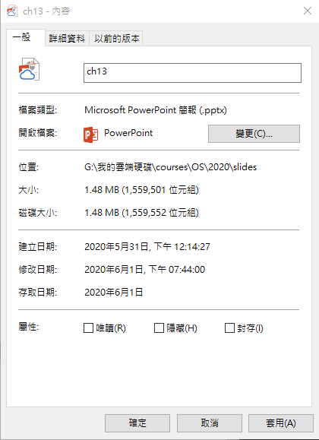
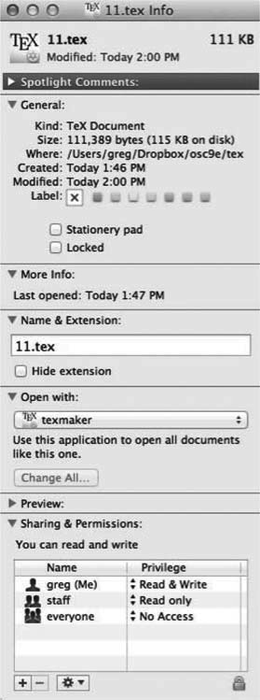
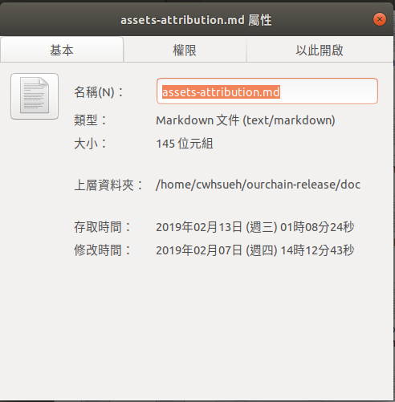
File info Windows

Slide 7
File Operations
File is an abstract data type
Create
Write – at write pointer location
Read – at read pointer location
Reposition within file - seek
Delete
Truncate
Open(F_{i}) – search the directory structure on disk for entry F_{i}, and move the content of entry to memory
Close (F_{i}) – move the content of entry F_{i} in memory to directory structure on disk

Slide 8
Open Files
Several pieces of data are needed to manage open files:
Open-file table: tracks open files
File pointer: pointer to last read/write location, per process that has the file open
File-open count: counter of number of times a file is open – to allow removal of data from open-file table when last processes closes it
Disk location of the file: cache of data access information
Access rights: per-process access mode information

Slide 9
Open File Locking
Provided by some operating systems and file systems
Similar to reader-writer locks
Shared lock similar to reader lock – several processes can acquire concurrently
Exclusive lock similar to writer lock
Mediates access to a file
Mandatory or advisory:
Mandatory – access is denied depending on locks held and requested
Advisory – processes can find status of locks and decide what to do

Slide 10
File Locking Example – Java API
/** File Locking Example . . .
** – From textbook */
import java.io.*;
import java.nio.channels.*;
public class LockingExample {
public static final boolean EXCLUSIVE = false;
public static final boolean SHARED = true;
public static void main(String arsg[]) throws IOException {
FileLock sharedLock = null;
FileLock exclusiveLock = null;
try {
RandomAccessFile raf = new RandomAccessFile("file.txt", "rw");
FileChannel ch = raf.getChannel(); // get the channel for the file
exclusiveLock = ch.lock(0, raf.length()/2, EXCLUSIVE); // locks the 1st half of the file - exclusive
/** Now modify the data . . . */
exclusiveLock.release(); // release the lock
sharedLock = ch.lock(raf.length()/2+1, raf.length(), // locks the 2nd half of the file – shared
SHARED);
/** Now read the data . . . */
sharedLock.release(); // release the lock
} catch (java.io.IOException ioe) {
System.err.println(ioe);
} finally {
if (exclusiveLock != null) exclusiveLock.release();
if (sharedLock != null) sharedLock.release();
}
}
}
Notes:
Java NIO (New IO) is an alternative IO API for Java
In the standard IO API you work with byte streams and character streams. In NIO you work with channels and buffers. Data is always read from a channel into a buffer, or written from a buffer to a channel.
Java NIO: Non-blocking IO

Slide 11
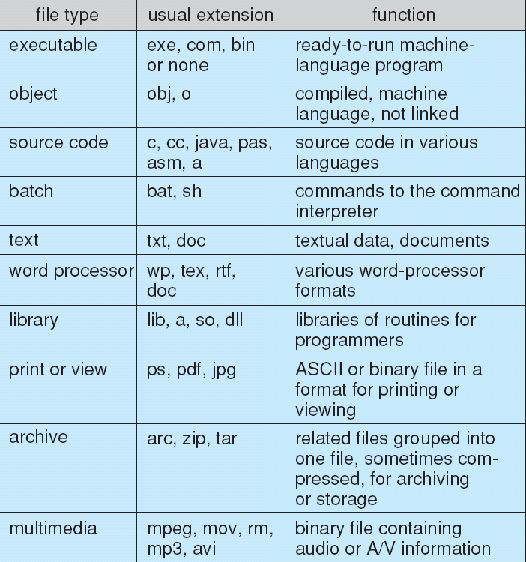
File Types – Name, Extension

Slide 12
File Structure
None - sequence of words, bytes
Simple record structure
Lines
Fixed length
Variable length
Complex Structures
Formatted document
Relocatable load file
Can simulate last two with first method by inserting appropriate control characters
Who decides:
Operating system
Program

Slide 13
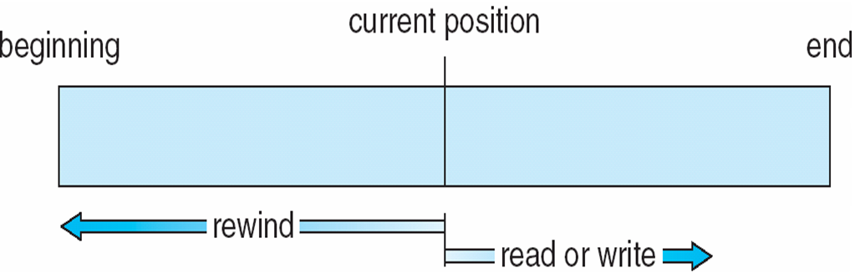
Sequential-access File

Slide 14
Access Methods
Sequential Access
read next
write next
reset
no read after last write
(rewrite)
Direct Access – file is fixed length logical records
read n
write n
position to n
read next
write next
rewrite n
n = relative block number
Relative block numbers allow OS to decide where file should be placed
See allocation problem in Ch 14

Slide 15
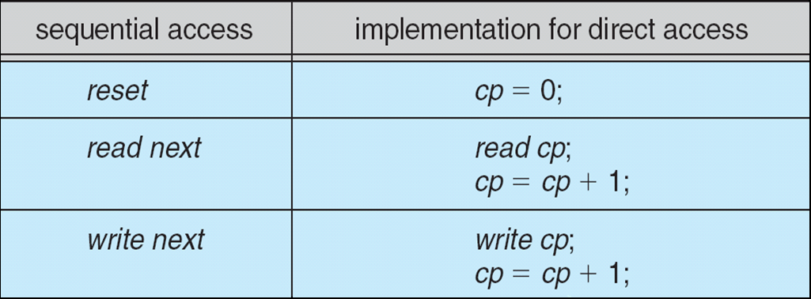
Simulation of Sequential Access on Direct-access File

Slide 16
Other Access Methods
Can be built on top of base methods
General involve creation of an index for the file
Keep index in memory for fast determination of location of data to be operated on (consider UPC code plus record of data about that item)
If too large, index (in memory) of the index (on disk)
IBM indexed sequential-access method (ISAM)
Small master index, points to disk blocks of secondary index
File kept sorted on a defined key
All done by the OS
VMS operating system provides index and relative files as another example (see next slide)
Notes:
UPC: Universal Product Codes

Slide 17
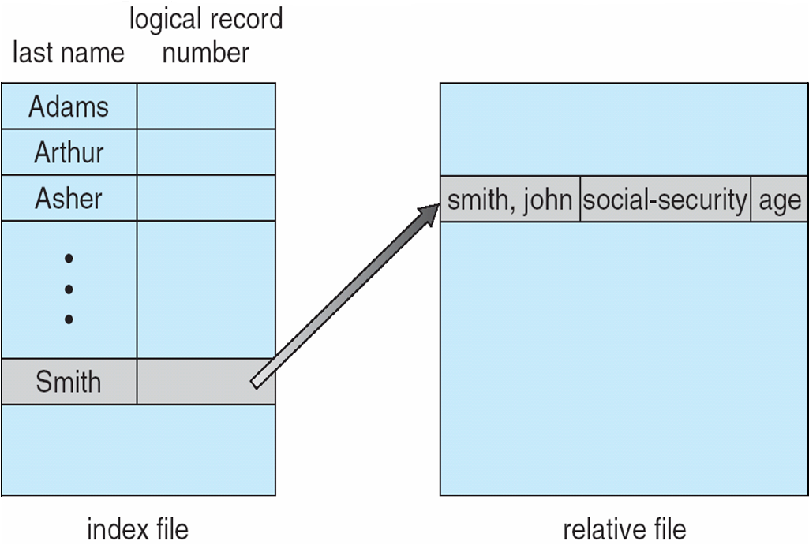
Example of Index and Relative Files

Slide 18
Directory Structure
A collection of nodes containing information about all files
Directory
Files
F 1
F 2
F 3
F 4
F n
Both the directory structure and the files reside on disk

Slide 19
Disk Structure
Disk can be subdivided into partitions
Disks or partitions can be RAID protected against failure
Disk or partition can be used raw – without a file system, or formatted with a file system
Partitions also known as minidisks, slices
Entity containing file system known as a volume
Each volume containing file system also tracks that file system’s info in device directory or volume table of contents
As well as general-purpose file systems there are many special-purpose file systems, frequently all within the same operating system or computer

Slide 20
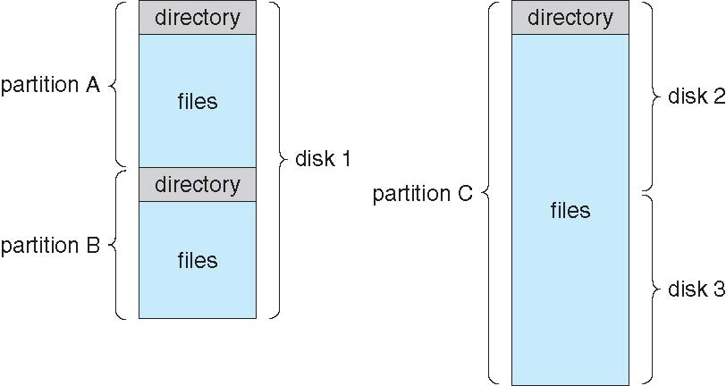
A Typical File-system Organization

Slide 21
Types of File Systems
We mostly talk of general-purpose file systems
But systems frequently have may file systems, some general- and some special- purpose
Consider Solaris has
tmpfs – memory-based volatile FS for fast, temporary I/O
objfs – interface into kernel memory to get kernel symbols for debugging
ctfs – contract file system for managing daemons
lofs – loopback file system allows one FS to be accessed in place of another
procfs – kernel interface to process structures
ufs, zfs – general purpose file systems
Notes:
ctfs
- contract file system
Description
The ctfs filesystem is the interface to the contract sub-system. ctfs is mounted during boot at /system/contract. For information on contracts and the contents of this filesystem, see contract(4).
Unix File System
UFS 全名為通用快閃記憶體儲存 ( 英文 : Universal Flash Storage )，版本從 1.0 一路進化到今天的 3.1，目前市面上絕大多數的手機大多都是從 UFS 2.0 開始採用。
ZFS 是什麼，它有什麼特性？
正如前面所說過的，ZFS 是一個先進的文件系統。因此，它有一些有趣的 特性 。比如：
存儲池
寫時拷貝
快照
數據完整性驗證和自動修復
RAID-Z
最大單個文件大小為 16 EB（1 EB = 1024 PB）
最大 256 千萬億（256*10¹⁵ ）的 ZB（1 ZB = 1024 EB）的存儲
原文網址：https://kknews.cc/news/aprbmnv.html

Slide 22
Operations Performed on Directory
Search for a file
Create a file
Delete a file
List a directory
Rename a file
Traverse the file system

Slide 23
Directory Organization
The directory is organized logically to obtain
Efficiency – locating a file quickly
Naming – convenient to users
Two users can have same name for different files
The same file can have several different names
Grouping – logical grouping of files by properties, (e.g., all Java programs, all games, …)

Slide 24
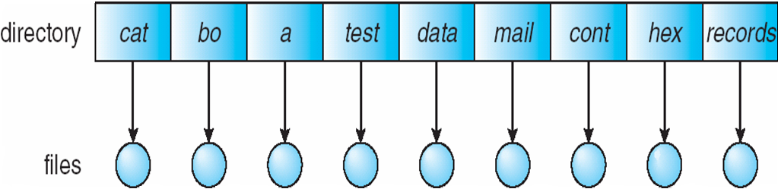
Single-Level Directory
A single directory for all users
Naming problem
Different names in a directory
Grouping problem

Slide 25
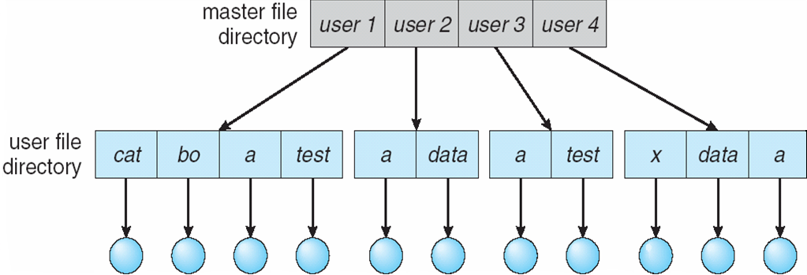
Two-Level Directory
Separate directory for each user
Path name
Can have the same file name for different user
Efficient searching
No grouping capability

Slide 26
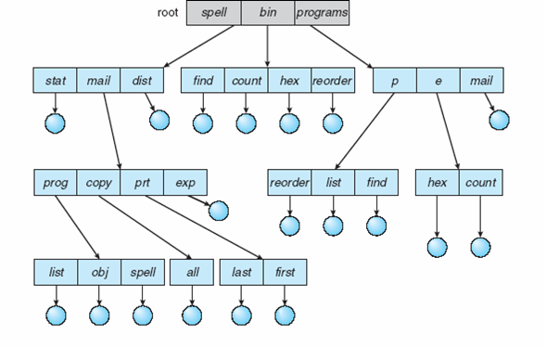
Tree-Structured Directories

Slide 27
Tree-Structured Directories (Cont.)
Efficient searching
Grouping Capability
Current directory (working directory)
cd /spell/mail/prog
type list

Slide 28
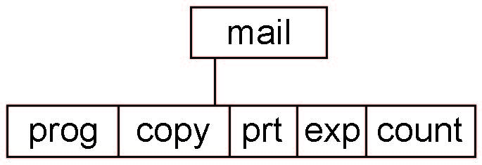
Tree-Structured Directories (Cont.)
Absolute or relative path name
Creating a new file is done in current directory
Delete a file
rm <file-name>
Creating a new subdirectory is done in current directory
mkdir <dir-name>
Example: if in current directory /mail
mkdir count
Deleting “mail” ⇒ deleting the entire subtree rooted by “mail”

Slide 29
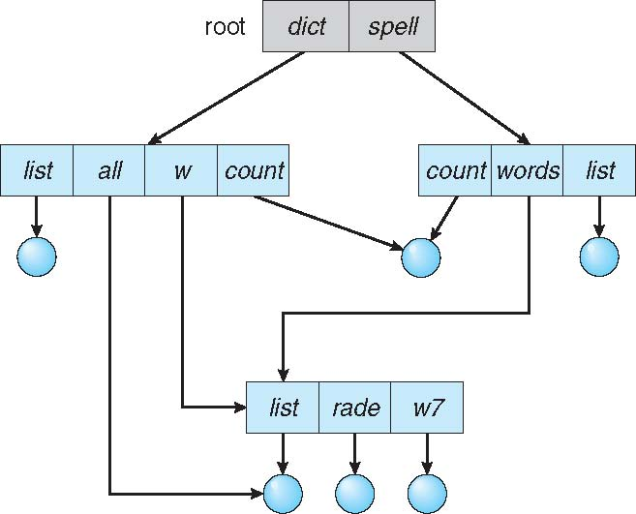
Acyclic-Graph Directories
Have shared subdirectories and files

Slide 30
Acyclic-Graph Directories (Cont.)
Two different names (aliasing)
If dict deletes list ⇒ dangling pointer
Solutions:
Backpointers, so we can delete all pointers Variable size records a problem
Backpointers using a daisy chain organization
Entry-hold-count solution
New directory entry type
Link – another name (pointer) to an existing file
Resolve the link – follow pointer to locate the file

Slide 31
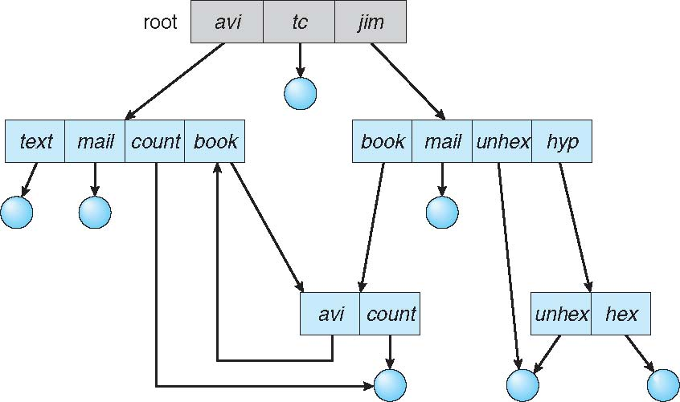
General Graph Directory

Slide 32
General Graph Directory (Cont.)
How do we guarantee no cycles?
Allow only links to file not subdirectories
Garbage collection
Every time a new link is added use a cycle detection algorithm to determine whether it is OK

Slide 33
Protection
File owner/creator should be able to control:
what can be done
by whom
Types of access
Read
Write
Execute
Append
Delete
List
Attribute change

Slide 34
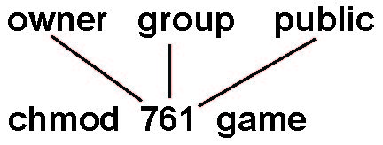
Access Lists and Groups
Mode of access: read, write, execute
Three classes of users on Unix / Linux
RWX
a) owner access 7 ⇒ 1 1 1 RWX
b) group access 6 ⇒ 1 1 0
RWX
c) public access 1 ⇒ 0 0 1
Ask manager to create a group (unique name), say G, and add some users to the group.
For a particular file (say game) or subdirectory, define an appropriate access.
Attach a group to a file chgrp G game

Slide 35
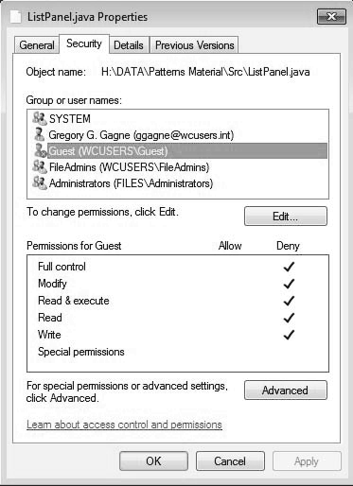
Windows 10 Access-Control List Management

Slide 36
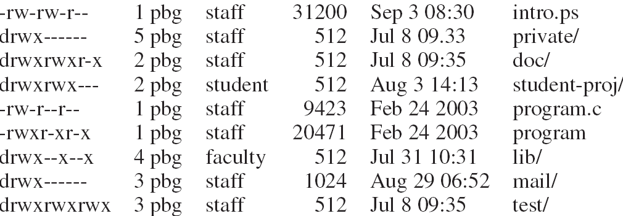
A Sample UNIX Directory Listing
owner
group

Slide 37
End of Chapter 13

