Slide 1
Chapter 14: File System Implementation

Slide 2
Outline
File-System Structure
File-System Operations
Directory Implementation
Allocation Methods
Free-Space Management
Efficiency and Performance
Recovery
Example: WAFL File System

Slide 3
Objectives
Describe the details of implementing local file systems and directory structures
Discuss block allocation and free-block algorithms and trade-offs
Explore file system efficiency and performance issues
Look at recovery from file system failures
Describe the WAFL file system as a concrete example

Slide 4
File-System Structure
File structure
Logical storage unit
Collection of related information
File system resides on secondary storage (disks)
Provided user interface to storage, mapping logical to physical
Provides efficient and convenient access to disk by allowing data to be stored, located, retrieved easily
Disk provides in-place rewrite and random access
I/O transfers performed in blocks of sectors (usually 512 bytes)
File control block (FCB) – storage structure consisting of information about a file
Device driver controls the physical device
File system organized into layers

Slide 5
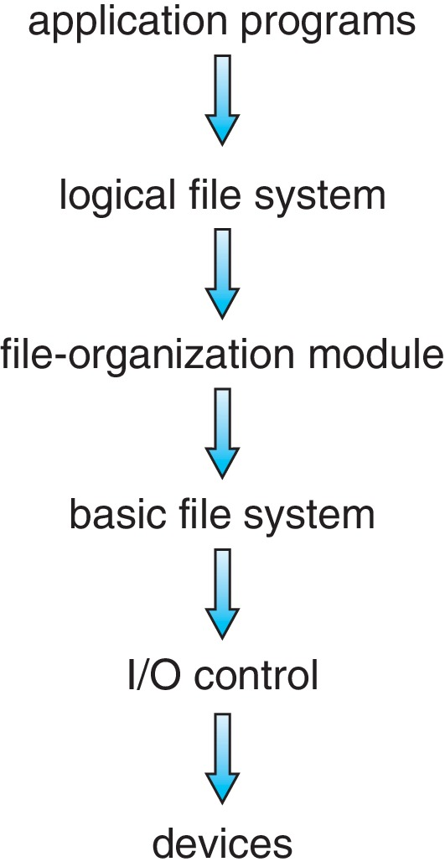
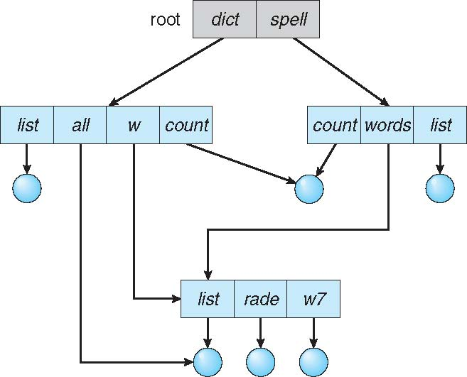

Layered File System
A Go Game Book

Slide 6
File System Layers
Device drivers manage I/O devices at the I/O control layer
Given commands like “read drive1, cylinder 72, track 2, sector 10, into memory location 1060” outputs low-level hardware specific commands to hardware controller
Basic file system given command like “retrieve block 123” translates to device driver
Also manages memory buffers and caches (allocation, freeing, replacement)
Buffers hold data in transit
Caches hold frequently used data
File organization module understands files, logical address, and physical blocks
Translates logical block # to physical block #
Manages free space, disk allocation
Notes:
LBA: logical block address

Slide 7
File System Layers (Cont.)
Logical file system manages metadata information
Translates file name into file number, file handle, location by maintaining file control blocks (inodes in UNIX)
Directory management
Protection
Layering useful for reducing complexity and redundancy, but adds overhead and can decrease performance
Logical layers can be implemented by any coding method according to OS designer
Many file systems, sometimes many within an operating system
Each with its own format (CD-ROM is ISO 9660; Unix has UFS, FFS; Windows has FAT, FAT32, NTFS as well as floppy, CD, DVD Blu-ray, Linux has more than 130 types, with extended file system ext3 and ext4 leading; plus distributed file systems, etc.)
New ones still arriving – ZFS, GoogleFS, Oracle ASM, FUSE, IPFS
Notes:
Oracle 自動儲存管理概述 自動儲存管理 (ASM) 是 Oracle Database 的一個特性，它為資料庫管理員提供了一個在所有伺服器和儲存平臺上均一致的簡單儲存管理介面。作為專門為 Oracle 資料庫檔案建立的垂直整合檔案系統和卷管理器，ASM 提供了直接非同步 I/O 的效能以及檔案系統的易管理性。ASM 提供了可節省 DBA 時間的功能，以及管理動態資料庫環境的靈活性，並且提高了效率。ASM 的主要優點有： 簡化和自動化了儲存管理 提高了儲存利用率和敏捷性 提供可預測的效能、可用性和可伸縮性
UFS: Unix File System, FFS: Fast File System
FUSE: User Level

Slide 8
File-System Operations
We have system calls at the API level, but how do we implement their functions?
On-disk and in-memory structures
Boot control block contains info needed by system to boot OS from that volume
Needed if volume contains OS, usually first block of volume
Volume control block (superblock, master file table) contains volume details
Total # of blocks, # of free blocks, block size, free block pointers or array
Directory structure organizes the files
Names and inode numbers, master file table

Slide 9
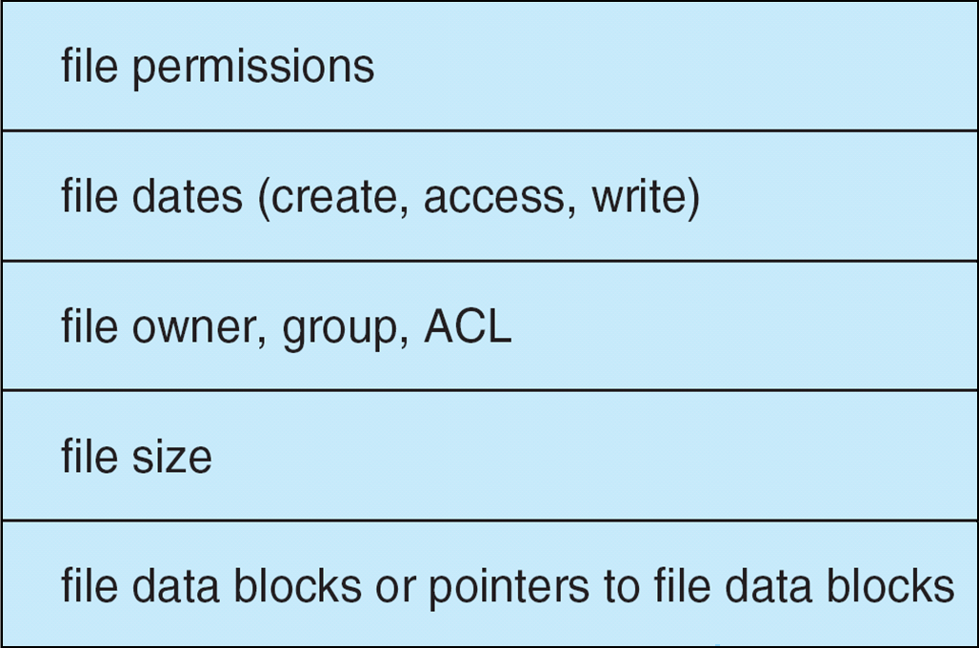
File-System Implementation (Cont.)
Per-file File Control Block (FCB) contains many details about the file
typically inode number, permissions, size, dates
NFTS stores into in master file table using relational DB structures

Slide 10
In-Memory File System Structures
Mount table storing file system mounts, mount points, file system types
system-wide open-file table contains a copy of the FCB of each file and other info
per-process open-file table contains pointers to appropriate entries in system-wide open-file table as well as other info
The following figure illustrates the necessary file system structures provided by the operating systems
Figure 14-3(a) refers to opening a file
Figure 14-3(b) refers to reading a file
Plus buffers hold data blocks from secondary storage
Open returns a file handle for subsequent use
Data from read eventually copied to specified user process memory address

Slide 11
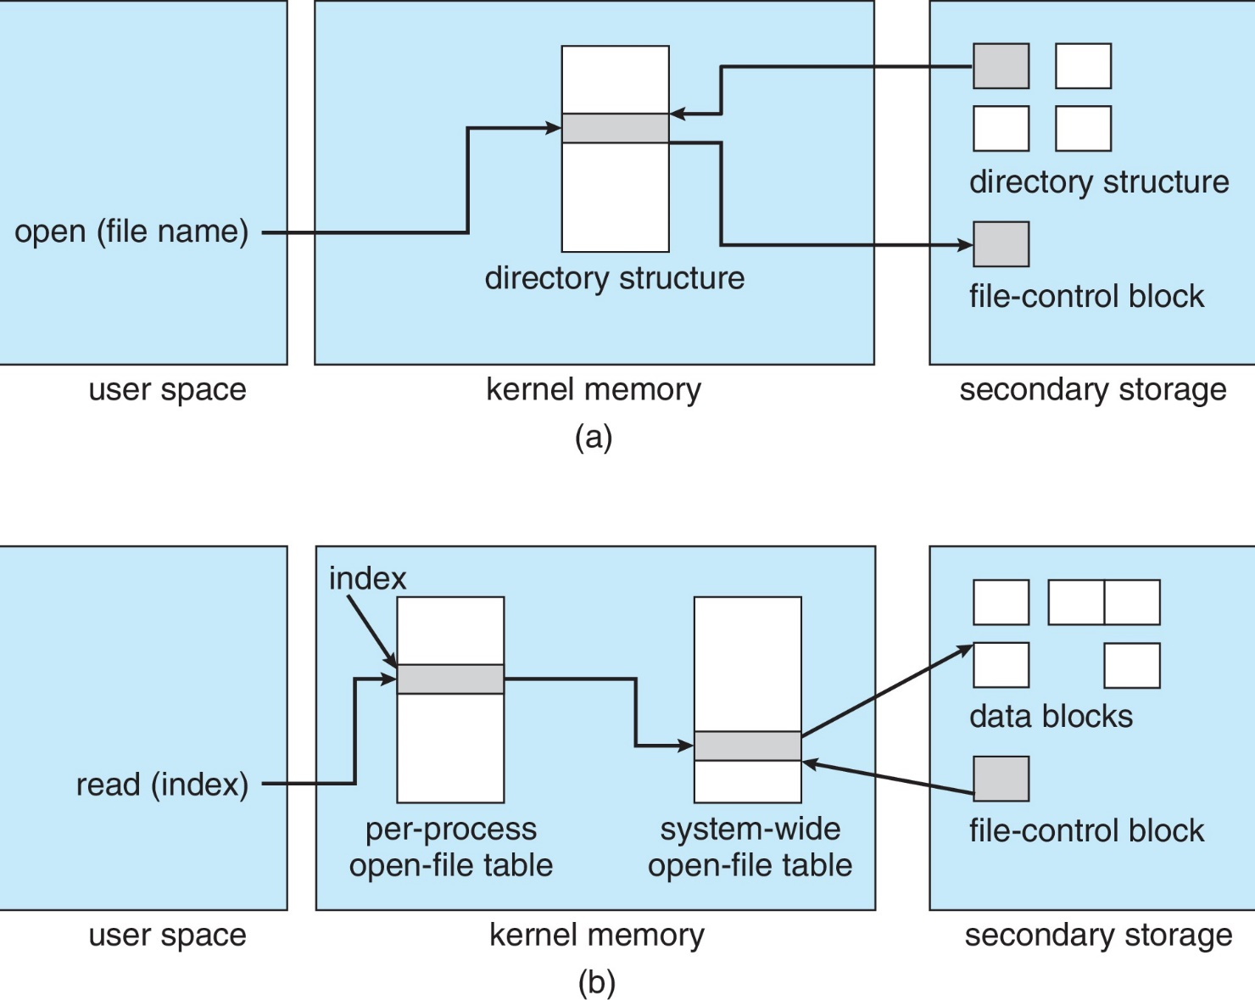
In-Memory File System Structures

Slide 12
Directory Implementation
Linear list of file names with pointer to the data blocks
Simple to program
Time-consuming to execute
Linear search time
Could keep ordered alphabetically via linked list or use B+ tree
Hash Table – linear list with hash data structure
Decreases directory search time
Collisions – situations where two file names hash to the same location
Only good if entries are fixed size, or use chained-overflow method

Slide 13
Allocation Methods - Contiguous
An allocation method refers to how disk blocks are allocated for files:
Contiguous allocation – each file occupies set of contiguous blocks
Best performance in most cases
Simple – only starting location (block #) and length (number of blocks) are required
Problems include finding space for file, knowing file size, external fragmentation, need for compaction off-line (downtime) or on-line

Slide 14
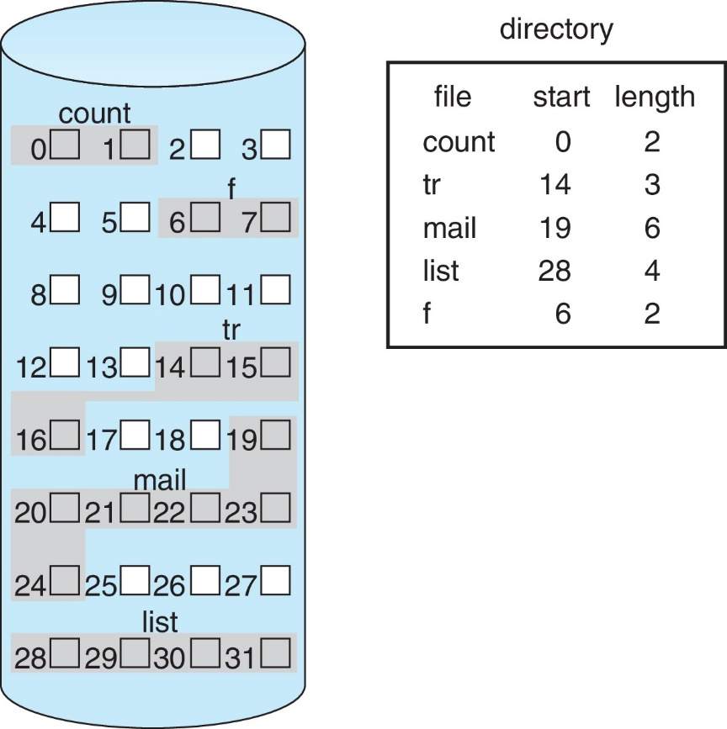
Contiguous Allocation
Mapping from logical to physical
Q
LA/512
R
Block to be accessed = Q + starting address
Displacement into block = R

Slide 15
Extent-Based Systems
Many newer file systems (i.e., Veritas File System) use a modified contiguous allocation scheme
Extent-based file systems allocate disk blocks in extents
An extent is a contiguous block of disks
Extents are allocated for file allocation
A file consists of one or more extents

Slide 16
Allocation Methods - Linked
Linked allocation – each file a linked list of blocks
File ends at nil pointer
No external fragmentation
Each block contains pointer to next block
No compaction, external fragmentation
Free space management system called when new block needed
Improve efficiency by clustering blocks into groups but increases internal fragmentation
Reliability can be a problem
Locating a block can take many I/Os and disk seeks

Slide 17
Linked Allocation
Each file is a linked list of disk blocks: blocks may be scattered anywhere on the disk
block =
pointer
Mapping
Q
LA/511
R
Block to be accessed is the Qth block in the linked chain of blocks representing the file.
Displacement into block = R + 1

Slide 18
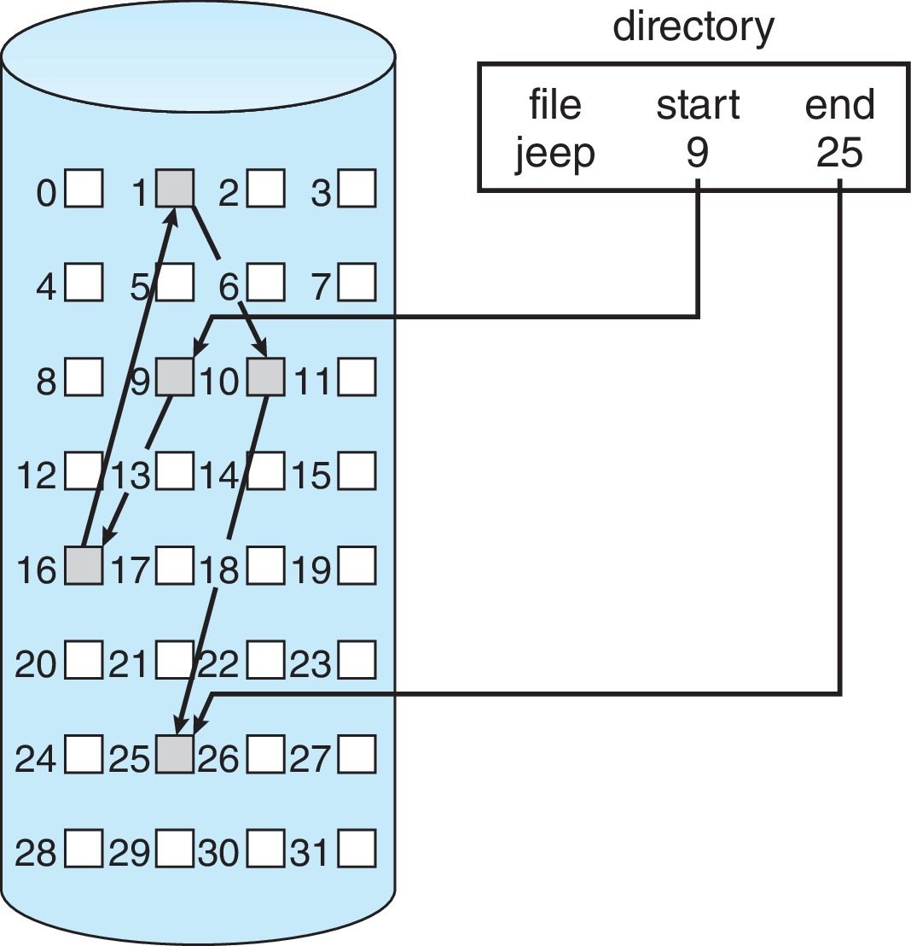
Linked Allocation

Slide 19
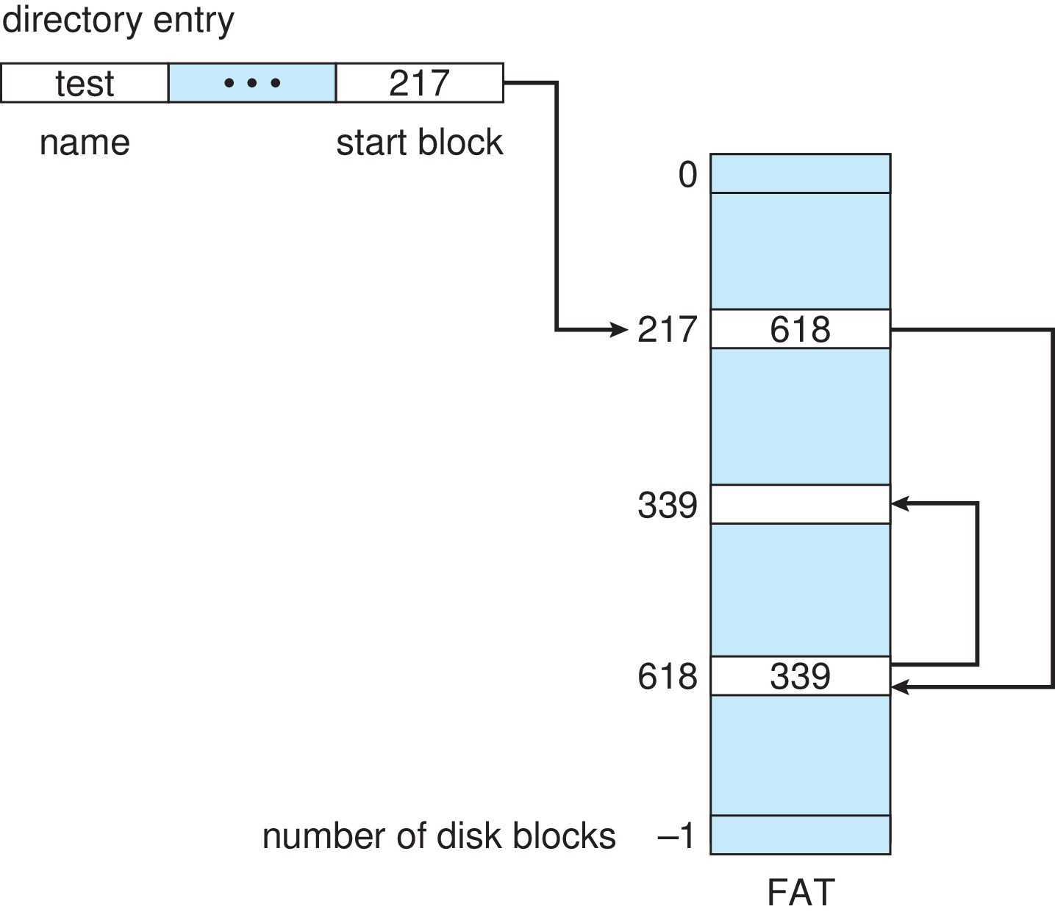
File-Allocation Table

Slide 20
Allocation Methods - Indexed
Indexed allocation
Each file has its own index block(s) of pointers to its data blocks
Logical view

Slide 21
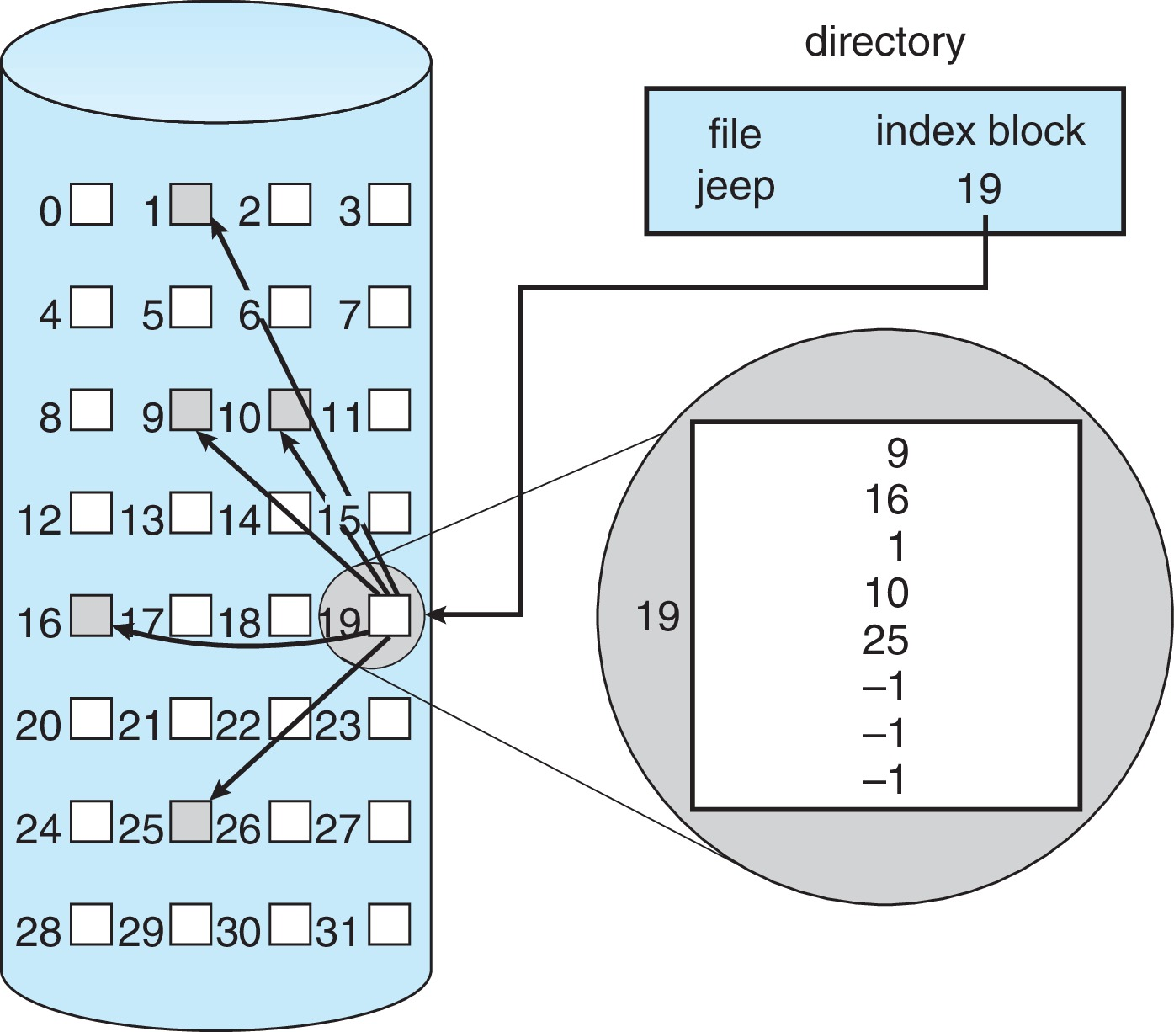
Example of Indexed Allocation

Slide 22
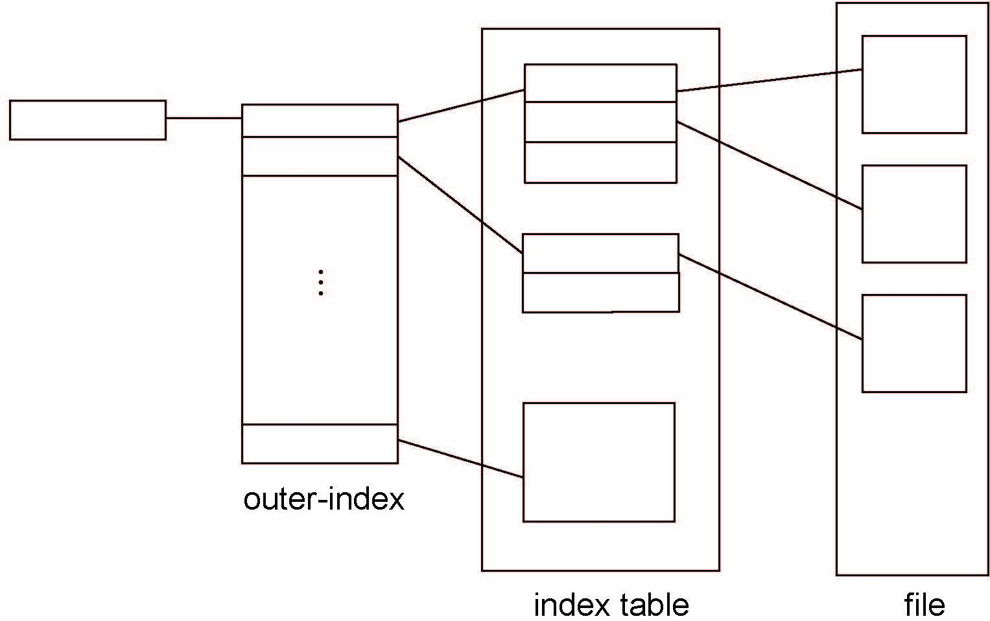
Indexed Allocation – Multilevel index

Slide 23
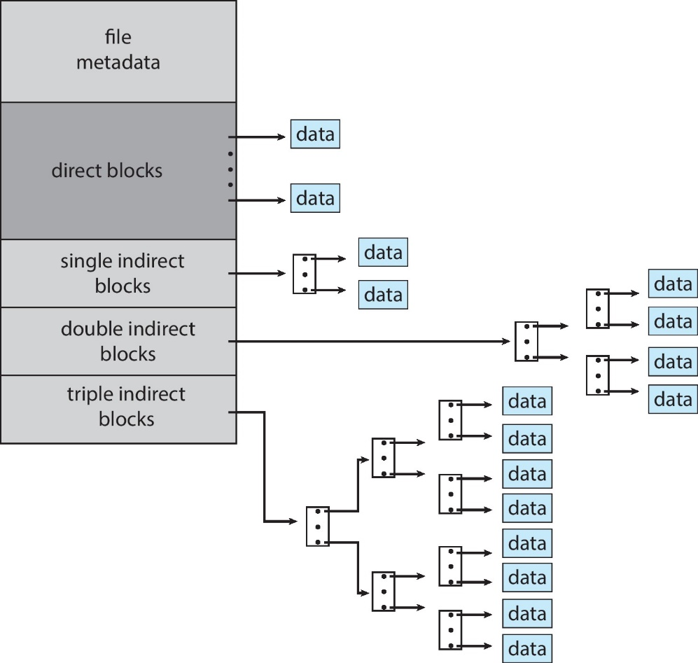
Combined Scheme: UNIX UFS
4K bytes per block, 32-bit addresses
More index blocks than can be addressed with 32-bit file pointer
Unix inode

Slide 24
Performance
Best method depends on file access type
Contiguous great for sequential and random
Linked good for sequential, not random
Declare access type at creation → select either contiguous or linked
Indexed more complex
Single block access could require 2 index block reads then data block read
Clustering can help improve throughput, reduce CPU overhead
For NVM, no disk head so different algorithms and optimizations needed
Using old algorithm uses many CPU cycles trying to avoid non-existent head movement
With NVM, goal is to reduce CPU cycles and overall path needed for I/O

Slide 25
Free-Space Management
File system maintains free-space list to track available blocks/clusters
(Using term “block” for simplicity)
Bit vector or bit map (n blocks)
0
1
2
n-1
…
1 ⇒ block[i] free
0 ⇒ block[i] occupied
bit[i] =

Block number calculation
(number of bits per word) *
(number of 0-value words) +
offset of first 1 bit
CPUs have instructions to return offset within word of first “1” bit

Slide 26
Free-Space Management (Cont.)
Bit map requires extra space
Example:
block size = 4KB = 2¹² bytes
disk size = 2⁴⁰ bytes (1 terabyte)
n = 2⁴⁰/2¹² = 2²⁸ bits (or 32MB)
if clusters of 4 blocks → 8MB of memory
Easy to get contiguous files

Slide 27
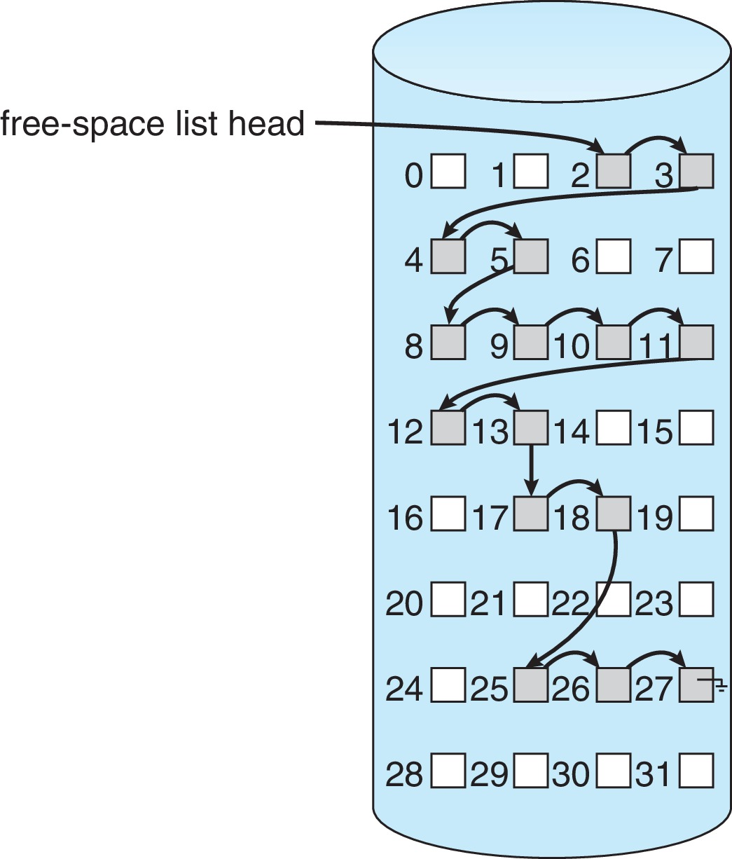
Linked Free Space List on Disk
Linked list (free list)
Cannot get contiguous space easily
No waste of space
No need to traverse the entire list (if # free blocks recorded)

Slide 28
Free-Space Management (Cont.)
Grouping
Modify linked list to store address of next n-1 free blocks in first free block, plus a pointer to next block that contains free-block-pointers (like this one)
Counting
Because space is frequently contiguously used and freed, with contiguous-allocation allocation, extents, or clustering
Keep address of first free block and count of following free blocks
Free space list then has entries containing addresses and counts

Slide 29
Free-Space Management (Cont.)
Space Maps
Used in ZFS
Consider meta-data I/O on very large file systems
Full data structures like bit maps couldn’t fit in memory → thousands of I/Os
Divides device space into metaslab units and manages metaslabs
Given volume can contain hundreds of metaslabs
Each metaslab has associated space map
Uses counting algorithm
But records to log file rather than file system
Log of all block activity, in time order, in counting format
Metaslab activity → load space map into memory in balanced-tree structure, indexed by offset
Replay log into that structure
Combine contiguous free blocks into single entry

Slide 30
TRIMing Unused Blocks
HDDS overwrite in place so need only free list
Blocks not treated specially when freed
Keeps its data but without any file pointers to it, until overwritten
Storage devices not allowing overwrite (like NVM) suffer badly with same algorithm
Must be erased before written, erases made in large chunks (blocks, composed of pages) and are slow
TRIM is a newer mechanism for the file system to inform the NVM storage device that a page is free
Can be garbage collected or if block is free, now block can be erased

Slide 31
Efficiency and Performance
Efficiency dependent on:
Disk allocation and directory algorithms
Types of data kept in file’s directory entry
Pre-allocation or as-needed allocation of metadata structures
Fixed-size or varying-size data structures

Slide 32
Efficiency and Performance (Cont.)
Performance
Keeping data and metadata close together
Buffer cache – separate section of main memory for frequently used blocks
Synchronous writes sometimes requested by apps or needed by OS
No buffering / caching – writes must hit disk before acknowledgement
Asynchronous writes more common, buffer-able, faster
Free-behind and read-ahead – techniques to optimize sequential access
Reads frequently slower than writes

Slide 33
Page Cache
A page cache caches pages rather than disk blocks using virtual memory techniques and addresses
Memory-mapped I/O uses a page cache
Routine I/O through the file system uses the buffer (disk) cache
This leads to the following figure

Slide 34
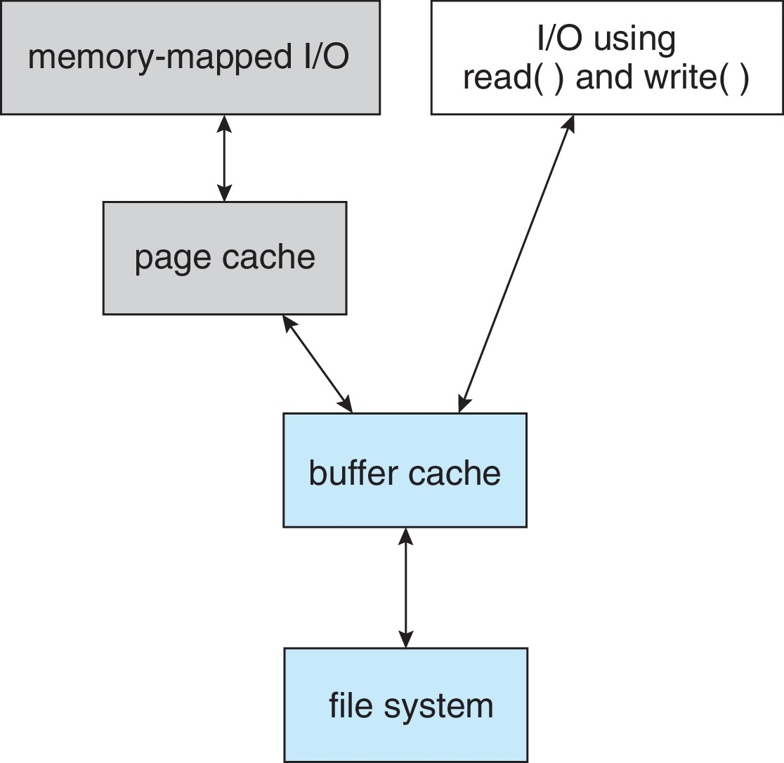
I/O Without a Unified Buffer Cache

Slide 35
Unified Buffer Cache
A unified buffer cache uses the same page cache to cache both memory-mapped pages and ordinary file system I/O to avoid double caching
But which caches get priority, and what replacement algorithms to use?

Slide 36
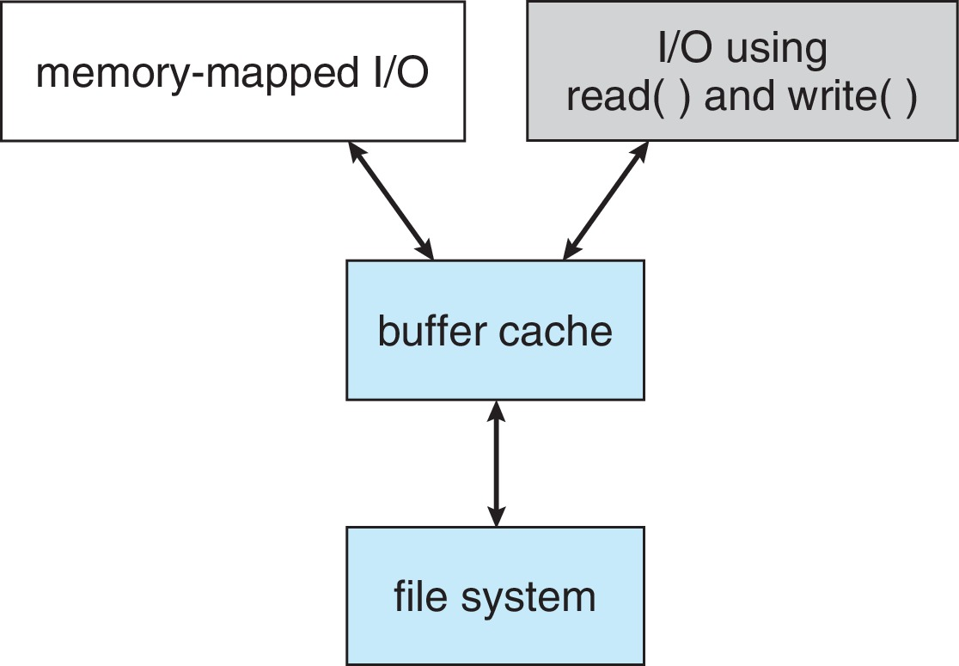
I/O Using a Unified Buffer Cache

Slide 37
Recovery
Consistency checking – compares data in directory structure with data blocks on disk, and tries to fix inconsistencies
Can be slow and sometimes fails
Use system programs to back up data from disk to another storage device (magnetic tape, other magnetic disk, optical)
Full backup, incremental backup
Recover lost file or disk by restoring data from backup

Slide 38
Log Structured File Systems
Log structured (or journaling) file systems record each metadata update to the file system as a transaction
All transactions are written to a log
A transaction is considered committed once it is written to the log (sequentially)
Sometimes to a separate device or section of disk
However, the file system may not yet be updated
The transactions in the log are asynchronously written to the file system structures
When the file system structures are modified, the transaction is removed from the log
If the file system crashes, all remaining transactions in the log must still be performed
Faster recovery from crash, removes chance of inconsistency of metadata

Slide 39
Example: WAFL File System
Used on Network Appliance “Filers” – distributed file system appliances
“Write-anywhere file layout”
Serves up NFS, CIFS, http, ftp
Random I/O optimized, write optimized
NVRAM for write caching
Similar to Berkeley Fast File System, with extensive modifications

Slide 40
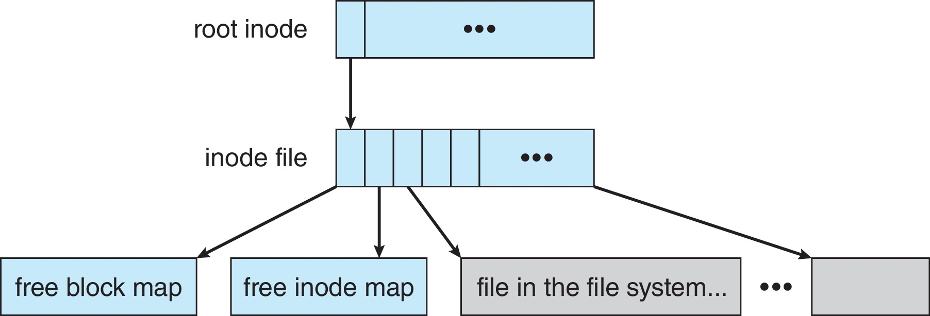
The WAFL File Layout

Slide 41
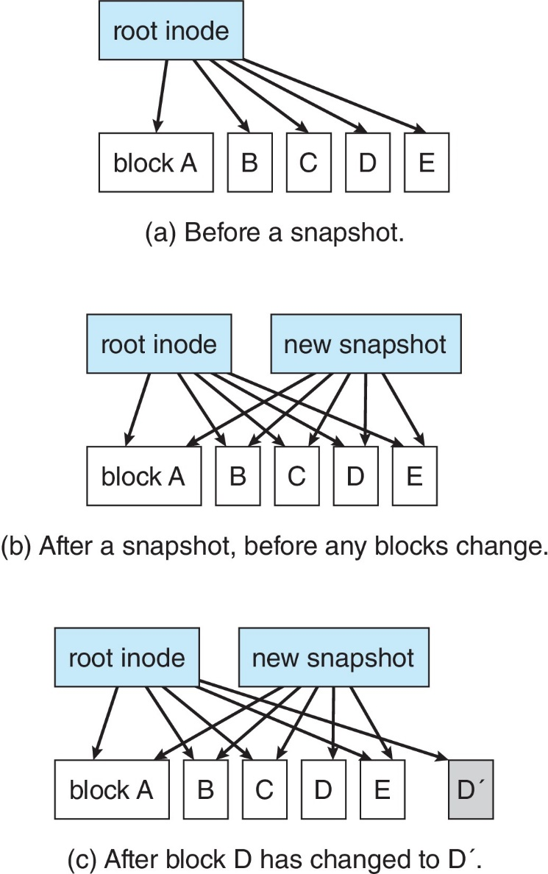
Snapshots in WAFL

Slide 42
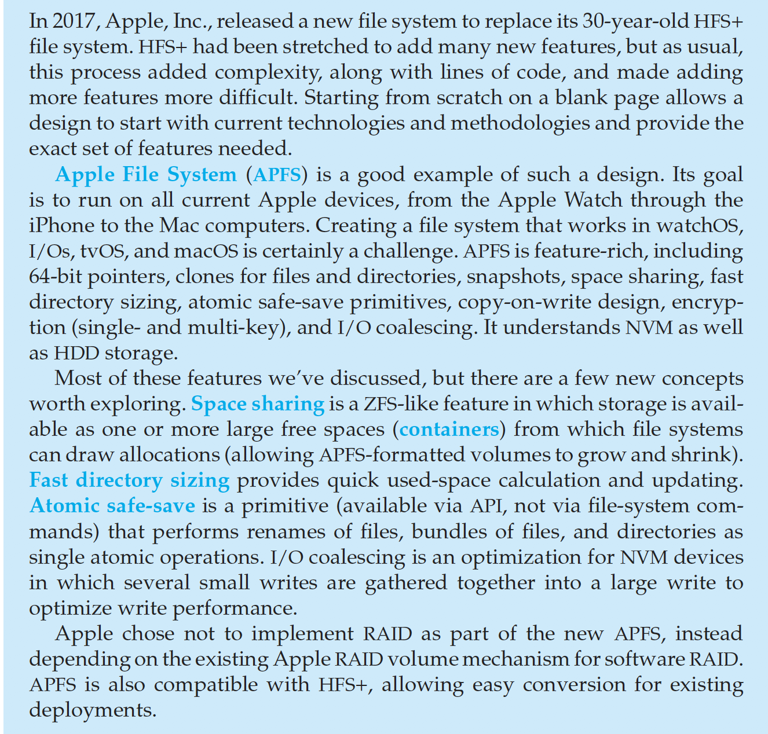
The Apple File System

Slide 43
End of Chapter 14

