Slide 1
Chapter 3: Processes

Slide 2
Outline
Process Concept
Process Scheduling
Operations on Processes
Interprocess Communication
IPC in Shared-Memory Systems
IPC in Message-Passing Systems
Examples of IPC Systems
Communication in Client-Server Systems

Slide 3
Objectives
Identify the separate components of a process and illustrate how they are represented and scheduled in an operating system.
Describe how processes are created and terminated in an operating system, including developing programs using the appropriate system calls that perform these operations.
Describe and contrast interprocess communication using shared memory and message passing.
Design programs that uses pipes and POSIX shared memory to perform interprocess communication.
Describe client-server communication using sockets and remote procedure calls.
Design kernel modules that interact with the Linux operating system.

Slide 4
Process Concept
An operating system executes a variety of programs that run as a process.
Process – a program in execution; process execution must progress in sequential fashion. No parallel execution of instructions of a single process
Multiple parts
The program code, also called text section
Current activity including program counter, processor registers
Stack containing temporary data
Function parameters, return addresses, local variables
Data section containing global variables
Heap containing memory dynamically allocated during run time

Slide 5
Process Concept (Cont.)
Program is passive entity stored on disk (executable file); process is active
Program becomes process when an executable file is loaded into memory
Execution of program started via GUI mouse clicks, command line entry of its name, etc.
One program can be several processes
Consider multiple users executing the same program

Slide 6
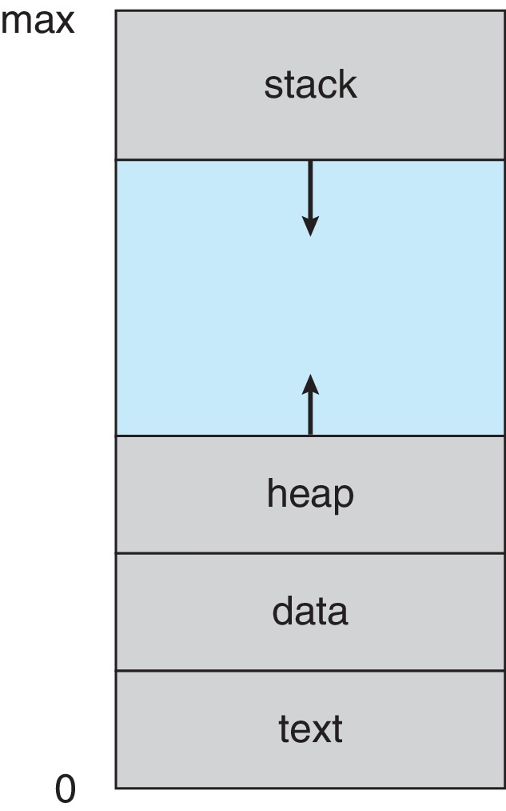
Process in Memory

Slide 7
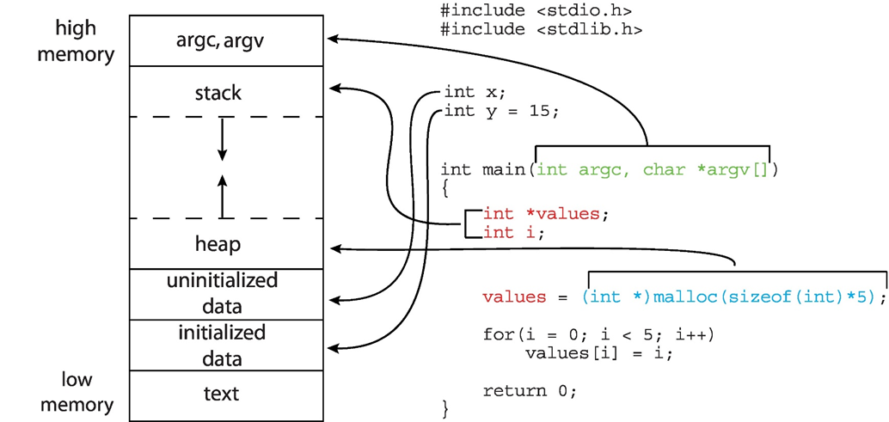
Memory Layout of a C Program

Slide 8
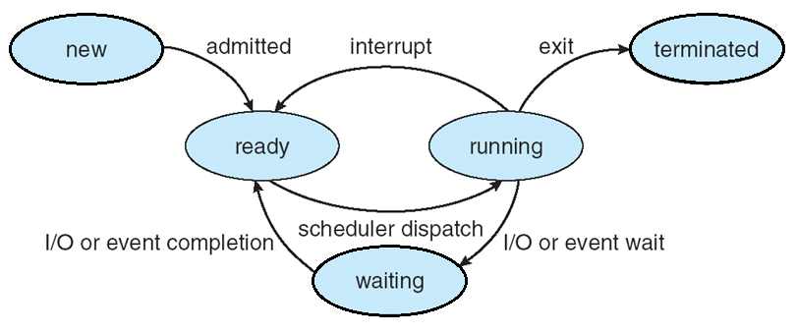
Process State
As a process executes, it changes state
new: The process is being created
running: Instructions are being executed
waiting: The process is waiting for some event to occur
ready: The process is waiting to be assigned to a processor
terminated: The process has finished execution
zombie

Slide 9
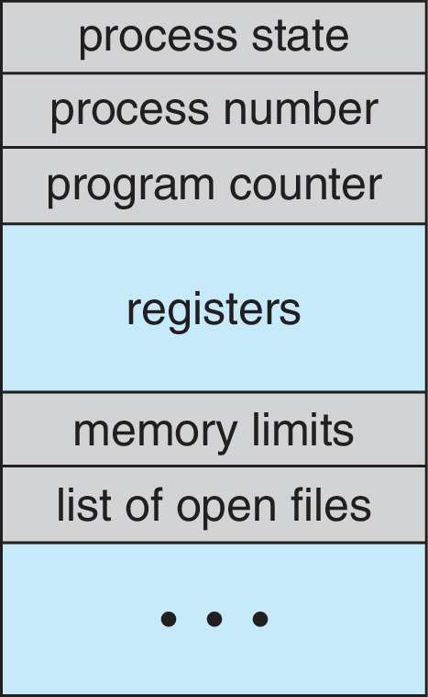
Process Control Block (PCB)
Information associated with each process(also called task control block)
Process state – running, waiting, etc.
Program counter – location of instruction to next execute
CPU registers – contents of all process-centric registers
CPU scheduling information- priorities, scheduling queue pointers
Memory-management information – memory allocated to the process
Accounting information – CPU used, clock time elapsed since start, time limits
I/O status information – I/O devices allocated to process, list of open files

Slide 10
Threads
So far, process has a single thread of execution
Consider having multiple program counters per process
Multiple locations can execute at once
Multiple threads of control -> threads
Must then have storage for thread details, multiple program counters in PCB
Explore in detail in Chapter 4

Slide 11
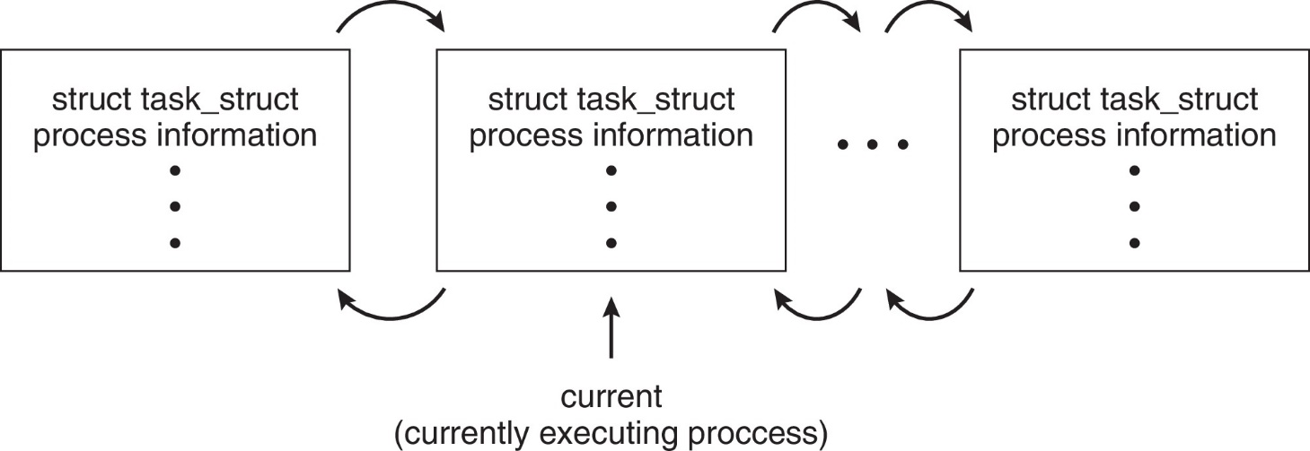
Process Representation in Linux
Represented by the C structure task_struct
pid t_pid; /* process identifier */ long state; /* state of the process */ unsigned int time_slice /* scheduling information */ struct task_struct *parent;/* this process’s parent */ struct list_head children; /* this process’s children */ struct files_struct *files;/* list of open files */ struct mm_struct *mm; /* address space of this process */

Slide 12
Process Scheduling
Process scheduler selects among available processes for next execution on CPU core
Goal -- Maximize CPU use, quickly switch processes onto CPU core
Maintains scheduling queues of processes
Ready queue – set of all processes residing in main memory, ready and waiting to execute
Wait queues – set of processes waiting for an event (i.e., I/O)
Processes migrate among the various queues
Notes:
static const int prio_to_weight[40] =
{ /* -20 */ 88761, 71755, 56483, 46273, 36291,
/* -15 */ 29154, 23254, 18705, 14949, 11916,
/* -10 */ 9548, 7620, 6100, 4904, 3906,
/* -5 */ 3121, 2501, 1991, 1586, 1277,
/* 0 */ 1024, 820, 655, 526, 423,
/* 5 */ 335, 272, 215, 172, 137,
/* 10 */ 110, 87, 70, 56, 45,
/* 15 */ 36, 29, 23, 18, 15, };

Slide 13
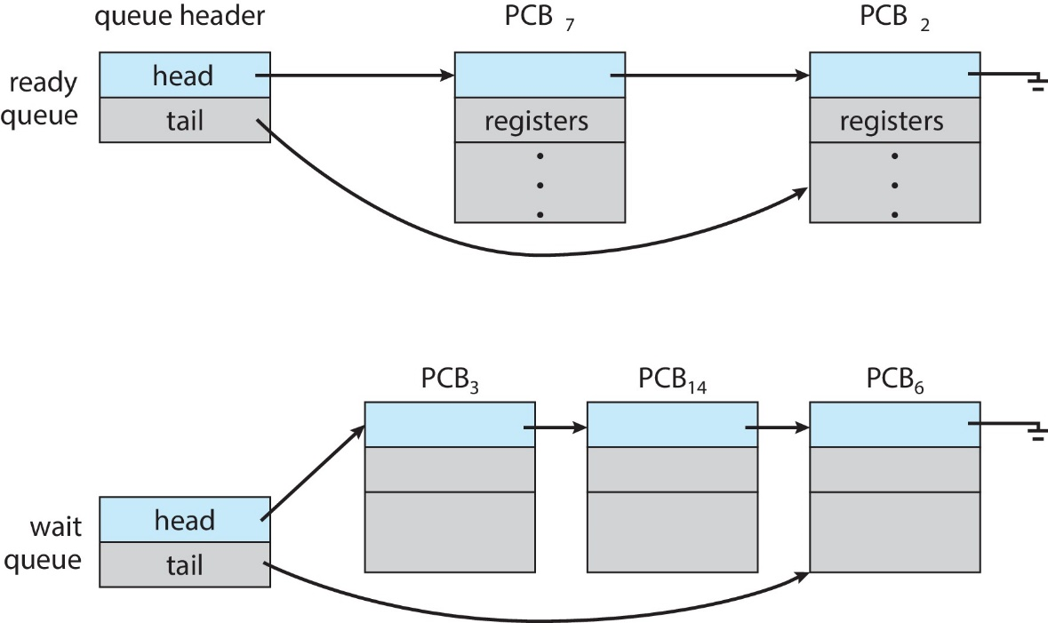
Ready and Wait Queues

Slide 14
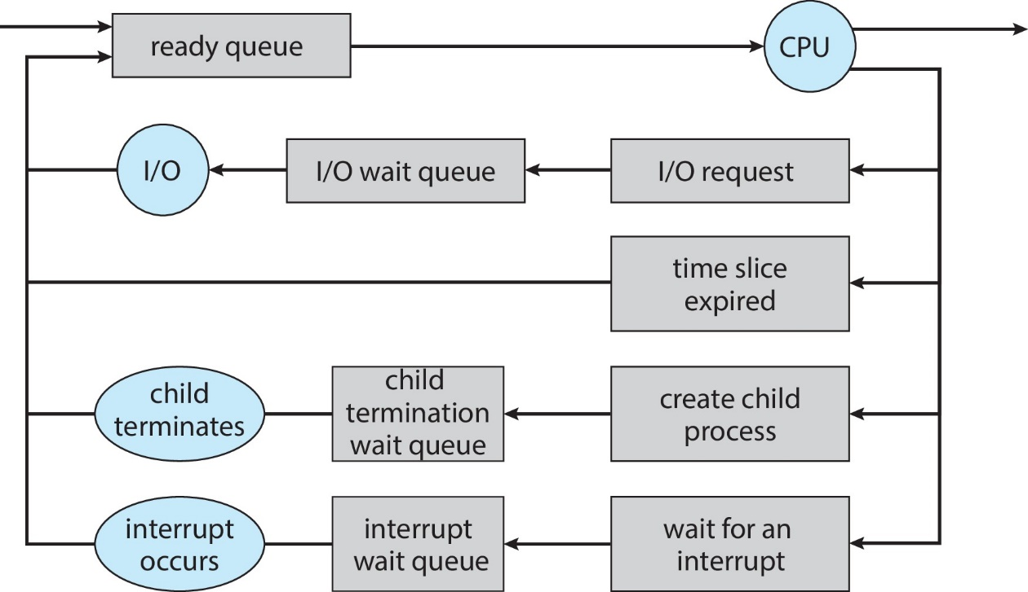
Representation of Process Scheduling

Slide 15
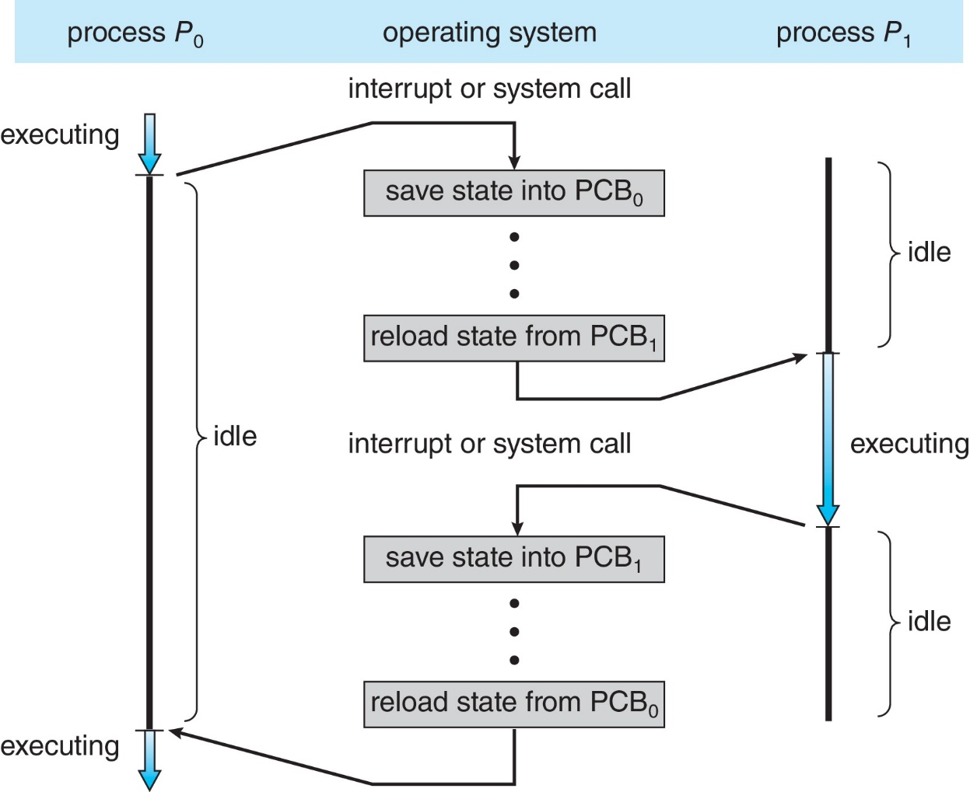
CPU Switch From Process to Process
A context switch occurs when the CPU switches from one process to another.

Slide 16
Context Switch
When CPU switches to another process, the system must save the state of the old process and load the saved state for the new process via a context switch
Context of a process represented in the PCB
Context-switch time is pure overhead; the system does no useful work while switching
The more complex the OS and the PCB ➔ the longer the context switch
Time dependent on hardware support
Some hardware provides multiple sets of registers per CPU ➔ multiple contexts loaded at once

Slide 17
Multitasking in Mobile Systems
Some mobile systems (e.g., early version of iOS) allow only one process to run, others suspended
Due to screen real estate, user interface limits iOS provides for a
Single foreground process- controlled via user interface
Multiple background processes– in memory, running, but not on the display, and with limits
Limits include single, short task, receiving notification of events, specific long-running tasks like audio playback
Android runs foreground and background, with fewer limits
Background process uses a service to perform tasks
Service can keep running even if background process is suspended
Service has no user interface, small memory use

Slide 18
Operations on Processes
System must provide mechanisms for:
Process creation
Process termination

Slide 19
Process Creation
Parent process create children processes, which, in turn create other processes, forming a tree of processes
Generally, process identified and managed via a process identifier (pid)
Resource sharing options
Parent and children share all resources
Children share subset of parent’s resources
Parent and child share no resources
Execution options
Parent and children execute concurrently
Parent waits until children terminate

Slide 20
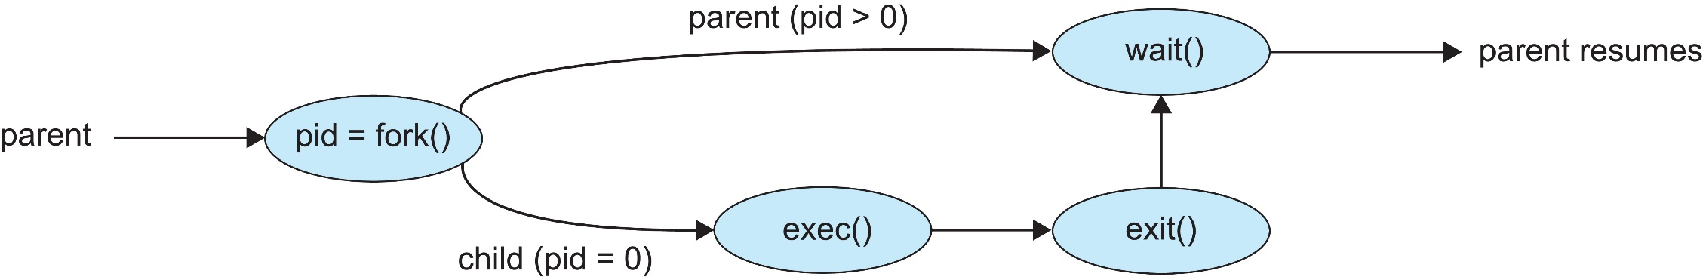
Process Creation (Cont.)
Address space
Child duplicate of parent
Child has a program loaded into it
UNIX examples
fork() system call creates new process
exec() system call used after a fork() to replace the process’ memory space with a new program
Parent process calls wait()waiting for the child to terminate

Slide 21
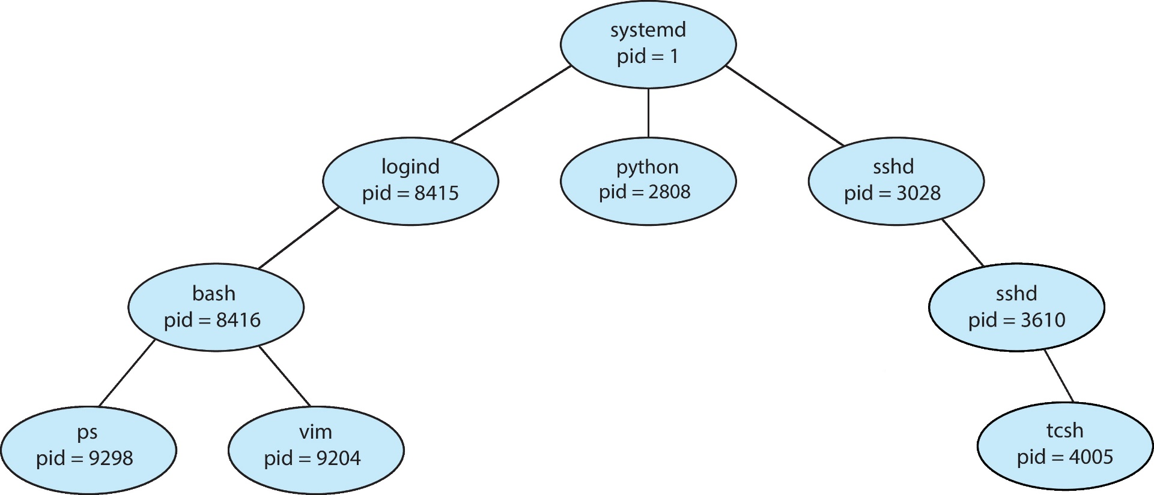
A Tree of Processes in Linux
Notes:
pstree

Slide 22
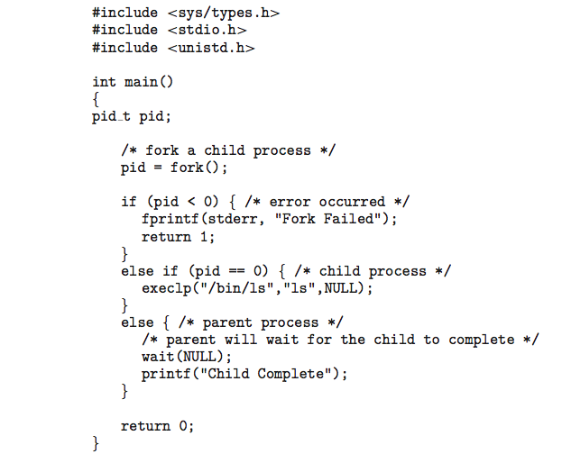
C Program Forking Separate Process

Slide 23
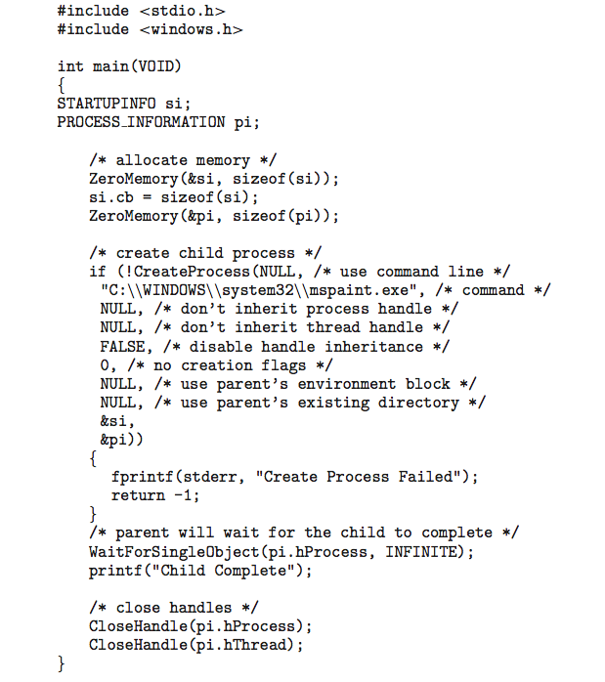
Creating a Separate Process via Windows API

Slide 24
Process Termination
Process executes last statement and then asks the operating system to delete it using the exit() system call.
Returns status data from child to parent (via wait())
Process’ resources are deallocated by operating system
Parent may terminate the execution of children processes using the abort() system call. Some reasons for doing so:
Child has exceeded allocated resources
Task assigned to child is no longer required
The parent is exiting, and the operating systems does not allow a child to continue if its parent terminates

Slide 25
Process Termination
Some operating systems do not allow child to exists if its parent has terminated. If a process terminates, then all its children must also be terminated.
cascading termination. All children, grandchildren, etc., are terminated.
The termination is initiated by the operating system.
The parent process may wait for termination of a child process by using the wait()system call. The call returns status information and the pid of the terminated process
pid = wait(&status);
If no parent waiting (did not invoke wait()) process is a zombie
If parent terminated without invoking wait(), process is an orphan

Slide 26
Android Process Importance Hierarchy
Mobile operating systems often have to terminate processes to reclaim system resources such as memory. From most to least important:
Foreground process
Visible process
Service process
Background process
Empty process
Android will begin terminating processes that are least important.

Slide 27

Multiprocess Architecture – Chrome Browser
Many web browsers ran as single process (some still do)
If one web site causes trouble, entire browser can hang or crash
Google Chrome Browser is multiprocess with 3 different types of processes:
Browser process manages user interface, disk and network I/O
Renderer process renders web pages, deals with HTML, Javascript. A new renderer created for each website opened
Runs in sandbox restricting disk and network I/O, minimizing effect of security exploits
Plug-in process for each type of plug-in

Slide 28
Interprocess Communication
Processes within a system may be independent or cooperating
Cooperating process can affect or be affected by other processes, including sharing data
Reasons for cooperating processes:
Information sharing
Computation speedup
Modularity
Convenience
Cooperating processes need interprocess communication (IPC)
Two models of IPC
Shared memory
Message passing
Notes:
Independent process cannot affect or be affected by the execution of another process
Cooperating process can affect or be affected by the execution of another process

Slide 29
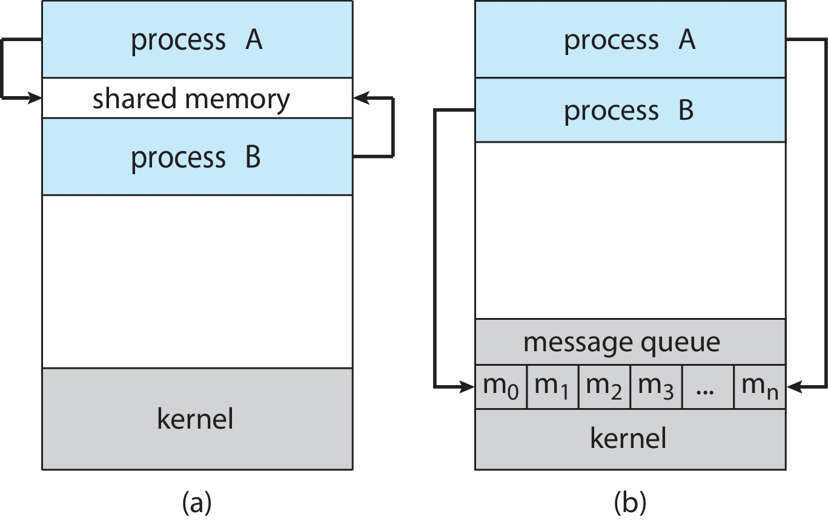
Communications Models
(a) Shared memory. (b) Message passing.

Slide 30
Producer-Consumer Problem
Paradigm for cooperating processes:
producer process produces information that is consumed by a consumer process
Two variations:
unbounded-buffer places no practical limit on the size of the buffer:
Producer never waits
Consumer waits if there is no buffer to consume
bounded-buffer assumes that there is a fixed buffer size
Producer must wait if all buffers are full
Consumer waits if there is no buffer to consume

Slide 31
IPC – Shared Memory
An area of memory shared among the processes that wish to communicate
The communication is under the control of the users processes not the operating system.
Major issues is to provide mechanism that will allow the user processes to synchronize their actions when they access shared memory.
Synchronization is discussed in great details in Chapters 6 & 7.

Slide 32
Bounded-Buffer – Shared-Memory Solution
Shared data
#define BUFFER_SIZE 10
typedef struct {
. . .
} item;
item buffer[BUFFER_SIZE];
int in = 0;
int out = 0;
Solution is correct, but can only use BUFFER_SIZE-1 elements

Slide 33
Producer Process – Shared Memory
item next_produced;
while (true) {
/* produce an item in next produced */
while (((in + 1) % BUFFER_SIZE) == out)
; /* do nothing */
buffer[in] = next_produced;
in = (in + 1) % BUFFER_SIZE;
}

Slide 34
Consumer Process – Shared Memory
item next_consumed;
while (true) { while (in == out)
; /* do nothing */ next_consumed = buffer[out];
out = (out + 1) % BUFFER_SIZE;
/* consume the item in next consumed */
}

Slide 35
What about Filling all the Buffers?
Suppose that we wanted to provide a solution to the consumer-producer problem that fills all the buffers.
We can do so by having an integer counter that keeps track of the number of full buffers.
Initially, counter is set to 0.
The integer counter is incremented by the producer after it produces a new buffer.
The integer counter is and is decremented by the consumer after it consumes a buffer.
Why bothers to fill all?

Slide 36
Producer
Consumer
item next_produced;
while (true) {
/* produce an item in next produced */
while (((in + 1) % BUFFER_SIZE) == out)
; /* do nothing */
buffer[in] = next_produced;
in = (in + 1) % BUFFER_SIZE;
}
item next_consumed;
while (true) { while (in == out)
; /* do nothing */ next_consumed = buffer[out];
out = (out + 1) % BUFFER_SIZE;
/* consume the item in next consumed */
}

Slide 37
Race Condition
counter++ could be implemented as register1 = counter register1 = register1 + 1 counter = register1
counter-- could be implemented as register2 = counter register2 = register2 - 1 counter = register2
Consider this execution interleaving with “count = 5” initially:
S0: producer execute register1 = counter {register1 = 5} S1: producer execute register1 = register1 + 1 {register1 = 6} S2: consumer execute register2 = counter {register2 = 5} S3: consumer execute register2 = register2 – 1 {register2 = 4} S4: producer execute counter = register1 {counter = 6 } S5: consumer execute counter = register2 {counter = 4}
Notes:
C(6,3)種

Slide 38
Race Condition (Cont.)
Question – why was there no race condition in the first solution (where at most N – 1) buffers can be filled?
More in Chapter 6.

Slide 39
IPC – Message Passing
Processes communicate with each other without resorting to shared variables
IPC facility provides two operations:
send(message)
receive(message)
The message size is either fixed or variable

Slide 40
Message Passing (Cont.)
If processes P and Q wish to communicate, they need to:
Establish a communication link between them
Exchange messages via send/receive
Implementation issues:
How are links established?
Can a link be associated with more than two processes?
How many links can there be between every pair of communicating processes?
What is the capacity of a link?
Is the size of a message that the link can accommodate fixed or variable?
Is a link unidirectional or bi-directional?

Slide 41
Implementation of Communication Link
Physical:
Shared memory
Hardware bus
Network
Logical:
Direct or indirect
Synchronous or asynchronous
Automatic or explicit buffering

Slide 42
Direct Communication
Processes must name each other explicitly:
send (P, message) – send a message to process P
receive(Q, message) – receive a message from process Q
Properties of communication link
Links are established automatically
A link is associated with exactly one pair of communicating processes
Between each pair there exists exactly one link
The link may be unidirectional, but is usually bi-directional

Slide 43
Indirect Communication
Messages are directed and received from mailboxes (also referred to as ports)
Each mailbox has a unique id
Processes can communicate only if they share a mailbox
Properties of communication link
Link established only if processes share a common mailbox
A link may be associated with many processes
Each pair of processes may share several communication links
Link may be unidirectional or bi-directional

Slide 44
Indirect Communication (Cont.)
Operations
Create a new mailbox (port)
Send and receive messages through mailbox
Delete a mailbox
Primitives are defined as:
send(A, message) – send a message to mailbox A
receive(A, message) – receive a message from mailbox A

Slide 45
Indirect Communication (Cont.)
Mailbox sharing
P₁, P₂, and P₃ share mailbox A
P₁, sends; P₂ and P₃ receive
Who gets the message?
Solutions
Allow a link to be associated with at most two processes
Allow only one process at a time to execute a receive operation
Allow the system to select arbitrarily the receiver. Sender is notified who the receiver was.

Slide 46
Synchronization
Message passing may be either blocking or non-blocking
Blocking is considered synchronous
Blocking send -- the sender is blocked until the message is received
Blocking receive -- the receiver is blocked until a message is available
Non-blocking is considered asynchronous
Non-blocking send -- the sender sends the message and continue
Non-blocking receive -- the receiver receives:
A valid message, or
Null message
Different combinations possible
If both send and receive are blocking, we have a rendezvous

Slide 47
Producer-Consumer: Message Passing
Producer
message next_produced; while (true) { /* produce an item in next_produced */
send(next_produced);
}
Consumer
message next_consumed; while (true) { receive(next_consumed) /* consume the item in next_consumed */ }

Slide 48
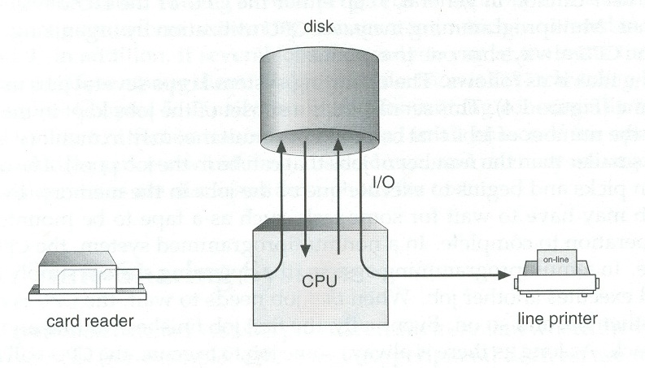
Buffering
Queue of messages attached to the link.
Implemented in one of three ways
1. Zero capacity – no messages are queued on a link. Sender must wait for receiver (rendezvous)
2. Bounded capacity – finite length of n messages Sender must wait if link full
3. Unbounded capacity – infinite length Sender never waits

Slide 49
Examples of IPC Systems - POSIX
POSIX Shared Memory
Process first creates shared memory segment shm_fd = shm_open(name, O CREAT | O RDWR, 0666);
Also used to open an existing segment
Set the size of the object
ftruncate(shm_fd, 4096);
Use mmap() to memory-map a file pointer to the shared memory object
Reading and writing to shared memory is done by using the pointer returned by mmap().

Slide 50
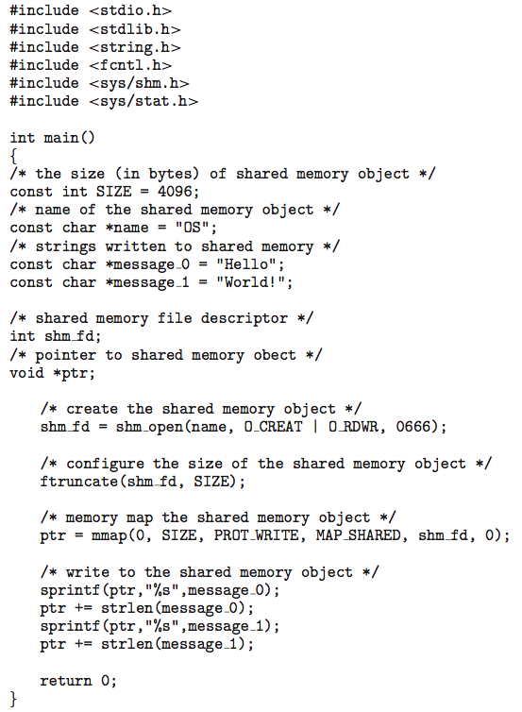
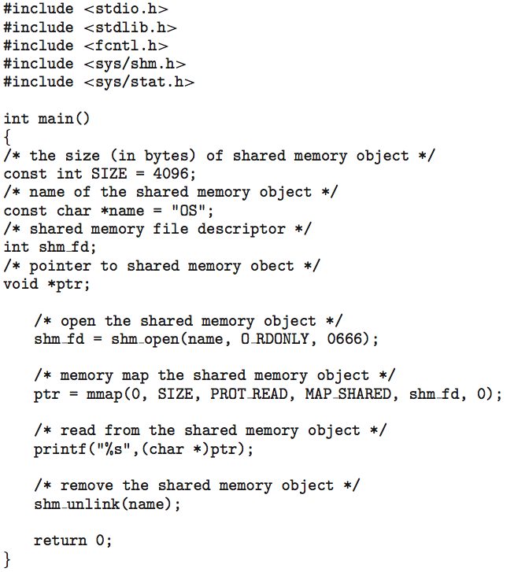
IPC POSIX Producer
IPC POSIX Consumer

Slide 51
Examples of IPC Systems - Mach
Mach communication is message based
Even system calls are messages
Each task gets two ports at creation - Kernel and Notify
Messages are sent and received using the mach_msg() function
Ports needed for communication, created via
mach_port_allocate()
Send and receive are flexible; for example four options if mailbox full:
Wait indefinitely
Wait at most n milliseconds
Return immediately
Temporarily cache a message

Slide 52
Mach Messages
#include<mach/mach.h>
struct message { mach_msg_header_t header;
int data;
}; mach port t client;
mach port t server;

Slide 53
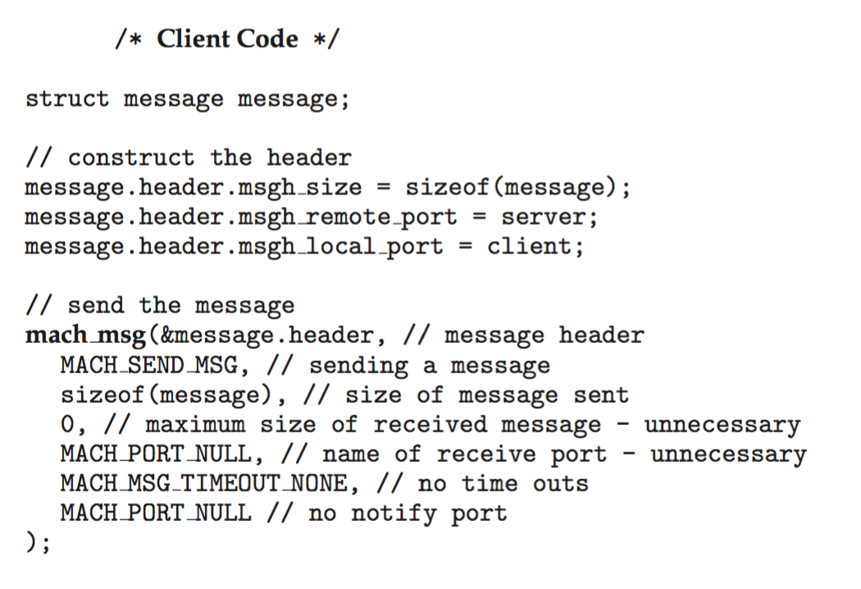
Mach Message Passing - Client

Slide 54
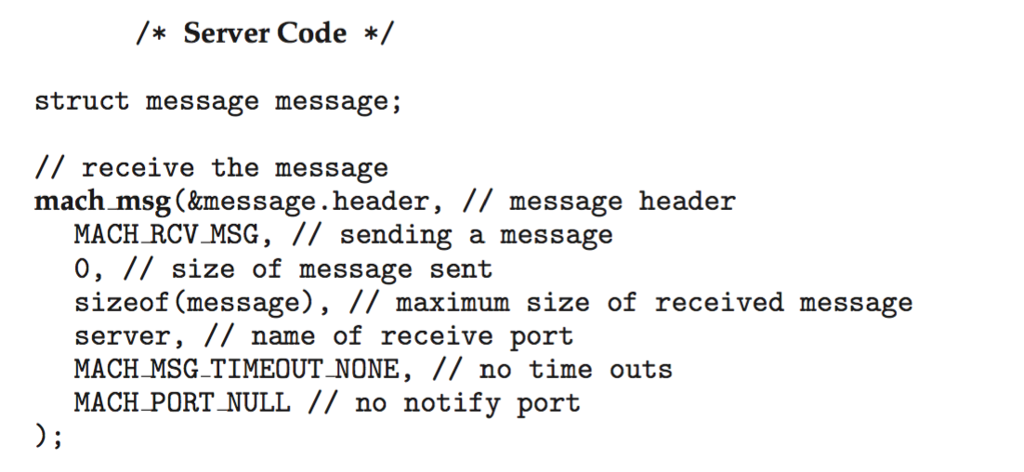
Mach Message Passing - Server

Slide 55
Examples of IPC Systems – Windows
Message-passing centric via advanced local procedure call (LPC) facility
Only works between processes on the same system
Uses ports (like mailboxes) to establish and maintain communication channels
Communication works as follows:
The client opens a handle to the subsystem’s connection port object.
The client sends a connection request.
The server creates two private communication ports and returns the handle to one of them to the client.
The client and server use the corresponding port handle to send messages or callbacks and to listen for replies.

Slide 56
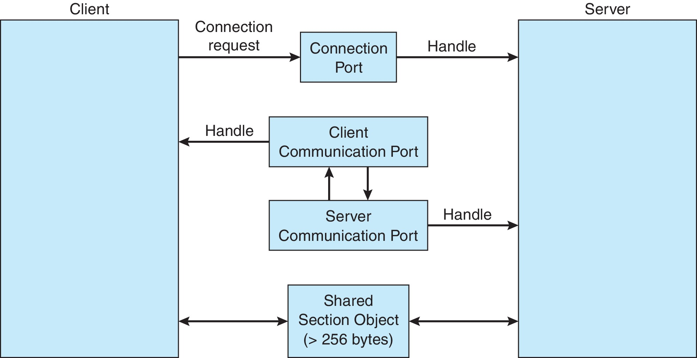
Local Procedure Calls in Windows

Slide 57
Pipes
Acts as a conduit allowing two processes to communicate
Issues:
Is communication unidirectional or bidirectional?
In the case of two-way communication, is it half or full-duplex?
Must there exist a relationship (i.e., parent-child) between the communicating processes?
Can the pipes be used over a network?
Ordinary pipes – cannot be accessed from outside the process that created it. Typically, a parent process creates a pipe and uses it to communicate with a child process that it created.
Named pipes – can be accessed without a parent-child relationship.

Slide 58
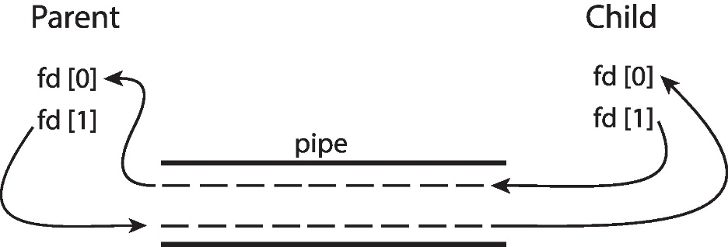
Ordinary Pipes
Ordinary Pipes allow communication in standard producer-consumer style
Producer writes to one end (the write-end of the pipe)
Consumer reads from the other end (the read-end of the pipe)
Ordinary pipes are therefore unidirectional
Require parent-child relationship between communicating processes
Windows calls these anonymous pipes

Slide 59
Named Pipes
Named Pipes are more powerful than ordinary pipes
Communication is bidirectional
No parent-child relationship is necessary between the communicating processes
Several processes can use the named pipe for communication
Provided on both UNIX and Windows systems

Slide 60
Communications in Client-Server Systems
Sockets
Remote Procedure Calls

Slide 61
Sockets
A socket is defined as an endpoint for communication
Concatenation of IP address and port – a number included at start of message packet to differentiate network services on a host
The socket 161.25.19.8:1625 refers to port 1625 on host 161.25.19.8
Communication consists between a pair of sockets
All ports below 1024 are well known, used for standard services
Special IP address 127.0.0.1 (loopback) to refer to system on which process is running

Slide 62
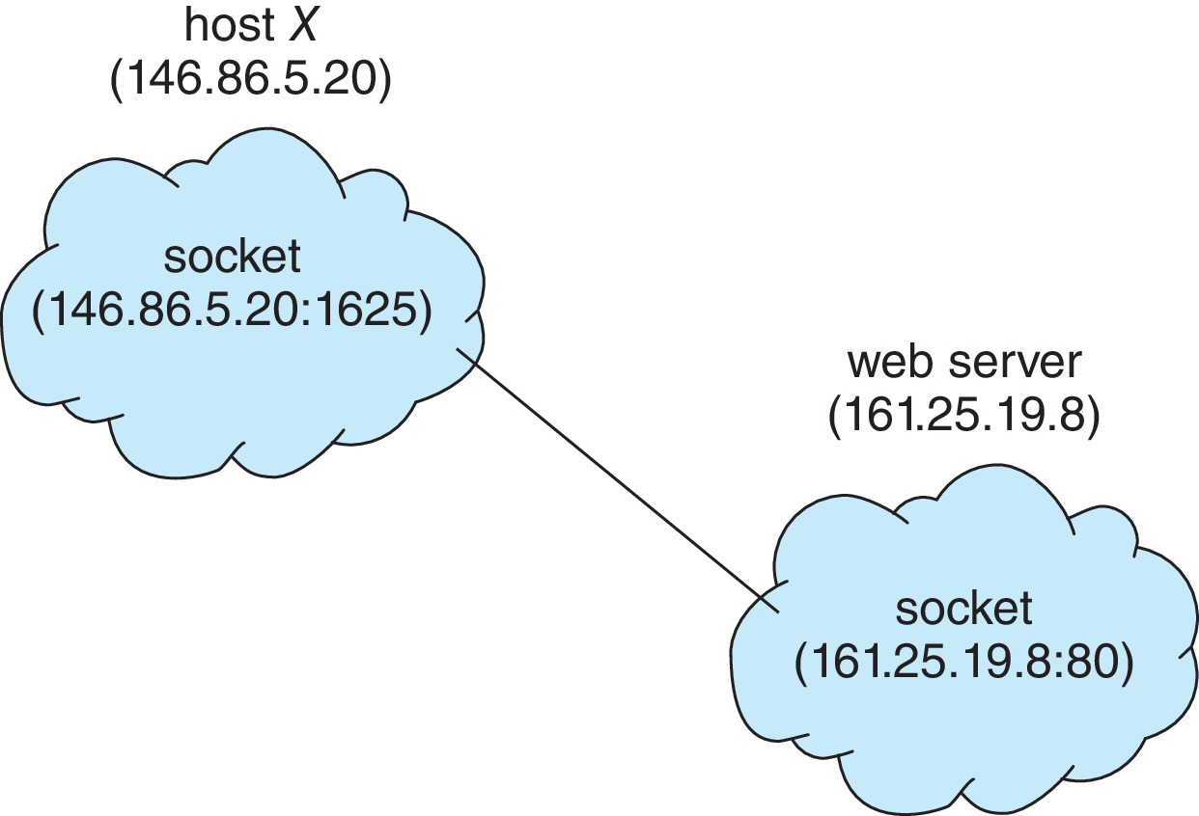
Socket Communication

Slide 63
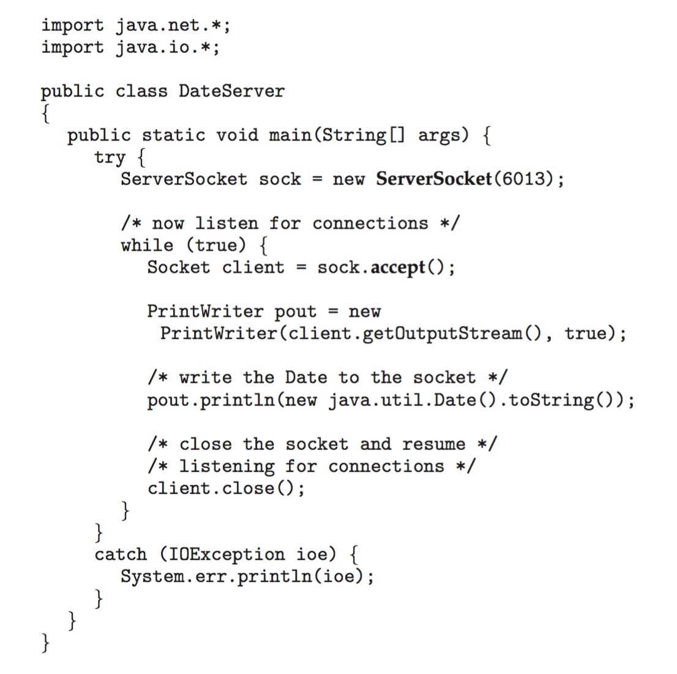
Sockets in Java
Three types of sockets
Connection-oriented (TCP)
Connectionless (UDP)
MulticastSocket class– data can be sent to multiple recipients
Consider this “Date” server in Java:

Slide 64
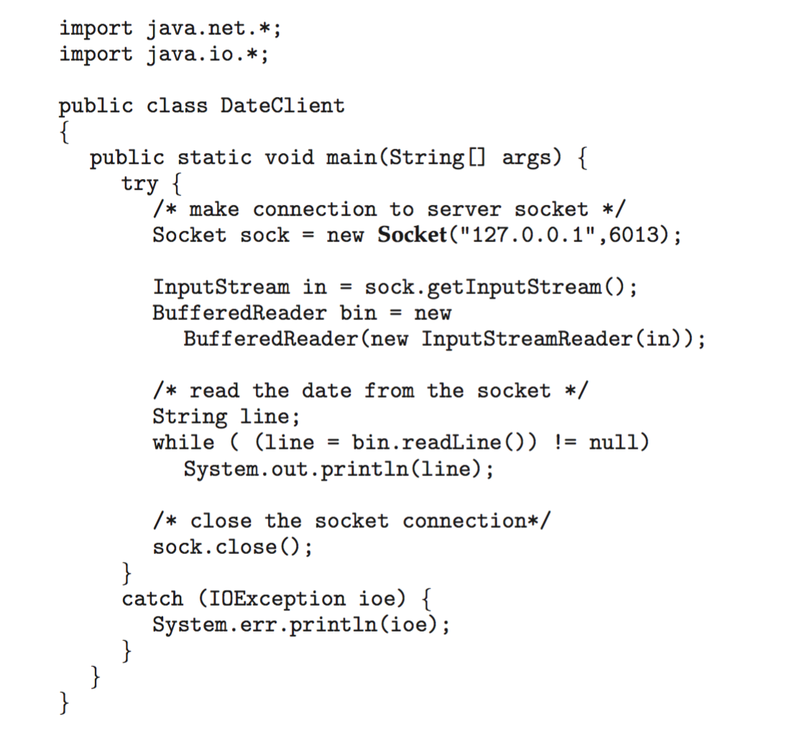
Sockets in Java
The equivalent Date client

Slide 65
Remote Procedure Calls
Remote procedure call (RPC) abstracts procedure calls between processes on networked systems
Again uses ports for service differentiation
Stubs – client-side proxy for the actual procedure on the server
The client-side stub locates the server and marshalls the parameters
The server-side stub receives this message, unpacks the marshalled parameters, and performs the procedure on the server
On Windows, stub code compile from specification written in Microsoft Interface Definition Language (MIDL)

Slide 66
Remote Procedure Calls (Cont.)
Data representation handled via External Data Representation (XDL) format to account for different architectures
Big-endian and little-endian
Remote communication has more failure scenarios than local
Messages can be delivered exactly once rather than at most once
OS typically provides a rendezvous (or matchmaker) service to connect client and server

Slide 67
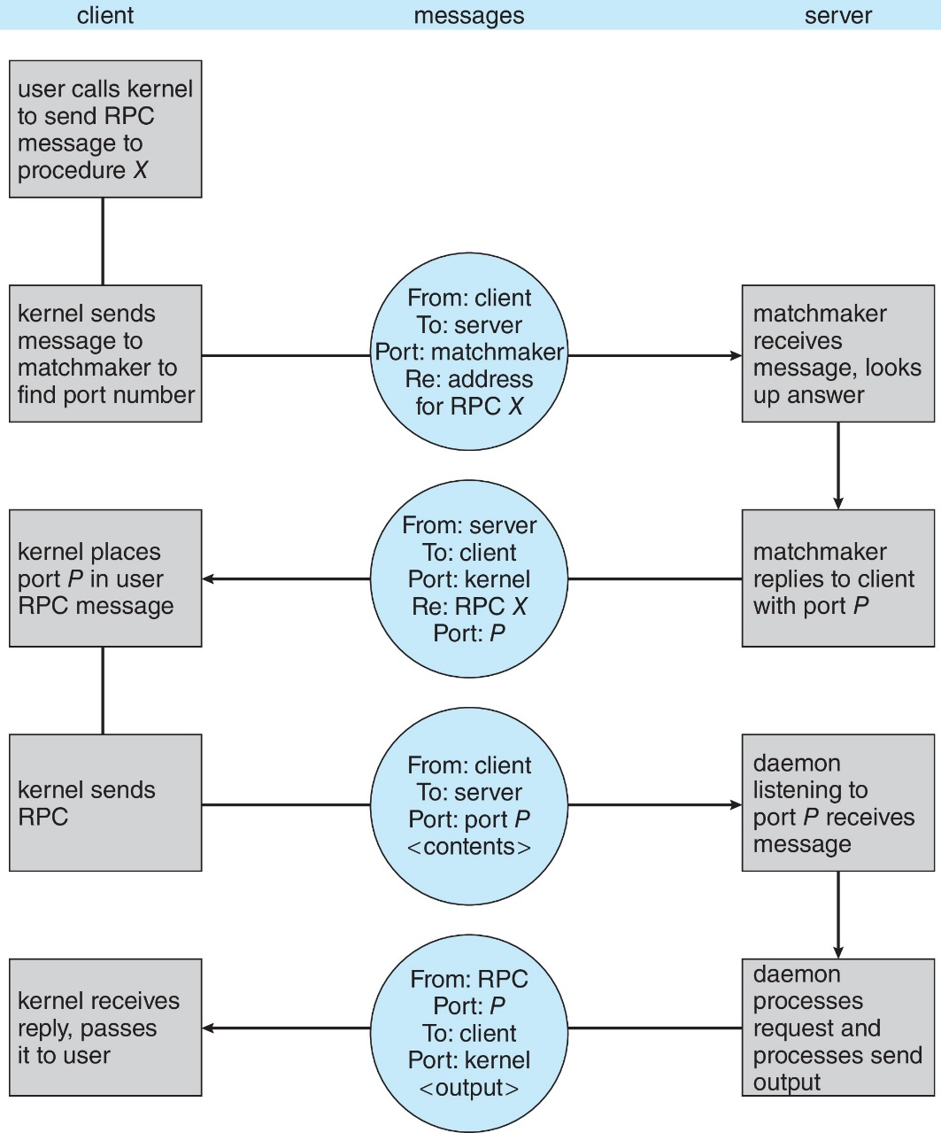
Execution of RPC

Slide 68
End of Chapter 3

