Slide 1
Chapter 7: Synchronization Examples

Slide 2
Outline
Explain the bounded-buffer synchronization problem
Explain the readers-writers synchronization problem
Explain and dining-philosophers synchronization problems
Describe the tools used by Linux and Windows to solve synchronization problems.
Illustrate how POSIX and Java can be used to solve process synchronization problems

Slide 3
二元號誌 (1/2) - binary semaphore
二元號誌的值只限定為 0 或 1。
利用硬體對二元數值的運算支援，二元號誌的實作要比計數號誌簡單快速得多。
可以利用二元號誌來實作計數號誌。
turn, flag, turn+flag
test&set, compare&swap, swap
mutex lock, semaphore
critical region
monitor

Slide 4
二元號誌 (2/2)
計數號誌可以利用兩個二元號誌以及一個整數實作。
void wait(S) {
wait(S1);
C--;
if (C < 0) {
signal(S1);
wait(S2);
}
signal(S1);
}
void signal(S) {
wait( S1);
C++;
if (C <= 0)
signal(S2);
else
signal(S1);
}

Slide 5
臨界區域 (1/4) - critical region
臨界區域的使用非常方便。
以下宣告一個具有共享變數 v 的臨界區域，在 B 條件式成立下，如果沒有其他行程在此臨界區域中執行，就會執行 S 敘述：
利用臨界區域來實作，程式設計師不用煩惱同步的問題，只要正確地把問題描述在臨界區域內。
有限緩衝區問題可以用臨界區域來簡單地解決同步的問題。
region v when B do S;

Slide 6
臨界區域 (2/4)
生產者與消耗者程式可以分別以臨界區域實作如下。
生 產 者
消 耗 者
region buffer when (count < n) {
pool[in] = nextp;
in = (in + 1) % n;
count++;
}
region buffer when (count > 0) {
nextc = pool[out];
out = (out + 1) % n;
count--;
}

Slide 7
臨界區域 (3/4)
臨界區域 region v when B do S 可利用 mutex、first_delay 及 second_delay 三個號誌實作。
mutex 號誌是用來確保臨界區的互斥條件成立。
如果行程因為 B 為 FALSE 而無法進入臨界區，該行程將會在號誌 first_delay 等待。
在號誌 first_delay 等待的行程重新檢查 B 值之前，會離開號誌 first_delay，而在號誌 second_delay 等待。
分成first_delay 與 second_delay兩段式等待的原因，是為了要避免行程持續忙碌地檢查 B 值。
當一個行程離開了臨界區之後，可能因為執行了敘述 S 而改變了 B 的值，所以需要重新檢查。

Slide 8
臨界區域 (4/4)
wait(mutex);
while (!B) {
first_count++;
if (second_count > 0)
signal(second_delay);
else
signal(mutex);
wait(first_delay);
first_count--;
second_count++;
if (first_count > 0)
signal(first_delay);
else
signal(second_delay);
wait(second_delay);
second_count--;
}
S;
if (first_count > 0)
signal(first_delay);
else if (second_count > 0)
signal(second_delay);
else
signal(mutex);
wait(mutex);
while (!B) {
first_count++;
if (first_count > 0)
signal(first_delay);
else
signal(mutex);
wait(first_delay);
first_count--;
first_count++;
if (first_count > 0)
signal(first_delay);
else
signal(first_delay);
wait(first_delay);
first_count--;
}
S;
if (first_count > 0)
signal(first_delay);
else if (first_count > 0)
signal(first_delay);
else
signal(mutex);
wait(mutex);
while (!B) {
first_count++;
if (first_count > 0)
signal(first_delay);
else
signal(mutex);
wait(first_delay);
first_count--;
}
S;
if (first_count > 0)
signal(first_delay);
else
signal(mutex);
wait(mutex);
while (!B) {
first_count++;
signal(mutex);
wait(first_delay);
first_count--;
}
S;
if (first_count > 0)
signal(first_delay);
else
signal(mutex);

Slide 9
Classical Problems of Synchronization
Classical problems used to test newly-proposed synchronization schemes
Bounded-Buffer Problem
Readers and Writers Problem
Dining-Philosophers Problem

Slide 10
Bounded-Buffer Problem
N buffers, each can hold one item
Semaphore mutex initialized to the value 1
Semaphore full initialized to the value 0
Semaphore empty initialized to the value N.

Slide 11
Bounded Buffer Problem (Cont.)
producer process
do {
// produce an item
wait (empty);
wait (mutex);
// add the item to the buffer
signal (mutex);
signal (full);
} while (TRUE);
consumer process
do {
wait (full);
wait (mutex);
// remove an item from buffer
signal (mutex);
signal (empty);
// consume the item
} while (TRUE);
Notes:
Where are the critical sections?

Slide 12
Readers-Writers Problem
A data set is shared among a number of concurrent processes
Readers – only read the data set; they do not perform any updates
Writers – can both read and write
Problem – allow multiple readers to read at the same time
Only one single writer can access the shared data at the same time
Several variations of how readers and writers are considered – all involve some form of priorities
Shared Data
Data set
Semaphore rw_mutex initialized to 1
Semaphore mutex initialized to 1
Integer read_count initialized to 0

Slide 13
Readers-Writers Problem (Cont.)
The structure of a writer process
while (true) { wait(rw_mutex);
... /* writing is performed */
...
signal(rw_mutex);
}

Slide 14
Readers-Writers Problem (Cont.)
The structure of a reader process
while (true){ wait(mutex); read_count++; if (read_count == 1) /* first reader */
wait(rw_mutex);
signal(mutex);
... /* reading is performed */
...
wait(mutex); read count--; if (read_count == 0) /* last reader */
signal(rw_mutex);
signal(mutex);
}

Slide 15
Readers-Writers Problem Variations
The solution in previous slide can result in a situation where a writer process never writes. It is referred to as the “First reader-writer” problem.
The “Second reader-writer” problem is a variation the first reader-writer problem that state:
Once a writer is ready to write, no “newly arrived reader” is allowed to read.
Both the first and second may result in starvation, leading to even more variations
Problem is solved on some systems by kernel providing reader-writer locks

Slide 16

Dining-Philosophers Problem
N philosophers’ sit at a round table with a bowel of rice in the middle.
They spend their lives alternating thinking and eating.
They do not interact with their neighbors.
Occasionally try to pick up 2 chopsticks (one at a time) to eat from bowl
Need both to eat, then release both when done
In the case of 5 philosophers, the shared data
Bowl of rice (data set)
Semaphore chopstick [5] initialized to 1

Slide 17
Dining-Philosophers Problem Algorithm
Semaphore Solution
The structure of Philosopher i :
while (true){
wait (chopstick[i] );
wait (chopStick[ (i + 1) % 5] );
/* eat for a while */
signal (chopstick[i] );
signal (chopstick[ (i + 1) % 5] );
/* think for a while */
}
What is the problem with this algorithm?

Slide 18
Monitor Solution to Dining Philosophers
monitor DiningPhilosophers
{
enum { THINKING; HUNGRY, EATING) state [5] ;
condition self [5];
void pickup (int i) {
state[i] = HUNGRY;
test(i);
if (state[i] != EATING) self[i].wait;
}
void putdown (int i) {
state[i] = THINKING;
// test left and right neighbors
test((i + 4) % 5);
test((i + 1) % 5);
}

Slide 19
Solution to Dining Philosophers (Cont.)
void test (int i) {
if ((state[(i + 4) % 5] != EATING) &&
(state[i] == HUNGRY) &&
(state[(i + 1) % 5] != EATING) ) {
state[i] = EATING ;
self[i].signal () ;
}
}
initialization_code() {
for (int i = 0; i < 5; i++)
state[i] = THINKING;
}
}

Slide 20
Solution to Dining Philosophers (Cont.)
Each philosopher “i” invokes the operations pickup() and putdown() in the following sequence:
DiningPhilosophers.pickup(i);
/** EAT **/
DiningPhilosophers.putdown(i);
No deadlock, but starvation is possible

Slide 21
Kernel Synchronization - Windows
Uses interrupt masks to protect access to global resources on uniprocessor systems
Uses spinlocks on multiprocessor systems
Spinlocking-thread will never be preempted
Also provides dispatcher objects user-land which may act mutexes, semaphores, events, and timers
Events
An event acts much like a condition variable
Timers notify one or more thread when time expired
Dispatcher objects either signaled-state (object available) or non-signaled state (thread will block)

Slide 22
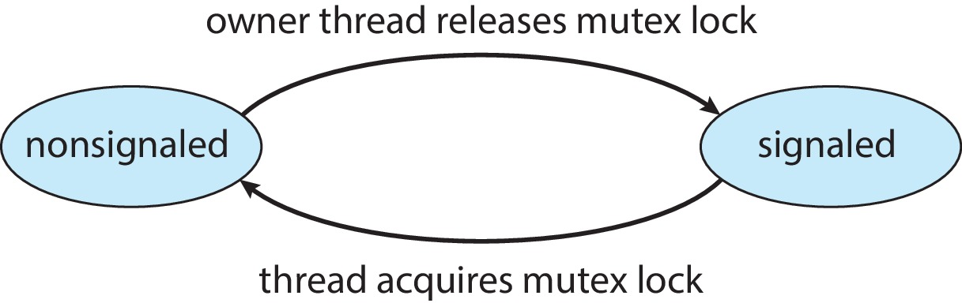
Kernel Synchronization - Windows
Mutex dispatcher object

Slide 23
Linux Synchronization
Linux:
Prior to kernel Version 2.6, disables interrupts to implement short critical sections
Version 2.6 and later, fully preemptive
Linux provides:
Semaphores
Atomic integers
Spinlocks
Reader-writer versions of both
On single-CPU system, spinlocks replaced by enabling and disabling kernel preemption

Slide 24
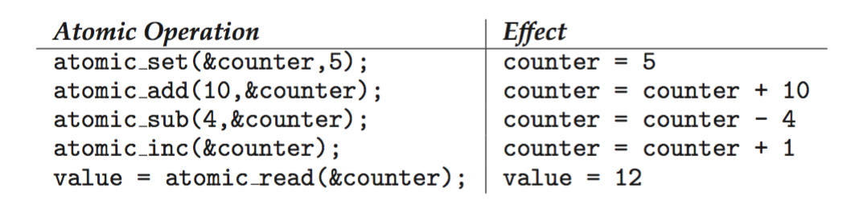
Linux Synchronization
Atomic variables atomic_t is the type for atomic integer
Consider the variables atomic_t counter; int value;

Slide 25
POSIX Synchronization
POSIX API provides
mutex locks
semaphores
condition variable
Widely used on UNIX, Linux, and macOS

Slide 26
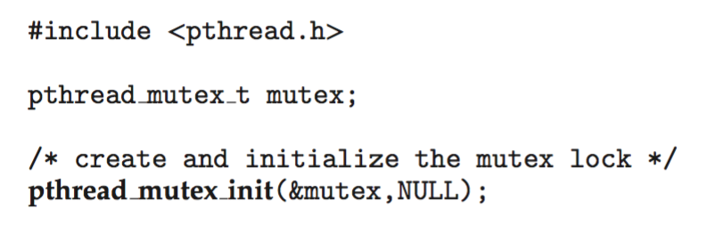
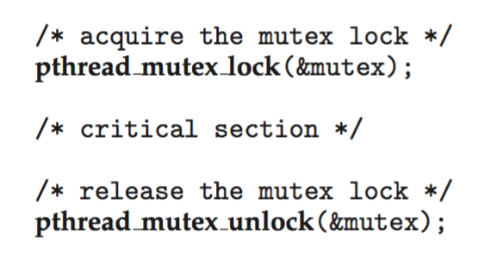
POSIX Mutex Locks
Creating and initializing the lock
Acquiring and releasing the lock

Slide 27
POSIX Semaphores
POSIX provides two versions – named and unnamed.
Named semaphores can be used by unrelated processes, unnamed cannot.

Slide 28
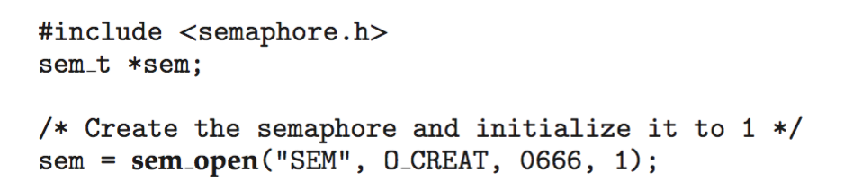
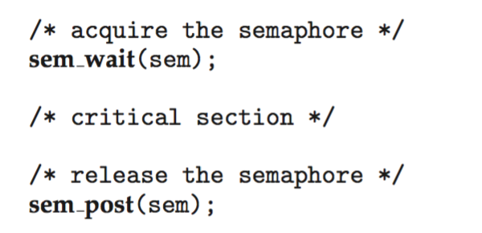
POSIX Named Semaphores
Creating and initializing the semaphore:
Another process can access the semaphore by referring to its name SEM.
Acquiring and releasing the semaphore:

Slide 29
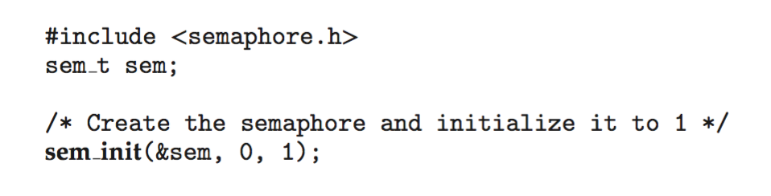
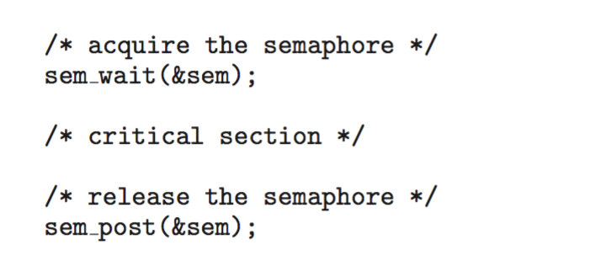
POSIX Unnamed Semaphores
Creating and initializing the semaphore:
Acquiring and releasing the semaphore:

Slide 30
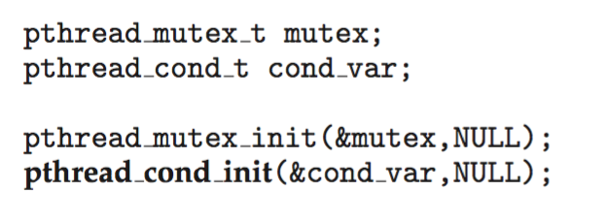
POSIX Condition Variables
Since POSIX is typically used in C/C++ and these languages do not provide a monitor, POSIX condition variables are associated with a POSIX mutex lock to provide mutual exclusion: Creating and initializing the condition variable:

Slide 31
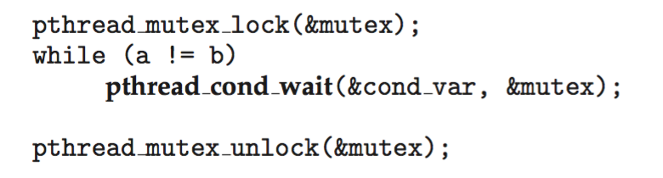
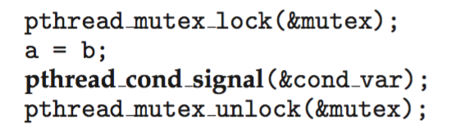
POSIX Condition Variables
Thread waiting for the condition a == b to become true:
Thread signaling another thread waiting on the condition variable:

Slide 32
Java Synchronization
Java provides rich set of synchronization features:
Java monitors
Reentrant locks
Semaphores
Condition variables

Slide 33
Java Monitors
Every Java object has associated with it a single lock.
If a method is declared as synchronized, a calling thread must own the lock for the object.
If the lock is owned by another thread, the calling thread must wait for the lock until it is released.
Locks are released when the owning thread exits the synchronized method.

Slide 34
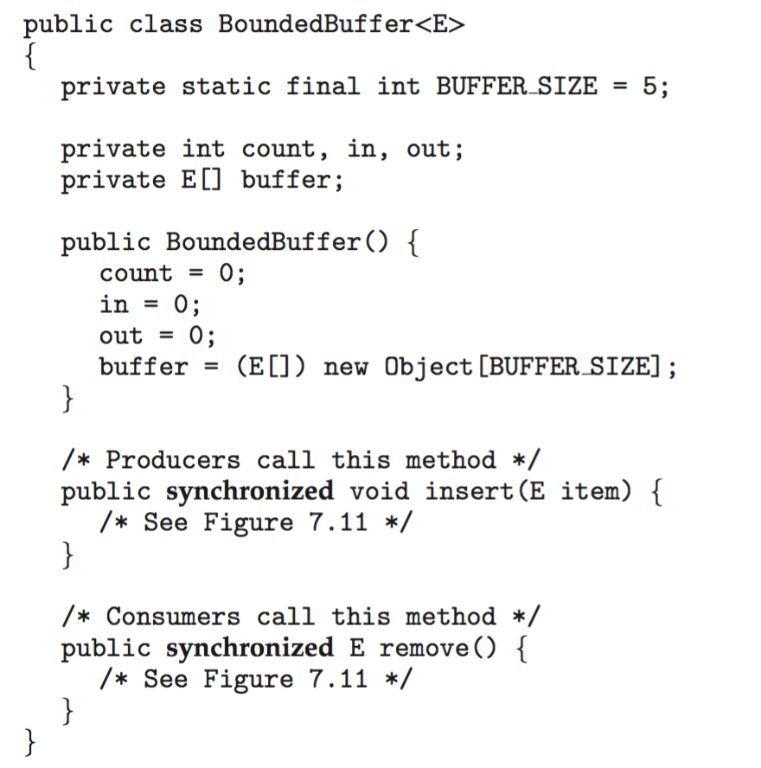
Bounded Buffer – Java Synchronization
Slide 37
Slide 37

Slide 35
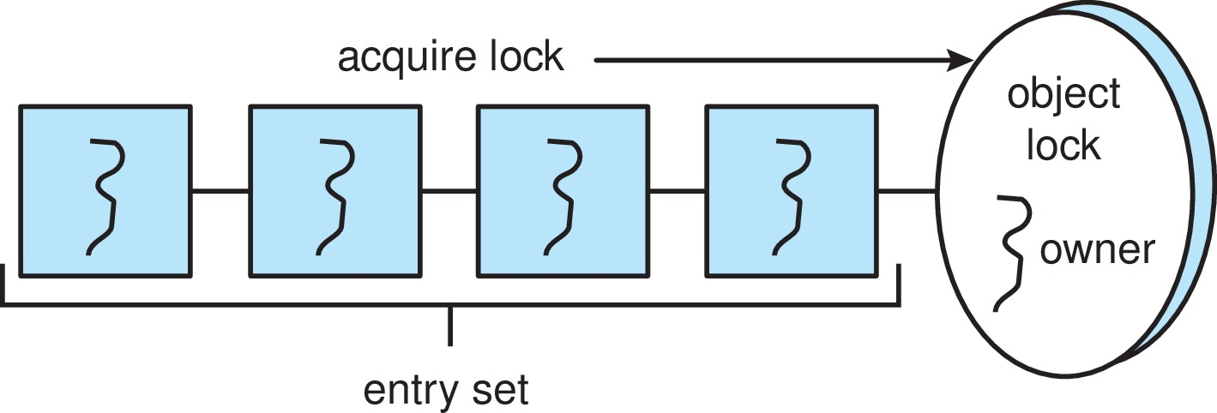
Java Synchronization
A thread that tries to acquire an unavailable lock is placed in the object’s entry set:

Slide 36
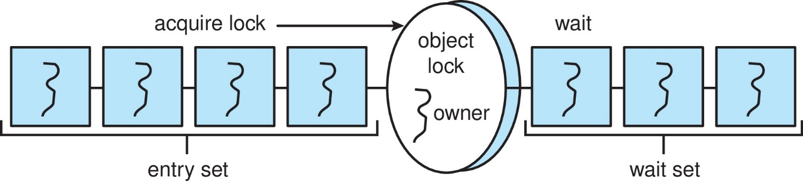
Java Synchronization
Similarly, each object also has a wait set.
When a thread calls wait():
It releases the lock for the object
The state of the thread is set to blocked
The thread is placed in the wait set for the object

Slide 37
Java Synchronization
A thread typically calls wait() when it is waiting for a condition to become true.
How does a thread get notified?
When a thread calls notify():
An arbitrary thread T is selected from the wait set
T is moved from the wait set to the entry set
Set the state of T from blocked to runnable.
T can now compete for the lock to check if the condition it was waiting for is now true.

Slide 38
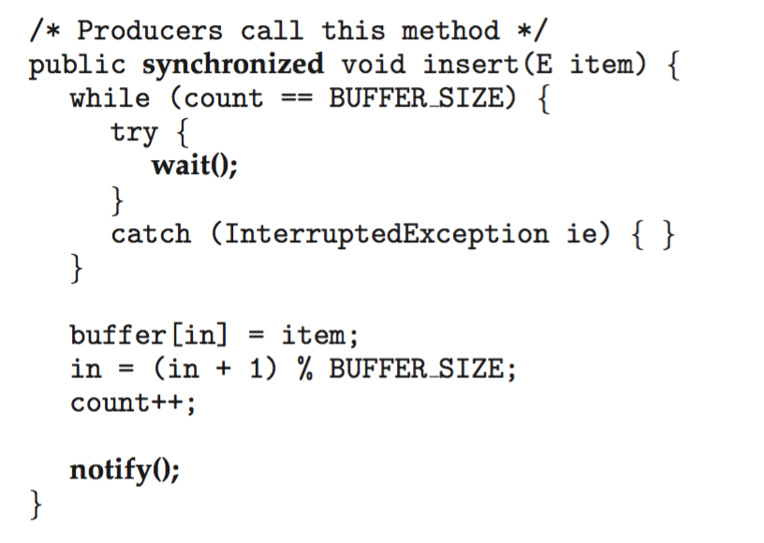
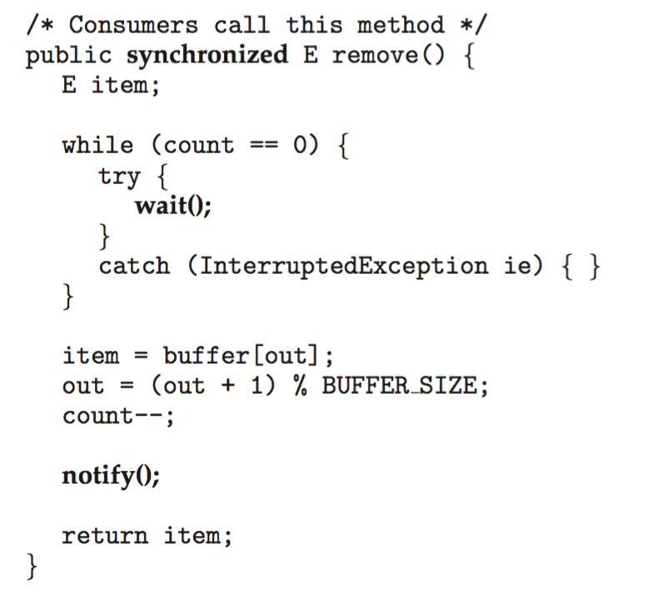
Bounded Buffer – Java Synchronization

Slide 39
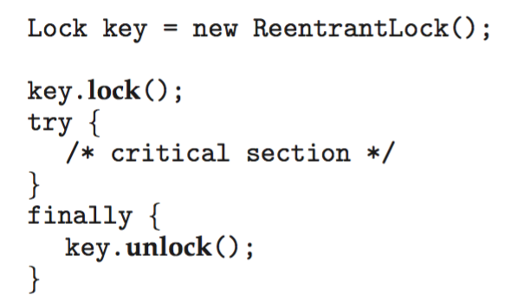
Java Reentrant Locks
Similar to mutex locks
The finally clause ensures the lock will be released in case an exception occurs in the try block.

Slide 40

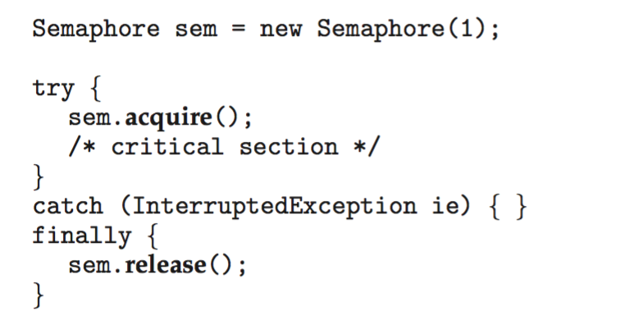
Java Semaphores
Constructor:
Usage:

Slide 41

Java Condition Variables
Condition variables are associated with an ReentrantLock.
Creating a condition variable using newCondition() method of ReentrantLock:
A thread waits by calling the await() method, and signals by calling the signal() method.

Slide 42
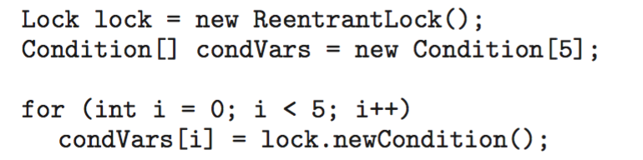
Java Condition Variables
Example:
Five threads numbered 0 .. 4
Shared variable turn indicating which thread’s turn it is.
Thread calls doWork() when it wishes to do some work. (But it may only do work if it is their turn.
If not their turn, wait
If their turn, do some work for awhile …...
When completed, notify the thread whose turn is next.
Necessary data structures:

Slide 43
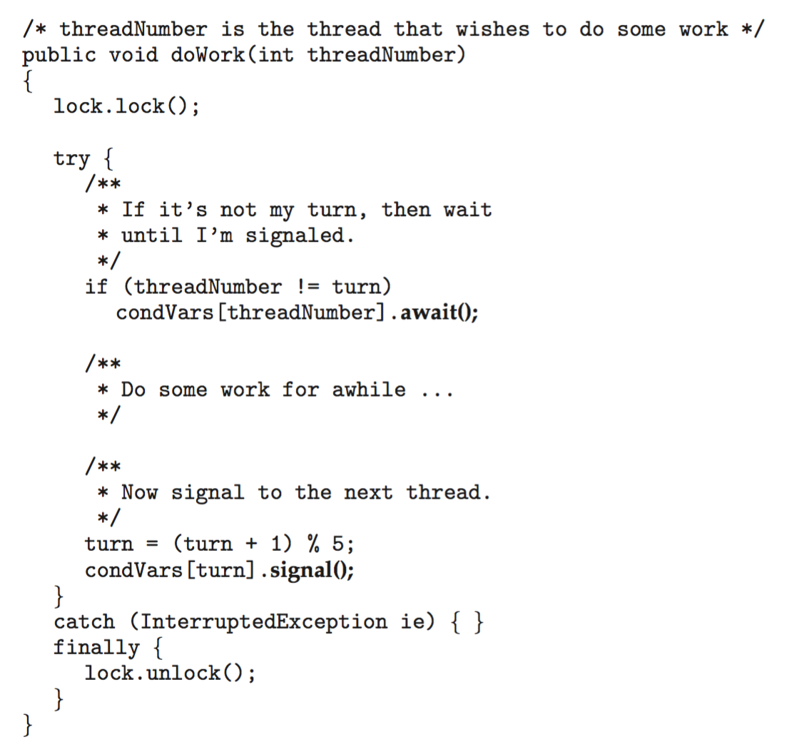
Java Condition Variables

Slide 44
Alternative Approaches
Transactional Memory
OpenMP
Functional Programming Languages

Slide 45
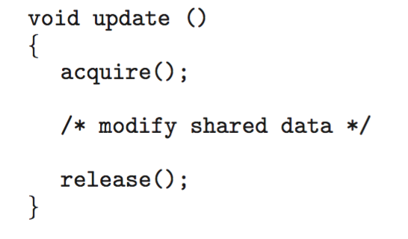
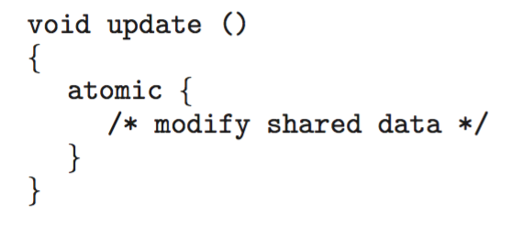
Transactional Memory
Consider a function update() that must be called atomically. One option is to use mutex locks:
A memory transaction is a sequence of read-write operations to memory that are performed atomically. A transaction can be completed by adding atomic{S} which ensure statements in S are executed atomically:

Slide 46
OpenMP
OpenMP is a set of compiler directives and API that support parallel programming.
void update(int value)
{
#pragma omp critical
{
count += value
}
}
The code contained within the #pragma omp critical directive is treated as a critical section and performed atomically.

Slide 47
Functional Programming Languages
Functional programming languages offer a different paradigm than procedural languages in that they do not maintain state.
Variables are treated as immutable and cannot change state once they have been assigned a value.
There is increasing interest in functional languages such as Erlang and Scala for their approach in handling data races.
Notes:
no need to lock at all
Lisp

Slide 48
End of Chapter 7

