Slide 1
Chapter 8
Declaration Processing
and
Symbol Tables
Department of Computer Science

Slide 2

Outlines of Chapter 8
Symbol Tables
  Constructing a symbol table
  Block-structured language and scope
  Basic implementation techniques
  Advanced features
Declaration Processing
  Variable and type declarations
  Function declarations
Type Checking

Slide 3
Symbol Table
A database of the declared names
Attributes associated with a name
  Class: type, variable, function, label
  Type: int, float, double, array, boolean, struct
  Scope
  Memory address (for code gen)
  Access attributes (for code gen)
Attributes are collected when a name is declared. Attributes are checked when the names are used in statements.

Slide 4
Function_decl
Type
ID
Para_list
Block
Decl_list
Stmt_list
Symbol
table
Semantic check
Storage
allocation,
Offset
computing

Slide 5
Int f (float h1, float h2, float h3)
void g(int a)
{
int w,x;
{
float, x,z[100][10];
f(x,w,z);
}
}
Symbol number | Symbol name | Attributes
1 | f | Int function (float, float, float)
2 | g | void function (int)
3 | a | int
4 | w | int
5 | x | int
6 | x | float
7 | z | float; array; two dimensional; 1000w

Slide 6
Static Scoping
PLs use scopes to confine a symbol in region. Scopes may be nested. A name is usually associated with its closest containing scope.
Variables, types, functions may be declared in a scope.
A name usually can be declared only once in a scope (overloading is an exception)
C is a flat language in that it does not allow functions to be declared in another function. (Pascal, ML allow this)
Notes:
Function overloading is a concept that allows programmers to define two or more functions with the same name and in the same scope. Each function has a unique signature, which is derived from: ... arguments' name. return type

Slide 7
A Symbol Table Interface
OpenScope()
  Open a new scope
CloseScope()
  Close the current scope, and revert to a previous scope
EnterSymbol(name, type)
  Enter the newly declared name into the symbol table for the current scope with the type info.
RetriveSymbol(name)
DeclaredLocally(name)?
Notes:
Current scope?

Slide 8
8.2 Block Structured Languages and Scopes
Visibility rules
  At any point in the text of a program, the accessible names are those that are declared in the current scope and in all other open scopes.
  If a name is declared in more than one open scope, then a reference to the name is resolved to the innermost declaration.
  New declarations can be made only in the current scope.

Slide 9
Scope Rules Example
A
Open scope
B
Open scope
You are here
C
Closed scope
D
Current scope
E

Slide 10
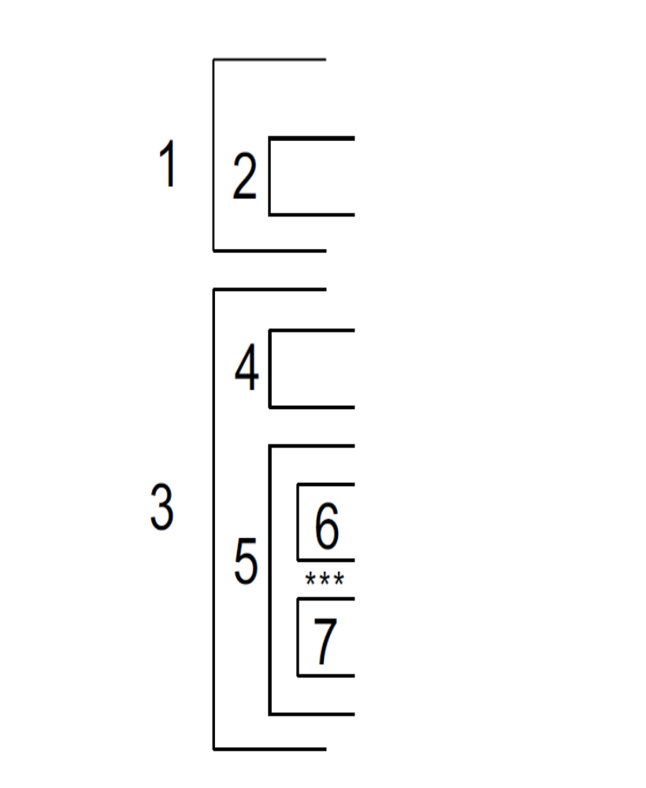
Scope Rules Example
1 Closed
2 Closed
You are here
3 Open
4 Closed
5 Current
6 Closed

Slide 11
Scope Rules in C--
Global variables, local variables, formal parameters
  Example:
int i,j,k;
int f1(int a, int j)
{
float k;
while (a < 1)
{ int k;
i= j + k; }
}
Scope 0 → i,j,k
Scope 1 → a,j,k
Scope 2 → k
Which scope is f1 in?

Slide 12
Symbol Table Organization
A single symbol table implementation
  The pair <name, scope #> should be unique
  To close a scope is more expensive
A
i,j,k
i(2)
j(1)
i(1)
B
i,l,m
k(2)
k(1)
C
i,k,n
n(2)
Q: where are B’s names (i,l,m)?
Notes:
Often used in Single Pass compilation

Slide 13
Symbol Table Organization
Multiple Symbol Table Implementation
  Push a new table when a new scope is entered
  Pop a symbol table when a scope is closed
i, k, n
A
i,j,k
i, j, k
B
i,l,m
Each scope has its
own table
C
i,k,n
Scope Stack
Notes:
May be used in multi-pass compilation

Slide 14
Many small table vs. One big Table
Many small table | One Big Table
Simpler | More complicated (how to locate all names in a scope)
Slower search (for global or undefined variables) | Faster search
Less efficient storage usage (no sharing among small tables) | Efficient storage usage (but needs to store scope #)
Hash table or search trees | Hash table only
Good for keeping symbol tables of closed scopes | Good for 1-pass compilers (entries may be discarded after a scope is closed)
Notes:
Slower search – for non-local names, yet local names are used infrequently

Slide 15
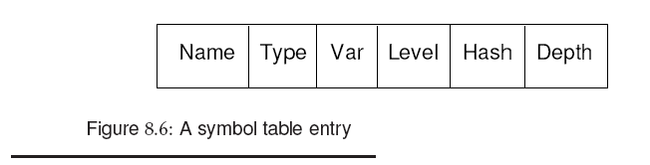
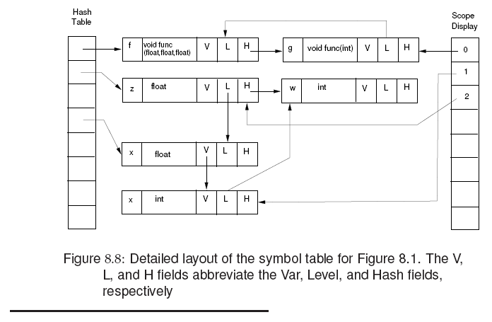

Figure 8.6
A symbol table
entry

Slide 16
Symbol Table Example
symtab *hashtable[ TABLE_SIZE ];
struct symtab {
char *name;
int scope; /* or store the VAR info */
int level; /* threads symbols in the same scope */
Type type; /* tag → what type is it? */
union {
ARRAY_desc *array_rec;
FUNC_desc *func_rec;
STRUCT_desc *struct_rec;
} symtab_urec;
struct symtab *next; }

Slide 17
Symbol Table Example
symtab *hashtable[ TABLE_SIZE ];
struct symtab {
char *name;
int scope; /* or store the VAR info */
int level; /* threads symbols in the same scope */
Type type; /* tag → what type is it? */
union {
ARRAY_desc *array_rec;
FUNC_desc *func_rec;
STRUCT_desc *struct_rec;
} symtab_urec;
struct symtab *next; }

Slide 18
8.3 Basic Implementation Techniques
Unordered list
Ordered list: binary search
Binary search tree
Hash tables
  Constant time search
  Most commonly used
  Conflicts resolution: chaining is commonly used
What is a good Hash function ?
In early years, V % P, P is a prime number
e.g. 31,61,127,257,509,1021,…
Notes:
Prime number as a divisor would give least conflicts when the table size is fixed.
However, if you can have a little more space, conflicts drop quickly.

Slide 19
Quick Review
Symbol table implementation
scope handling
unified big table
multiple private small tables
basic table organization
scalable table organization
Department of Computer Science and Information Engineering
Notes:
Long search time for global variables … how to speed it up?

Slide 20
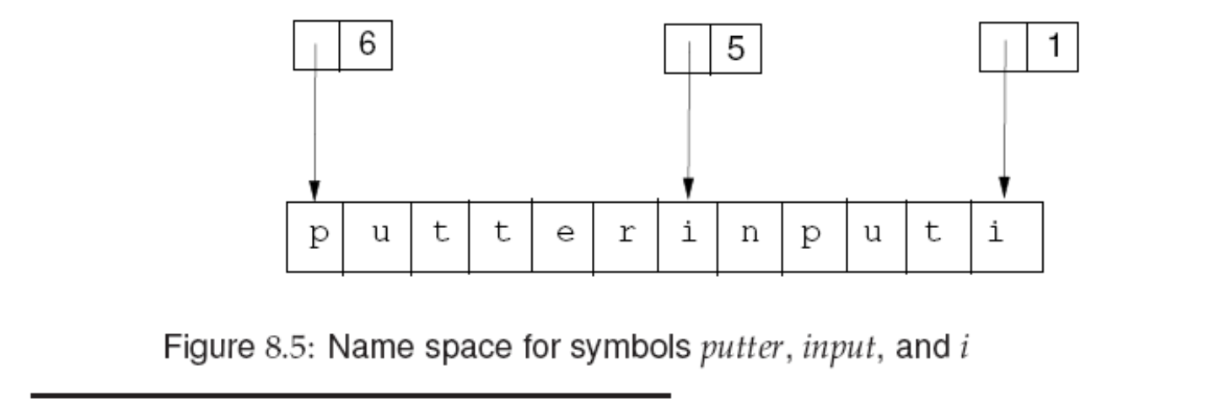
Name Space
Should we store the identifier’s name in the symbol table?
  Name length differ significantly, space is wasted if space of max size is reserved.
Solution
  Store the identifiers in a name space, and store the index and its length in the symbol table.

Slide 21
Segmented Name Space Index
Segmented name space: string table can be a collection
of fixed size string segments, dynamically allocated.
index length
Selector = index div slength
Offset = index mod slength
slength is the length of each seqment
seg 0
seg 1
length
selector
name
offset
seg n

Slide 22
Semantic record in Parser.y layout
%{
  C declarations
%}
Yacc/Bison declarations
%%
Grammar rules (including action routines)
%%
Additional C code

Slide 23
Parser.y layout
%union {
int num;
char* lexeme; …}
%token <lexeme> ID
%token <num> const
%type <num> expr term
%%
expr : expr ‘+’ term
%%
int eval (char c, int a,b) {}
{$$=eval(‘+’,$1,$3)};

Slide 24
Set up token attributes
Step 1: define the %union in parser.y
Step 2: modify the lexer.l to pass token attributes to the parser.
In lexer.l, insert code as follows:
{ID} {yylval.lexeme = strdup(yytext);
return ID; }
{int_constant} {yylval.value = atoi(yytext); …}
Name Space?
But constants can be integer constants, float point constants and string constants, how to handle constants other than integers ?

Slide 25
Set up token attributes
Step 1: define the %union in parser.y
Step 2: modify the lexer.l to pass token attributes to the parser.
In lexer.l, insert code as follows:
{ID} {yylval.lexeme = strdup(yytext);
return ID; }
{int_constant} {yylval.value = atoi(yytext); …}
factor : ( relop_expr )
: CONST
: var_ref
: …..
Csci1631-2008

Slide 26
Example
%union {
char* lexeme;
Const_Type *const_rec;
TYPE type; /* general semantic rec type */ int intval; /* evaluate const exp */
List *list; /* handle all lists */
ArrayInfo *arr_info;
VarRef *var_ref;
…. }
Token attribute type
  %token <lexeme> ID
  %token <const_rec> CONST
Typedef struct {
C_type ctype;
Union {
int intval;
double fval;
char *sc; } const_u;
} Const_Type;

Slide 27
Set up token attributes
In lexer.l, insert code as follows:
{ID} {yylval.lexeme = strdup(yytext);
return ID; }
{int_constant} {Const_type *p; p=Allocate(Const_type);
p->ctype = INT;
p->const_u.intval=atoi(yytext);
yylval.const_rec=p;
return(CONST);
}
{float_const} {…. p->ctype=FLT; p->const_u.fval=atof(yytext); …..}
{s-const} {…. p->ctype=STRING,…}

Slide 28
Scope Implementation in 1-pass
funct_decl → type ID ( param_list ) { block }
Inserting actions:
funct_decl → type ID ( {scope++;}
param_list )
{EnterSymbolparam($5);
EnterSymbolfunc($1,$2,$5);}
{ block } {scope--}
Stmt → ( block )
stmt → ( {scope++;} block ) {scope--;}
1
2
3
4
5
6
Scope = 0

Slide 29
Extensions
Fields and Records
Struct A {
int a, b;
float c;
double d;
char e;
}
Two possible implementations:
Allocate a symbol table for
each struct.
Each struct is assigned a unique number. Each field name is stored in the global table associated with its struct number.

Slide 30
Scope of Struct Type
Struct S {
Struct T {
int a;
int b;
} x;
double z1, z2, z3;
Struct T y;
}
Struct T xyz;
Struct S {
Struct S next;
int a;…}
Struct S {
Struct S {int a;int b;} x;…
Struct S {
int a;
Struct S *next;…
illegal!
illegal!
OK in C!
But not in C++
Innermost containing block
OK!

Slide 31
Handling Array Declaration in 1-pass
Var_list : id
| Var_list ‘,’ id
| id dim_decl
| Var_list ‘,’ id dim_decl
Adding action routines:
Var_list : Var_list ‘,’ id dim_decl
{ addtype($3, scope, current_type, $4);}
| id dim_decl
{ addtype($1, scope, current_type, $2);}
dim_decl : ‘[‘ cexpr ‘]’ | dim_decl ‘[‘ cexpr ‘]’ {get dim info}
cexpr means constant expressions
For each array declaration, we need to record the number of dimensions and the size of each dimension.
A[3x5+6]
cexpr

Slide 32
Handle Array Declarations in AST
Var_list : id dim_decl
| Var_list ‘,’ id dim_decl
AST_Node *temp;
Type_Array *Array_info;
Array_info = (Type_Array*) malloc(sizeof(Type_Array));
Array_info->dim=0; /* init */
While(temp->type==DIM_DECL){
dim_number=do_cexpr(temp->child);
if (dim_number <= 0) {error_msg(); }
arrinfo->dim_limit[arrinfo->dim]=dim_number;
arrinfo->dim=arrinfo->dim+1;
temp = temp->sibling;
}
Attributes collection during
AST tree walk

Slide 33
Attribute Collection in Parser
Example: Array Declaration
%type <num> cexpr
%type <dim_rec> dim_decl
  dim_decl : ‘[‘ cexpr ‘]’
  {$$->n =1; $$->dimsize[0]=$2}
  | dim_decl ‘[‘ cexpr ‘]’
  {$$->n = i = $1->n +1; $$->dimsize[i]=$2}
  cexpr : cexpr ‘+’ cexpr {$$ = $1 + $3}
  | cexpr ‘*’ cexpr {$$ = $1 * $3}

Slide 34
dim_decl : ‘[‘ cexpr ‘]’
{$$->n =1; $$->dimsize[0]=$2}
| dim_decl ‘[‘ cexpr ‘]’
{$$->n = i = $1->n +1; $$->dimsize[i]=$2}
  float ABC [100][200][30];
[
dim_decl
{1, [100]}
ID
ABC
float

Slide 35
dim_decl : ‘[‘ cexpr ‘]’
{$$->n =1; $$->dimsize[0]=$2}
| dim_decl ‘[‘ cexpr ‘]’
{$$->n = i = $1->n +1; $$->dimsize[i]=$2}
  float ABC [100][200][30];
[
[
dim_decl
{1, [100]}
dim_decl
{2, [100,200]}
ID
ABC
ID
ABC
float
float

Slide 36
Building a List (e.g. parameters)
%type <plist> param_list
%type <p_var> param
p_list_type *plist;
param_type *p_var;
param_list :
param_list “,” param {$$=merge_list($1,$3);}
| param {creat_list($1)};
;
Merge_list → should $3 be insert at the front or at the end of $1 ?

Slide 37
Overloading
Same symbols may mean more than one thing
  In Pascal, the same identifier can denote the name of a function and its return value
  f := f(0,1) + 1; f on the left-hand side denotes the return variable, f on the right-hand side denote the function call.
  In Ada, the name of a procedure, function, operator can be overloaded.
The symbol table must provide all the possible meanings of a name. The key is to link together all possible definitions.

Slide 38
Forward References
Handling forward references
there is a risk that a forward reference to a name may be resolved to a non-local definition.
Example:
type T = integer;
procedure foo;
type P = T;
T = real;
P should be a pointer to real, but it is easy to incorrectly interpret P as a pointer to integer.

Slide 39
The above problem can be resolved by chaining together all references to a pointer to type T until the end of the type section is reached. All type names can then be looked up and resolved.
Forward references to labels in goto’s can also be resolved in a similar way. Once the label address is known, we can back filled the branch/jump instruction. In Pascal, labels must be declared before they can be defined.
If unrestricted forward references are allowed, the only way to handle them is to make more than one pass over the program.

Slide 40
Type Checking
Type checking makes sure the source program follows semantic rules.
Examples of type checking
  An object is defined exactly once
  An operator is applied to compatible operands
  De-referencing is applied only to a pointer
  Indexing is done only on array objects
  Function is called with the correct number and type of arguments

Slide 41
Static and Dynamic Type Checking
Static type check: type checking done at compile time
Dynamic type check: type checking done at run time. Runtime objects have tags.
A strongly typed language eliminates the need for dynamic checking of types
Some type checking can only be performed at runtime
  Array index for array [0..255] of integer

Slide 42
Type checking of expressions (AST)
CheckExpr (AST_Node* exprnode)
{
AST_node* leftop = exprNode->child;
AST_node* rightop = leftop->rightSibling;
if (leftop->datatype != rightop->datatype)
Error….
}
But how do we know the type of each sub-expression ?
a) recursive traverse down
b) bottom up traverse to compute synthesized attributes
Notes:
One pass compilation would have the type collected for each sub-expression
In multiple pass compiler, we may have to recursively traverse down and a bottom up pass to get such synthesized attributes.

Slide 43
Type Conversion
Implicit type conversions called coercions
  In assignments
  In expression evaluation
  In parameter passing
  In function return
Coercion is often a symptom of weak typing
Explicit type conversions are performed by programmers such as type casting.

Slide 44
Type Expressions
integer is a basic type
array (1..100) of integer is a type expression
struct { integer a; float b;} is a type expression
* integer is a type expression
int f(integer a; float b;} is a type expression
struct S { integer a[100][200];
float *b;
struct { integer a; float c;} d; } is a type expression

Slide 45
Equivalence of Type Expressions
Name Equivalence
two variables have the same type if they have the same associated type expressions
Structural Equivalence
two variables have the same type if their associated type expressions are structurally equivalent, i.e., two type expressions are either the same basic type, or are formed by applying the same constructor to structurally equivalent types.

Slide 46
A, B : array (1..100) of integer;
C, D : array (1..100) of integer;
A and B are of the same type, C and D are of the same type, but the two types A and C may be incompatible.
Ada, Pascal, Modula-2 are using this name equivalence rule.
Algol68 uses structural equivalence rule, so A,B,C,D are equivalent.
C uses name equivalence for structs and unions, and structural equivalence for arrays
Notes:
Name is often an implicit name
If you want to variables to be considered the same type, they must associated with the same type expression.

Slide 47
A, B : array (1..100) of integer;
C, D : array (1..100) of integer;
A and B are of the same type, C and D are of the same type, but the two types may be incompatible.
Question:
The two type expressions are actually identical ! So why is A not compatible with C?
They are not the same name
(implicit name for type expression)

Slide 48
Modern languages tend to use name equivalence rules, because
Type comparison is just a comparison of pointers
Programmers can get full benefit of type checking
Useful for type-inferred aliasing analysis – less possible aliasing
It is hard (time consuming) to implement structural equivalence.

Slide 49
C type equivalence test
Char *p, *q;
Short j;
Short int k;
Int a[100], b[200], c[100];
Int d[]; /* as in function parameter list or extern */
The types of p and q are the same
The types of j and k are the same
The types of a and b are different
The types of a and c are the same
The types of a and d are the same

Slide 50
C type equivalence test
Struct {int a,b;} x, y;
Struct S {int a,b;} w;
Typedef Struct S T1,T2;
Struct S u;
T1 z;
T2 zz;
Q1: x, y and w are compatible T or F
Q2: z, zz and u are compatible T or F
F
T

Slide 51
C type equivalence test
Struct {int a,b;} x, y;
Struct S {int a,b;} w;
Typedef int A[3];
A B[10];
Int C[10][3];
x = w;
C = B;
No
No
Notes:
One is jagged array, the other is a multidimensional array

Slide 52
Implicit conversion of constants
Assuming X is an array of float.
In the following For loop
for (I=0; I< n; I++)
X(I) = 1;
the compiler can automatically convert it to fp constant with no runtime cvt operations
for (I=0; I< n; I++)
X(I) = 1.0;
This speeds up the loop by 9 times
(some machines are slower on fp-int conversions)

Slide 53
Overloading
An overloaded symbol is one that has different meanings depending on its context.
Example:
  Arithmetic operators +,-,*,/
The key to handling overloaded names in the symbol table is to link together all possible definitions.
Overloading is resolved when a unique meaning can be determined.
function “+” (x,y: complex) return complex
function “+” (x,y: integer ) return complex
function “+” (x,y: integer ) return integer
A,B: complex then A+B is not ambiguous
but what if A,B are integer?

Slide 54
Overloading
function “+” (x,y: complex) return complex
function “+” (x,y: integer ) return complex
function “+” (x,y: integer ) return integer
R = A + B + C what is the type of R if A, B, C are integer?
R = (A+B) + (C+D) what is the type for (A+B) and (C+D) if A,B,C,D are integer?
Ada requires a complete expression to have a unique type, we can use the unique type infor to narrow down the type choices for each subexpression.

Slide 55
Type inferred aliasing analysis
  {
  a = f(x);
  *p = b;
  c = a + c;
  }
  Can we reuse a ?
  Can we schedule the load of c ahead of the store of *p?
Register Allocation
Code Scheduling
Yes, if data type of *p is different from a and c
Notes:
C is basically a weak typed language, so type inferenced aliasing analysis must go with ANSI-C

Slide 56
How to tell if two type expressions are identical?
struct { int a; float b[5];
struct { int c; double d;} x,y;
}
struct { int a; float bb[5];
struct { int cc; double dd;} x,y;
}
Are these two type expressions identical?
They are structural equivalent, not name equivalent.

Slide 57
How to test if two type expressions are identical, if structural equivalence is used?
struct { int a; struct { int c; double d;} x,y;
double b[5];
}
struct { int a; struct { int cc; double dd;} x,y;
float bb[5];
}
A fast encoding would tell they are NOT equivalent.

Slide 58
Efficient test for structural Inequivalence
Type expressions can be encoded as an integer value. A simple integer comparison can tell structural inequivalence immediately.
Basic types: boolean: 0, char 1, integer 2, real 3
Type constructors: pointer 1, array 2, freturns 3
Type expressions
  char 0 0 0 1
  freturn(char) 0 0 3 1
  pointer(freturn(char)) 0 1 3 1
  array(pointer(freturn(char))) 2 1 3 1

Slide 59
How to test if two type expressions are identical, if structural equivalence is used?
struct { int a; float b[5];
struct { int c; struct {.. Int k[3] …} w;} x,y;}
struct { int a; float bb[5];
struct { int cc; struct {.. Int k[4] …} z;} x,y;}
A fast encoding would fail to tell if they are equivalent. So a more expensive recursive algorithm must be used.

Slide 60
How to tell if two expressions are identical?
x = (A+B*C);
…….
y = (A + B*C);
are these two expressions identical?
do they generate the same value?

Slide 61
DAG for Expressions
A Directed Acyclic Graph (DAG) for an expression identifies the Common SubExpressions (CSE) in the expression.
For expression A+(B*C) + (B*C*A) - B
Tree
DAG
-
-
+
B
+
+
*
*
+
A
*
A
*
*
A
B
C
B
C
B
C

Slide 62
Value Numbering
Suppose each node is stored in an array, and is referenced by its index (called value number).
The signature of an operator node be a triple <op,l,r> consisting of its label op, left child l, and right child, r.
Search the array for a node m with <op,l,r>, if found, return m, else create a new node.
1
2
3
4
5
id | Pointer to symtab
num | 10
+ | 1 | 2
:= | 1 | 3
…
I := I+10

Slide 63
Value Numbering
An efficient way to search for <op,l,r> is to use hashing.
All nodes are kept in k lists, called buckets.
A hash function compute the number of bucket from the signature <op,l,r>.

Slide 64
Example
(A+B*C) – D *(A+B*C)
Assume A,B,C are stored
in entry 4,5,6.
B*C is stored in entry 15
A+B*C in entry 16
when the 2nd A+B*C
is processed, we will
search for <*,5,6> first,
then <+,4,15>
15 <*,5,6>
16 <+,4,15>

