Slide 1
Calling Convention
and
Caller/Callee Register Convention
Department of Computer Science

Slide 2
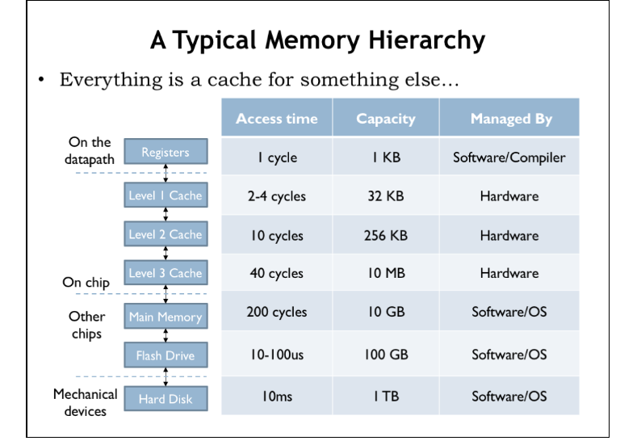
Department of Computer Science
Notes:
Small size and physical proximity make them fast, direct access via a small number of bits
(fast and compact) parallel accessing is easy, when effectively used, can reduce memory bandwidth

Slide 3

Why not 1024 registers?
ISA issues
  Register specifier impact instruction length
State saving/restoring issues
  More registers, higher the state saving/restoring cost
Cannot be effectively used to cut down memory traffic
  Registers are different from memory: Strings, Arrays, and Structures are difficult to be allocated in registers.
  Arrays are the major source of memory traffic.
  Can you take the address of a register?
Department of Computer Science

Slide 4
Calling Convention
A calling convention is an implementation scheme for how subroutines receive parameters, how they return results. How to set up for a function call and how to clean up the environment afterward.
A calling convention involves
  Parameters, return values/addresses
  Parameter passing
  Stack set up and clean up
  Save/restore previous frame pointer
  Caller/Callee save registers
Department of Computer Science

Slide 5
ARMv8 Register Convention
Register Number | Purpose
X30 | Link reg for Call
X29 | Frame pointer
X16-X18 | Intra-procedure call scratch reg
X0-X7 | Arguments
X9-X15 | Caller Save
X19-X29 | Callee Save
Department of Computer Science

Slide 6
RISC-V Register Convention
Register Number | Purpose
X1 | Return address
X2 (sp) | Stack top
X3 | Global pointer
X8 (fp) | Frame pointer
X16-X18 | Intra-procedure call scratch reg
X10-X17 | Arguments
X5-X7, X28-X31 | Caller Save
X9, X18-X27 | Callee Save
Department of Computer Science

Slide 7
Caller Save Registers
Function A ()
$T1 = a*b;
$S2=B(1,2,3);
c = $T1+$S2;
…
return
A() is caller, and B() is callee. A wants the value in $T1 to be unchanged after the call of B(). So A must saves $T1 before the call to B() and restores $T1 when B() returns.
Department of Computer Science

Slide 8
Caller Save Registers
Function A ()
$T1 = a*b;
$S2=B(1,2,3);
c = $T1+$S2;
…
return
Save $T1
Restore $T1
Department of Computer Science

Slide 9
Callee Save Registers
Function A ()
$S1 = a*b;
$S2=B(1,2,3);
c = $S1+$S2;
…
return
A() modifies reg $S1, and $S2. For some routines that call A(), reg $S1 and $S2 will be changed after A() returns. So reg $S1 and $S2 must be saved/restored. Since $S1/$S2 are callee saved registers, it is A()’s responsibility to save and restore them.
Department of Computer Science

Slide 10
Callee Save Registers
Function A ()
$S1 = a*b;
$S2=B(1,2,3);
c = $S1+$S2;
…
return
Save $S1,$S2
Restore $S1,$S2
Department of Computer Science

Slide 11
Caller or Callee Save Registers?
Function A ()
$X1 = a*b;
… = B(1,2,3);
…
… = C(4,a);
…
… = D(x,y);
… = $X1;
return
Caller Save
$T1 = a*b;
… = B(1,2,3);
…
… = C(4,a);
…
… = D(x,y);
… = $T1;
Save
Restore
Save
＂
Restore
Save
Restore
Total Cost: 6
Department of Computer Science

Slide 12
Caller or Callee Save Registers?
Function A ()
$X1 = a*b;
… = B(1,2,3);
…
… = C(4,a);
…
… = D(x,y);
… = $X1;
return
Callee Save
$S1 = a*b;
… = B(1,2,3);
…
… = C(4,a);
…
… = D(x,y);
… = $S1;
Save
Restore
Total Cost: 2
Department of Computer Science

Slide 13
General Rules
Caller registers are allocated to temporaries.
Why?
Callee registers are allocated to local variables
Why?
Callee registers are allocated to CSEs
Why?
Department of Computer Science

Slide 14
General Rules
Caller registers are allocated to temporaries.
Why?
temporaries are short-lived
Callee registers are allocated to local variables
Why?
Callee registers are allocated to CSEs
Why?
local variables and CSEs are tend to live longer (may be as long as the procedure invocation)
Department of Computer Science

Slide 15
Simple Test
Function A ()
…
lw $8 -4($fp)
lw $9 -8($fp)
add $10, $8,$9
sw $10, -12($fp)
$v0 = B(1,2,3); /* function call */
add $v0, $v0, $v0
return
What registers must be saved/restored across the call to B?
None – no values live across function call B
Department of Computer Science

Slide 16
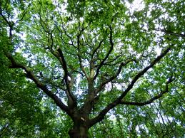
Another Test
Suppose Function A () is a leaf routine:
A leaf routine calls no others
What registers should be used for
Function A? Why?
Function A should use Caller Save registers as many
as possible – no need to save/restore any regs.
Department of Computer Science

Slide 17
Another Variation
Suppose Function A () is a non-leaf routine:
A() calls B(),C(),D(), in the ELSE part
But else is rarely true.
What registers should be used for
Function A? Why?
Function A should use Caller Save registers
because save/restore occur in infrequent paths.
Department of Computer Science

Slide 18
X86/32 Register Convention
Register Number | Purpose
EAX | Int and pointer return value
ST0 | FP return value
ESP, EBP | Stack top and Frame pointer
EAX,ECX,EDX | Caller Save and arguments
EBX,EDI,ESI | Callee Save
Department of Computer Science

Slide 19
ARMv7 Register Convention
Register Number | Purpose
R15 | PC
R14 | Link for BL
R13 | Stack Top
R12 | Intra-procedure call scratch reg
R0-R3 | Arguments
R4-R11 | Callee Save
They do not have caller save registers !!
Department of Computer Science

