Slide 1

[Samsung PRISM] End Review Report
AI,ML, Text Classification
[Multi-Domain Recognition and Classification]
Team
College Professor(s):
Dr. K. S. Umadevi
Dr. Geraldine Bessie Amali
Students:
Utkrisht Sahai
Rishik Reddy
Namit Gupta
Priyal Bhardwaj
Date: 1 Apr 2021

Slide 2



Work-let Area – ML, Text Classification| Multi-Domain Recognition and Classification
Problem Statement
Due to the rising demand of voice assistance, there is a need for the assistant to be quick in understanding the user intention and do the corresponding action.
The NLP system should be smart enough to recognize the utterance as single or multi-domain utterance and classify them to respective domain or domains.
Goal is to develop a model which recognizes an utterance as a single domain or multi-domain and then classify the utterance to the corresponding domain(s).
Based on the accuracy of the model, this can be proposed to Bixby Voice Assistant for utterance classification
Work-let expected duration – 5 months
Expectations
Need to create a combination of different domain dataset with the provided corpus
The NLP model should be able to recognize as single domain utterance or multi-domain utterance and then classify the utterance to the respective domain(s).
Deploy the model and test and train for best results
Training/ Pre-requisites
Good knowledge on ML and Deep Learning concepts
Hands on in Machine learning development frameworks like Tensorflow, Keras, Python, PyTorch etc
Model development, training, deploy and inference
4
Students
Kick Off < 1st Month >
Understand what is NLP and NLU system
Gain knowledge on ML and ANN
Research and Identify which algorithm can be used
Milestone 2 < 2nd Month >
Creating our own sample dataset for the model
Create a corpus based on the dataset provided to the team
Designing the model to learn the training data
Recognize the text as single or multi-domain utterance
Milestone 3 < 3rd and 4th Months >
Classify the text to respective multi - domains
Evaluate the performance of and keep retraining for the best optimal accuracy
Closure < 5th Month >
E2E testing
Share the accuracy report for the algorithm that were tried
Additional Documentation:
https://www.researchgate.net/publication/230719862_Multi-Domain_Learning_When_Do_Domains_Matter
https://dl.acm.org/doi/10.5555/1613715.1613801
https://www.mdpi.com/2071-1050/10/2/488
Prathyusha M,
Lead Engineer prathyusha.m@samsung.com
+91- 8056910819
Bharanidharan S,
Engineer bharanidha.s@samsung.com
+91- 9698907530

Slide 3
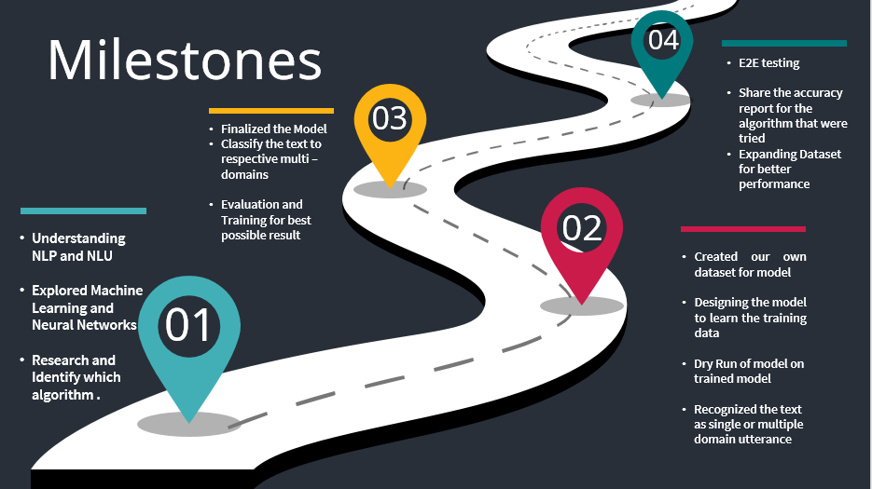

Slide 4
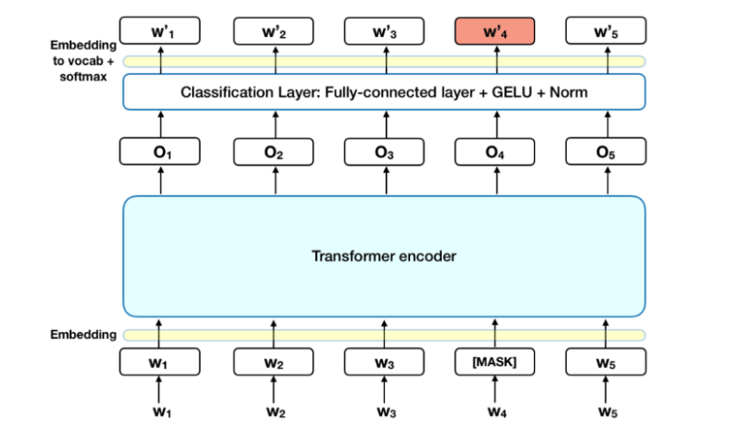
Approach / Solution
We have chosen Bidirectional Encoder Representations from Transformers(BERT) Model as our final approach for our Multi Domain, Multi Indent Classification Problem.
Provides Better Contextual Awareness , long memory and is bi-directional.
BERT’s key technical innovation is applying the bidirectional training of Transformer, a popular attention model, to language modelling.
BERT makes use of Transformer, an attention mechanism that learns contextual relations between words (or sub-words) in a text.
Steps Involved in Prediction –
Adding a classification layer on top of the encoder output.
Multiplying the output vectors by the embedding matrix, transforming them into the vocabulary dimension.
Calculating the probability of each word in the vocabulary with softmax.

Slide 5
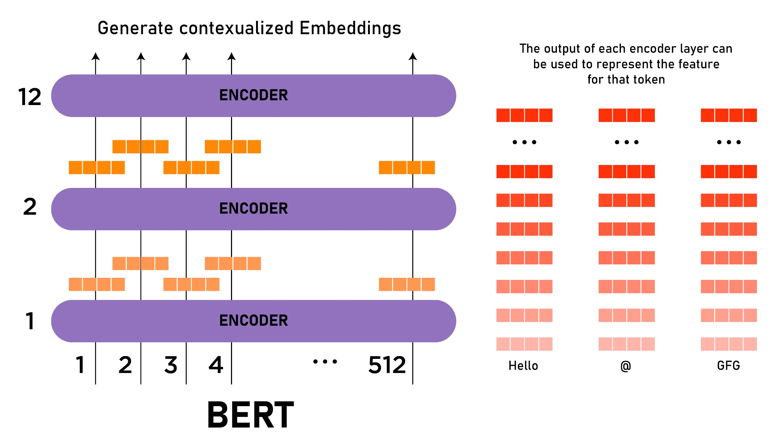
Approach / Solution
Concept Diagram :

Slide 6
Dataset(s) Analysis / Description
Dataset Capture / Preparation / Generation :
We chose a Toxic Comments multi-domain classification dataset from Kaggle as reference and hence we created our own multi-domain dataset with domains like Calculator, Contacts, Calendar, Music, Settings apps etc.
This dataset is a sample prepared by our team , consisting of relevant entries WRT to mobile apps chosen.
The dataset is generated by linking different voice utterances with their respective domains.
Dataset Understanding / Analysis :
This dataset contains different voice commands with their respective multi-domains.
Every voice utterance is assigned a unique ID to identify its particular multi-domain apps that the voice command should open or work upon.
Each utterance/text sentence has the corresponding domains(mobile applications) marked as 0(absent) or 1(present).
Dataset is both multi-domain as well as multi indent.
Dataset Pre-Processing / Related Challenges :
We have balanced the classification classes throughout the dataset of each individual class.
Shuffled the dataset entries themselves to avoid any biasing and better model training and prediction
We Pre-processed the input text removing special characters, extra spaces etc. and then tokenized the input for the model.
Multi-hot Encoded the final Categories , this allows forming of result vector at the end.

Slide 7
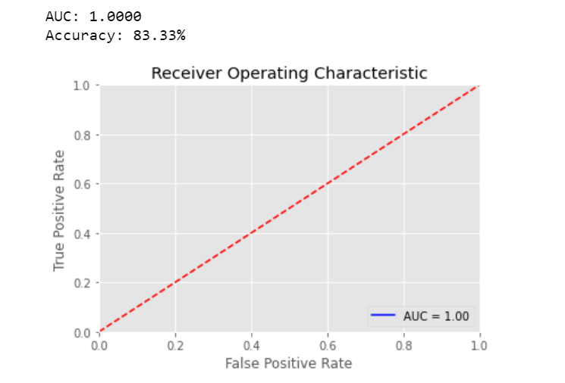
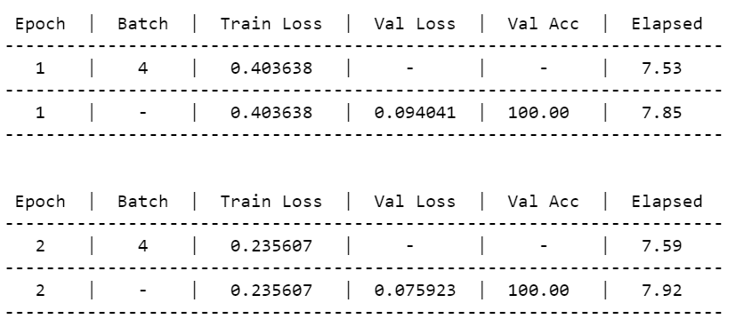
Experimental Results / Simulations / Observations
Results :
(provide numerical data / bar charts / plots / images / videos / tabulated results etc. Use full slide or multiple slides up to max 3 slides to demonstrate the results)
We have plotted the graph of True and False Positive Rates both w.r.t epochs:
Accuracy of the model in evaluating test set:
We observe a steady increase in accuracy and decrease in loss in both training and validation data , the loss and accuracy became increasingly stable with growing epochs and reached maximum at 2nd epoch having accuracy of 0.8333

Slide 8
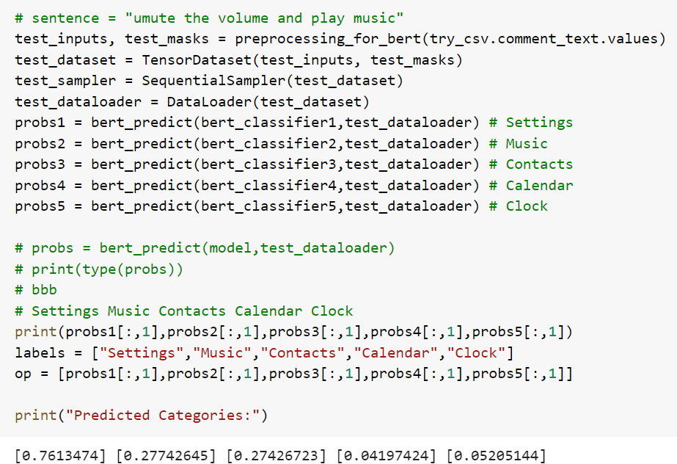
Experimental Results / Simulations / Observations
Major Observations / Conclusions & Challenges :
(provide details about your findings, experimental opinion – Use separate slide if necessary)
Analyzing the model by inputting an arbitrary Command:

Slide 9
Deliverable
Final Deliverables :
Training the model on optimum parameter.
To further increase the accuracy of our model by increasing the dataset size to a large extent as the current dataset has a limited number of entries.
It took us a lot of time to train and test our model and make any further improvements because of insufficient computation power (GPU) available.
Patent Plan :
Expand the Dataset in order to make it a standard for everyone’s use
In depth Comparative Study with Other Models such as Multinomial Adversarial Networks
Summarize the Study and go for publication or patent .

Slide 10
Work-let Closure Details
KPIs delivered/Expectations Met:
Thus, we compared different NLP techniques like LSTM, BERT, RMDL , Word2Vec for our voice recognition multi-domain classification project and BERT model came out to be best suitable.
We created a dataset with some sample dataset close to ours from Kaggle.
Accuracy of the model can be further improved by increasing the size of dataset.
Better Hyper-parameters and Tuning can be achieved through prolonged access of GPU .
GitHub Upload details:
Parameter | Details
KLOC [Lines of Code in Thousands] | [ xx ]
Model /Algorithm Details | [ xx ]
Details of Datasets uploaded [No of files – Images, Videos, etc.] | [ xx ]
List of Reports Uploaded [Name of All Documents uploaded | [ xx ]
Link to Github Repository | [ xx ]

Slide 11
Thank you

