Slide 1
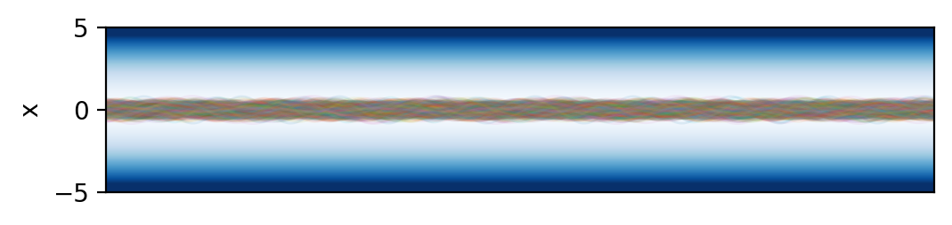
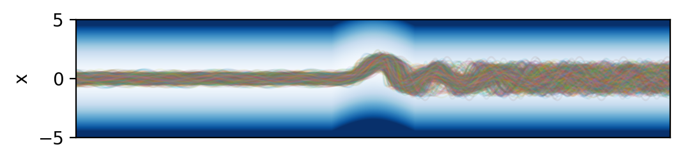
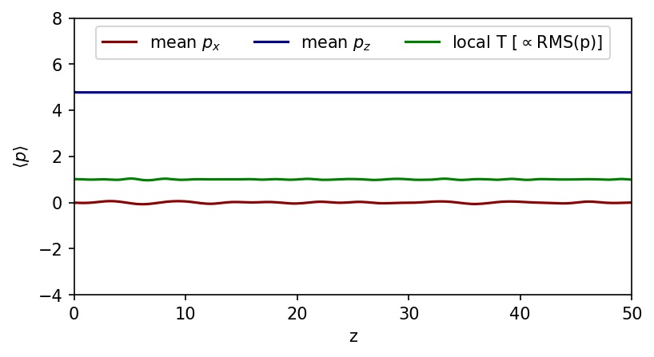
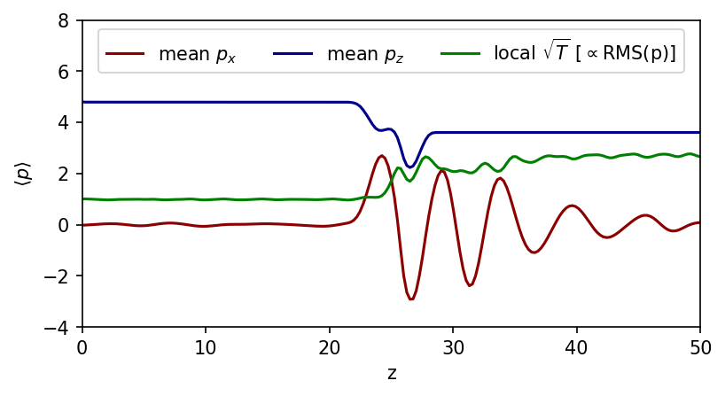
Unperturbed
Perturbed
Potential
Ensemble averages

Slide 2
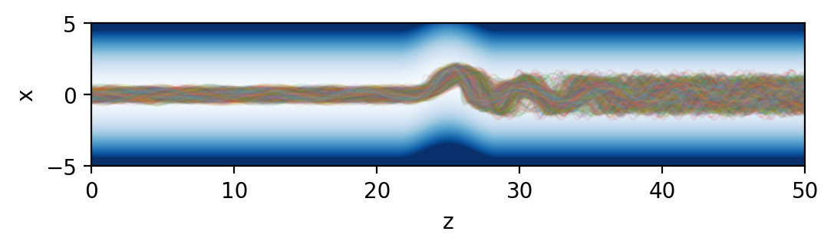
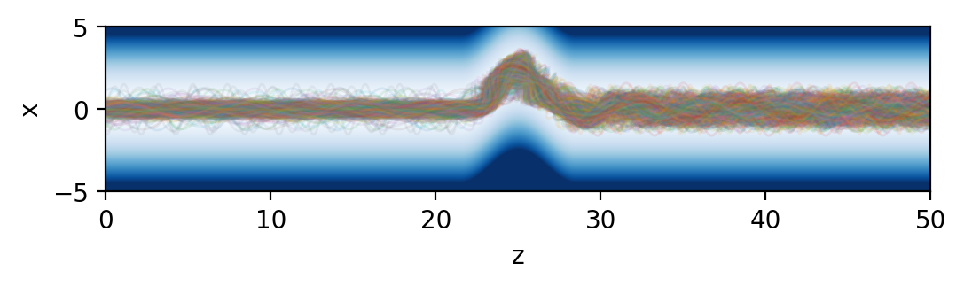
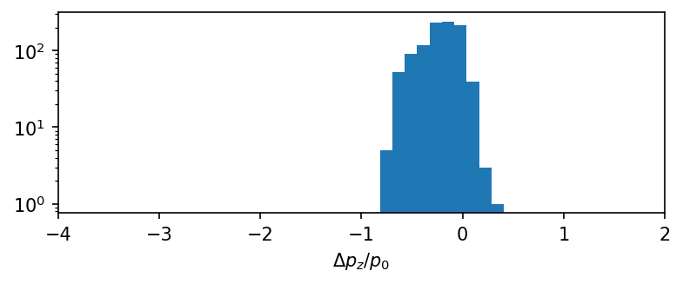
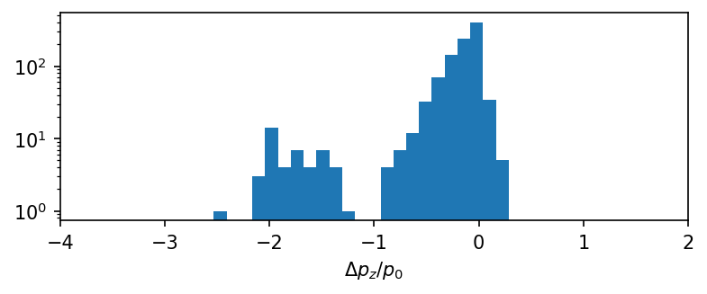
B₁=1
B₁=2
Reflected
Reflected
Trajectories

Slide 3
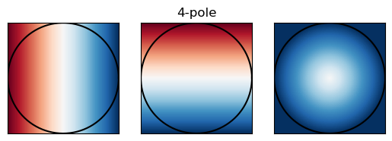
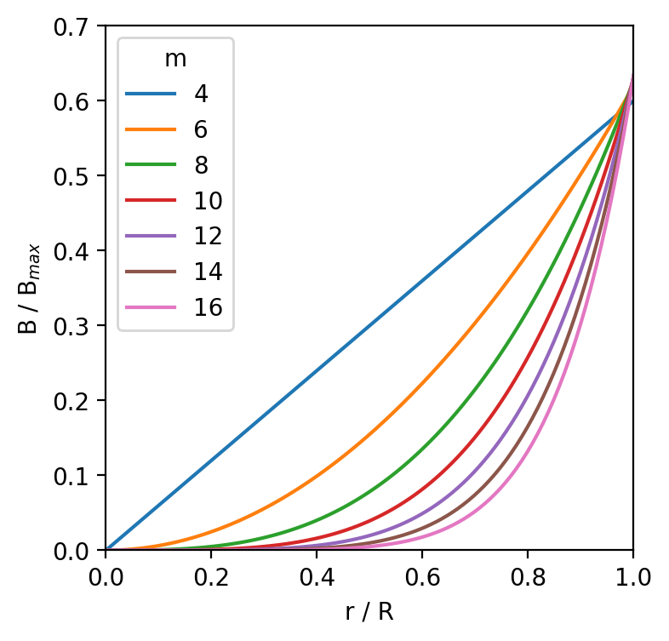
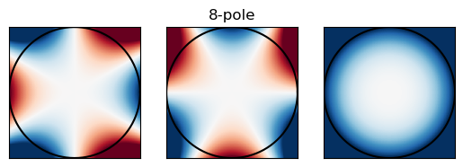
B_{x}
B_{y}
|B|

Slide 4
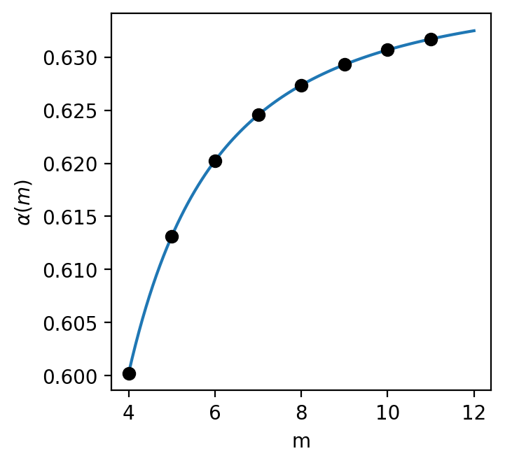
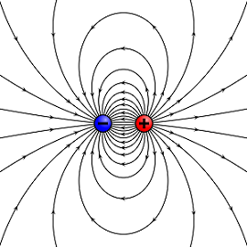
R
B=𝛼(N)B₀
B=B₀
N=8

Slide 5
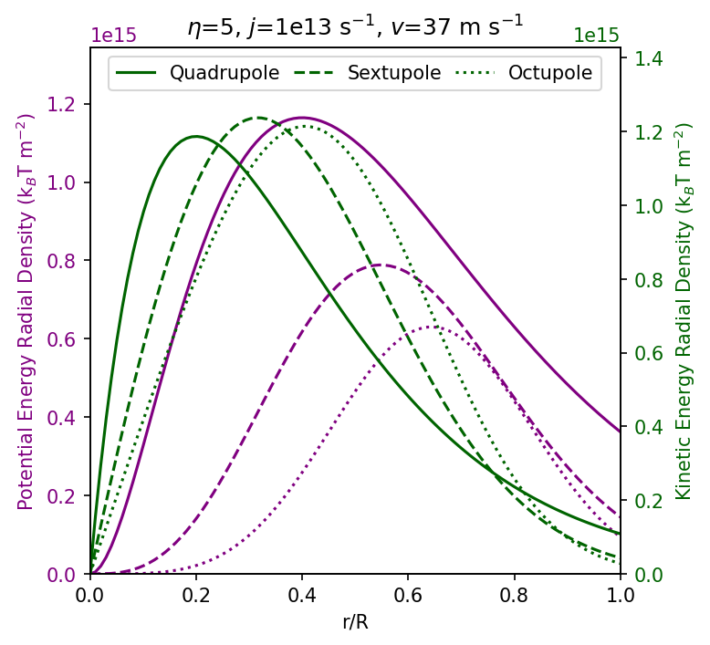
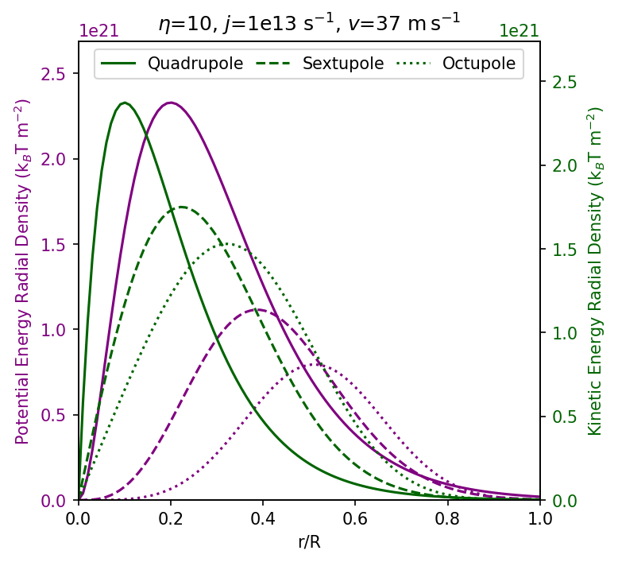
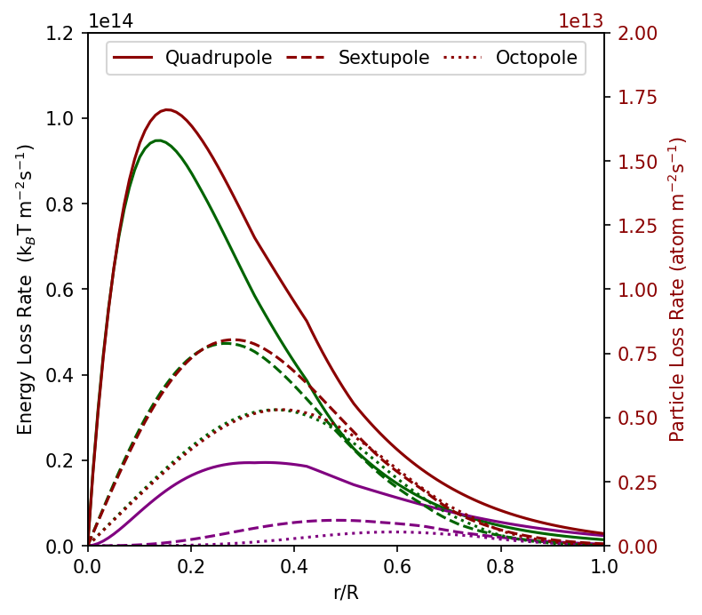
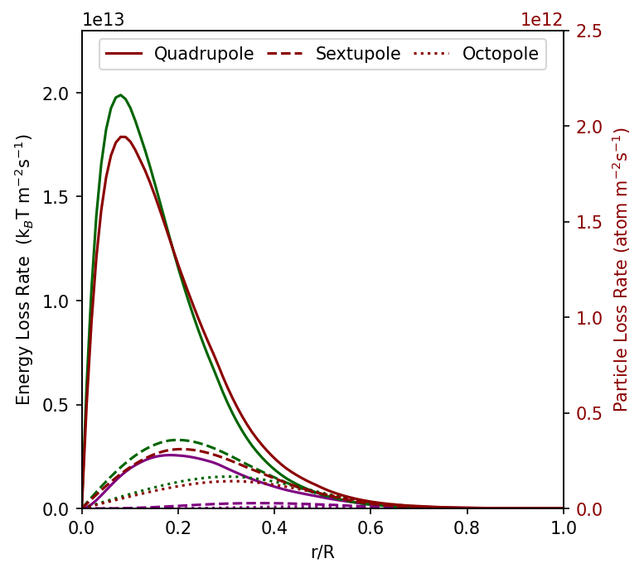
a
b
Kinetic Energy Density
Potential Energy Density
c
d
Kinetic Energy Loss Rate
Potential Energy Loss Rate
Particle Loss Rate

Slide 6
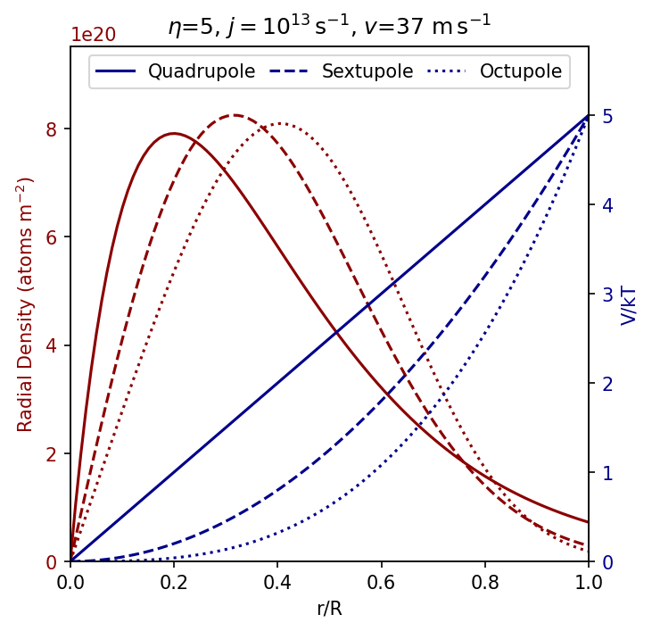
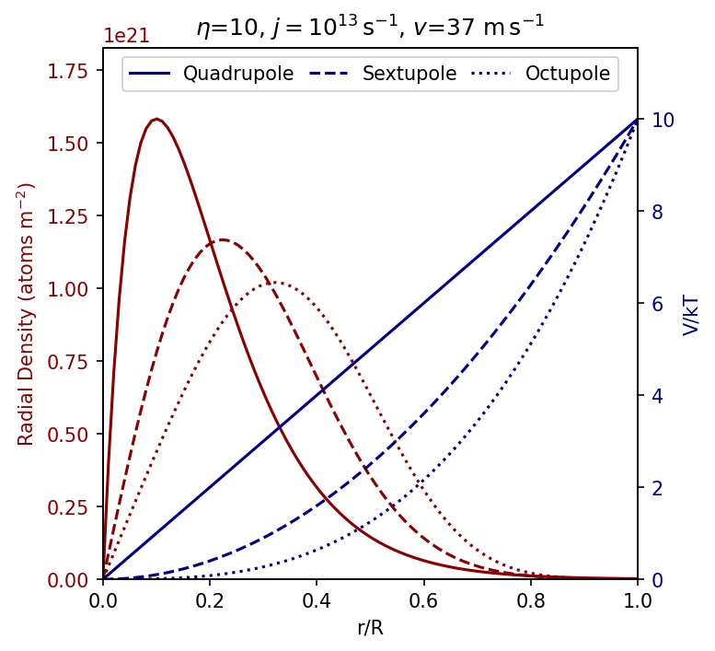
a
b

Slide 7
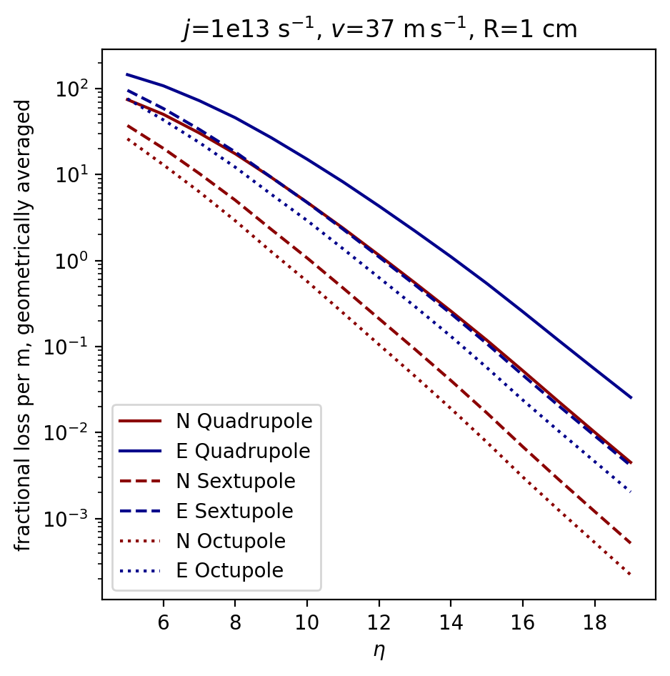
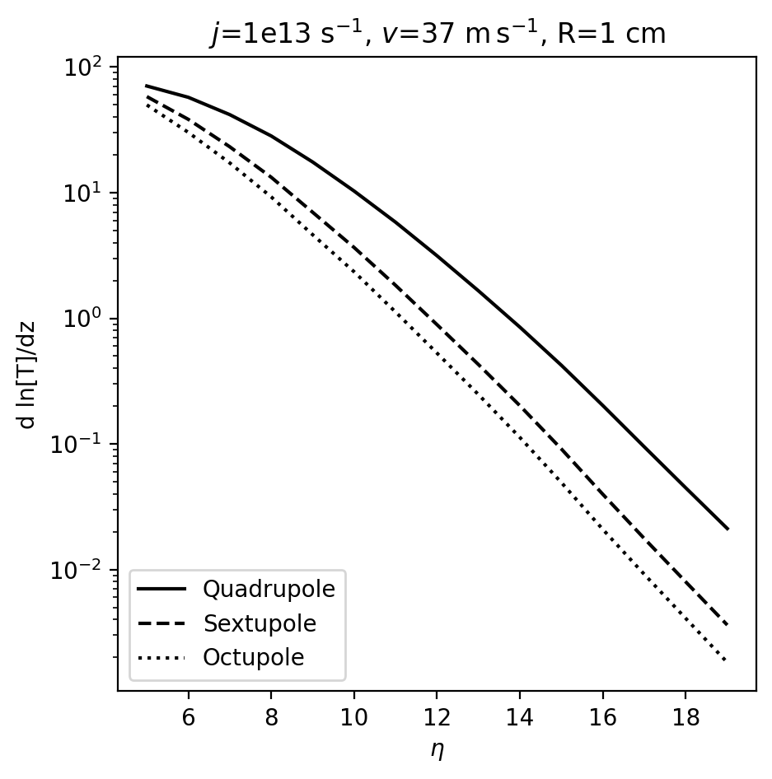
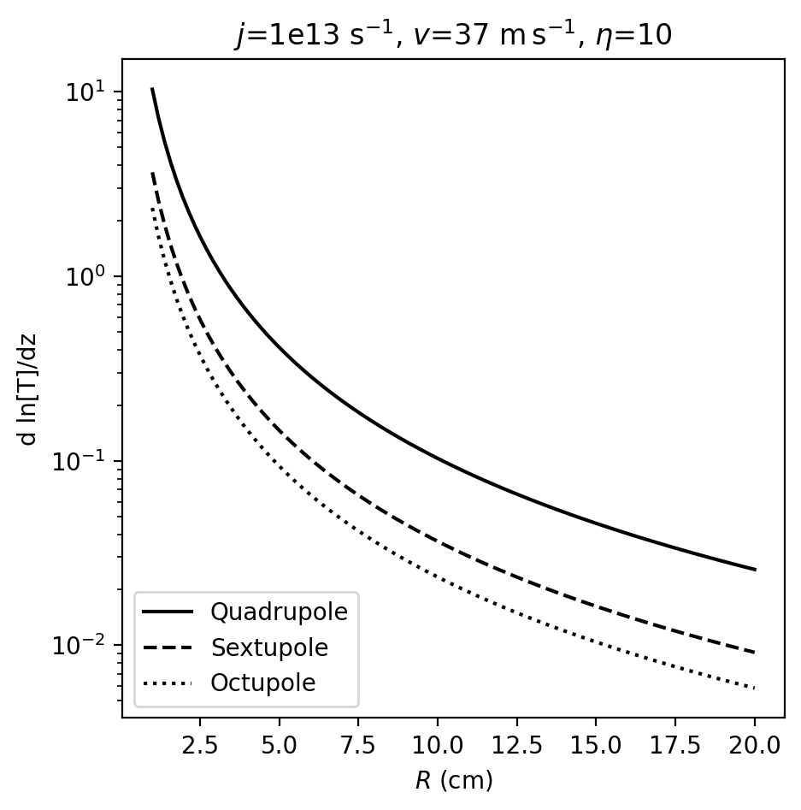
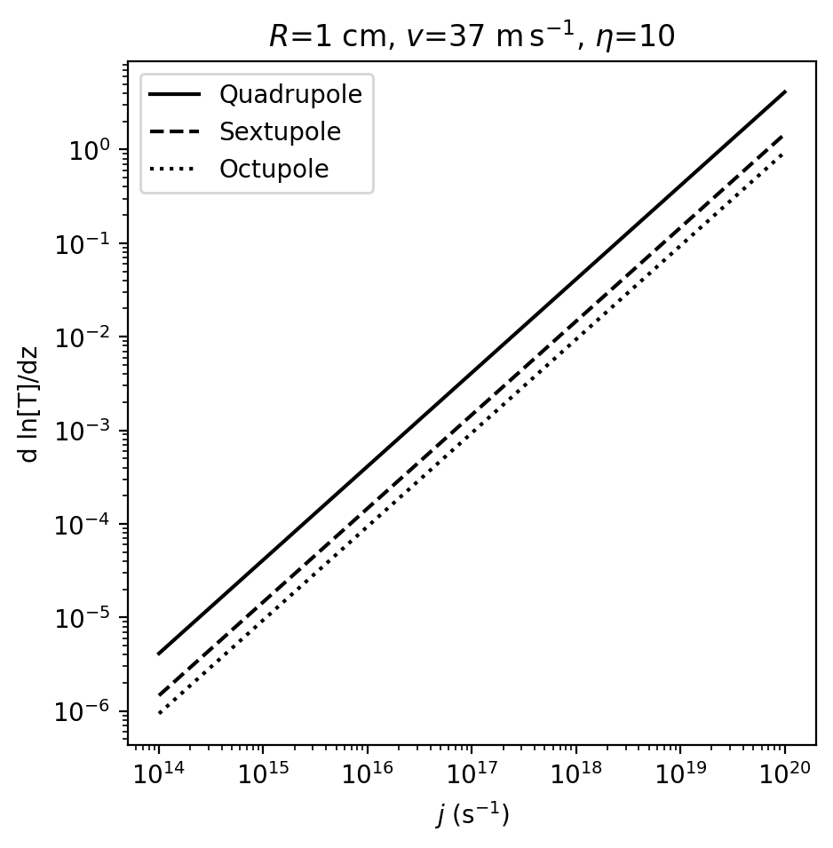
a
b
c
d

Slide 8
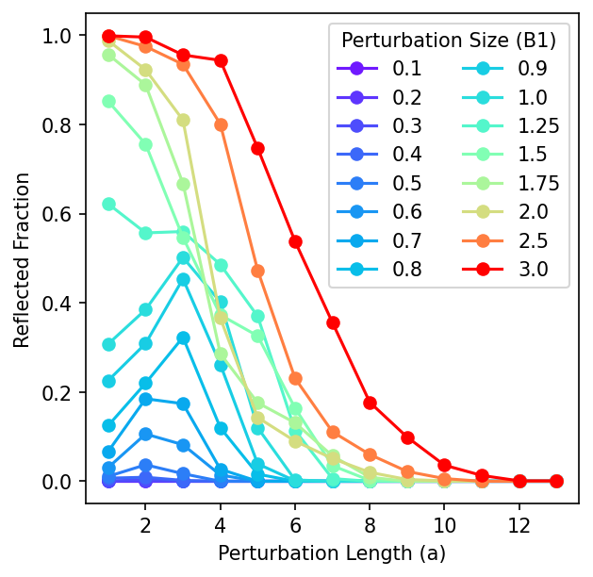
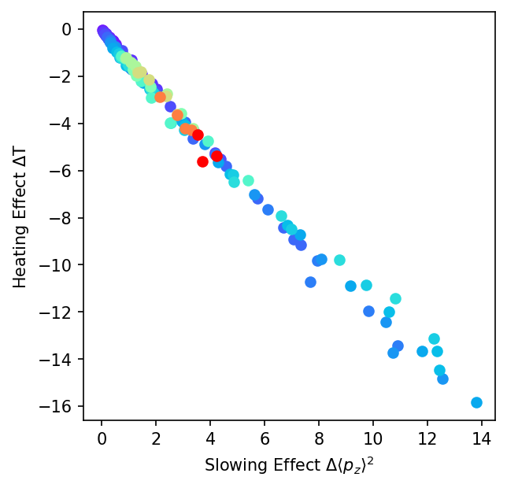
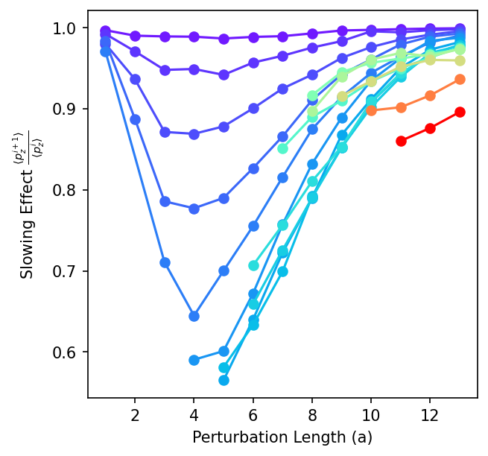
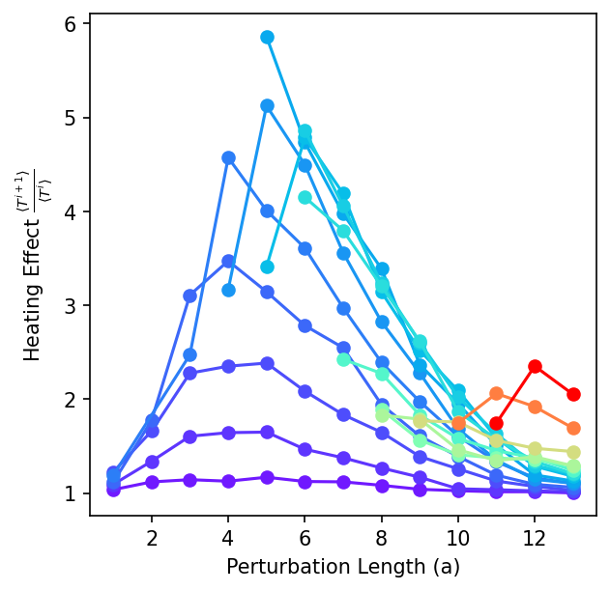
Notes:
In [ ]:

Slide 9
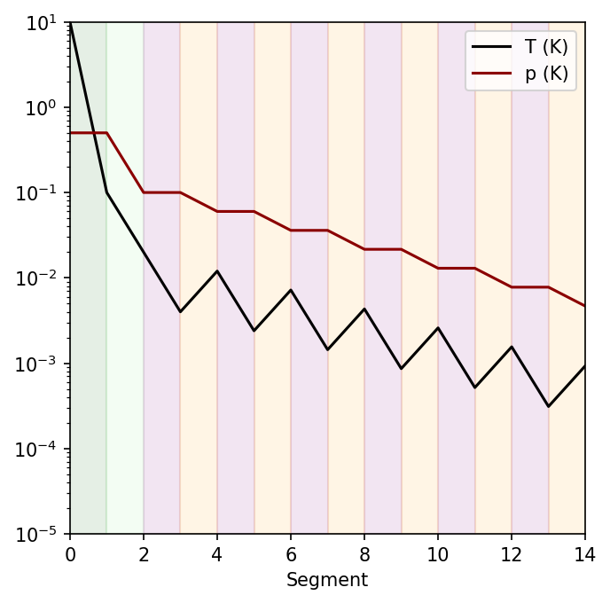
T or p (K)
Pre-cooler
Catcher
Cooling
Cooling
Cooling
Cooling
Cooling
Cooling
Slowing
Slowing
Slowing
Slowing
Slowing
Slowing

Slide 10
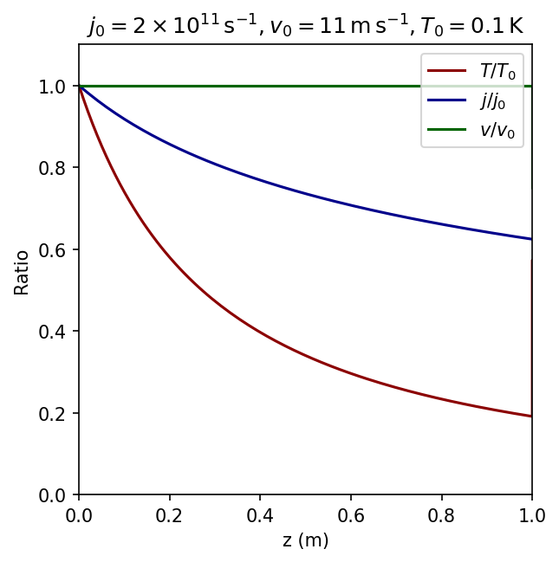
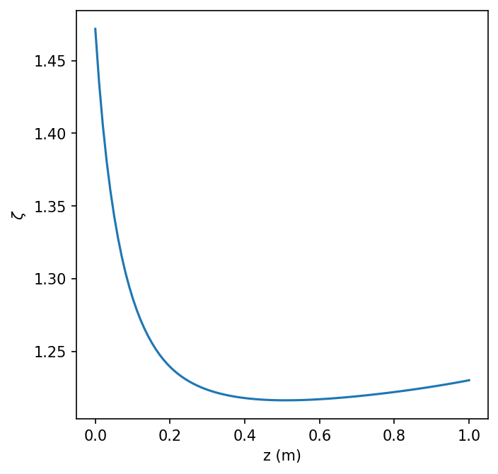
a
b

Slide 11
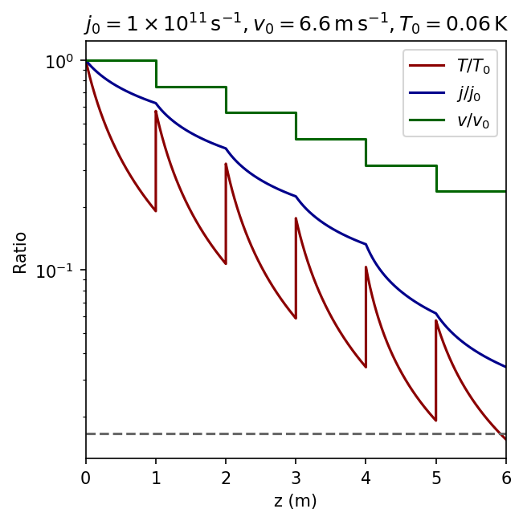
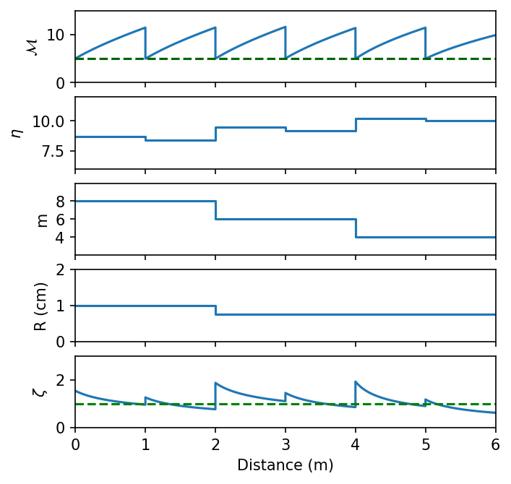
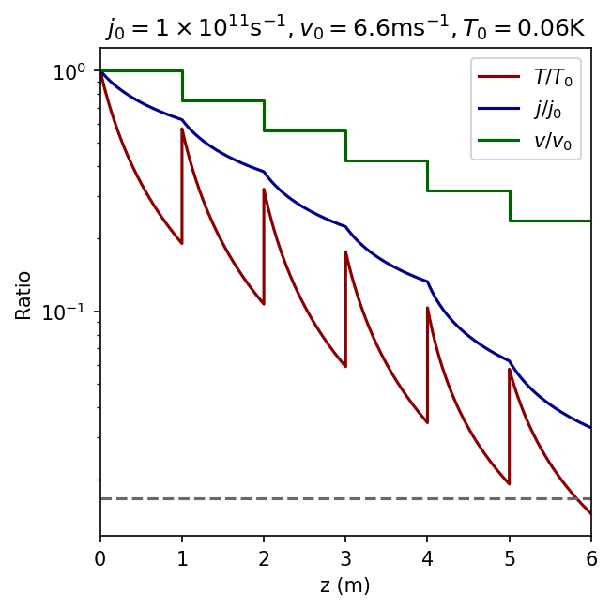
a
b
Octupoles
Sextupoles
Quadrupoles

Slide 12
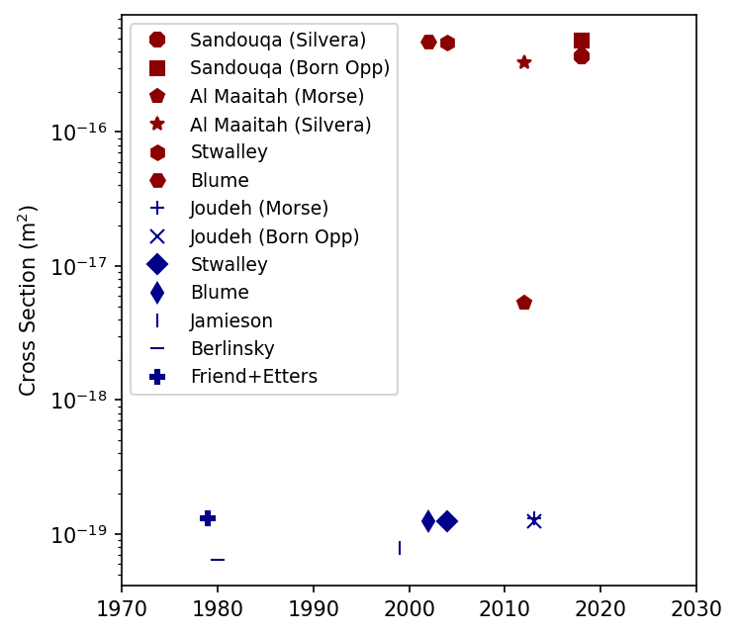

Slide 13
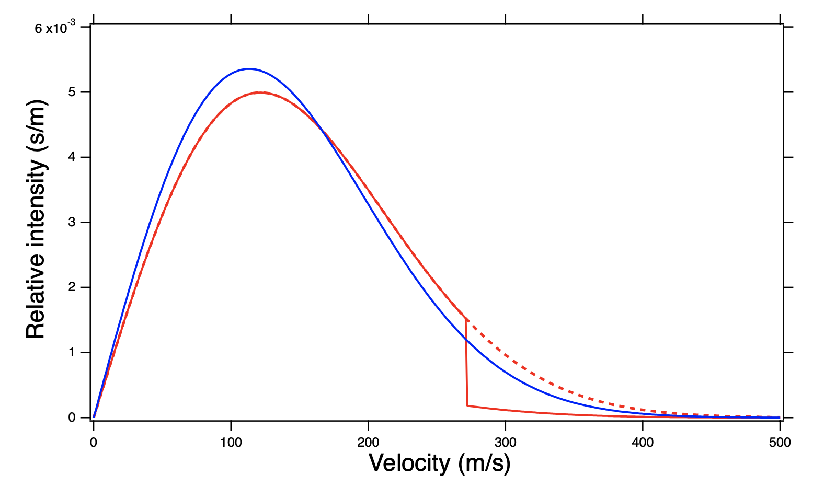
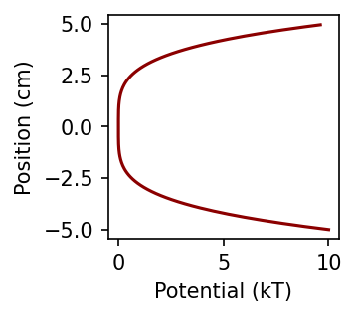
Highest energy atom escapes→
Multipole atom guide
“evaporation knife”

Slide 14
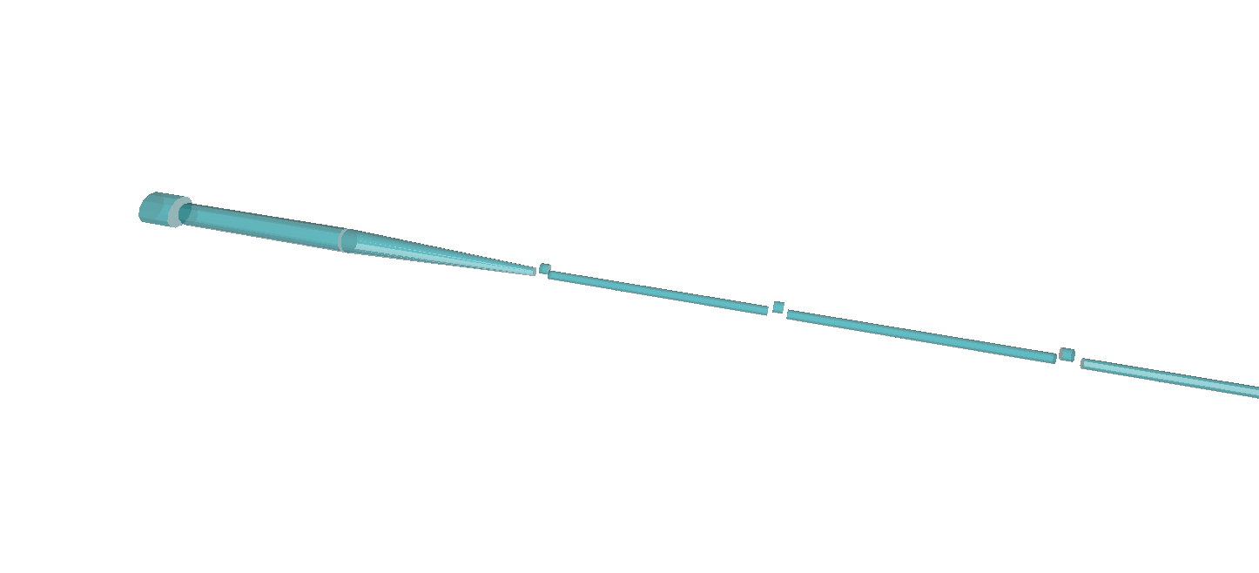
Summary of Lithium MECB Configuration
Zeeman
slower end
Catcher
Pre-cooler
Cooler-slower (6 units)
ɸ = 10¹² s⁻¹
v = 11 m s⁻¹
T = 1 K
ɸ = 2x10¹¹ s⁻¹
v = 11 m s⁻¹
T = 0.1 K
ɸ = 10¹¹ s⁻¹
v = 11 m s⁻¹
T = 0.1 K
ɸ = 10¹¹ s⁻¹
v = 6 m s⁻¹
T = 0.6 K
ɸ = 6x10¹⁰ s⁻¹
v = 6 m s⁻¹
T = 0.12 K
etc
ɸ = 4x10⁹ s⁻¹
v = 0.3 m s⁻¹
T = 0.001 K

Slide 15
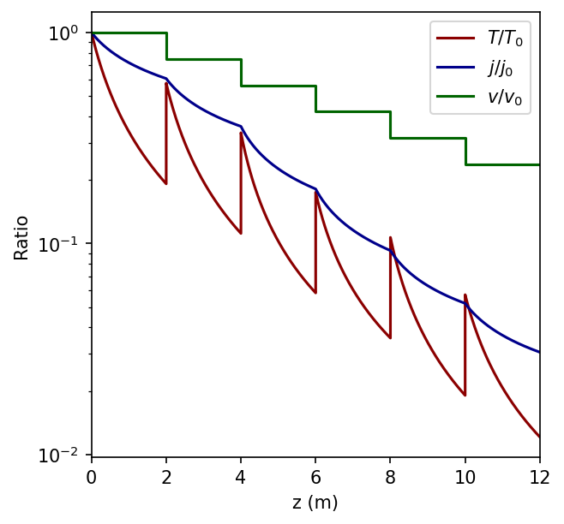
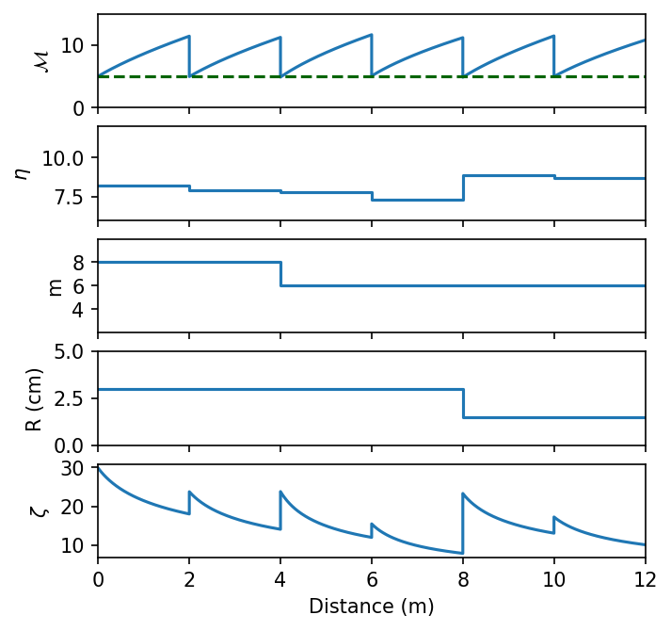
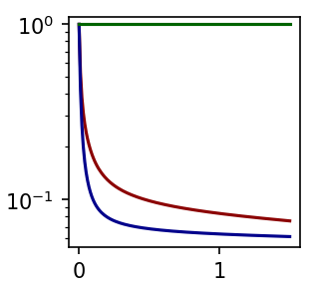
a
b
Cooler-slower
(8-poles and 6-poles)
Pre-cooler
(4-poles)

Slide 16
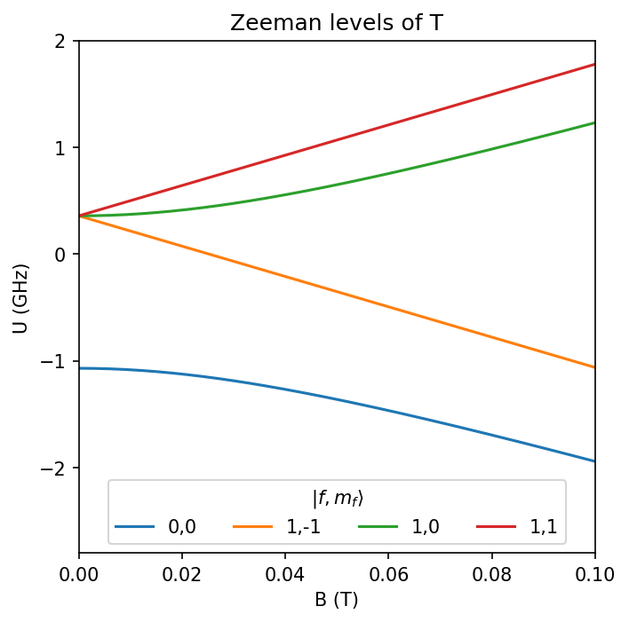
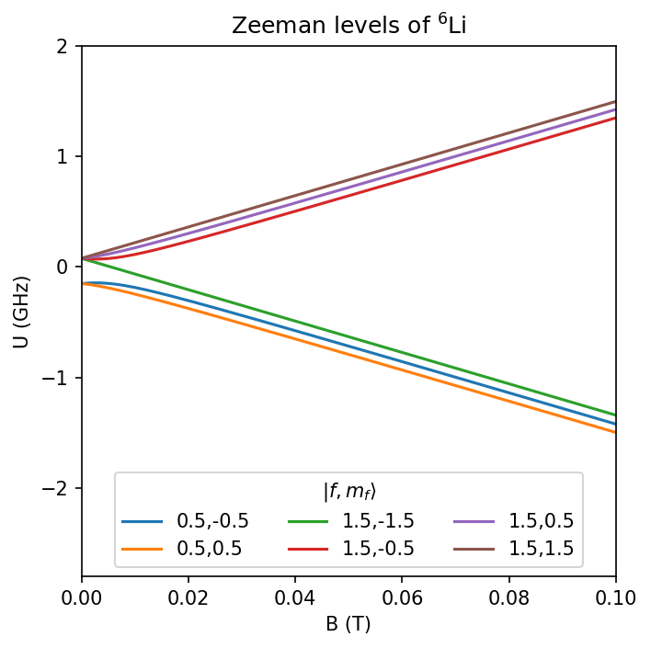
d
Trapped state
c
Trapped state
b
a

Slide 17
j (arb units)
considered in this work
Toward trap
T (arb units)

Slide 18
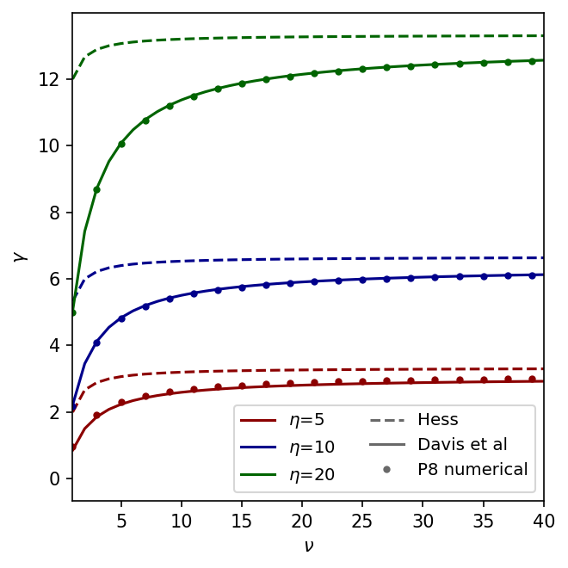

Slide 19
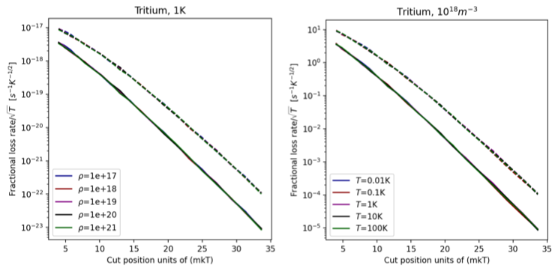
a
b

