Slide 1
Pythia: A Privacy Aware, Peer-to-Peer Network for Social Search
Shirin Nilizadeh, Naveed Alam, Nathaniel Husted, Apu Kapadia
School of Informatics and Computing
Indiana University Bloomington
WPES 2011

Slide 2
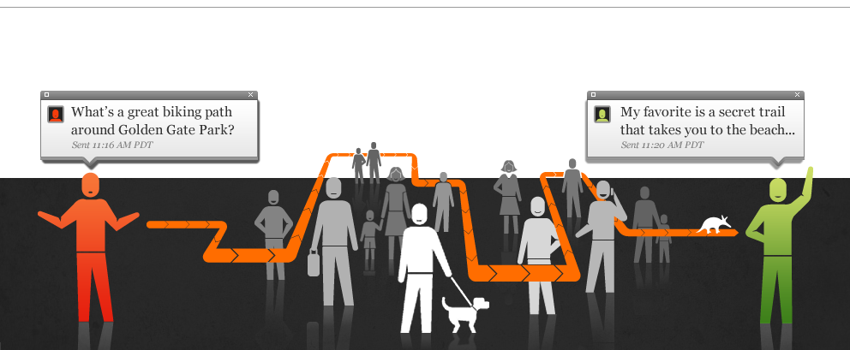
The “village model” Searching for the right person
Picture taken from vark.com
Notes:
There is a service online called Aardvark,
For example, Aardvark provides a service that does social search. I have taken this picture from their website.
Aardvark let people ask their complicated questions from other people in their social network. it connects askers with online experts who are close to the asker in the social network,
This is called village model which searches for the right person to answer your question
in contrast, …
All of us have some expertise and we are willing to help others with our expertise.
At the same time, in different occasions, we may have some questions looking for someone to answer them.
in addition, answers provided by our friends may be more valuable in many cases since we have more common
Social Search: leverage the power of social networks to connect askers with online experts who are close to the asker in the social network, thus facilitating live exchanges of information between real humans
Talk about social search examples: Aardvark, Facebook Questions,

Slide 3

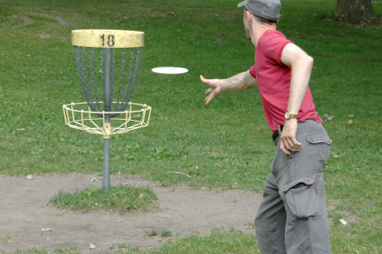
The “library model” of finding the right page, doesn’t always work (Not everything can be Googled!)
Q1. What is the best disc golf course at IU? I have decent skills and am looking for good challenges with trees and slopes. Also, a place that isn’t too crowded on weekend mornings.
Q2. I’m looking for a great course in computer security, and I see one being taught by Prof. Kapadia and another by Prof. Myers. Any experiences with them? Any comments on one vs. the other?
Notes:
- Library model, which finds the right page or document that already exists on the web. But it doesn’t always work because not everything can be googled.
For example, if some people like my advisor take disc golfing pretty seriously, may have this question that what is the best disc golf course at IU? He can not find the answer by searching the web
implications of asking and answering about other professors!
Or, a student may have this struggle that which course is better to take, the one taught by Prof. kapadia or Prof. Myers? It’s obvious that who has experience can answer the question and You may imagine that what will happen if the student say bad things about Prof. Kapadia and he becomes aware of them!
Q1. “some people like my advisor take this sport pretty seriously".
Q2. You may imagine that what will happen if the student say bad things about Prof. Kapadia and he becomes aware of them!
Aardvark s perfect for those times when you need a subjective opinion (“What’s the best Twitter app for iPhone?”) rather than an easily Google-able fact (“How much does Twitterific cost?”).
http://www.wiinintendo.net/2010/05/20/wiiware-zoo-disc-golf/

Slide 4
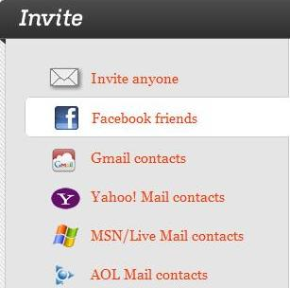
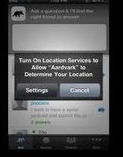
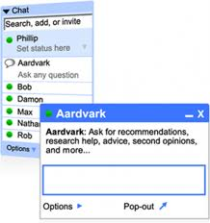
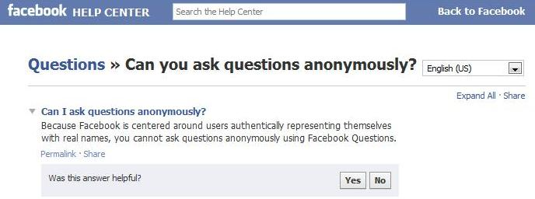
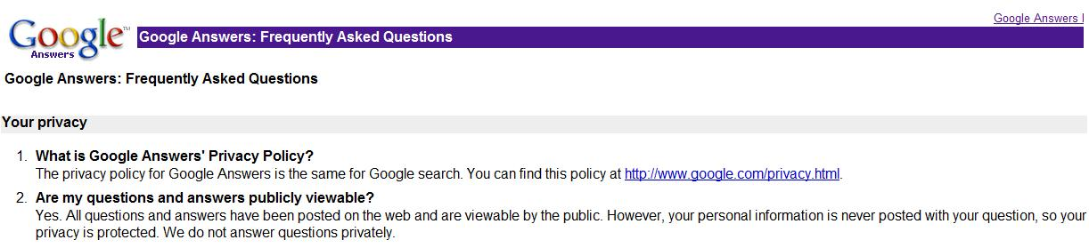
Centralized architectures leverage personal information to provide better answers but are not ideal for privacy
Aardvark Profile’s Privacy Policy (vark.com/privacy):
“We store information that we collect through cookies, log files, and explicit interactions with the service to create a "profile" of your preferences. We tie your personally identifiable information to information in the profile, in order to improve the content of the service for you. We do not share your profile with other third parties.”
Notes:
What is the problem with existing services? Well, they all have centralized architecture and they all have access to personal information and actually try to provide better answers based on this information.
Have access to personal information, who you are, who are your friends, what are you expertise, what are your questions and answers
iphone app for aardvark even asks for your location
People want to be anonymous
We know how Facebook and Google have access to all of our information.

Slide 5
Objective: Design a privacy-aware peer-to-peer social network to support sensitive Q&A
Notes:
The objective is to design a privacy-aware p2p social netwok to support Q&As
4In Greek mythology, Pythia was the gateway to the Delphic Oracle, “the most important oracle in Greece,” and “answered questions put to her by worshippers.”

Slide 6

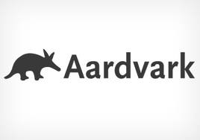

Our main goal is to provide “expertise unlinkability”
A3. At … Square at 4 pm! I expect 10,000!
Tag Bob with Syria activist
Q3. Where in Damascus will the protesters continue their protest today? How many people do you expect will join?
A2. Baath Party (governing party) , Arab Socialist Movement, Arab Socialist Union, etc.
A1. For President Bashar al-Assad to step down, for the ruling Baath Party to allow other political parties, equal rights for Syria's ethnic and religious groups, and broad political freedoms.
Tag Bob with Syria politics
Q2. What are active political parties in Syria?
Q1. Why are people in Syria protesting?
User Profile:
Username: Alice
Interests/ Expertise:
1- Texas Restaurants
2- Anthropology
User Profile:
Username: Bob
Interests/ Expertise:
1- Syria
2- Computers and Technology
Notes:
- The main property to maintain is expertise unlinkabilty which means that a peer’s private expertise should not be attributable to her identity.
- For example, Bob may be Syria activist who doesn’t want to advertise his association widely with the movement.
Consider he uses Aardvark and at the same time Alice asks aardvark about Syria protests. Since Bob has Syria in his profile, aardvark will send the question to him, he successfully answers the question and the conversation is built, Alice may ask about politics and he answers properly, they both aardvark and alice will link him to the Syria Politics. Is she askd about ongoing events and he responses very precise, he can be linked to Syria activist.
Ideally Bob is looking for such a system that cannot reveal his expertise and at the same time communicate with people who have questions.
- Expertise unlinkability: A peer’s private expertise areas should not be attributable to her identity beyond a certain threshold probability.
For example, Bob may be a pro-choice advocate who doesn’t want to advertise his association widely with the pro-choice movement.
We assume a threshold that is sufficient to provide plausible deniability. For example, some authors consider a probability of 0.5 to be sufficient [20]. We assume more conservative probabilities on the order of 0.1 to be sufficient for plausible deniability.
However, in cases where the prior probability is higher than 0.1, we say plausible deniability is attained if the threshold is below the prior probability.
- For example, if 33% of nodes in a community are experts on a particular topic, then if the attacker cannot infer Alice is an expert in that topic with probability more than 0.33, we say plausible deniability is attained.
Interest unlinkability: This property states that an asker’s private query tags should not be attributable to her identity beyond reasonable probability

Slide 7
Our P2P design supports private queries
and leverages social neighborhoods
Notes:
To provide such property, we proposed a distributed design that leverages social neighborhoods.
In our design we cluster social network to communities and questions will be flooded through these communities. Answers will be provided by the nodes in the community so answerers would be close to the asker in the social network.
The community is the anonymity set for the nodes in the community. So the size of communities is a trade off. Communities should be small enough to limit the overhead of flooding but large enough to provide an anonymity set that has reasonable degree of anonymity.
For details about the protocol please read the paper, here we present the highlights
each community has a representative,
when one has a question, he sends it to the representative through onion routing and the representative asks the question on behalf of him by flooding the question to the community. In the same way, answerers send the answers to the representative. And he will send them back to the asker through reply onion.

Slide 8
We evaluate the privacy provided against honest-but-curious attackers
Global Attacker: views all messages and infer the online/offline and idle status of all the nodes at any time
Colluding Attackers: some fraction of nodes are compromised and thus have partial knowledge
Capability: attackers can link (or not link) questions/answers from a particular expert
Notes:
nodes in the network participate in the protocol fairly but try to infer as much information as possible from passive observations
global attackers can view all messages exchanged in the system and infer the online/offline and idle status of all the nodes at any time. Colluding attackers have only partial knowledge of this type—we assume some
fraction of nodes c (0 < c < 1) are compromised and these colluding attackers can infer the online and idle status of their neighbors only, and view messages exchanged with their neighbors.

Slide 9
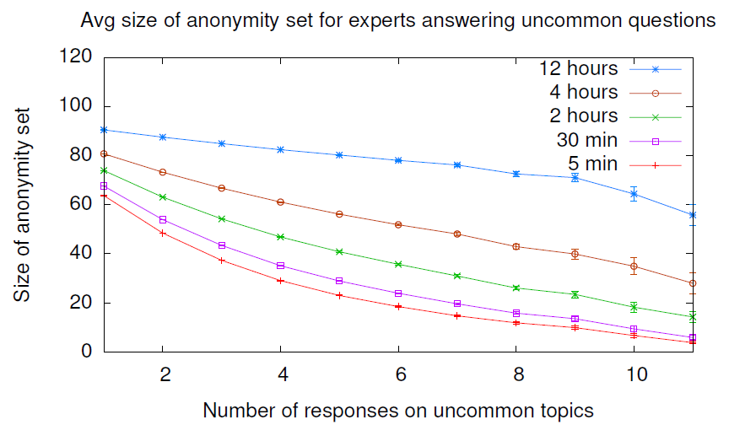
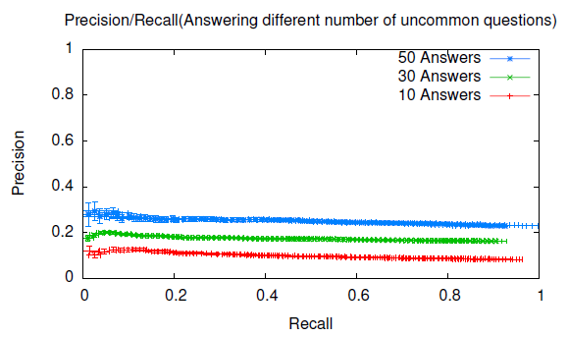
Anonymity of users degrades over time; however if answers are not linkable, anonymity improves greatly.
Simulation:
5 scale-free graphs with 60,000 nodes
Communities’ size: 85-115 nodes
Human models from Skype and Aardvark usage were used to simulate queries and answers.
Notes:
(read the paper, it has the details, here we present the highlights)
- We show the results for Global-linkable attacker and Global- unlinkable attacker
- 5 randomly generated scale-free graphs with 60,000 nodes using the NetworkWork Bench4 (NWB), tool and the Barabasi-Albert (BA) model.
Anonymity degrades when expert answers more questions since adversaries are able to narrow down the set of potential users that may be that expert.
This adversary is too strong, since we assume the adversary can link responses from the same expert together.
can learn less from global unlinkable,
The anonymity set degrades as you expected when more questions are answered.
The anonymity is fine when we have
plot shows the precision vs. recall for the adversaries, where each point corresponds to a particular position of the line in the sorted list of counts. The flat precision shows this attack is not successful in finding the answerers at top of the list and answerers are uniformly distributed in the list.
Figure 2 shows that experts have a high degree of anonymity against Global-Unlinkable adversaries.
The degradation of anonymity after four weeks of system operation under the Global-Linkable. Anonymity sets for experts were measured depending on how many questions they answered in the four-week period.
- We can see that for various levels of aggregation (time scales at which questions and answers are exchanged in the network) the anonymity set degrades faster for lower aggregation times and slower for higher aggregation times.
-
- In this attack, adversaries maintain presence counts of users while answers are received for sensitive topics. After 4 weeks, adversaries sort the list of answerers by descending order of counts, and draw a line after each answerer in the list with the hope that a large number of answerers are included in the list above the line.
Even after 4 weeks, the precision is at best 0.1 for rare topics, which provides plausible deniability.

Slide 10
Discussion
Shielding Participants keep track of their anonymity sets, and compute their loss of anonymity when they ask or answer questions.
Reputation Nodes could advertise their expertise along with reputation information for that expertise.
Incentives Our current model largely relies on altruism. In addition to reputation mechanisms, simple policies can help control freeriding
Notes:
Shielding sets.
Participants would recognize the set of users that are usually online while they are online, and only ask or answer questions when a large fraction of these users are online. Participants can thus keep track of their anonymity sets, and compute their loss of anonymity when they ask or answer questions.
Metrics. For expertise unlinkability, it would be better to characterize the probability of a person being an expert using the prior
probability to then calculate the posterior probability of being an expert based on the size of the anonymity set. This information
could be combined with other information relating to the estimate of how many experts are suspected to exist within the anonymity set.
Advertising. When nodes join the network, they may advertise their expertise using a DHT based approach. A representative can then select remote communities more efficiently and purposefully and direct questions to communities with potential answerers for a topic. However, a sophisticated method is needed to resist linkage attacks where joins/leaves of nodes in communities cannot be easily correlated with entries added/removed from the DHT.
Reputation. Nodes could advertise their expertise along with reputation information for that expertise. For example, users could
accumulate anonymous digital cash [2] for answering questions, and then prove their “wealth” as an indicator of reputation. A detailed reputation mechanism is outside the scope of this paper and we leave details for such a scheme to future work.
Incentives. Our current model largely relies on altruism. In addition to reputation mechanisms, simple policies can help control
freeriding; e.g., the number of questions that users can ask may depend on how recently the user has joined or on the number of questions that a user has answered. Incentive mechanisms could take into account the quality of answers provided, which could then be combined with a reputation system.

Slide 11

Thank you!

Slide 13
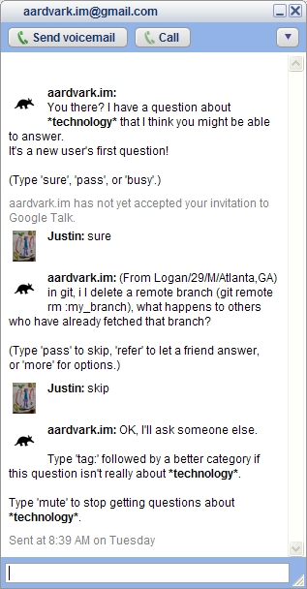


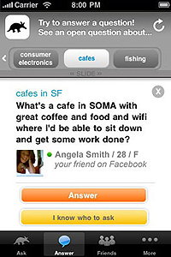
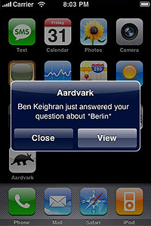



Q&A forums don’t actively locate experts
Pictures taken from touchtip.com
Picture taken from nerdliness.com
Notes:
- In Q&A forums, experts may answer questions but they don’t actively locate experts.
Questions must be posted on the website and experts will answer them if they check and see the questions. So it may take some days or months to get the answers.
Where as systems based on social search, where actively find the expert, ping the expert to answer and send a notification to the asker when the answer is ready.
- does not actively seek experts
- The service locates the expert and the expert getting pinged to answer a question through it’s messenger.
a notification that a question was answered.
Yahoo Answers!
Your question is open for others to answer for 4 days. You can extend or shorten this time period.

Slide 14
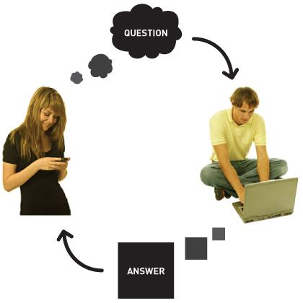


Social search leverages humans for more relevant results
Example
Where does the shoe company Nike get its name from?
Example
The company name was changed from BRS (Blue Ribbon Shoes) to Nike, Inc. in 1978. Named after Nike, the Greek goddess of the victory.
Picture taken from answers.chacha.com
Notes:
1- ask question
2- route the question to the knowledgeable person on that topic in their Guide community.
3- The answer is then returned within a few minutes.
Chacha: a search engine which brings a fundamentally different kind of intelligence to the problem - human brain power.
-“Guides” on the back end figure out the answer still using traditional searches
ChaCha employs people to help users sift through the results. This is cleverly done using a familiar chat interface. When you first come to the site, you are presented with a standard search box. Type in a query and you get back a traditional list of matches. if for some reason you are not happy with the quality of the results, you can request a chat session with a (human) Search Guide to help you find what you're looking for.
The ChaCha about section states:
"By searching with a Guide your query is sent to a real person who is skilled at finding information on the internet and knowledgeable on the subject at hand so that you get the few exact results you want, not the millions of results you don't. ChaCha only provides quality, human approved results.”
Netflix or something else? (Shirin: How Netflix leverage humans for more relevant results?)
These all still fall under the “library model”
I think chacha is somewhere in between of “library model” and village model. Since it benefits from both humans and documents.

Slide 15
A
I
I
R
R
I
I
A
I
R
R
I
Q
A
Which course is better to take , the one taught by Prof. Kapadia or the one taught by Prof. Menczer? Any experiences with them? Any comments on one vs. the other?
Representative floods the community asking if anyone wants to
answer a question about Classes at Informatics.
After formation of communities, users advertise their interests to the representative
using onion routing.
A user wants to answer – informs representative – gets acknowledgement – answers question

Slide 16
Our main goal is to provide “expertise unlinkability”
A3. At … Square at 4 pm! I expect 10,000!
Tag Bob with Syria activist
Q3. Where in Damascus will the protesters continue their protest today? How many people do you expect will join?
A2. Baath Party (governing party) , Arab Socialist Movement, Arab Socialist Union, etc.
A1. For President Bashar al-Assad to step down, for the ruling Baath Party to allow other political parties, equal rights for Syria's ethnic and religious groups, and broad political freedoms.
Tag Bob with Syria politics
Q2. What are active political parties in Syria?
Q1. Why are people in Syria protesting?
User Profile:
Username: Alice
Interests/ Expertise:
1- Texas Restaurants
2- Anthropology
User Profile:
Username: Bob
Interests/ Expertise:
1- Syria
2- Computers and Technology
Notes:
- The main property to maintain is expertise unlinkabilty which means that a peer’s private expertise should not be attributable to her identity.
- For example, Bob may be Syria activist who doesn’t want to advertise his association widely with the movement.
Consider he uses Aardvark and at the same time Alice asks aardvark about Syria protests. Since Bob has Syria in his profile, aardvark will send the question to him, he successfully answers the question and the conversation is built, Alice may ask about politics and he answers properly, they both aardvark and alice will link him to the Syria Politics. Is she askd about ongoing events and he responses very precise, he can be linked to Syria activist.
Ideally Bob is looking for such a system that cannot reveal his expertise and at the same time communicate with people who have questions.
- Expertise unlinkability: A peer’s private expertise areas should not be attributable to her identity beyond a certain threshold probability.
For example, Bob may be a pro-choice advocate who doesn’t want to advertise his association widely with the pro-choice movement.
We assume a threshold that is sufficient to provide plausible deniability. For example, some authors consider a probability of 0.5 to be sufficient [20]. We assume more conservative probabilities on the order of 0.1 to be sufficient for plausible deniability.
However, in cases where the prior probability is higher than 0.1, we say plausible deniability is attained if the threshold is below the prior probability.
- For example, if 33% of nodes in a community are experts on a particular topic, then if the attacker cannot infer Alice is an expert in that topic with probability more than 0.33, we say plausible deniability is attained.
Interest unlinkability: This property states that an asker’s private query tags should not be attributable to her identity beyond reasonable probability

