Slide 1


Cachet: A Decentralized Architecture for Privacy Preserving Social Networking with Caching
Shirin Nilizadeh,¹ Sonia Jahid,² Prateek Mittal,³ Nikita Borisov,² Apu Kapadia¹
Indiana University Bloomington
University of Illinois at Urbana-Champaign
University of California, Berkeley
CoNEXT 2012

Slide 2
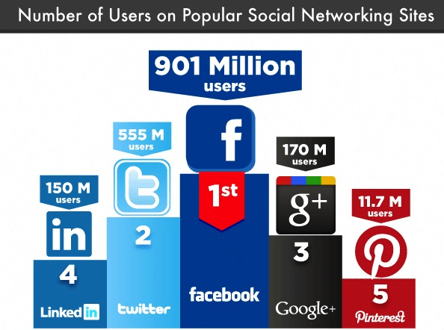


Online Social Networks (OSNs) have revolutionized the way we communicate
Credit:
Dave Larson, Infographic: Spring 2012 Social Media User Statistics, http://blog.tweetsmarter.com/social-media/, May 2012
Notes:
In the last decade, online social networks (OSNs) such as Facebook, Google+, and Twitter have revolutionized the way our society communicates and have become the de facto mechanism for information sharing between users. Their user bases exceed hundreds of millions of users and their adoption is still growing at a rapid pace.1

Slide 3
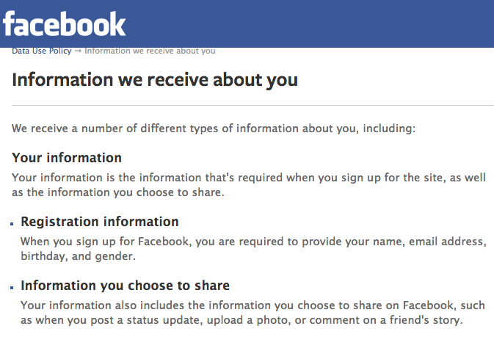

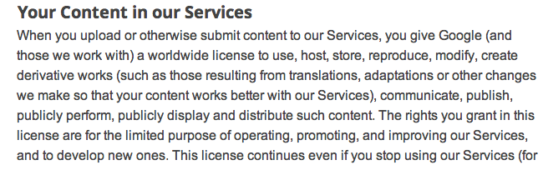
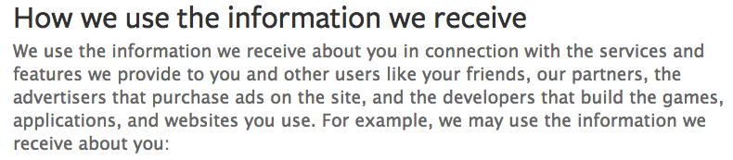
But at the cost of privacy: Users are not in control of their data
You give Google a worldwide license to use, host, store, reproduce, modify, create derivative works, communicate, publish, publicly perform, publicly display and distribute such content.
our partners, the advertisers that purchase ads on the site and the developers that build the games, application and websites you use.
Notes:
However, the success of OSNs has come at the cost of user privacy.
However, these designs suffer from a key problem:
the social network provider has full access to the user’s data, and, in fact, several providers have been caught selling user data
Online social networks (OSNs) such as Facebook and Google+ have revolutionized the way people interact and are being used by hundreds of millions of users across the world.
Underline the sharing with third parties

Slide 4
Objective A decentralized and efficient architecture for social networking that provides strong security and privacy guarantees

Slide 5
Security and Privacy Requirements
Confidentiality
Content should be accessible to only those who are authorized
Integrity
No one should be able to perform unauthorized updates to the data
Availability
User content should remain available, even if the owner is offline, and despite potential malicious attempts to destroy the data
Flexible Policies
Fine grained access control, e.g.,“(friend AND co-worker) OR family”
Relationship Privacy
Relationships between users should remain hidden from third parties
Adversary model
Storage nodes untrusted with data & relationships, social contacts trusted
DHTs can tolerate up to 25% of malicious nodes, focus is not on routing-based attacks, Sybil or DoS attacks
Notes:
What are the requirements of such distributed system?

Slide 6
Existing mechanisms for decentralized privacy-preserving social networking
Without support for encryption
Diaspora [http://joindiaspora.com]
“…barring some revolutionary design as yet unthought-of…”
LotusNet [Aiello et al. ’12]
Lack fine-grained policies
SafeBook [Cutillo et al. ’09 ], PeerSoN [Buchegger et al. ’09]
Better policies, but high overhead of revocation, trusted stores
Persona [Baden et al. ’09]
Pure gossip, less availability
[Mega et al. 2011]
Notes:
Using cryptography to protect the contents stored by a centralized OSN provider
No relationship privacy, users’ interactions can be monitored, and their content can be censored or removed
our view, however, is that this does not sufficiently protect users' privacy as it allows the provider to learn user relationships and patterns of interactions by means of traffic analysis.
Previous work on decentralized OSNs [3, 7, 13, 18, 22, 40] has explored several design decisions: how nodes are organized (in a structured distributed hash table (DHT) or with links between social contacts), where content is stored (by the owner, social contacts, or in a DHT), how it is disseminated (push or pull), and how access control is enforced (cryptographically or with online authentication). We argue that to efficiently support the complex functionality of an OSN, a combination of methods must be used. For example, replicating data at random DHT nodes ensures its availability even when users are online; however, assembling a newsfeed requires thousands of DHT lookups and, as we saw in our preliminary work [32], can take hundreds of seconds to generate. Likewise, encrypting stored content can provide strong confidentiality guarantees, yet we found that we need online authentication of updates and annotations to ensure the availability of data. Furthermore, attribute-based encryption schemes that provide highly fexible policies are computationally expensive and contribute significantly to the above performance overhead.

Slide 7
Basic Architecture
A slightly different version of this architecture was presented in 4th IEEE International Workshop on Security and Social Networking (SESOC '12), Switzerland, Mar 19, 2012.
Notes:
Sonia Jahid, Shirin Nilizadeh, Prateek Mittal, Nikita Borisov, and Apu Kapadia, "DECENT: A Decentralized Architecture for Enforcing Privacy in Online Social Networks", 4th IEEE International Workshop on Security and Social Networking (SESOC '12), Lugano, Switzerland, Mar 19, 2012.

Slide 8




Users’ Information is stored in a Distributed Hash Table (DHT)
Carol
Visit Alice’s status
Eve
Bob
Alice’s Status update
Alice
Alice’s Status update
Alice’s Status update
Alice’s Status update
Alice’s Status update
Notes:
Replace circles
Go to animation and talk about DHT
To ensure availability despite node churn and malicious attacks, several replicas of an object are maintained.
Objects in DECENT are stored in the DHT using the object ID as the key.
Several replicas of an object
Write policy prevents malicious users from creating modifications that will be accepted by the readers
DECENT DHT supports an append request, which is used to add a comment reference to an existing object.
The Storage nodes are not able to
Relate data to its owner
Figure out data owner’s social graph

Slide 9
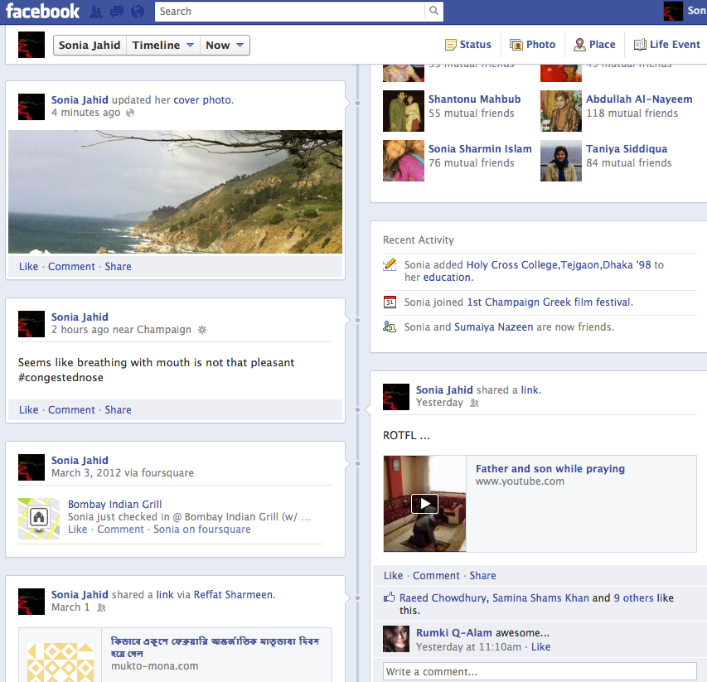
Cachet uses an object-oriented data structure
Alice’s Status
Object
Data
Policy
Reference List
Status Message
Status
Read
Write/Delete
Append
Video
Object
Like!
Bob’s policy
Link
Comment
Bob’s Comment
Notes:
Check with Sonia about her page
Types of objects in OSN are diverse and complex:
Text, links, photos, videos, or a collection of objects (e.g., a photo album), …
Objects can have some other objects attached to them: comments, likes, …
Container object: the main content and a list of comments/annotations
A user’s proﬁle is a root object
Each user’s content is organized in a hierarchical fashion
Read policy (R policy) : an attribute-based policy
Write policy (W policy): an identity-based policy (owner)
Append policy (A policy): an attribute-based policy

Slide 10






Attribute Based Encryption supports flexible confidentiality policies
OR
Attribute-based encryption (ABE)
User-defined attribute-based policy
We extend EASiER [Jahid et al. ‘11] (e.g., friend-of-friend attributes, thresholding)
Previous schemes do not provide flexible policies and efficient revocation
AND
Colleague
Friend
Neighbor
Alice
Bob
Carol
Diana
friend,
neighbor
colleague
friend,
colleague
Notes:
Talk about how other schemes do not provide …. (non-ABE vs ABE)
[1] S.Jahid, P.Mittal, N.Borisov, EASiER: Encryption-based Access Control in Social Networks with Efficient Revocation
Alice assigns attributes to her friends
Sends decryption keys corresponding to the attributes to friends
Encrypt the object
Each user issues different encryption keys to social contacts based on their attributes.
AB policies can represent formulas over attributes, using operators such as ^ , _ ,

Slide 11
Providing confidentiality and integrity (read, write and append policies)
APK
WPK
ABE(ASK,AP)
Enc(K_{Alice}, WSK)
Symmetric Encrypted with K
Alice’s wall
Alice’s status
Ref to Alice’s status =
(objID; ABE(K; P); WPK)
List of references to other objects
…
Ref to object n
Sign with WSK
Ref to a comment
Sign with ASK
Notes:
DHT nodes also implement a special append operation that adds a new annotation to the object while leaving existing content unmodified. When objects are being
stored at malicious nodes, confidentiality is still preserved due to cryptography. However, the malicious nodes can impact the integrity and availability guarantees by deviating
from the protocol, e.g., by deleting objects and/or returning previous versions of objects. Malicious nodes in the DHT can be tolerated using replication.

Slide 12
Downloading and reconstructing a wall or an aggregated newsfeed is a lengthy process
Retrieve and ABDecrypt ‘update’ objects
Retrieve new objects from DHT
Decrypt updates with symmetric keys.
Bob: Check my newsfeed
Symmetric Decryption
ABDecryption
Bob’newsfeed:
Alice’s recent update
Carol’s recent update
.
.
.
Bob
Alice’s update: Ref. to Status 2000
Alice’s status: Status 2000
Alice’s update: Ref. to Status 2000
Alice’s status Status 2000
Alice
Carol’s update:
Ref. to Photo 54
Carol’s photo 54
Carol’s update:
Ref. to Photo 54
Carol’s photo: Photo 54
Notes:
Put the names of alice and bob
Our preliminary analysis [32] indicates that these operations can take hundreds of seconds, and thus the design needs to be improved for practical deployments
Let’s assume that every user have an update object that contains reference to the latest created object. Now, if Alice, …

Slide 13
Social Caching leverage social trust relationships to reduce expensive decryption operations
Notes:
a gossip-based social caching algorithm that, in combination with an underlying DHT, leverages social trust relationships for dramatically increased performance and reliability

Slide 14
Online social contacts can provide decrypted objects to contacts who also satisfy the policy
Alice’s Status
Read Policy: Bob and Carol
Alice’s Status
Read Policy: Bob and Carol
Carol
Eve
Bob
Alice
Alice’s Status
Read Policy: Bob and Carol
Alice’s Status
Read Policy: Bob and Carol
Alice’s Status
Read Policy: Bob and Carol
Alice’s Status
Read Policy: Bob and Carol
Notes:
Nodes maintain continuous secure (SSL) connections with online contacts to receive updates directly as soon as they are produced. We describe a presence protocol, which itself uses social caching for finding online contacts. Since ABDecryption of objects is a time-consuming bottleneck, online social contacts who satisfy the ABE policy are leveraged to provide cached, decrypted objects to other contacts who also satisfy the policy for objects related to online contacts. We emphasize that a data object is not cached by a social contact unless he/she satises the ABE policy.
The basic object structure in Cachet is extended to include a list of users' IDs that are authorized to decrypt and read the object. Therefore, an object can be forwarded to/cached by the intersection set of one's social contacts and the users in the attached list, and the ABE policies are honored as before.

Slide 15

Need to build the social overlay first: The presence protocol is also decentralized
Presence object
Carol
Eve
Bob
Presence object:
<Current IP address, Port>
Alice
Presence object
Presence object
Presence object
Notes:
Usually a centralized server keeps track of users' presence information (e.g., their current IP address) in P2P networks. In Cachet a distributed approach is applied where every peer stores a presence object in the DHT so that social contacts can obtain a peer's presence information at any time.
The presence object has the same structure as other objects, and is ABEncrypted so that the storage node cannot learn the contents of the presence object. It contains the peer's current IP address, and port. With this IP address, peers can connect to their social contacts directly and maintain live connections. The object is signed so that the storage node only allows the owner to update or rewrite it.
Whenever a peer joins or leaves the Cachet network, it updates its presence information.
Note that retrieving and decrypting presence objects for all of one's social contacts will have overhead similar to constructing a newsfeed directly from the DHT. To speed up this process presence objects are cached using gossip-based social caching along with content updates. As such, once a few social contacts have been located, discovery of other contacts can proceed at an accelerated pace. Once links to online contacts have been established, subsequent updates are pushed to online contacts directly using the caching protocol described next.

Slide 16
Gossip-based social caching algorithm: A greedy approach
Creating the Presence Table
Selecting a Contact; If all contacts are visited or known to be offline, proceed to step 7
DHT Lookup and Connection
Pulling Information
Caching Information
Updating Presence Table; returning to Step 2 to locate the next social contact to connect to.
Performing DHT Lookups for online social contacts with No Mutual Social Contacts
Update
object
Carol
Presence object
Eve
Update
object
Presence
object
Diana
Update
object
Bob
Presence object
Update
object
Update
object
Mary
Alice
Friend | # mutual friends | On/Off
Bob | 25
Carol | 20
Mary | 13
Diana | 7
Eve | 2
Friend | # mutual friends | On/Off
Bob | 25 | On
Carol | 20
Mary | 13
Diana | 7
Eve | 2
Friend | # mutual friends | On/Off
Bob | 25 | On
Carol | 20 | Off
Mary | 13
Diana | 7 | Off
Eve | 2 | On
Friend | # mutual friends | On/Off
Bob | 25 | On
Carol | 20 | Off
Mary | 13 | On
Diana | 7 | Off
Eve | 2 | On
Presence object
Presence object
Notes:
When a node comes online and joins the Cachet network, it does not have the presence or newsfeed information for any of its social contacts. We now describe the caching algorithm used to progressively retrieve cached, unencrypted versions of these objects to greatly speed up the process of loading the newsfeed.
1- lists all social contacts along with their presence statuses, The social contacts are listed in descending order based on the number of mutual social contacts in common with P
2-unvisited contact Q from the presence list as follows. P chooses the first contact in the presence table whose status is known to be online. If none exist, then it chooses the top contact with an undfiened status. If all contacts are visited or known to be onine, P proceeds to step 7;
Our algorithm seeks to minimize the number of such decryptions (corresponding to DHT lookups for the objects) by dynamically learning which peers yield the most cached objects.
The basic idea of the caching algorithm is for the user to perform a few DHT lookups to get presence objects of some social contacts. Then, she identifies those who are online and contacts them to 1) inform them that she is online, and 2) pull both the cached presence objects and the cached recent updates of their mutual social contacts.
A user:
Performs a few DHT lookups to get presence objects;
Contacts online social contacts and pulls both the cached presence and update objects;
Recursively repeat these steps until no new contacts are obtained.
The user then uses the new unencrypted presence objects to recursively repeat the two steps above until no new contacts are obtained. At this point another DHT lookup is made for a social contact whose status is unknown and the process is repeated until the presence and status objects of all contacts have been obtained. If a user is contacted by a social contact Q who was online before,
Gossip-based protocols are reliable and robust tools for data dissemination especially when used in P2P and wireless networks [9, 10, 20, 29, 42]. However, relying purely on gossip protocols for disseminating updates through the social network has some drawbacks: 1) redundant information is passed around and stored in the network, even at nodes that do not desire this information; and 2) social circles have correlated patterns of online presence, making it challenging to ensure availability when large parts of a circle are offine.

Slide 17
We built a simulator to study cache performance
Newsfeed application, prototype in Java
Simulation environment
FreePastry Simulator
Social graph: Facebook friendship graph from the New Orleans regional network with 63,732 nodes and 1.54 million edges
10%, 30%, 50% online friends
Based on Skype statistics, the 10-30% range is more pertinent
Performance metrics
hitRate = fraction of newsfeed constructed from cache
progressiveHitRate(d) = fraction of newsfeed after d lookups
Notes:
The 10-30% range is perhaps more pertinent because, for example, Skype has about 45M concurrent users online and 200M active users per month
Hit Rate: the percentage of the newsfeed or the presence objects that has been provided by social contacts.
Let em be a single unit experiment for a user u with m social contacts. Let d be the number of DHT lookups (involving ABDecryptions) that have been performed for obtaining either u's newsfeed or u's social contacts' presence objects, then:
Progressive hit rate: the percentage of the newsfeed or the presence status objects that have been obtained after d DHT lookups and pulling social contacts' cached objects
Let em be a single unit experiment for a user, u, who should retrieved presence information of m social contacts and let (d) be the number of obtained social contacts’ presence or status objects after d DHT lookups, then

Slide 18
Social caching provides most of the newsfeed… …but not all of it (need the DHT)
Notes:
Trade off between 10% better performance and privacy leakage (online/offline status /activity level of FoFs will be revealed). There also would be more communication overhead for transmitting and caching FoFs’ presence objects.
The average Newsfeed Hit Rate as a function of the number of updates and the fraction of online social contacts. It can be seen that social caching provides most of the update objects needed for viewing the newsfeed. By comparing the two figures it can be seen that leveraging FoFs increases the hit rate slightly, but the difference is not great.

Slide 19
Most of the social cache’s benefit comes from the first ~15 DHT lookups
The Average Progressive Hit Rate for users who have 100 to 200 social contacts
Notes:
30% is reasonable
Just a few (5) lookups you get
This Figure shows the Average Progressive Hit Rate for users who have 100 to 200 social contacts. It can be seen that after a few DHT lookups, users learn about online/oine status of most of thier social contacts. Similarly, most of newsfeed up- dates can be retrieved after performing a few DHT lookups and contacting the identied online social contacts.

Slide 20
Speedup of loading the newsfeed: 5X-10X (25X-50X for the first 80-90% updates)
Even with only 10% of social contacts online, social caching provides performance improvement.
Notes:
This Figure shows the latency for retrieving the newsfeed in Cachet both with and without social caching enabled.
We simulate the cryptographic operations for EASiER [31] with 1 attribute policy and 100 revocations run on a standard machine with 2.40GHz Intel Core 2 Duo, 4GB memory, and running Ubuntu 10.04. With this setting, the ABDecryption takes 422ms. The symmetric key decryption (openssl aes-128-enc) takes 0.04ms on a le of size 2500 bytes, the average size of a status update object. We simulated the communication overhead between peers by setting the average communication latency to be 180ms.

Slide 21
Discussion: Can we deploy Cachet today?
Privacy issues
Users are aware of being excluded, policies to linked objects are visible
Identities of users who satisfy a particular policy will be known to all of those identities
Deployment challenges
node churn, NAT
Replace Facebook?
Maybe, hopefully, but not necessarily the goal
Add {c|C}achet to P2P networks that use social links
Skype, Tor, BitTorrent, …

Slide 22




Cachet…
is a decentralized approach for privacy-preserving OSNs
uses attribute-based encryption for flexible confidentiality and integrity policies
is a DHT and a social-overlay hybrid for better availability
Shirin Nilizadeh
Sonia Jahid
Prateek Mittal
Nikita Borisov
Acknowledgments and Disclaimers
This material is based upon work supported by the National Science Foundation under Awards CNS-0953655 and CNS-1115693, by the Boeing Trusted Software Center at the University of Illinois and by the National Security Agency. These sponsors don’t necessarily share our views.
Notes:
We have presented Cachet, a decentralized architecture for social networks that provides strong security and privacy guarantees while eciently supporting the central functionality of OSNs. Cachet uses an object-oriented design for flexible data management, attribute-based cryptography for access control, and a hybrid combination of distributed hash table and social contacts for information retrieval. The use of social contacts is the key to making the architecture practical; social contacts in Cachet not only provide information about their own updates, but also about updates from other mutual contacts. Our experimental evaluation using the FreePastry simulator shows that the average time to reconstruct an aggregate newsfeed is less than 10 seconds, as compared with hundreds of seconds without the use of social caching. Our architecture thus demonstrates that a decentralized approach to privacy-preserving social networking is practical
ACKNOWLEDGMENTS
This material is based upon work supported by the National
Science Foundation under Awards CNS{0953655 and
CNS{1115693, by the Boeing Trusted Software Center at the
University of Illinois and by the National Security Agency.

