Slide 1
SuperChat
By: Group 2

Slide 2
Requirements Volatility

Slide 3
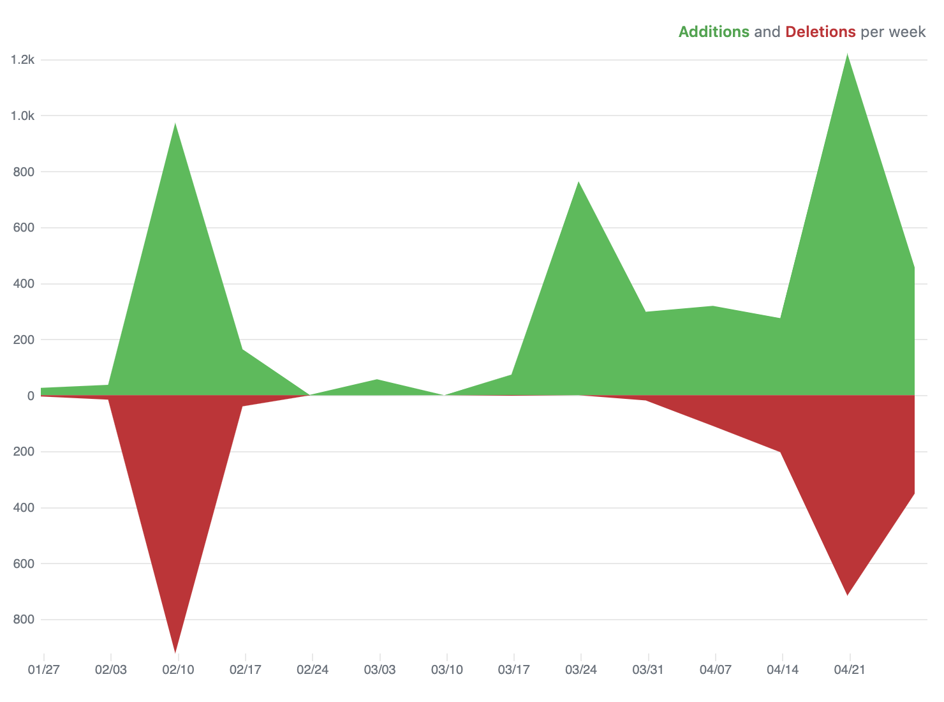
Code Changes

Slide 4
Gerardo’s take
Working with a nonstandard C++ library to make a product
Solving a problem I’ve solved before in a different domain (obfuscation)
Working with the Frameworks established in the software textbook
-----User Stories: writing up scenarios before coding to establish runtime behavior
-----configuration and integration: looking at code on GH and SO
-----Fat-client model: Reducing processing on server to maintain fast response

Slide 5
Gerardo’s Take
Teamwork and Communication Failures
On my part, sparse feedback on material that was wrong.
Messages would go unreplied for days.
No clear distribution of tasks.
Teamwork and Communication Successes
We met up consistently after spring break.
Pair programming
Homogeneous vision of the product

Slide 6
Luis’s take
Combining two different programing languages to form one piece of software
The way ncurses functioned along asio and how the project came together as a whole

Slide 7
Luis’s Take
Teamwork and Communication Failures
Not being able to properly communicate with my team
Backing out on set meeting times
Teamwork and Communication Successes
Made progress on the project when we met up
Managed to divide up the work
Everyone made progress on their individual parts

Slide 8
Matthew’s take
Lamda functions

Slide 9
Matthew’s Take
Teamwork and Communication Failures
Inability to meet up very often
Teamwork and Communication Successes
Had our code done before Friday

