Slide 1
Intro to Flutter Workshop
Dr Lindsay Wells
School of ICT
University of Tasmania
Notes:
Based upon original content by Ananda Maiti

Slide 2
Agenda
Opening the Github Codespace
Getting Started
Creating Widgets
Understanding State
A Sample Application (Flutter-mon)
What to learn next

Slide 3
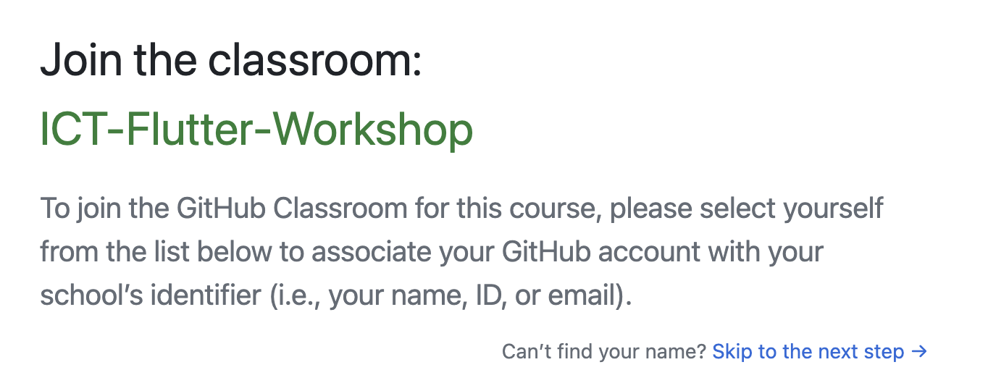
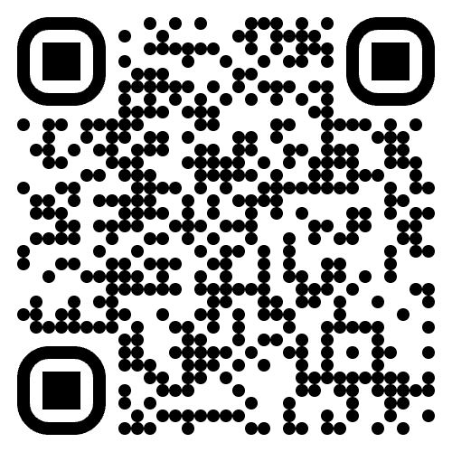
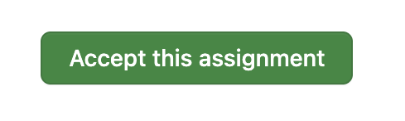
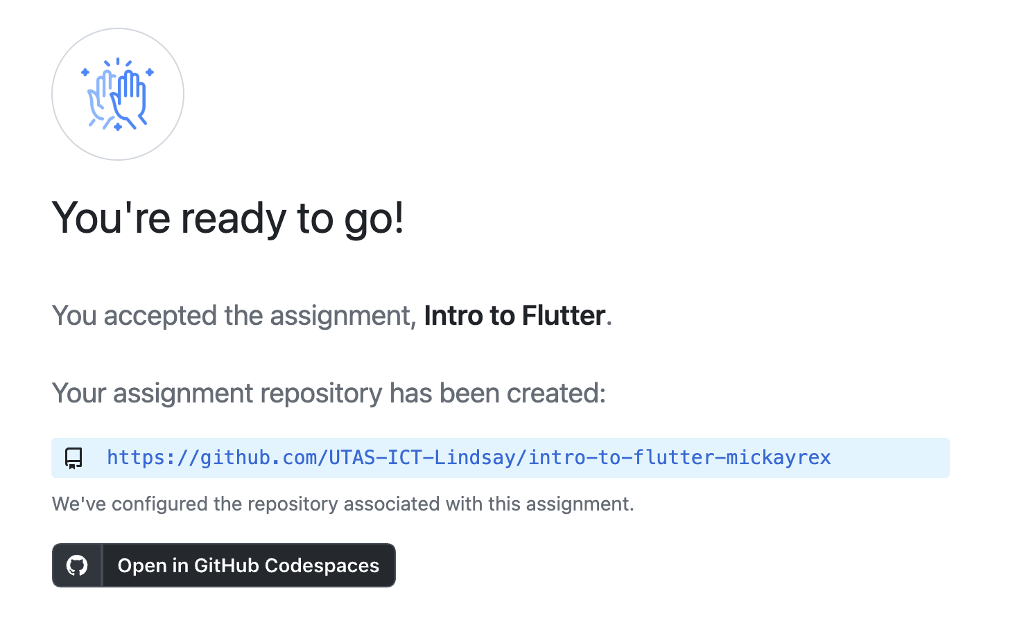
Getting the Code
1
2
Remember this
https://classroom.github.com/a/1rQUe32v
3. Click this

Slide 4
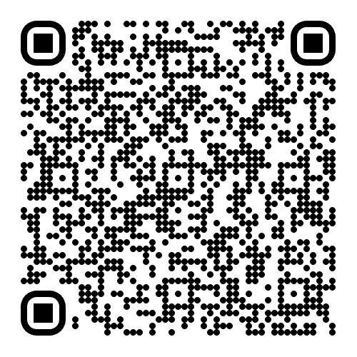
If that last one doesn’t work
You can just click “open codespace”
https://github.com/UTAS-ICT-Lindsay/ict-flutter-workshop-intro-to-flutter-intro_to_flutter

Slide 5
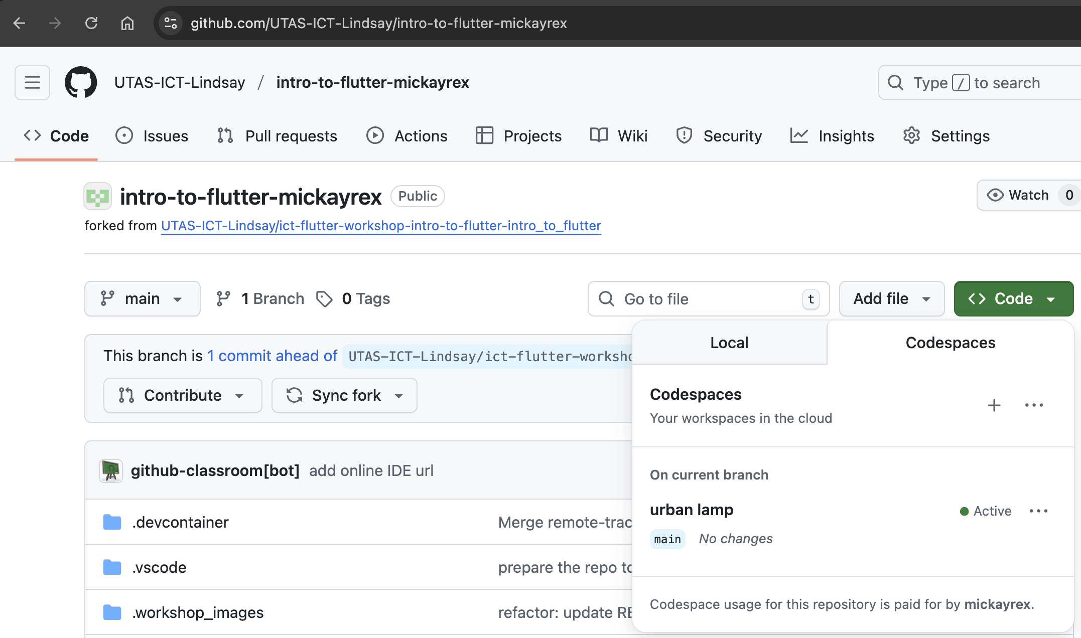
After the Workshop
1
2
3
mickayrex = your github username

Slide 6
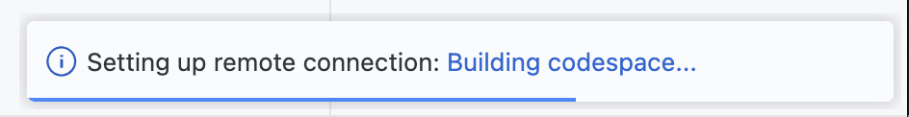



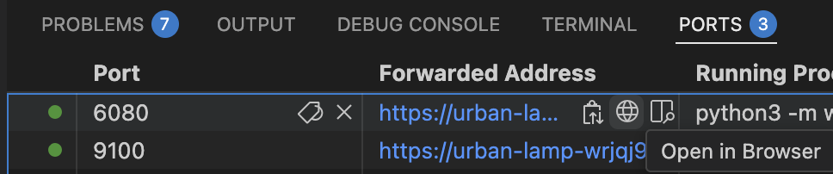
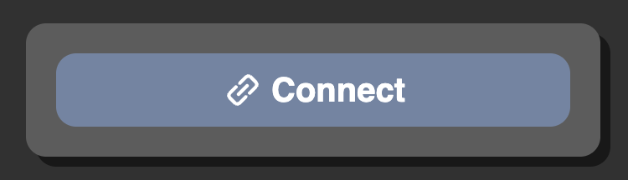
Setting up ~5 mins? 🤞
The Codespace needs to initialize
Everything is ready when you see Linux (linux-x64) in the bottom-right
Can read WORKSHOP.md while you wait
Once ready use Run & Debug tab
Choose Run Flutter
Open port 6080 in a new browser
Connect to remote desktop (VNC)

Slide 7
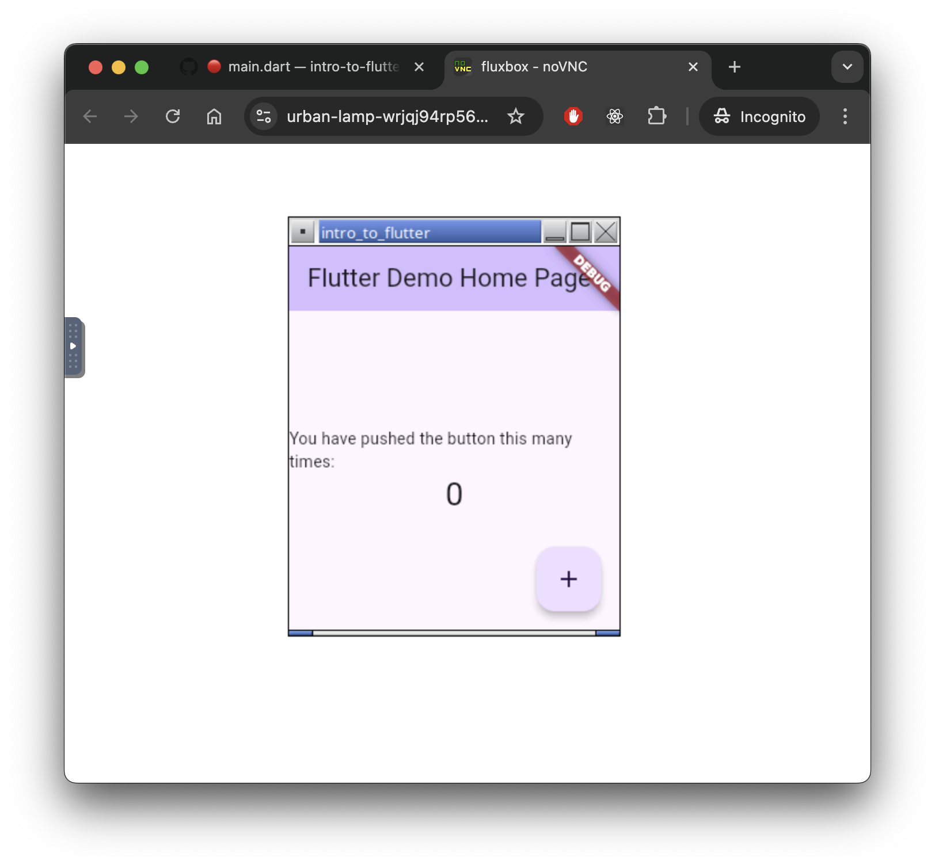
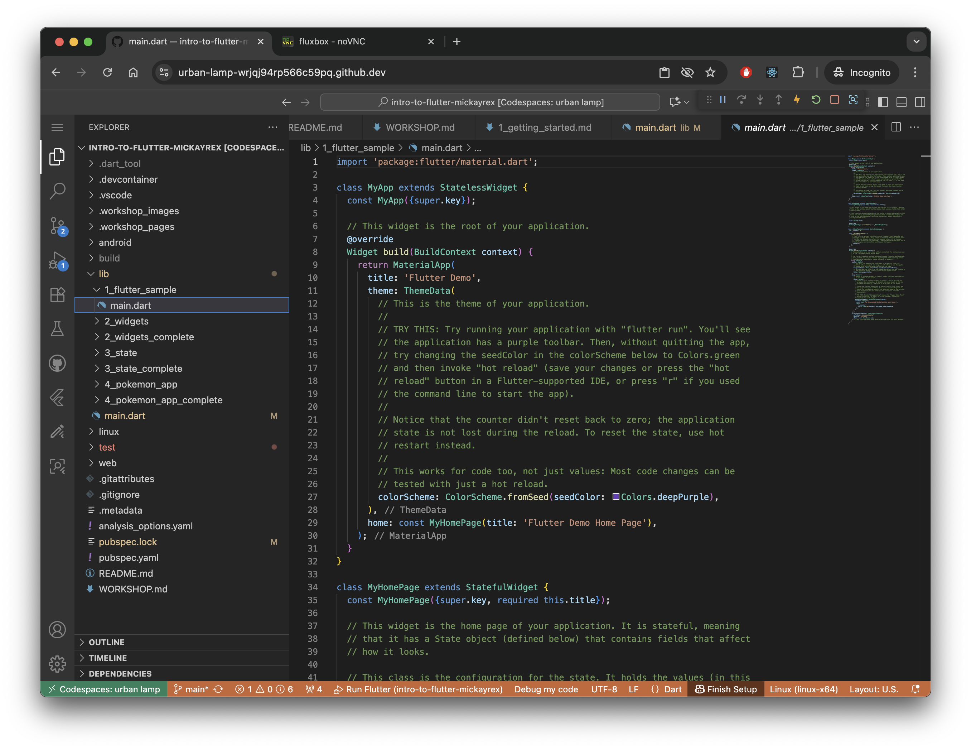

Slide 8
