Slide 1


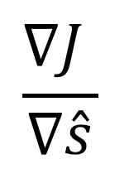
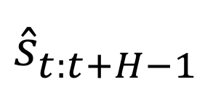

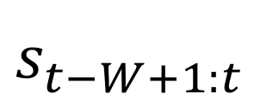
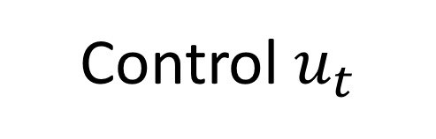
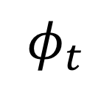

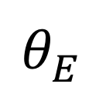

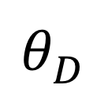
Timeseries Generator
Control System
Encoder
Forecast Decoder
$${\hat{s}}_{t:t+H−1}^{}$$
$$\frac{∇J }{∇\hat{s}}$$
$$s_{t−W+1:t}^{}$$
$$φ_{t}$$
$$θ_{D}^{}$$
$$θ_{E}^{}$$
Controller
$π$
Cost $J$
Plant State
$x_{t}$
Control $u_{t}$

