Slide 1
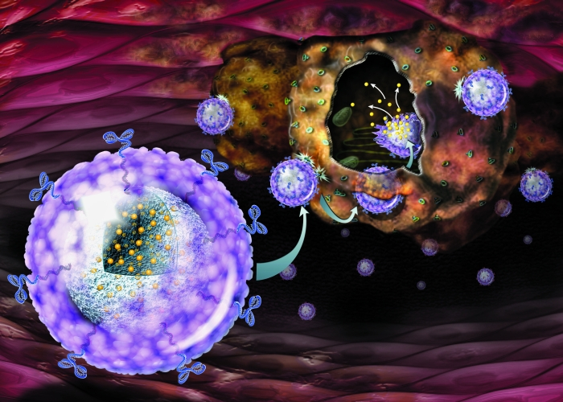

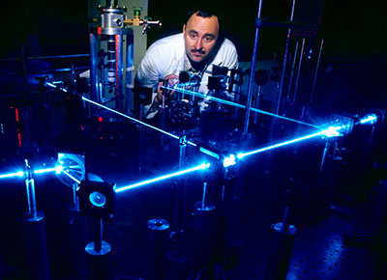
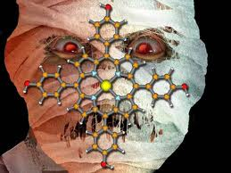
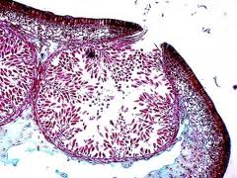
Science Careers
Natural Sciences Career Fair and Expo

Slide 2
Why are you here?

Slide 3
Choices
Technology
Quant
Research Career outside academia
Academia and Research
Not Sure?

Slide 4
If you aren’t ready…
Don’t have a resume?
Don’t know what to say to recruiters?
Just go…
-Eavesdrop
-Talk to people who look like they aren’t actively busy with other students.
-Collect literature
-Take notes and do research later on the company

Slide 5
Ready to hand out a Resume?
Use our Resume Guide
Use our Resume Template Link
If you have questions before Monday, please email me at ruth.franks@austin.utexas.edu
I’ll be glad to help via email
I apologize for having to run off to the hospital.
I’ll be back for another session very soon!

Slide 6
Places to Look for Example Resumes
http://hireitpeople.com/resume-database/79-other-resumes?limit=20&start=20
http://jobs.sciencecareers.org/logon/?PipelinedPage=%7e%2fsavedcv%2f&PipelinedQueryString=

Slide 7
Advice for Careers in Physics
http://www.aps.org/careers/guidance/development/index.cfm

