Slide 1
Active Speaker Detection
Project Introduction

Slide 2
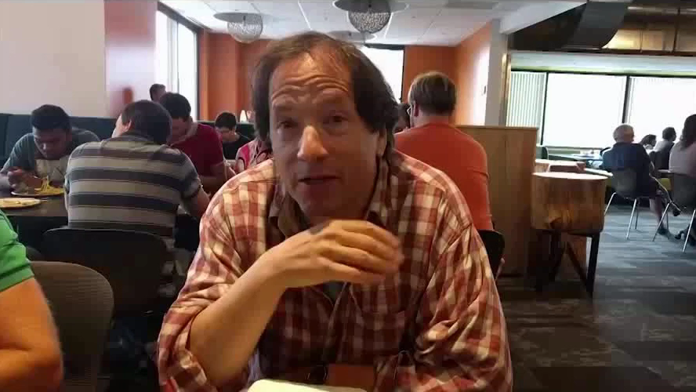
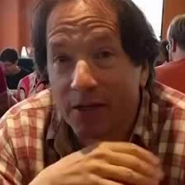
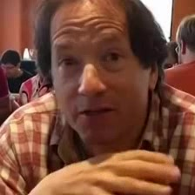



How do we represent data in this problem?
...
Speaking?
Not Speaking?
Speaking?
Not Speaking?
Speaking?
Not Speaking?
Speaking?
Not Speaking?

Slide 3
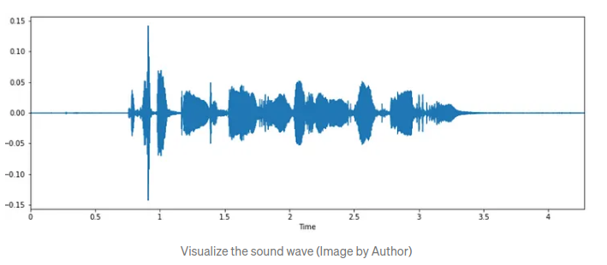
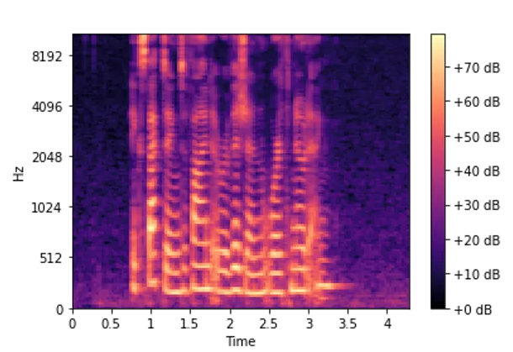
Active Speaker Detection
Detect whether each visible face in a video is speaking or not.
...
Visual Features
Feature Fusion
Detector
Audio Features
...
Speaking
Speaking
Not
Speaking
Not
Speaking

Slide 4
Research Papers
TalkNet
LoCoNet

Slide 5
Tasks
Read the research papers
Replicate TalkNet and LoCoNet on the validation set of AVA-Active Speaker dataset
Run inference with TalkNet and LoCoNet on AVDIAR dataset for ASD and report results
Make a presentation introducing the research papers, results obtained so far, and next steps.
Finetune TalkNet and LoCoNet on AVDIAR dataset for ASD
Ideas for improvement? New research problem?

