Slide 1
PyTorch

Slide 2
Installation
Either create a new conda environment and activate it or activate an existing environment
Run the installation command
conda install pytorch==1.13.1 torchvision==0.14.1 torchaudio==0.13.1 pytorch-cuda=11.7 -c pytorch -c nvidia
Reference : https://pytorch.org/get-started/previous-versions/

Slide 3
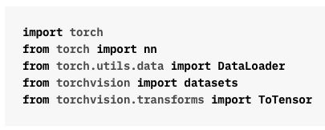
Import PyTorch

Slide 4
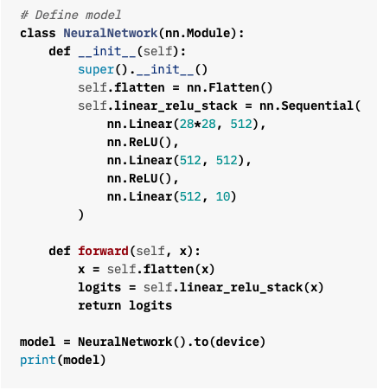
Defining a Fully Connected Model
PyTorch models inherit from nn.Module
__init__ method is used to initialize model parameters/layers
forward method computes the forward pass
Move the model to GPU

Slide 5
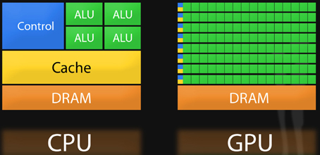
Parallel Computation with GPUs
Property
# Processors
Clock Speed
Best suited for
CPU
Small
High
2-4 GHz
Single Instruction,
Single Data (SISD)
GPU
Large
Lower
700 MHz – 1 GHz
Single Instruction,
Multiple Data (SIMD)
Picture Credit : https://nyu-cds.github.io/python-gpu/01-introduction/

Slide 6
Data Loader – Data Loading Pipeline
CPU RAM
GPU RAM
NN Model Computations
Inefficiencies
GPU waits while data is being loaded by CPU
CPU speed is still a bottleneck
Solutions
Load next iteration’s data in parallel to current computation
Use multiple threads for data loading
Storage

Slide 7
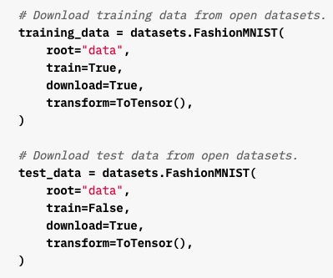
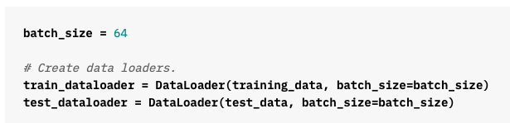
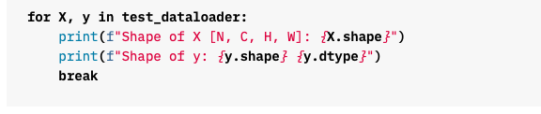

Data Loader with PyTorch
FashionMNIST is provided by PyTorch

Slide 8

Training a Model – Loss And Optimizer
Define a Loss Function and an Optimizer

Slide 9
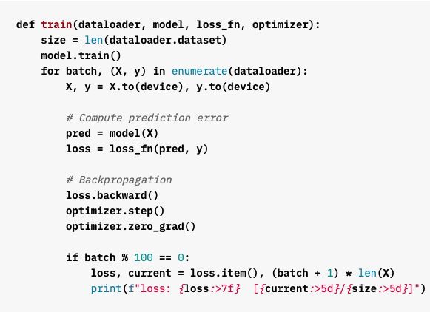
Training a Model – Training Function
Iterate through each batch of data
Move data to the GPU
Forward pass
Loss Computation
Compute gradients of all parameters
Update step
Reset gradients to zero – important in PyTorch

Slide 10
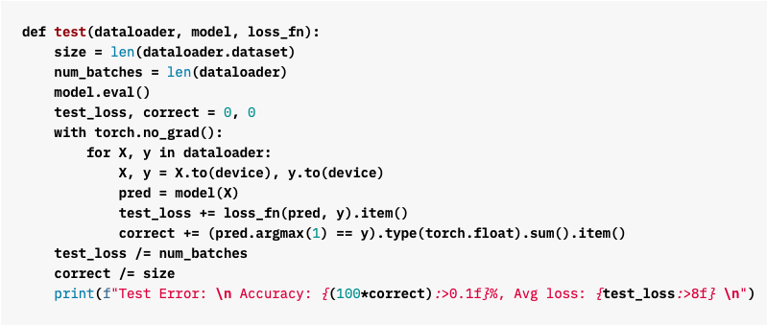
Testing the Model
Similar to train(), except for the missing gradient computation and update steps

Slide 11
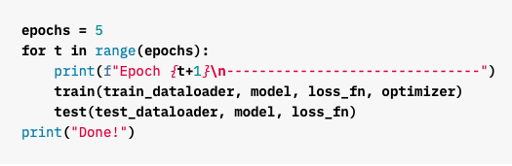
Training the Model – Perform update steps for multiple epochs

Slide 12


Saving and Loading the Model Parameters
Saving the Model Parameters
Loading the Model Parameters
Save models parameters at regular intervals. If training is interrupted, we can restart training from one of the saved checkpoints instead of training from the beginning.

Slide 13
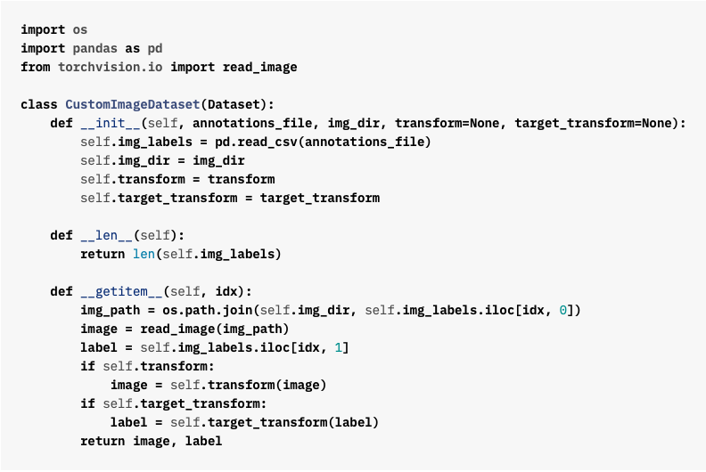
Custom Dataset Loader
Collate Function
Default : Creates one tensor with all data in a batch
Modify by writing a custom function, if necessary
Default function that is called to fetch each datapoint

Slide 14
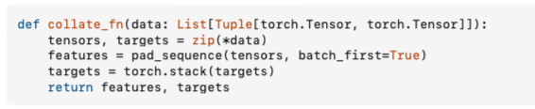
Sample Collate Function
Picture Credit : https://stackoverflow.com/questions/65279115/how-to-use-collate-fn-with-dataloaders

Slide 15
References
Python Tutorials
https://pytorch.org/tutorials/beginner/basics/intro.html

