Slide 1
Linear Regression with Gradient Descent
Siva

Slide 2






Active Speaker Detection
...
...
Speaking
Speaking
Not
Speaking
Not
Speaking
Inference
Data Representation
Images – Features
Audio – Spectrogram - Features
Deep Neural Network
Contains Parameters
Trained with gradient descent
Let’s study the mechanics of gradient descent using Linear Regression as an example.

Slide 3
House rent prediction with Linear Regression
Description : Given the size of a house in square feet, predict its rent
What do we need to build a machine learning solution for this problem?
Data
Model
Training Algorithm

Slide 4
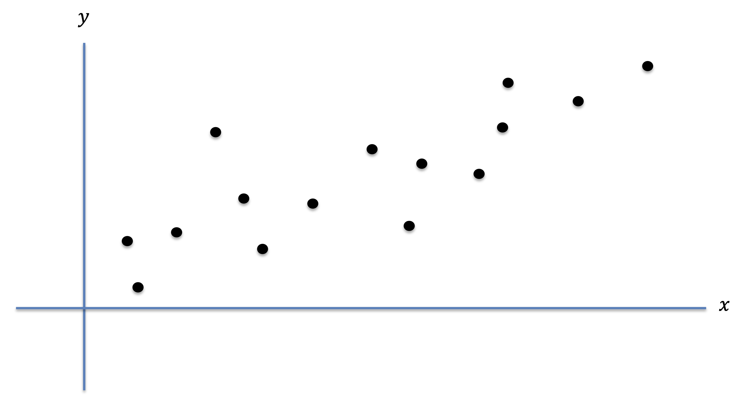
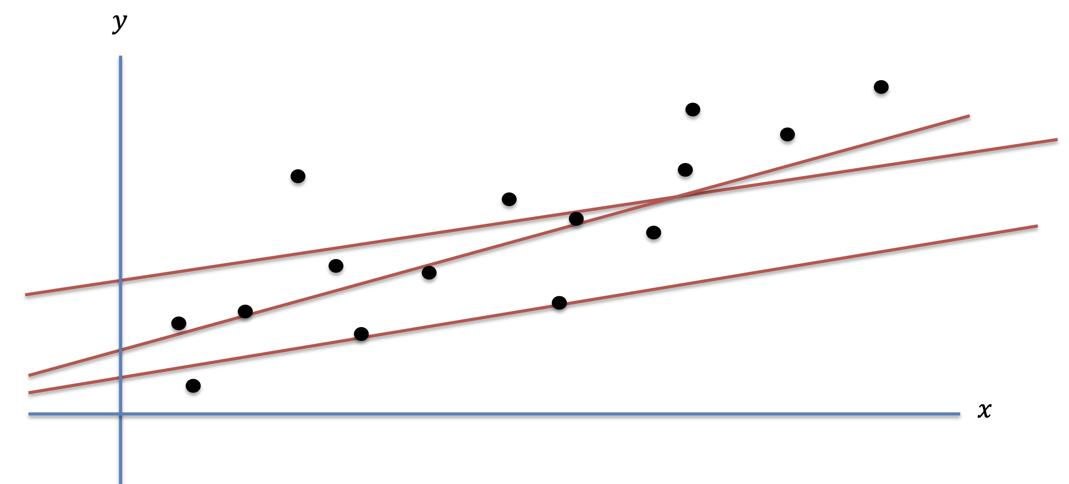
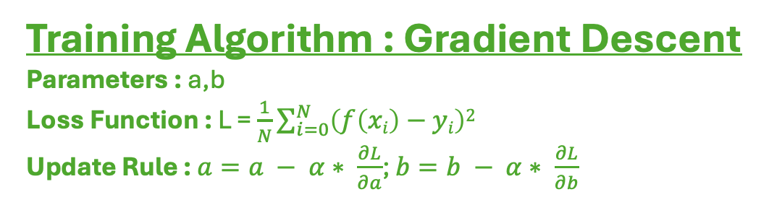
House rent prediction with Linear Regression
Data
i | Size in Sq. Ft. (x) | Price in $ (y)
1 | 500 | 1000
2 | 343 | 925
3 | 750 | 1350
4 | 820 | 1400
5 | 900 | 1500
Model : f(x) = a*x + b
Training Algorithm : Gradient Descent
Parameters : a,b
Loss Function : L = $\frac{1}{N}\sum_{i=0}^{N}{\left(f\left(xi\right)−yi\right)2}$
Update Rule : $a=a − α∗ \frac{∂L}{∂a}$; $b=b − α∗ \frac{∂L}{∂b}$
House Rent Prediction Dataset
N data points, each data point is a tuple of size and the corresponding price
Representation : (x_{i}, y_{i}), where i ε {1, 2, …, N}

Slide 5
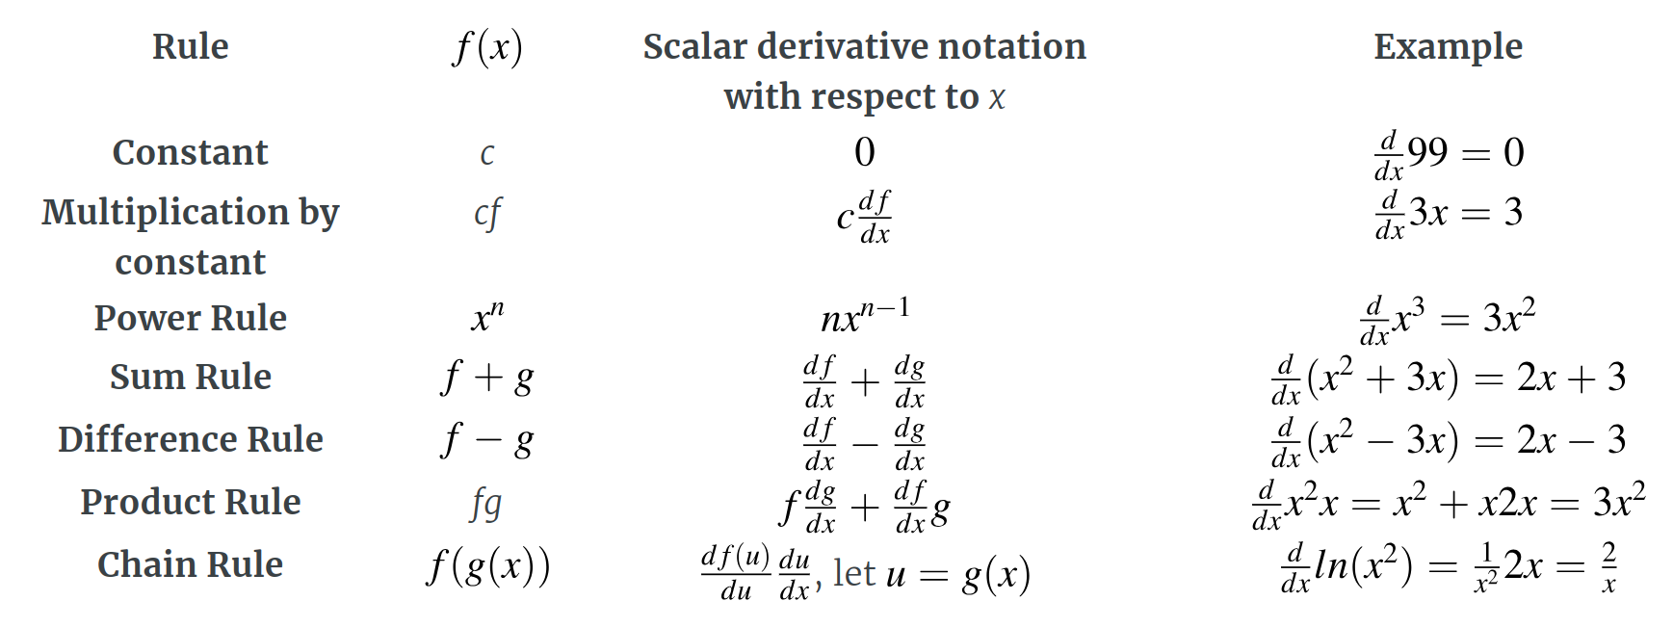
Calculus Refresher : Derivatives

Slide 6

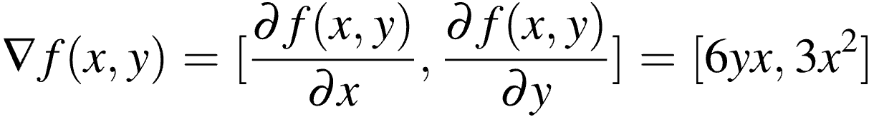
Calculus Refresher : Partial Derivatives

Slide 7
Linear Regression
Input : (x¹, y¹), (x², y²), …, (x^{m}, y^{m})
(x^{i}, y^{i}) is the i^{th} data item, x^{i} and y^{i} are real numbers
Example : Pairs of size of a house and rent of the house
(500, 900), (700, 1200), (400, 750), …, (2000, 3000)
Goal : Find a function f such that f(x^{i}) is a good approximation to y^{i}
Can use it to predict y values corresponding to previously unseen x values

Slide 8

Linear Regression
Hypothesis Space : Set of allowable functions f: X -> Y
Example Hypothesis Class : Linear Functions f(x) = ax + b
How do we find the best element of this hypothesis space?

Slide 9
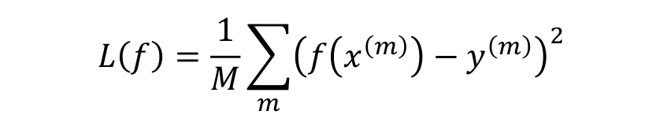
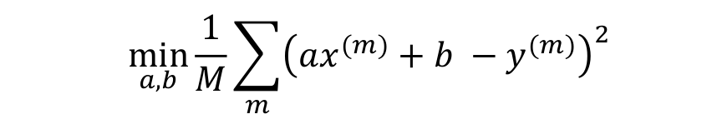
Linear Regression
Input : (x¹, y¹), (x², y²), …, (x^{m}, y^{m})
(x^{i}, y^{i}) is the i^{th} data item, x^{i} and y^{i} are real numbers
Hypothesis Space: Linear Functions f(x) = ax + b
Error Metric : Squared difference between the predicted value and the actual value
The optimal linear hypothesis is then given by

Slide 10
Linear Regression
Gradient Descent : Iterative method to minimize a convex differentiable function f(x)
Pick an initial point x0
Iterate until convergence
x_{t+1} = x_{t} - α_{t}*(df(x_{t})/dx)
α_{t} is the t^{th} step size (also called learning rate)

Slide 11
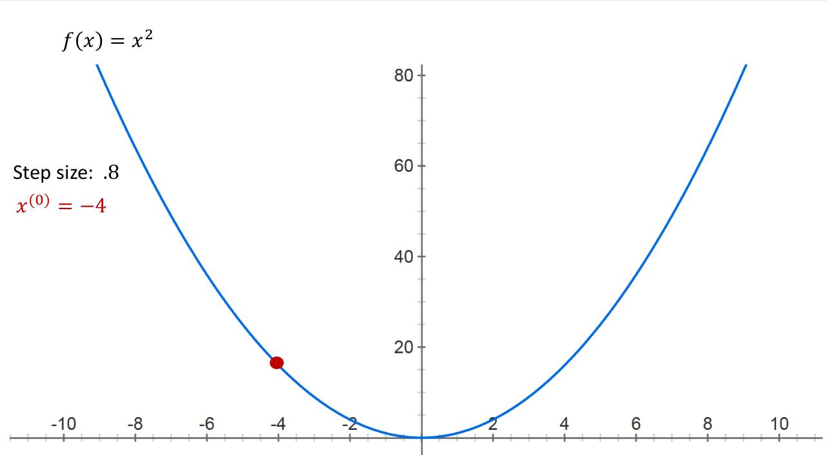
Gradient Descent

Slide 12
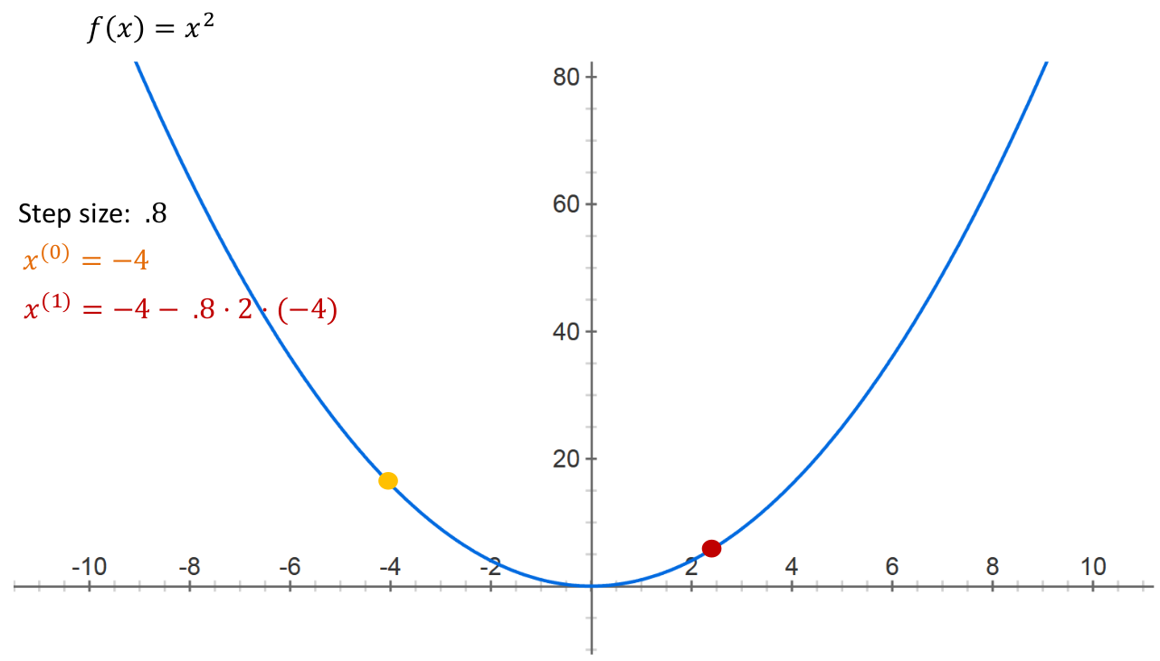
Gradient Descent

Slide 13
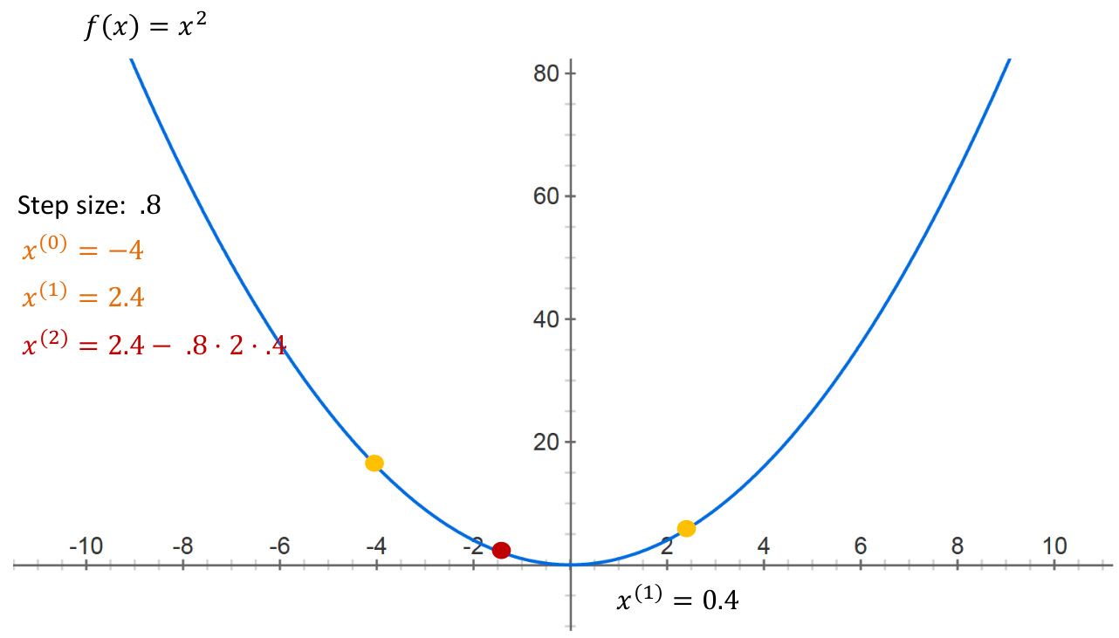
Gradient Descent

Slide 14
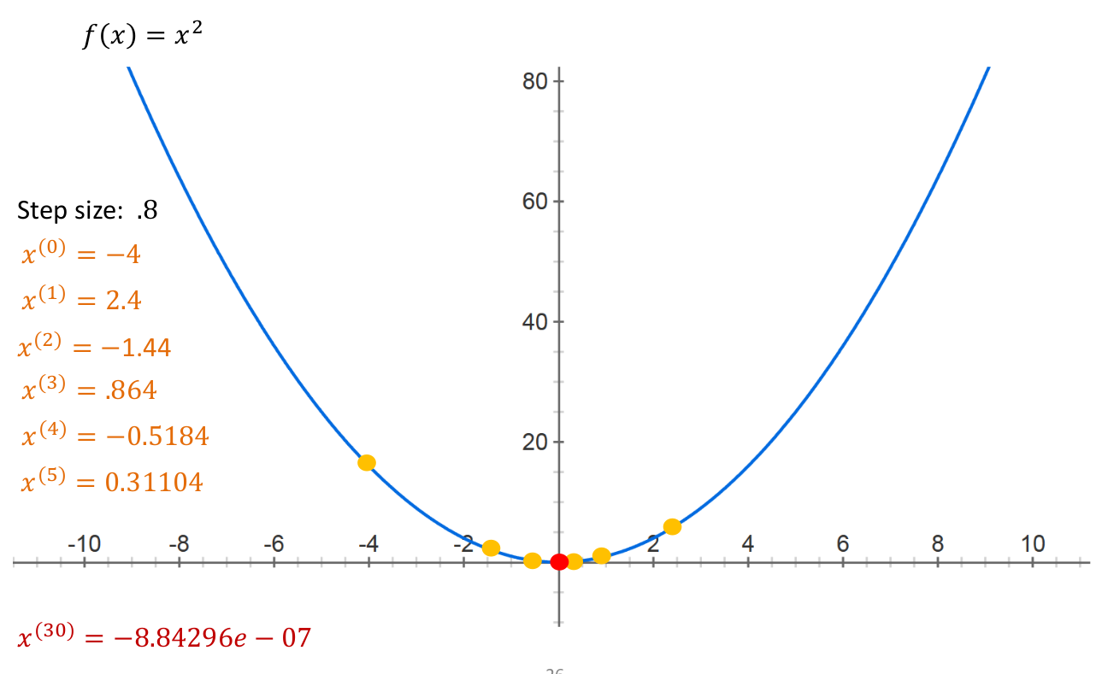
Gradient Descent

Slide 15
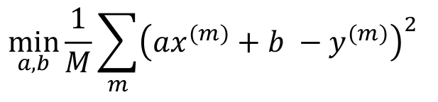
Gradient Descent for Linear Regression
Loss Function f(a,b) =
Compute partial derivates for each of the parameters and update the parameters for each step
a_{t+1} = a_{t} - α_{t}*(df(a_{t},b_{t})/da)​
b_{t+1} = b_{t} - αt*(df(a_{t},b_{t})/db)​

Slide 16
Assignment 1
Description : Implement a Linear Regression Model using Python
Data : house-rent-prediction-dataset on Kaggle

Slide 17
Resources
Prof. Rouzzi's course on Machine Learning
Calculus for deep learning
Python Tutorial
Sections 1, 2, 3, 4, 6, 9.1
Reading CSV files in Python

