Slide 1
Linear Algebra for Deep Learning
Siva

Slide 2
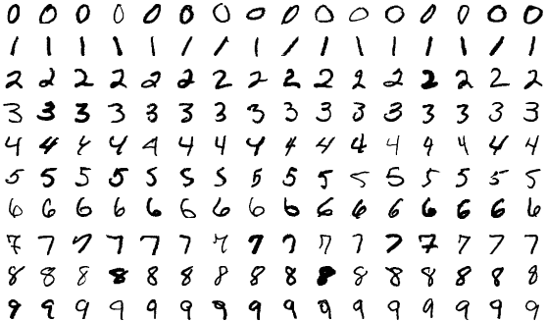
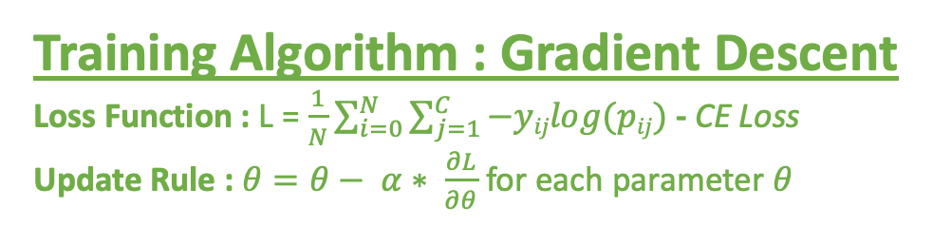
Digit Classification with Logistic Regression
Classification Task : Classify each image into one of the classes – 0, 1, 2, 3, 4, 5, 6, 7, 8, 9
Data
Model : f(x) ->
1
2
3
4
5
6
7
8
9
Training Algorithm : Gradient Descent
Loss Function : L = $\frac{1}{N}\sum_{i=0}^{N}{\sum_{j=1}^{C}{−yijlog(pij})}$ - CE Loss
Update Rule : $θ=θ− α∗ \frac{∂L}{∂θ}$ for each parameter $θ$
MNIST Dataset
Datapoints : Images with labels
Image Size : 28 x 28
Image Type : Binary
One-hot encoding

Slide 3
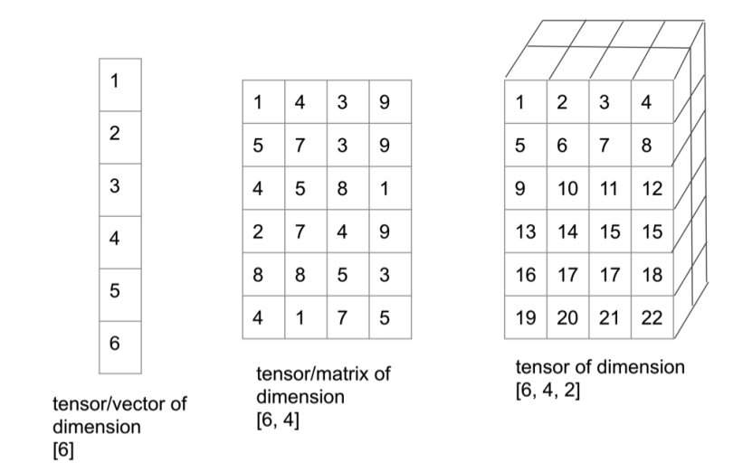
Mathematical Objects in Linear Algebra
Scalar
a₁
Matrix
…
a₁₁ a₁₂ a_{1m}
a₂₁ a₂₂ a_{2m}
a_{n1} a_{n2} a_{nm}
…
…
…
…
Vector
…
Row Vector of size n or (1 x n)
…
a₁ a₂ a_{n}
Shape : n x m
a₁
a₂
a_{n}
Column vector of size n or (n x 1)
…

Slide 4
Matrix-Scalar Operations
…
…
a₁₁ a₁₂ a_{1m}
a₂₁ a₂₂ a_{2m}
a_{n1} a_{n2} a_{nm}
b₁₁ b₁₂ b_{1m}
b₂₁ b₂₂ b_{2m}
b_{n1} b_{n2} b_{nm}
…
…
Scalar : y
A =
…
…
…
B =
…
…
…
…
…
Scalar-matrix operations tend to be element-wise
Addition
A + y = B : a_{ij} + y = b_{ij} , where i 𝛜 [1,n] and j 𝛜 [1,m]
Multiplication
A * y = B : a_{ij} * y = b_{ij}, where i 𝛜 [1,n] and j 𝛜 [1,m]

Slide 5
Matrix-Scalar Operations : Examples
1 2 3
4 5 6
7 8 9
11 12 13
14 15 16
17 18 19
1 2 3
4 5 6
7 8 9
10 20 30
40 50 60
70 80 90
+ 10 =
* 10 =
1 2 3
4 5 6
7 8 9
9 8 7
6 5 4
3 2 1
1 2 3
4 5 6
7 8 9
0.1 0.2 0.3
0.4 0.5 0.6
0.7 0.8 0.9
10 -
=
÷ 10 =

Slide 6
Matrix-Matrix Operations : Addition
…
…
…
a₁₁ a₁₂ a_{1m}
a₂₁ a₂₂ a_{2m}
a_{n1} a_{n2} a_{nm}
b₁₁ b₁₂ b_{1m}
b₂₁ b₂₂ b_{2m}
b_{n1} b_{n2} b_{nm}
c₁₁ c₁₂ c_{1m}
c₂₁ c₂₂ c_{2m}
c_{n1} c_{n2} c_{nm}
…
…
…
A =
…
…
…
B =
…
…
…
C =
…
…
…
…
…
…
Shape : n x m
Shape : n x m
Shape : n x m
In matrix operations, there are constraints on sizes of matrices.
Addition
Constraint : Sizes of the matrices should be the same
A + B = C : a_{ij} + b_{ij} = c_{ij}

Slide 7
Matrix-Matrix Operations : Multiplication
…
…
…
a₁₁ a₁₂ a_{1m}
a₂₁ a₂₂ a_{2m}
a_{n1} a_{n2} a_{nm}
b₁₁ b₁₂ b_{1l}
b₂₁ b₂₂ b_{2l}
b_{m1} b_{m2} b_{ml}
c₁₁ c₁₂ c_{1l}
c₂₁ c₂₂ c_{2l}
c_{n1} c_{n2} c_{nl}
…
…
…
A =
…
…
…
B =
…
…
…
C =
…
…
…
…
…
…
Shape : n x m
Shape : m x l
Shape : n x l
In matrix operations, there are constraints on sizes of matrices.
Multiplication
Constraint : The number of columns of the first matrix should be equal to the number of rows of the second matrix.
A * B = C : Σa_{ik}*b_{kj} = c_{ij}
m
K=1
c₁₂ = a₁₁*b₁₂ + a₁₂*b₂₂ + a₁₃*b₃₂ + … + a_{1m}*b_{m2}

Slide 8
Matrix-Matrix operations : Examples
1 2 3
4 5 6
7 8 9
1 2 3
4 5 6
7 8 9
30 36 42
66 81 96
102 126 150
1 2 3
4 5 6
7 8 9
1
4
7
30
66
102
*
=
*
=
1 2 3
4 5 6
7 8 9
2 3 1
5 6 4
8 9 7
3 5 4
9 11 10
15 17 16
2
5
8
1 2 3
4 5 6
7 8 9
+
=
*
=
Incompatible shapes
1 2 3
4 5 6
7 8 9
2
5
8
1 2 3
4 5 6
7 8 9
+
=
Incompatible shapes
1 2 3
*
=
30 36 42

Slide 9
Some properties of these Operations
Commutative : Changing the order of operands does not change the result
A+y = y+A
A*B ≠ B*A
Associative : Rearranging the parentheses in an expression does not change the result
(A*B)*C = A*(B*C)
Distributive : A*(B+C) = A*B + A*C

Slide 10
Identity Matrix
A matrix that is multiplied by identity matrix is equal to itself.
Similar to a number that is multiplied by 1 being equal to itself.
A*I = I*A = A
Identity matrices are square matrices with all diagonal elements equal to 1 and non-diagonal elements equal to 0
1 0
0 1
1 0 0
0 1 0
0 0 1
I_{2x2} =
I_{3x3} =
1 2
3 4
1 2 3
4 5 6
7 8 9
1 0 0
0 1 0
0 0 1
1 2 3
4 5 6
7 8 9
*
1 0
0 1
=
1 2
3 4
=
*

Slide 11
Inverse and Transpose
If a matrix is multiplied by its inverse, the result is an identity matrix.
Similar to a number multiplied by its inverse (1/number) resulting in 1.
A matrix B is the transpose of matrix A if b_{ij}=a_{ji}. Transpose of matrix A is represented by A^{T}, i.e., B=A^{T}
A*A⁻¹ = A⁻¹*A = I
1 2 3
4 5 6
7 8 9
1 4 7
2 5 8
3 6 9
A =
A^{T} =

Slide 12
Vector Norms
Vector norms measure the magnitude of a vector
Consider X = [x₁, x₂, …, x_{i}, …, x_{m}]
L_{P} = ||X||_{P} = (Σ|x_{i}|^{P})^{1/P}
L1 norm or Manhattan Norm : ||X||₁ = (|x₁| + |x₂| + … + |x_{m}|)
L2 norm or Euclidean Norm : ||X||₂ = (|x₁|² + |x₂|² + … + |x_{m}|²)^{1/2}
Manhattan Distance between X and Y : ||X - Y||₁ = (|x₁ - y₁| + |x₂ - y₂| + … + |x_{m}-y_{m}|)
Euclidean Distance between X and Y : ||X - Y||₂ = (|x₁ - y₁|² + |x₂ - y₂|² + … + |x_{m}-y_{m}|²)^{1/2}
Unit Vector : ||X||₂ = 1
Normalize X : X ÷ ||X||₂

Slide 13
Resources
List of Linear Algebra Basics for Deep Learning
Prof. Rouzzi's course on Machine Learning
Calculus for deep learning

