Slide 1
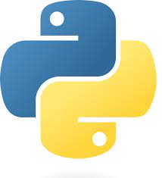

Introduction to Python, and OpenCV
Harsh Singh

Slide 2
Python Variable and Data Types

Slide 3
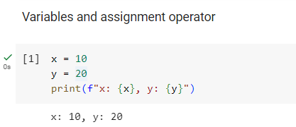
Python Variable
In Python, variables are used to store information.
Variables are assigned using the equals sign (=), known as the assignment operator.
Variables can hold different types of values, such as numbers, strings, lists, etc.

Slide 4
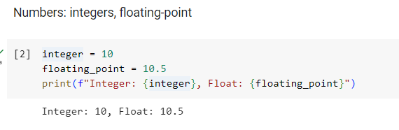
Numerical Value
Python supports several types of numbers, including integers, floating-point numbers, and complex numbers.
Integers are whole numbers. Floating-point numbers have a decimal point. Complex numbers include a real and imaginary part.

Slide 5
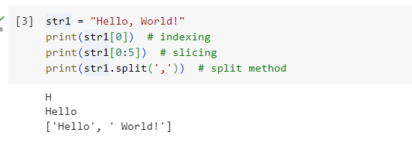
Strings: indexing, slicing, string methods
Strings in Python are sequences of characters, and are defined by enclosing characters in quotes.
You can access individual characters using indexing and a range of characters using slicing.
Python has a set of built-in methods that you can use on strings.

Slide 6
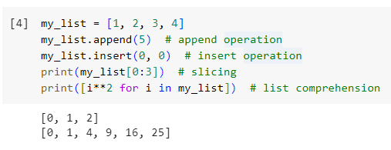
Lists
Lists are one of the most versatile data types in Python. They are ordered, and each element in the list can be changed (they're mutable).
Lists support operations like append and insert.
Lists also support operations like slicing and list comprehension.

Slide 7
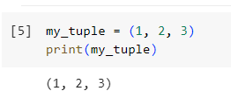
Tuples
Tuples are similar to lists but they are immutable, which means elements inside a tuple cannot be changed.

Slide 8
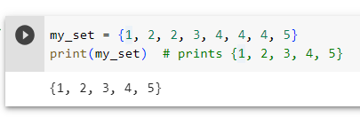
Sets
Sets are used to store multiple items in a single variable, but unlike lists or tuples, they are unordered and don't allow duplicate values.

Slide 9
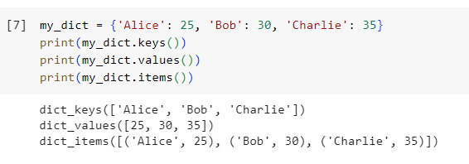
Dictionaries
Dictionaries are used to store data values in key-value pairs.
A dictionary is a collection which is ordered*, changeable and does not allow duplicates.

Slide 10
Python Operators

Slide 11
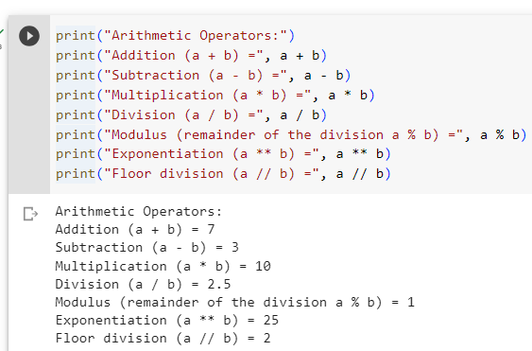
Arithmetic Operators

Slide 12
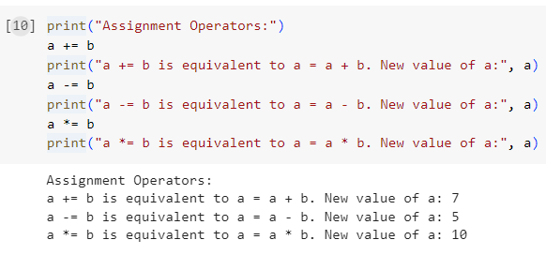
Assignment Operators

Slide 13
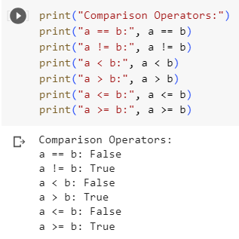
Comparison Operators

Slide 14
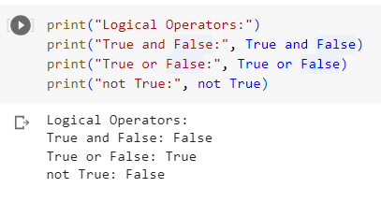
Logical Operators(and/or/not)

Slide 15
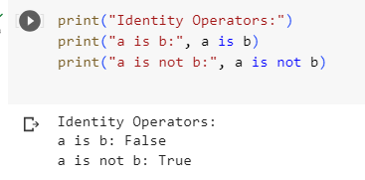
Identity Operators(is/is not)

Slide 16
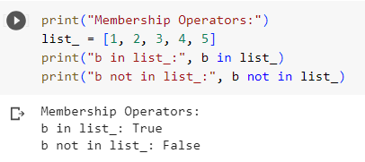
Membership Operators (in/not in)

Slide 17
Conditional statements and loops

Slide 18
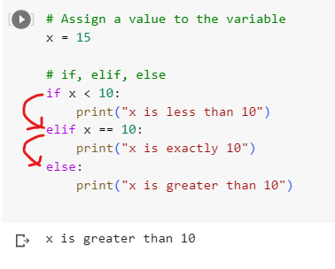
Conditional Statements: 'if', 'elif', 'else'

Slide 19
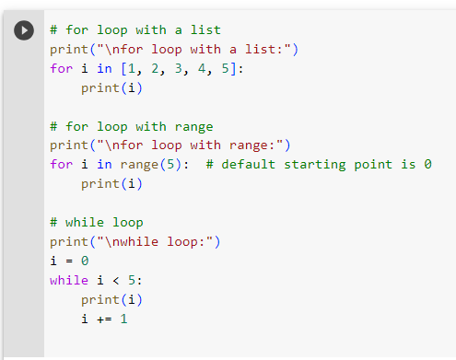
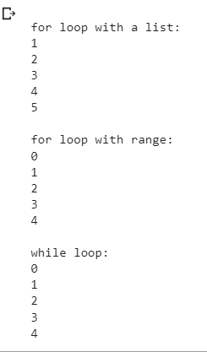
Looping: 'for' and 'while' loops

Slide 20
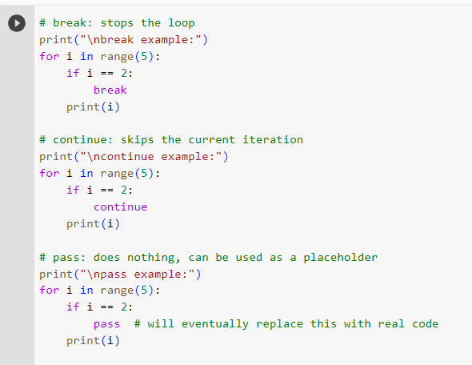
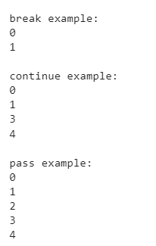
Flow control with 'break', 'continue', and 'pass'

Slide 21
Functions, Classes, and Modules

Slide 22
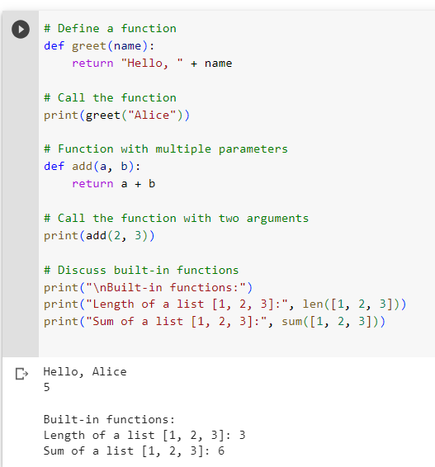
Functions in Python

Slide 23
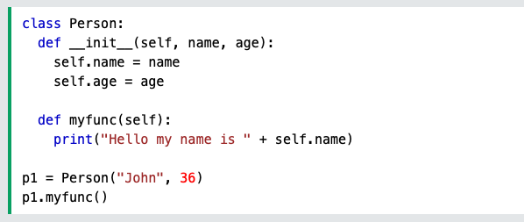
Classes in Python
Classes are collections of Variables and Methods
Objects are instances of a class
p1 is an object of class Person
p1 has access to all variables and methods of the class
self parameter
A reference to the parameters and methods of a class
First argument to all methods by default
__init__() method is called by default when an object of the class is created.

Slide 24
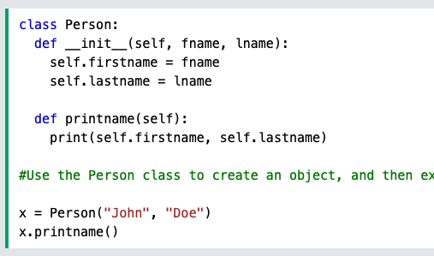
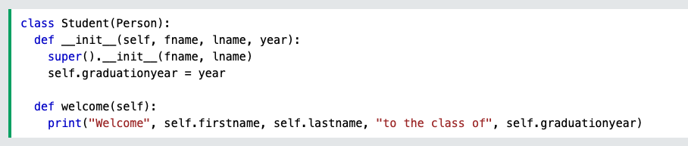
Inheritance in Python
A class can inherit methods and properties from another class
The class Student inherits the methods and variables of the parent class Person.
super() is a reference to the parent class.

Slide 25
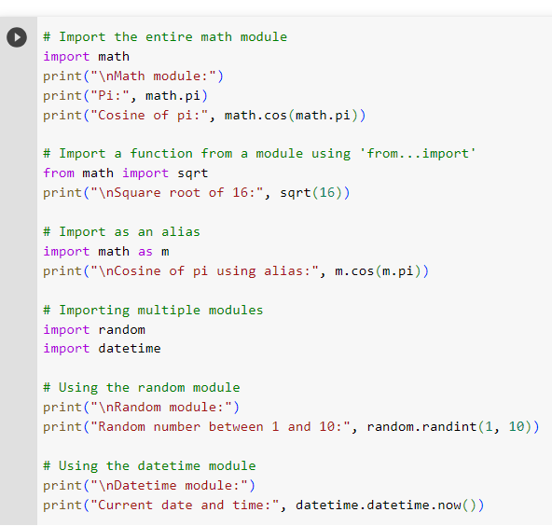
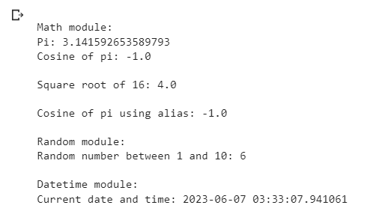
Modules in Python

Slide 26
Quick Introduction of Important Modules in Python (Numpy, Pandas, Matplotlib)

Slide 27
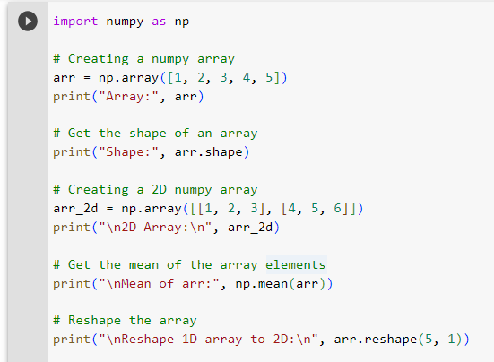
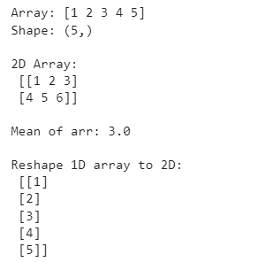
NumPy
NumPy is a Python library for handling large, multi-dimensional arrays and matrices.
It provides tools for mathematical and logical operations on these arrays.

Slide 28
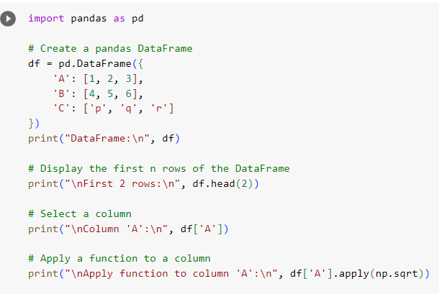
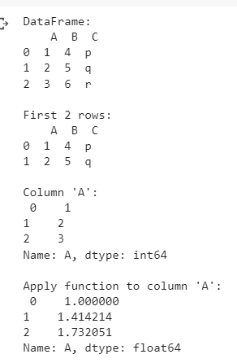
Pandas
Pandas is a data manipulation and analysis library in Python.
It offers structures for managing numerical tables and time series.

Slide 29
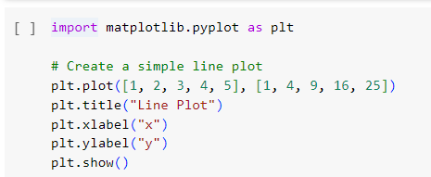
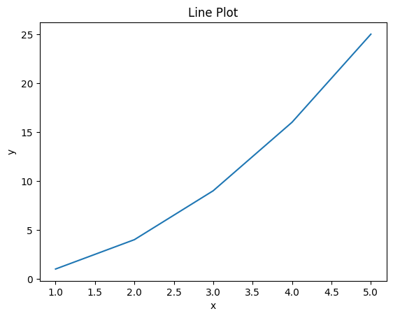
Matplotlib
Matplotlib is a plotting library for Python.
It allows creation of static, animated, and interactive visualizations.

Slide 31
Introduction to OpenCV
OpenCV (Open Source Computer Vision Library)
OpenCV is an open-source library filled with computer vision algorithms, designed to be cross-platform and compatible with languages like Python.
It is freely available for use under the open-source license.
Why use OpenCV?
OpenCV offers versatility, catering to a variety of applications from object identification to 3D reconstruction.
It is designed for real-time operations, making it ideal for computer vision tasks that need to run promptly.
OpenCV and Python
Python, with its intuitive syntax, is widely used for data science, including computer vision tasks.
OpenCV's functions are directly accessible to Python, enabling easy integration with existing Python workflows and making prototyping faster.
Use import cv2 in google colab to use openCV

Slide 32
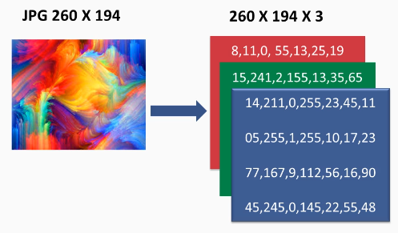
How to represent an Image?
An image in RGB color is represented as a 3-channel matrix, where each channel represents the intensity of Red, Green, and Blue color components.
The combination of these three color channels forms the color information for each pixel in the image.

Slide 33
Reading and Displaying Images using OpenCV
Reading Images with cv2.imread()
The cv2.imread() function is used to read an image from a file.
It takes the image file path as an argument and returns the image as a NumPy array(BGR order).
Example:
import cv2
image = cv2.imread('image.jpg')
Displaying Images with cv2.imshow()
The cv2.imshow() function is used to display an image in a window.
It takes the window name as the first argument and the image to be displayed as the second argument.
Example:
import cv2
cv2.imshow('Image', image)
cv2.waitKey(0)
cv2.destroyAllWindows()
For Google Colab, we will use cv2_imshow()

Slide 34
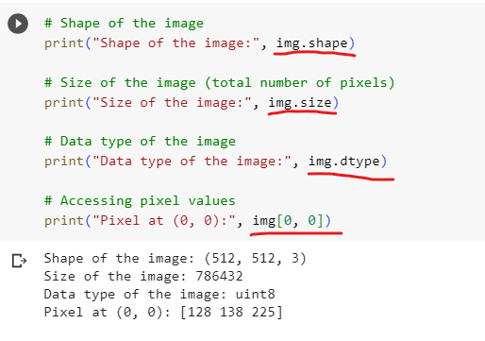
Image Properties

Slide 35
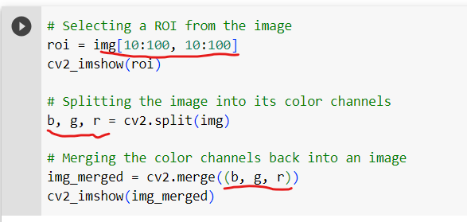
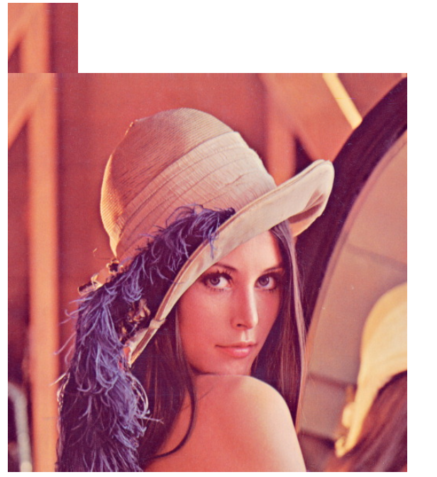
Image ROI (Region of Interest), Splitting, and Merging Images

Slide 36
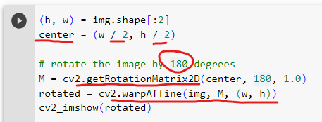
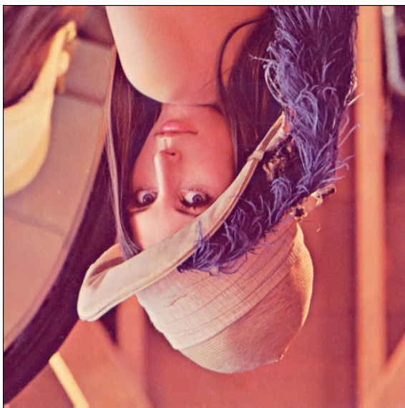
Rotate image

Slide 37

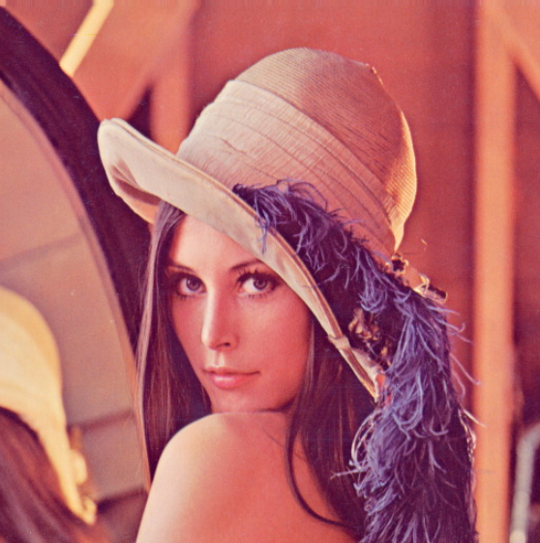
Flipping Image

Slide 38
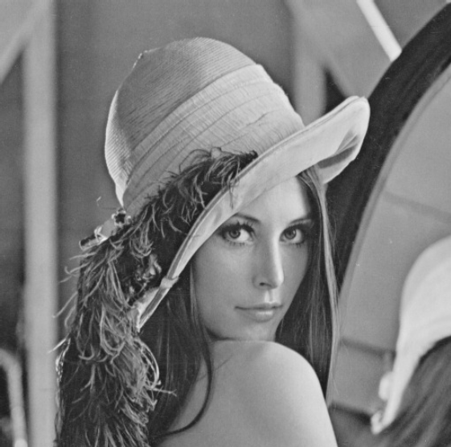
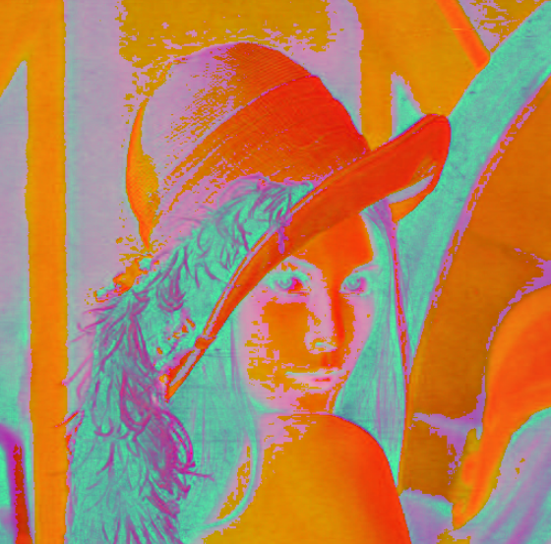
Color Spaces
Grayscale Color Space:
Grayscale color space represents images using shades of gray, with each pixel's value indicating its intensity. It is commonly used in image analysis tasks.
To convert an image to grayscale in OpenCV: gray_image = cv2.cvtColor(image, cv2.COLOR_BGR2GRAY)
HSV Color Space:
HSV color space represents colors based on three components: Hue, Saturation, and Value. It provides a more intuitive representation of color compared to RGB.
To convert an image to HSV color space in OpenCV: hsv_image = cv2.cvtColor(image, cv2.COLOR_BGR2HSV)
Gray
HSV

Slide 39
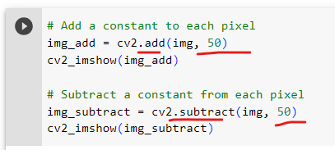
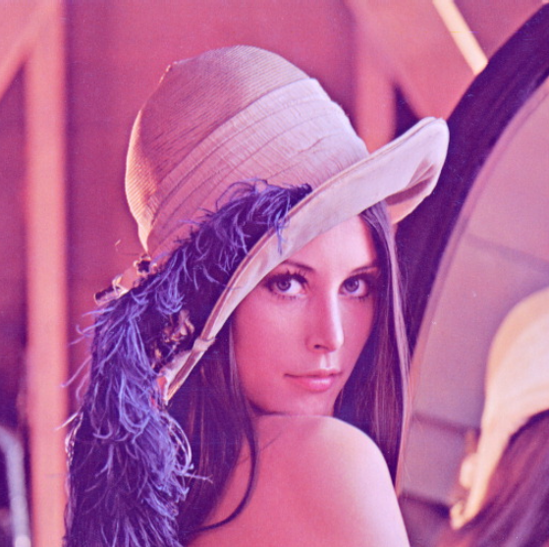
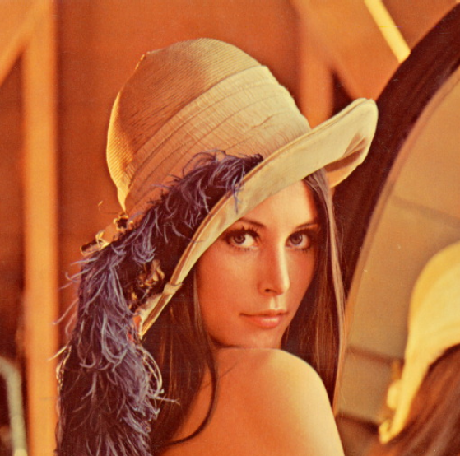
Arithmetic Operations on Images
Addition
Subtraction

Slide 40
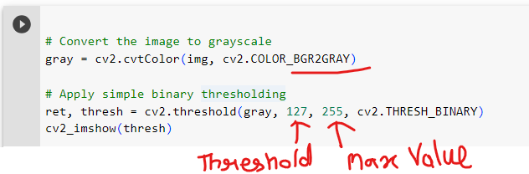
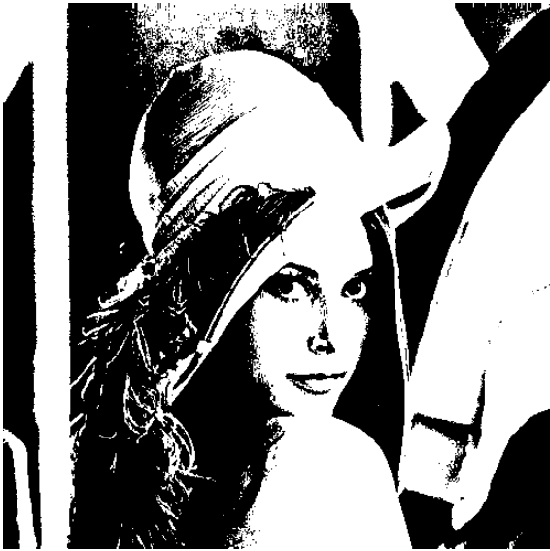
Image Thresholding
Image thresholding is a technique used to convert a grayscale image into a binary image, where each pixel is classified as either black or white based on a specified threshold value.
Threshold

Slide 41
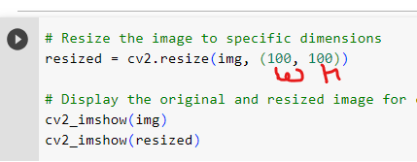
Image Resizing
cv2.resize(img, (w,h))
Resize

Slide 42
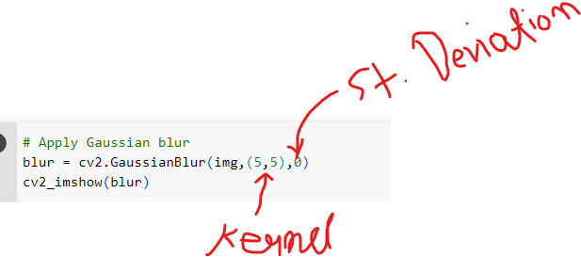
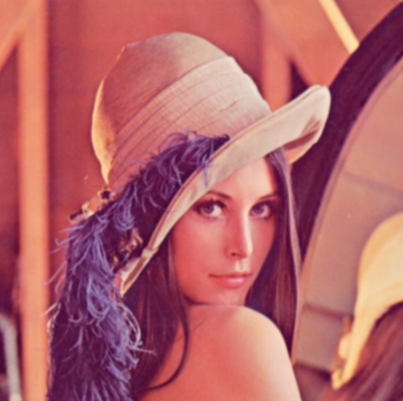
Gaussian Blur
Gaussian blur is a commonly used image blurring technique that reduces image noise and smoothens the edges by convolving the image with a Gaussian kernel.
In the given code, cv2.GaussianBlur() is used to apply Gaussian blur to the image img with a kernel size of (5, 5) and a standard deviation of 0.
Gaussian Blur

Slide 43
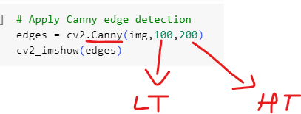
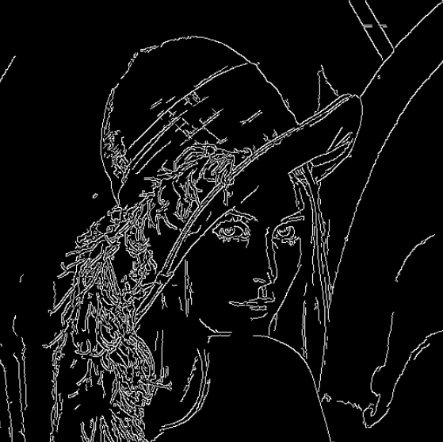
Edge Detection
cv2.Canny(): The Canny edge detection algorithm is a popular method used to detect edges in an image, based on the intensity gradient of pixels.
Canny Edge Detection

Slide 44


Image Contours
cv2.findContours(): This function is used to find contours in a binary image. It takes three arguments: the binary image (thresh), the contour retrieval mode (cv2.RETR_TREE), and the contour approximation method (cv2.CHAIN_APPROX_SIMPLE). It returns a list of contours and a hierarchy representing the relationship between contours.
cv2.drawContours(): This function is used to draw contours on an image. It takes five arguments: the original image (img), the list of contours, the contour index (-1 to draw all contours), the contour color ((0,255,0) for green), and the contour thickness (3 pixels). The function modifies the original image by drawing the contours on it.
Plot contours

Slide 45


Drawing a line on Image
Drawing a line

Slide 46


Drawing a Rectangle on Image
Drawing a Rectangle

Slide 47


Drawing a Circle on Image
Drawing a Circle

Slide 48


Writing text on Image
Writing Text

Slide 49


Template Matching
cv2.matchTemplate(): This function is used to find the template (pattern) in the input image. It takes three arguments: the input image (image_gray), the template image (template), and the matching method (cv2.TM_CCOEFF_NORMED). The matching method determines how the template is compared to the input image to find the best match.
res: This variable stores the result of the template matching operation. It represents a correlation map, where each pixel value indicates the similarity between the template and the corresponding region in the input image.
cv2.minMaxLoc(): This function is used to find the minimum and maximum values in an array. In this case, it is used to find the minimum and maximum values in the correlation map (res). It returns the minimum value (min_val), maximum value (max_val), coordinates of the minimum value (min_loc), and coordinates of the maximum value (max_loc).
Template Matching

Slide 50

Face and Eye Detection
The input image is read using cv2.imread() and converted to grayscale using cv2.cvtColor(). Then, the detectMultiScale() method is applied to the grayscale image using the face_cascade classifier to detect faces. The resulting face regions are stored in the faces variable as rectangles. Same goes for eyes.
Haar Classifiers

Slide 51

Writing an Image file

Slide 52



How to represent a video
A video is sequence of frames

Slide 53



Video Processing and Motion Detection
Motion Detection

Slide 54
Demo
Face Detection from live stream at Google Colab
Virtual Makeup (https://pavankunchala-virtual-makeup-streamlit-app-4rnqh4.streamlit.app/)
Various Filters (https://hars-singh-photo-converter-photo-converter-6di3kd.streamlit.app/ )
Real time edge detection and other filters (https://webrtc.streamlit.app/opencv_filters)

