Slide 1
BatchNorm, Dropout, and Transfer Learning

Slide 2
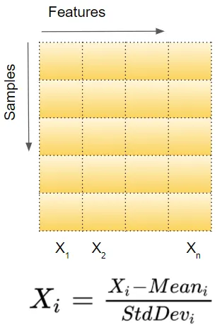
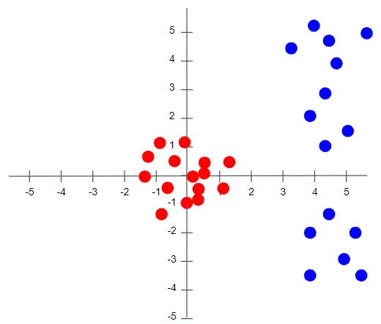
Batch Normalization
Illustration of Normalization
Image Credits: https://towardsdatascience.com/batch-norm-explained-visually-how-it-works-and-why-neural-networks-need-it-b18919692739

Slide 3
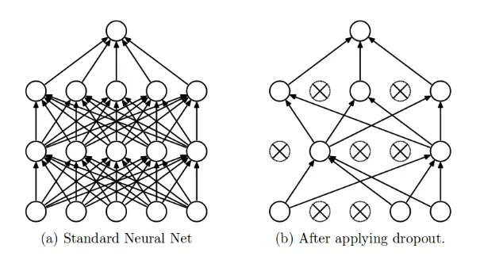
Dropout
Image Credit: https://towardsdatascience.com/dropout-in-neural-networks-47a162d621d9

Slide 4
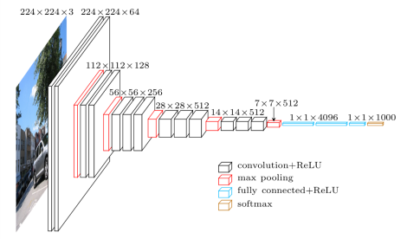
Transfer Learning - VGG Architecture
Paper Title : Very Deep Convolutional Networks For Large-Scale Image Recognition
Conference : ICLR 2015
VGG-Net Architecture
Image Credit : https://paperswithcode.com/method/vgg
Paper Link : https://ora.ox.ac.uk/objects/uuid:60713f18-a6d1-4d97-8f45-b60ad8aebbce/files/m8c05832586c47c4e0f88fd58ebd22c0d

Slide 5
Transfer Learning – VGGish Implementation Details
Implementation Interface : https://pytorch.org/audio/main/prototype.pipelines.html
Paper Title : CNN Architectures for Large-Scale Audio Classification
Conference : ICASSP 2017
Paper Link : https://arxiv.org/pdf/1609.09430

