Slide 1
All About Android
Prof. John Cole
Senior Lecturer
The University of Texas at Dallas
www.utdallas.edu/~John.Cole

Slide 2
Instructor: John Cole
Completed MS in Computer Science from Illinois Institute of Technology
40 years of writing software in a large variety of industries.
6.5 years as an adjunct (part-time) faculty member at UTD from January 2006 through May 2012, full time since then. Also taught at Collin College and, long ago, IIT

Slide 3
Schedule
Day 1: Logistics, setting up. Installing Eclipse with ADT. Java review Android Tutorials: Your first app.
Day 2: Android app design. Building real apps
Day 3: Your first graphical Android app
Day 4: Finishing your app; future direction
Day 5: Open

Slide 4
Logistics
We start at 10:00 and finish at 5:00 every day. Please try to be early to set up.
There will be breaks at 10:30 and 3:00.
Lunch will be from noon until 1:00. I’ll be joining you, and it is included with your payment.
If you need to use the restroom, you do not need to ask permission.
Cell phones don’t work well if at all in here.

Slide 5
More Logistics
The general format of this workshop is some lecture followed by actual work on a program.
My assistants and I will be available to help you during the programming sessions.
If you don’t have an Android device, work with someone who does (with their permission, of course.)

Slide 6
More Logistics
The emulator isn’t a good way to take this course because of lack of sensors, excruciatingly slow speed, and other limitations.
This class isn’t graded, so you are encouraged to learn from each other as well as the instructor.

Slide 7
What You Need
A computer capable of running the Eclipse Java development tools.
An Android device of your choice: Phone, tablet, etc.
A USB cable to connect the device to your computer
Curiosity

Slide 8
Your Background
Do we need a refresher in Java and, in particular, Swing?
Or can we go directly into Android?
What about multithreading? Timer?

Slide 9
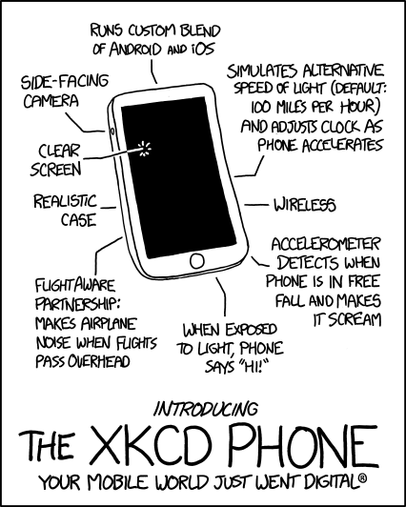
I Want One
Link to comic strip

Slide 10

CS Department: Highlights
The UTD CS department started as a small program within the Mathematical Sciences in the 70s
One of the largest CS departments in the US today
Over 60 faculty members
120+ Research and Teaching Assistants
15 Staff members including 4 Tech. Support
1500+ Students (130 Ph.D. +700 MS +720 BS)
Full range of programs in CS, SE and TE:
-- BS, MS and Ph.D.
________________________________________________________________________
Department of Computer Science Jonsson School of Engineering and Computer Science

Slide 11
CS Department: Accomplishments
Ranked 29th in UC Irvine’s publications ranking of CS graduate programs
Ranked 24th worldwide in UC Irvine’s publications ranking of SE graduate programs
8 of our faculty hold Young Investigator awards
Top 5 producer of CS degrees
Placed 14th worldwide in ACM Programming Competition (just behind MIT & CalTech in US)
________________________________________________________________________
Department of Computer Science Jonsson School of Engineering and Computer Science

Slide 12
CS Department: Distinguished Faculty
Over 55 memberships on editorial boards of computer science journals
Research expenditure over $16 million in last two years
Published 250+ papers last year
Involved in numerous leading technical conferences as conference chairs or program committee chairs/members
________________________________________________________________________
Department of Computer Science Jonsson School of Engineering and Computer Science

Slide 13
And now…
Back to our regularly scheduled programming.

Slide 14
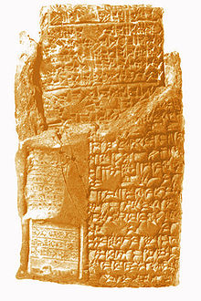
History of Writing
Babylonian Stone Tablet, circa 1000 BCE

Slide 15
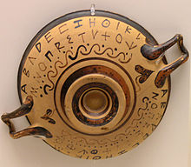
History of Writing
Greek Alphabet on Pottery, circa 300 BCE

Slide 16
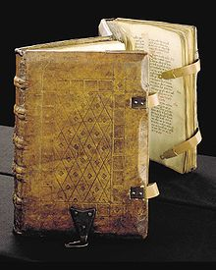
History of Writing
Parchment, middle ages:

Slide 17
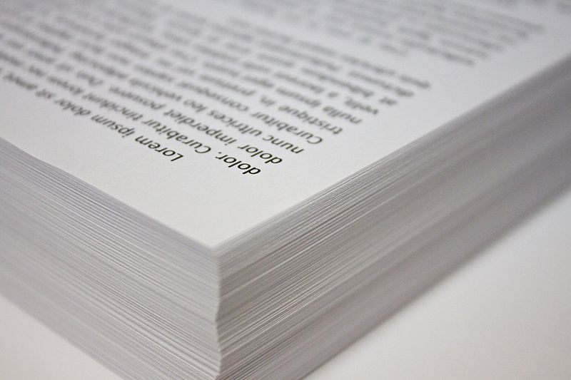
History of Writing
Paper, modern era

Slide 18
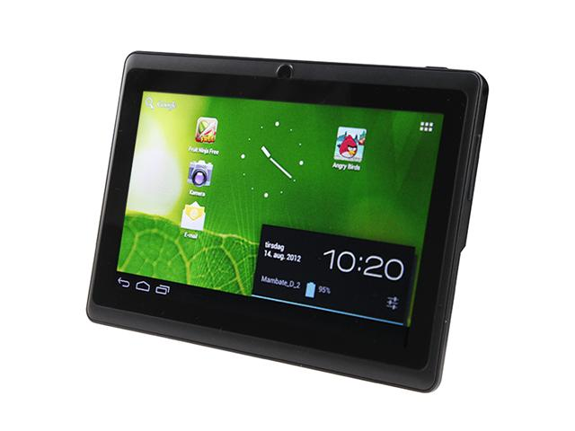
History of Writing
21st Century Stone Tablet

Slide 19
Useful Links
Android design guidelines
Eclipse with Android Developer Tools
Android Class Reference
Main Android Tutorials Page
Android Bouncing Ball Tutorial
Android Gesture Sample Code

