Slide 1
All About Android
Introduction to Android

Slide 2
Creating a New App
“These aren’t the droids we’re looking for.” Obi-wan Kenobi
1. Bring up Eclipse.
2. Click on File->New->Android Application Project
3. Enter an application name, such as HelloWorld. This is how your app will show on your device.

Slide 3
Creating a New App (continued)
4. The Project Name and Package name will default. No reason to change them.
5. On the next page, you can leave everything as defaults unless you want your projects in a specific location.
6. You can change the icon or use the defaults.
7. On the next screen, choose Blank Activity

Slide 4
Creating a New App (continued)
8. On the final screen, change the name of the activity to something about your project, such as HelloWorldActivity.
9. Click Finish and you’re done.

Slide 5
What Just Happened
You should now have a .java file with the name of your activity as a class name and file name that extends Activity
Your file will have an OnCreate method, which is equivalent to calling the “main” method in a standard Java program. This is the constructor of your application.

Slide 6
Running The App
Configure your device for USB Debugging (this is different for every device)
Connect your Android device to your computer with the USB cable
Do not select anything when Windows pops up and asks how to connect, or (strangely), set it up as a camera.

Slide 7
Running The App
Right-click on the project name on the left and select Run As->Android Application from the context menu
Eclipse should now have downloaded the app to your device and started it. If you have done this correctly, the app is running.

Slide 8
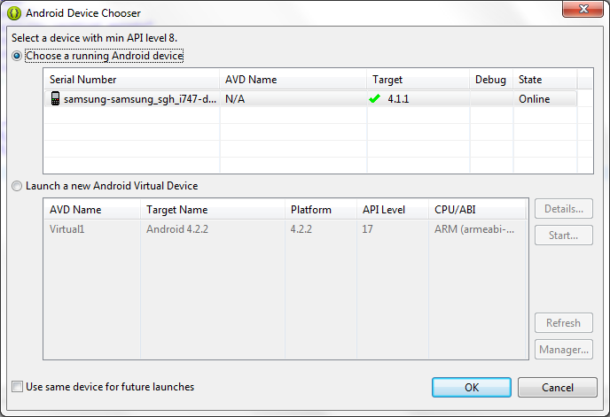
Running the App
You should get a screen that looks like this:

Slide 9
Running the App
If your device is connected properly, it will show in the top box. You see my Samsung Galaxy S3 phone.
You can also run in the emulator, which is slow and doesn’t provide the same interface.

Slide 10
What You Have
activity_main.xml is the screen design for your app. Like Swing, it has a layout manager
The TextView contains a reference to a string in the resource file:
<TextView
android:layout_width="wrap_content"
android:layout_height="wrap_content"
android:text="@string/hello_world" />

Slide 11
What You Have
Under res\values you have a file called strings.xml
Clicking on one of the string designators shows you its value and allows you to change it

Slide 12
The Program
You have a main class, but no main method. Your class is:
public class MainActivity extends Activity
So in Android, every screen is an activity

Slide 13
The Program
The Activity class contains various methods. This example overrides the OnCreate message:
@Override
protected void onCreate(Bundle savedInstanceState)
{
super.onCreate(savedInstanceState);
setContentView(R.layout.activity_main);
}

Slide 14
The Application Manifest
Every Android project includes a manifest file, AndroidManifest.xml, stored in the root of its project file.
This defines the structure and metadata for your app, its components, and hardware and other requirements.

Slide 15
Other Useful Overrides
onPause – called when the activity is paused
onResume – called when the activity becomes visible (active) again
onStop – called before the activity stops
This may look somewhat familiar if you have written java applets

Slide 16
What Makes an Android App?
Activities – These are the presentation layer for your app. You create extensions to this class for your different UI components.
Services – These run without a UI, updating data sources and activities, etc.
Content Providers – Shareable persistent storage such as the SQLite database

Slide 17
What Makes an Android App?
Intents – A powerful interapplication message-passing framework. You can use them to start and stop services and pass information to different activities.
Broadcast Receivers – Intent listeners. (Subscribers, in the publish-subscribe design pattern)

Slide 18
What Makes an Android App?
Widgets – Visual application components that are typically added to the device home screen.
Notifications – These enable you to alert users to application events without stealing focus or interrupting their current Activity.

Slide 19
The Android Application Lifecycle
Android apps have limited control over their lifecycle
Android manages resources to ensure a smooth and stable user experience

Slide 20
Android Processes
Active processes – foreground processes with which the user is interacting. These are killed only as a last resort
Visible processes – these are inactive processes hosting visible Activities that are not in the foreground

Slide 21
Android Processes
Started Service processes – Hosting Services that have started. Since they don’t interact with the user, they have slightly lower priority.
Background Processes – These host Activities that aren’t visible and have no running Services.
Empty Processes – Android will often retain an application in memory after it ends.

Slide 22
The Android Application Class
Your app’s Application object remains instantiated whenever your app runs. Application is not restarted as a result of configuration changes.

Slide 23
Application Event Overrides
onCreate – Called when the application is created. Create the application singleton and initialize state variables.
onLowMemory – Lets a well-behaved app free memory when the system is low on resources.
onTrimMemory – Called when the runtime wants the app to reduce its memory.
onConfigurationChanged – Applications are not restarted when the configuration changes, so this must be handled in this method.

Slide 24
Layouts
As in Swing, Android uses layouts to define the user interface
It is better to use XML to lay out your screen, but you can do it in code
Android has three layouts: Linear, Relative, and Grid
You can nest layouts within layouts

Slide 25
Linear Layout
Allows you to create a simple UI that aligns a sequence of child views (controls, etc.) in either a vertical or horizontal line.
Simplest and least flexible of the layout managers.

Slide 26
Relative Layout
You can define the position of each element in terms of its parent and the other Views

Slide 27
Grid Layout
Uses a grid to organize other Views.
Useful for screens that require alignment in 2 directions.
Supports row and column spanning.

Slide 28
Layout Guidelines
Avoid redundancy
Don’t nest them too deep
Limit the number of views
Notes:
To-Do List sample

