Slide 1
All About Android
Android Programming
Design Guidelines

Slide 2
Mobile App Design
The guidelines are phrased in the first person:
Enchant me
Simplify my life
Make me amazing
Most of what follows is from Google: Link to the design guidelines

Slide 3
Enchant Me
Android apps are sleek and aesthetically pleasing.
Transitions are fast and clear
Layout and typography are crisp and meaningful.
App icons are works of art in their own right.
Like a well-made tool, your app should strive to combine beauty, simplicity and purpose to create a magical experience that is effortless and powerful.

Slide 4
Simplify My Life
Android apps make life easier and are easy to understand.
When people use your app for the first time, they should intuitively grasp the most important features.
Android apps remove ongoing chores like file management and syncing.

Slide 5
Simplify My Life
Simple tasks never require complex procedures, and complex tasks are tailored to the human hand and mind.
People of all ages and cultures feel firmly in control, and are never overwhelmed by too many choices or irrelevant flash.

Slide 6
Make Me Amazing
It's not enough to make an app that is easy to use. Android apps empower people to try new things and to use apps in inventive new ways.
Android lets people combine applications into new workflows through multitasking, notifications, and sharing across apps.
At the same time, your app should feel personal, giving people access to superb technology with clarity and grace.

Slide 7
How to Enchant Me
Delight me in surprising ways
Real objects are more fun than buttons and menus
Let me make it mine
Get to know me

Slide 8
How to Simplify My Life
Keep it brief
Pictures are faster than words
Decide for me but let me have the final say
Only show what I need when I need it
I should always know where I am
Never lose my stuff
If it looks the same, it should act the same
Only interrupt me if it's important

Slide 9
How to Make Me Amazing
Give me tricks that work everywhere
It's not my fault
Sprinkle encouragement
Do the heavy lifting for me
Make important things fast

Slide 10
Android UI Overview
Three screens:
Home. Has just a few apps, usually the time, perhaps some other user-selected widget
All Apps: Series of screens with your installed apps.
Recents: (This isn’t on my phone, but it is on the tablet) Shows recently used apps

Slide 11
System Bars
Status Bar at the top
System Bar at the bottom
Notifications are short messages that the user can access from the Status Bar

Slide 12
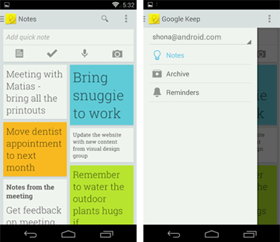
Common App Interface
Action Bar
Navigation drawer
Content area

Slide 13
The Action Bar
Command and control center for your app
The action bar is a dedicated piece of real estate at the top of each screen that is usually persistent throughout the app
Makes important actions prominent and accessible in a predictable way (such as New or Search)
Supports consistent navigation and view switching within apps.
Reduces clutter by providing an action overflow for rarely used actions.
Provides a dedicated space for giving your app an identity.
Persistent throughout the app.

Slide 14
Action Bar Components
App Icon
View Control
Action Buttons
Action overflow, if there are more action buttons than easily fit in the bar.
You can also split the action bar

Slide 15
Navigation Drawer
The user can bring the navigation drawer onto the screen by swiping from the left edge of the screen or by touching the application icon on the action bar.
Because they are transient, navigation drawers make views less cluttered. You can also use them at deeper levels in the navigation hierarchy, allowing users to switch to your app's most important screens from anywhere in the app.

Slide 16
When to use the Navigation Drawer
The navigation drawer is not a general replacement for top-level navigation via spinners or tabs. The structure of your app should guide your choice of which pattern to use for top-level switching.
More than 3 top-level views
Cross-navigation from lower levels
Deep navigation branches

Slide 17
Devices and Displays
Be flexible
Stretch and compress your layouts to accommodate various heights and widths
Optimize layouts
On larger devices, take advantage of extra screen real estate. Create compound views that combine multiple views to reveal more content
Assets for all
Provide resources for different screen densities (DPI) to ensure that your app looks great on any device

Slide 18
Display Strategies
One approach is to work in the base standard (normal size and MDPI) and scale it up or down for the other buckets. Another approach is to start with the device with the largest screen size, and then scale down and figure out the UI compromises you'll need to make on smaller screens.

Slide 19
Themes
Themes are Android's mechanism for applying a consistent style to an app or activity. The style specifies the visual properties of the elements that make up your user interface, such as color, height, padding and font size. To promote greater cohesion between all apps on the platform, Android provides two system themes that you can choose from when building apps:
Holo Light
Holo Dark

Slide 20
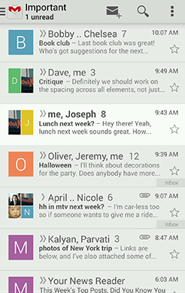
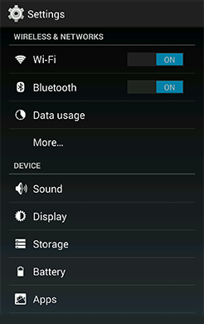
Themes
Holo Light
Holo Dark

Slide 21
Touch Feedback
Use illumination and dimming to respond to touches, reinforce the resulting behaviors of gestures, and indicate what actions are enabled and disabled.
Be responsive to touches in a subtle but noticeable way

Slide 22
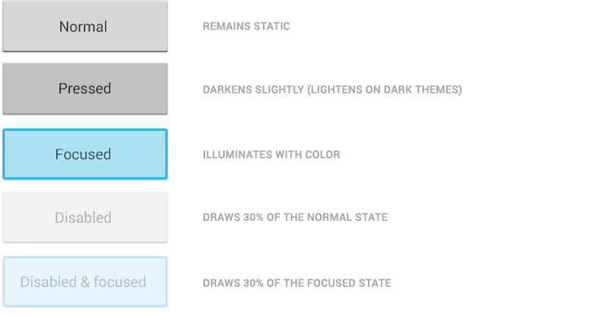
States

Slide 23
Communication
When your objects react to more complex gestures, help users understand what the outcome will be.
In Recents, when a user starts swiping a thumbnail left or right, it begins to dim. This helps the user understand that swiping will cause the item to be removed.

Slide 24
Boundaries
When users try to scroll past the beginning or end of a scrollable area, communicate the boundary with a visual cue. Many of Android's scrollable UI widgets, like lists and grid lists, have support for boundary feedback built in. If you’re building custom widgets, keep boundary feedback in mind and provide it from within your app.
Tilting a panel is one way to show this

Slide 25
Metrics and Grids
Devices vary not only in physical size, but also in screen density (Dots Per Inch). To simplify the way you design for multiple screens, think of each device as falling into a particular size bucket and density bucket:
The size buckets are handset (smaller than 600dp) and tablet (larger than or equal 600dp).
The density buckets are LDPI, MDPI, HDPI, XHDPI, XXHDPI, and XXXHDPI.

Slide 26
Metrics and Grids
Optimize your application's UI by designing alternative layouts for some of the different size buckets, and provide alternative bitmap images for different density buckets.
In the “res” folder, you’ll see:
Drawable_hdpi
Drawable_mdpi
Drawable_ldpi
Drawable_xhdpi

Slide 27
Metrics and Grids
dp = density-independent pixels
Devices vary in the amount of density-independent pixels (dp) they can display.

Slide 28
48DP Rhythm
On average, 48dp translate to a physical size of about 9mm (with some variability). This is comfortably in the range of recommended target sizes (7-10 mm) for touchscreen objects and users will be able to reliably and accurately target them with their fingers.
If you design your elements to be at least 48dp high and wide you can guarantee that:
your targets will never be smaller than the minimum recommended target size of 7mm regardless of what screen they are displayed on.
you strike a good compromise between overall information density on the one hand, and targetability of UI elements on the other. (Remember Fitts’s Law)

Slide 29
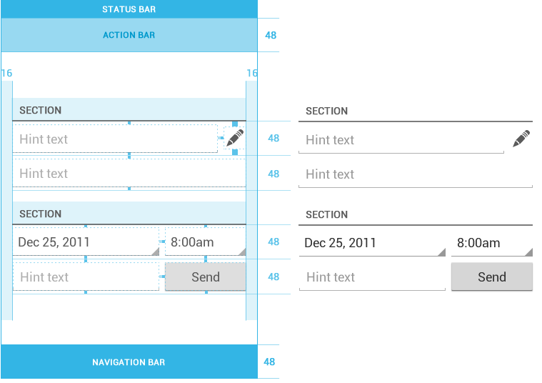
Mind the Gaps
Spacing between each UI element is 8dp.

Slide 30
Typography
Ice Cream Sandwich introduced the Roboto typeface
The current TextView framework offers Roboto in thin, light, regular and bold weights, along with an italic style for each weight. The framework also offers the Roboto Condensed variant in regular and bold weights, along with an italic style for each weight. re

Slide 31
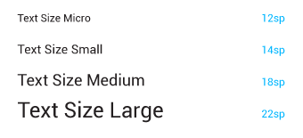
Typographic Scale
Contrast in type sizes can go a long way to create ordered, understandable layouts. However, too many different sizes in the same UI can be messy. The Android framework uses the following limited set of type sizes:

Slide 32
Typographic Scale
Users can select a system-wide scaling factor for text in the Settings app. In order to support these accessibility features, type should be specified in scale-independent pixels (sp) wherever possible. Layouts supporting scalable types should be tested against these settings.
From the XML:
<dimen name="ThirtyPitch">30sp</dimen>

Slide 33
Color
More detail here: http://developer.android.com/design/style/color.html
Use color mostly for emphasis
Blue is the standard accent color

Slide 34
Iconography
An icon is a graphic that takes up a small portion of screen real estate and provides a quick, intuitive representation of an action, a status, or an app.
You can provide the icon in different sizes.
When your app runs, Android checks the characteristics of the device screen and loads the appropriate density-specific assets for your app.

Slide 35
Launcher
The launcher icon is the visual representation of your app on the Home or All Apps screen. Since the user can change the Home screen's wallpaper, make sure that your launcher icon is clearly visible on any type of background.

Slide 36
Launcher – Size and Scale
Launcher icons on a mobile device must be 48x48 dp.
Launcher icons for display on Google Play must be 512x512 pixels.

Slide 37
Launcher – Style
Use a distinct silhouette. Three-dimensional, front view, with a slight perspective as if viewed from above, so that users perceive some depth.

Slide 38
Action Bar Icons
Graphic buttons that represent the most important actions people can take within your app. Each one should employ a simple metaphor representing a single concept that most people can grasp at a glance.
Be aware of cultural differences. Remember the elephant.
Download the Action Bar Icon Pack (4.3MB)

Slide 39
Action Bar Icons – Size and Scale
Action bar icons for phones should be 32x32 dp.

Slide 40
Action Bar Icons – Style
Pictographic, flat, not too detailed, with smooth curves or sharp shapes. If the graphic is thin, rotate it 45° left or right to fill the focal space. The thickness of the strokes and negative spaces should be a minimum of 2 dp.

Slide 41
Writing Style
When writing text that appears in your app, keep it concise, simple, and friendly
More detail here

Slide 42
Android’s Voice
Concise
Describe only what the user needs to know.
Eliminate redundancy, such as titles that restate the body of an information box.
Keep text as short as possible

Slide 43
Android’s Voice
Simple
Use short words, active verbs, and common nouns.
Put the most important thing first. “Front-load” the first 11 characters with the most salient information in the string.
Don’t try to explain subtle differences. They are lost on most users.
Focus on the user’s concern, not technical issues

Slide 44
Android’s Voice
Simple
Use short words, active verbs, and common nouns.
Put the most important thing first. “Front-load” the first 11 characters with the most salient information in the string.
Don’t try to explain subtle differences. They are lost on most users.
Avoid being confusing or annoying.

Slide 45
Formatting Text
Capitalization
Use sentence-style capitalization for all UI strings: “Words to live by.”
Capitalize all important words in:
App names (Calendar, Google Drive)
Named features (Android Beam, Face Unlock)
Proper nouns (Statue of Liberty, San Francisco Giants)
Be conservative. Don't capitalize words that aren't part of a formal feature name:
Sim card lock, Home screen, not Sim Card Lock, Home Screen.

Slide 46
Formatting Text
Punctuation
Period. Don't use a period after a single sentence or phrase used in isolation, such as in a toast, label, or notification. Wherever two or more sentences run together, use a period for each sentence.
Ellipsis. Use the ellipsis character (…) (Option-; on MacOS and &hellip; in HTML) to indicate
Incompleteness, such as an action in progress (“Downloading...”) or truncated text.

