Slide 1
Advanced Java and Android
Day 1
Object-Oriented Programming in Java

Slide 2
OO Programming Concepts
Object-oriented programming (OOP) involves programming using objects. An object represents an entity in the real world that can be distinctly identified. For example, a student, a desk, a circle, a button, and even a loan can all be viewed as objects. An object has a unique identity, state, and behaviors. The state of an object consists of a set of data fields (also known as properties) with their current values. The behavior of an object is defined by a set of methods.

Slide 3
OO Programming Concepts
Objects can also generate and respond to events
An event is an a signal from either some external source such as the keyboard, mouse, etc. to the program

Slide 4
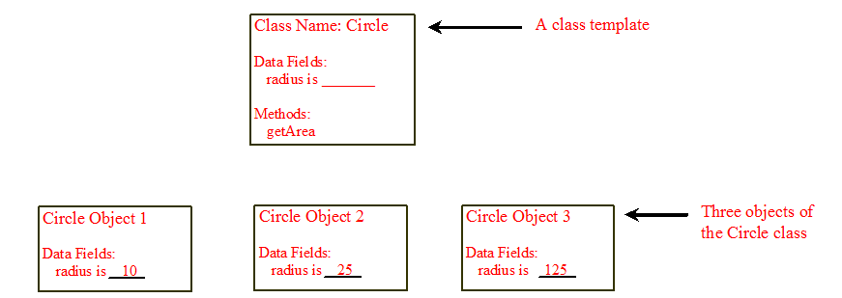
Objects
An object has both a state and behavior. The state defines the object, and the behavior defines what the object does.

Slide 5
Classes
Classes are an abstraction for a kind of object. For example, the idea of Circle is the circle class. An actual circle with radius 3.7 is an object of type Circle.
A Java class uses variables to define data fields and methods to define behaviors. Additionally, a class provides a special type of methods, known as constructors, which are invoked to construct objects from the class.

Slide 6
Classes
public class Circle
{
double radius; // Radius of the circle
public Circle()
{
radius=1;
}
public Circle(double newRadius)
{
radius=newRadius;
}
public getArea()
{
return radius * radius * Math.PI;
}
}

Slide 7
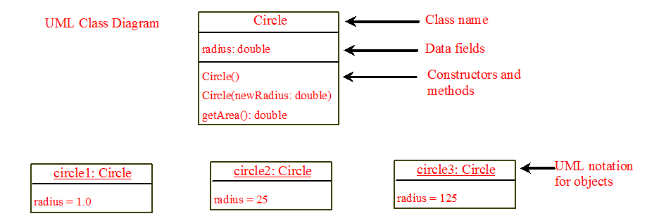
UML Class Diagram

Slide 8
Show Circle Program

Slide 9
Constructors
Constructors are a special kind of methods that are invoked to construct objects.
Circle() {
}
Circle(double newRadius) {
radius = newRadius;
}

Slide 10
Constructors
A constructor with no parameters is referred to as a no-arg constructor.
Constructors must have the same name as the class itself.
Constructors do not have a return type—not even void.
Constructors are invoked using the new operator when an object is created. Constructors play the role of initializing objects.

Slide 11
Constructors
While constructors have no declared return type, when you invoke a constructor with new, you get an object of the type of the class. For example:
Circle circle1 = new Circle();
Returns an object of type Circle and puts the reference into circle1.

Slide 12
Default Constructor
A class may be declared without constructors. In this case, a no-arg constructor with an empty body is implicitly declared in the class. This constructor, called a default constructor, is provided automatically only if no constructors are explicitly declared in the class.

Slide 13
Declaring Object Reference Variables
To reference an object, assign the object to a reference variable.
To declare a reference variable, use the syntax:
ClassName objectRefVar;
Example:
Circle myCircle;

Slide 14
Declaring/Creating Objects in a Single Step
ClassName objectRefVar = new ClassName();
Example:
Circle myCircle = new Circle();
Assign object reference
Create an object

Slide 15
Accessing Objects
Referencing the object’s data:
objectRefVar.data
e.g., myCircle.radius
Invoking the object’s method:
objectRefVar.methodName(arguments)
e.g., myCircle.getArea()

Slide 16
Reference Data Fields
The data fields can be of reference types. For example, the following Student class contains a data field name of the String type.
public class Student {
String name; // name has default value null
int age; // age has default value 0
boolean isScienceMajor; // isScienceMajor has default value false
char gender; // c has default value '\u0000'
}

Slide 17
The null Value
If a data field of a reference type does not reference any object, the data field holds a special literal value, null.

Slide 18
Default Value for a Data Field
The default value of a data field is null for a reference type, 0 for a numeric type, false for a boolean type, and '\u0000' for a char type. However, Java assigns no default value to a local variable inside a method.
public class Test {
public static void main(String[] args) {
Student student = new Student();
System.out.println("name? " + student.name);
System.out.println("age? " + student.age);
System.out.println("isScienceMajor? " + student.isScienceMajor);
System.out.println("gender? " + student.gender);
}
}

Slide 19
Example
Java assigns no default value to a local variable inside a method.
public class Test {
public static void main(String[] args) {
int x; // x has no default value
String y; // y has no default value
System.out.println("x is " + x);
System.out.println("y is " + y);
}
}
Compilation error: variables not initialized
Compilation error: variables not initialized

Slide 20
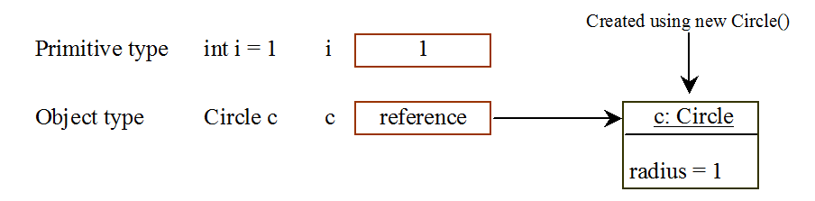
Differences between Variables of Primitive Data Types and Object Types

Slide 21
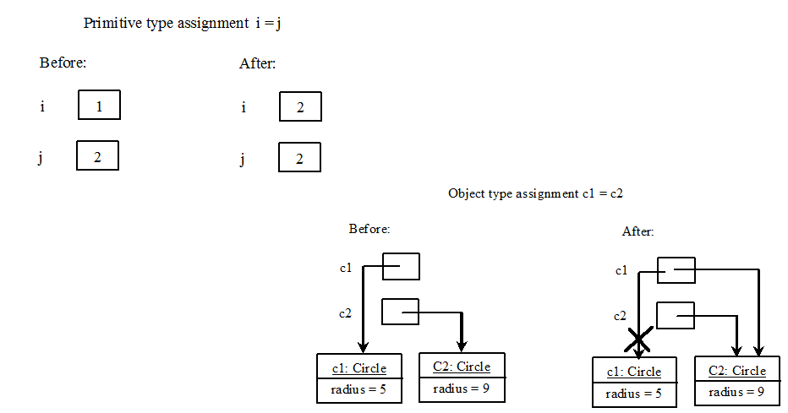
Copying Variables of Primitive Data Types and Object Types

Slide 22
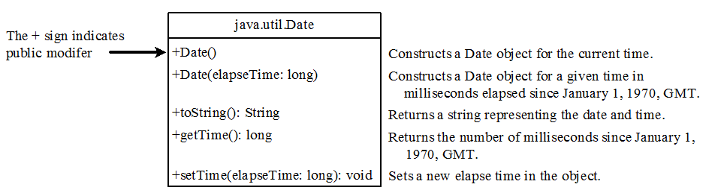
The Date Class
Java provides a system-independent encapsulation of date and time in the java.util.Date class. You can use the Date class to create an instance for the current date and time and use its toString method to return the date and time as a string.

Slide 23
The Date Class Example
For example, the following code
java.util.Date date = new java.util.Date();
System.out.println(date.toString());
displays a string like Sun Mar 09 13:50:19 EST 2003.

Slide 24
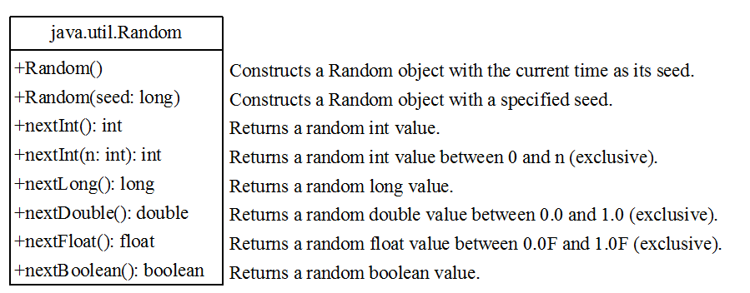
The Random Class
A useful random number generator is provided in the java.util.Random class.

Slide 25
The Random Class Example
If two Random objects have the same seed, they will generate identical sequences of numbers. For example, the following code creates two Random objects with the same seed 3.
quences of numbers. For example, the following code creates two Random objects with the same seed 3.
Random random1 = new Random(3);
System.out.print("From random1: ");
for (int i = 0; i < 10; i++)
System.out.print(random1.nextInt(1000) + " ");
Random random2 = new Random(3);
System.out.print("\nFrom random2: ");
for (int i = 0; i < 10; i++)
System.out.print(random2.nextInt(1000) + " ");
From random1: 734 660 210 581 128 202 549 564 459 961
From random2: 734 660 210 581 128 202 549 564 459 961

