Slide 1
Advanced Java and Android Programming
Multithreading

Slide 2
Threads Concept
Multiple threads on multiple CPUsCPUs
Multiple threads sharing a single CPUsingle CPU

Slide 3
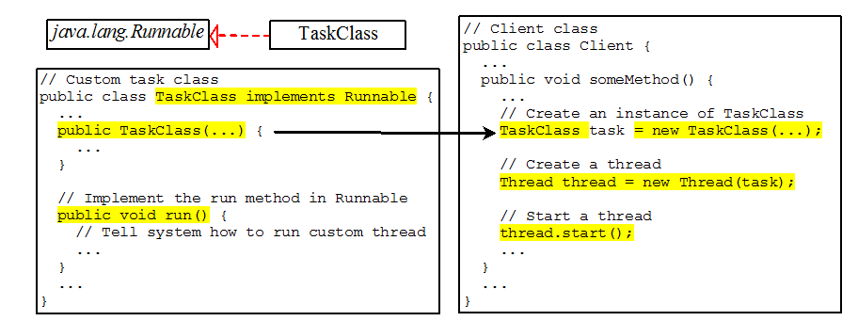
Creating Tasks and Threads

Slide 4
Using the Runnable Interface
Create and run three threads:
The first thread prints the letter a 100 times.
The second thread prints the letter b 100 times.
The third thread prints the integers 1 through 100.

Slide 5
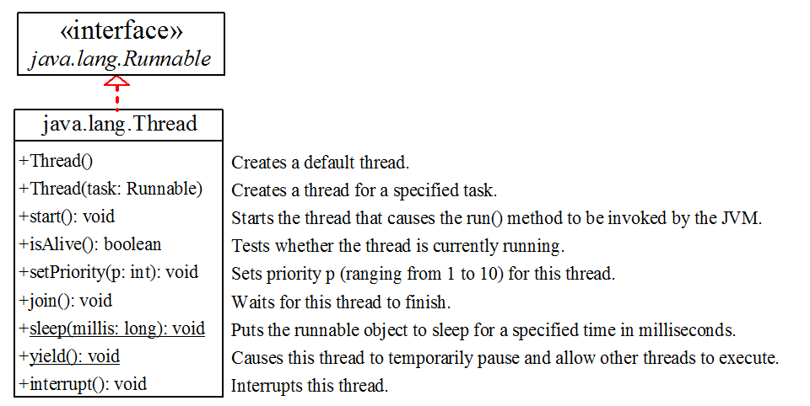
The Thread Class

Slide 6
The Static yield() Method
You can use the yield() method to temporarily release time for other threads. For example, suppose you modify the code in Lines 53-57 in TaskThreadDemo.java as follows:
public void run() {
for (int i = 1; i <= lastNum; i++) {
System.out.print(" " + i);
Thread.yield();
}
}
Every time a number is printed, the print100 thread is yielded. So, the numbers are printed after the characters.

Slide 7
The Static sleep(milliseconds) Method
The sleep(long mills) method puts the thread to sleep for the specified time in milliseconds. For example, suppose you modify the code in Lines 53-57 in TaskThreadDemo.java as follows:
public void run() {
for (int i = 1; i <= lastNum; i++) {
System.out.print(" " + i);
try {
if (i >= 50) Thread.sleep(1);
}
catch (InterruptedException ex) {
}
}
}
Every time a number (>= 50) is printed, the print100 thread is put to sleep for 1 millisecond.

Slide 8
The join() Method
You can use the join() method to force one thread to wait for another thread to finish. For example, suppose you modify the code in Lines 53-57 in TaskThreadDemo.java as follows:
The numbers after 50 are printed after thread printA is finished.

Slide 9
isAlive(), interrupt(), and isInterrupted()
The isAlive() method is used to find out the state of a thread. It returns true if a thread is in the Ready, Blocked, or Running state; it returns false if a thread is new and has not started or if it is finished.
The interrupt() method interrupts a thread in the following way: If a thread is currently in the Ready or Running state, its interrupted flag is set; if a thread is currently blocked, it is awakened and enters the Ready state, and an java.io.InterruptedException is thrown.
The isInterrupt() method tests whether the thread is interrupted.

Slide 10
Thread Priority
Each thread is assigned a default priority of Thread.NORM_PRIORITY. You can reset the priority using setPriority(int priority).
Some constants for priorities include Thread.MIN_PRIORITY Thread.MAX_PRIORITY Thread.NORM_PRIORITY

Slide 11
Thread Synchronization
A shared resource may be corrupted if it is accessed simultaneously by multiple threads. For example, two unsynchronized threads accessing the same bank account may cause conflict.

Slide 12
Race Condition
What, then, caused the error in the example? Here is a possible scenario:
The effect of this scenario is that Task 1 did nothing, because in Step 4 Task 2 overrides Task 1's result. Obviously, the problem is that Task 1 and Task 2 are accessing a common resource in a way that causes conflict. This is a common problem known as a race condition in multithreaded programs. A class is said to be thread-safe if an object of the class does not cause a race condition in the presence of multiple threads. As demonstrated in the preceding example, the Account class is not thread-safe.

Slide 13
The synchronized keyword
To avoid race conditions, more than one thread must be prevented from simultaneously entering certain part of the program, known as critical region. The critical region in the Listing 29.7 is the entire deposit method. You can use the synchronized keyword to synchronize the method so that only one thread can access the method at a time. There are several ways to correct the problem in Listing 29.7, one approach is to make Account thread-safe by adding the synchronized keyword in the deposit method in Line 45 as follows:
public synchronized void deposit(double amount)

Slide 14
Synchronizing Instance Methods and Static Methods
A synchronized method acquires a lock before it executes. In the case of an instance method, the lock is on the object for which the method was invoked. In the case of a static method, the lock is on the class. If one thread invokes a synchronized instance method (respectively, static method) on an object, the lock of that object (respectively, class) is acquired first, then the method is executed, and finally the lock is released. Another thread invoking the same method of that object (respectively, class) is blocked until the lock is released.

Slide 15
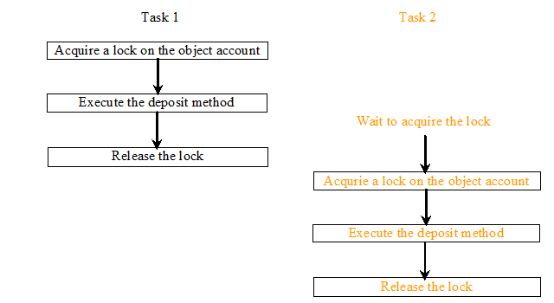
Synchronizing Instance Methods and Static Methods
With the deposit method synchronized, the preceding scenario cannot happen. If Task 2 starts to enter the method, and Task 1 is already in the method, Task 2 is blocked until Task 1 finishes the method.

Slide 16
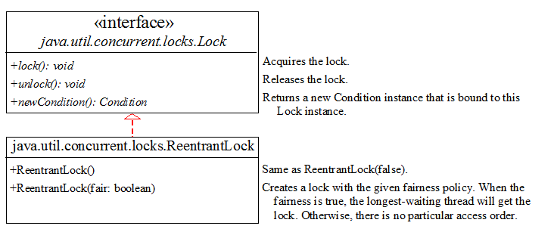
Synchronization Using Locks
A synchronized instance method implicitly acquires a lock on the instance before it executes the method.
JDK 1.5 enables you to use locks explicitly. The new locking features are flexible and give you more control for coordinating threads. A lock is an instance of the Lock interface, which declares the methods for acquiring and releasing locks, as shown in Figure 29.14. A lock may also use the newCondition() method to create any number of Condition objects, which can be used for thread communications.

Slide 17
Fairness Policy
ReentrantLock is a concrete implementation of Lock for creating mutual exclusive locks. You can create a lock with the specified fairness policy. True fairness policies guarantee the longest-wait thread to obtain the lock first. False fairness policies grant a lock to a waiting thread without any access order. Programs using fair locks accessed by many threads may have poor overall performance than those using the default setting, but have smaller variances in times to obtain locks and guarantee lack of starvation.

Slide 18
Example: Using Locks
Show the AccountWithSyncUsingLock example

