Slide 1
5V
SDA
5V
SDA
SCL
SCL
UNO 1
UNO 2
GND
GND

Slide 2
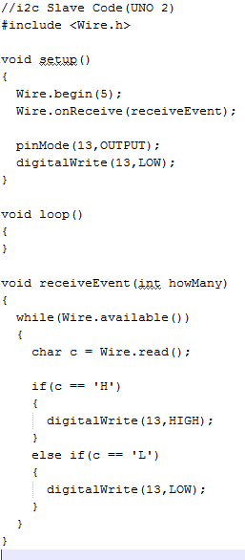
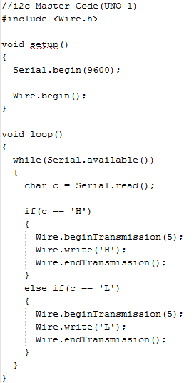
Master Write Slave Read

Slide 3
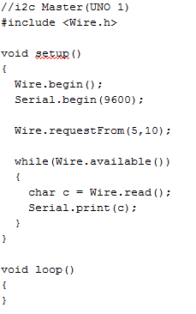
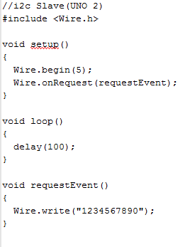
Slave Write Master Read

