Slide 1
GameMaker
Sai Chaitanya Batlanki

Slide 2
Learning objectives of the workshop
Basics of the GameMaker software.
Algorithmic approach that characterizes writing computer programs.
The perception behind incremental program enhancement.
The objective behind event-based computer programming.
Develop an understanding of object-oriented programming.
If you want a head start on learning Java or C++, you can learn to use the GameMaker scripting language.

Slide 3
What is GameMaker?
GameMaker is a software produced by YoYo games, in order to make people experience the thrill of making a computer do what they ask it to do, under the guise of producing a game.
GameMaker creates an event-driven, object-oriented simulation with a visual drag-and-drop interface.
GameMaker program executables can be run on a standalone computer, mobile device or from within a web page (after loading a plug-in)
The “Lite” Edition can be downloaded for free! There is also a “Pro Edition” that costs $20.

Slide 4
Where can I get GameMaker?
Go to http://www.yoyogames.com/legacy
As discussed earlier, The “Lite” Edition can be downloaded for free! There is also a “Pro Edition” that costs $20.

Slide 5

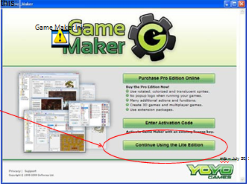
Getting started
Double-click on the GameMaker icon on your desktop.
We can also start the program from start menu or search options on windows 8.
Now,
Click here

Slide 6
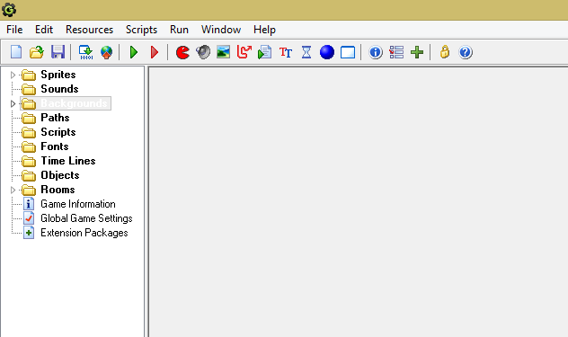
The first screen
Project Explorer with various categories.

Slide 7
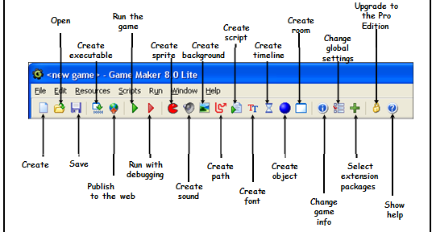
The first screen
Remembering these icons is important as they make our work easy .

Slide 8
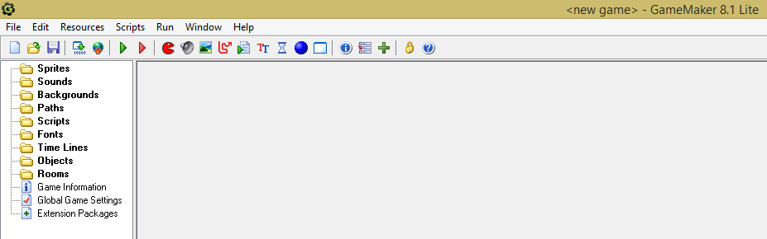
Resources
All the things that we can add to the game are called resources.
On the GameMaker software we can get them from any of the below areas:

Slide 9
Resources by definitions
Sprites: Images that are used to show the objects
Objects: The things in the game
Rooms: The scenes (levels) in which the objects live
Backgrounds: The images used as background for the rooms
Instances: One particular occurrence of an object
Sounds: These can be used in games, either as background music or as effects
Scripts: Small pieces of code that can be used to extend the possibilities of your game

Slide 10
How do I build a game in GameMaker?
Describe the game you are trying to create What is it supposed to do? What is it supposed to look like?
Define the sprites
Define the sounds
Define the objects themselves, but not (yet) their events and actions
Go back and define each object’s events and actions
Define the room
Put the object instances in the room
Note: It is suggestible to define the objects first and their events and actions later because some of those actions will need to be asked for in terms of objects (that might not have been created yet).

Slide 11

What next?
Now that we are acquainted with the basic terminology required for working on the GameMaker software, let’s stretch ourselves to know more about various resources and their functionalities.

Slide 12
Sprites
Sprite = picture
It can’t do anything but look good
Visual representation of game objects
Any common drawing format (gif, jpeg, tiff, png, pnt, cut, etc.)
Single image
Sprite things beyond where we go today..
Multiple image
Animated: explosions, walking
Rotated

Slide 13
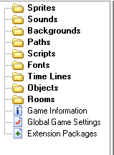
Adding Sprites
Click “Pacman” on the menu bar
Or
Select Create Sprite from the Resources Menu
Or
Use Ctrl-Alt-S keyboard shortcut

Slide 14
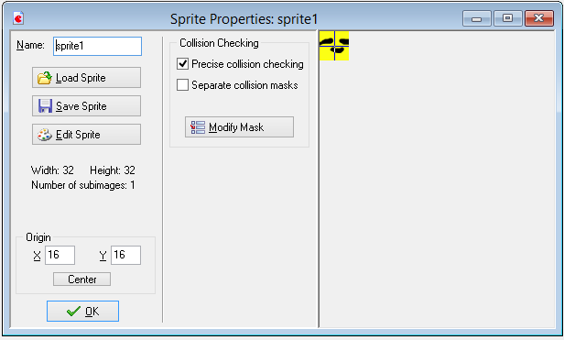
Sprite Properties
Use this to find pictures you can use for your sprite
This is where you name the sprite.
Use the following naming convention.
spr_NameOfSprite
Origin.
(0, 0) is the top left corner of the image. This is used for placing the image on the screen
Use this to change the sprite.
Size, color, …
Not super powerful editing, but you can modify the image

Slide 15
Sprite Properties: Starter Recommendations
Remove Precise collision checking
Precise collision checking slows the computer
Change the Name
Spr_nameOfSprite
Keep Transparent background
Extra: Consider Bounding Box settings or use an Object Mask (specially for animated sprites)
The bounding box is used to determine when you bump into something (have a collision.)
You will need to go to each of the sprites and set the Bounding Box for each sprite.
Center the Origin from the Upper-Left corner

Slide 16
Extra: Edit Sprite
Can use any paint or graphics program
Transform functions
Mirror, Flip, Rotate, Scale, Stretch, etc.
Images functions
Cycle, Colorize, Shift Hue, Crop, etc.
Animation functions
Expand canvas, shift image for center of rotation
Counter-clockwise Rotation
Number of Images = 360 / degrees of rotation
Initial image must face RIGHT
Advantage of Game Maker Registered Version

Slide 17
Quick Review
Sprite = picture
Pacman shortcut
Load a picture
Name spr_thename
Now onto objects
Object = Something on the screen
Room = The screen

Slide 18
Object = Three main parts
A sprite. This is the image it will have on the screen.
Events that make the object react.
An object is created
A key is pressed
A collision with another object
A click of the mouse
…
Actions related to the events.
How the object moves when a key is pressed,
or it runs into a wall,
or when a mouse is clicked or…..

Slide 19
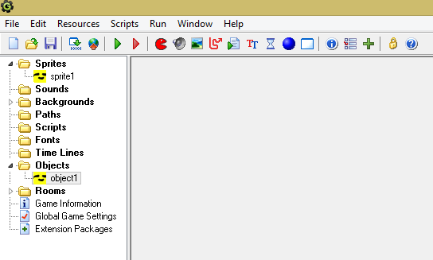
How do I create an Object?
Click on the blue ball or Resources -> Create Object or ctrl-alt-O
Use the sprite you created earlier

Slide 20
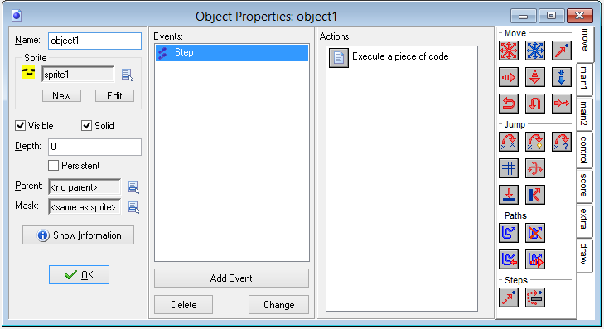
Tying a sprite to the object
Name the Object using the following naming convention.
obj_nameForYourObject
i.e. obj_rock
Select the sprite: Click to the pull down menu to the right of the <no sprite> to see the sprites available in this game and select the sprite you want to use for this object
Check visible if you want to see it.
Check solid for walls etc.
Check persistent if this object will exist when you go to different levels (rooms). Like a main character.
Depth: The lower number in the Depth, the more ‘upfront’ and object is. So if two objects go past each other on the screen, the object with the lower depth number will go over the object with the larger depth number.
Objects with the same depth are shown based on when they are created.

Slide 21
Events and Actions
Now that the object has an associated sprite we need to give it some personality with an associated behavior.
The next section will describe how to have the object react.
It takes two pieces
Picking events to react to
Defining the actions they will take when the event occurs.

Slide 22
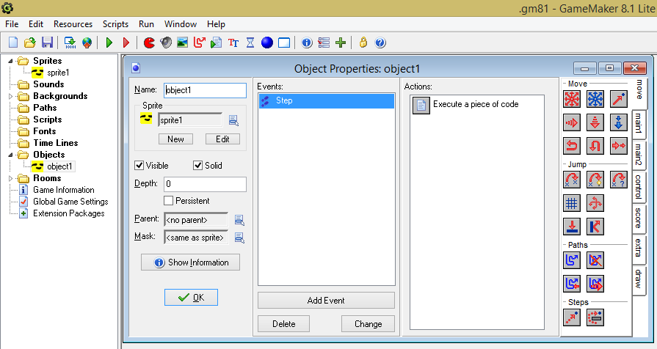
Events
1) Start by double clicking on the object. (obj_rock in this example)
This window will show the events as you define them for your object
This window will show the actions associated with whichever event is currently selected.
Click here to start defining an event.

Slide 23
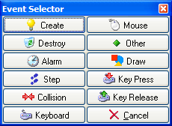
Event Selector
Here is the Event Selector menu that lists possible events. Included are a few brief descriptions:
Create: Defines what the object will do when it is created. Example: Have it moving in a direction.
Destroy: What happens when the object is destroyed.
Step: What happens during each step of the game. Steps happen several times a second so often this event includes some random action. Like having a 1 in 100 chance of an enemy appearing.
Collision: This is used to define how the object will react when hitting other objects. For example. Stopping when it hits a wall, getting points when it collides with a treasure, making a noise when it collides with a bell,…
Mouse: Reacting to Mouse clicks (Left, right, middle, wheel, …)
Other: Several events. Will often use the ‘Boundary’ event to destroy objects when they leave the boundary of the game.

Slide 24
Event Selector
Keyboard: Reacting to when a key is pressed and as long as it is being held down it will continue to do the actions associated with the key being pressed. (Think machine gun)
Key Press: This event occurs when a key is pressed, but only one time (Think of a rifle)
Key Release: This event occurs when the key is released. (Rifle)

Slide 25
Review
Sprite= Picture
Room = The screen
Object = Something on the screen
Basic parts of an object
Associated Sprite
Events the object will respond to
Actions the object will take when the associated events occur.
Next we will look at a few of the actions available

Slide 26
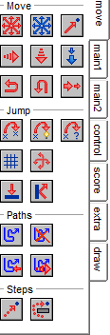
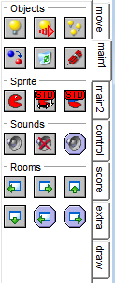
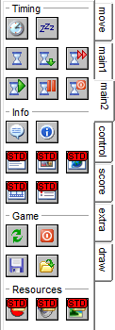
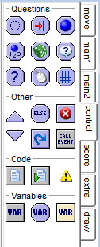
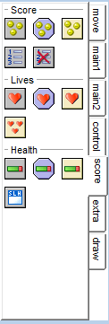
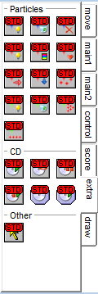
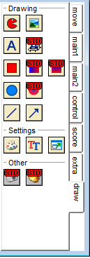
Event overview

Slide 27
Too many events?
We’ll take a little closer look at the move events then look at an example of having he rock controlled by the keyboard. (Example- Rock demonstration)

Slide 28
Actions: Move
Move Fixed : Give it a direction and speed for moving. (This is the action we will use for the rock)
Move Free: Give it direction and speed.
Move Towards: Pick object, and speed.
Speed Horizontal: Sets the horizontal speed.
Speed Vertical: Sets the vertical speed.
Set Gravity:
Reverse Horizontal: Good for when you run into a boundary
Reverse Vertical
Set Friction
Note: All “Move” actions are defined in the description from left to right beginning from the top.

Slide 29
Actions: Jump
Jump to Position: Give an (x, y) coordinate
Jump to Start
Jump to Random
Align to Grid
Wrap Screen: Allows you drive run off of one side of the screen only to reappear on the other side of the screen
Move to Contact
Bounce
Note: All “Jump” actions are defined in the description from left to right beginning from the top.

Slide 30
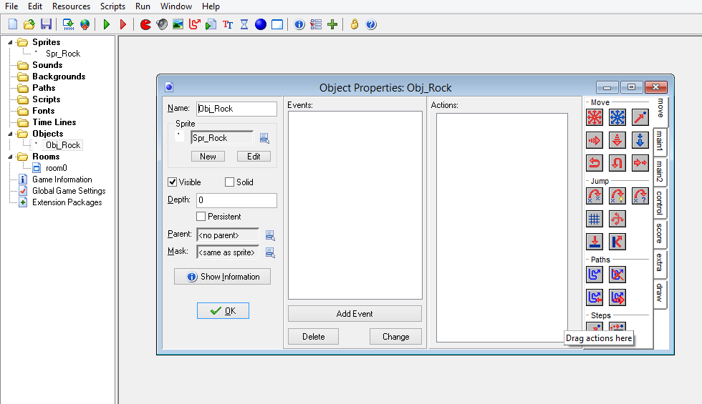
Example: Rock, Hit Key, Move
1) Double click on the rock object
2) Click on ‘Add Event’

Slide 31
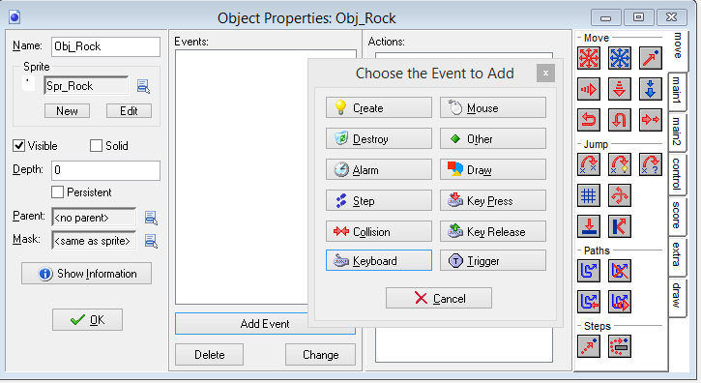

Keyboard Event
Click on Keyboard
Select <Left>

Slide 32
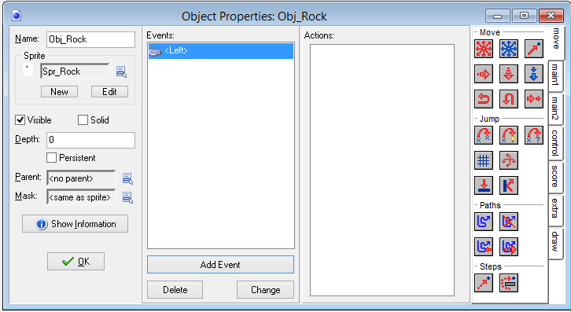
Pick Action
1) Select the ‘move’ tab
2) Drag and drop the ‘Move Fixed’ icon into the Actions window.

Slide 33
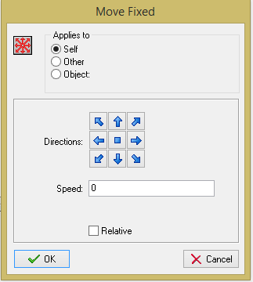
Pick the Direction
Select the direction for the object to travel. Since we are attaching this action to when the left arrow is clicked, select the left arrow.
Pick a speed. We’ll start with 5. If you want faster, pick a high number.
Leave ‘Relative’ un-clicked.

Slide 34
Review and check
Sprite = Picture
Room = Screen
Object = Something on the screen
Parts of an Object
Associated Sprite
Events to respond to
Actions associated with the Events
Your turn: Create an event and associated action for having the object move right when the right arrow is pressed

Slide 35
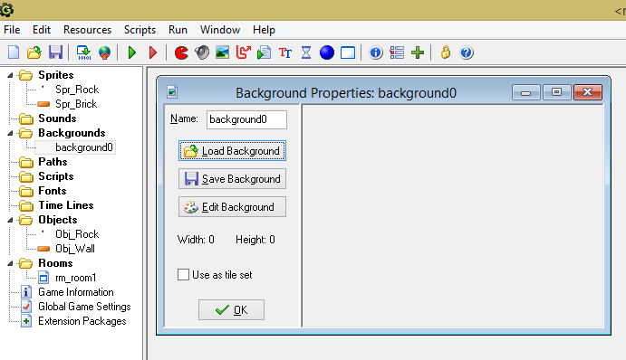
Background
These are usually large images that are used as backgrounds (or foregrounds) for the rooms in which the game takes place, but they can also be large images composed of many smaller ones called tiles which you can then place individually in your room to create complex visual designs for levels with far less processing overhead than you would get with objects and sprites.
Click on the background or Resources -> Create Resource or ctrl-alt-R

Slide 36
Rooms
Now we have a Rock sprite
We have created a Rock object using this sprite.
We have created two events (Left arrow hit, Right arrow)
We have associated two actions to the events (Move left and move right)
Now it’s time to make a Room.

Slide 37
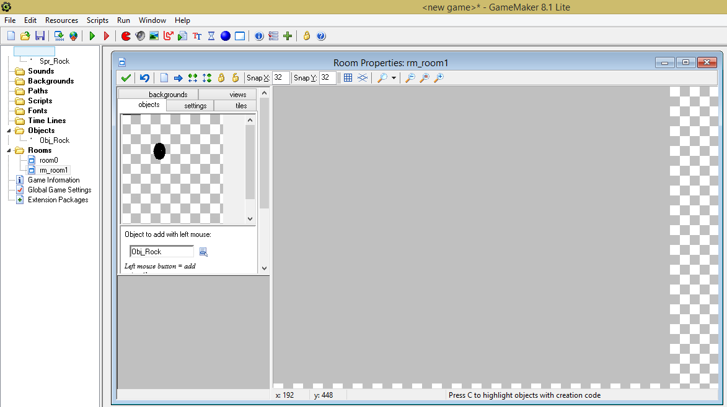
Adding a Room
Click on the White Box
Or
Resources(right click) -> Create Room
Or
Ctrl-Alt-R
Click on the Pull down menu and select the obj_Rock object.

Slide 38
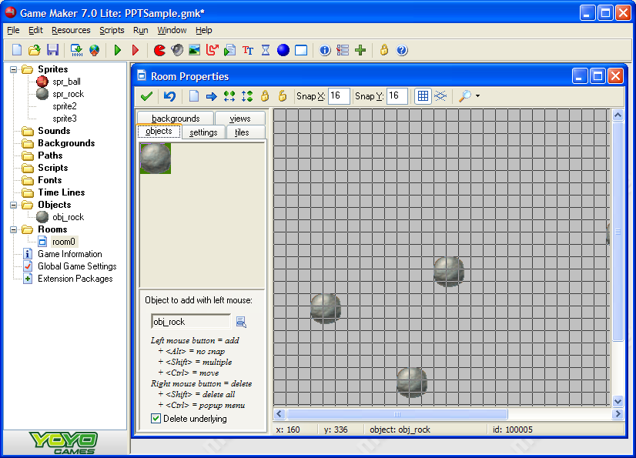
Adding Objects to the Room
Left click where you want the Rocks to show up
Right click on the objects to remove them.

Slide 39
Review
Sprite = Picture
Object = Something on the screen
Associated sprite
Events to respond to
Actions associated with the events
Background = Background for the room
Room = Screen
We now have enough for a basic, although not terribly riveting, game.
We have a rock that will move left and right based on keys that are pressed.

Slide 40
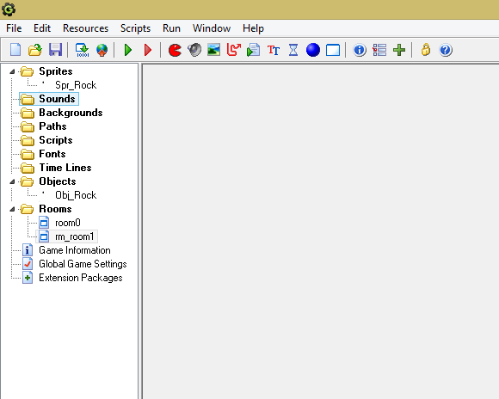
Running the game
Click on the green triangle or
Run -> Run normally or
Hit F5

Slide 41
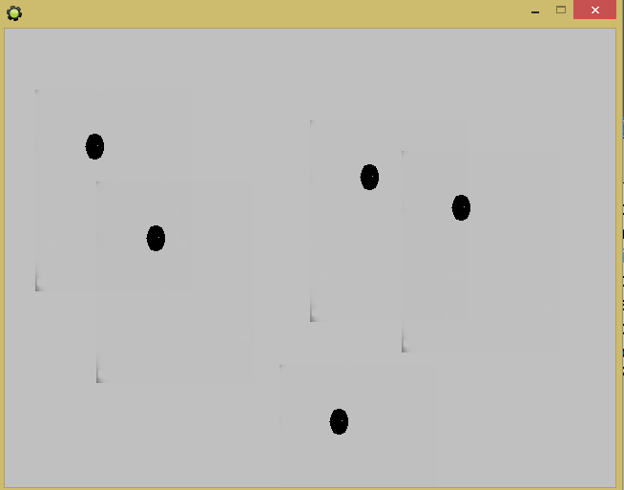
Game
Hit the ‘esc’ key to end the game.
What happens when it gets to the sides?
What other movement would you like to add to the rock?

Slide 42
Game-1
Create a brick sprite, brick object and use the brick objects to make walls.
Create collision events so that when the rock hits the wall object it stops horizontal direction
Create a maze
Add events and actions needed for the Rock to be able to go through the maze.
Test the rock going through the maze
Pushes
Add features to the game
Find other images for sprites. GIFs, Pac man, ..
Monsters
Secret walls
Battles
Treasures

