Slide 1
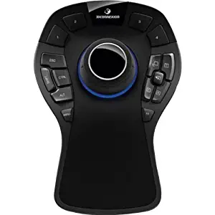
Navigate / Manipulate
Unassigned
Jog / Plan-execute
Nav “Go”
Wrist jog CW
Wrist jog CCW
Bias compliance
Toggle compliance
Next end effector
Arm go home
Close gripper
Toggle inset camera
Open gripper
Arm plan
Arm execute

