Slide 1
Javascript

Slide 2
Week 4 - Objectives
(1) Learn how to incorporate and use javaScript in html documents.
(2) Learn the basic syntax of javascript.
(3) Learn about some javascript Objects –String, Navigator and Math.
(4) Learn about the Event Driven Programming Document Object Model (DOM)
(5) Learn about validation of forms using javascript.

Slide 3
Javascript
Javascript is a programming language built into all modern browsers such as Mozilla, Internet Explorer and Opera.
Javascript is used for :-
  HTML page features such as drop down menus, rollovers and other dynamic HTML features.
  processing of user input (checking forms)
  maintaining persistent data (cookies)
  Automatic updating of web pages (AJAX)
Javascript adds a Programming capability to web pages.

Slide 4
Javascript Standards
The European Computer Manufacturer’s Association has released a javaScript standard that now has ISO (International Standards Organisation) approval.
This standard is known as ECMAScript.
The latest versions of the major browsers (IE, Mozilla, etc.) say that they conform to the ECMAScript standard and by and large, this is now true.
Microsoft calls its version of Javascript/ECMAScript JScript.

Slide 5
Javascript as a programming language
Javascript is a Programming Language
The syntax of javascript is based on the syntax of the C programming language.
Javascript has all the features of a high level programming language – variables, datatypes, arithmetical and logical operators, conditional statements, and functions.
Javascript also has Objects.

Slide 6
Javascript and Objects
Strictly speaking, Javascript is not an Object Oriented Language because it does not implement class based inheritance (we will be talking more about Objects and Classes in later lectures).
Javascript does have a lot of predefined Objects and users can define their own objects.

Slide 7
Using Javascript
Javascript has two characteristic features.
It runs inside browsers and in conjunction with HTML, CSS and the DOM, it can alter the behaviour of web pages.
It is a full featured programming language with data types, variables, conditional branches, loops and some OOP features.
We are going to be primarily concerned with the first feature
but you will need some knowledge of the second feature. For
those students with no knowledge of programming, or for those who need to brush up, we have provided some reference materials.

Slide 8
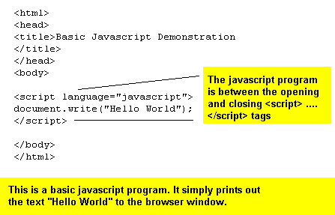
A simple Javascript program

Slide 9
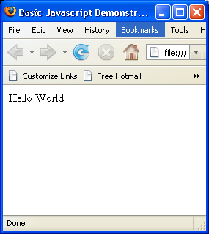
Result of running the previous slide

Slide 10
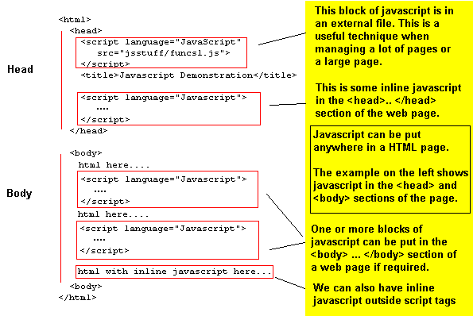
Javascript in web pages

Slide 11
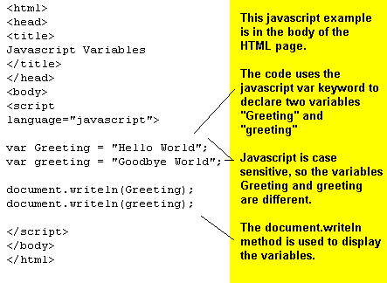
JavaScript and Variables

Slide 12
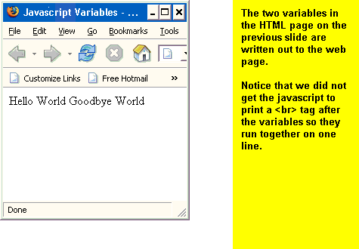
The result of accessing the HTML Page on the previous slide

Slide 13
JavaScript Functions
JavaScript allows for the creation of user-defined functions.
These user-defined functions can be defined in either the head or body of a html document.

Slide 14
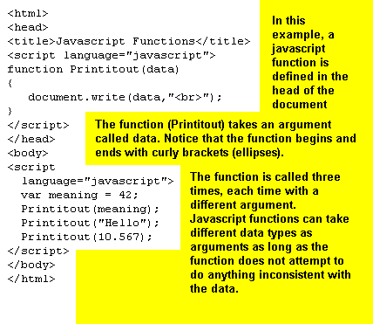
JavaScript Functions (2)

Slide 15
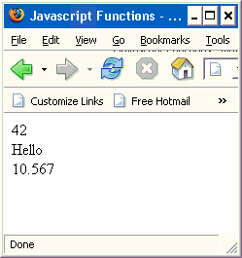
The result of viewing the previous page
Note that variables of different types were passed in as arguments to Printitout() and were converted to strings by the write method.

Slide 16
Some Javascript Objects
Navigator
Image
Array
Date
Math
plus many others……
We will be looking at the Navigator, String and Math Objects

Slide 17
What is an Object ?
At this stage of the course, an object may be regarded as a collection of functions and variables that are grouped together as one entity.
Object Oriented Programming (OOP) uses its own terminology for functions and variables. These are described as methods and properties respectively.

Slide 18
Javascript Objects
Javascript Objects are of 3 types.
Host Objects – these are objects that are premade. Every time you use javascript in a web page, these objects are already in existence.
Native Objects – these are objects created by the javascript code in a web page. Not all native objects are created in every piece of javascript. It depends on the requirements of the page.
User Defined Objects – we won’t be dealing with these

Slide 19
Native Objects and Host Objects
Object Type | Examples
Host Object | Navigator, Document, Window
Native Object | String, Image, Math, Array, Date, RegExp

Slide 20
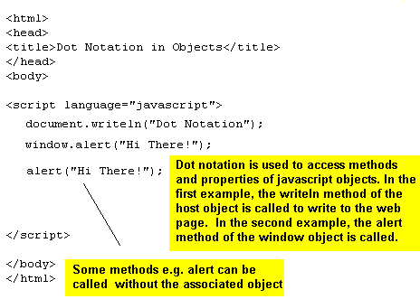
Dot Notation in Javascript Objects

Slide 21
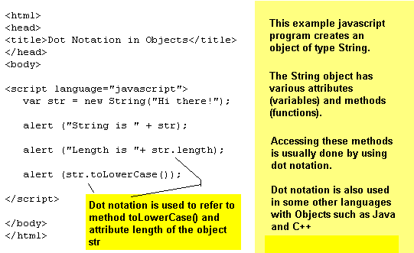
Accessing Methods (functions) and attributes (variables) in Javascript Objects.

Slide 22
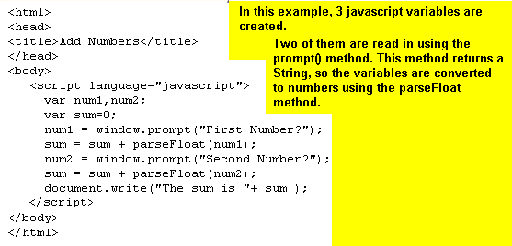
Using the prompt() method

Slide 23
JavaScript Strings
String – A String is a sequence of characters.
Javascript Strings are native objects
Methods provided by the javascript String class include substr, substring, indexOf, charAt, charCodeAt and about a dozen others.

Slide 24
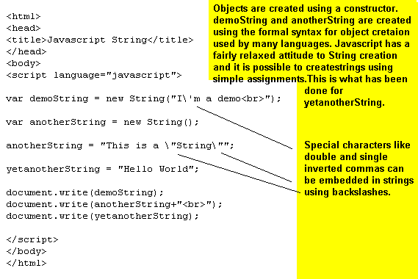
Creating a Javascript String Object

Slide 25
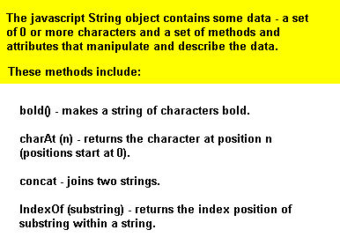
The String Object and its methods

Slide 26
More String Object methods
String Object Methods (2)
length –This is a property of all String Objects. It is the
String’s length (number of characters in the string)
substr(start_pos, number) – returns a substring of a string.
substring(start_pos, end_pos) – returns a substring of a string.
toLowerCase() – converts the value of a String object to lower case letters.
toUpperCase() – converts the value of a String object to uppercase letters.

Slide 27
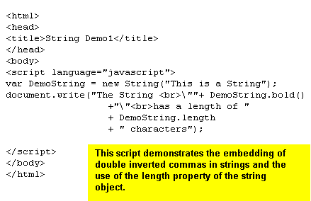
Demonstration of some String Methods

Slide 28
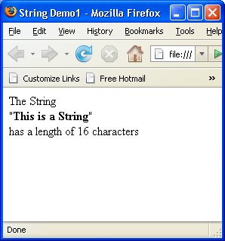
Output of the HTML page on the previous slide

Slide 29
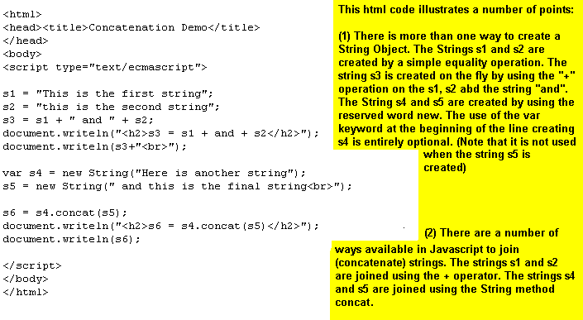
More String object methods Concatenate

Slide 30
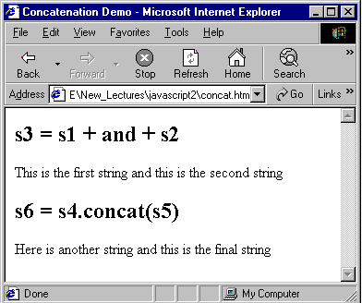
Output of the previous slide

Slide 31
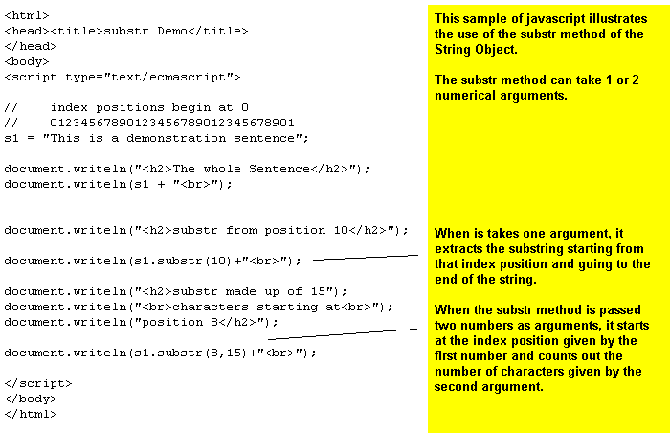
String Object Methods substr

Slide 32
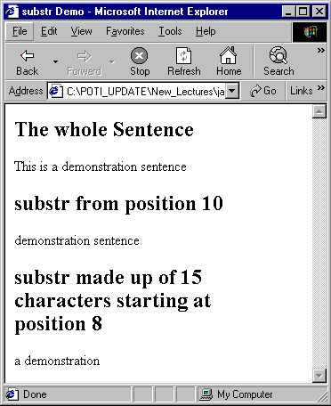
Output from the previous slide

Slide 33
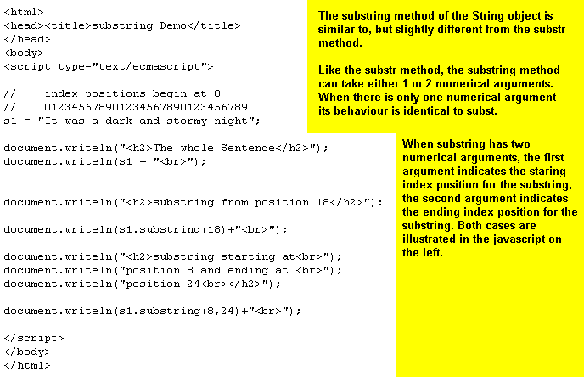
String Object Methods substring

Slide 34
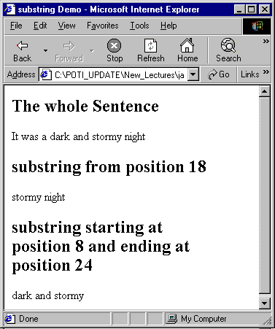
Output from the previous slide

Slide 35
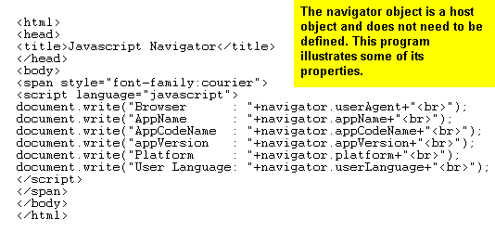
The Navigator Object

Slide 36
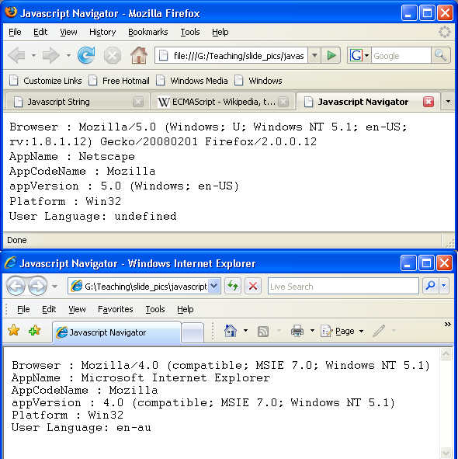
Output from the previous slide

Slide 37
Event-driven Programming
The event-driven model is one in which programs can react to any one of a number of events.
MS-Windows and Unix X-Windows are both event-driven systems. JavaScript and Java can also be programmed so they are event driven.
This model contrasts with the older model which waits for 1 specific type of input and will do nothing till that specific input occurs.

Slide 38
GUI Events
In Windowing GUI systems, the sorts of events that can occur are:-
Mousedown, Mouseclick, Mouseup, Mouseover, Keypress,Keyup, Keydown, Mousemove, WindowResize, Windowopen, WindowClose as well as many others.
JavaScript can be programmed to take specific actions when certain events occur.

Slide 39
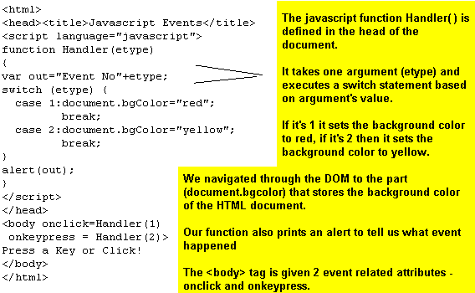
An Event-driven HTML Page that uses JavaScript

Slide 40

Typical Attribute Events
The event attribute names are :- onblur, onclick, ondblclick, onfocus, onkeydown, onkeypress, onkeyup, onmosedown, onmousemove, onmouseout, onmouseover, onmouseup
The syntax of the call is

Slide 41
The Document Object Model
There are 3 Document Object Models – DOM 0, DOM1 and DOM2.
DOM 0 is obsolete, DOM 1 will be obsolete eventually.
DOM 2 functionality is unevenly implemented in different browsers, so we will not be looking at it in this lecture.
DOM 2 is a DOM standard created by the W3C

Slide 42
The Document Object Model
Every time a web page is accessed by a browser, a DOM is created for that page.
Every image, link, paragraph, button, form etc. as well as the properties of these objects and the page in general is contained in the object and is accessible through JavaScript.
We have already seen an example of how the DOM may be used when we changed the value of document.body.bgcolor

Slide 43
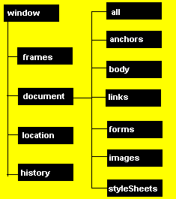
DOM 1 or
DHTML Object Structure
(abbreviated)

Slide 44
Handling the complexity of the DHTML Object Structure
The DOM1 Object Model is big.
One way to simplify access to particular components of a HTML document is to use the id attribute. This method is endorsed by the W3C

Slide 45
Demonstration of how to simplify the DHTML Object by using the id attribute
Click on the following URL and look at the source code.
http://learn.it.uts.edu.au/poti/id_demo/picdemo.html

Slide 46
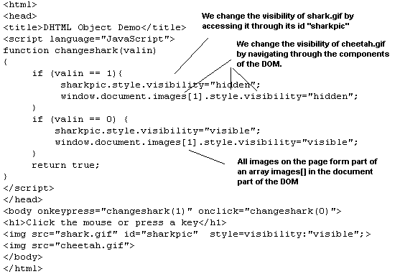
Picdemo.html

Slide 47
How picdemo.html works
Picdemo.html works by putting two gif files on the screen
The <body> tag picks up 2 kinds of events keypress and mouseclick
When either of these events occurs the JavaScript function changeshark() is called with an argument of either 0 or 1

Slide 48
How picdemo.html works (2)
The function changeshark() changes the visibility of the two gif files.
It needs to access the visibility property of the style associated with the two graphics images.
The shark.gif image is accessed by using the “sharkpic” id, which was set in the <img> tag for shark.gif
The cheetah.gif image is accessed the hard way, by tracing it through the images collection.

Slide 49
How picdemo.html works (3)
We could have used several other methods to access the style as well.
For example there is a JavaScript function “getElementById(idvalue)” that we could have used.
The following page gives a demonstration of how it can be used to access a particular html elements attributes or style properties. All that is necessary is that the id attribute is used to give a unique identifier to the tag.

Slide 50
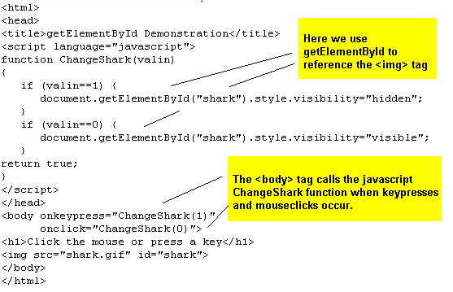
Accessing a tag using getElementById

Slide 51
JavaScript Maths and Operators
JavaScript Mathematical Operators include +,-,*,/,%. These are the addition,subtraction, division, multiplication and modulus operators respectively.
The modulus operator gives the remainder when a number is divided by another number. For example (17%6) is 5.
The increment and decrement operators are ++ and --. These act by increasing or decreasing the value of the variable they are applied to by 1. For example if the variable d has a value of 4 then after executing c--, its value is 3.

Slide 52
Logical Operations in JavaScript
Less than | < | Logical AND | &&
Less than or equal | <= | Logical OR | ||
Greater than | > | Not equal | !=
Greater than or equal | >= | equals | ==

Slide 53
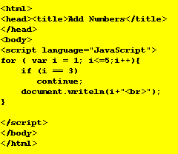
Loops and the continue statement

Slide 54
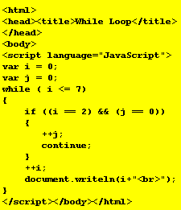
While loops

Slide 55
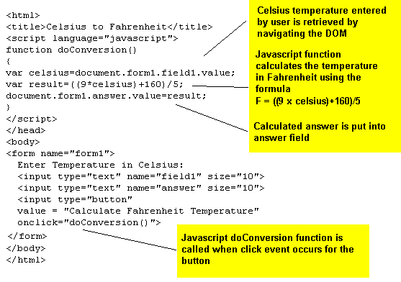
Example Javascript Calculation Program

Slide 56
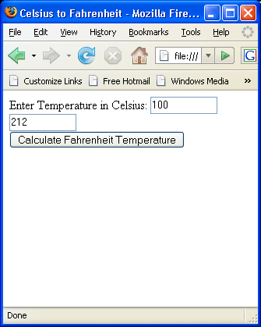
Output of the program on the previous slide

Slide 57
Math Object
The Math object is used to perform various trignometric, log and exponential and various other functions.
Examples: Math.sin(x); Math.pow(2,3), Math.max(4,6), Math.log(x), Math.random(0)
Note that the trignometric functions (sin, cos. tan all take arguments measured in radians).
The Math object also defines some constants. Example: Math.PI

Slide 58
Validating Data
Validating Data means checking that data entered through the input fields in a form is correct.
Data Validation occurs on the Client side before data is transmitted to a web server.

Slide 59
Validating Data
Javascript can be used to ensure fields have data in them, and also to check that the data is of the right type.
The relevant tags are usually given identifiers for the Javascript to be able to access the data.
The String() object and its methods are extensively used for data validation.

Slide 60
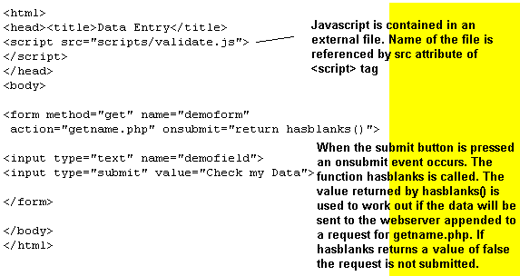
Validating Data – an example

Slide 61
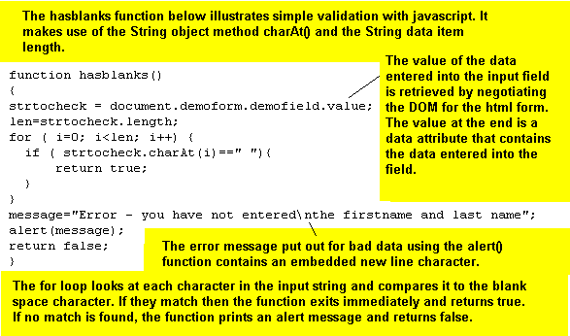
validate.js

Slide 62
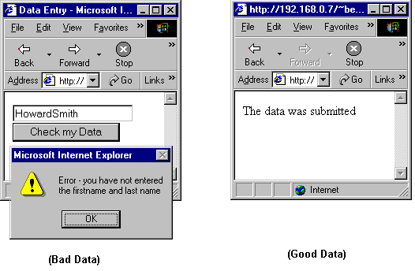
The result(s) of submitting the page

Slide 63
Data Validation – Checking for blank fields
Another very common and important aspect of validating data is checking that any data has been entered at all.
Almost all e-commerce sites requiring buyers to enter data have html forms with some fields that MUST have data in them.

Slide 64
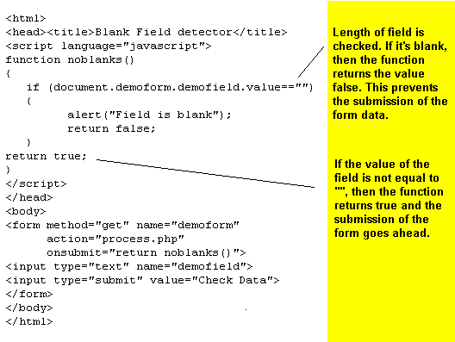
Simple Validation
Checking for a blank field

Slide 65
Data Validation in practice
In practice, data validation of form data requires that a number of different characteristics of the input data be checked.
Firstly some fields may be compulsory. Users should be given some indication that filling out the field is compulsory on the form.
Once compulsory fields have been checked to see they are not blank, the data should be checked to see that it is in the right format and (sometimes) has a particular size (e.g. Credit Card Numbers should contain only numbers – also most Credit Card Numbers are 12 characters wide)

Slide 66
Data Validation in practice (2)
Forms should contain hints to the user that indicate that fields are compulsory where applicable. Hints about the format of data should also be provided where possible.

Slide 67
Further Information
There is a lot of material on Javascript on the web. The W3C has very good website about DHTML at http://www.w3schools.com/dhtml
There is also a good reference to the main javascript objects at
http://www.w3schools.com/dhtml/dhtml_intro.asp
The site also has lots of other useful information.
Another good site is :-http://www.dannyg.com/
Two advanced books on Javascript are:
DOM Scripting by Jeremy Keith
Professional Javascript by Nicholas Zakas (2nd Ed.)

