Slide 1
Advanced Javascript & the Document Object Model (DOM)
Lecture 5

Slide 2
Part 1 – Lecture Summary
Characteristics of Javascript
Introduction to the DOM
InnerHTML
Javascript Objects, AJAX and javascript libraries.
Some practical applications of javascript

Slide 3
Javascript
Responsible for the Behavioural Layer of websites.
Interpreted language embedded in browser.
Works on the client side
Syntax resembles that of C, C++ and Java
Object Oriented
Predefined Objects

Slide 4
What Javascript does and how it does it
Provides code that reacts to events in the web page.
Does this by interacting with the Document Object Model (DOM) of the web page.
Using asynchronous javascript and XML (AJAX) it can also send user independent requests to web servers and process their responses.

Slide 5
Structure, Presentation and Behaviour – a caveat
The strict division of labour between (X)HTML
for structure, CSS for presentation and Javascript
for behaviour is not the full picture. For example:
CSS Pseudo classes like :hover are altering behaviour.
Javascript can add, delete and change (X)HTML tags. Thus altering structure.
Javascript can change styles – thus altering presentation.

Slide 6
Javascript Standards
Javascript is a dialect of a more general scripting language (ECMAScript)
The versions of Javascript in most browsers have proprietory i.e. non-standard extensions.
All new code must be standards compliant javascript.
Javascript debuggers are available for all the major browsers.

Slide 7
The role of Javascript
Javascript has many roles in contemporary websites.
Special effects (event driven programming)
Form validation (a traditional role, but still important)
AJAX – Interaction with the web server.
As a component of “Web 2.0” i.e. as a tool allowing content from other websites to be incorporated into your website.
Before examining these roles, we need to look at the DOM and how javascript interacts with it.

Slide 8
The DOM
Every web page is represented as a hierarchical tree structure.
All the page’s html elements, attributes and content are in the web page’s DOM.
The DOM structure is standardised by the W3C.
Javascript can add, delete and alter a web page’s DOM on occurrence of particular event – this is the “behavioural” layer of a web page.

Slide 9
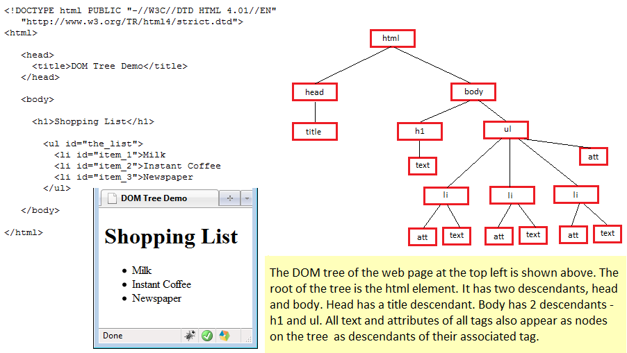
The DOM – an example

Slide 10
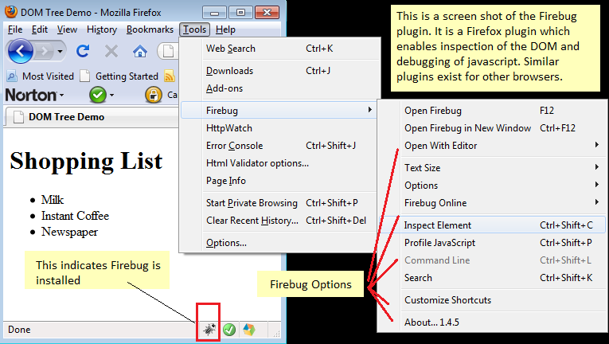
Using Firebug to visualise the DOM

Slide 11
Exploring the DOM
Each node in the DOM has built in functions that can be read and altered by javascript code. Some of these functions are :
Function | Description
GetElementById(element_id) | Returns to the element with a specific id attribute * See later slides for a warning
GetElementsByTagName(tag) | Returns an array of references to all occurrences of the tag in the page.
getAttribute(attribute) | Acts on an individual tag and returns the text of the attribute value.
setAttribute(attribute_text) | Acts on an individual tag and sets the text of the attribute value to the supplied argument.

Slide 12
DOM Child Nodes
Element tags in the DOM may have child nodes. These can consist of :
Other element tags that are contained within the opening and closing tags of the parent element – eg. A <p> ... </p> element inside a <div>
Text nodes. e.g. the text between an <h1>...</h2> element.

Slide 13
DOM Node properties
Function | Description
nodeName | Returns the name of the node. Read only property.
nodeType | Returns the type of the node as a number. Values range from 1 to 12. 1 =element, 2=attribute 3 = text, 4 -12 are less well known node types. Read only property
childNodes | An array of the child nodes of a node. Only element nodes return an array. Other nodes return an array of zero length. Read only
firstChild | The first child node of an element node. Read only
lastChild | The first child node of an element node. Read only
nextSibling | The next child after another child node. Read only
parentNode | The parent of a specified node. Read only.

Slide 14
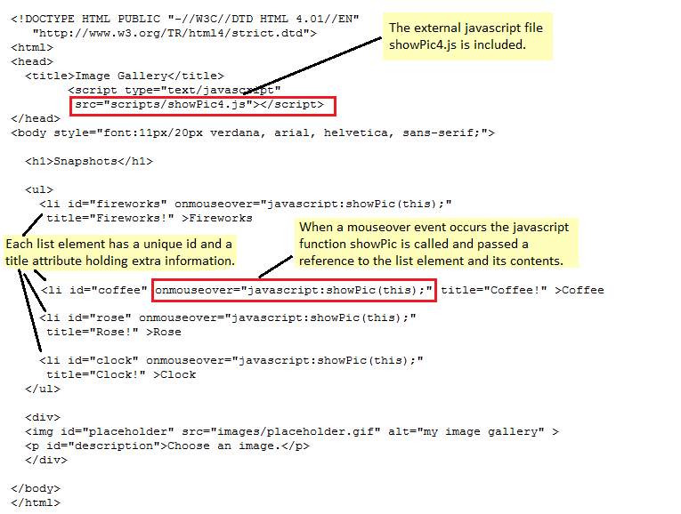
Simple DOM Manipulation

Slide 15
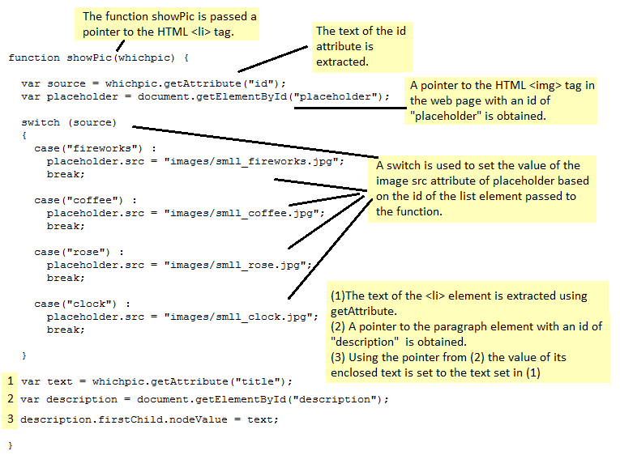
Simple DOM Manipulation

Slide 16
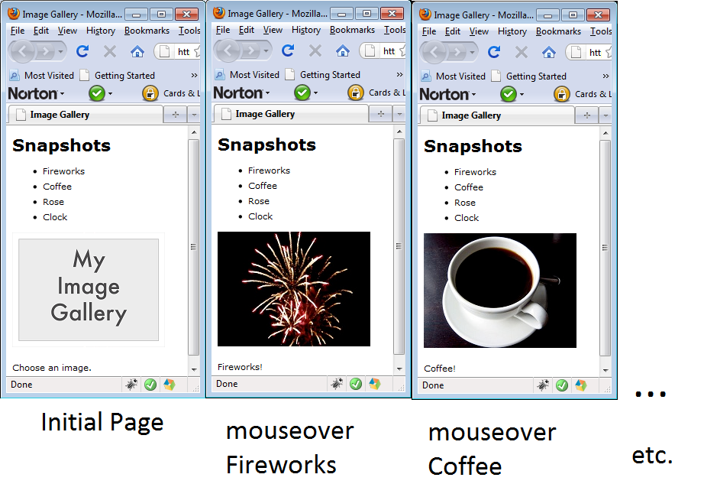
Simple DOM Manipulation

Slide 17
Inner HTML
Not part of the W3C standardised DOM.
Originally introduced by Microsoft in IE4, but has since been adopted by all the other major browsers.
It can be used to alter the HTML between an opening and closing tag. Can be useful in some situations.
innerHTML may possibly become part of the next DOM standard. WHATWG is pushing for it to be included in HTML 5 standard.
Next slide shows an example.

Slide 18
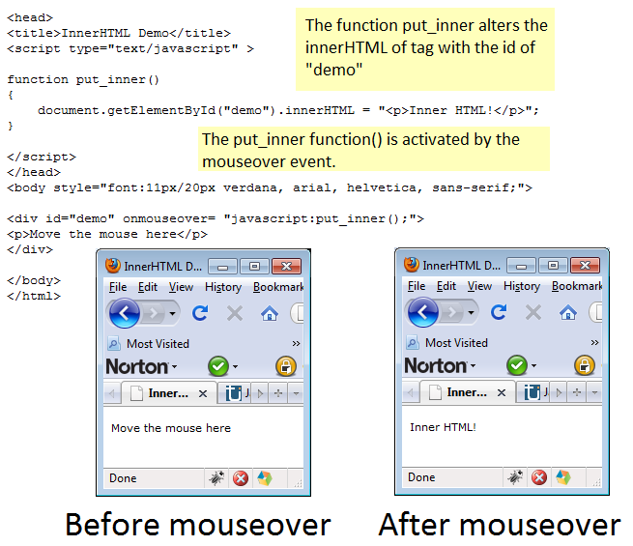
InnerHTML

Slide 19
Standards Compliant Javascript
The previous slide used the non-standard innerHTML method to achieve a particular result.
The next slide shows how the same result can be achieved using standards compliant javascript.

Slide 20
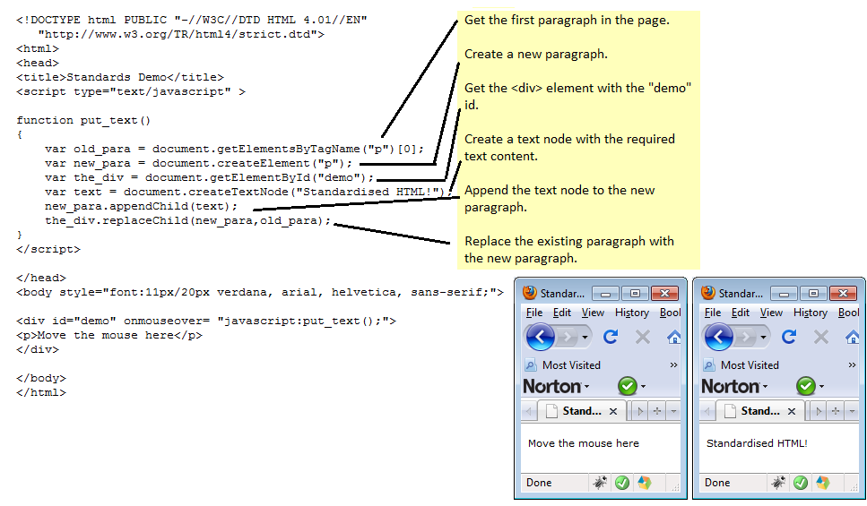
Standards Compliant Javascript

Slide 21
Javascript Objects
Javascript has 3 types of objects:
Host Objects – these are objects that are automatically brought into existence every time you create a web page.
Native Objects – these are objects created by your own javascript code using classes that already exist in javascript.
User defined objects (beyond the scope of this course) – Note: these user defined objects are not the same as JSON (Javascript Object Notation).

Slide 22
Host and Native Objects
Object Type | Some Examples
Host Object | Document, Navigator, Window
Native Object | String, Image, Math, Array, Date, RegExp

Slide 23
Javascript Object Notation (JSON)
This is not a way of creating user defined objects in Javascript.
It is a way of formatting data and transmitting data.
Easy to understand alternative to XML.
Support for JSON is built into the latest browsers.

Slide 24
AJAX
Asynchronous Javascript and XML (AJAX) is a way for browsers to send HTTP requests independently (asynchronously) of user actions and reract to the responses sent back.
The response from the web server is not limited to being in XML format – it can also be in JSON or plain text.

Slide 25
Javascript Libraries
Over the last few years, the capabilities of javascript have been extended by javascript libraries.
Javascript libraries can be used to enhance web pages and make it easier to use AJAX.
They are also useful for hiding differences between browsers. Some popular libraries are :
JQuery
DOJO
Scripaculous and Prototype
YUI
Mootools
And many others.....

Slide 26
Intermission

Slide 27
Part 2 –Some Practical Javascript
Google Maps using Javascript
A simple drop down menu
Form validation
Recap – how much do we know so far and how much more do we need to know ?

Slide 28
Javascript and distributed resources
Javascript can be used to access distributed resources on the web and put them together on the one page.
Relatively new role for Javascript.
Has given Javascript a new lease of life.
As a first example, we will look at accessing Google maps using javascript.

Slide 29
The Google Maps API
Involves the following components in the web page :
Downloading a library at http://maps.google.com/maps
Your own javascript code which creates a GMap2 object
Setting the properties of the GMap2 object so it has the controls and display features that you want.

Slide 30
The Google Maps API
Your first step is to register with Google Maps
to use the Google Maps API.
Website is :
http://code.google.com/apis/maps/signup.html
Each website gets a unique key.
The key is used to access the Google Maps API.

Slide 31
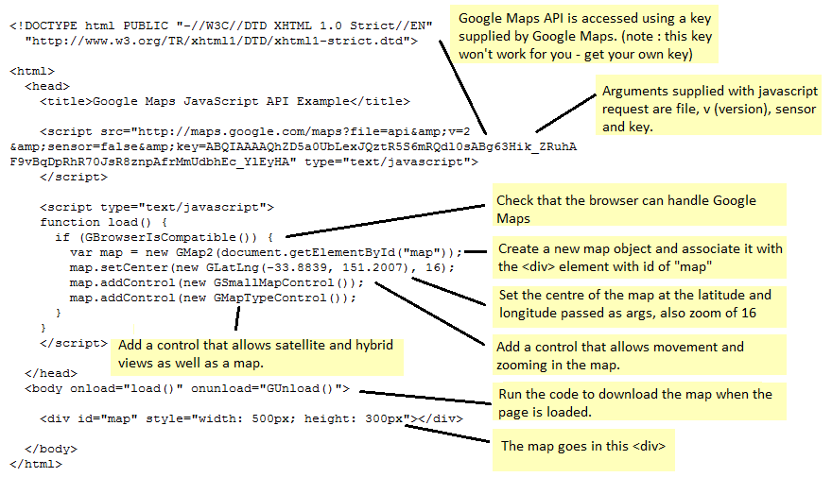
Google Maps API – a simple example

Slide 32
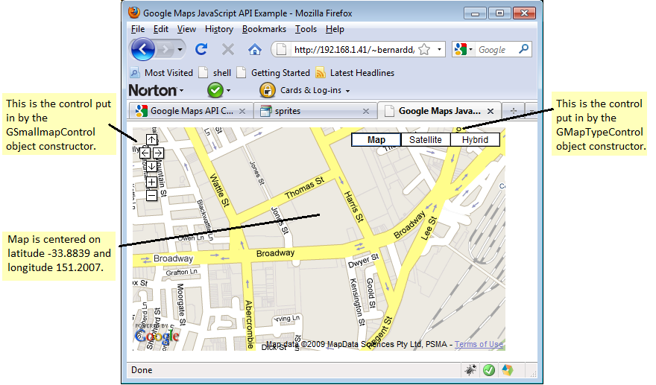
Google Maps API – a simple example

Slide 33
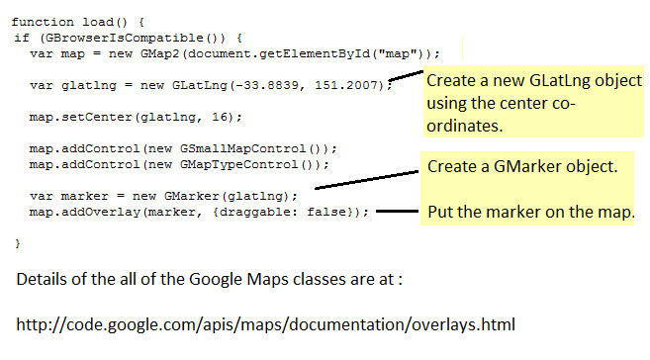
Adding a marker to a Map

Slide 34
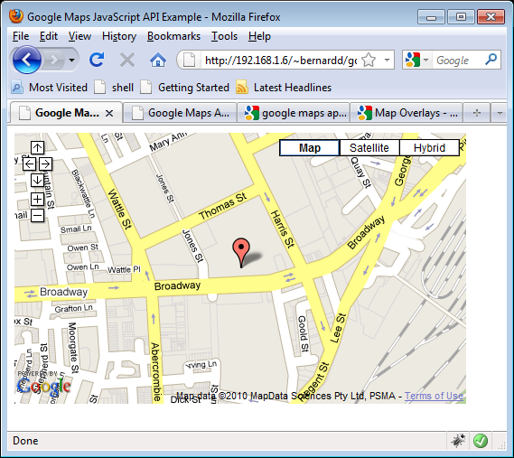
How the previous page appears

Slide 35
Other Google Maps Features
Info windows.
Embedding forms in info windows.
Retrieving latitude and longitude by clicking on a map.
Using AJAX to interact with the Google Maps API
Many other features.....
See http://code.google.com/apis/maps/documentation/

Slide 36
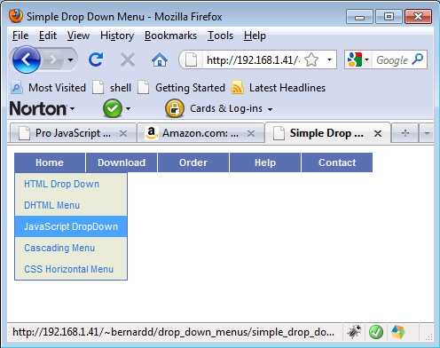
A simple drop down menu
Uses a combination of CSS, HTML and Javascript.

Slide 37
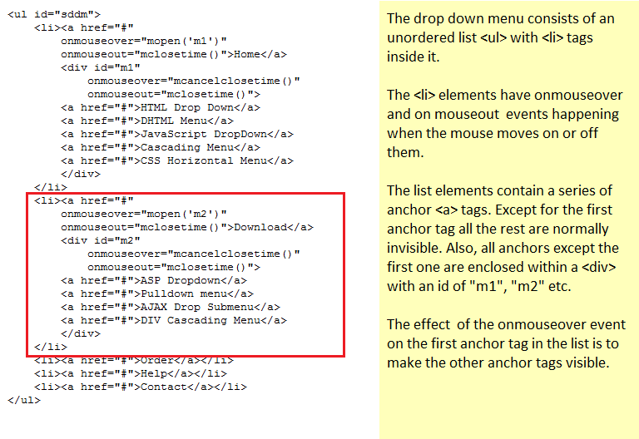
Simple drop down menu – the HTML

Slide 38
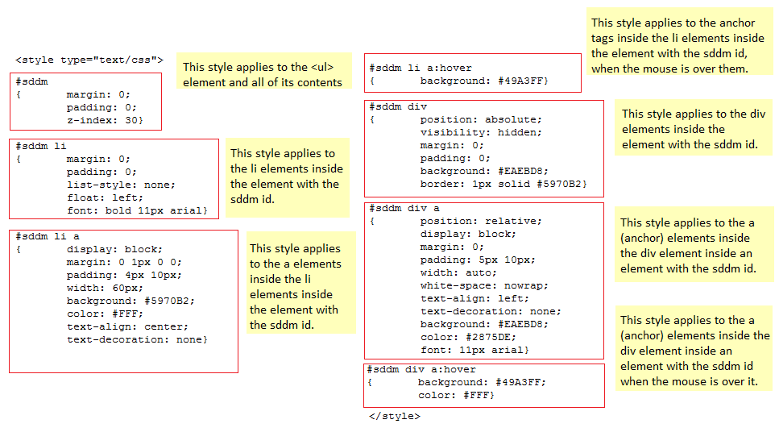
Simple drop down menu – the CSS

Slide 39
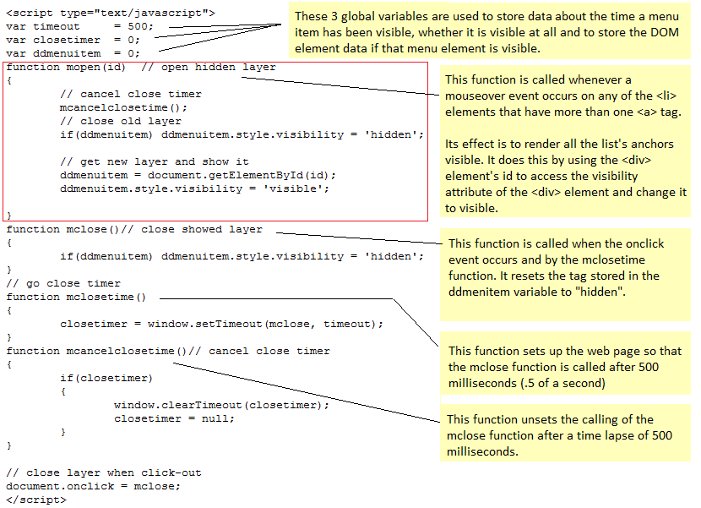
Simple drop down menu – the Javascript

Slide 40
A short digression – The list-style property
Lists have a CSS property called the list-style property.
The default value for this means that the list displays in point form down the page.
Many other values of this property are possible.
In the drop down menu example the list-style property was set to “none”.
The effect of this is demonstrated in the next slide.

Slide 41
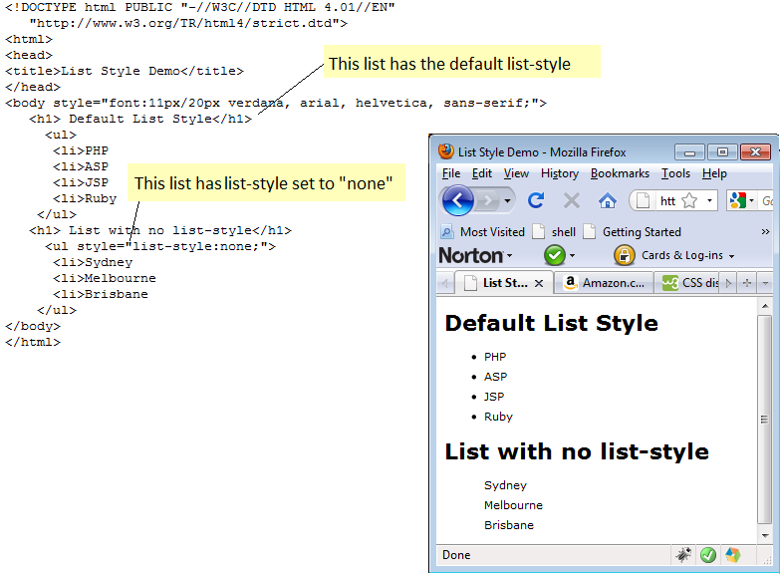
The list-style property

Slide 42
Form Validation
Refers to the checking of form data for correctness before submitting it to a server.
Traditional Role for Javascript
Still as important as it ever was. Invalid submitted data can affect security and response times of websites.
Especially important in e-commerce

Slide 43
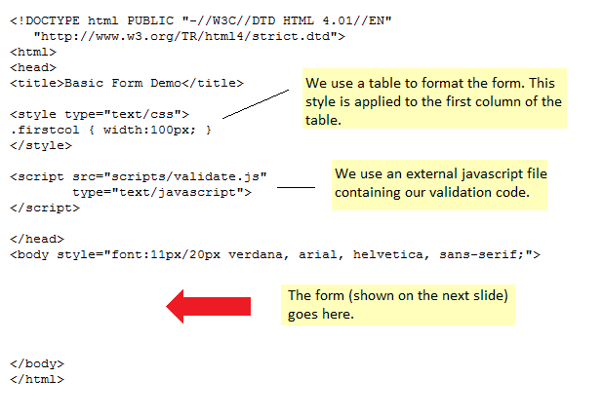
A Basic Form

Slide 44
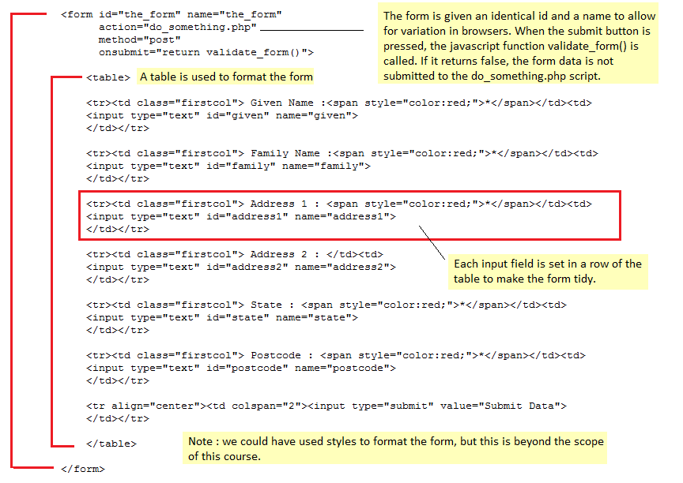
The Form

Slide 45
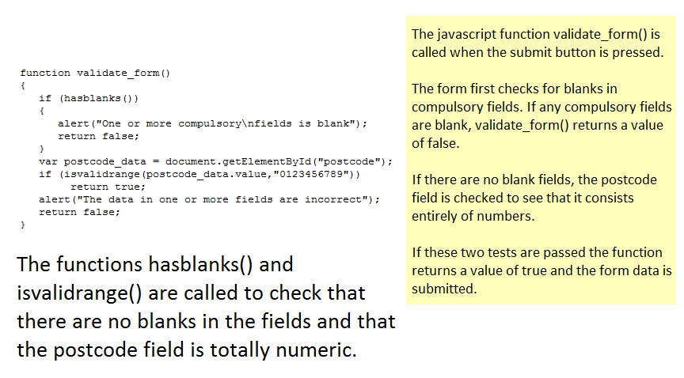
Form Validation

Slide 46
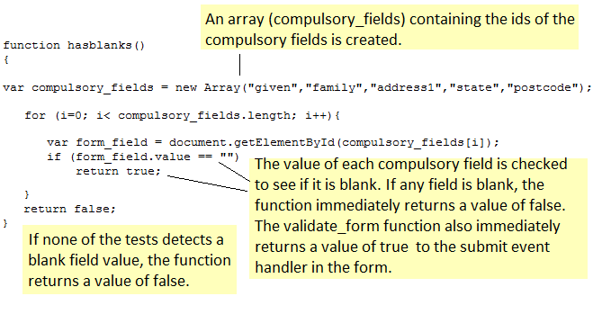
Form Validation

Slide 47
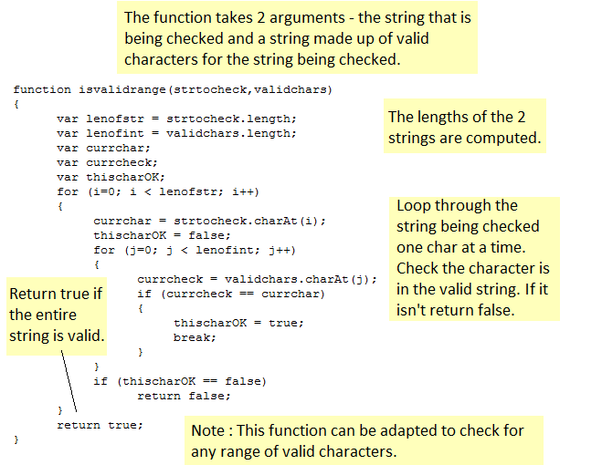
Form Validation

Slide 48
Form Validation
The example functions can be easily re-used to validate other types of fields – e.g. alphabetical, alphanumeric, etc.
Also possible to do validation using RegExp object
The degree of validation carried out is directly proportional to the criticality of the data.
Drop down lists and AJAX can also be used to validate fields.

Slide 49
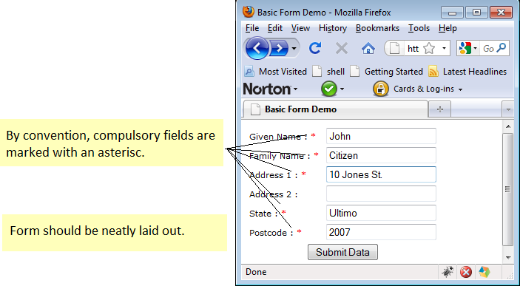
Form Validation

Slide 50
A recap – where are we ?
So far we have looked at 3 essential components of websites – (X)HTML, CSS and Javascript.
Are these enough to create a fully functioning, maintainable website ?
NO.....
We still need to learn about ....

Slide 51
More essential parts of web programming
Server Side scripting languages e.g. PHP, JSP, ASP, perl etc.
Once we have learned about at least one scripting language (and basic HTML, CSS and Javascript) we have the essential knowledge, but we also should know about :
AJAX
Javascript Libraries
Accessing databases from server side scripting languages.
Web Security

Slide 52
Lecture Summary
Characteristics of Javascript
Responsible for the behavioural layer (note CSS also has some influence as well)
Object Oriented Language
Interpreted language
The DOM
Every web page has one
Javascript can interact with the DOM
DOM Nodes and their properties

Slide 53
Lecture Summary
InnerHTML
Invented by Microsoft but now a feature of all browsers and will probably become part of HTML 5
Alters the HTML between an opening and closing tag
Inner HTML example
Javascript Objects, AJAX and advanced features
Objects – Host, Native and user defined
JSON
AJAX
Javascript Libraries.

Slide 54
Lecture Summary
Some practical applications of javascript
Google Maps
Drop down menus
Form validation

Slide 55
References
W3C Schools Javascript Website : http://www.w3schools.com/js/default.asp
Keith, Jeremy : DOM Scripting
Sambells, Jeffrey : Advanced DOM Scripting
The websites referred to in the lecture and many others....
* Books on Javascript more than 3 years old are not reliable due to the rapid recent development of Javascript.

