Slide 1

Publishing versioned datasets using OCFL and nginx
Mike Lynch – University of Technology Sydney
Notes:
ARDC funding - Data and Services Discovery projects - Institutional Role in a Data Commons

Slide 2

Data repositories
Notes:
A happy data repository with a dataset the right size being ingested

Slide 3

Data repositories
Notes:
This will always happen

Slide 4
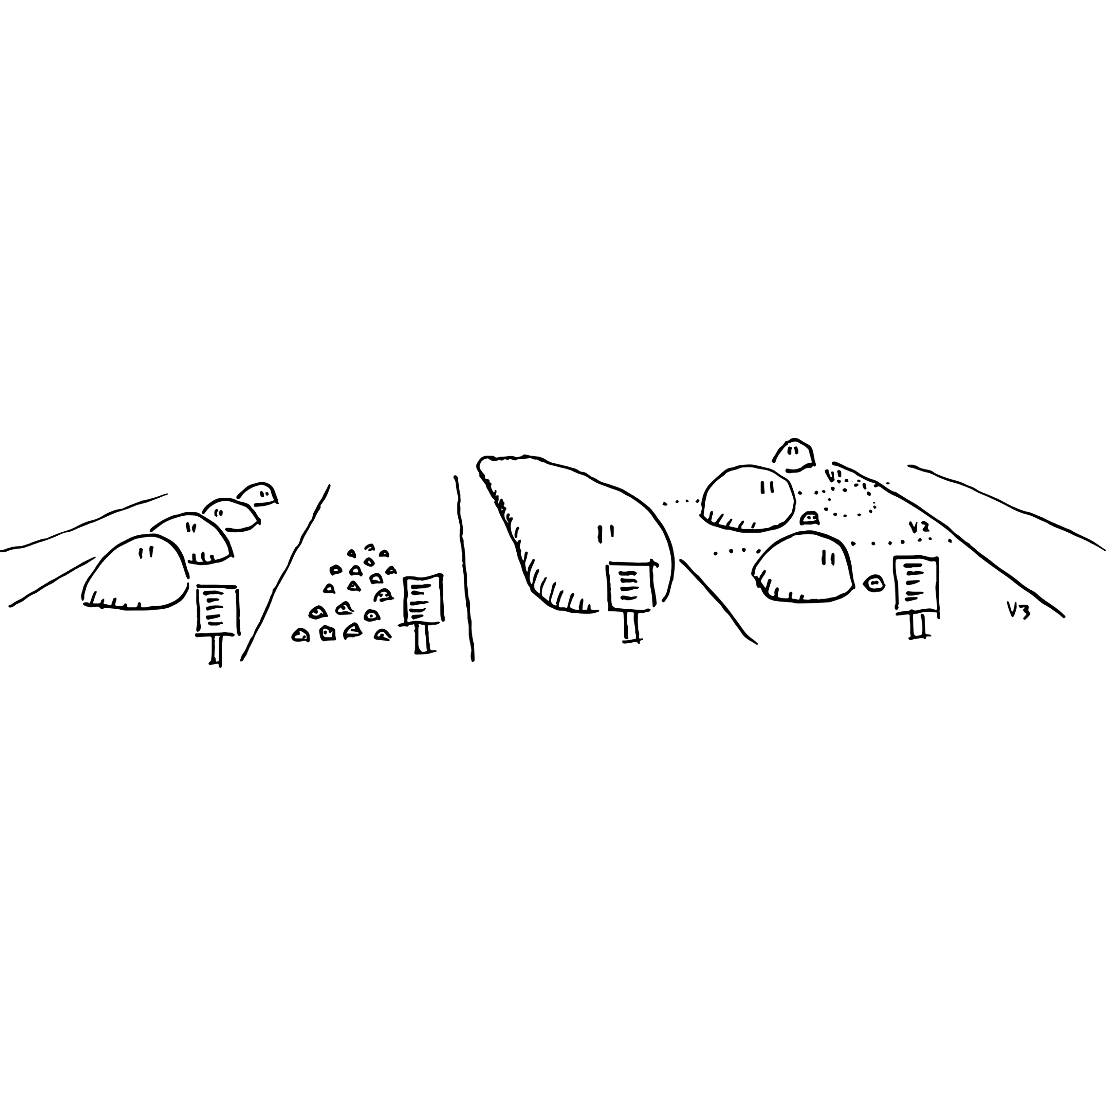
Oxford Common File Layout
A standard layout for static, file-based repositories
Human and machine readable (JSON)
Lightweight file-level versioning

Slide 5
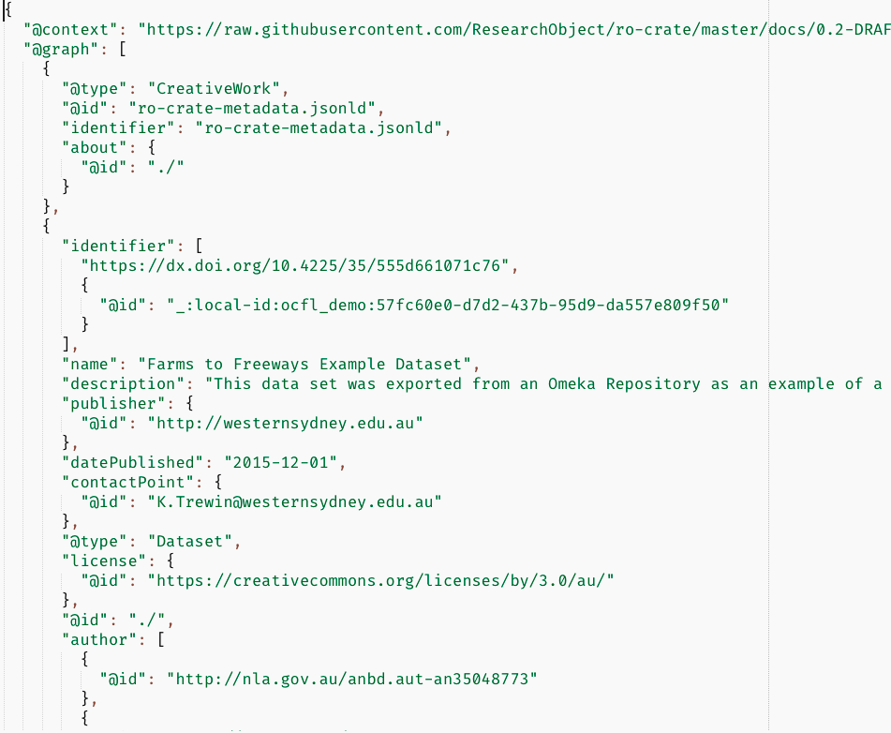

RO-Crate
Research Objects + DataCrate
JSON-LD metadata

Slide 6
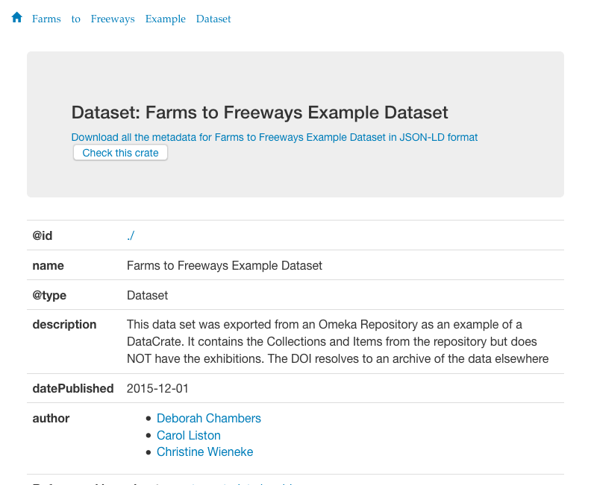
RO-Crate
Research Objects + DataCrate
JSON-LD metadata
HTML preview

Slide 7
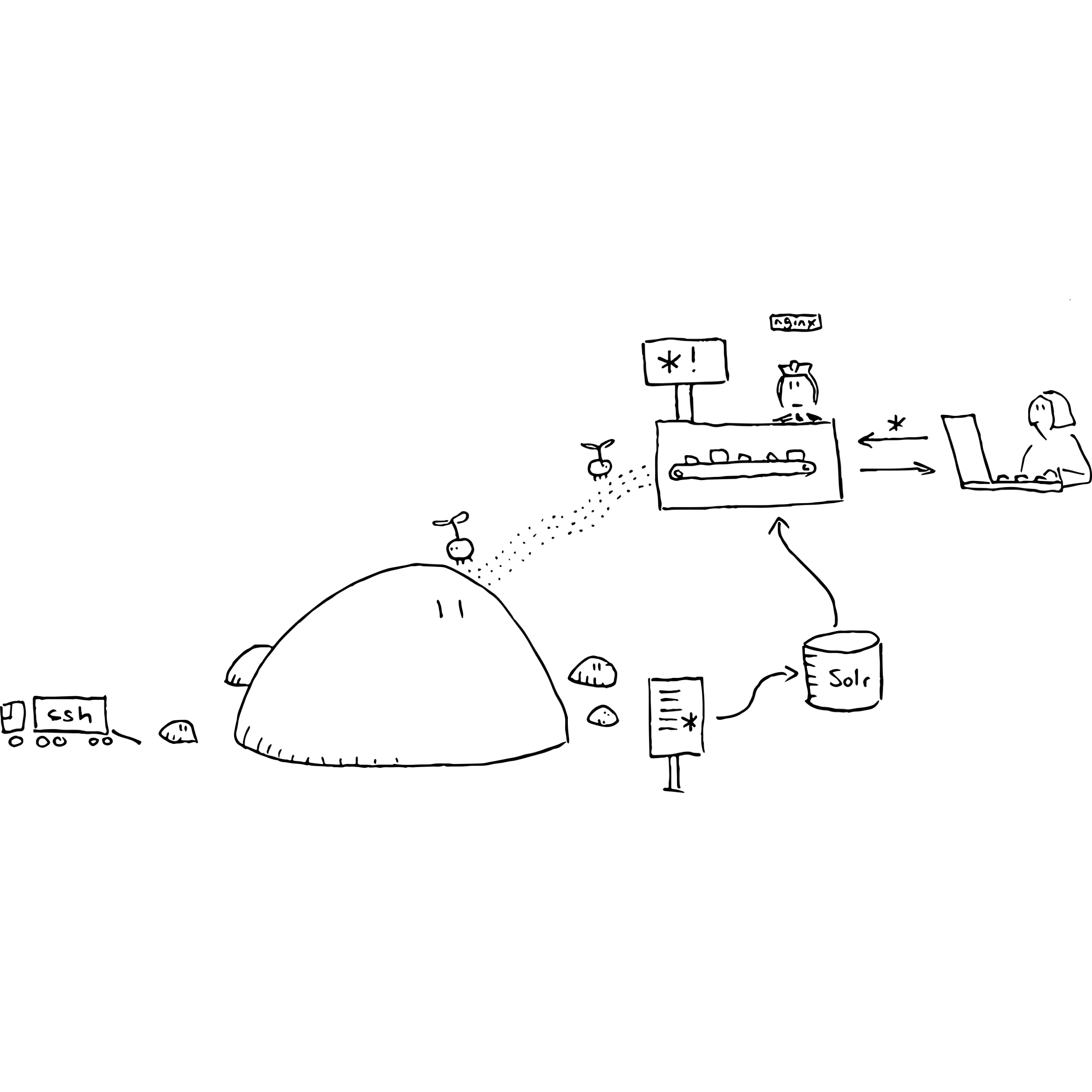
nginx and Solr
fast, versioned web endpoints
Solr indexes metadata and licences
licences enforced on both search results and payloads

Slide 8
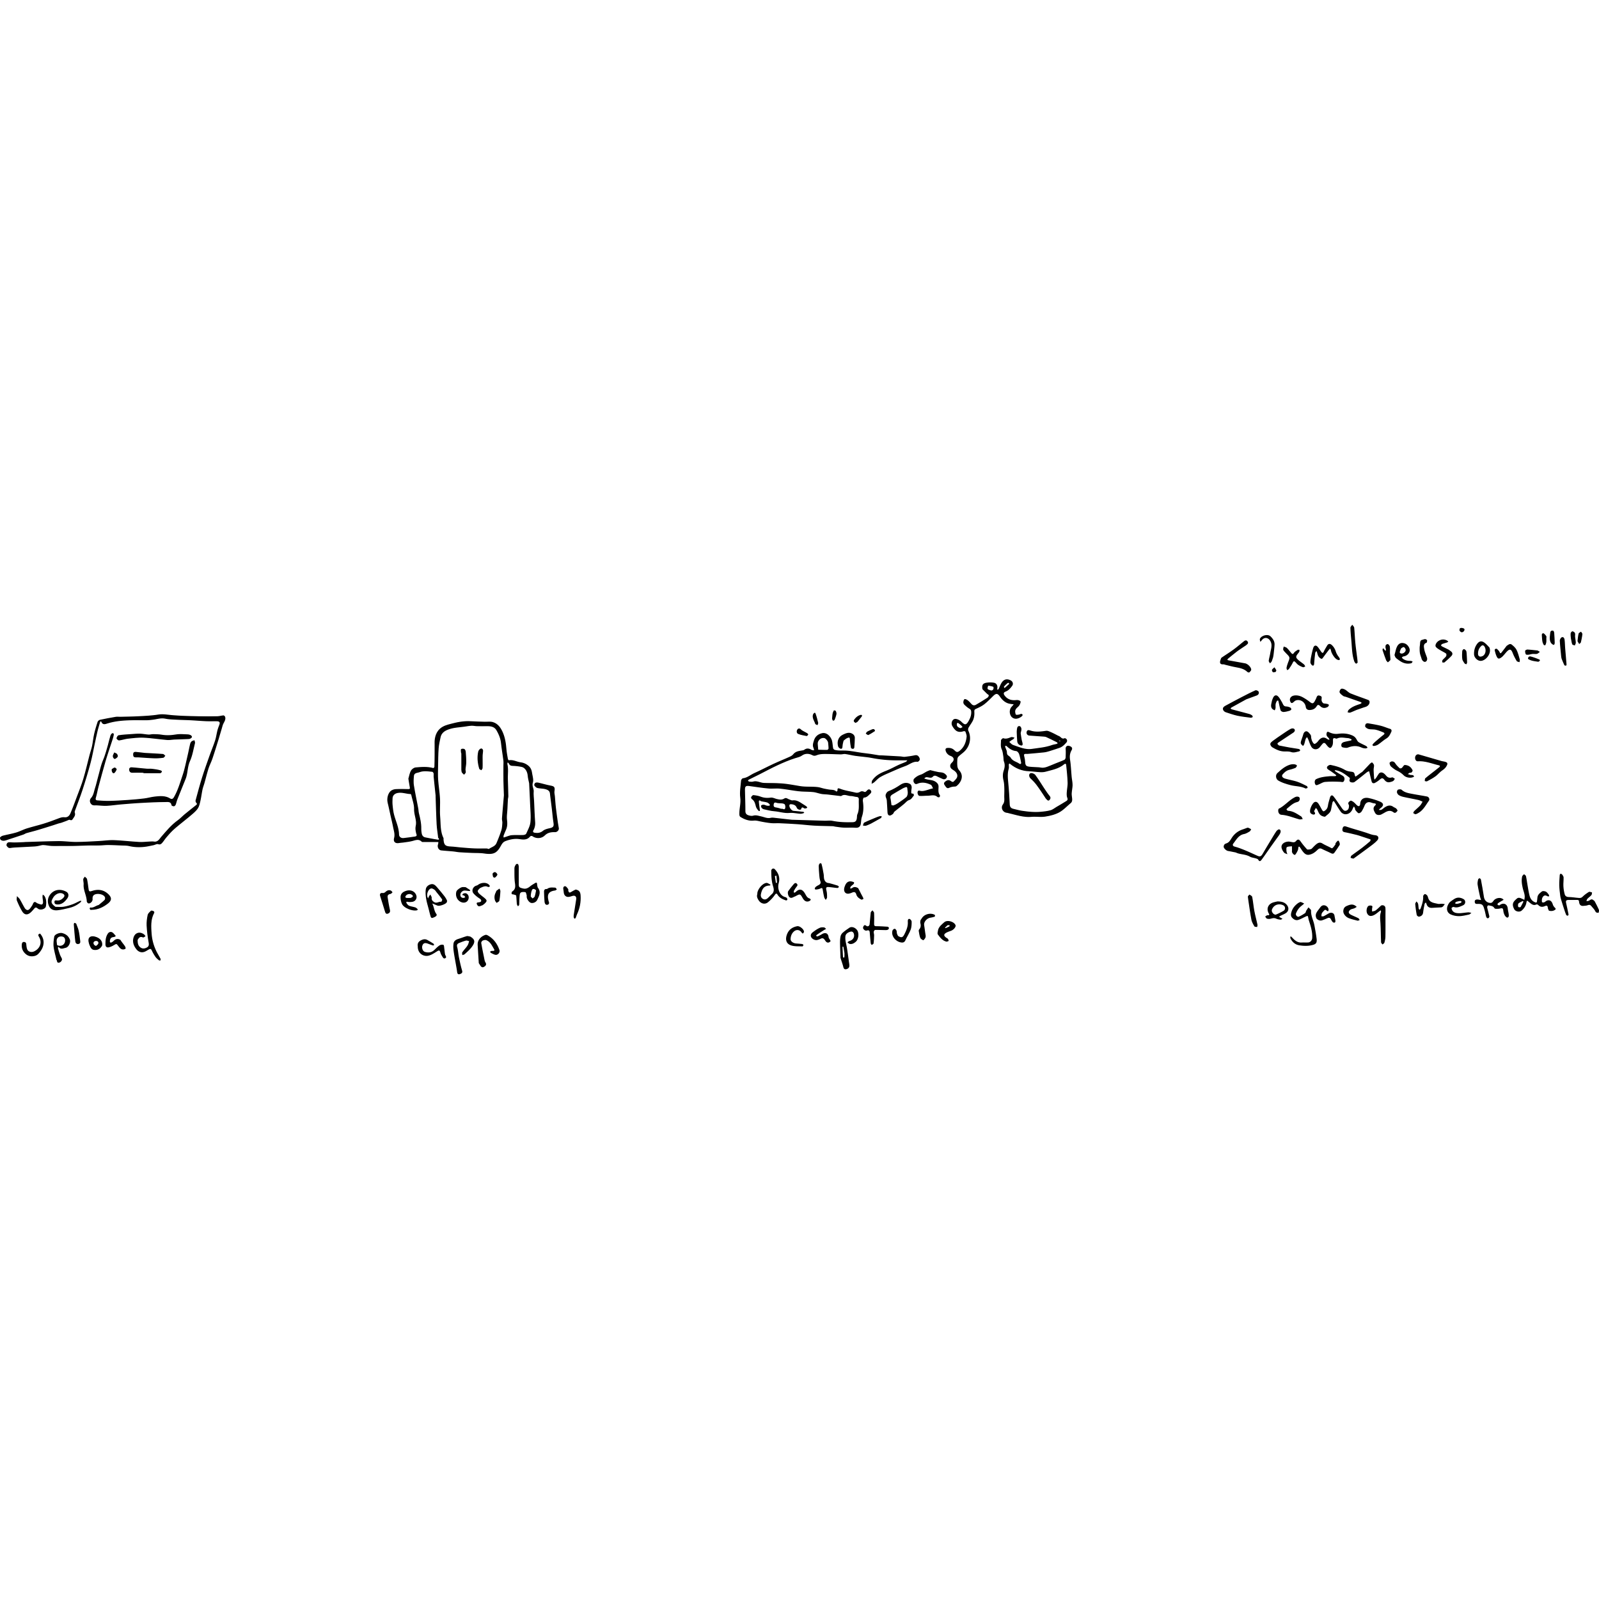
Examples
In production for UTS data publication repository
PARADISEC – crosswalking to OCFL and RO-Crate
State Library of NSW – Mitchell collection of public domain books
Notes:
Image of multiple input sources

Slide 9
Links and acknowledgements
https://ocfl.io/
https://researchobject.github.io/ro-crate/
https://github.com/UTS-eResearch/ocfl-nginx
Docker: mikelynch/nginx-ocfl
This research/project is supported by the Australian Research Data Commons (ARDC). The ARDC is enabled by NCRIS.

