Slide 1

Git Ready to Go
Presented by Christopher Doege
As a part of UTSA ACM

Slide 2
Workshop Etiquette
Raise your hand if you need help
Officers will be posted around the room to assist you with installation and git issues.
Do not talk during the presentation
Short breakout sessions will be held to ensure everyone is caught up
Have fun and learn!

Slide 3
Breakout Session: #1 Downloads For Days
Git CLI
https://git-scm.com/downloads
OR
Git GUI
https://desktop.github.com/
AND
Go
https://golang.org/dl/

Slide 4
Installation Instructions Windows
http://www.wadewegner.com/2014/12/easy-go-programming-setup-for-windows/

Slide 5
What is Git?
Developer tool
Used by most companies
Hosts open source projects
Resume Booster
Both CLI and GUI interfaces
Provides Version Control
Allows you to revert and track changes
Accountability for public contributions
Collaboration

Slide 6
Why do we need it?
Coding Standards
Mindset of pushing code where anyone can see it
Accountability for code contributed and added
Sharing of open sourced information
Helps others learn
Allows anyone to contribute
Easy collaboration
Simple interface
Powerful utilities

Slide 7
Getting Started
If you’ve already made an account:
Research how the .git/ folder works
Look into object files and how git uploads files
Navigate to Github.com
Sign-up for an account
Let me know when everyone has finished
Officers will be going around to assist everyone

Slide 8
Setting up your account (CLI)
Setting up global configurations:
git config --global user.name “usn_here”
git config --global user.email user@name.com
git config --global core.editor vim
Lets Verify your setup
git config --list

Slide 9
Setting Up SSH
Check your SSH version
Generate your key
ssh-keygen -t rsa -b 4096 –C user@name.com
Press enter to save the file to ~/.ssh/
Enter a secure password (protects your key)

Slide 10
Adding your SSH key
Ensure your SSH-agent is enabled
eval "$(ssh-agent -s)”
Add your SSH key to your SSH-agent
ssh-add ~/.ssh/id_rsa
Login to your Github account
Setup your SSH Key on git (demo)

Slide 11
Workflow
3 Trees of Git:
Working Directory
Stores local files
Index (Staging Area)
Stages changes for the next commit
Head
Points to the last commit you made.

Slide 12
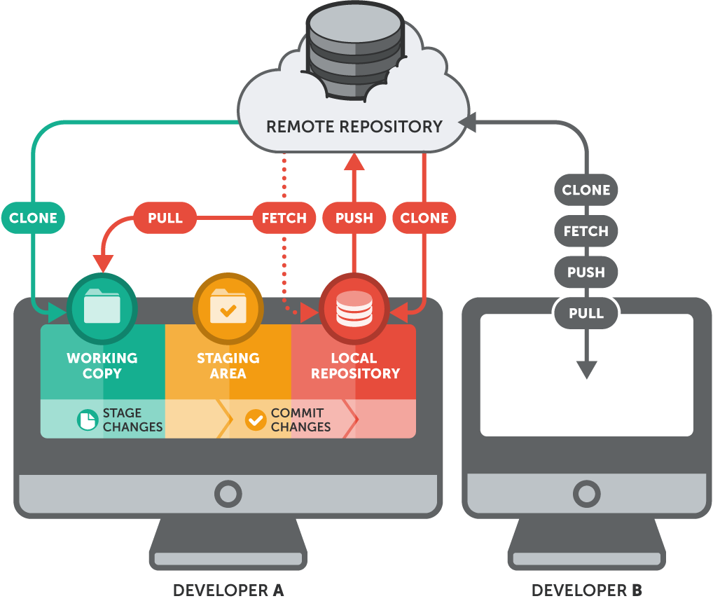
Workflow Cont…

Slide 13
Git Local File Syntax (CLI)
Adding files to Git
git add <file>
Add multiple files within current directory
git add .
git add *
Be Careful! Can cause issues
Committing / Staging files for push
git commit –m “commit message.”

Slide 14
Git Repository Management
Pulling from source
git clone <url>
Pulling to local repository
git pull origin <master>
Pushing to remote repository
git push origin <master>
Replace master with branch
Resetting Local Repository
git reset -- hard

Slide 15
Managing Branches
Listing Branches
git branch
Adding a Branch
git checkout –b name_of_branch
Pushing a Branch
git remote add name_of_branch url
git push url name_of_branch

Slide 16
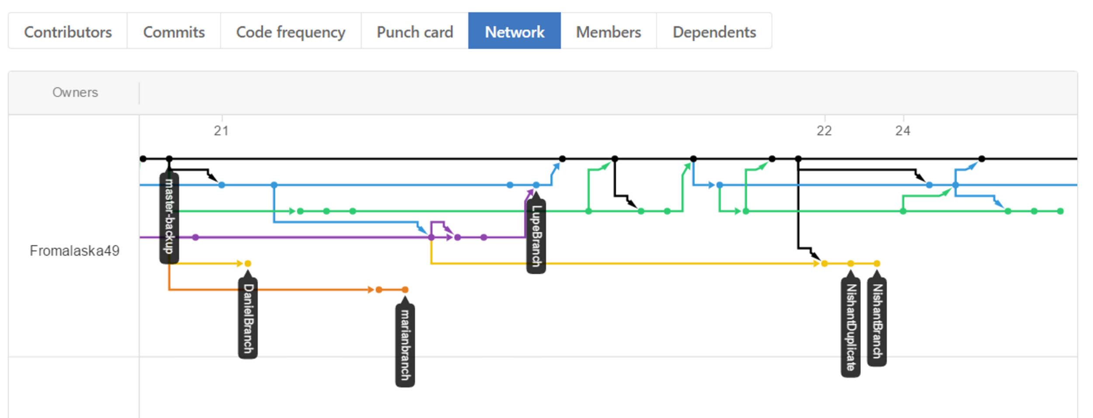
Managing Branches Cont..
View of Branches and commits
git@github.com:UTSA-ACM/Git-Ready-To-Go.git
git@github.com:UTSA-ACM/Git-Ready-To-Go.git

Slide 17
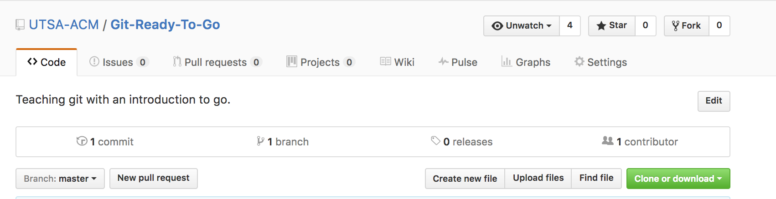
Breakout Session: #2
Fork the repository
https://github.com/UTSA-ACM/Git-Ready-To-Go

Slide 18
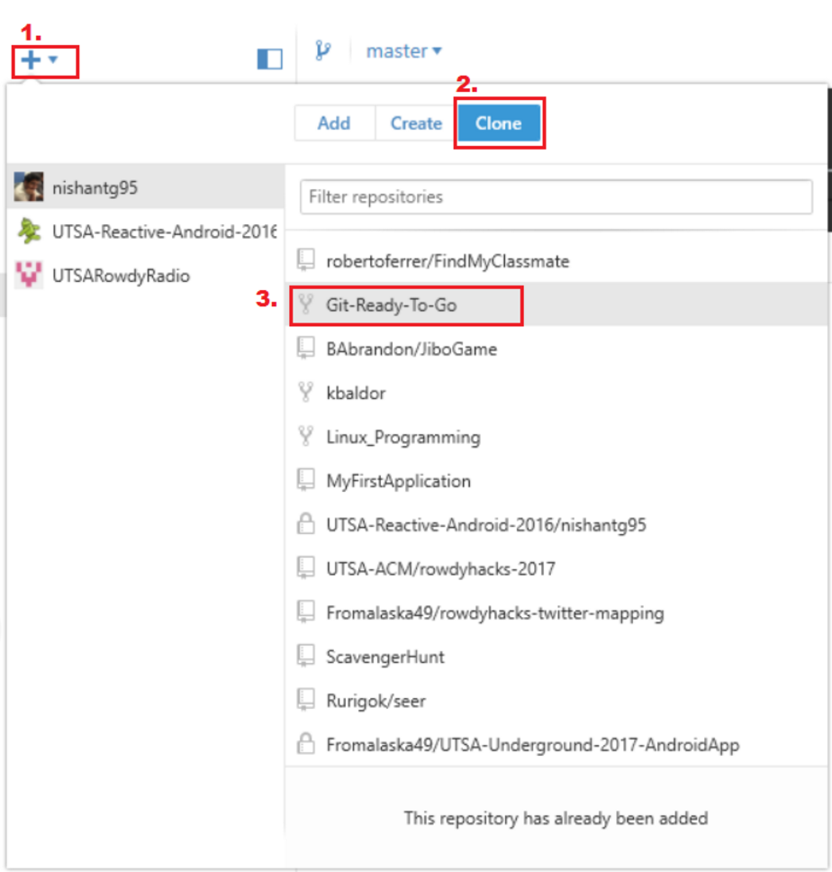
Getting the repository GUI
Clone the Repository

Slide 19
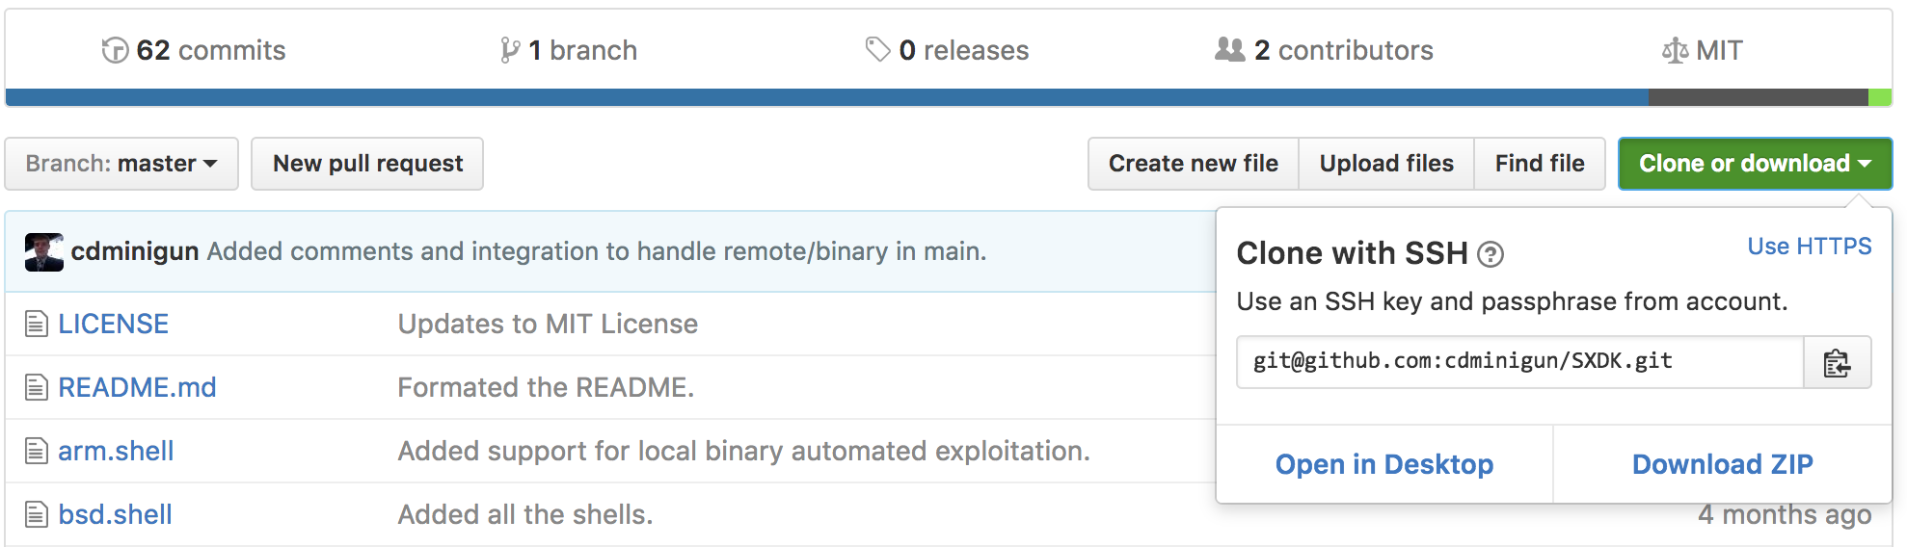
Getting the Repository CLI
Copy the URL / SSH path and type
git clone “<CTRL-V>”
Please paste the url/path within the quotations

Slide 20
Now for some Go!
What is Go?
Developed by Google
Great for Test Driven Development (TDD)
Why is it useful?
Scalability
Simple to learn and work with
Great to learn multiple programming languages

Slide 21
Overview of Go
Imperative Language
Statements change program state, similar to English.
Statically Typed
Syntactically similar to Java and C
Compiles to native code
Functions can return multiple values
Pointers but no pointer arithmetic
Data is passed by value.
Arrays start at an index of 0

Slide 22
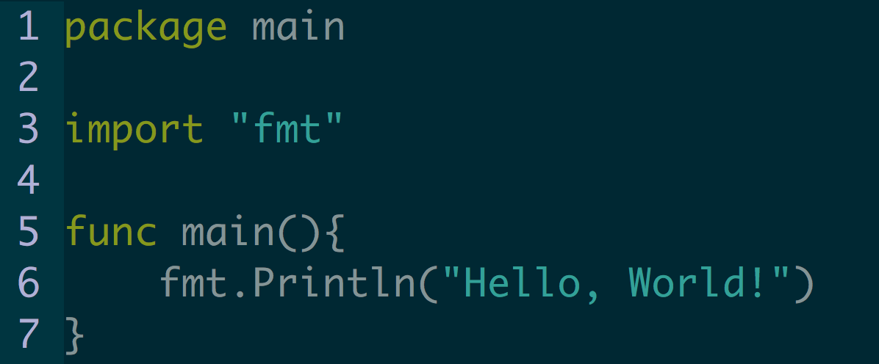
First Go Program: Hello World

Slide 23
Dissecting a Go Program
package main
This is known as a “package declaration”
Similar syntax as to how java does public class.
import “fmt”
Imports the packages needed for standard input and output

Slide 24
Dissecting a Go Program Cont…
func main() { …. }
Beginning of function declaration
Similar to int main() { in C
Similar to public static void main() { in java.
Fmt.Println(“Hello World”)
Utilizing the format package to access functions
The function Println allows a user to print a line with input inside of the (“..”)
Similar to System.out.Println(“Hello World”) in java

Slide 25
Breakout Session: #3
Copy mynameis.go to a new file
Name it <github usn>.go
Edit the file to add missing portions and to have the file print out “Hello, my name is <name>” to standard out.
Ironically, you can write <name>, though I’d rather a substitution
Commit your changes and push them to your forked repository!

Slide 26
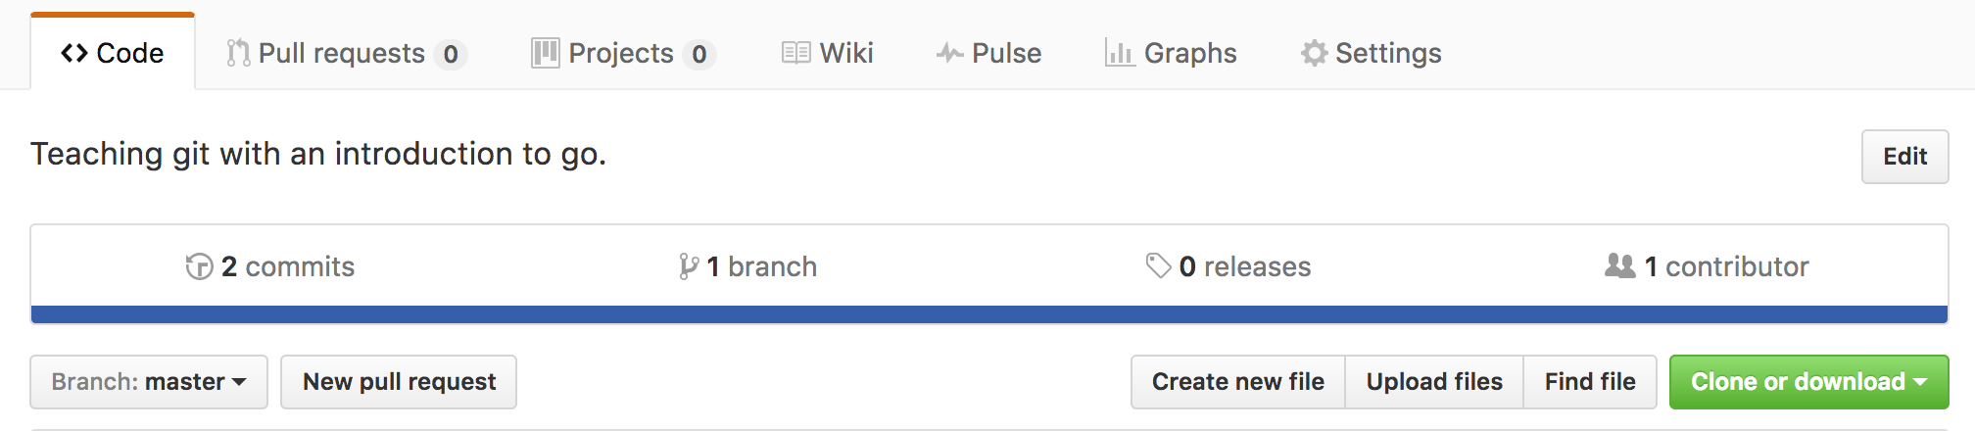
Breakout Session #4 Pull requests for days!
Navigate to your forked repository on Github
Click “New pull request”

Slide 27
Concepts Learned:
Allows for Pull Requests to main repository
Merge conflicts with different names are minimal / easy to handle
Allows for easy to manage contributions
What about merge conflicts with files that have similar names?

Slide 28
Data Types
bool
string
int, uint, int8, uint8, int16, uint16, int32, uint32, int64, uint64, uintptr
byte //alias for uint8
rune //alias for int32, represents unicode
float 32, float64
complex 64, complex 128

Slide 29
Declaring Variables
var i int = 30
Normal assignment
Utilizes the form of var <var_name> <data_type>
const tan string = “Synergize.”
Defines a constant
i := 30
Defines a shortcut for type declarations that detects the data type based upon input.

Slide 30
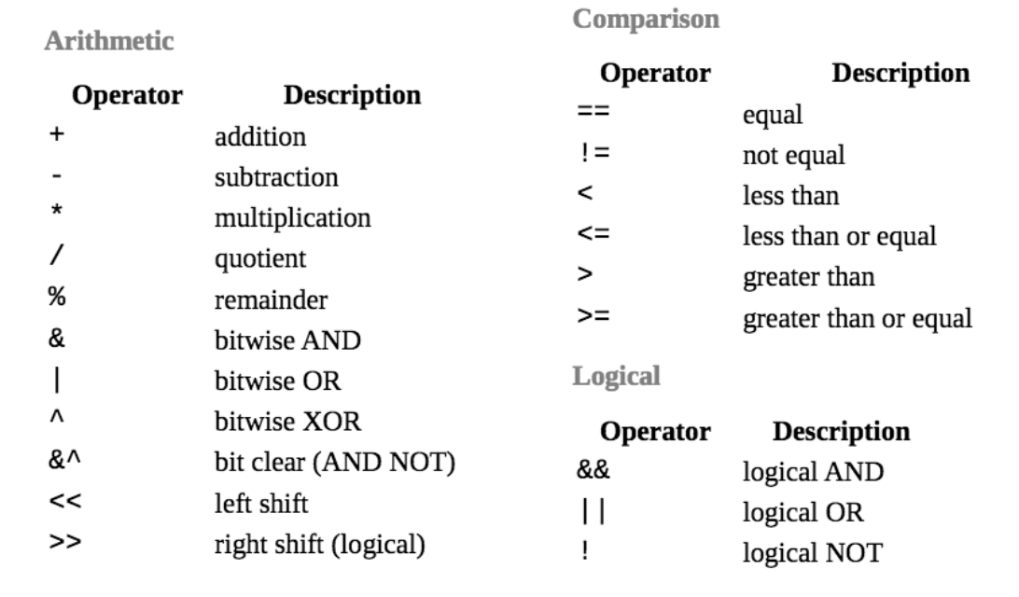
Data Manipulation

Slide 31
Standard input
fmt.Scan(var1, var2, …, varN)
Certain variables need to be passed as addressees
Able to take multiple values in
Assumes the data type based upon the data type of the variable.
fmt.Scanf(“%<char>”, var1, var2, …, varN)
Depends upon format codes specified
Can take multiple values in

Slide 32
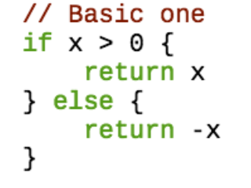
Control Statements
Basic If statement control flow

Slide 33
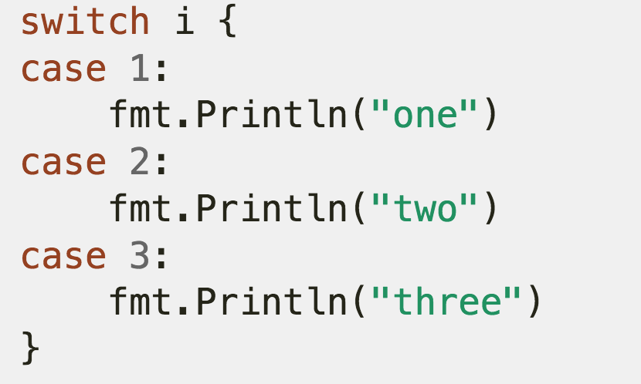
Control Structures Cont…
Switch Statement

Slide 34
Breakout Session: #5
General: Addition Calculator
Take two double or integer values from user input
Add the two values together and return the total through standard out
Advanced: Mult/Divd/Add/Sub Calculator
Determine the arithmetic operator
Perform the action
Return the value to the user through standard out

