Slide 1
Python GUIs

Slide 2
What is GUI?
GUI (Graphical User Interface) is a type of interface that allows users to communicate with eletronic devices using images rather than text command.
A GUI represents the information and actions available to a user through graphical icons. The actions are usually performed through direct manipulation of the graphical elements.

Slide 3
Tools for GUI Dev
EasyGui: is a module for very simple, very easy GUI programming in Python.
Tkinter: standard GUI toolkit included with Python, simple and easy
WxPython: xWidgets is a C++ library that lets developers create applications for Windows, OS X, Linux and UNIX, with binding for Python
PyQt: Python bindings for the Qt application development framework , not just GUI features

Slide 4
What is QT?
Qt is a cross platform development framework written in C++.
Qt was developed by Trolltech (now owned by Nokia)
Though written in C++, Qt can also be used in several other programming languages, through language bindings available for Ruby, Java, Perl, and also Python with PyQt.

Slide 5
What it QT? Cont…
The Qt toolkit is a collection of classes to simplify the creation of programs. Qt is more than just a GUI toolkit: Databases, XML, WebKit, multimedia, networking, OpenGL, scripting, non-GUI..
Qt is available on several platforms, in particular: Unix/Linux, Windows, Mac OS

Slide 6
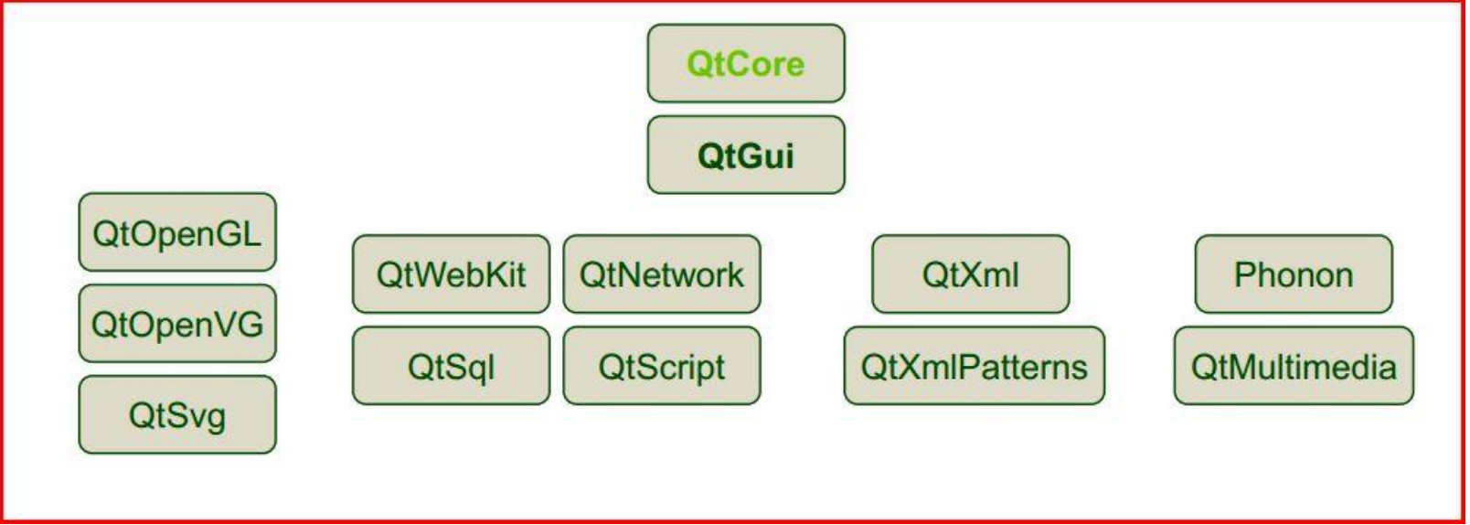
Qt is built from modules
All modules have a common scheme and are built from the same API design ideas

Slide 7
QTCore
Object and meta-object system: QObject, QMetaObject
Basic value types: QByteArray, QString, QDate, QTime, QPoint[F],QSize[F]
File system abstraction: QFile, QDir, QIODevice, QTextStream, QDataStream
Basic application support: QCoreApplication – encapsulates an application QEvent – communication (see also signals and slots) QTimer – signal-based timed event handling

Slide 8
QTGui
Widgets: QCheckBox, QComboBox, QDateTimeEdit, QLineEdit, QPushButton,QRadioButton, QSlider, QSpinBox, etc.
Basic value types: QColor, QFont, QBrush, QPen Painting system and devices: QPainter, QPaintDevice, QPrinter, QImage, QPixmap, Qwidget
Basic application support: QApplication – encapsulates a GUI application
Rich text: QTextEdit, QTextDocument, QTextCursor

Slide 9
QObject
The QObject class is the base class of all Qt objects.
QObject is the heart of the Qt Object Model.
Three major responsibilities of QObject:
Memory Management
Introspection (runtime identification of object types)
Event handling

Slide 10
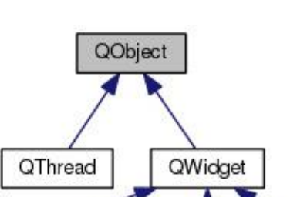
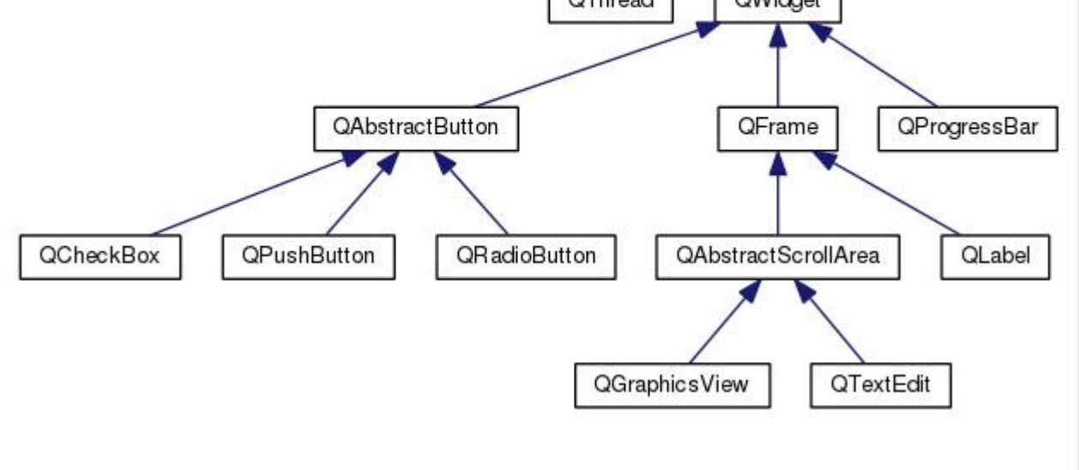
QObject Cont..

Slide 11
QT Object Model
All PyQt classes that derive from QObject can have a “parent”. A widget that has no parent is a top-level window, and a widget that has a parent (always another widget) is contained (displayed) within its parent.
PyQt uses the parent–child ownership model to ensure that if a parent—for example, a top-level window—is deleted, all its children, for example, all the widgets the window contains, are automatically deleted as well

Slide 12
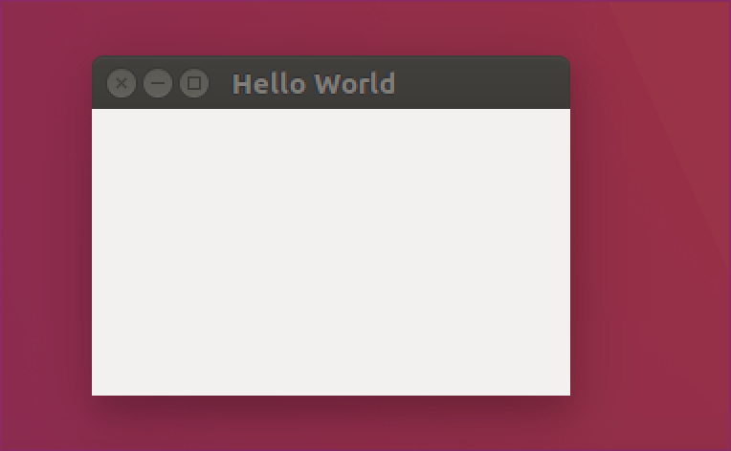
Sample Example
A tiny PyQt applications has the following elements:
an application object
a main window (which has a central widget), or
a main widget
This is the traditional ”Hello World” application, with as little code as possible:

Slide 13
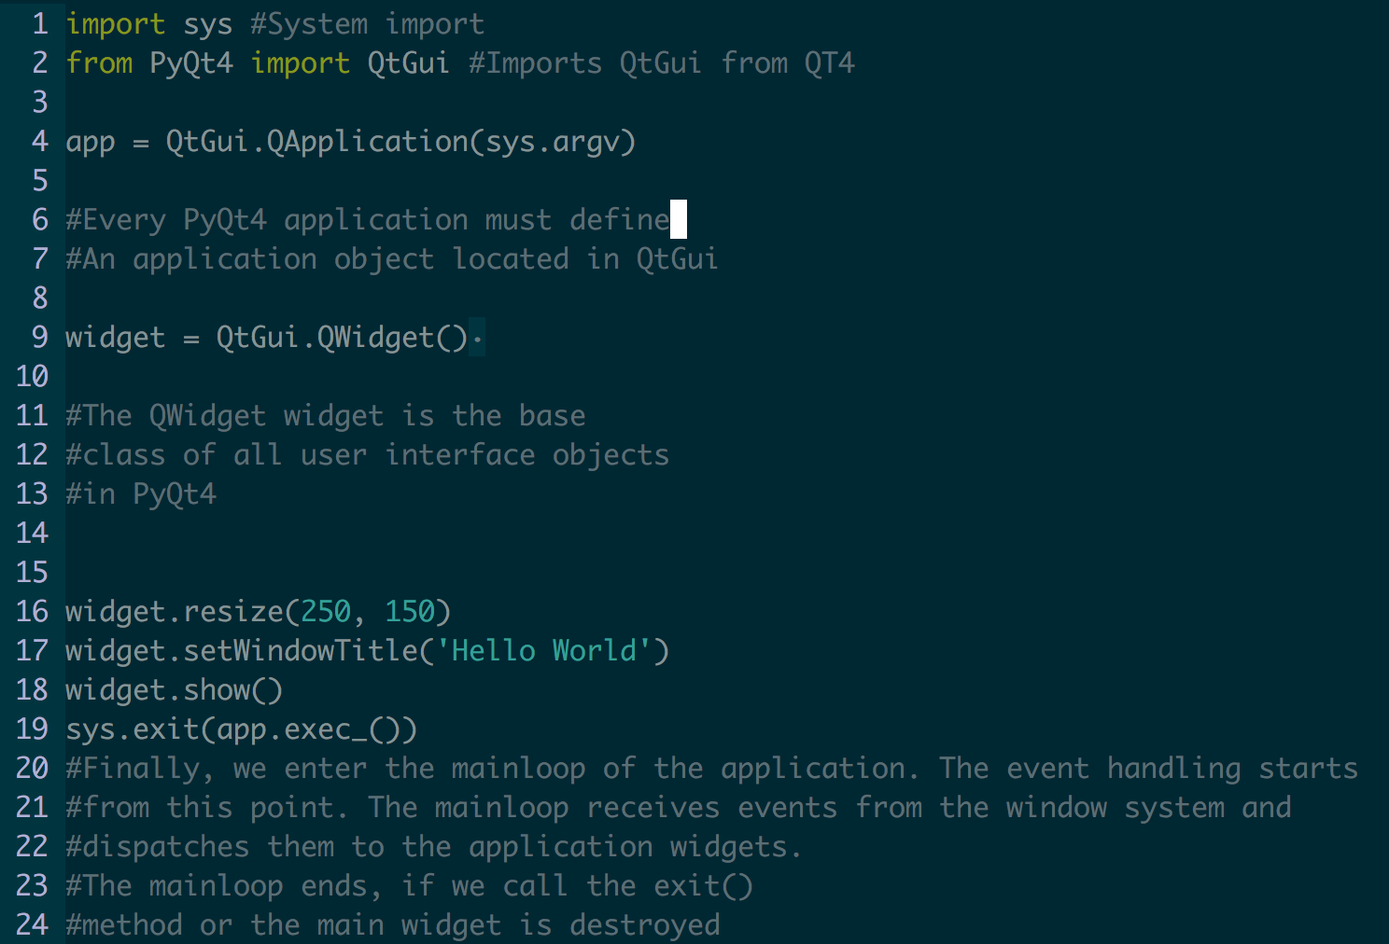
Sample Example Code

Slide 14
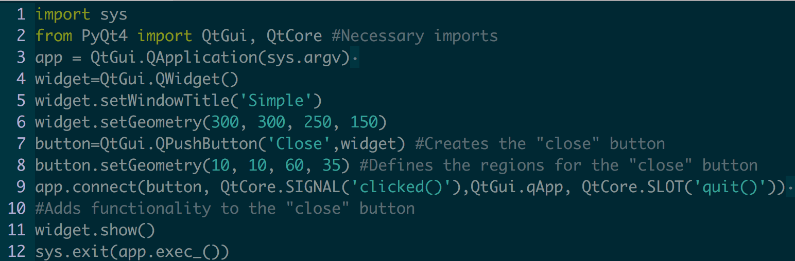
Sample Example 2
Lets implement the functionality to close our box
Note
Ctrl-C in the terminal doesn’t close the app

Slide 15
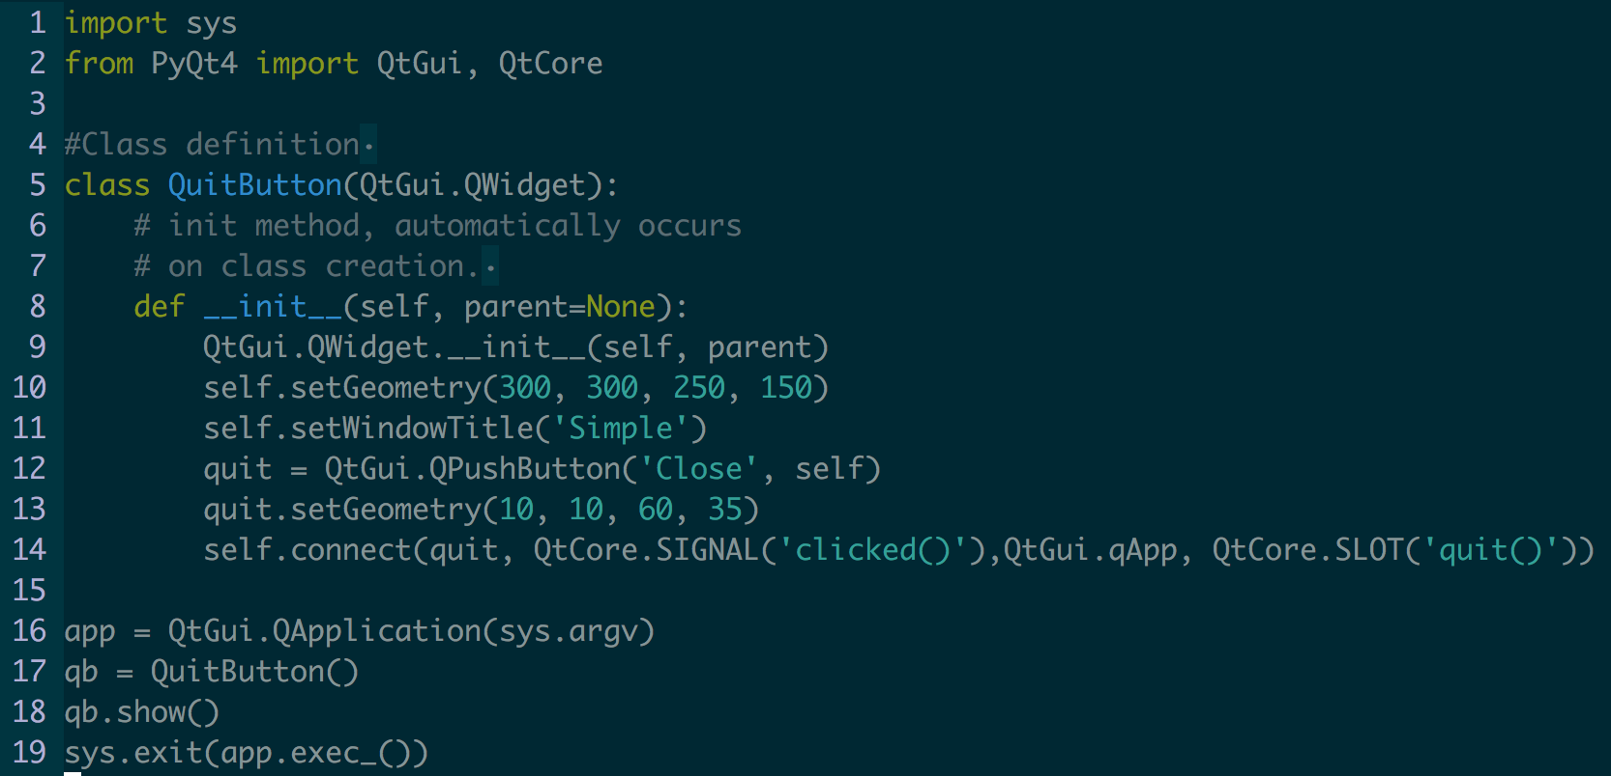
Sample Example 2- Class

Slide 16
Layout Management
Important thing in programming is the layout management. Layout management is the way how we place the widgets on the window. The management can be done in two ways. We can use absolute positioning or layout classes.
The programmer specifies the position and the size of each widget in pixels.
NOTES:
The size and the position of a widget do not change, if you resize a window
Applications might look different on various platforms

Slide 17
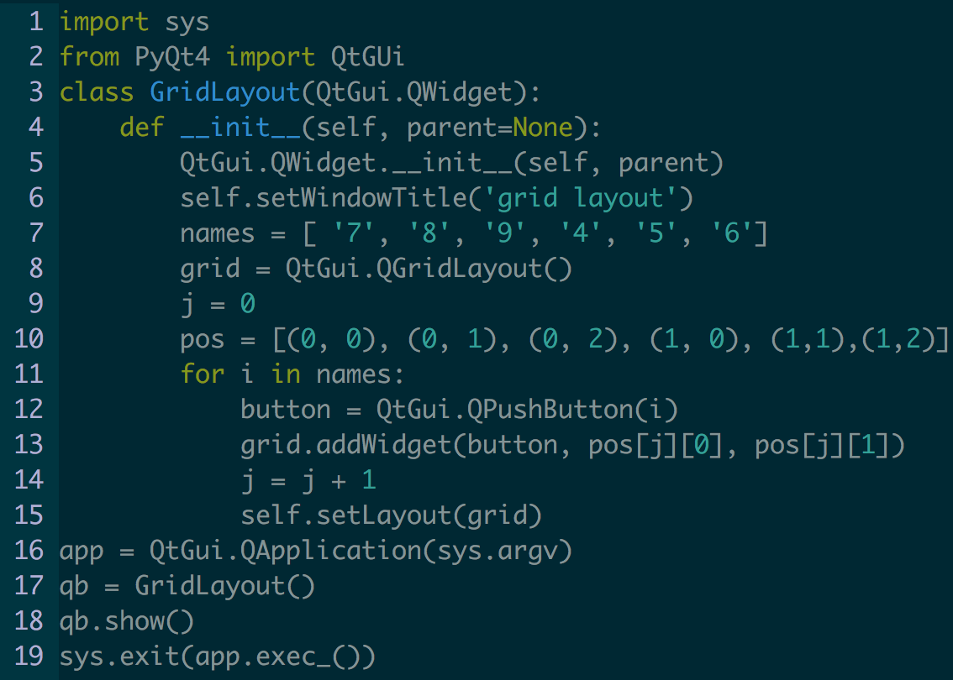
Sample Example 3

