Slide 1
DJI drone workshop
Fly a DJI Mavic 2 PRO in Webots.
Find the red, green and blue objects.
Use the camera to identify each colour.
60 MINUTES / LAPTOP ONLY
01
Notes:
The model uses Webots physics and a custom assisted controller. It is not DJI firmware. No competition.

Slide 2
Our hour together
Time | Activity
0–15 min | Introduction, setup and controls
15–35 min | Find and identify three objects
35–55 min | Your own free practice
55–60 min | Share what you tried
20 MINUTES FOR YOUR OWN PRACTICE
02
Notes:
Install Webots and Python beforehand. Preserve the full twenty minutes for participants to explore.

Slide 3
What you need
Webots R2025a installed on your laptop.
Python 3 installed and selected in Webots.
The whole workshop ZIP extracted.
No extra Python packages are needed.
BEFORE THE SESSION
03
Notes:
Setup guide includes links and Python troubleshooting. Official release: https://github.com/cyberbotics/webots/releases/tag/R2025a

Slide 4
Opening the world
Open the DJI_Outdoor_Workshop folder.
Go to webots, then worlds.
Open dji_outdoor.wbt.
Start Real-time and click inside the 3D scene.
FILE > OPEN WORLD
04
Notes:
Keep all assets and controller folders together. Do not run the Python file separately.

Slide 5
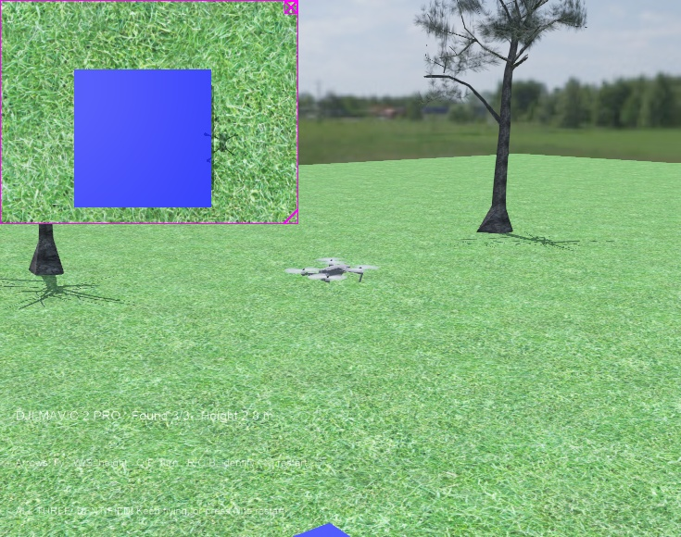
The drone takes off for you
Automatic takeoff
Wait for READY.
Use the small camera view to look down.
WAIT FOR READY
05
Notes:
This scene uses the official Cyberbotics DJI Mavic 2 PRO model with grass, trees, a house and a country sky. Source: https://github.com/cyberbotics/webots/tree/R2025a/projects/robots/dji/mavic

Slide 6
Your flight controls
Key | Action
Arrow keys | Forward, backward and sideways
W / S | Move higher / lower
Q / E | Turn left / right
N | Restart from the launch pad
CLICK THE 3D SCENE FIRST
06
Notes:
Directions follow the drone heading. Height request is limited to 2–8 m. N also clears identified objects and triggers takeoff. Release arrows to slow down and hover.

Slide 7
A short practice flight
Tap Up to move forward.
Release it and let the drone settle.
Try moving sideways with Left or Right.
Try W and S to change your height.
SMALL KEY PRESSES HELP
07
Notes:
Allow a couple of seconds to settle. The physical drone accelerates and decelerates. Turning Q/E changes forward direction.

Slide 8
How to identify an object
Fly over a coloured block.
Centre it in the camera and stop moving.
Press R for red, G for green or B for blue.
Check that the Found counter increases.
LOOK THROUGH THE DOWNWARD CAMERA
08
Notes:
Position must be within 1 m of the matching block and the drone must be roughly level. The participant identifies the colour manually. The program validates position, not computer vision.

Slide 9
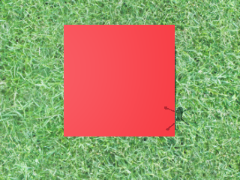
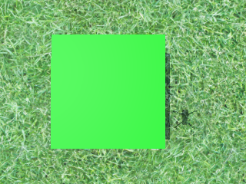
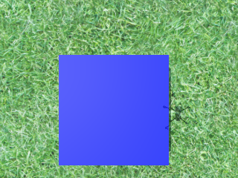
Your task is complete at 3/3
RED / R
GREEN / G
BLUE / B
Look for ALL THREE IDENTIFIED and Found 3/3.
RED / GREEN / BLUE
09
Notes:
These are actual camera images from the Webots flight test. Each object counts once. There is no ranking or timer.

Slide 10
Your next 20 minutes are free
Choose what you want to practise.
Try another route or a different height.
Practise turning and stopping over a block.
Press N whenever you want a fresh start.
35–55 MINUTES
10
Notes:
These are optional ideas, not extra requirements. Let participants work independently. No competition or compulsory path planning.

Slide 11
If something does not work
Problem | What to try
Nothing moves | Start Real-time, then click the 3D scene
No camera view | Drone menu: Camera Devices > camera
Colour does not count | Centre the block, stop, press its letter
Drone is lost or tipped | Press N to restart
START WITH THESE CHECKS
11
Notes:
For Python errors, use the setup guide and Webots Console. Camera overlays may be disabled in Overlays menu. Slow computers need more wall-clock time.

Slide 12
What did you notice?
Which camera view helped you find the blocks?
What changed when you flew higher?
What helped you stop over an object?
FINAL 5 MINUTES
12
Notes:
Connect observation from above to rover scouting. This is an introductory exercise, not a statement of current URC competition rules.

