Slide 1
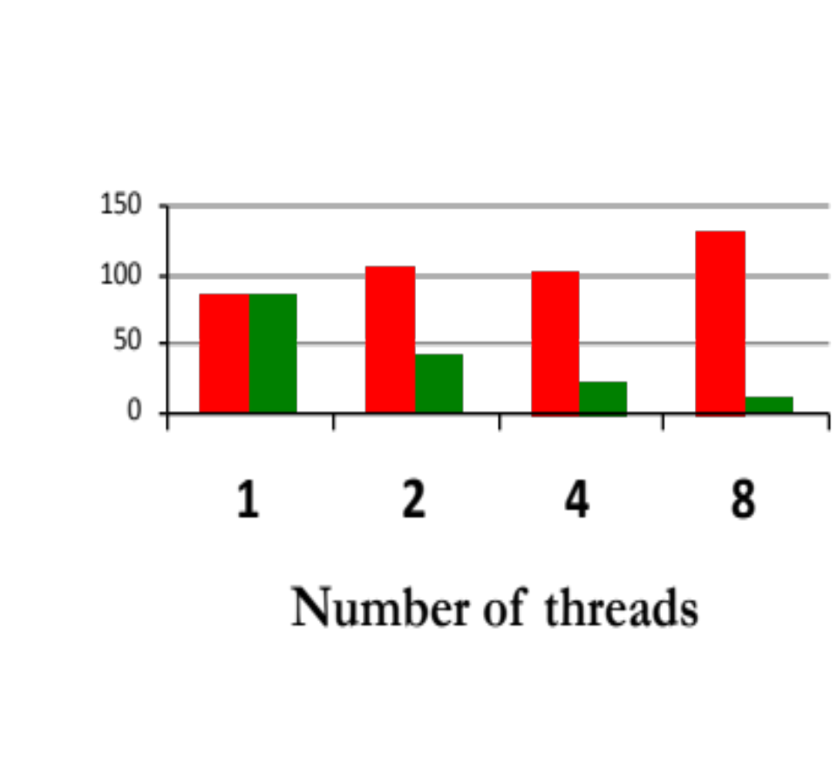
int array[total];
int window=total/numThreads;
void threadFunc(int start)
{
for(index=start; index<start+window;
index++)
for(j=0; j<10000000; j++)
array[index]++;
}
■ Reality
■ Expectation
Runtime (s)

Slide 2
int array[total];
int window=total/numThreads;
void threadFunc(int start) {
for(index=start;index<start+window;index++){
int local=array[index];
for(j=0;j<10000000;j++)
local++;
array[index] = local;
}
}

Slide 3
Parallel Phase I
Parallel Phase II
T1
T4
Serial Phase I
Serial Phase II
Serial Phase III
T2
T3
T5

Slide 4
Cheetah Runtime
FS Detection
FS Assessment
Link
Application
Accesses Collection
FS Report
User Space
Driver
Operating System
PMU
Hardware

Slide 5
False Sharing Causes Performance Problems
Core 1
Core 2
Task 1
Task 2
Invalidate
Cache
Cache
Main Memory
Cache line: basic unit of data transfer
Notes:
Now I am going to explain that using a simplified model.
we only use two threads: thread 1 is running on core 1 and thread 2 is running on core 2.
Core 1 and core 2 have their private caches.
Cache normally locates in the same chip with Processor, which has much higher access speed than accesses of main memory.
Whenever a program is trying to access something,
data is fetched to the cache automatically in the unit of cache line, normally 32 bytes or 64 bytes in order to improve the speed of accesses.
Cache line is introduced to reduce the number of fetches.
However, cache line creates the performance problem when there are false sharing inside.
Different cache coherence protocol have different ways to handle updates, including MSI and MESI protocol,
whether this is write-invalidate or write-update.
I am talking about write-invalidate here.
When thread 1 modify some words in a cache line, cache coherence protocol will notice that core2 has the copy of the same data.
Then it should invalidate this data on core in order to guarantee the correctness in true sharing situation.
However, it is unnecessary for false sharing problem.

Slide 6
False Sharing Causes Performance Problems
Core 1
Core 2
Task 1
Task 2
Invalidate
Cache
Cache
Main Memory
Interleaved accesses cause cache invalidations
Notes:
So when thread 2 tries to access something, it has to wait until the data is fetched from core 1.
Same for thread 2, when thread 2 modify something, the data in core 1 will be invalidated.
If there are many interleaved writes from different threads, this can cause a lot of cache invalidations.
The big number of cache invalidations may cause serious performance problem.
The hardware trend, with more cores on a single machine or larger cache line size, makes false sharing problems increasingly common.

