Slide 1
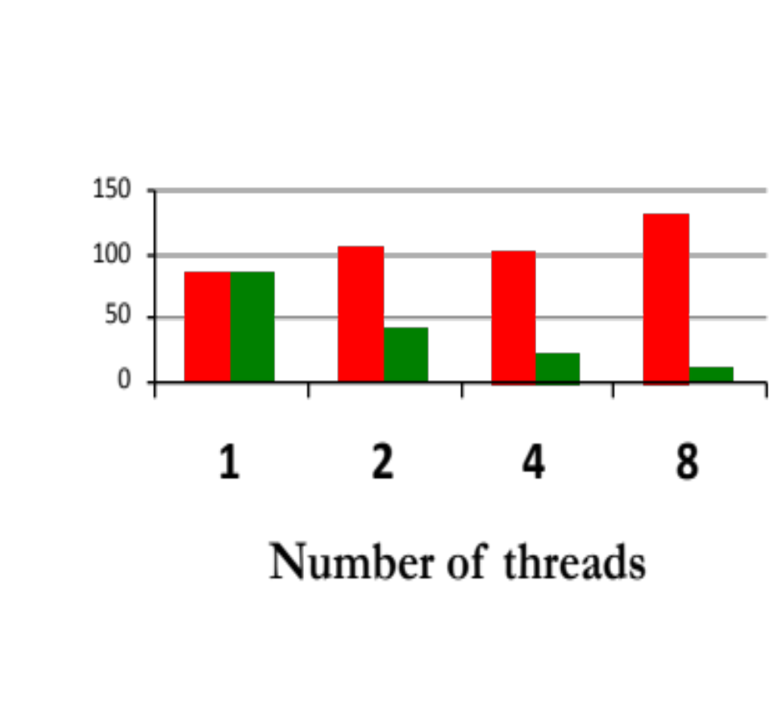
int array[total];
int window=total/numThreads;
void threadFunc(int start)
{
for(index=start; index<start+window;
index++)
for(j=0; j<10000000; j++)
array[index]++;
}
■ Reality
■ Expectation
Runtime (s)

Slide 2
int array[total];
int window=total/numThreads;
void threadFunc(int start) {
for(index=start;index<start+window;index++){
int local=array[index];
for(j=0;j<10000000;j++)
local++;
array[index] = local;
}
}

Slide 3
Parallel Phase I
Parallel Phase II
T1
T4
Serial Phase I
Serial Phase II
Serial Phase III
T2
T3
T5

Slide 4
Cheetah Runtime
FS Detection
FS Assessment
Link
Application
Data Collection
FS Report
User Space
Driver
Operating System
PMU
Hardware

