Slide 1
Sepsis Categorization Validation: Modified Approach
06-08-2026
Mohamed Ali
Kelsea Marble
Clinical Informatics Center, UTSW Medical Center

Slide 2
Introduction

Slide 3
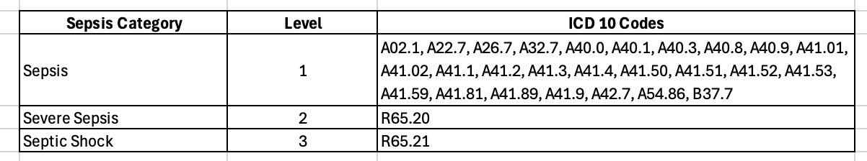
Current Categorization and Distribution
Billing diagnosis based:
There can be more then one sepsis ICD 10 code billed.
Existing logic categorizes by:
Highest present on admission diagnosis
If none, highest not present on admission diagnosis
Modified logic categorizes by:
Highest sepsis level
If any are present on admission, then categorize as present on admission
Notes:
Tremor – shaking, often starting in one hand (especially when resting)
Bradykinesia – slowness of movement
Rigidity – stiffness or resistance to movement
Postural instability – problems with balance and coordination

Slide 4
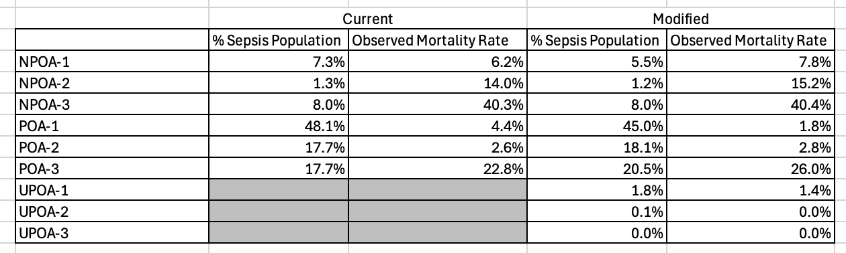
Current Categorization and Distribution (cont.)
March 2025 – February 2026 discharge date
Notes:
Tremor – shaking, often starting in one hand (especially when resting)
Bradykinesia – slowness of movement
Rigidity – stiffness or resistance to movement
Postural instability – problems with balance and coordination

Slide 5
Data

Slide 6
Encounter Inclusion Criteria & Data Processing
Population: Sepsis-related billing diagnoses for discharges spanning June 2022 – June 2026
Data Sources: Event-level data including flowsheet entries, medication administrations, procedure orders, and lab results
Evaluation: Comparisons were made between billing-based and computed categorizations to identify variable trends and discrepancies

Slide 7
Cohort Characteristics
Condensed demographics table for presentation use
Demographics and race
Characteristic
Overall
Total encounters
14,606
Date Range:
June 2022 – June 2026 (4 years)
Age, median [IQR], years
63.8 [48.9, 73.5]
Female
6,829 (46.8%)
Male
7,777 (53.2%)
White
9,669 (66.2%)
Black or African American
3,373 (23.1%)
Asian combined
727 (5.0%)
Other / Some other race
395 (2.7%)
Unavailable / Unknown
442 (3.0%)
Values are N (%) unless otherwise specified. Asian combined includes Asian, East Asian, South Asian, and Southeast Asian categories.

Slide 8
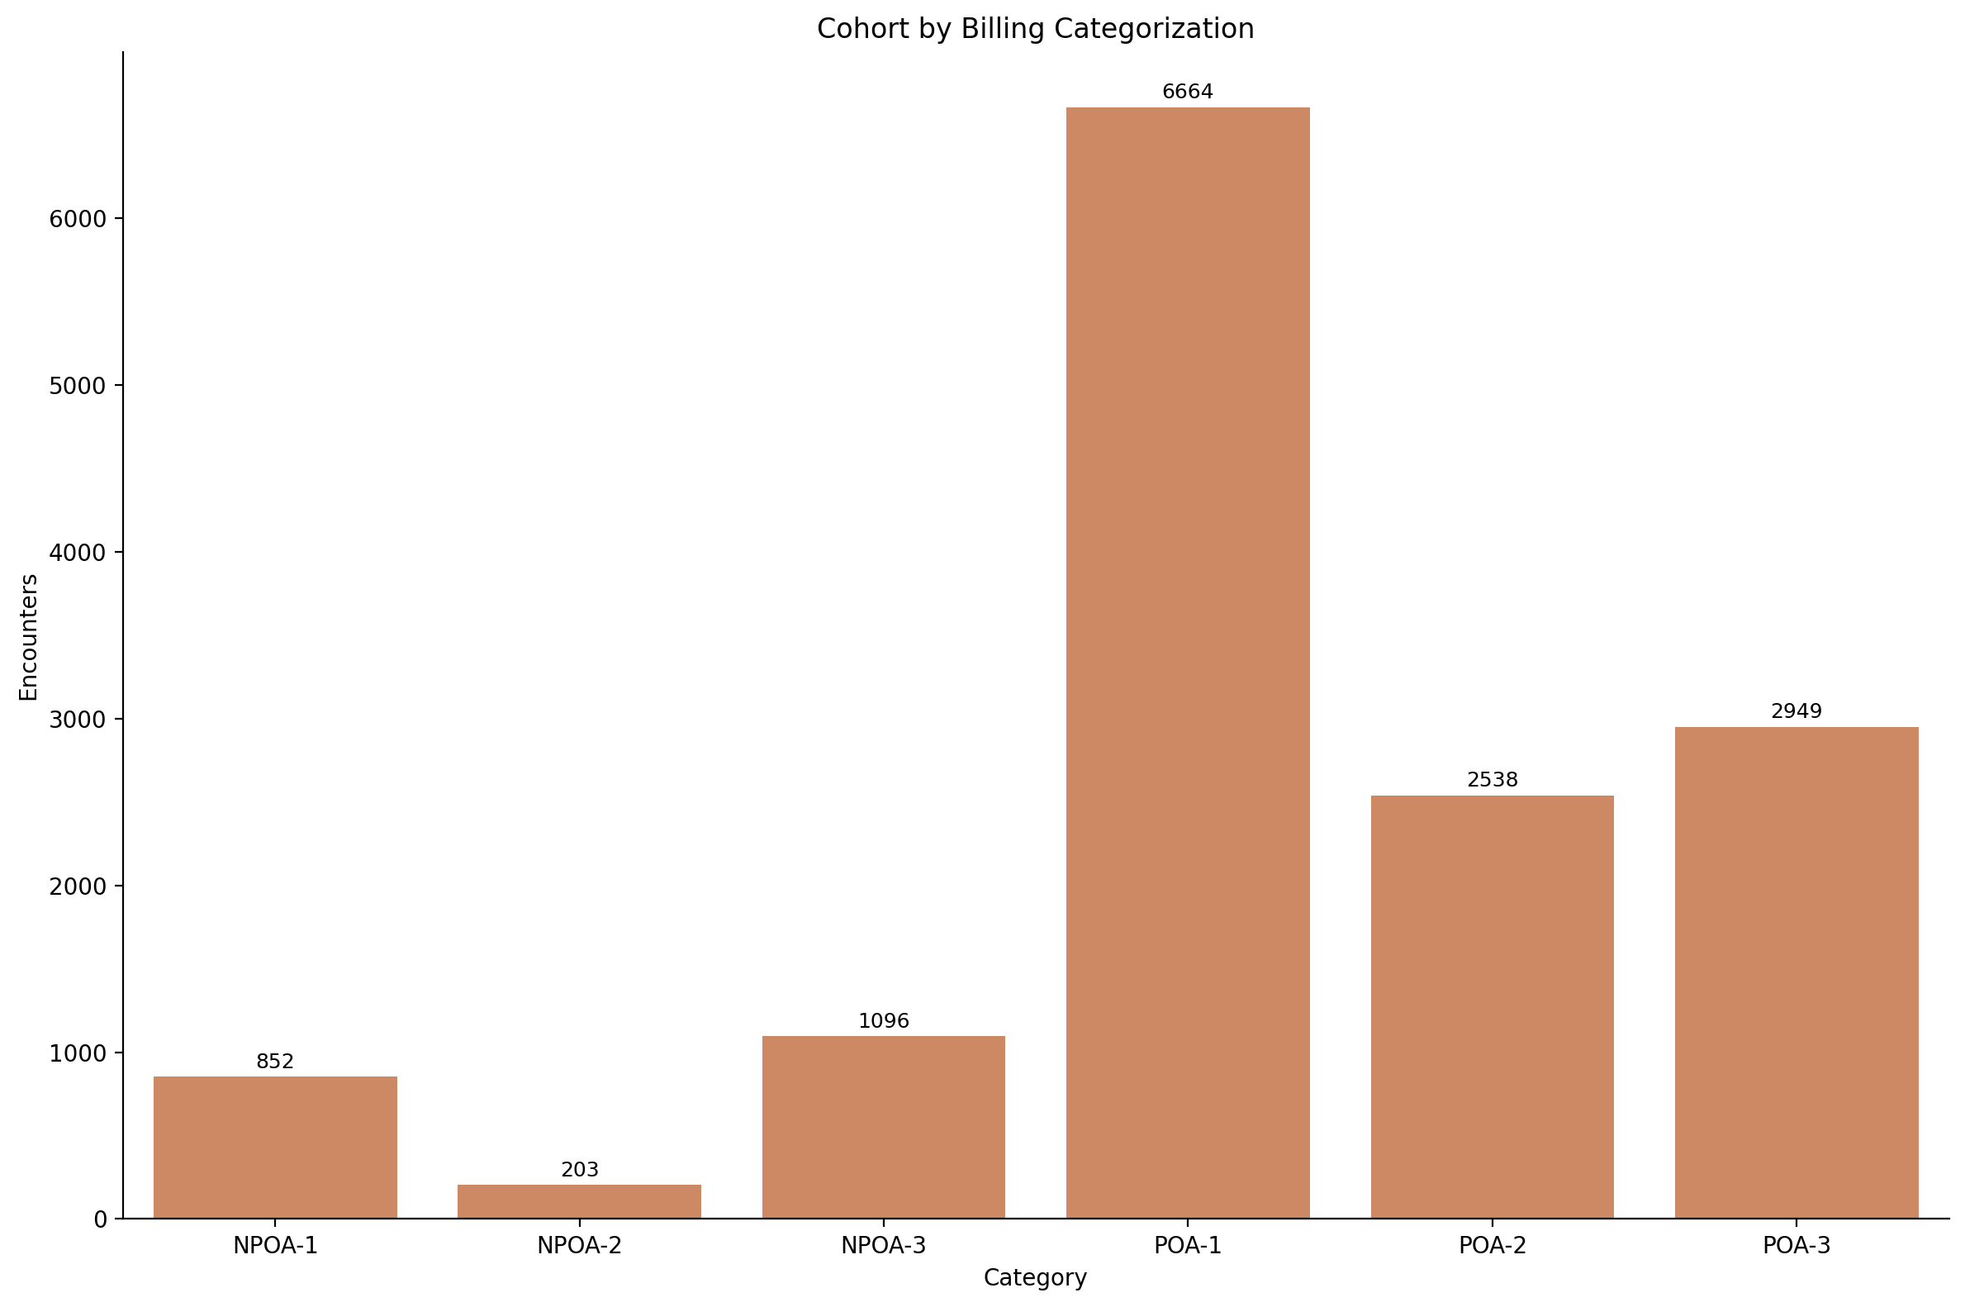

Slide 9
Computed Categorization Algorithm

Slide 10
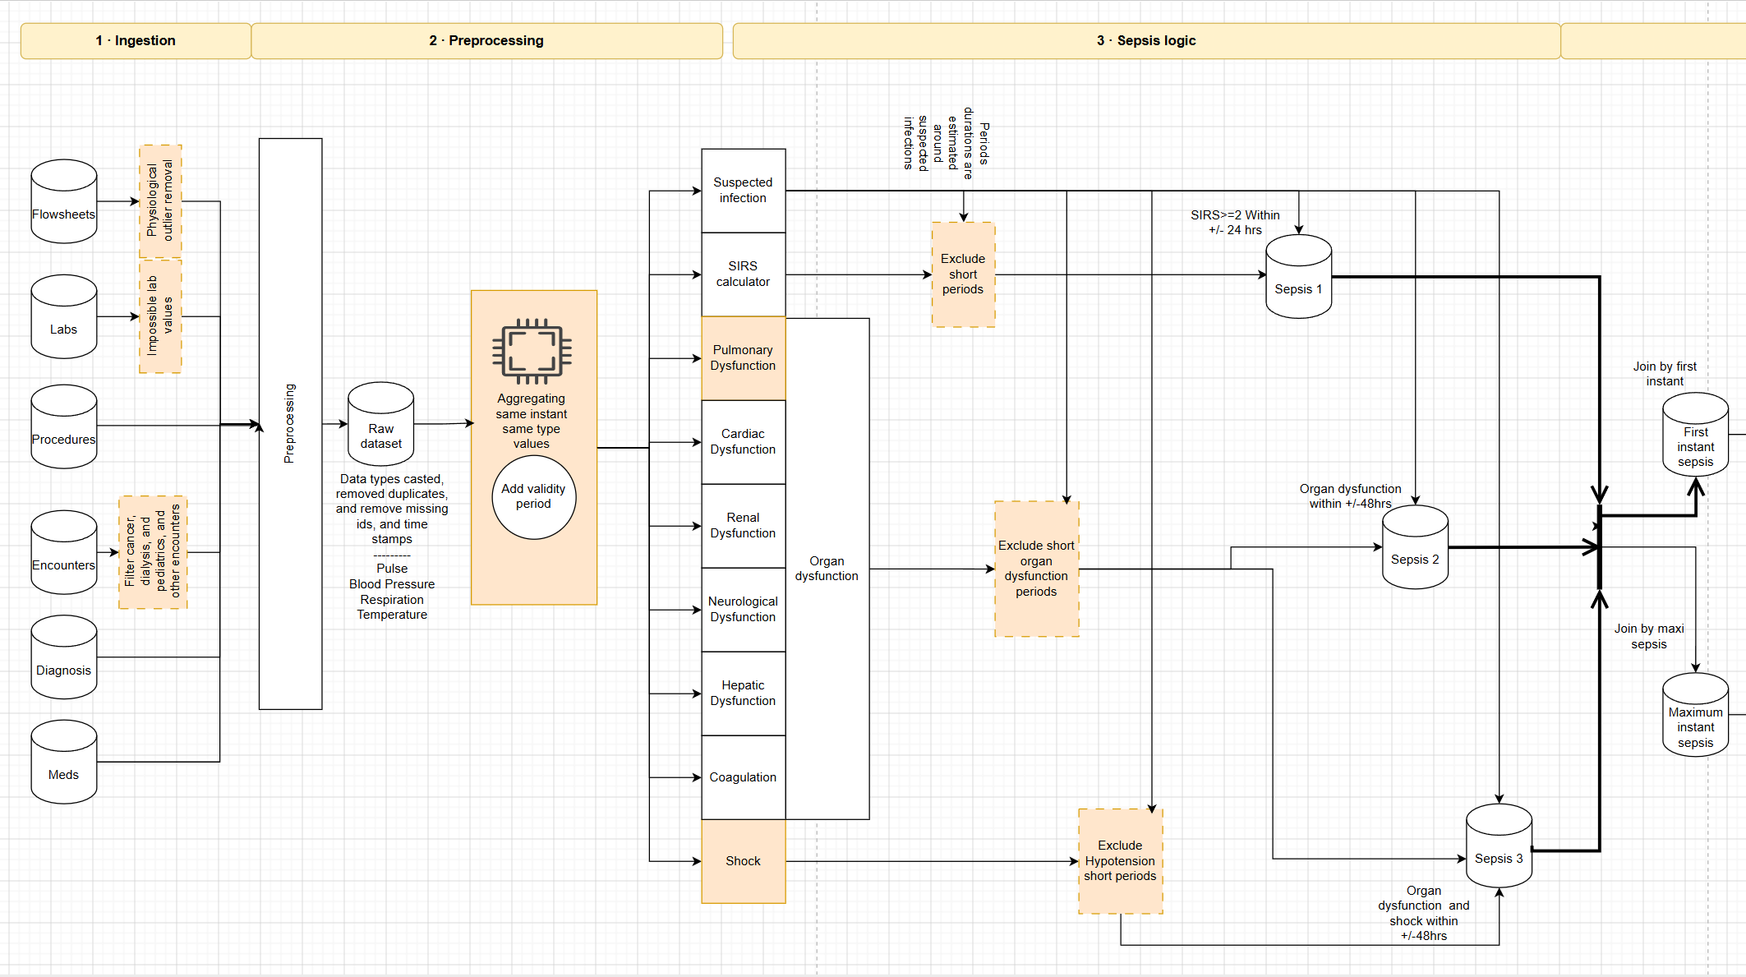
Newly added/modified to v3

Slide 11
POA vs NPOA: Two Reference Timepoints
Choose one reference timepoint, then classify each event relative to it.
Arrival
time 0
Inpatient Admission
reference option
Arrival + 48 h
reference option
Reference A
POA: Sepsis Begin time ≤ Arrival + 48 h
NPOA: sepsis begin time > Arrival + 48 h
Arrival + 48 h
selected reference
Reference B
POA: Sepsis Begin ≤ Admission Time
NPOA: sepsis begin time > Admission Time
Admission Time
selected reference
Rule: sepsis begin time ≤ selected reference → POA | sepsis begin time > selected reference → NPOA

Slide 12
Billing Algorithm vs. Computed Algorithm Results – Encounters Distribution

Slide 13
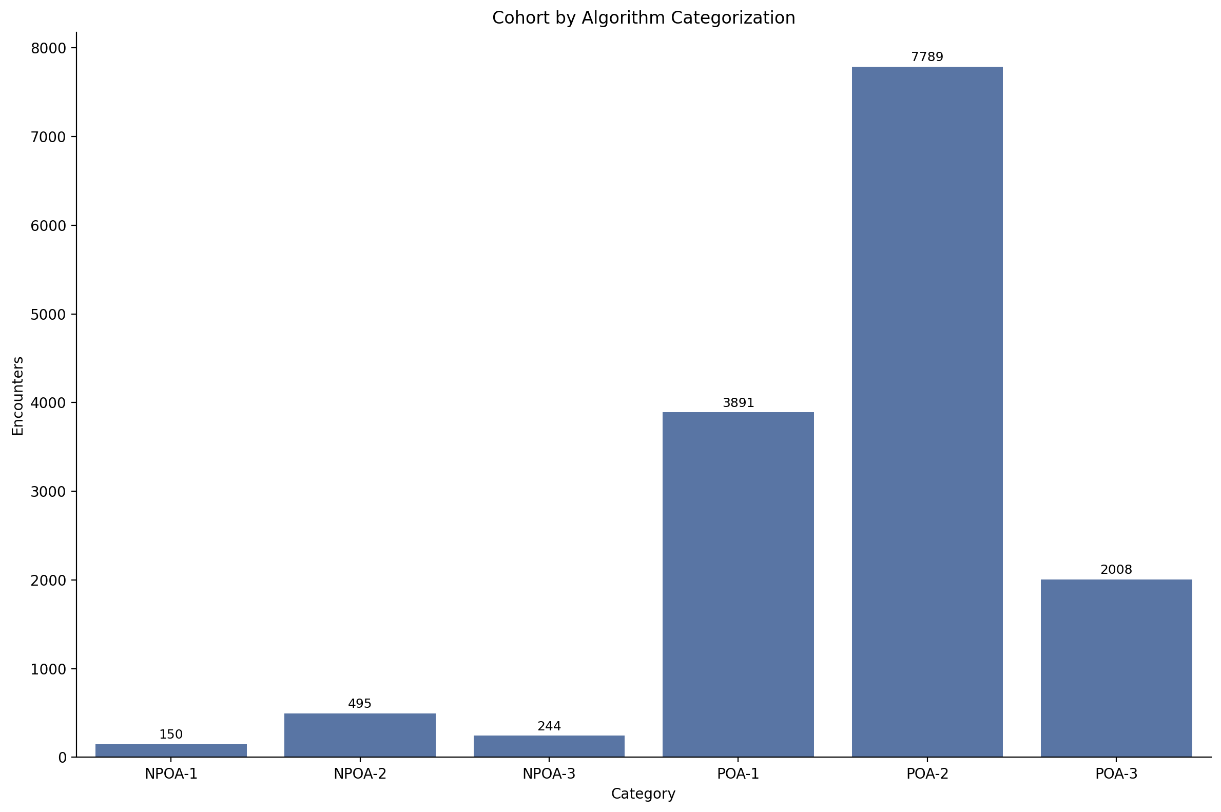
Sepsis Categorization Distribution

Slide 14
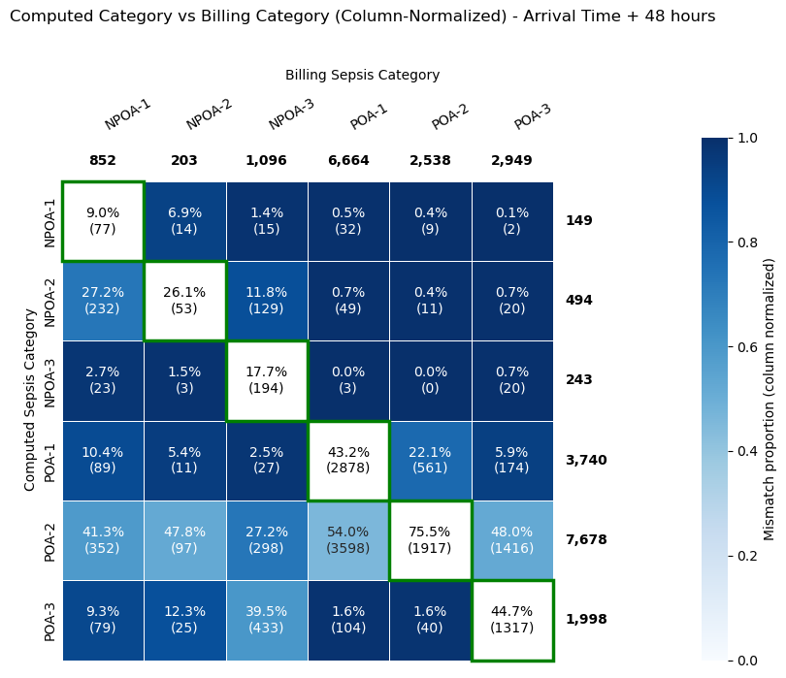
Results
70% of billing NPOA3 moved to POA2 and POA3

Slide 15
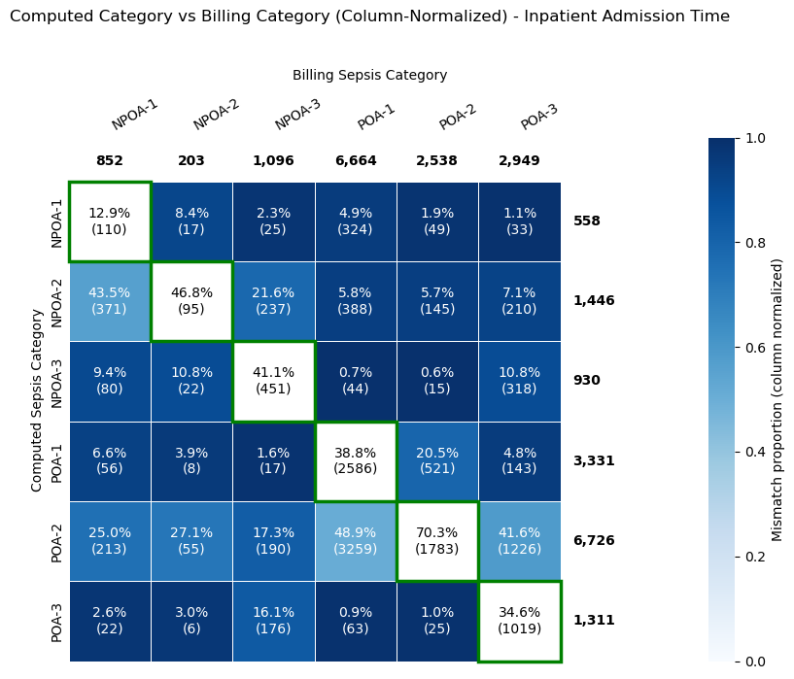
Results
35% of billing NPOA3 moved to POA2 and POA3

Slide 16
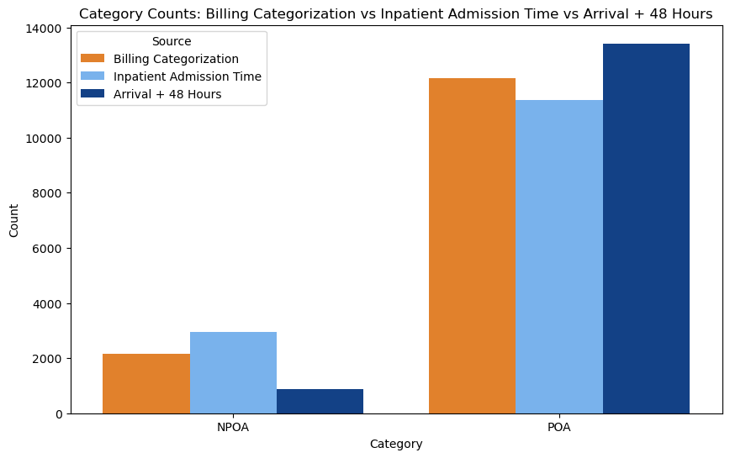

Slide 17
Billing Algorithm vs. Computed Algorithm Results – Clinical Indicators

Slide 18
Clinical Indicators – Length of Stay

Slide 19
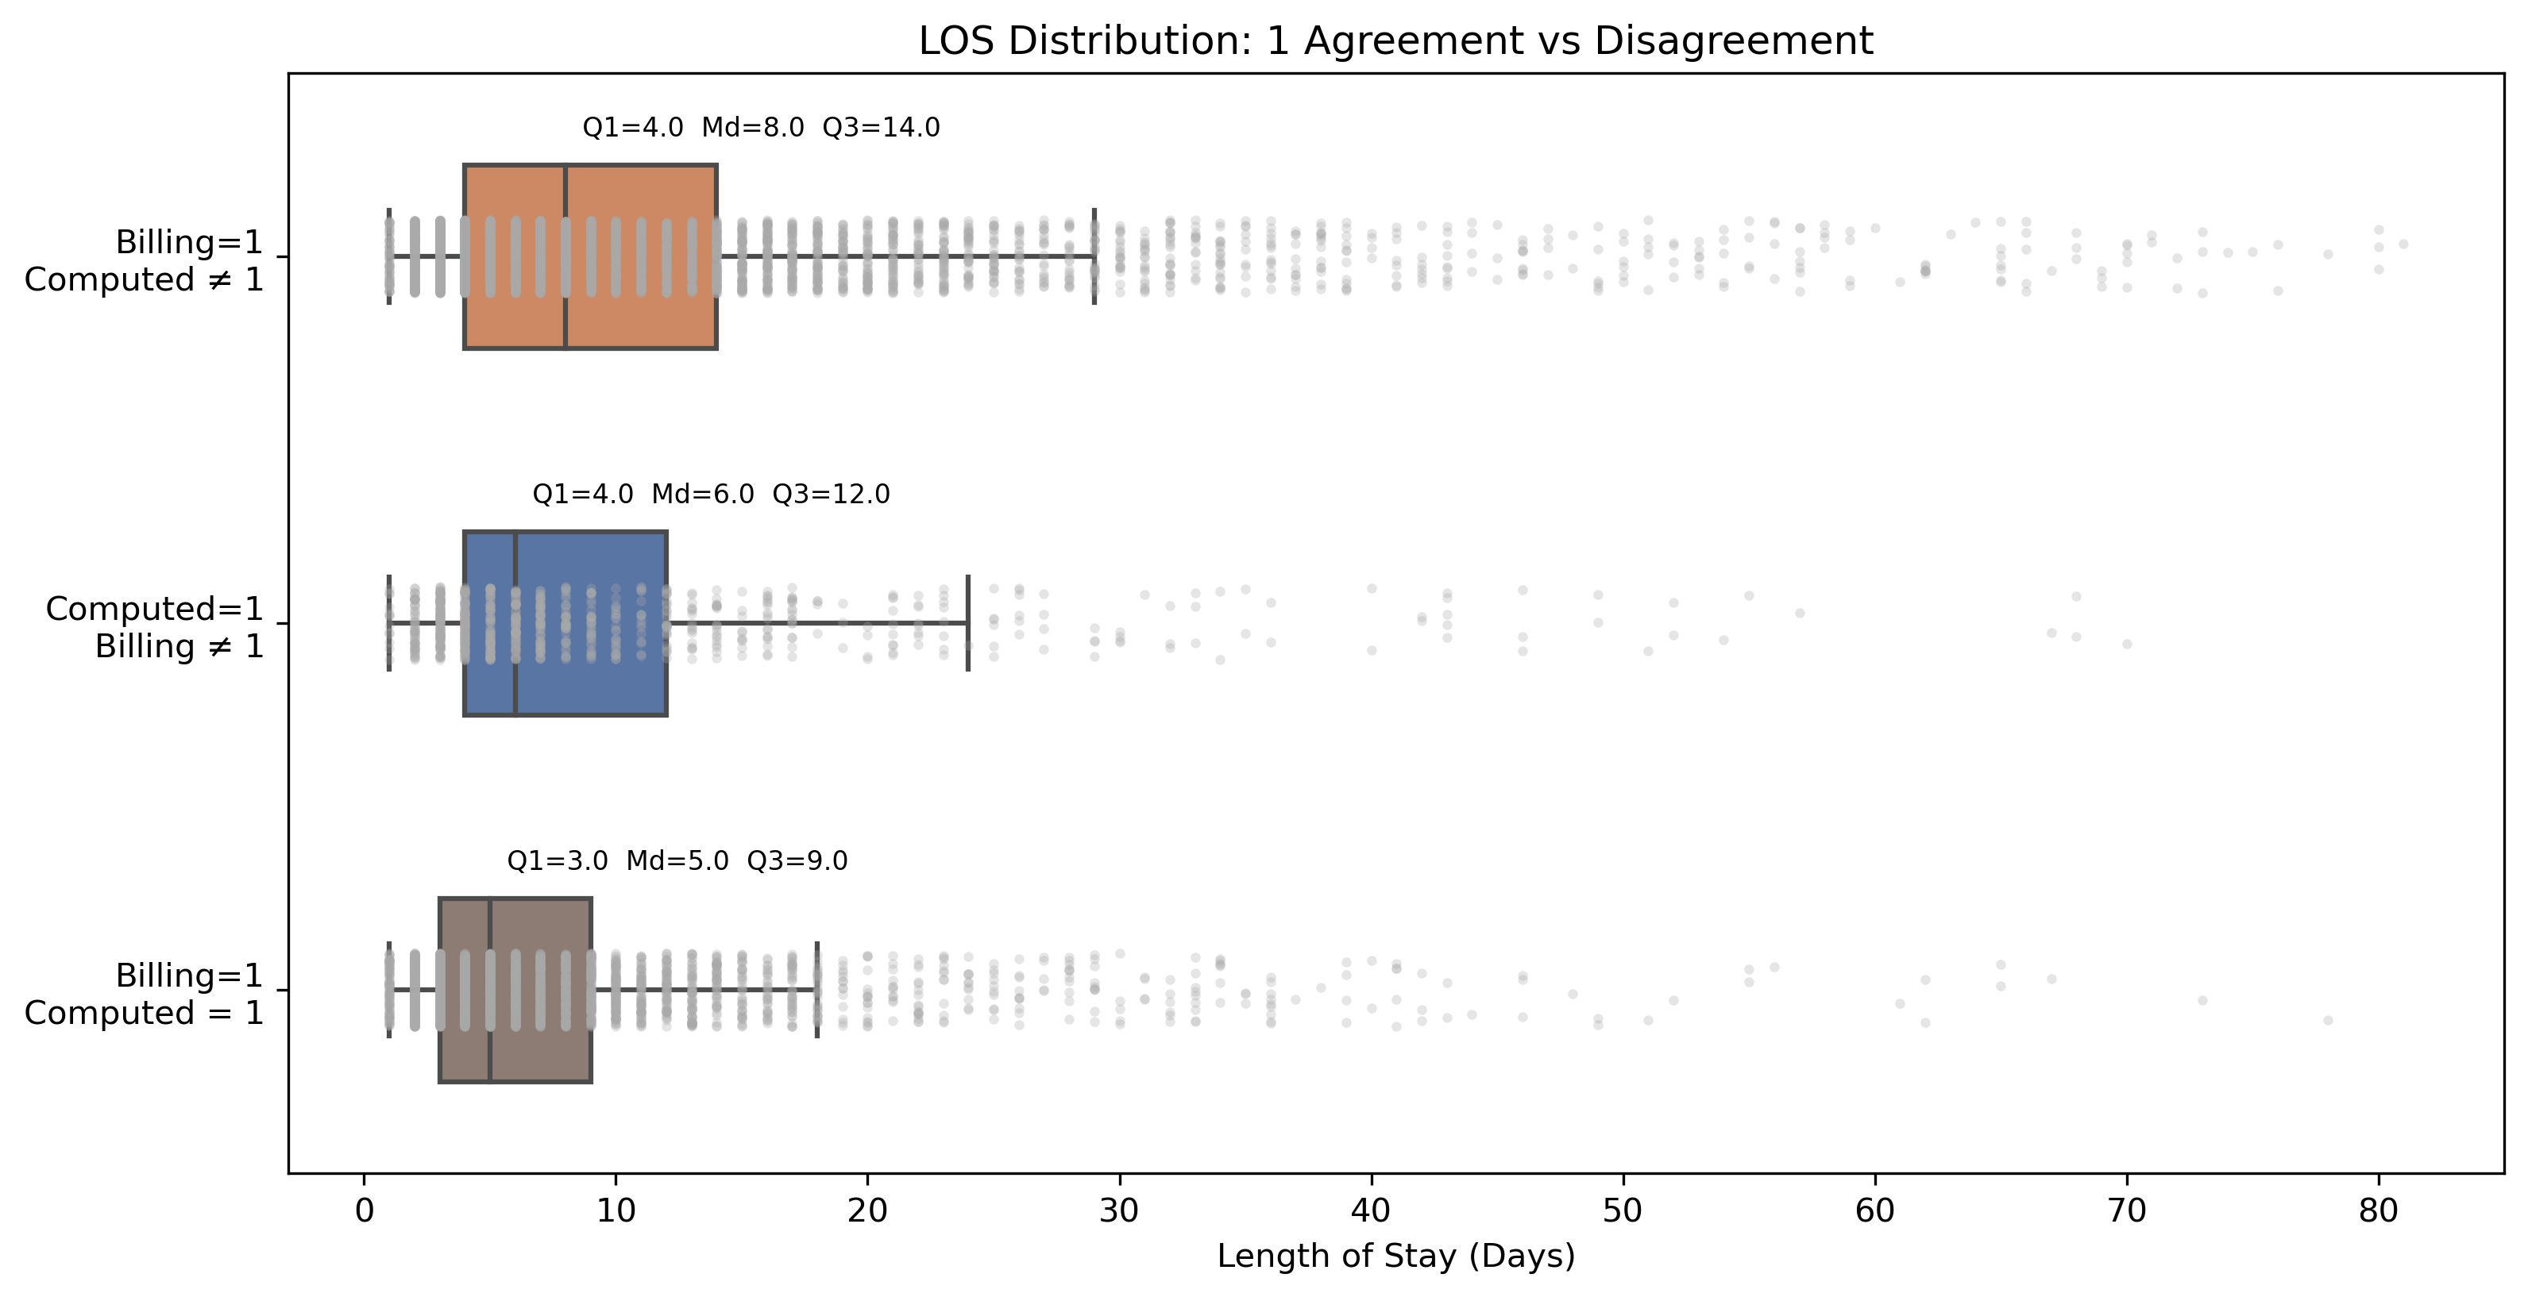

Slide 20
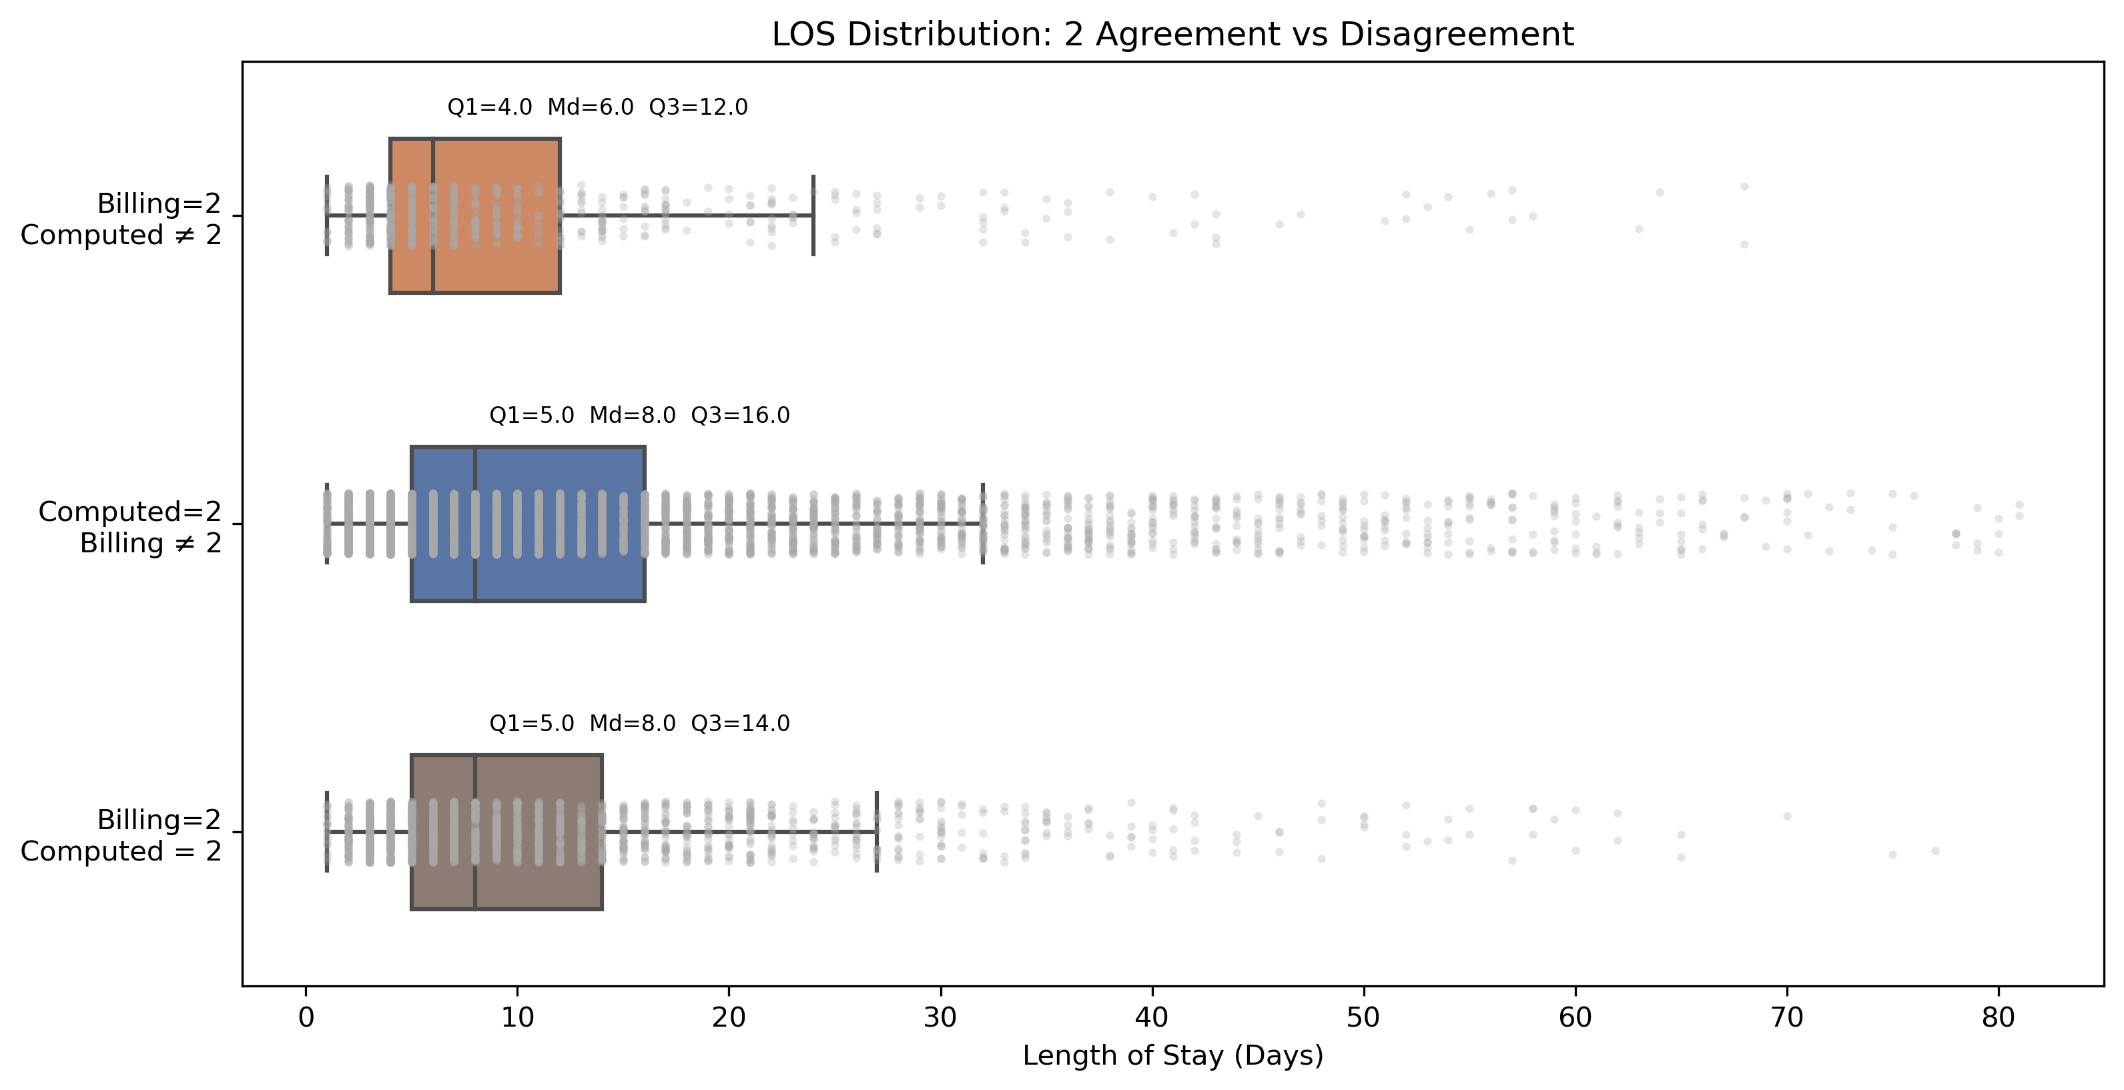

Slide 21
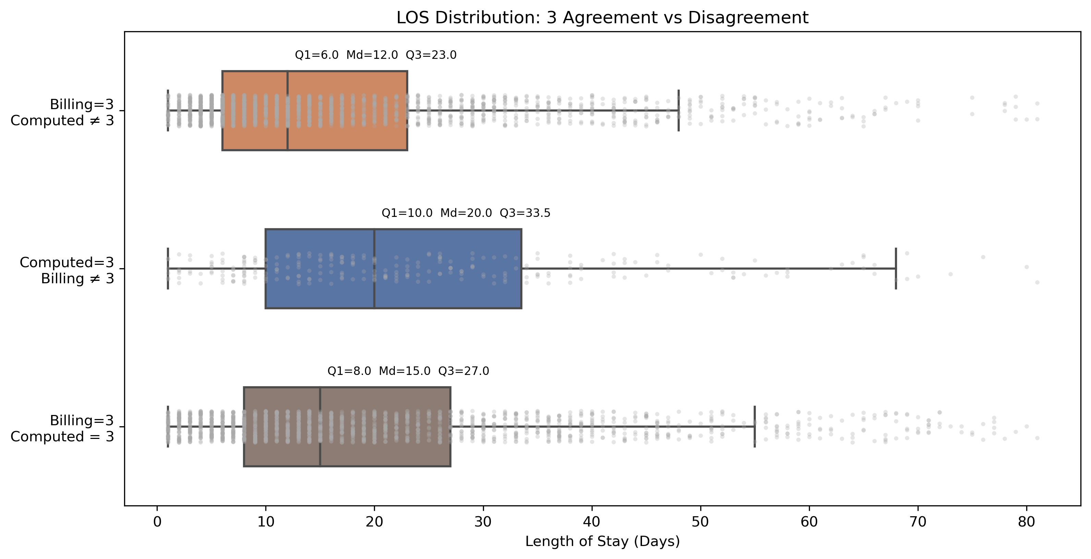

Slide 22
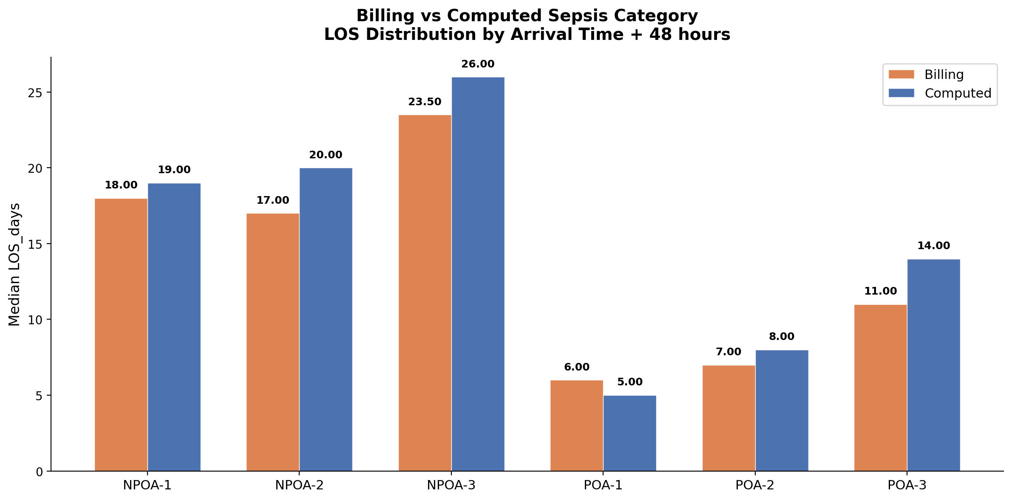

Slide 23
Clinical Indicators – Mortality Rate

Slide 24
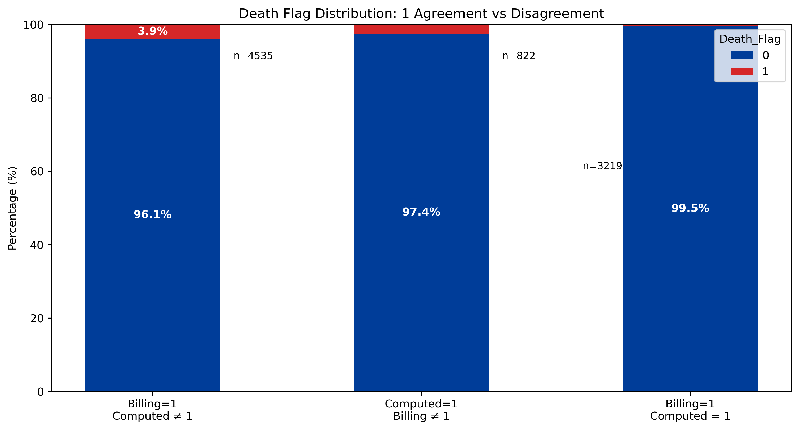

Slide 25
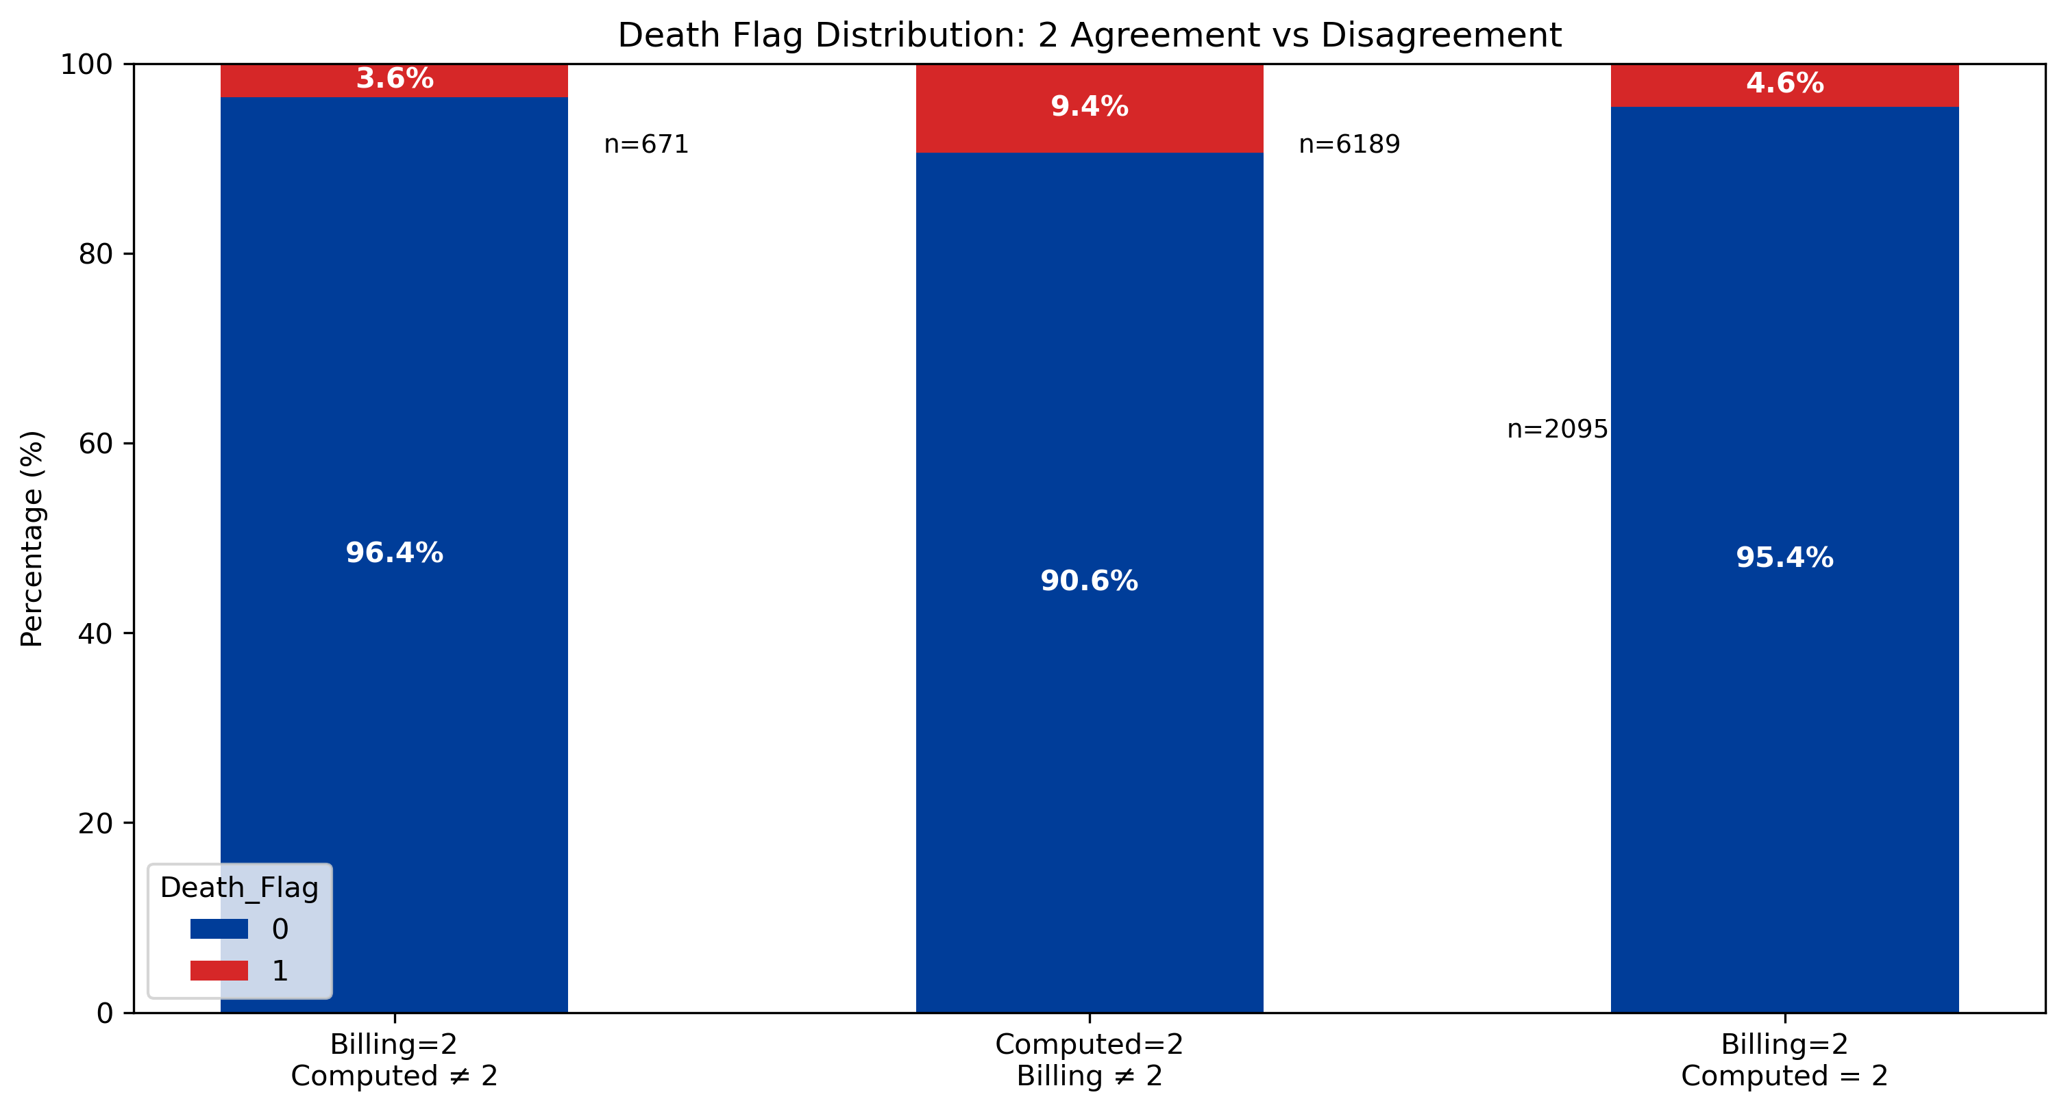
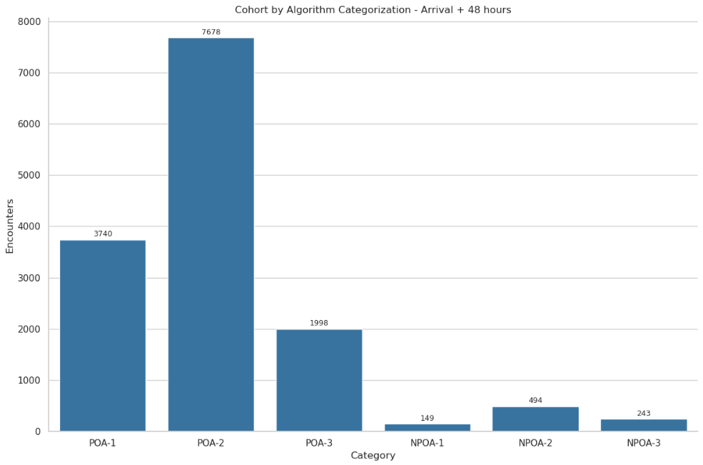

Slide 26
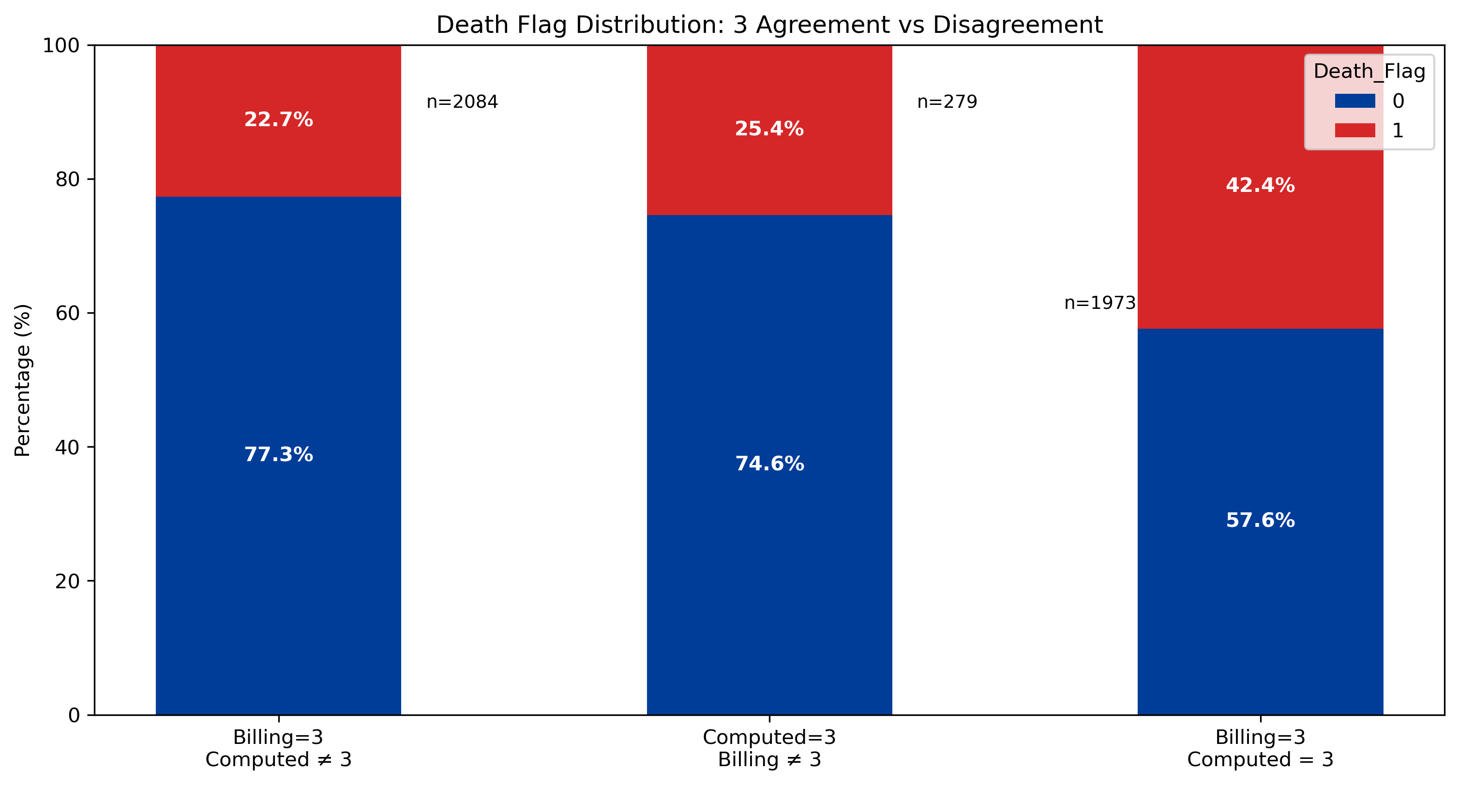
Septic shock ~37% (2021) "An Assessment of Sepsis in the United States and Its Burden on Hospital Care" (Sept 2024)”

Slide 27
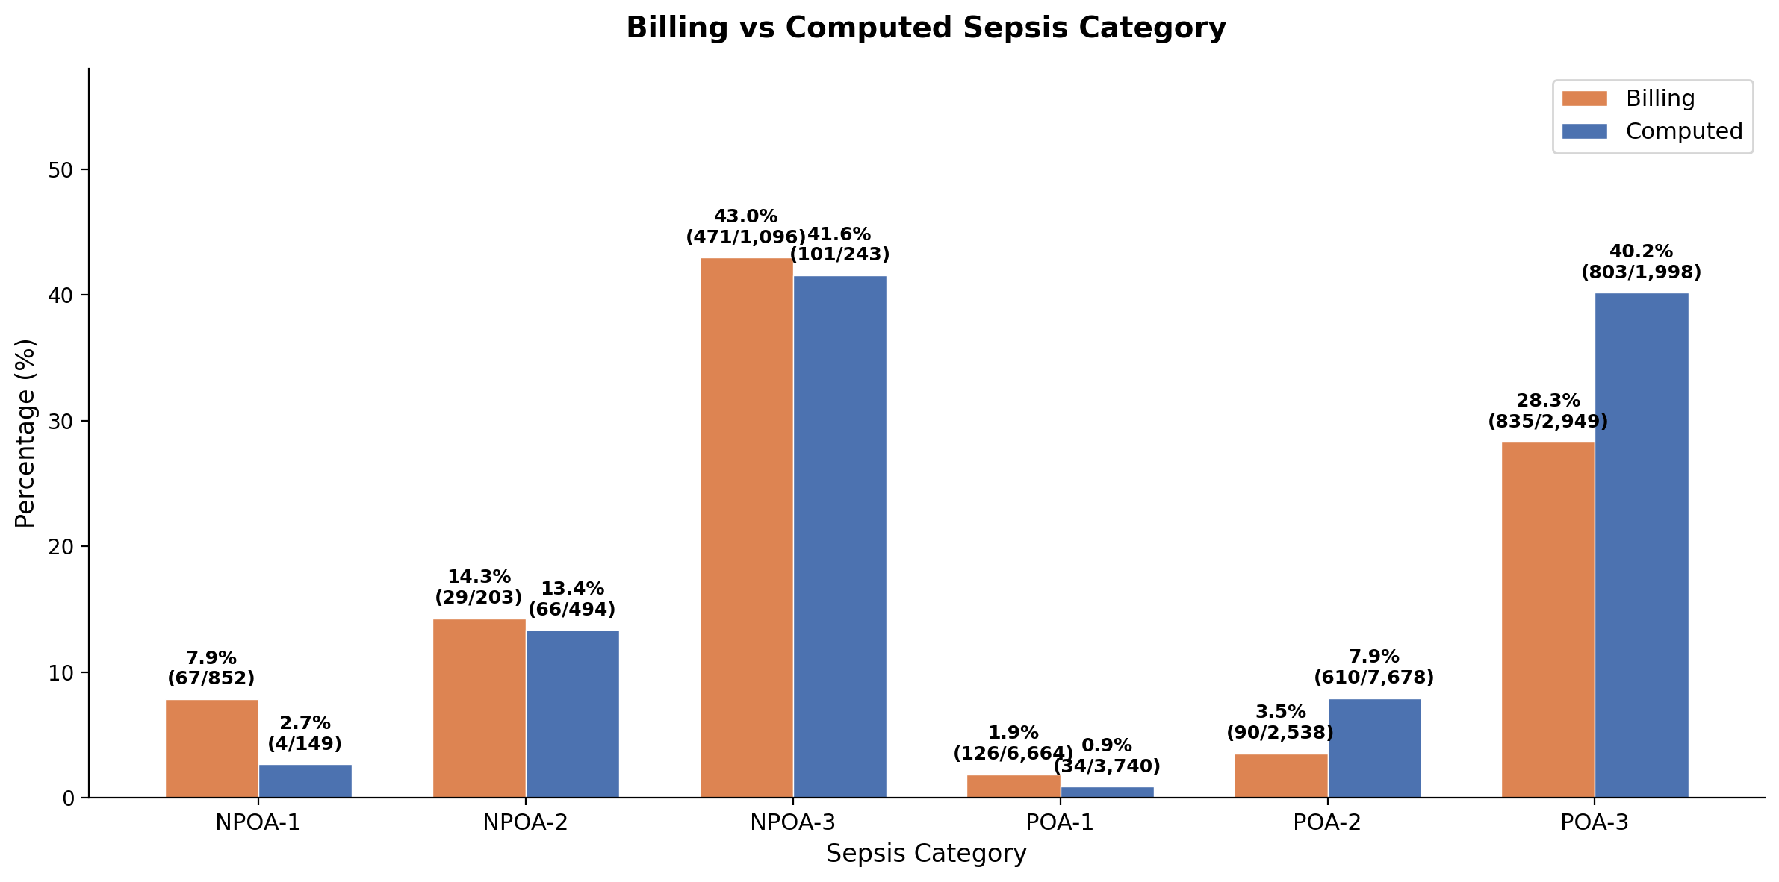
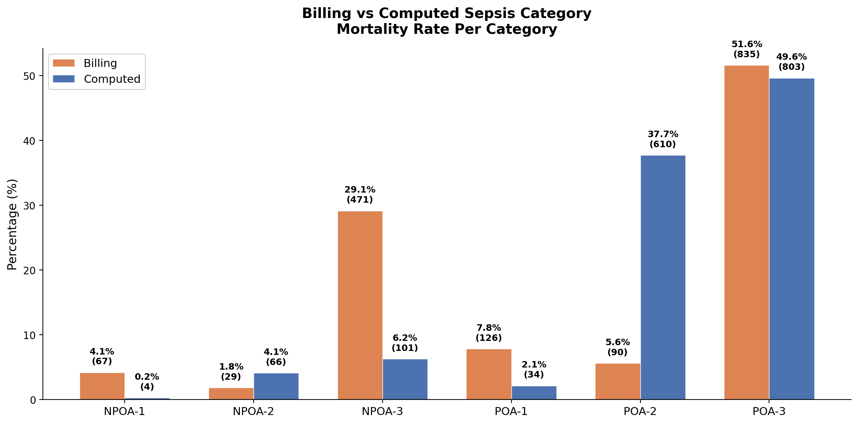

Slide 28
Clinical Indicators – Early Vasopressor Administration

Slide 29
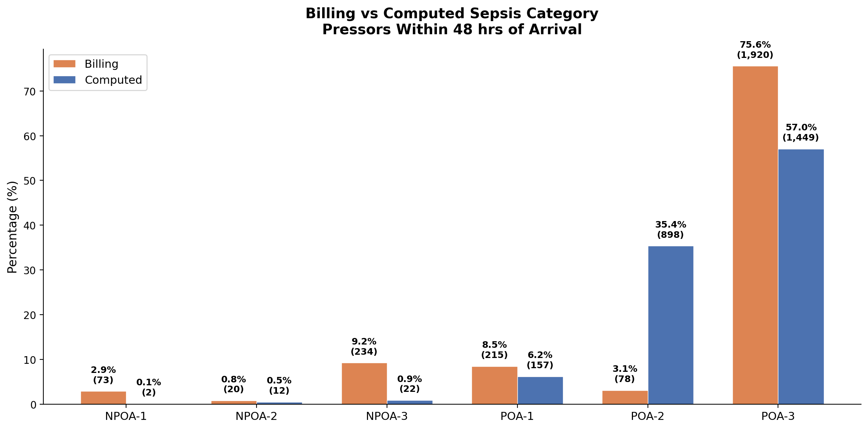

Slide 30
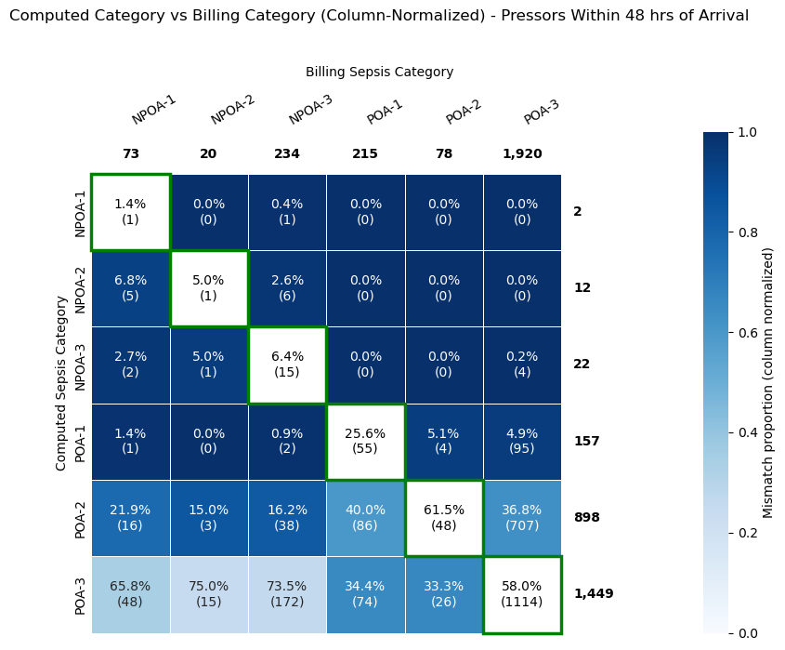
(9.2%)
2504
(87%)
2504
(98%)

Slide 31
Conclusion & Future Work

Slide 32
Updates and Improvements
Cleaner data inputs and more consistent organ dysfunction logic
Data quality safeguards
Clinical logic consolidation
1
Physiological outlier handling
Impute implausible physiological values using the closest valid reading instead of dropping the row.
6
Pulmonary dysfunction integration
Merge updated pulmonary dysfunction criteria into the organ dysfunction framework.
2
Lab result outlier handling
Remove or correct implausible laboratory values before downstream calculations.
7
Organ dysfunction logic update
Consolidate revised dysfunction rules so organ-level flags are generated consistently.
3
Validity-based missing-value imputation
Standardize imputation by applying measurement-specific validity periods.
8
Septic shock criteria update
Remove the time constraint between organ dysfunction and septic shock
4
Same-timestamp conflict resolution
Resolve conflicting readings recorded at the same instant using a consistent rule.
9
Short-episode filtering
Remove brief sepsis, organ dysfunction, and hypotension intervals to reduce transient false positives.
5
Filter short episodes
Remove short episodes of SIRS, hypotension, and other clinical variables that might result due to an error for a short period of time < 5 minutes
Outcome: fewer false positives, cleaner time windows, and clearer clinical logic.

Slide 33
Newly added/modified to v3

Slide 34
Conclusion
Sepsis classification at the time of admission proves unreliable, optimal classification timing requires further investigation.
The Billing Algorithm underestimates severity, frequently downgrading Severe Sepsis (Sepsis + Organ Dysfunction) to Sepsis-1.
The Computed Algorithm overestimates severity, over-classifying patients into Severe Sepsis (Sepsis + Organ Dysfunction).
Clinical indicators serve as viable proxies for evaluating algorithm performance and can be expanded incrementally while a ground truth dataset is developed.

Slide 35
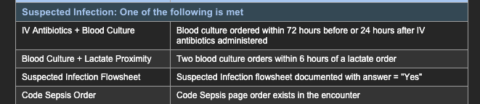
Future Work
Planned Next Steps
  Address identified limitations in the current algorithm to improve classification accuracy across severity levels.
Collaborative Opportunities
  Curate a cohort of misclassified encounters for review, informing iterative algorithm refinement.
  Expand the set of clinical indicators (LOS, Mortality rate, Early Vasopressors) to reduce dependence on large ground-truth cohorts when benchmarking algorithm performance.
  Re-evaluate the suspected infection criteria, particularly the conditional relationship between antibiotic administration and blood culture collection.

Slide 36
Thank you
Notes:
Tremor – shaking, often starting in one hand (especially when resting)
Bradykinesia – slowness of movement
Rigidity – stiffness or resistance to movement
Postural instability – problems with balance and coordination

