Slide 1
Office of Student Financial Aid
Annual Reports Glen C. Falk

Slide 2
OSFA Org Chart
Here is the current OSFA Organization chart.

Slide 3
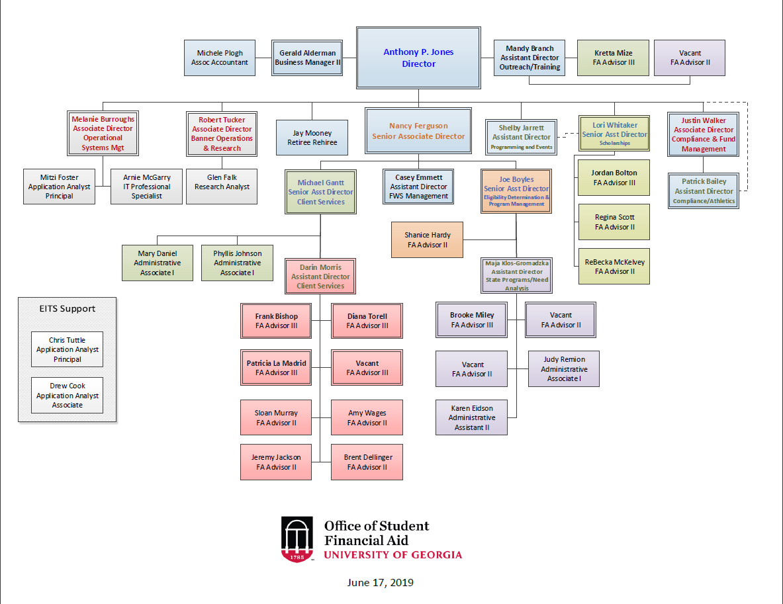
Figure 1: OSFA Org Chart

Slide 4
01. Student Financial Aid Summary
You can label chapter and section titles using {#label} after them, e.g., we can reference Chapter 1. If you do not manually label them, there will be automatic labels anyway, e.g., Chapter ??.
Figures and tables with captions will be placed in figure and table environments, respectively.
par(mar = c(4, 4, .1, .1)) plot(pressure, type = 'b', pch = 19)

Slide 5
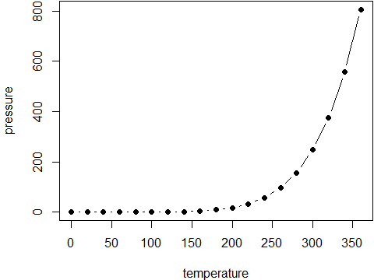
Figure 2: Here is a nice figure!

Slide 6
Reference a figure by its code chunk label with the fig: prefix, e.g., see Figure 2. Similarly, you can reference tables generated from knitr::kable(), e.g., see Table 1.
knitr::kable( head(iris, 20), caption = 'Here is a nice table!', booktabs = TRUE )

Slide 7
Sepal.Length | Sepal.Width | Petal.Length | Petal.Width | Species
5.1 | 3.5 | 1.4 | 0.2 | setosa
4.9 | 3.0 | 1.4 | 0.2 | setosa
4.7 | 3.2 | 1.3 | 0.2 | setosa
4.6 | 3.1 | 1.5 | 0.2 | setosa
5.0 | 3.6 | 1.4 | 0.2 | setosa
5.4 | 3.9 | 1.7 | 0.4 | setosa
4.6 | 3.4 | 1.4 | 0.3 | setosa
5.0 | 3.4 | 1.5 | 0.2 | setosa
4.4 | 2.9 | 1.4 | 0.2 | setosa
4.9 | 3.1 | 1.5 | 0.1 | setosa
5.4 | 3.7 | 1.5 | 0.2 | setosa
4.8 | 3.4 | 1.6 | 0.2 | setosa
4.8 | 3.0 | 1.4 | 0.1 | setosa
4.3 | 3.0 | 1.1 | 0.1 | setosa
5.8 | 4.0 | 1.2 | 0.2 | setosa
5.7 | 4.4 | 1.5 | 0.4 | setosa
5.4 | 3.9 | 1.3 | 0.4 | setosa
5.1 | 3.5 | 1.4 | 0.3 | setosa
5.7 | 3.8 | 1.7 | 0.3 | setosa
5.1 | 3.8 | 1.5 | 0.3 | setosa
Table 1: Here is a nice table!

Slide 8
You can write citations, too. For example, we are using the bookdown package (Xie 2020) in this sample book, which was built on top of R Markdown and knitr (Xie 2015).

Slide 9
COA
COA Tables
Example one - flextable
Example two - gt
COA
Undergrad
costs
ay2009-10
ay2010-11
ay2011-12
ay2012-13
ay2013-14
ay2014-15
ay2015-16
ay2016-17
ay2017-18
ay2018-19
Resident Costs*:
Tuition & Fees
$7,530
$8,736
$9,472
$9,842
$10,262
$10,836
$11,622
$11,634
$11,818
$11,830
Books & Supplies
960
1,030
1,078
848
916
800
840
1,006
986
986
Room & Board
8,046
8,460
8,708
8,970
9,246
9,246
9,450
9,616
10,060
10,038
Misc. & Travel
1,464
1,510
1,562
1,590
1,640
1,798
3,222
3,952
3,540
3,834
Resident Total Costs
$18,000
$19,736
$20,820
$21,250
$22,064
$22,680
$25,134
$26,208
$26,404
$26,688
Nonresident Costs*:
Tuition & Fees
$25,740
$26,946
$27,682
$28,052
$28,472
$29,046
$29,832
$29,844
$30,392
$30,404
Books & Supplies
960
1,030
1,078
848
916
800
840
1,006
986
986
Room & Board
8,046
8,460
8,708
8,970
9,246
9,246
9,450
9,616
10,060
10,038
Misc. & Travel
1,464
1,510
1,562
1,590
1,640
1,798
3,746
4,662
4,250
4,334
Nonresident Total Costs
$36,210
$37,946
$39,030
$39,460
$40,274
$40,890
$43,868
$45,128
$45,688
$45,762
Example three - kable
costs
ay2009-10
ay2010-11
ay2011-12
ay2012-13
ay2013-14
ay2014-15
ay2015-16
ay2016-17
ay2017-18
ay2018-19
Resident Costs*:
Tuition & Fees
$7,530
$8,736
$9,472
$9,842
$10,262
$10,836
$11,622
$11,634
$11,818
$11,830
Books & Supplies
960
1,030
1,078
848
916
800
840
1,006
986
986
Room & Board
8,046
8,460
8,708
8,970
9,246
9,246
9,450
9,616
10,060
10,038
Misc. & Travel
1,464
1,510
1,562
1,590
1,640
1,798
3,222
3,952
3,540
3,834
Resident Total Costs
$18,000
$19,736
$20,820
$21,250
$22,064
$22,680
$25,134
$26,208
$26,404
$26,688
Nonresident Costs*:
Tuition & Fees
$25,740
$26,946
$27,682
$28,052
$28,472
$29,046
$29,832
$29,844
$30,392
$30,404
Books & Supplies
960
1,030
1,078
848
916
800
840
1,006
986
986
Room & Board
8,046
8,460
8,708
8,970
9,246
9,246
9,450
9,616
10,060
10,038
Misc. & Travel
1,464
1,510
1,562
1,590
1,640
1,798
3,746
4,662
4,250
4,334
Nonresident Total Costs
$36,210
$37,946
$39,030
$39,460
$40,274
$40,890
$43,868
$45,128
$45,688
$45,762
costs
ay2009-10
ay2010-11
ay2011-12
ay2012-13
ay2013-14
ay2014-15
ay2015-16
ay2016-17
ay2017-18
ay2018-19
Resident Costs*:
Tuition & Fees
$7,530
$8,736
$9,472
$9,842
$10,262
$10,836
$11,622
$11,634
$11,818
$11,830
Books & Supplies
960
1,030
1,078
848
916
800
840
1,006
986
986
Room & Board
8,046
8,460
8,708
8,970
9,246
9,246
9,450
9,616
10,060
10,038
Misc. & Travel
1,464
1,510
1,562
1,590
1,640
1,798
3,222
3,952
3,540
3,834
Resident Total Costs
$18,000
$19,736
$20,820
$21,250
$22,064
$22,680
$25,134
$26,208
$26,404
$26,688
Nonresident Costs*:
Tuition & Fees
$25,740
$26,946
$27,682
$28,052
$28,472
$29,046
$29,832
$29,844
$30,392
$30,404
Books & Supplies
960
1,030
1,078
848
916
800
840
1,006
986
986
Room & Board
8,046
8,460
8,708
8,970
9,246
9,246
9,450
9,616
10,060
10,038
Misc. & Travel
1,464
1,510
1,562
1,590
1,640
1,798
3,746
4,662
4,250
4,334
Nonresident Total Costs
$36,210
$37,946
$39,030
$39,460
$40,274
$40,890
$43,868
$45,128
$45,688
$45,762
Example four - xtable
## % latex table generated in R 3.6.3 by xtable 1.8-4 package ## % Mon Mar 09 16:08:04 2020 ## \begin{table}[ht] ## \centering ## \begin{tabular}{} ## \toprule ## & costs & ay2009-10 & ay2010-11 & ay2011-12 & ay2012-13 & ay2013-14 & ay2014-15 & ay2015-16 & ay2016-17 & ay2017-18 & ay2018-19 \\ ## \midrule ## 1 & Resident Costs*: & & & & & & & & & & \\ ## 2 & Tuition \& Fees & \$7,530 & \$8,736 & \$9,472 & \$9,842 & \$10,262 & \$10,836 & \$11,622 & \$11,634 & \$11,818 & \$11,830 \\ ## 3 & Books \& Supplies & 960 & 1,030 & 1,078 & 848 & 916 & 800 & 840 & 1,006 & 986 & 986 \\ ## 4 & Room \& Board & 8,046 & 8,460 & 8,708 & 8,970 & 9,246 & 9,246 & 9,450 & 9,616 & 10,060 & 10,038 \\ ## 5 & Misc. \& Travel & 1,464 & 1,510 & 1,562 & 1,590 & 1,640 & 1,798 & 3,222 & 3,952 & 3,540 & 3,834 \\ ## 6 & Resident Total Costs & \$18,000 & \$19,736 & \$20,820 & \$21,250 & \$22,064 & \$22,680 & \$25,134 & \$26,208 & \$26,404 & \$26,688 \\ ## 7 & Nonresident Costs*: & & & & & & & & & & \\ ## 8 & Tuition \& Fees & \$25,740 & \$26,946 & \$27,682 & \$28,052 & \$28,472 & \$29,046 & \$29,832 & \$29,844 & \$30,392 & \$30,404 \\ ## 9 & Books \& Supplies & 960 & 1,030 & 1,078 & 848 & 916 & 800 & 840 & 1,006 & 986 & 986 \\ ## 10 & Room \& Board & 8,046 & 8,460 & 8,708 & 8,970 & 9,246 & 9,246 & 9,450 & 9,616 & 10,060 & 10,038 \\ ## 11 & Misc. \& Travel & 1,464 & 1,510 & 1,562 & 1,590 & 1,640 & 1,798 & 3,746 & 4,662 & 4,250 & 4,334 \\ ## 12 & Nonresident Total Costs & \$36,210 & \$37,946 & \$39,030 & \$39,460 & \$40,274 & \$40,890 & \$43,868 & \$45,128 & \$45,688 & \$45,762 \\ ## \bottomrule ## \end{tabular} ## \end{table}
COA Charts
costs | ay2009-10 | ay2010-11 | ay2011-12 | ay2012-13 | ay2013-14 | ay2014-15 | ay2015-16 | ay2016-17 | ay2017-18 | ay2018-19
Resident Costs*:
Tuition & Fees | $7,530 | $8,736 | $9,472 | $9,842 | $10,262 | $10,836 | $11,622 | $11,634 | $11,818 | $11,830
Books & Supplies | 960 | 1,030 | 1,078 | 848 | 916 | 800 | 840 | 1,006 | 986 | 986
Room & Board | 8,046 | 8,460 | 8,708 | 8,970 | 9,246 | 9,246 | 9,450 | 9,616 | 10,060 | 10,038
Misc. & Travel | 1,464 | 1,510 | 1,562 | 1,590 | 1,640 | 1,798 | 3,222 | 3,952 | 3,540 | 3,834
Resident Total Costs | $18,000 | $19,736 | $20,820 | $21,250 | $22,064 | $22,680 | $25,134 | $26,208 | $26,404 | $26,688
Nonresident Costs*:
Tuition & Fees | $25,740 | $26,946 | $27,682 | $28,052 | $28,472 | $29,046 | $29,832 | $29,844 | $30,392 | $30,404
Books & Supplies | 960 | 1,030 | 1,078 | 848 | 916 | 800 | 840 | 1,006 | 986 | 986
Room & Board | 8,046 | 8,460 | 8,708 | 8,970 | 9,246 | 9,246 | 9,450 | 9,616 | 10,060 | 10,038
Misc. & Travel | 1,464 | 1,510 | 1,562 | 1,590 | 1,640 | 1,798 | 3,746 | 4,662 | 4,250 | 4,334
Nonresident Total Costs | $36,210 | $37,946 | $39,030 | $39,460 | $40,274 | $40,890 | $43,868 | $45,128 | $45,688 | $45,762

Slide 10
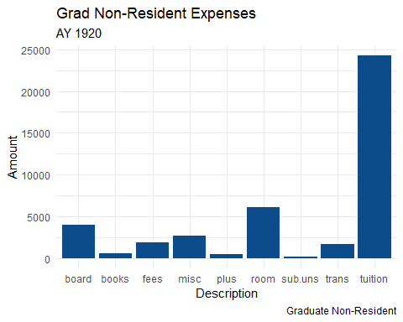

Slide 11
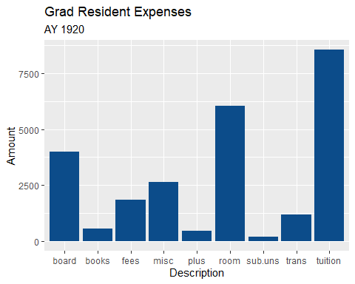
(#fig:2.2.2-coa-res)coa-res

Slide 12
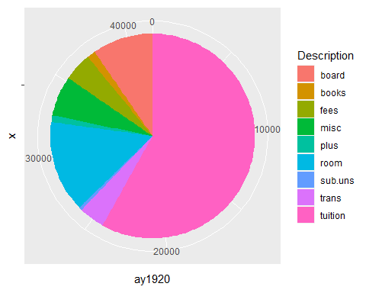
(#fig:2.2.3-coa-non)coa-grad-non-pie

Slide 13
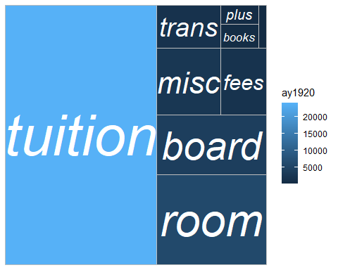
(#fig:2.2.4-coa-non)coa-grad-non-treemap

Slide 14
(#fig:2.2.5-coa-res)coa-grad-res-treemap

Slide 15

Financial Aid Awarded

Slide 16
Undergraduate Cost of Attendance

Slide 17
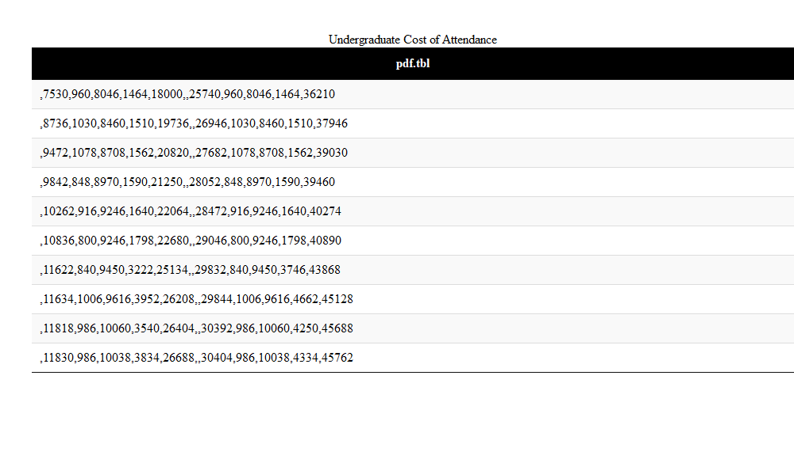

Slide 18
x
NA
7530
960
8046
1464
18000
NA
25740
960
8046
1464
36210
(#tab:2.o-UG-COA)Undergraduate Cost of Attendance Table

Slide 19
x
NA
8736
1030
8460
1510
19736
NA
26946
1030
8460
1510
37946

Slide 20
x
NA
9472
1078
8708
1562
20820
NA
27682
1078
8708
1562
39030

Slide 21
x
NA
9842
848
8970
1590
21250
NA
28052
848
8970
1590
39460

Slide 22
x
NA
10262
916
9246
1640
22064
NA
28472
916
9246
1640
40274

Slide 23
x
NA
10836
800
9246
1798
22680
NA
29046
800
9246
1798
40890

Slide 24
x
NA
11622
840
9450
3222
25134
NA
29832
840
9450
3746
43868

Slide 25
x
NA
11634
1006
9616
3952
26208
NA
29844
1006
9616
4662
45128

Slide 26
x
NA
11818
986
10060
3540
26404
NA
30392
986
10060
4250
45688

Slide 27
x
NA
11830
986
10038
3834
26688
NA
30404
986
10038
4334
45762

Slide 28
Types and Sources of Aid.xls
Some significant applications are demonstrated in this chapter.
Example one
Example two

Slide 29
Academic Year Student Financial Aid Awards by Type
We have finished a nice book.
Xie, Yihui. 2015. Dynamic Documents with R and Knitr. 2nd ed. Boca Raton, Florida: Chapman; Hall/CRC. http://yihui.name/knitr/.
———. 2020. Bookdown: Authoring Books and Technical Documents with R Markdown. https://CRAN.R-project.org/package=bookdown.

