Slide 1

Reproducible Research and Workflow with RMarkdown and ProjectTemplate Introduction to R Workshop
Dr Jeromy Anglim
Deakin University
jeromy.anglim@deakin.edu.au

Slide 2
Motivation: How to create documents?
Types and distinctions
Formal Documents
Journal articles, books, book chapters, theses, consulting reports, etc.
Informal documents
preliminary analyses, statistical homework,
Online content
web pages, blog posts, forum posts Browser metaphor versus page/slide-based metaphor
Context
When to use reproducible analysis?
When to use knitr with R Markdown or LaTeX?

Slide 3
What is reproducible analysis?
Reproducibility varies on a continuum
One particular form:
code transforms raw data and meta-data into processed data,
code runs analyses on the data, and
code incorporates analyses into a report
Ideally, the process involves a one-click build
Public sharing of document, code, and data is optional, but forms part of gold standard of scientific openness

Slide 4
Aims of reproducible analysis
Ability to reproduce analysis
Increase accuracy
Ability to verify analyses are consistent with intentions
Ability to review analysis choices
Increase clarity of communication
Increased trustworthiness
Increased accuracy + Ability for others to verify
Extensibility
Ability to easily modify or re-use existing analyses

Slide 5
Reproducible analysis in R
Combine R and plain text file format to produce documents (e.g., pdfs, HTML documents, etc.)
Popular instances
Sweave
knitr

Slide 6
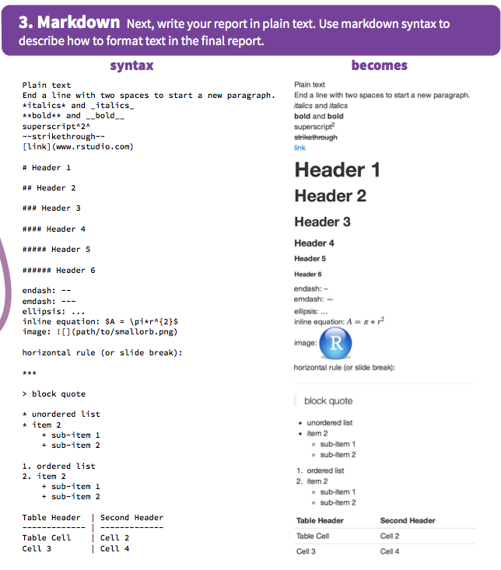
What is markdown?
RStudio RMarkdown cheat sheet
Simple, readable, intuitive, light-weight markup Convert to HTML
Raw HTML can be interspersed to add functionality
Various extensions and flaours of markdown
Popular on websites: e.g., StackOverflow, GitHub, Reddit
see also: http://daringfireball.net/projects/markdown/

Slide 7
knitr, Rmarkdown, RStudio
knitr
R Package developed by Yihui Xie for weaving R (and other languages) with various markup languages including markdown
RMarkdown
A file format that combines R code chunks and markdown text which is converted by knitr into markdown, and other formats (e.g., HTML, pdf, etc.).
RStudio
RStudio facilitates the application of knitr to RMarkdown to produce HTML, pdfs, and so on
Syntax highlighting; Easy to run and create code chunks; Single button to convert RMarkdown to complete documents; useful debugging information
pandoc
General purpose tool used convert between document formats; included in Rstudio
LaTeX
If you want to be able to convert to PDF, you may need a LaTeX installation
http://latex-project.org/ftp.html

Slide 8
RMarkdown
Refer to the excellent RStudio RMarkdown Cheat Sheet
General workflow
Create an RMarkdown File
either use Rstudio File – New File – RMarkdown or just create a file with an empty text file with the .rmd extension
Optionally add a header
Options to specify output format (see RMarkdown cheat sheet)
Write the main document in Markdown
Embed R code chunks
R code chunks can be customised to control output

Slide 9
Example: 1-rmarkdown-example
Open "project-examples/1-rmarkdown-example/rmarkdown-example.Rproj"
Then in RStudio, open "project-examples/1-rmarkdown-example/01-multiple-regression.rmd"
General points and RMarkdown
It is a good strategy to put library, options, data importing and data processing at the start of the RMarkdown file.
Or as we'll see later, have a single command like in ProjectTemplate that sets up your project at the start (library, options, data importing, data processing, loading scripts, etc.) of your RMarkdown document.
RMarkdown can be a nice way to organise analysis code even if you have no interest in compiling documents.
It's easy to organise code into blocks.
It's easy to run code in blocks
You can intersperse commentary

Slide 10
Exercise 1
Create a new folder on your computer
Create a new RMarkdown document in RStudio and save to folder
e.g., In RStudio o to "File – New – Rmarkdown"
Type a little text after the header using some headings, dot points, and any other markdown syntax you wish.
Create a first code chunk; put the following code inside; run the code chunk
library(MASS) data(survey)
Add a second code chunk where you add some summary information about the survey dataset: e.g.,
summary(survey) head(survey)
Compile the document by clicking the "Knit" button
Add a third chunk that includes some figures (e.g., a scatterplot of height and pulse)
Compile the document by clicking the "Knit" button

Slide 11
Example: 2-latex-sweave-example
This example provides an illustration of LaTeX and Sweave
LaTeX is a document markup system designed for making beautiful scientific documents
Pros
The typesetting is beautiful
It is excellent for mathematics
It handles complex documents well (e.g., PhD thesis; Scientific books): Table of contents, cross-references, references,
Cons
If your collaborators and the people who consume your documents (e.g., journal editors, clients, etc.) expect a different system, then you may have an unpleasant time.
While it does a lot of things automatically, customising can be difficult, and there is a learning curve (a bit like R)

Slide 12
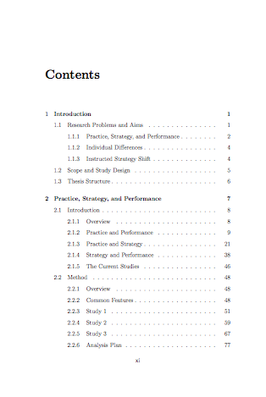
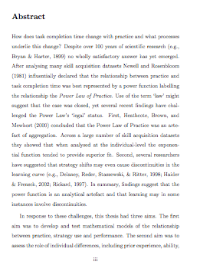
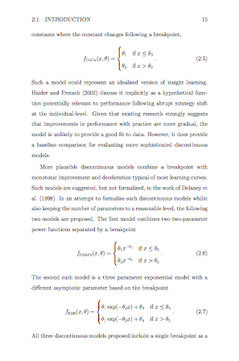
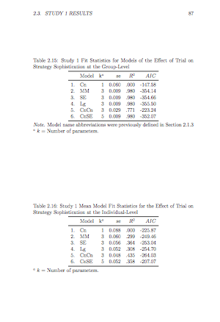
Example pages of PDF of LaTeX Document

Slide 13
Sweave and LaTeX
Both Sweave and knitr are systems that can combine LaTeX and R code chunks
The notation for indicating R code chunks is slightly different to RMarkdown but the concepts are the same.
The main difference is the actual LaTeX.
Note that you don't have to use Sweave to combine R and LaTeX. You can export your images and your LaTeX tables and then manually incorporate them yourself.

Slide 14
ProjectTemplate
http://projecttemplate.net/
Why use ProjectTemplate
Systematic place to store configuration and package loading settings
Automatically load r-script files
Automatically load data files stored in data directory
Automate running initial data manipulation code
Installation
install.project("ProjectTemplate", dep = TRUE)

Slide 15
Standard Process for Creating a ProjectTemplate Project
Create the folder structure
library('ProjectTemplate') create.project('myproject')
Review config/global.dcf
Choose settings
Specify packages to load
Add data for auto-loading to data directory
Add any additional R support functions to the lib directory
Load the project
library('ProjectTemplate') load.project()
Write any initial data manipulation code and place in the munge directory
Create data analysis files (e.g., r-scripts, RMarkdown, Sweave Files) in home or reports directory
Include the load project commands above at the top of each such file

Slide 16
Customise your own version of ProjectTemplate
Once you start using ProjectTemplate, you find that there are many customisations that you always make to a new project
libraries that you always use
settings that you prefer over the defaults (e.g., as_factors: FALSE)
particular ways that you generate analysis scripts
Integration with RStudio project structure
Save this customised version to a special folder on your computer
To create a new project
Make a copy of your customised folder structure
Rename the project
You only need to complete the project specific customisations
Over time you may recognise features that you want to add to your customised project

Slide 17
My Customised ProjectTemplate
Basic description
http://jeromyanglim.blogspot.com.au/2014/05/customising-projecttemplate-in-r.html
Overview of files
https://github.com/jeromyanglim/AnglimModifiedProjectTemplate
Zip file of Template
https://github.com/jeromyanglim/AnglimModifiedProjectTemplate/archive/master.zip

Slide 18
Customised ProjectTemplate Workflow
Setup ProjectTemplate Folder Structure
Download the zip file (I have it bookmarked) and unzip it
https://github.com/jeromyanglim/AnglimModifiedProjectTemplate/archive/master.zip
Rename the folder and the RStudio Project file
Data
Ensure that raw data is roughly in the right format
Place data files in data folder with the names you want the data.frames to have in R (e.g., mydata.csv becomes mydata in R)
Additional script files
Functions that get created during the project or functions that need to be imported get put in .r script files in the lib folder (e.g., "myfuntions.r")
Data manipulation
Before analysing data, it is usually necessary to clean the data, create new variables, merge data, and so on.
This all goes in scripts in the munge folder.
Run library("ProjectTemplate"); load.project() to load the data and then write any data manipulation code.

Slide 19
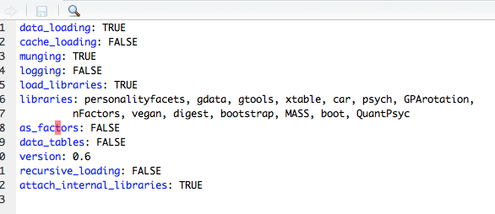
Configuration
Configuration settings are stored in config/global.dcf
data_loading, munging, load_libraries: indicate which aspects of ProjectTemplate should run
libraries: Specify which packages you want to use
as_factors: Specifies whether by default strings should be imported as factors

Slide 20
Customised ProjectTemplate Workflow
Analyses
Store analyses (i.e., code to generate summary statistics, models, tables, figures, etc.) in Rmarkdown files
You need a code chunk before any analysis that loads the project with the following code
library("ProjectTemplate"); load.project()
It can be useful to have multiple RMarkdown files: e.g., for exploratory analyses, final analyses and so on.
If you store your RMarkdown files in a subfolder, you also need to include the following in the first code chunk: library(knitr) opts_knit$set(root.dir = normalizePath('../'))
Alternatively, just put file in the working directory

Slide 21
Running ProjectTemplate
What happens when you run library("ProjectTemplate"); load.project()
Configuration file is loaded
Options are set
Scripts in the lib file are loaded
Packages specified in the configuration file are loaded
Data in the data folder is loaded into R
Data manipulations specified in the munge folder are run
The benefits
Thus, after running a single command you are now ready to analyse your data, or perform new analyses.

Slide 22
Manual integration with MS Word
Results Text
Keep the code that generates the relevant script (".r", ".rmd", etc.)
Run the code and read off the values
or export the output using one of several options:
Running a knitr document so that input and output is displayed
Running the script in batch mode from the command-line: R CMD BATCH yourfile.r
Tables
Prepare content of table in R as a data.frame
Save as a csv file write.csv(mytable, file="output/mytable.csv")
Double click csv file to open in Excel and copy contents into a data processing Excel file
Use Excel to add lines, adjust alignment, etc.
Paste formatted table into MS Word
Figures
Export figures to a folder pdf(file="output/filename.pdf") plot code here dev.off()
Drag and drop image file into relevant place in Word document

Slide 23
Example: 3-simple-project-template-example
Example shows
unzip customised project template
rename folder and files
add data file to "data" folder
add script to "lib" folder
show example of data manipulations in the "munge" folder
show example of analysis in the rmd file

Slide 24
Exercise 2: Project Template
Go to "exercise-project-template/raw-materials" unzip the Customised version of ProjectTemplate
Give the folder and the rstudio project file an appropriate name
Put cas.sav into the data folder (California Schools Data)
Open the Rstudio project file in RStudio
Open "reports/explore.rmd" and run library(ProjectTemplate); load.project()
Add a few basic analyses of cas to the next R code chunk
Go to "munge/01-munge.R" and add a new variable to cas (e.g., create a variable called performance which is the sum of cas$math and cas$english
Return to "reports/explore.rmd" and add another code chunk. Create a histogram of cas$performance.
Now imagine that you are exiting RStudio and then returning again. i.e., Quit RStudio and then reload the Rstudio Project file
Open "reports/explore.rmd" and run library(ProjectTemplate); load.project()
You should see that your histogram code for cas$performance still runs

Slide 25
Example: 4-complex-project-template-example
Example of analyses for a journal article performed using ProjectTemplate
Things to note
Metadata
It can be useful to import metadata (e.g., how to score tests, variable labels, etc.)
Variable lists
I often refer to large variable sets in analyses. Thus, storing these variable sets in a list can make it easier to refer to them.
Exporting tables, figures, plain text
I use RMarkdown as a way of organising analyses where specific results are exported for inclusion in another document.

Slide 26
Thank you for coming...

