Slide 1
I 320D · DATA SCIENCE FOR BIOMEDICAL INFORMATICS · SPRING 2026
Gene Expression Time Series During Immune Response
Temporal clustering of host transcriptomes during H3N2 influenza challenge
"Co-clustering implies co-regulation (usually)."
Project 14 · The University of Texas at Austin · School of Information

Slide 2
Why measure gene expression over time?
Influenza infection unfolds as a temporal wave of gene activation
THE BIOLOGY
OUR GOAL
When the immune system encounters a pathogen, thousands of genes are dynamically up- and down-regulated over hours to days.
Some respond within hours (innate antiviral defense). Others take days (adaptive immunity, B-cell expansion).
RNA-sequencing captures this entire transcriptomic landscape — but only if we sample frequently enough.
Cluster genes by their temporal expression profile to find groups that turn on and off together.
Then ask: which biological pathways do those clusters represent? And do symptomatic patients differ from asymptomatic ones?
Why it matters: vaccine design, antiviral drug development, sepsis biology — all depend on understanding these temporal programs.
I 320D · Project 14 · Gene Expression Time Series
2

Slide 3
Two datasets, one challenge
H3N2 influenza inoculation in healthy adults
17
15
11,886
ANALYSIS PIPELINE
1
Load & map probe IDs → gene symbols (mygene)
subjects
timepoints
genes
2
Variance filter → top 500 most dynamic genes
Hours 0 → 108
after symbol mapping
3
Z-score normalize per gene across samples
141 symptomatic samples 127 asymptomatic samples
4
Hierarchical clustering with correlation distance
5
GO/KEGG enrichment (g:Profiler) + GSEA
6
Symptomatic vs. asymptomatic comparison
I 320D · Project 14 · Gene Expression Time Series
3

Slide 4
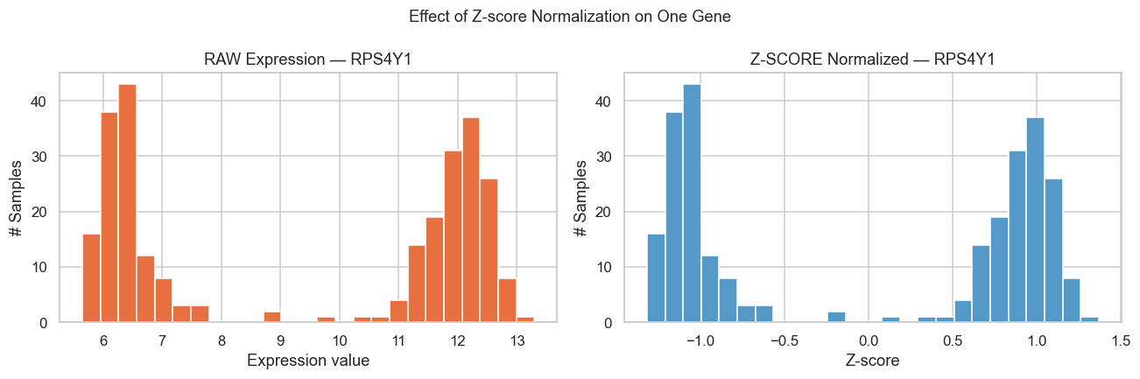
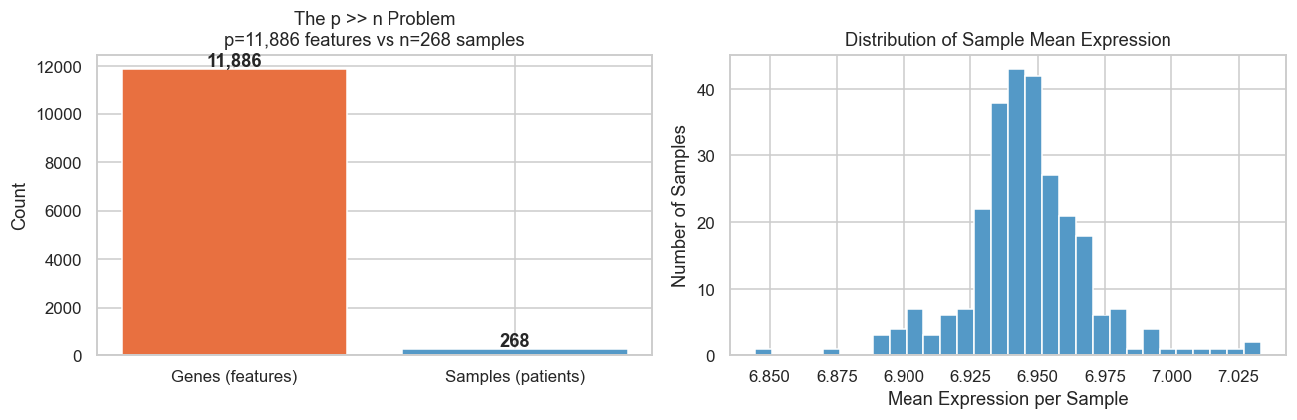
Taming the curse of dimensionality
From 11,886 noisy genes to 500 informative ones
THE p >> n PROBLEM
Effect of Z-score normalization
11,886 genes vs. 268 samples = 44:1 ratio
In high dimensions, every pair of points has a similar distance — clusters become statistically indistinguishable from random partitions.
OUR FIX: TWO-STEP REDUCTION
1. Variance filter: Keep only the top 500 most variable genes — the ones that actually change during the time course.
2. Z-score normalization: Center each gene at mean=0, std=1, so a gene at 10,000 units doesn't drown out one at 10.
Distribution of features vs samples
I 320D · Project 14 · Gene Expression Time Series
4

Slide 5
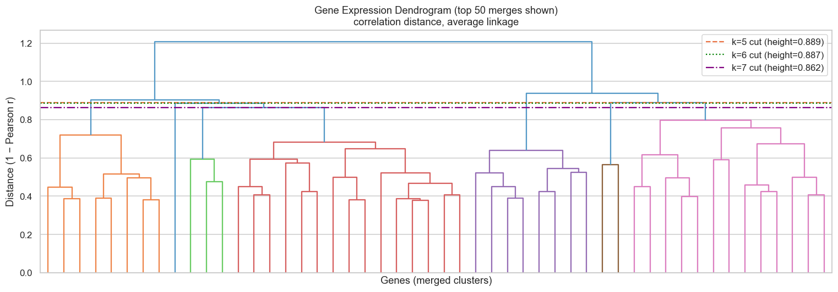
Hierarchical clustering of gene trajectories
Correlation distance + average linkage, cut at k = 5
WHY CORRELATION DISTANCE?
1 − Pearson r between gene trajectories.
Groups genes by shape of their time course, ignoring absolute expression levels — exactly what "co-regulated" means.
CLUSTER SIZES (k = 5)
Cluster 1
115 genes
mean r = 0.59
Cluster 2
258 genes
mean r = 0.51
Cluster 3
37 genes
mean r = 0.55
HOW TO READ
Y-axis = correlation distance. Long vertical lines = big differences forced to merge.
Cut at the longest gap → 5 natural temporal modules.
Cluster 4 (2 genes) is an outlier and excluded from enrichment.
Cluster 4
2 genes
mean r = 0.43
Cluster 5
88 genes
mean r = 0.38
I 320D · Project 14 · Gene Expression Time Series
5

Slide 6
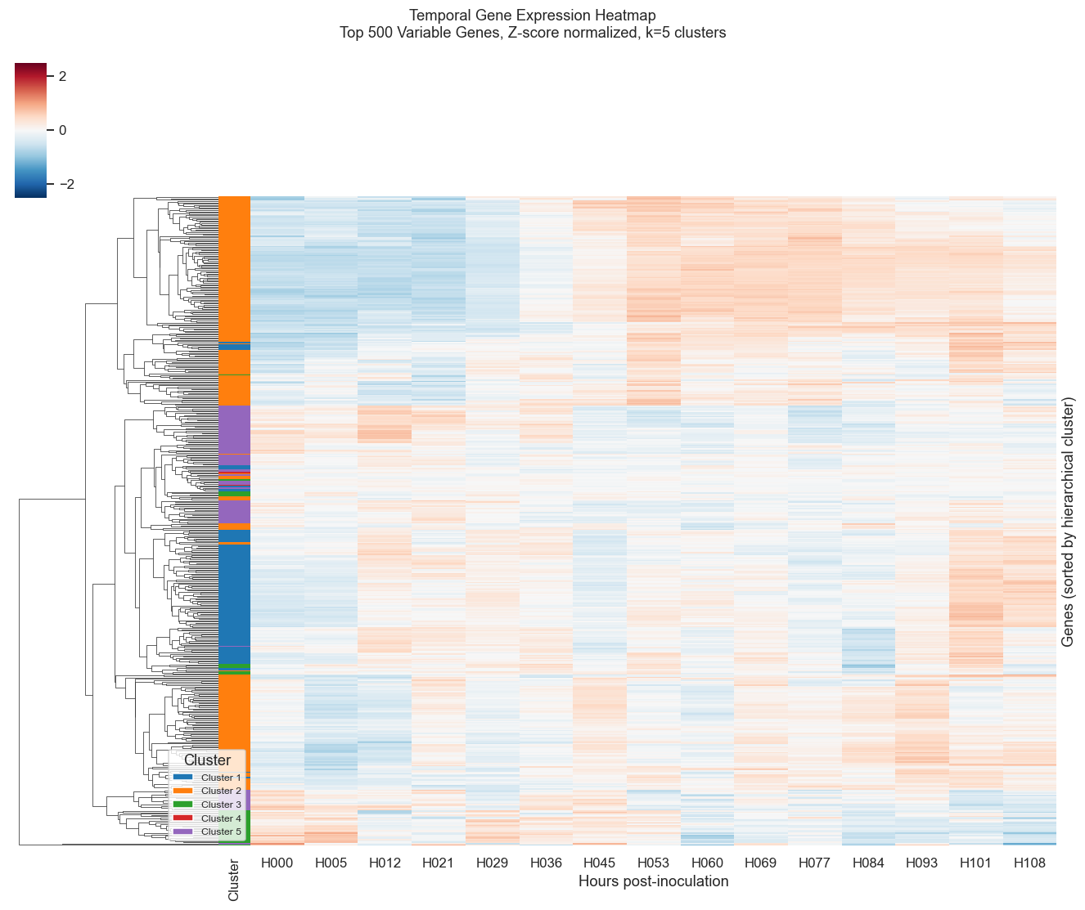
Five temporal modules emerge
Genes sorted by cluster · 15 timepoints · Z-score color scale
WHAT YOU'RE SEEING
Red = expression above this gene's average. Blue = below average.
Time flows left to right (Hour 0 → 108).
The colored sidebar marks each gene's cluster assignment.
KEY OBSERVATIONS
Distinct vertical bands = synchronized waves of activity.
Some clusters peak early (Hr 12–36), others late (Hr 60+).
Anti-correlated bands (red-where-blue) suggest reciprocal regulation.
Pattern would be invisible without prior variance filtering & normalization.
I 320D · Project 14 · Gene Expression Time Series
6

Slide 7
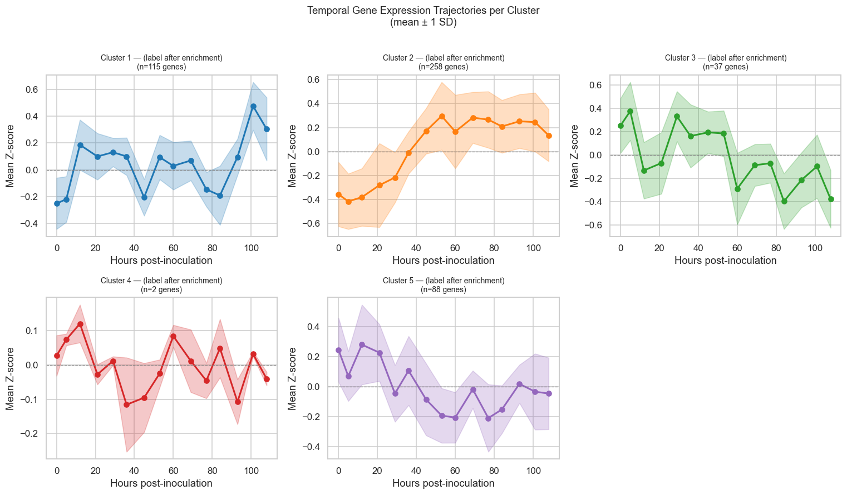
Each cluster has a distinct temporal signature
Mean Z-score ± 1 SD per cluster across the time course
TENTATIVE LABELS
(based on Step 6 enrichment)
Cluster 1
Metabolism / Energy
115 genes
Cluster 2
Antiviral Defense
258 genes
Cluster 3
Cytokine Signaling
37 genes
Cluster 5
Adaptive Immunity
88 genes
I 320D · Project 14 · Gene Expression Time Series
7

Slide 8
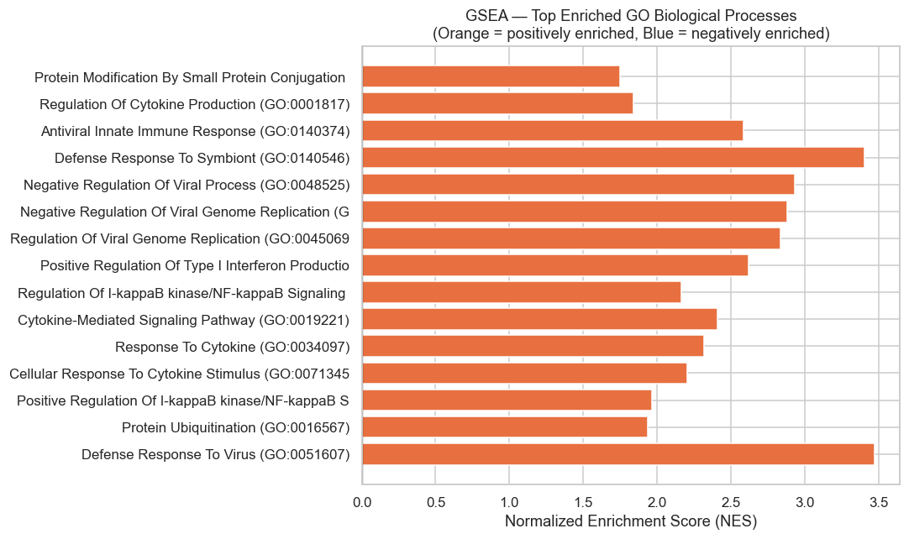
The biology checks out: antiviral defense dominates
Fisher's exact test (g:Profiler) + GSEA pre-ranked
TOP GO BIOLOGICAL PROCESSES BY CLUSTER
CLUSTER 2 · 258 genes · Antiviral Defense
▸ defense response
▸ response to other organism
▸ defense response to virus
CLUSTER 5 · 88 genes · Adaptive Immunity
▸ immune response
▸ adaptive immune response
▸ leukocyte mediated immunity
GSEA: top hit "Defense Response To Virus" — NES = 3.47
CLUSTER 1 · 115 genes · Metabolic / Energy
▸ oxidative phosphorylation
▸ aerobic respiration
▸ cellular respiration
I 320D · Project 14 · Gene Expression Time Series
8

Slide 9
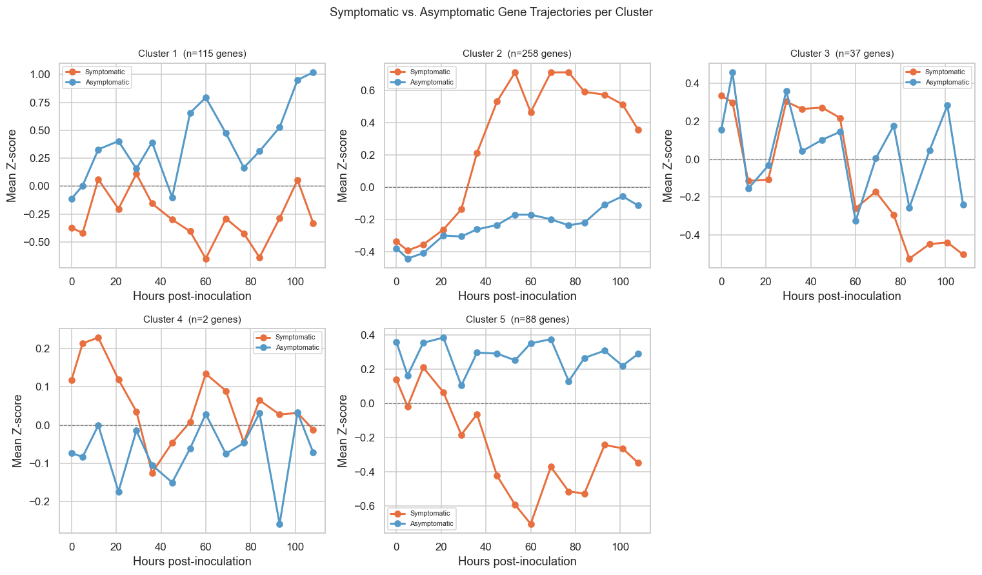
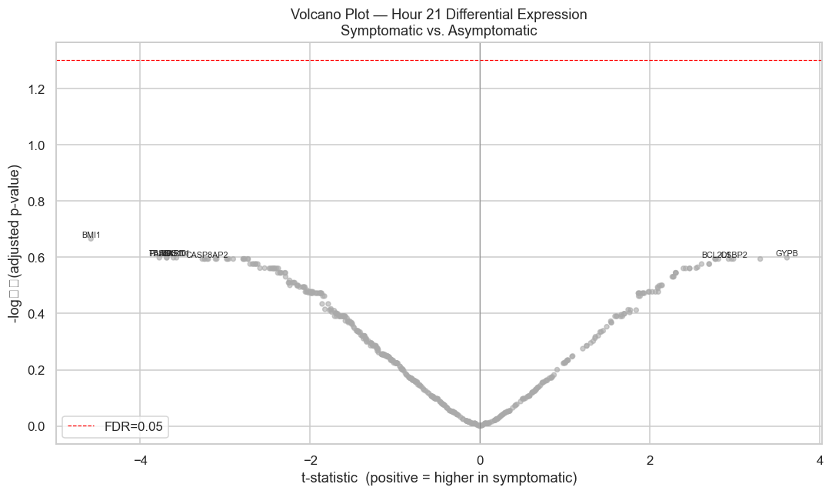
Can we predict who gets sick from the first 24 hours?
Hour-21 differential expression: signal exists but is underpowered
Volcano plot at Hour 21 (n = 8 vs 8)
Symptomatic (orange) vs. asymptomatic (blue) per cluster
0
genes pass FDR < 0.05
with n = 8 vs 8 across 500 tests
11 / 20
top candidates in Cluster 1
(metabolism / energy module)
BMI1, GYPB, PASK
top 3 candidate genes by raw p-value
trend exists; needs larger cohort to confirm
I 320D · Project 14 · Gene Expression Time Series
9

Slide 10
CONCLUSIONS
Five temporal programs of immune response, with caveats
Co-expression captures real biology
1
Five clusters partition gene space into interpretable modules: antiviral defense (258 genes), adaptive immunity, metabolism, and cytokine signaling. GSEA confirms with NES = 3.47 for "Defense Response To Virus."
Method choice matters at every step
2
Probe IDs needed mapping to symbols. Variance filtering rescued the analysis from p≫n. Correlation distance + average linkage gave biologically coherent clusters. Skipping any step would silently corrupt the result.
Clinical signature: signal present, power lacking
3
0 genes pass FDR at Hour 21, but candidates concentrate in Cluster 1 (metabolism). Consistent with a real but subtle effect requiring more subjects. Future work: a priori candidate restriction + multivariate models on the full trajectory.
Thank you · Questions?

