Slide 1
Template For Reference Only
Group X: Team Name
Name 1, Name 2, Name3
June X, 2026

Slide 2
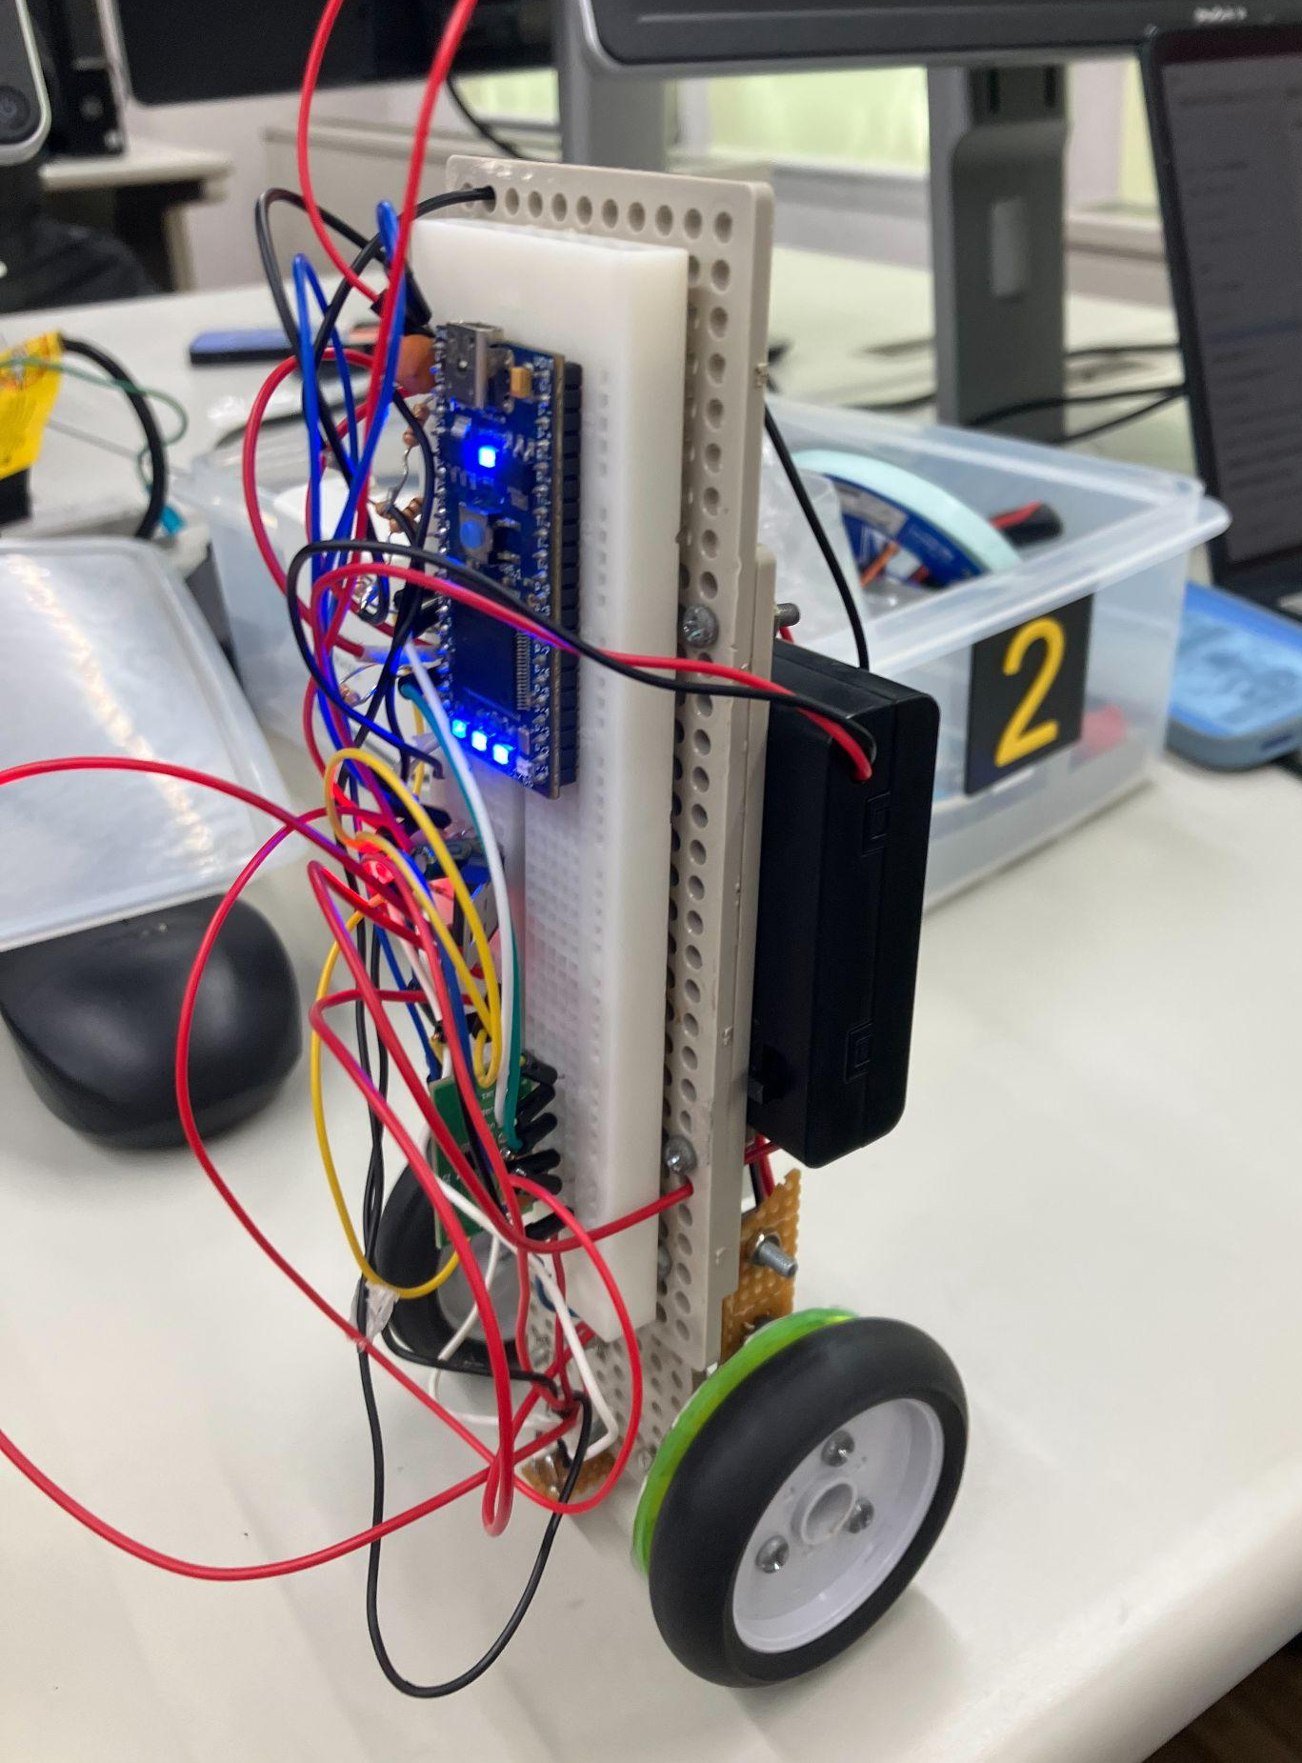
1. Introduction
For Reference Only
Objectives
Xxxx
Xxxx
Week 1
Challenge: xxx
Result: xxx
Week xxx
xxxx
Final Results
Completed xxx
xxxx
Additional videos, images, or charts
Additional videos, images, or charts
Additional videos, images, or charts

Slide 3
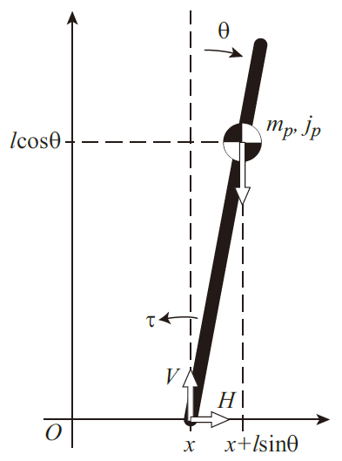
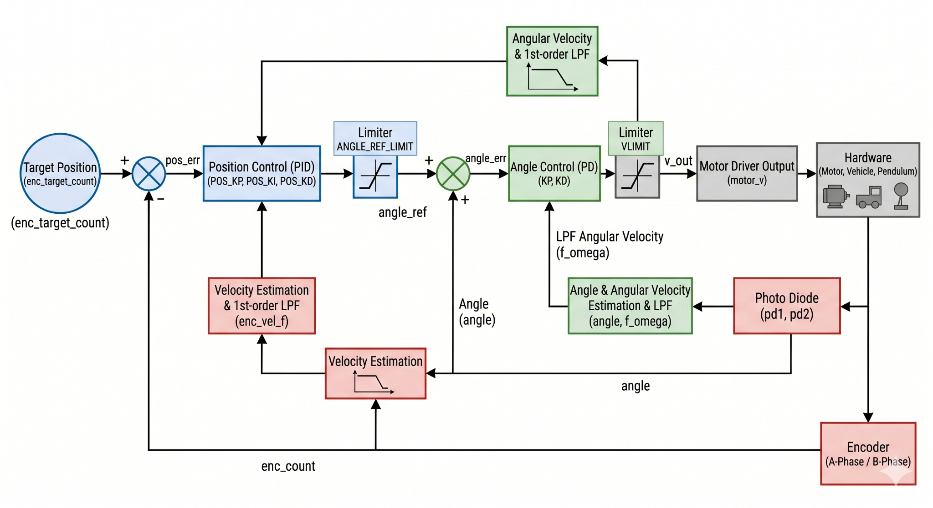
2. Method
For Reference Only
Modeling
Xxxx
xxxx
Control designing
Angle feedback. :
Xxx
Xxx
Position feedback
Implementation
Control frequency: xxx
Debugging method:
Xxxxx
xxx
xxxxx
Additional videos, images, or charts
For Reference Only

Slide 4
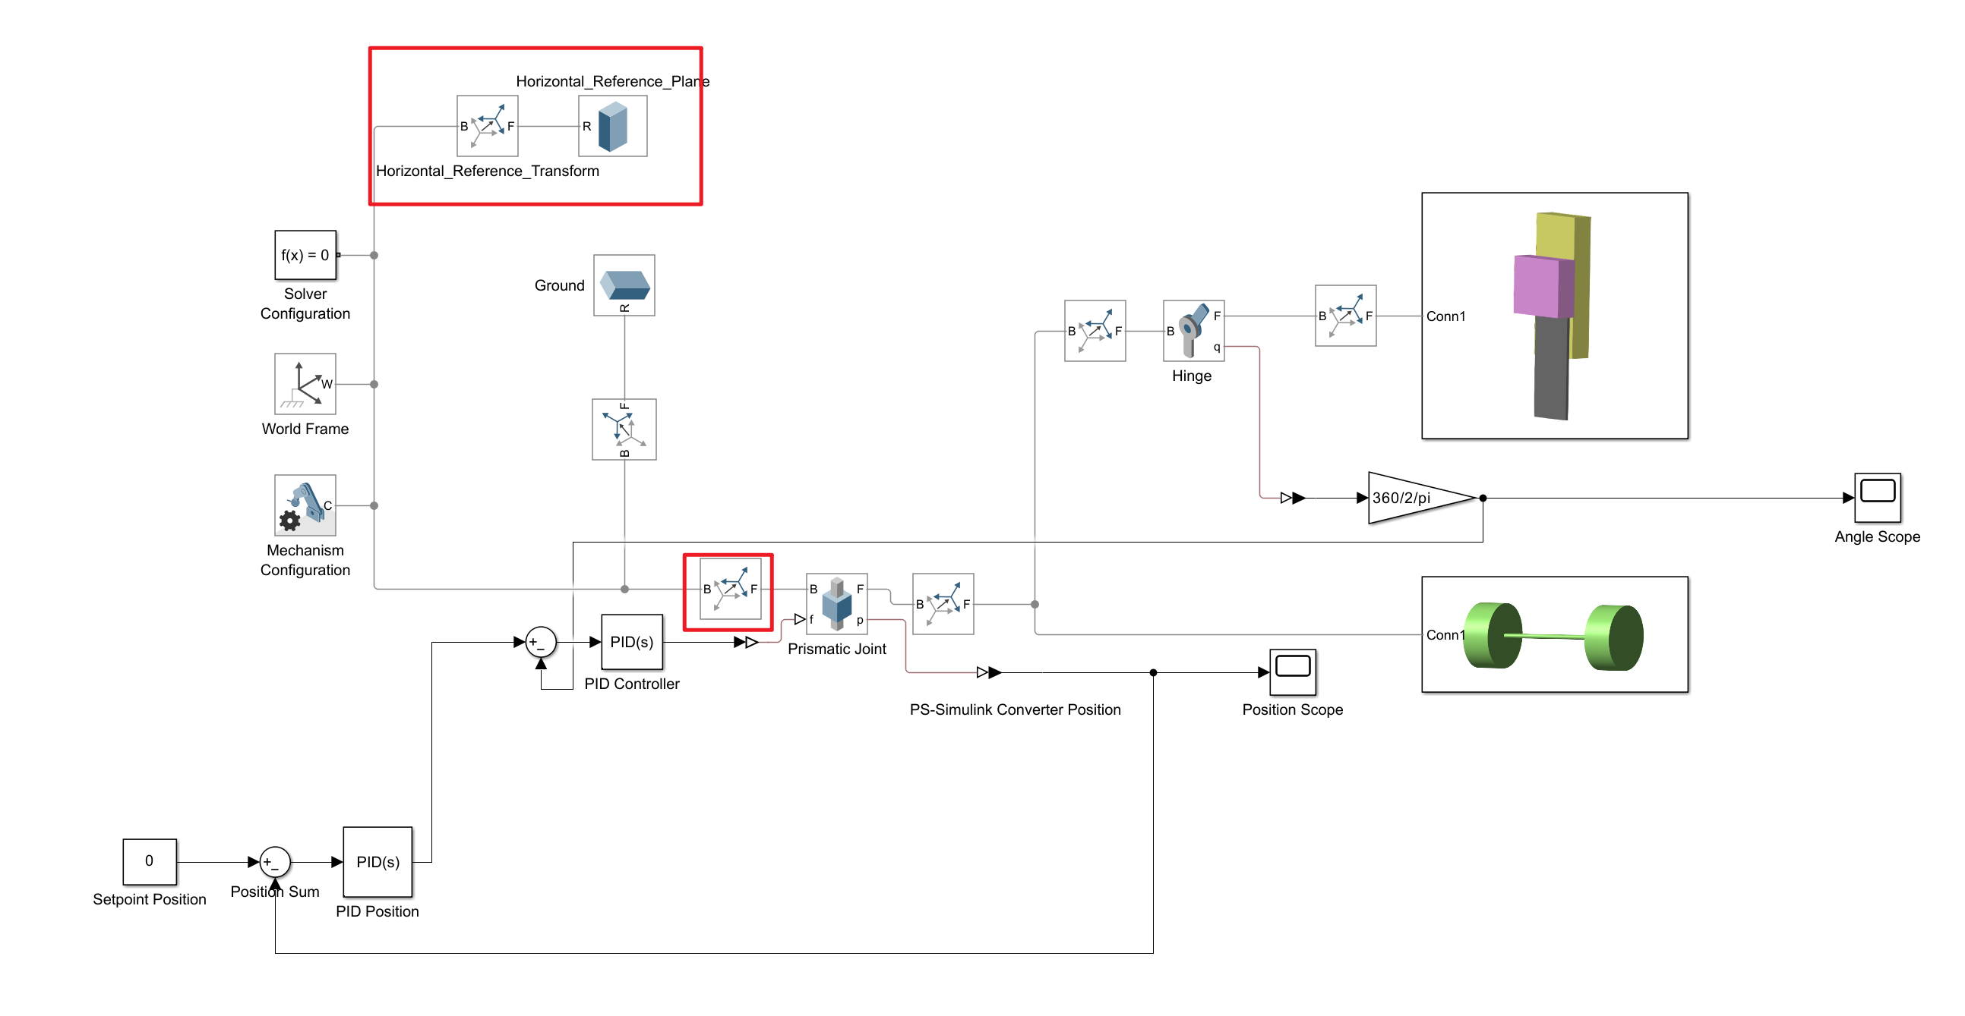
3. Experiment
For Reference Only
Assembly
Serial Connection to PC
Angle Feedback, Tune Kp
Simulation xxxxx
Xxxx
xxxx

Slide 5

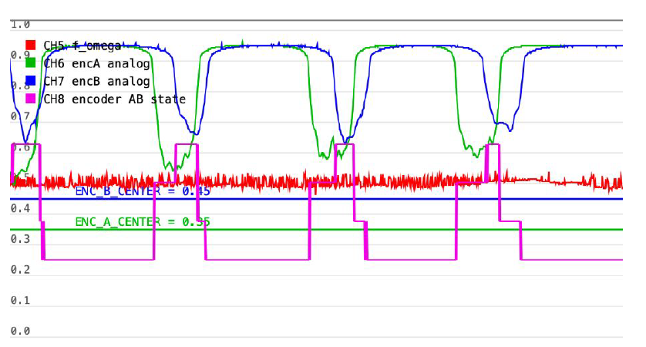
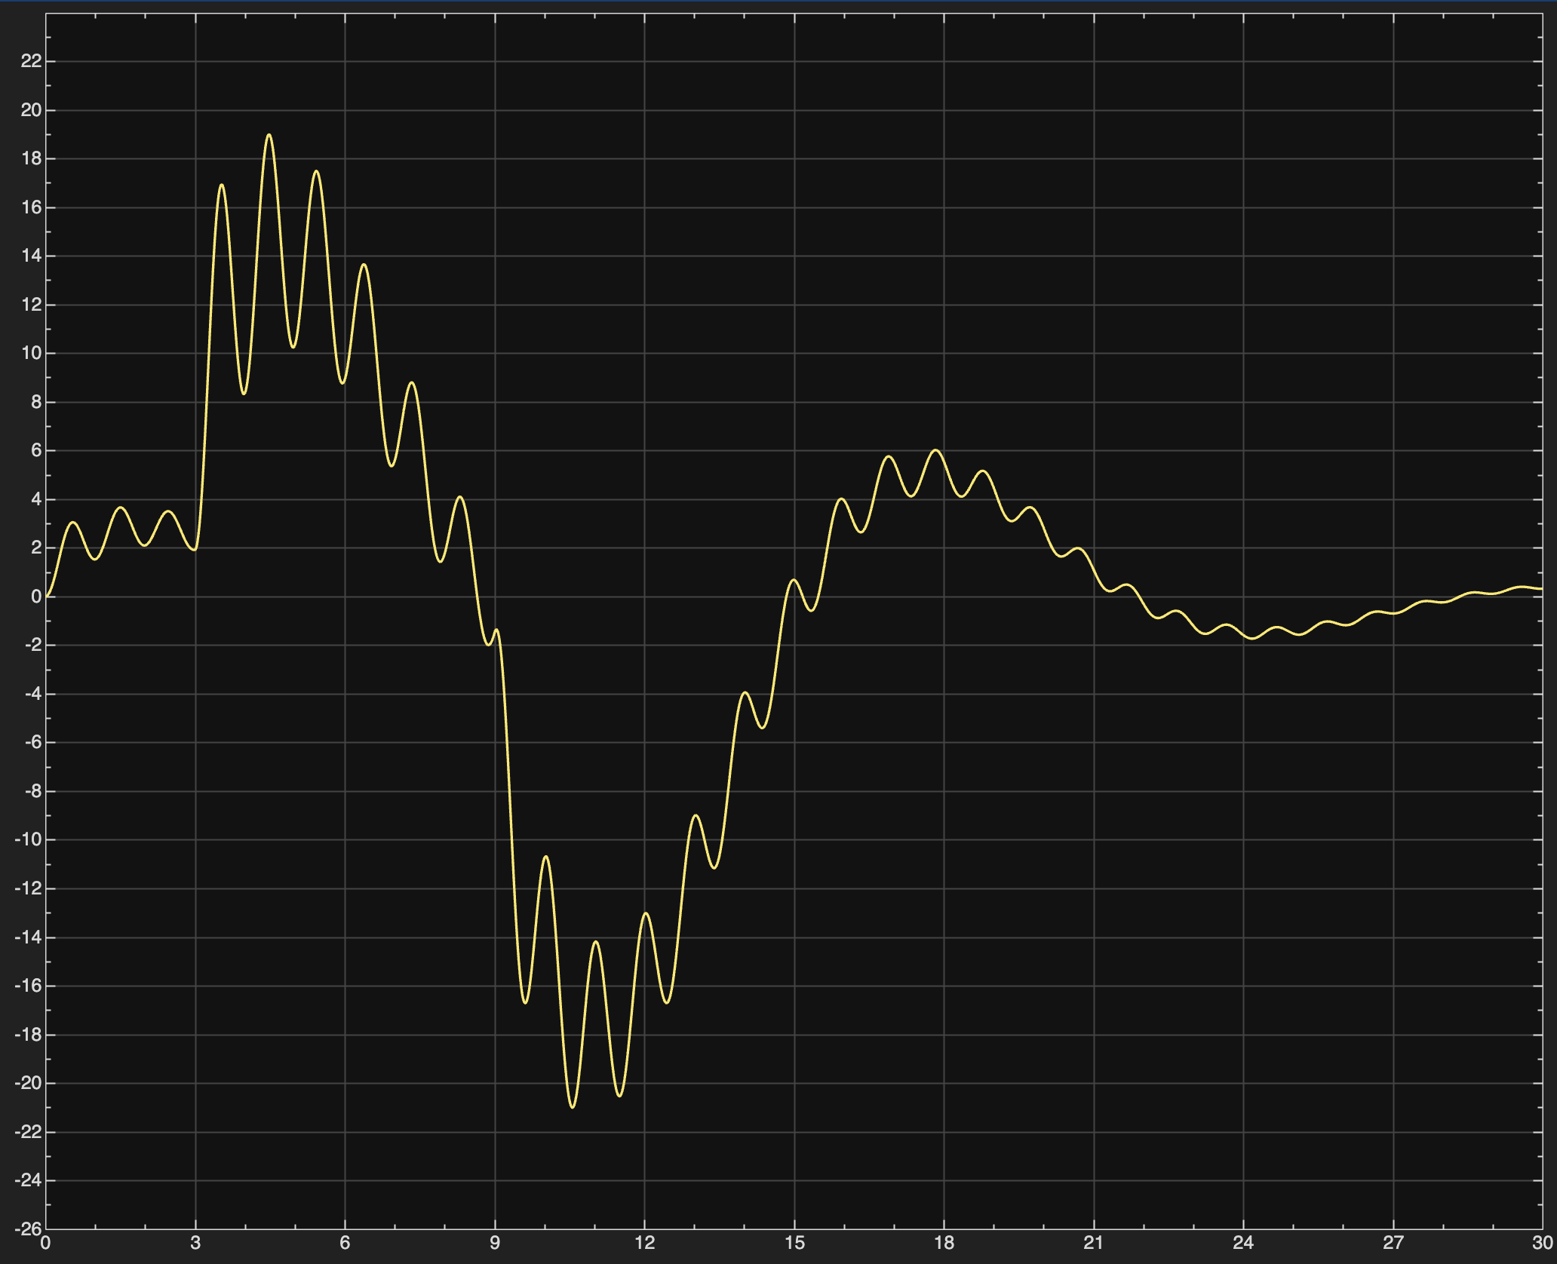
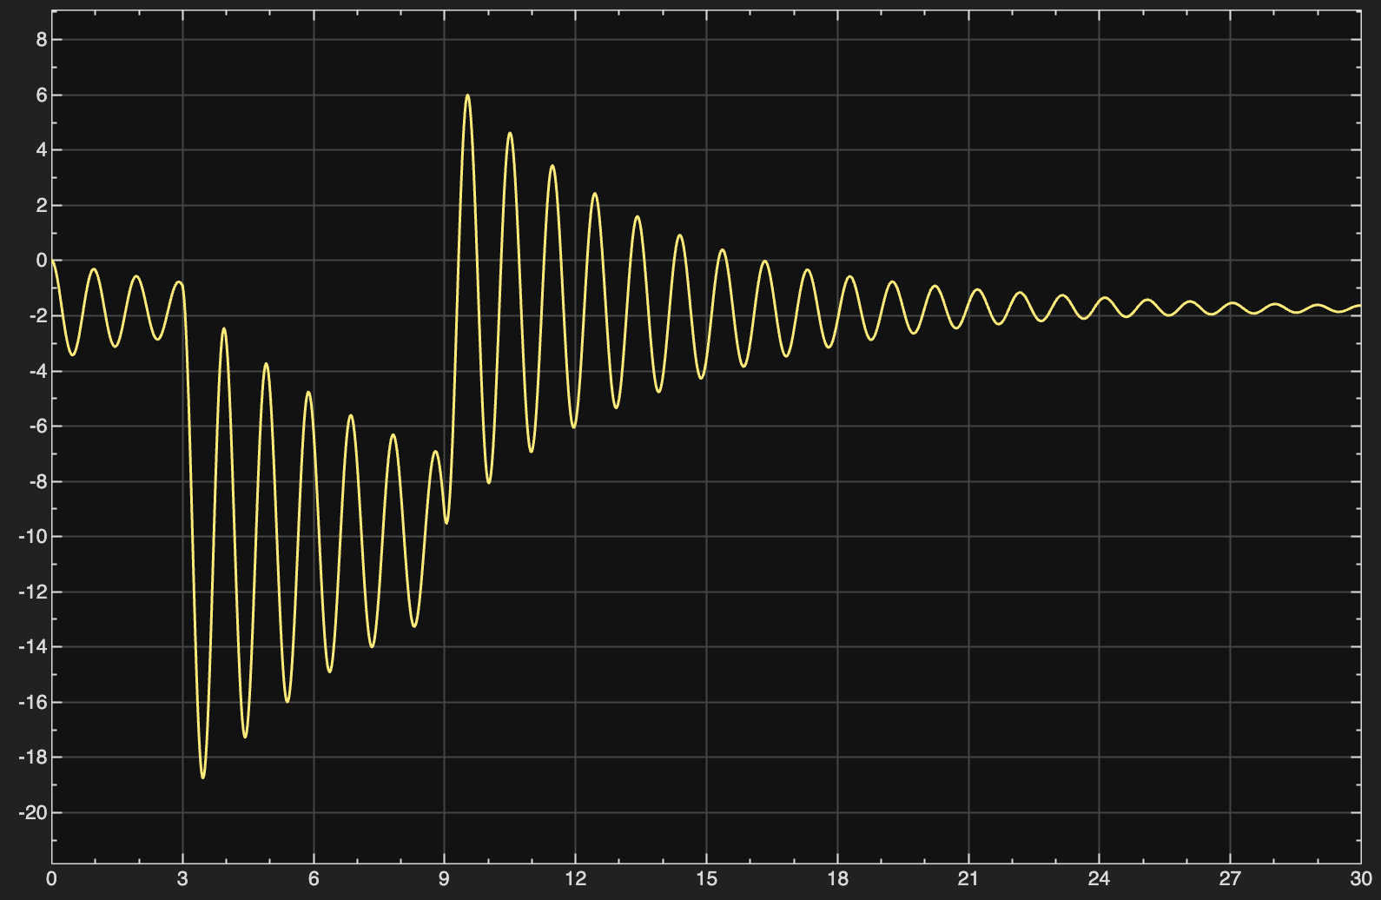

4. Data
For Reference Only
For Reference Only
Please remember to add axis titles.
Please remember to add axis titles.
For Reference Only
XXXXX
Standing Time
Error
Max Slope: xxx
xxxx
Additional videos, images, or charts

Slide 6
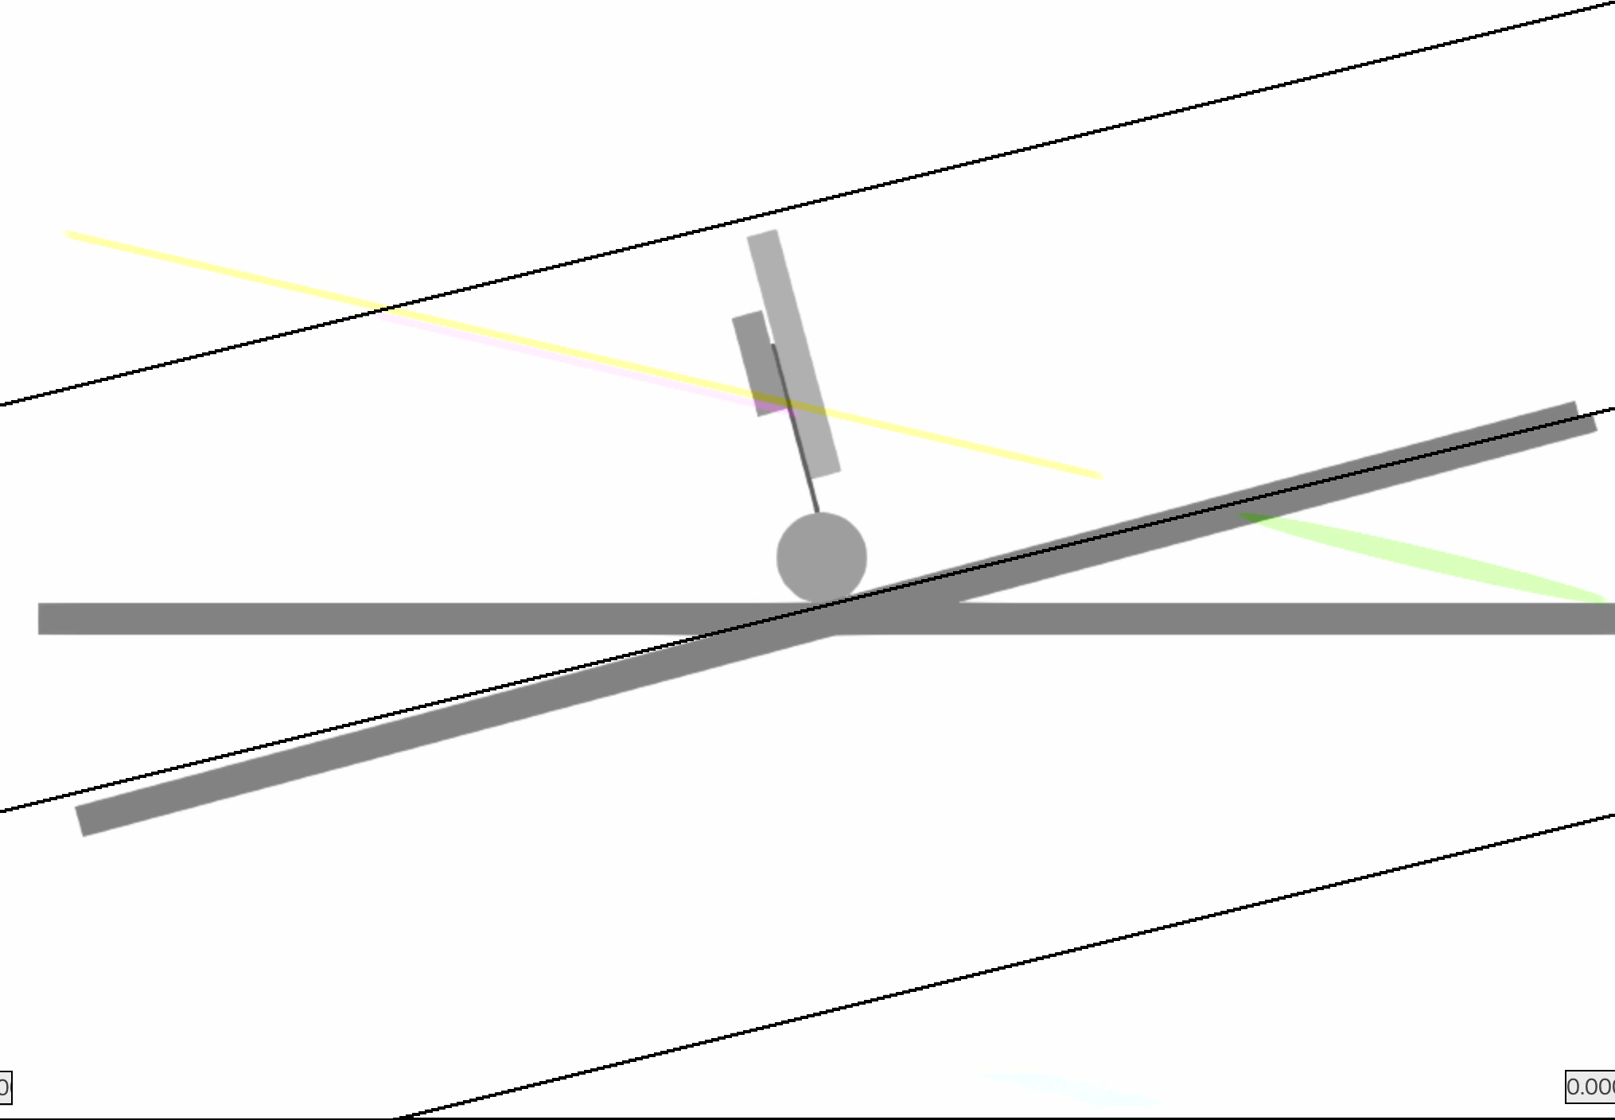
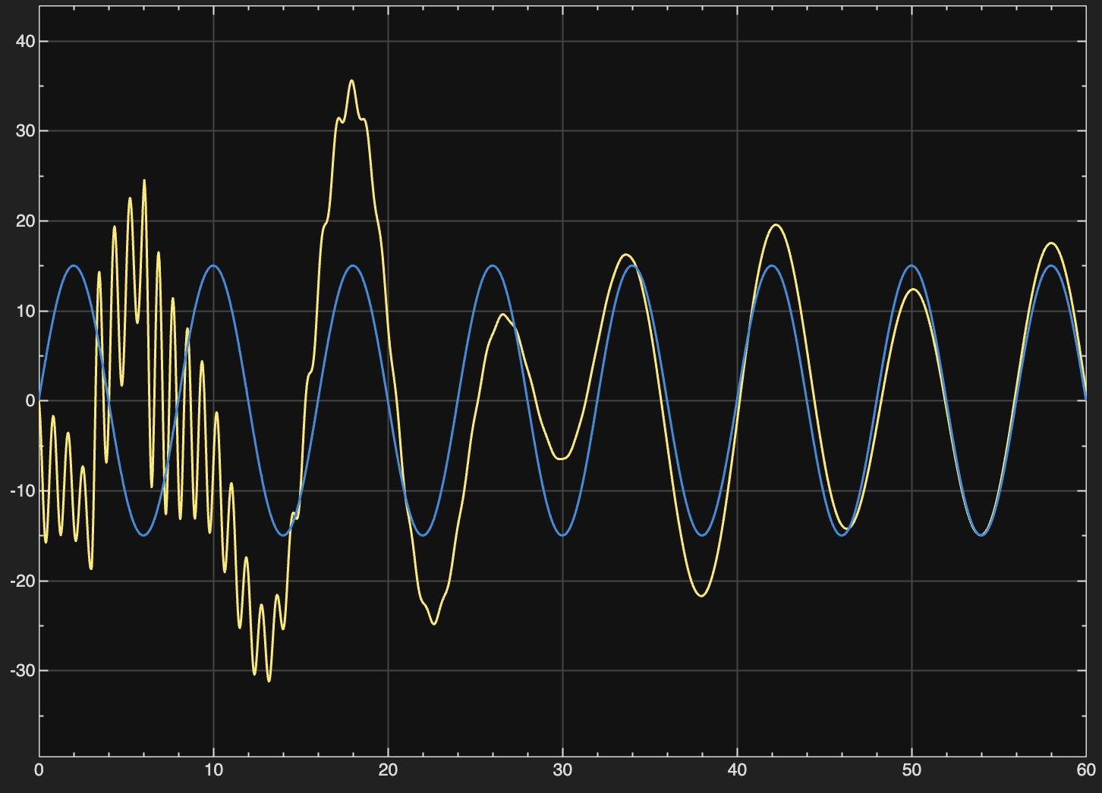
5. Extended Experiment
For Reference Only
Extended 1: Slop Simulation
Xxxx
xxxx
Target
machine
pulse
Please remember to add axis titles.
Extended 2: LQR Controller
Xxxx
xxxx
Additional videos, images, or charts

Slide 7
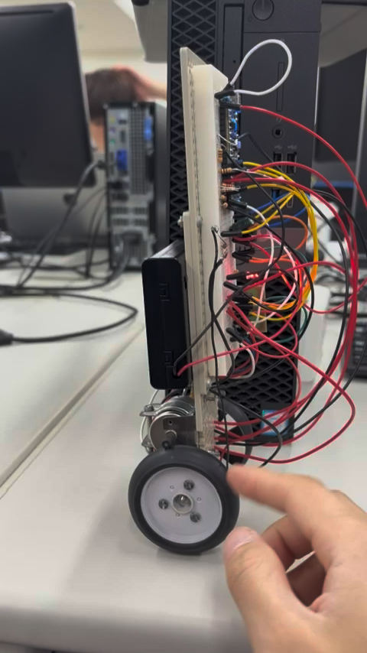
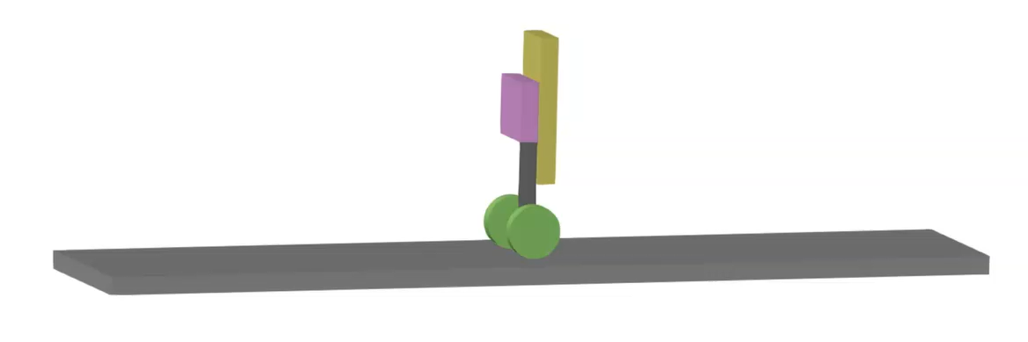
6. Results & Future Work
For Reference Only
XXXXXXXXXXXX
Xxxx
xxxx

Slide 8
7. What We Learned
For Reference Only
XXXXX
Xxxx
xxxx
Photo

Slide 9



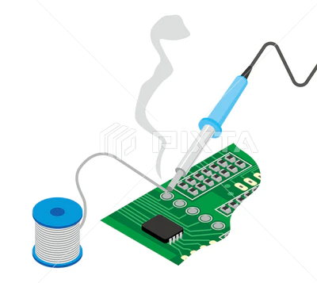
8. Teamwork & Roles
For Reference Only
Photo 1
Photo 2
Photo 3
[Name]
[Name]
[Name]
Hardware XXXX
XXXX
XXXX
Week 1: XXX
Week 2: XXX
Week 3: XXX
Photo

Slide 10
Photo

