Slide 1
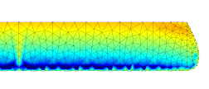
c0
c1
c2
c3
c4
c5
2
2
2
2
2
wing root
wing tip

