Slide 1
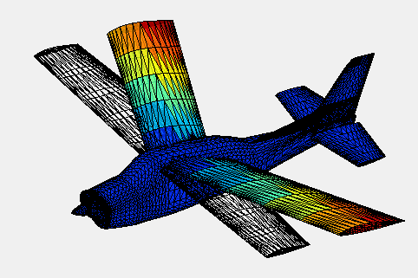
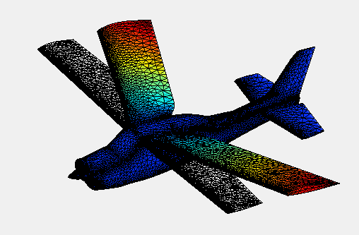
3D(x-y-z) Interpolation
Using Delaunay Triangulation

