Slide 1
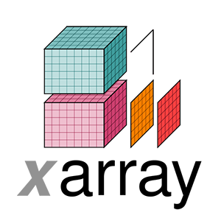

Slide 2
Resources
homepage http://xarray.pydata.org/
Stefan Hoyer’s SciPy talk https://www.youtube.com/watch?v=X0pAhJgySxk
EGU 2017 tutorial https://pure.iiasa.ac.at/id/eprint/14952/1/xarray-tutorial-egu2017-answers.pdf
Ryan Abernathey’s tutorial https://rabernat.github.io/research_computing/xarray.html

Slide 3
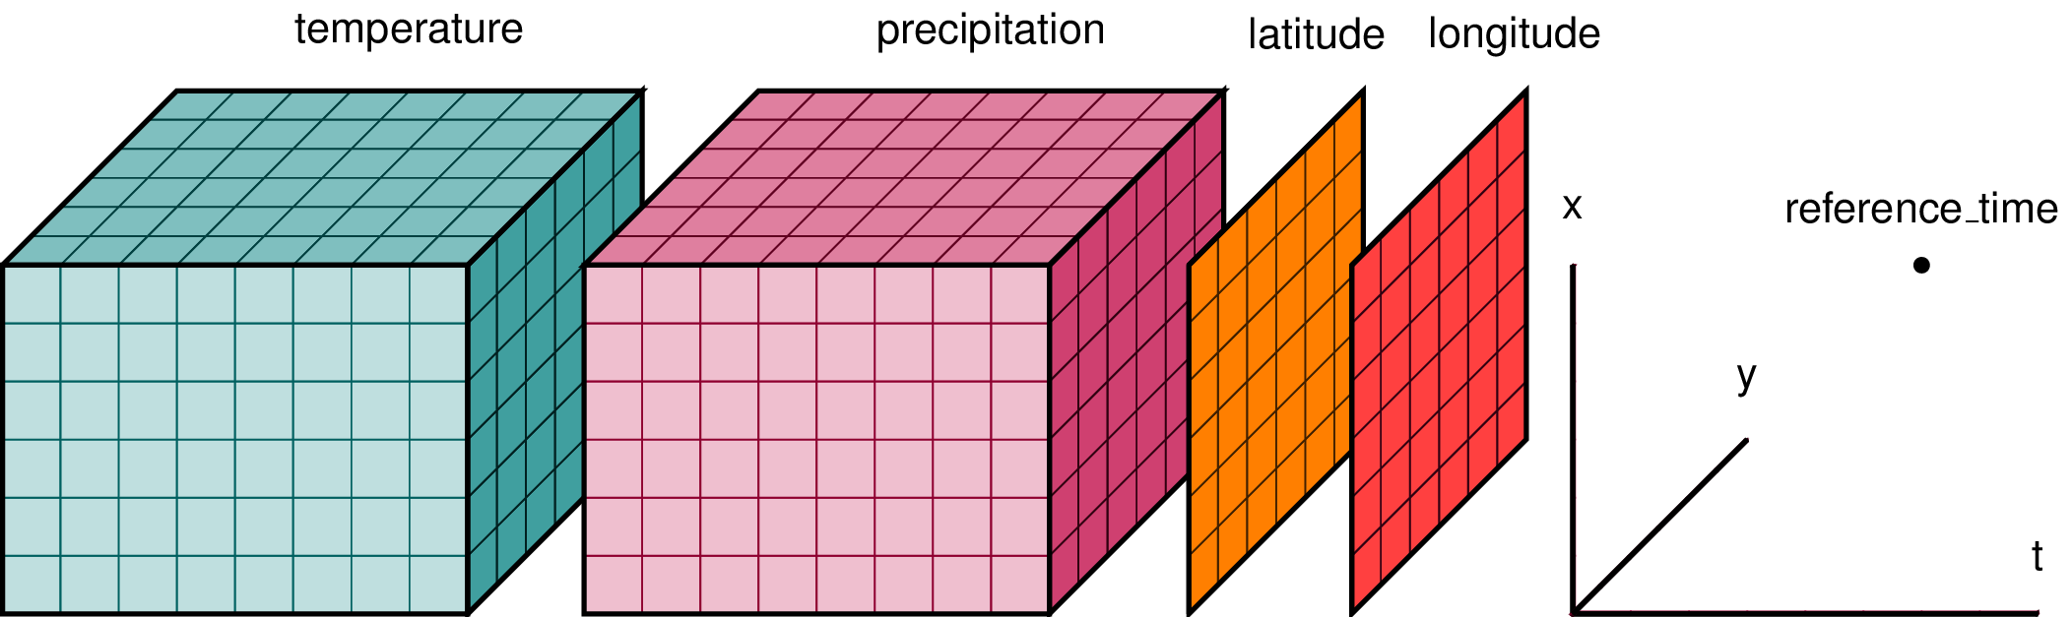
Two data structures
DataArray
“single variable”
N-dimensional
labeled dimensions (‘time’, ‘nlat’, ‘nlon’)
labeled coordinates: examples ‘date(time)’ (0): ‘2017-01-01’ rectangular grid ’latitude(nlat)’ (12): 60 deg S or non-rectangular grid ‘LAT(nlat, nlon)’ (5, 10): 50 deg N
DataSet
container of DataArrays

Slide 4
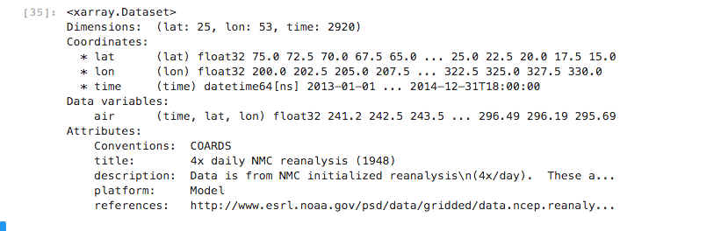
Example

Slide 5
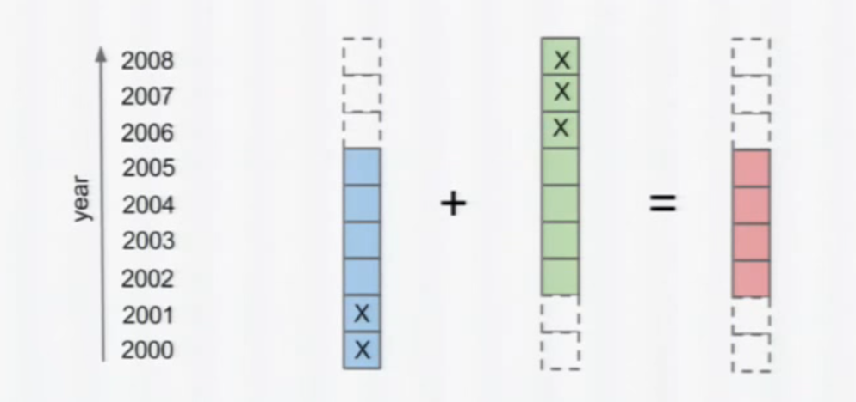
Missing values

Slide 6
Opening data
Single file
xarray.open_dataset(...)
xarray.open_dataarray(..)
Multiple files
xarray.open_mfdataset(...)

Slide 7
Now: tutorial
git clone git@github.com:UU-IMAU/Python-for-lunch-Notebooks.git
or download manually : https://github.com/UU-IMAU/
DataSet / DataArray
indexing
arithmetic
plotting
attributes
input/output
georeferenced plotting (Cartopy)

